Slide 1
EAE snRNA Data Analysis
Summer 2024
Experiment & Data: Joseph Lawrence (Melendez Lab)
Bioinformatics: Michelle Franco, Lia Di (Qiu lab)

Slide 2
Samples & workflow
Samples & data after filtering
NCAR0: WT, w/o disease (14,102 features, 12,600 cells)
NCAR1: WT, with disease (14,888 features, 6,860 cells)
CRE0: KO, w/o disease (14,630 features, 10,790 cells)
CRE1: KO, with disease (15,973 features, 10,537 cells)
Informatics workflow
Download from 10X Genomics
Read into Seurat objects in R
Filter: RNA counts > 200, Gene features < 10K, percent mt < 10%
Merge & Subset common features: 18,288 features, 38,960 samples
Normalize & Integration with 2000 anchor features (output file: “1-integrated.rds”)
Run PCA ➤ UMAP ➤ Harmony ➤ Find clusters (resolution = 0.35; “2-umap.rds”)
To Do 1: Cell type identification (Michelle)
To Do 2: Differential gene expression (DEG) analysis (Michelle)
To Do 3: Pathway enrichment analysis (Michelle)

Slide 3

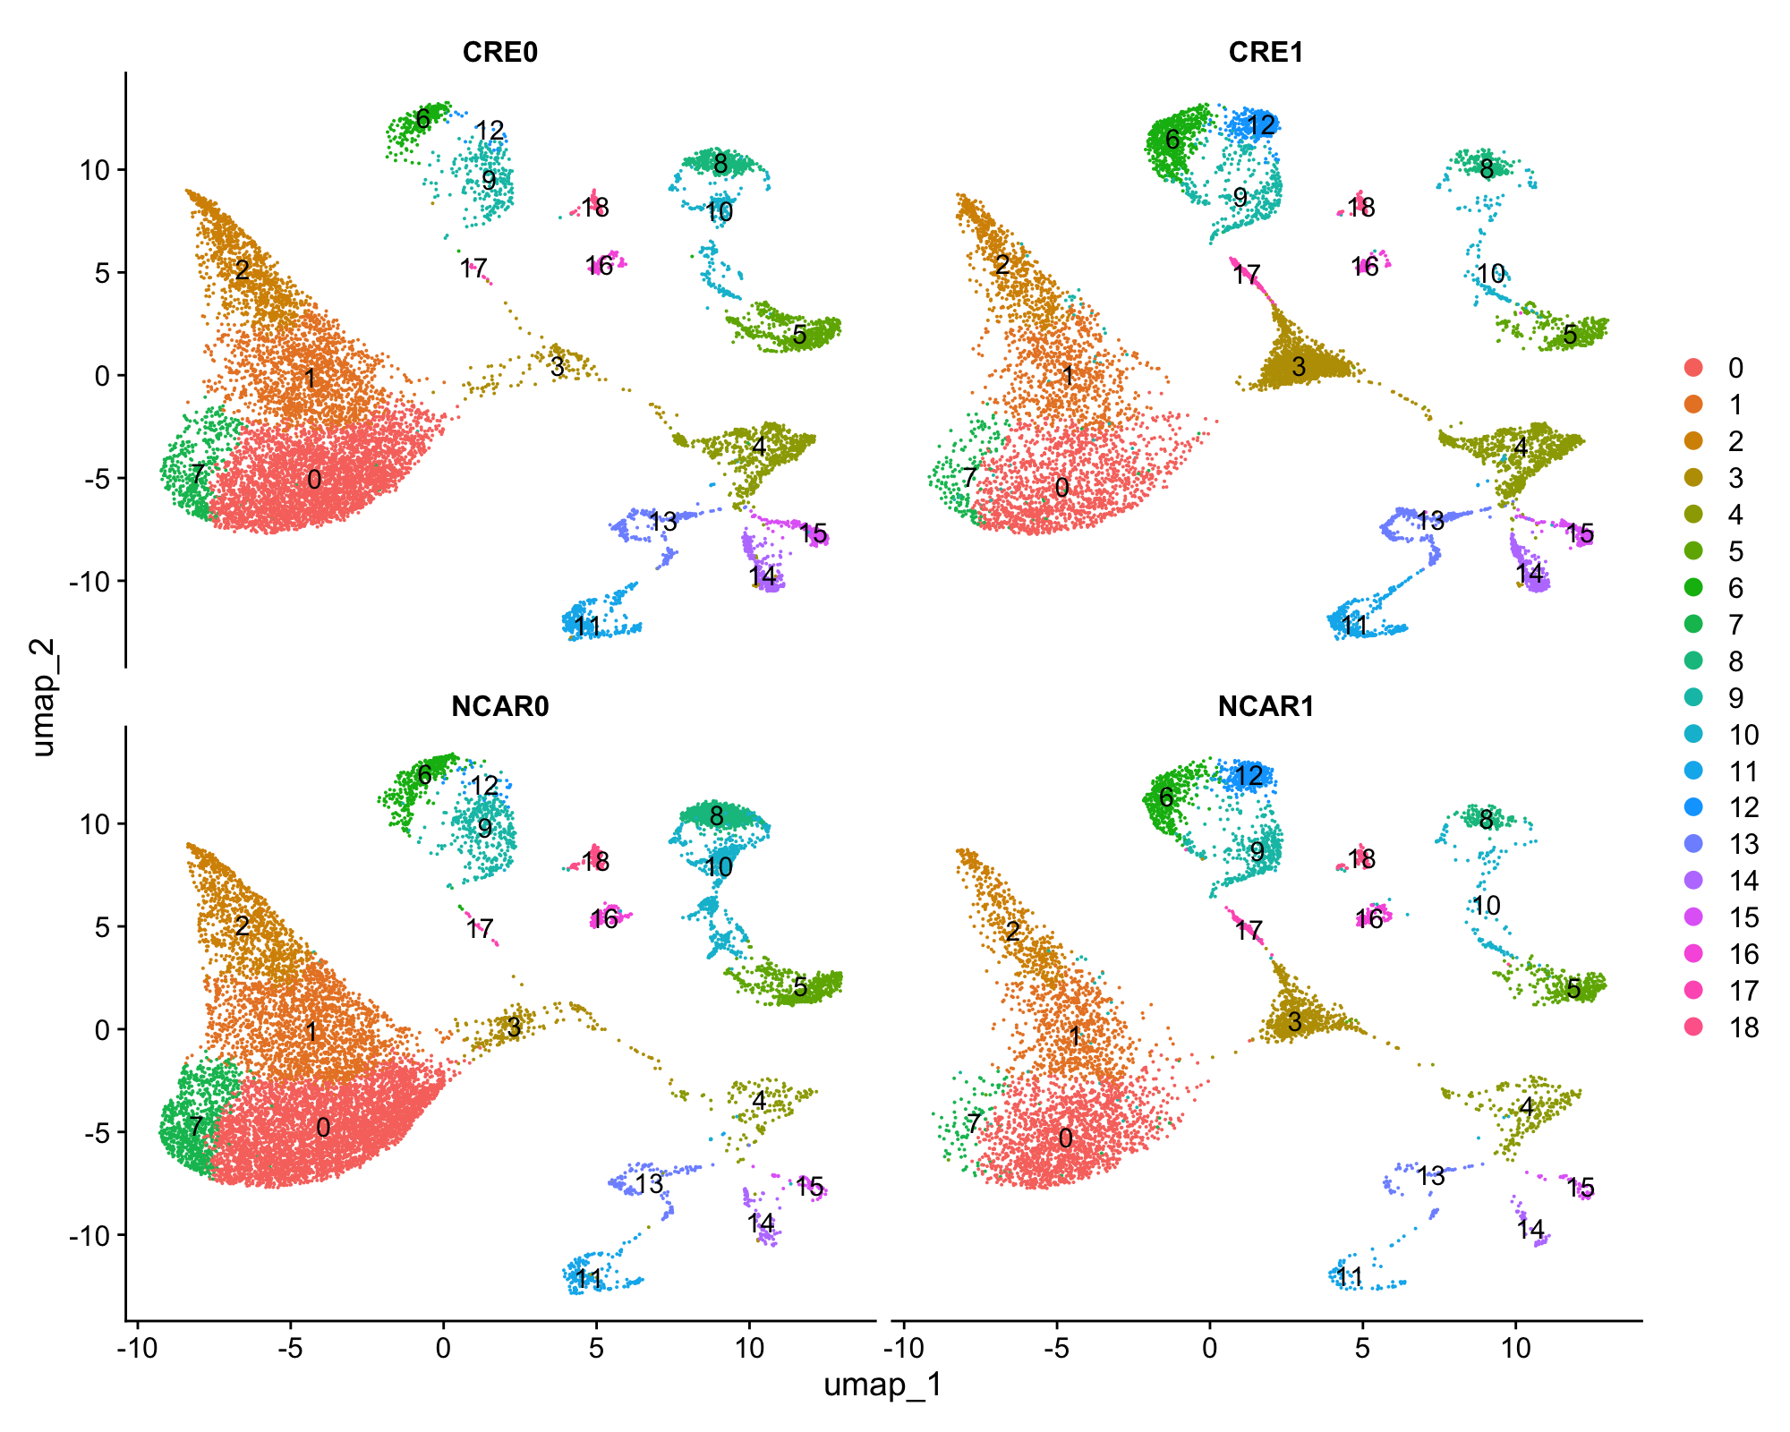
Cell Counts
CRE0 CRE1 NCAR0 NCAR1
0 3653 1433 4598 1669
1 1542 769 1966 759
2 1047 683 1067 466
3 155 1737 247 630
4 740 988 163 237
5 594 392 499 340
6 259 648 407 459
7 461 185 863 100
8 393 209 823 139
9 253 394 380 429
10 257 146 713 128
11 363 329 187 69
12 21 402 33 410
13 270 366 140 69
14 251 288 74 39
15 178 172 49 46
16 80 92 109 128
17 12 222 13 150
18 52 56 166 104

