Slide 1
DNA Binding by BosR Controls RpoS-­ Dependent and -­ Independent Gene Expression in Borrelia burgdorferi
(Grassmann et al., Molecular Microbiology, 2025)

Slide 2
Introduction
Borrelia burgdorferi, the etiologic agent of Lyme disease, cycles between Ixodes ticks and mammalian hosts
Successful host adaptation requires large scale transcriptional reprogramming
The genome encodes very few transcriptional regulators
BosR is the sole FUR-family regulator in B. burgdorferi
BosR is known to activate rpoS, the sigma factor governing the mammalian phase regulon
Most prior studies focused on BosR’s role within the RpoN/RpoS pathway
Research Question:
Does BosR control gene expression through both RpoS-dependent and RpoS-independent mechanisms?

Slide 3
Conceptual Model
BosR functions as a global transcriptional regulator
It exerts control through two distinct mechanisms:
RpoS-dependent regulation via activation of rpoS and cooperation with RNAP-RpoS
RpoS-independent regulation via direct DNA binding (FUR-like activity)
The DNA-binding activity of BosR is essential for both regulatory roles
Mutation of the conserved DNA-contact residue R39 will stop BosR’s regulatory capacity
So loss of BosR DNA binding will disrupt both RpoS-dependent and independent gene expression.

Slide 4
Methods
Techniques:
RNA-seq for global transcriptome profiling
PCA and differential expression analysis to define BosR regulons
Electrophoretic Mobility Shift Assays (EMSAs) to assess DNA binding
Comparative analyses:
WT vs ΔbosR
WT vs BosR-R39A
Integration with existing ΔrpoS datasets
Strains analyzed:
Wild type (WT)
ΔbosR (bosR deletion mutant)
BosR-R39A (DNA-binding-defective mutant)
Growth conditions:
In vitro temperature shifted cultures
Mammalian host adapted spirochetes grown in Dialysis Membrane Chambers (DMCs in rats)

Slide 5
Key findings
BosR regulates hundreds of genes in both environments:
RpoS-dependent genes (ex: ospC, dbpA, bbk32, mcp4/5)
Encode surface proteins, chemotaxis factors, and virulence determinants
RpoS-independent genes
Involved in DNA repair (mutS, uvrD), chemotaxis (cheB, cheR, cheW), transport, and metabolism
DNA binding is essential:
BosR-R39A cannot bind DNA
rpoS transcription is severely reduced
Both RpoS-dependent and independent regulons collapse
Contrary to earlier models:
Classical oxidative stress genes (napA, sodA, cdr) are not regulated by BosR under these conditions
No single conserved BosR DNA-binding motif identified → Suggests regulation depends on local DNA context or topology

Slide 6
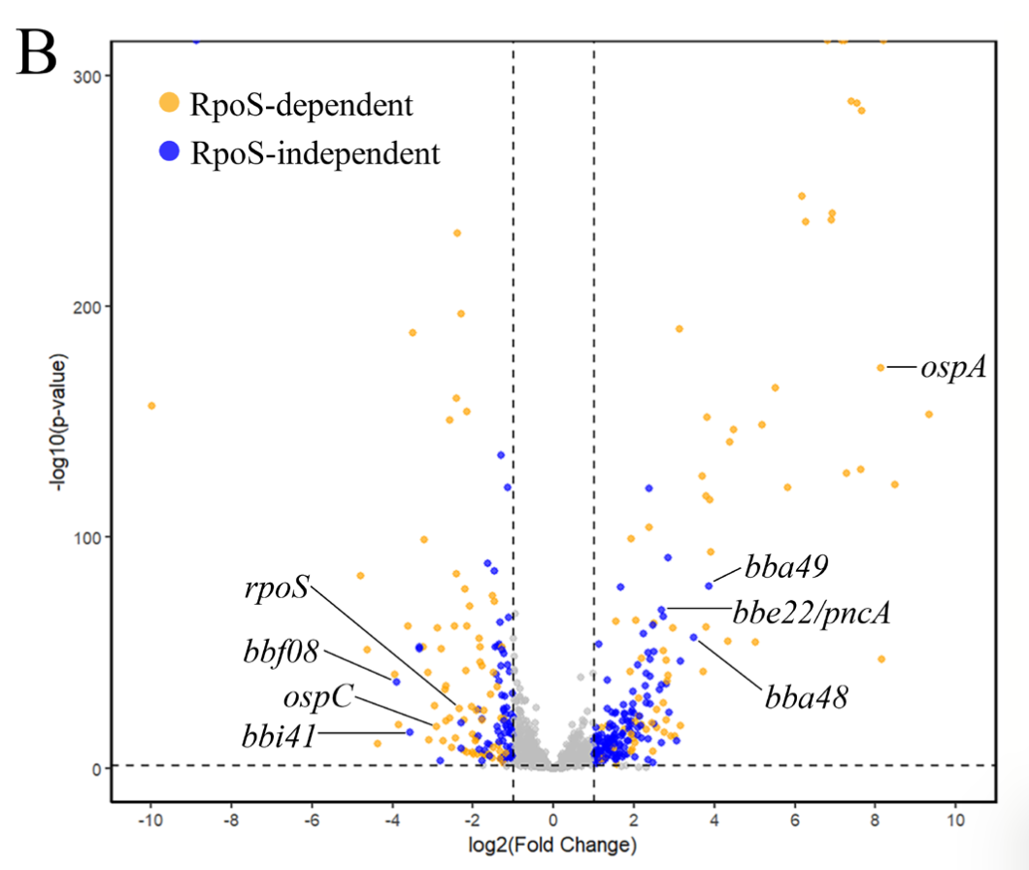
Each dot represents a single gene.
Right = genes activated by BosR
Left = genes repressed by BosR
Higher = more statistically significant
Genes at the top are the most confidently regulated
Figure 2B demonstrates that BosR globally regulates gene expression in host-adapted Borrelia burgdorferi through both RpoS-dependent and RpoS-independent pathways.

Slide 7
Conclusion
BosR is a bifunctional global regulator in Borrelia burgdorferi
It controls gene expression through:
Cooperation with RNAP–RpoS to establish the mammalian-phase transcriptome
Direct, FUR-like DNA binding to regulate RpoS-independent genes
DNA binding is necessary for both functions
BosR does not rely on a single consensus motif for promoter recognition
Biological significance:
This study shows how B. burgdorferi achieves complex transcriptional control with a minimal regulatory protiens
This helps us understand how the bacterium adapts ticks vs mammals and how it controls genes that make it infectious

