Slide 1


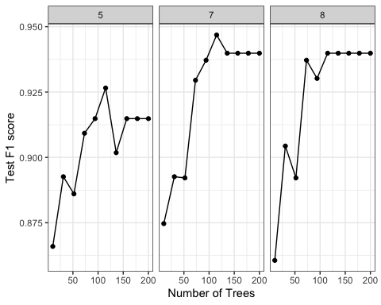
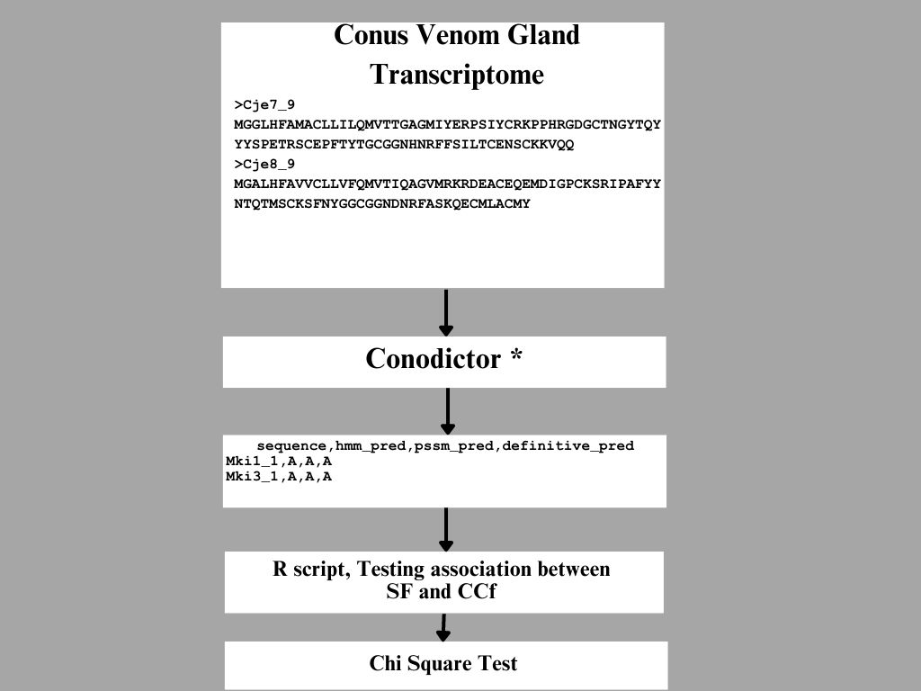
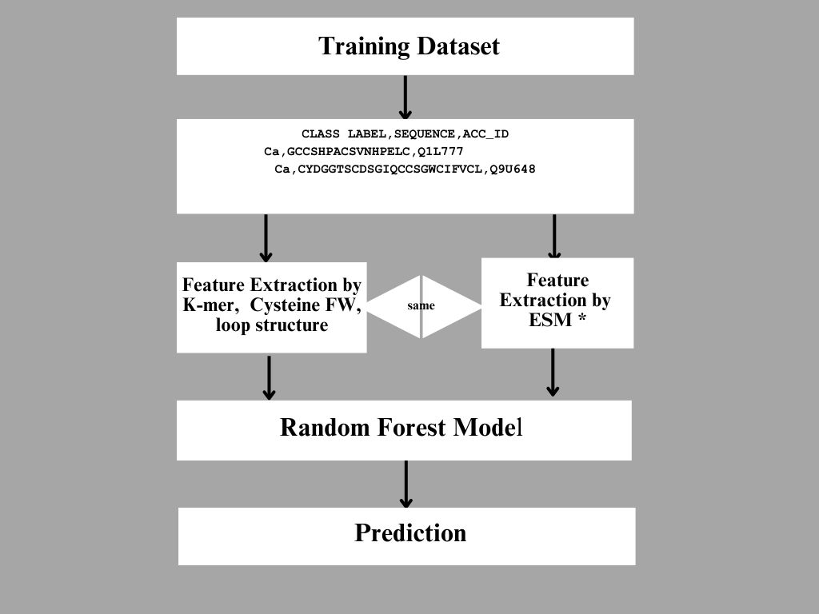
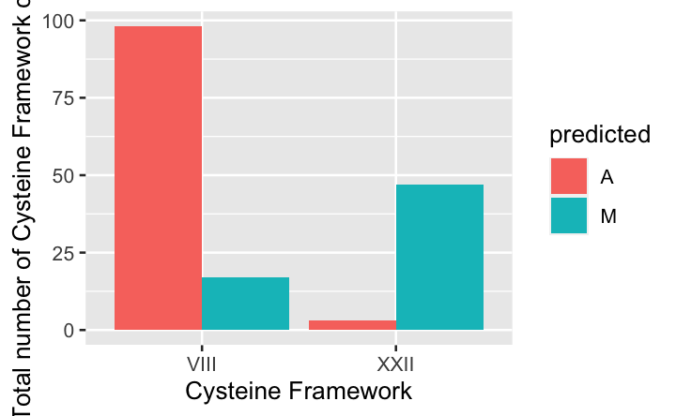
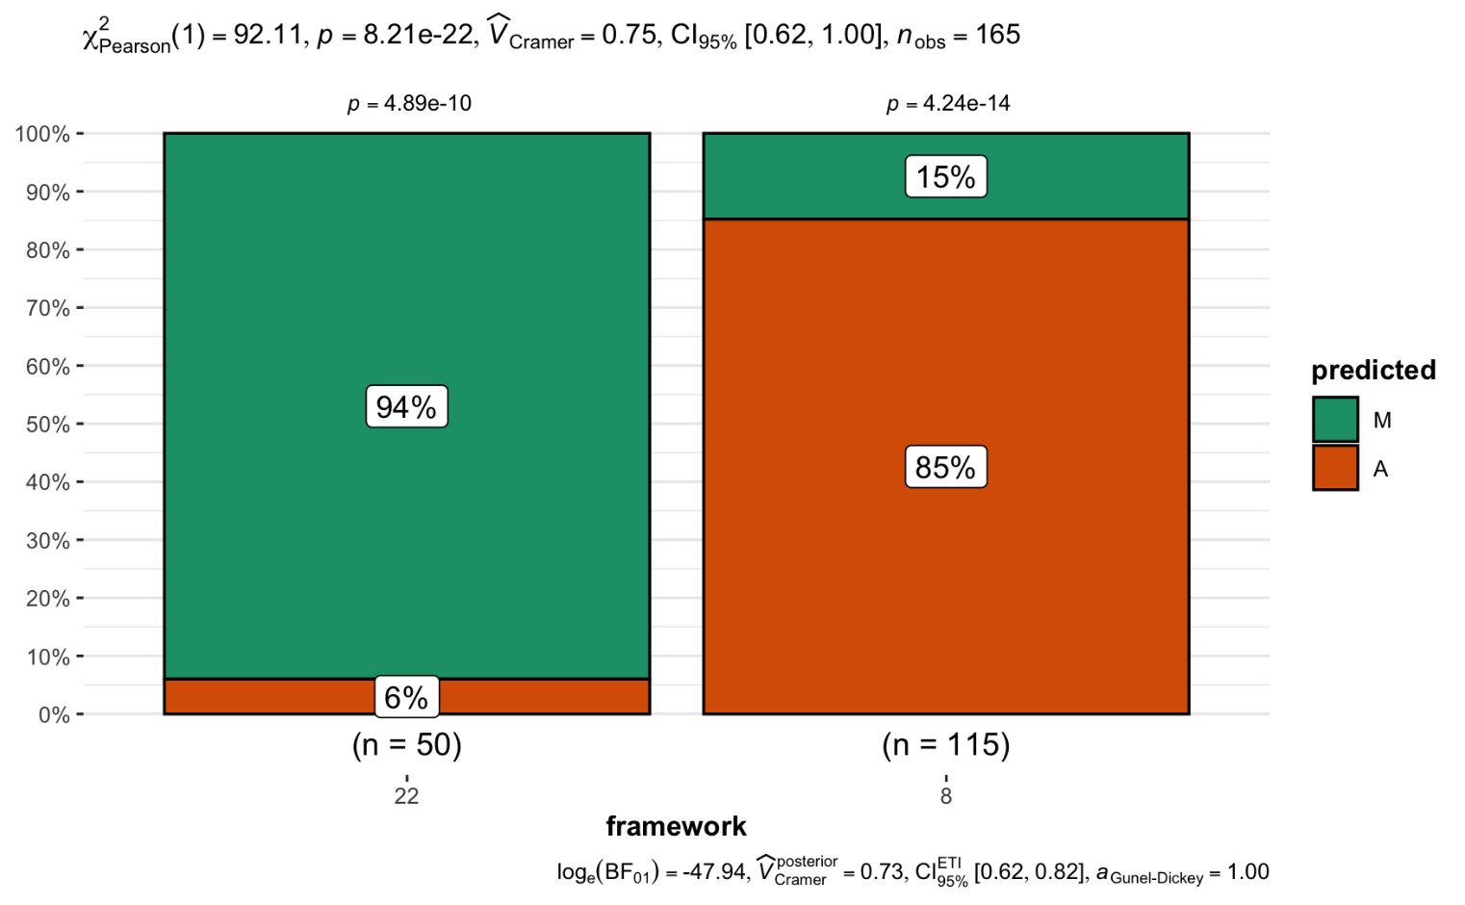
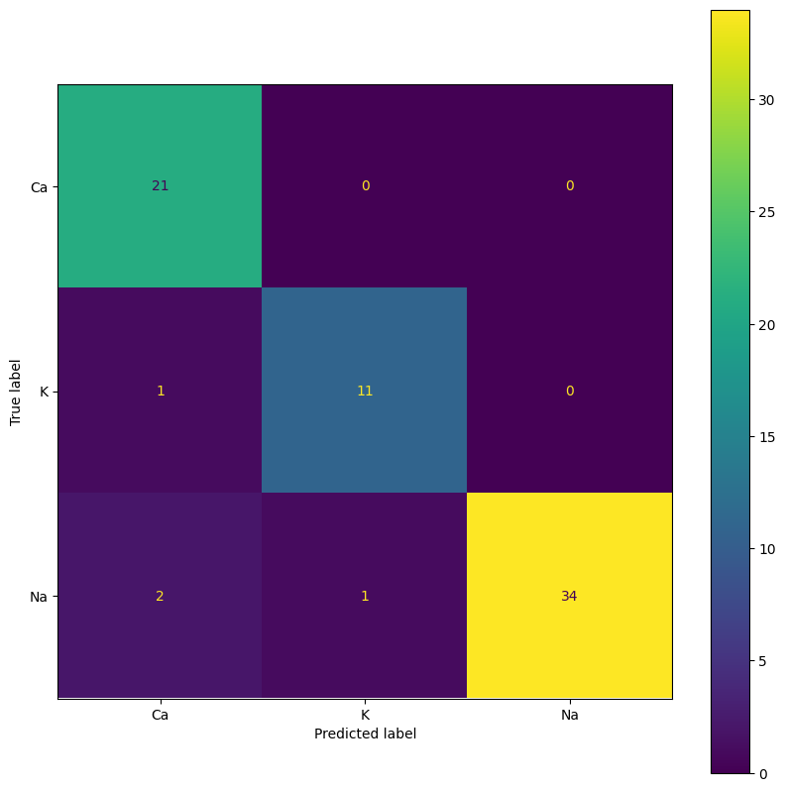
Computational Classification of Ligand Specificities of Marine Snail Toxins using Machine Learning and Protein Language Models
Hagar Abuzaid¹, Tara Doma Lama¹, Eric Li², Jessy Ramiraz³, Arezoo Bybordi⁴, Anita Raja^{2, 4}, Mande Holford^{3, 4}, Weigang Qiu^{1, 4}
¹Department of Biological Sciences, ²Computer Science, ³Chemistry, Hunter College CUNY; ⁴Graduate Center, CUNY
Background
Methods and Materials
Conopeptides are toxins that are released from the venom of cone snails (Conidae) ranging from 10 to 45 amino acids in sequence length.
Conotoxins are highly diverse and consist of multiple families driven by co-evolutionary pressure between Canidae and their prey.
Conotoxins show high specificity to target proteins including ligand-gated, voltage-gated, and G-protein coupled receptors (GPCRs).
Due to their high degree of specificity and chemical potency, they were considered drug candidates for the treatment of neurological disorders, for instance, epilepsy.
Computational Identification of Conotoxin Ligand Specificities Using Machine Learning and Protein Language Models
Figure 4. The number of estimators is the number of trees (X-axis). Max depth (panels) is the length of the longest path from the tree root to the leaf. F1 score (Y-axis) is the harmonic average between precision “TP/(TP+FP)” and recall “TP/(TP+FN)”. The best F1 score in max depth was 7.
Results
Main Hypothesis
Cysteine framework is a better predictor of ligand specificity of snail toxins than superfamilies.
Conclusion
Introduction
Our statistical analysis demonstrate that the distribution of superfamily isn’t uniform throughout the frameworks and vice versa.
The primary sequence determines the fold of the protein and the protein fold determines the function.
Max depth was found to be 7 decision trees
We were able to accurately predict the targeted ion channels
Superfamilies group snail toxin by sequence similarity of their signal peptides
Conopeptides are small peptide molecules produced by marine cone snails that have diverse biological activities and potential therapeutic applications.
Cysteine frameworks refer to the arrangement of disulfide bonds that crosslink specific amino acid residues in the peptide sequence.
Conopeptides can have different cysteine frameworks, ranging from simple linear arrangements to complex cyclic or knotted structures.
ConoDictor is a tool that enables fast and accurate classification of conopeptides into superfamilies based on their amino acid sequence.
Other machine learning classifying methods were applied in analyzing the targeted ion channels like random forest and protein language models
Figure 1. The superfamilies A (red) and M (blue) are significantly associated with cysteine families VIII and XXII, repspectively
Figure 2. Results of the Chi-square test: X² = 92.11 with p = 8.21 * 10⁻²² , indicating highly significant association
Predicted
True counts
Ca
Future work
K
Future works would reveal what structural mechanisms associating superfamilies with cysteine frameworks in marine toxins.
Na
Acknowledgments
Ca
K
Na
This work is supported by the 2023 CUNY Planning Grant Program.
Figure 3. Confusion matrix. The matrix shows high accuracy of the ConoDictor2 predictions for three ion channels.
References cited
Mansbach et al (2019). Snails In Silico: A Review of Computational Studies on the Conopeptides. Marine Drugs, 17(3): 145
Zhang et al (2016). Using the SMOTE technique and hybrid features to predict the types of ion channel-targeted conotoxins". Journal of Theoretic Biology, 403 (21):75-84
Shi et al (2022). ToxMVA: An end-to-end multi-view deep autoencoder method for protein toxicity prediction. Computers in Biology and Medicine, 151 (Part B): 106322

