Slide 1
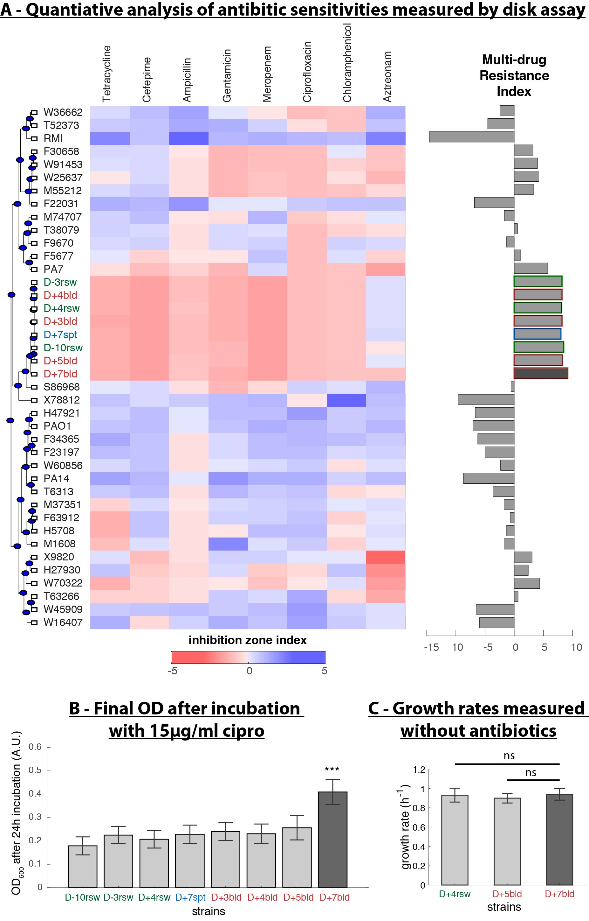
Figure 3. The P. aeruginosa that infected the patient was already resistant to several antibiotics and acquired aztreonam resistance without a measurable fitness cost. (A) Antibiotic resistance profiles show that all 8 patient isolates are multi-drug resistant. (B) Overnight bacterial cultures supplemented with 15μg/ml ciprofloxacin confirm that isolate D+7bld gain secondary resistance comparing to all other isolates from this patient. (***, p<0.01) (C) Precise growth rates measured in vitro using the growth-curve synchronization method (2) show that there is no fitness cost to aztreonam resistance in vitro. (ns, not significant)

Slide 2
TO DO LIST
Plot/Reproduce MIC heatmap (heatmap.2, heatmap.3)
Plot SNP matrix grouped by genes
Visualize MIC with significant SNPs, one Ab at a time
Plot tree with APE function (plot.phylo)
Plot SNP matrix (condensed) with text() function
Plot Ab level with segments() function
Github Repository created: “mic-boost”: push R and python scripts
Write methods
Simulation protocol
Gene selection; SNP filtering (alignment & remove synonymous SNPs)
XG-boost & data visualization

