Slide 1
Adaptation in protein fitness landscapes is facilitated by indirect paths (Wu et al., 2016)
Presented by Winston Koh

Slide 2
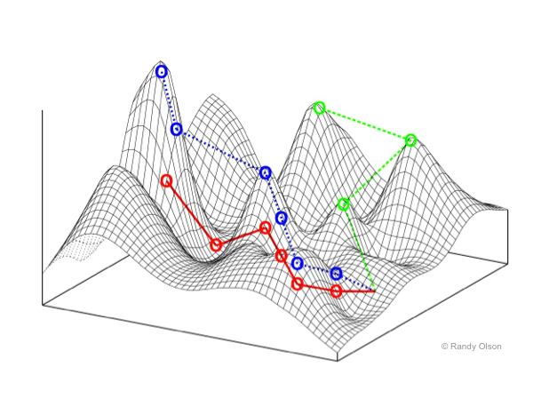
Fitness Landscapes
Fitness landscapes show the relationship between genotype and fitness.
Adaptation is the process of moving towards peaks in a fitness landscape.
The path towards a peak is not always direct.
A protein sequence of length L has L dimensions that can provide additional routes for adaptation.
Epistasis (interactions between 2 or more loci) also affects paths along a fitness landscape by limiting the number of accessible paths.
Source: Fitness landscape, Wikipedia

Slide 3
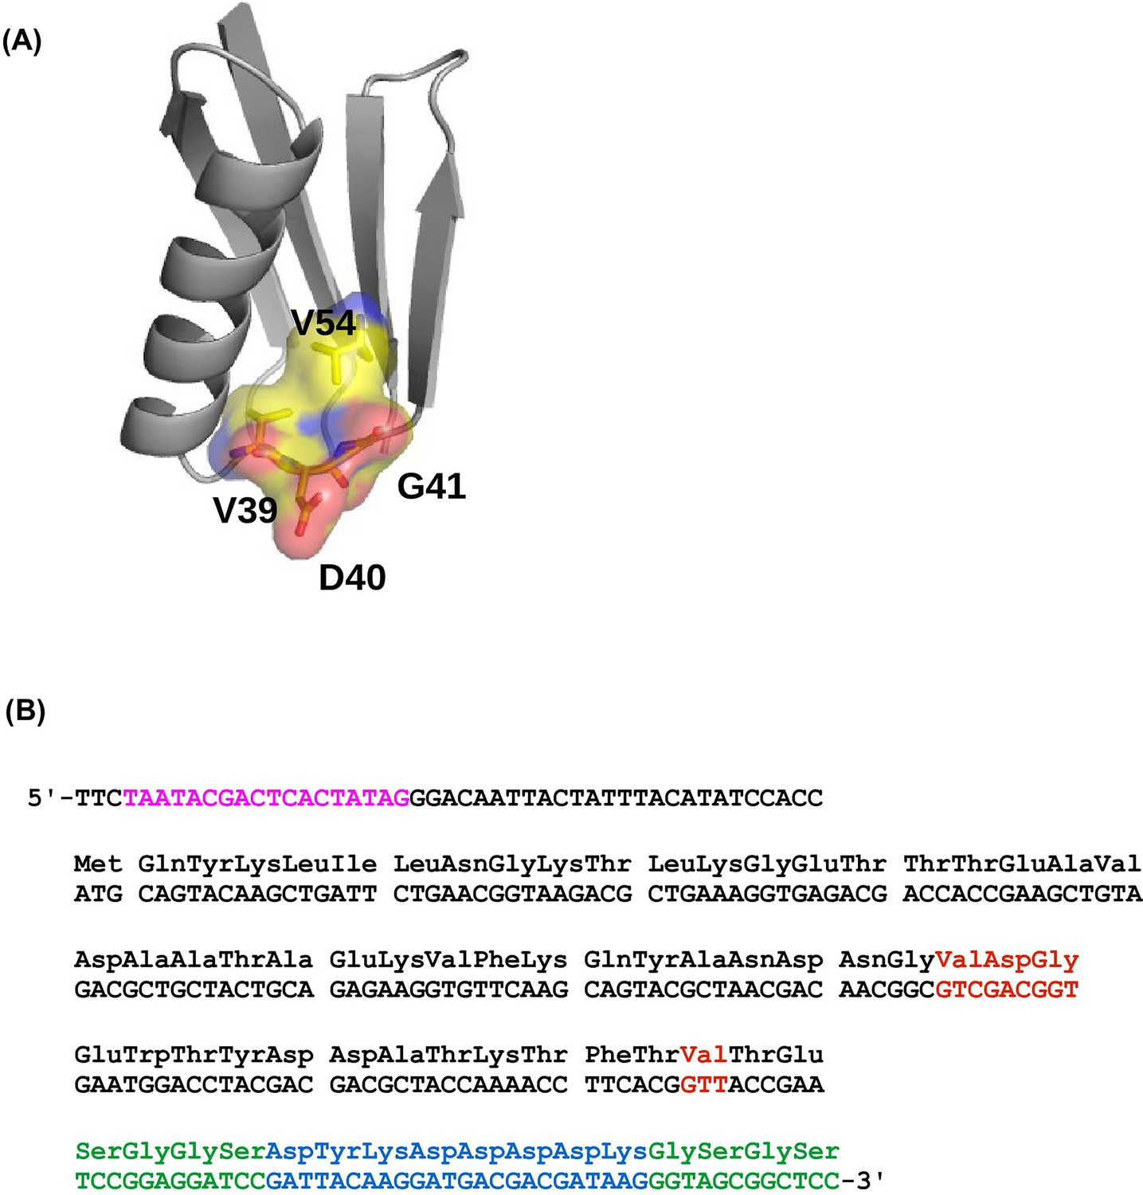
Experiment
Goal: generate an empirical fitness landscape to study how high dimensionality and epistasis influence evolutionary accessibility.
Protein G domain B1 is an immunoglobulin-binding protein expressed in Streptococcal bacteria.
Fitness was evaluated for all variants at 4 amino acid sites (V39, D40, G41 and V54).
These sites contain most of the top 20 positively epistatic interactions among all pairwise interactions in GB1.
20 possible amino acids at 4 sites = 20⁴ = 160,000 total variants.
Figure 1—figure supplement 1
Notes:
(B) Red = randomized amino acid sites.

Slide 4
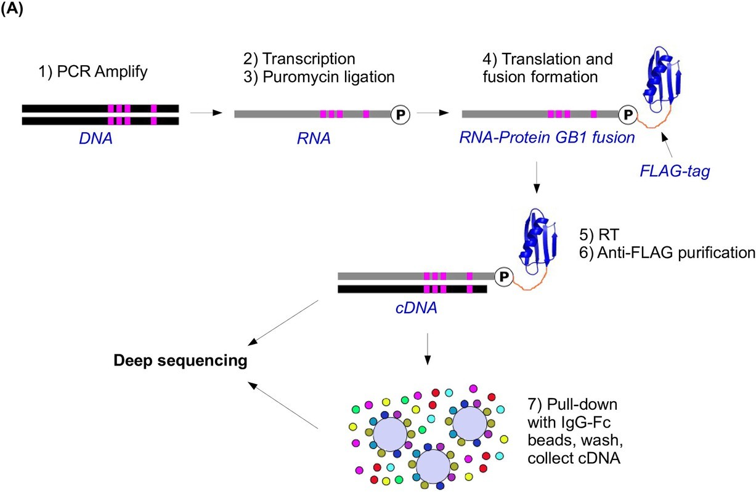
Methods
Mutant library containing all amino acid combinations was generated by codon randomization.
Fitness was evaluated using affinity selection by mRNA display.
mRNA display: fusing mRNA to the peptide that it encodes.
Fitness of the protein is based on its stability and function (binding affinity to IgG-Fc).
Selection is done by immunoprecipitation.
Sequence before and after immunoprecipitation to get “input” and “selected” libraries.
Figure 1—figure supplement 3
Notes:
1. Constructed mutant library
2. Fused mRNA to the protein that it encodes.
3. Reverse transcribe to cDNA and sequence to get “input library.”
4. Immunoprecipitation to test fitness of variants.
5. Wash, get cDNA, and sequence to get “selected library”

Slide 5
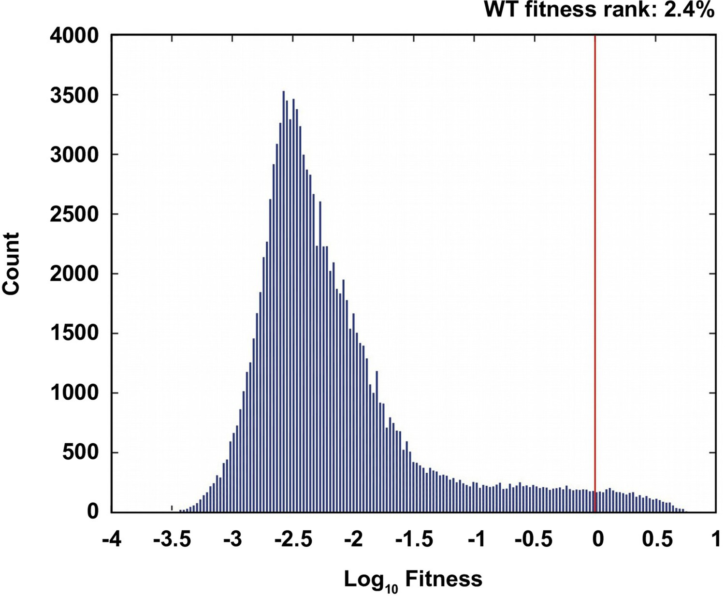

Results
Fitness was calculated by finding the relative frequency before and after selection, and then comparing to that of the wild type protein.
$fitness=\frac{{count}_{mut,selected}/{count}_{mut,input}}{{count}_{WT,selected}/{count}_{WT,input}}$
2.4% of mutants were beneficial (fitness > 1).
The protein’s fitness is not the same as organismal fitness, though there is a correlation.
Figure 1—figure supplement 4

Slide 6
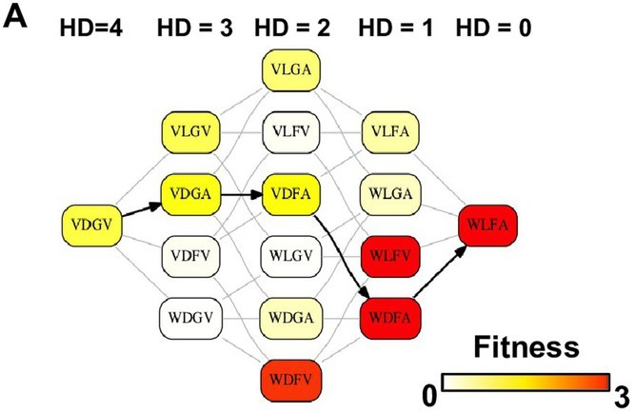
Epistasis Analysis
Pairwise epistasis was analyzed by looking at subgraphs of sequence space that represented a landscape connecting WT to a beneficial quadruple mutant that has a higher fitness than any intermediates.
Each of the 4 sites only has 2 possible amino acids, for a total of 16 variants.
These graphs represent direct paths of adaptation, where each step reduces the Hamming distance to the destination.
Figure 1

Slide 7
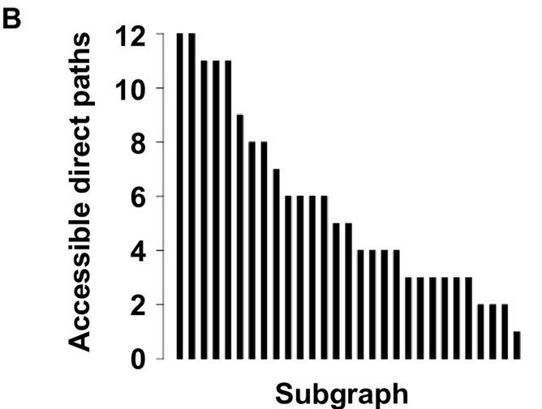
Epistasis Analysis (cont.)
There are 29 total subgraphs with these criteria.
Each of these graphs has 24 possible paths.
Out of the 24 possible paths, the number of selectively available paths (where fitness increased monotonically) varied from 12 to 1.
The probabilities of realizing each accessible path were calculated and found to be skewed, suggesting that a small fraction of paths leads to most of the realizations in adaptation.
Figure 1

Slide 8
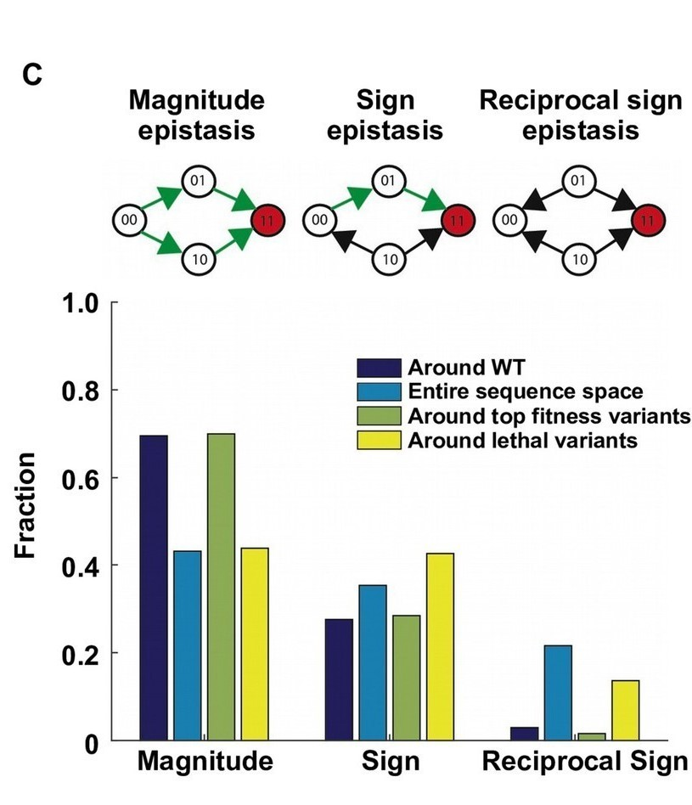
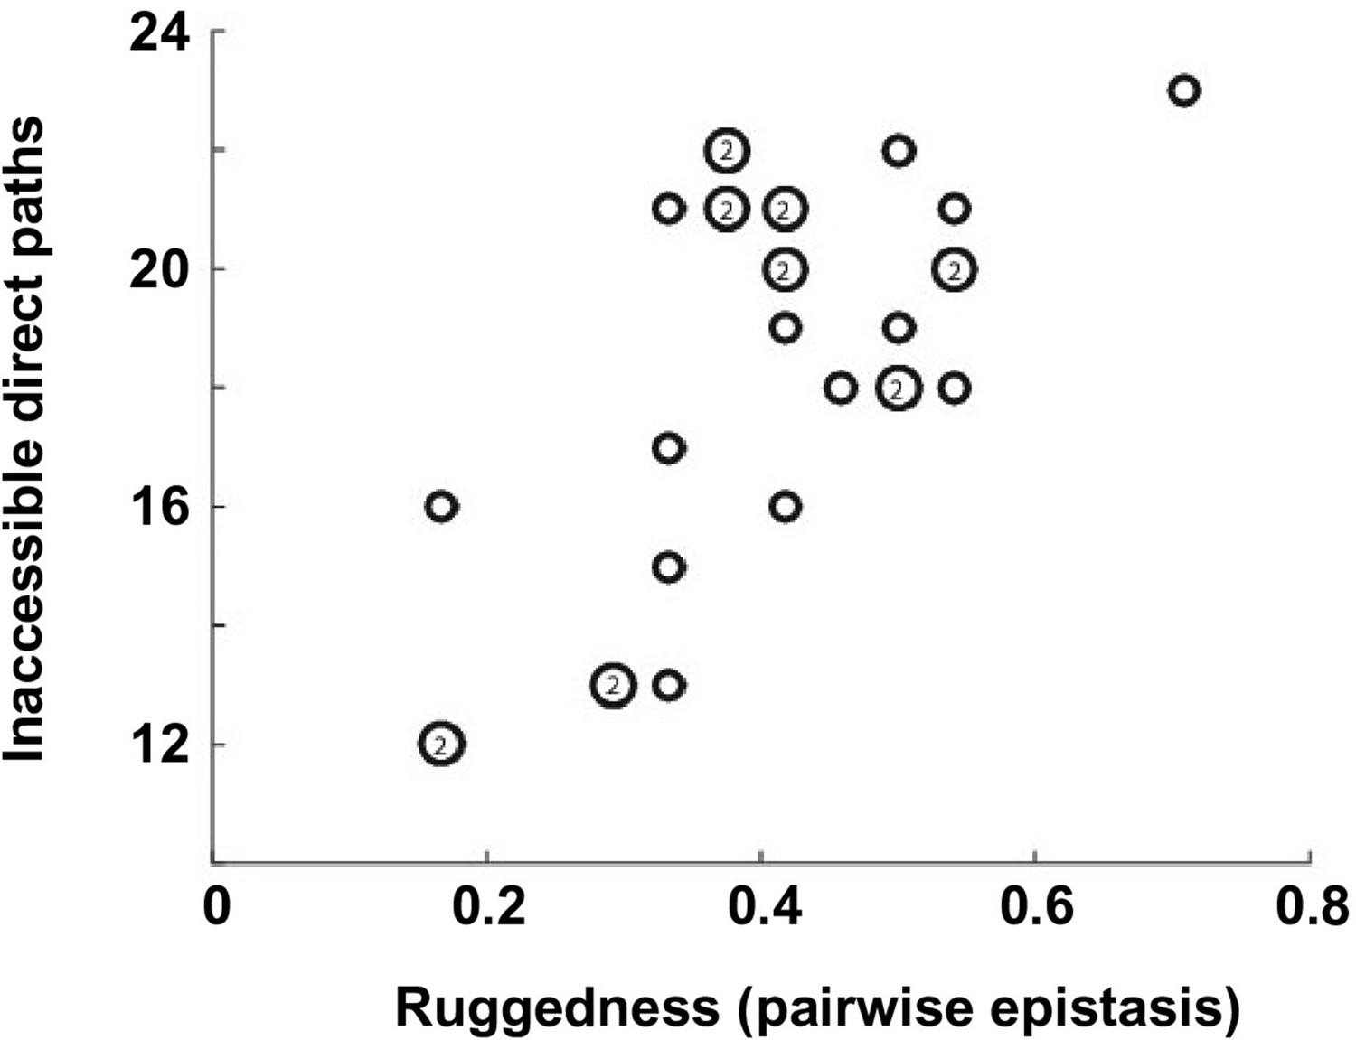
These results indicate that existence of sign epistasis and reciprocal sign epistasis, both of which constrain the accessibility of direct paths.
Random samples around the fitness landscape show that the two types of epistasis are prevalent.
The number of inaccessible direct paths was found to be positively correlated (Pearson correlation = 0.66) with ruggedness (quantified as f_{sign} + 2f_{reciprocal} where f is the fraction of each type of epistasis)
Sign epistasis: mutation A has the opposite effect in the presence of mutation B.
Reciprocal sign: both mutations A and B have the opposite effect in the presence of each other.
Figure 1
Figure 1—figure supplement 6
Notes:
ab Ab aB AB
Sign epistasis 0 1 -1 2 AB has opposite sign to Ab or aB
Reciprocal sign epistasis 0 -1 -1 2 AB has opposite sign to Ab and aB
Bar plot: the fraction of pairwise epistasis, randomly sampled in 4 different areas.

Slide 9
Extra-dimensional Bypass
Reciprocal sign epistasis has been shown to block direct paths on a fitness landscape, but this only occurs within a subgraph.
In reality, a protein sequence has many more dimensions that allow for further adaptation.
There are two mechanisms of bypassing a path blocked by epistasis:
Conversion bypass: converting an amino acid to a third option.
Detour bypass: mutating a third site.
Both types of bypass require the use of indirect paths.

Slide 10
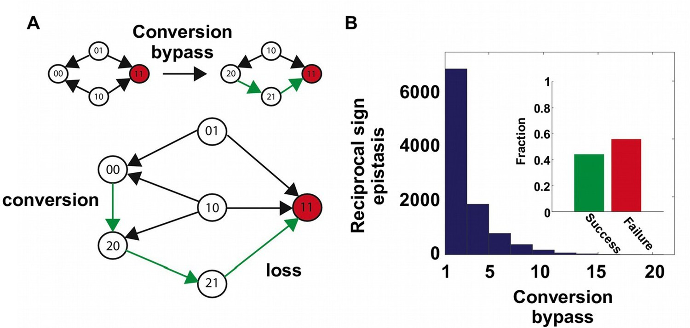
Conversion Bypass
Bypasses reciprocal sign epistasis by converting a site to an extra amino acid.
For 2 interacting sites, if there are only 2 types of amino acids, then there are only 2 neighbors to reach the double mutant.
If we consider all 20 amino acids, then there are 38 neighbors.
The 36 additional neighbors can lead to routes that bypass the reciprocal sign epistasis.
In a random sample of 20,000 reciprocal sign epistasis interactions, over 40% had at least 1 successful conversion bypass available.
Figure 2

Slide 11
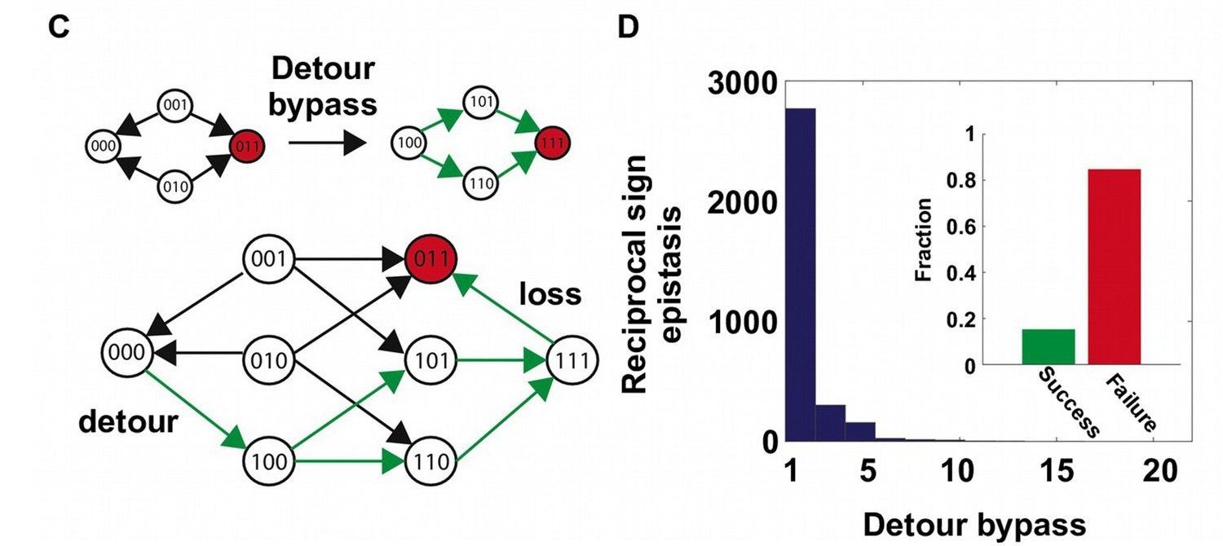
Detour Bypass
Bypasses reciprocal sign epistasis by gaining a mutation at a third site.
Detour bypass was not found to be as prevalent as conversion bypass in a random sample.
The number of possible detour bypasses is proportional to the sequence length of the entire protein.
19 × (L – 2) for bypassing pairwise epistasis.
This may make detour bypasses more frequent in systems with a longer protein length.
Figure 2

Slide 12
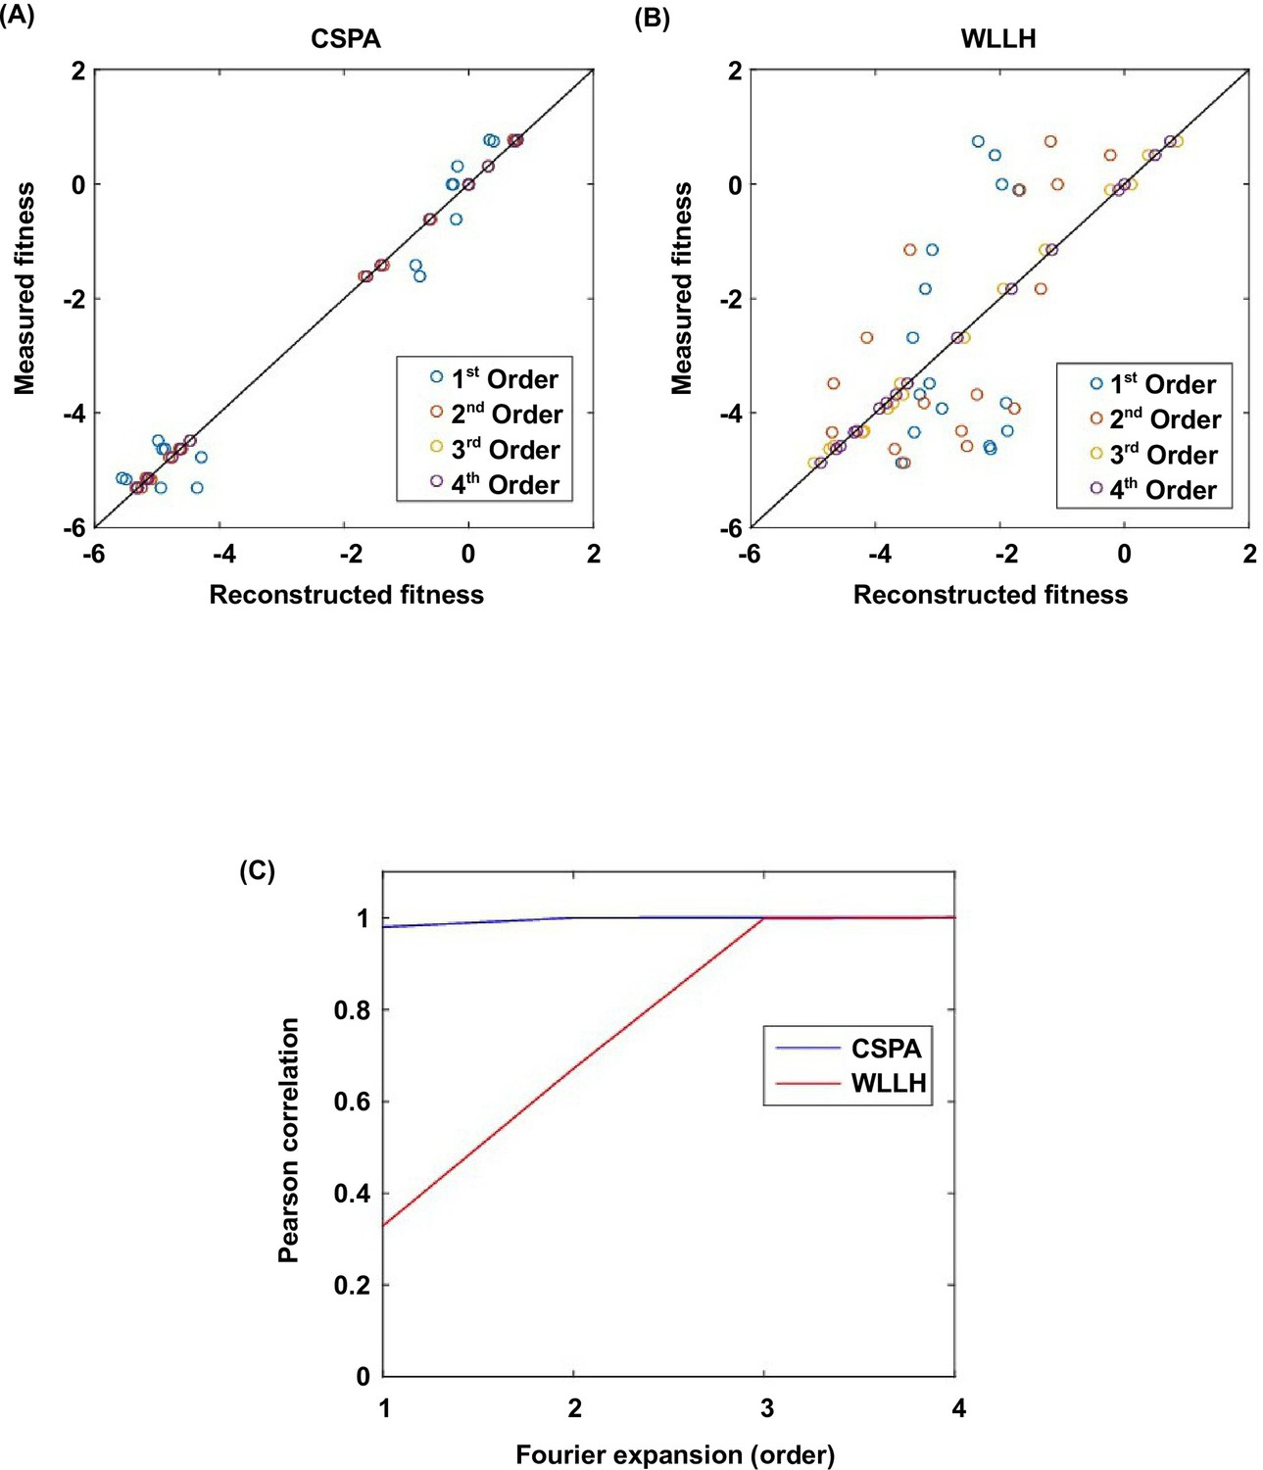
Higher-order Epistasis
Decomposition of the fitness landscape by Fourier analysis confirms the presence of higher-order epistasis.
Fourier analysis decomposes the fitness landscape into epistatic interactions of different orders.
Fitness can be reconstructed by expansion of Fourier coefficients up to a certain order (4th order for 4 amino acid sites).
The Fourier coefficients can be interpreted as epistatic interactions of different orders.
1st order = effects of single mutations 2nd order = pairwise epistasis 3rd and 4th = higher-order epistasis
If the second order Fourier expansion does not reproduce the measured fitness, it indicates the presence of higher-order epistasis.
Figure 3—figure supplement 2
Notes:
Higher-order epistasis has a small contribution to fitness (bottom 0.1%)
Higher-order epistasis has a large contribution to fitness (top 0.1%)
Expansion to the fourth order Fourier coefficients will always reproduce the measured fitness (i.e., Pearson correlation equals 1)

Slide 13
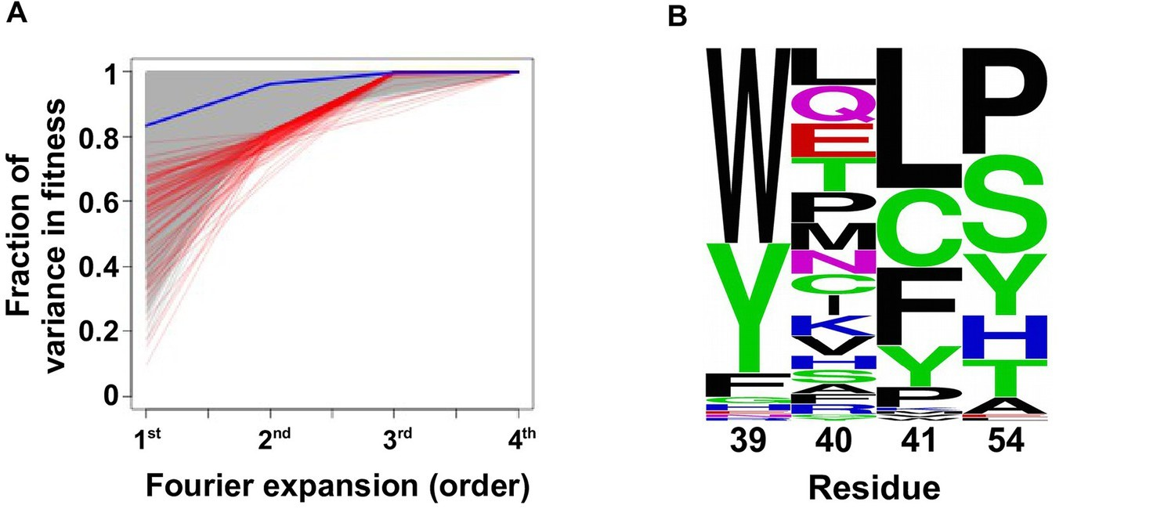
Figure 3
The 0.1% of subgraphs with the greatest fitness contribution from higher order epistasis have a skewed composition of amino acids.
This indicates that higher-order interactions are enriched among specific amino acid combinations of site 39, 41 and 54.
These sites physically interact with each other in the core of the protein and affect the protein’s stability.

Slide 14
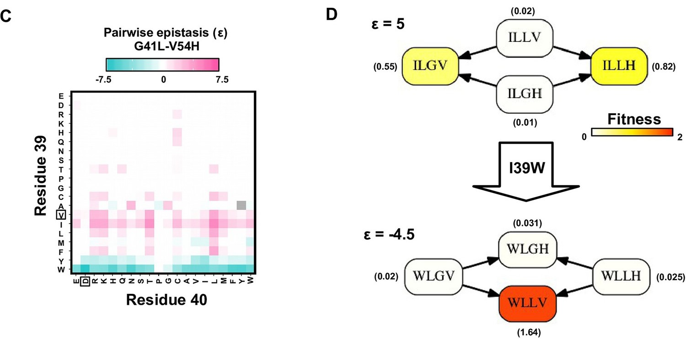
Figure 3
In the presence of higher-order epistasis, pairwise epistasis depends on genetic background.
To show this, the magnitude of pairwise epistasis was calculated between pairs of amino acid substitutions.
e.g., G41L and V54H were positively epistatic when site 39 was isoleucine [I], but the interaction changed to negative epistasis when site 39 carried a tyrosine [Y] or a tryptophan [W]

Slide 15
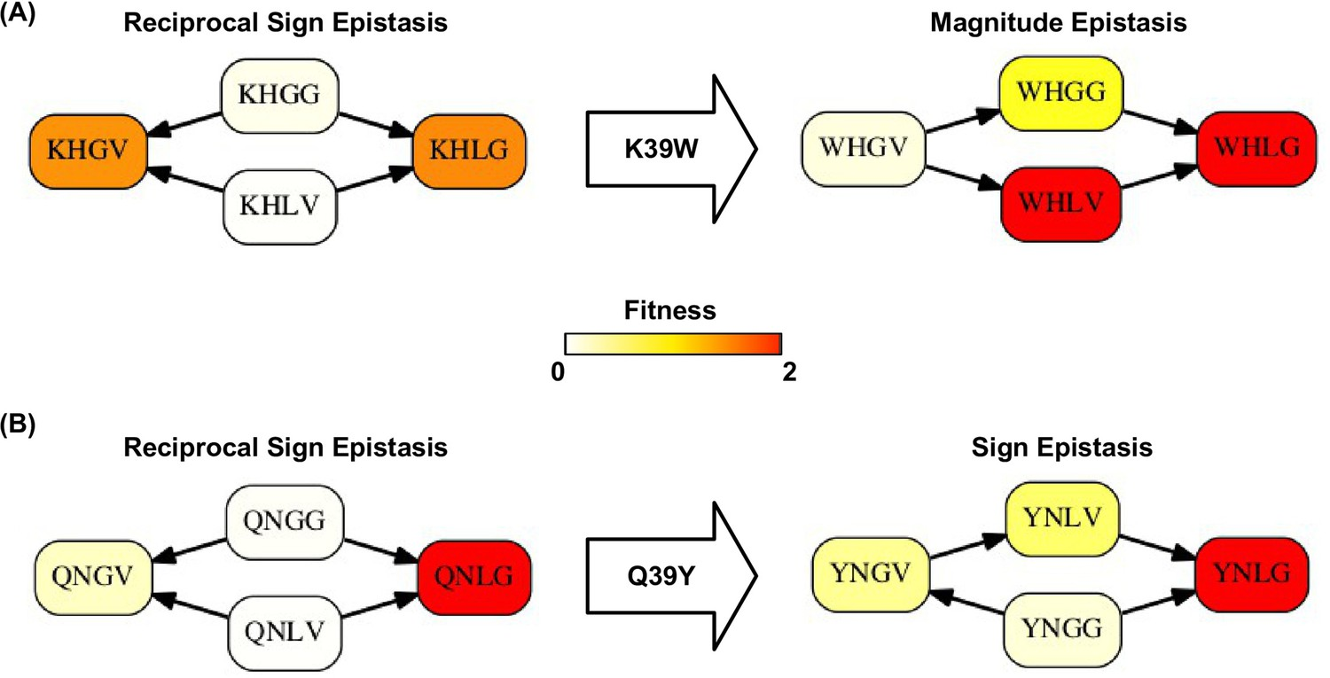
Figure 3—figure supplement 5
Higher-order epistasis can also change the type of epistasis.
e.g., From reciprocal sign epistasis to magnitude or sign epistasis.
This is important for the existence of detour bypass.

Slide 16
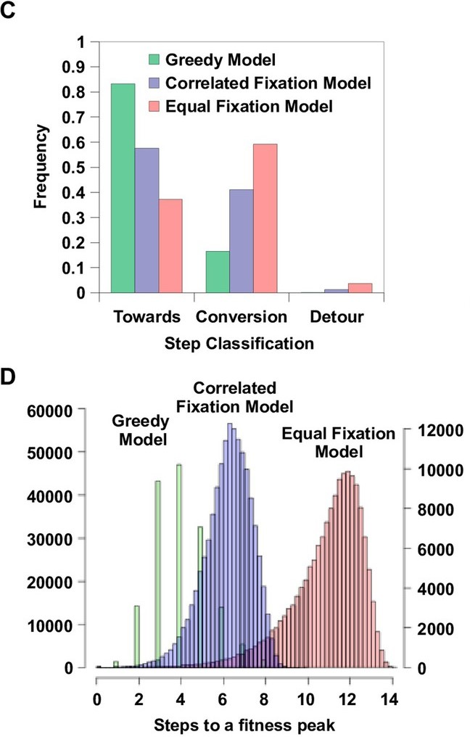
Adaptation simulation
Figure 4
To study the impact of indirect paths at a global scale, the adaptation was simulated in the entire sequence space of 160,000 variants.
3 different models of adaptive walks: Greedy Model, Correlated Fixation model, and Equal Fixation Model.
Among all possible paths to fitness peaks, many paths to fitness involved indirect paths (using extra-dimensional bypass).
Conversion was pervasive during adaptation.
Detour was less frequent.
Indirect adaptive paths involve variants of intermediate fitness, so the use of conversion and detour steps depended on the strength of selection.
Greedy and Correlated Fixation models are more likely to fix larger fitness gains, leading to shorter adaptive paths.
Notes:
(C) The frequency of different types of mutational step are shown. Three models, including the Greedy Model (green), Correlated Fixation Model (blue) and Equal Fixation Model (red), are used to simulate 1000 adaptive paths starting from each variant in the sequence space. All the adaptive paths end at a fitness peak.
(D) The distribution of the length of the adaptive path initiated at different starting points. For Correlated Fixation Model and Equal Fixation Model, the length was computed by averaging over 1000 simulated paths for each starting point. The scale on the left is for Greedy Model. The scale on the right is for Correlated Fixation Model and Equal Fixation Model.

Slide 17
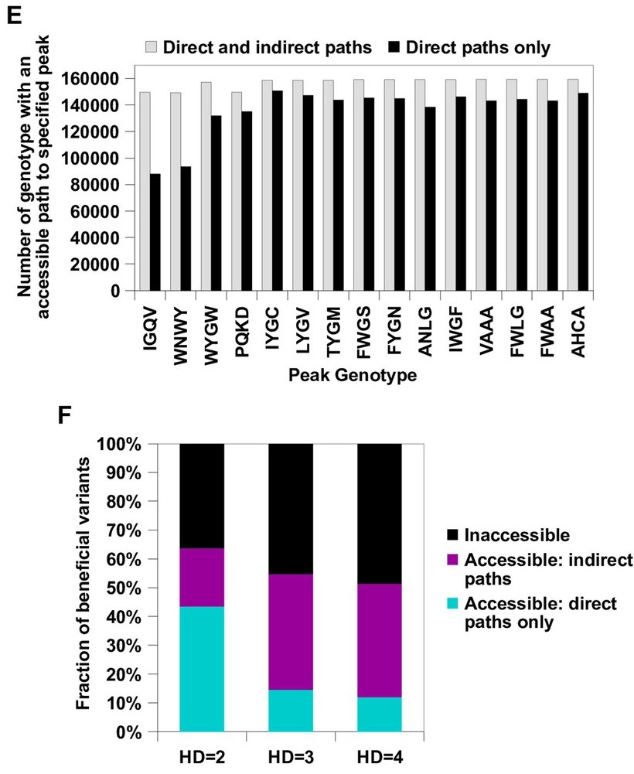
Figure 4
Indirect paths facilitate adaptation in rugged fitness landscapes by increasing the number of genotypes with access to fitness peaks.
This is true even when considering the constraints imposed by the standard genetic code.
Single nucleotide substitutions cannot produce all possible amino acid substitutions.
These results suggest that indirect paths promote evolutionary accessibility in rugged fitness landscapes.
Enhanced accessibility allows proteins to explore more sequence space and delay the trajectory to fitness peaks.
Notes:
(E) Indirect paths increased the number of genotypes accessible to each fitness peak. The 15 peaks are ordered by increasing fitness (from left to right).
(F) A large fraction of beneficial variants in the sequence space (fitness > 1) were accessible from WT only via indirect paths. Beneficial variants were classified by their Hamming distance (HD) from WT.

Slide 18
Discussion
This analysis was simplified in a few ways:
Fitness increased monotonically via sequential fixation of one-step beneficial mutants. Adaptation might occur by allowing the sequence to cross fitness valleys (e.g., genetic drift, recombination).
The genetic code limits the number of possible amino acid substitutions.
Single nucleotide substitutions reduce the number of neighbors in protein space from 19L to 6L.
Some variants (6.6%) had missing fitness values due to low read counts. These fitness values had to be imputed, so the actual fitness landscape might be different.

Slide 19
Summary
Pairwise epistasis can block direct paths on a fitness landscape and trap proteins in a sub-optimal form.
Proteins can overcome ruggedness and reach fitness peaks by taking indirect paths via conversion and detour bypass.
Higher-order epistasis plays an important role in facilitating extra-dimensional bypass.
Citation:
Wu et al (2016). “Adaptation in protein fitness landscapes is facilitated by indirect paths”, Elife 5:e16965. doi: 10.7554/eLife.16965.

