Slide 1
GP 160 HIV
Pam

Slide 2
Experiment
They employ a computational approach that allows estimation of the fitness landscape (fitness as a function of sequence) of the polyprotein that comprises HIV’s spike.
They validate the inferred landscape through comparisons with diverse experimental measurements.

Slide 3
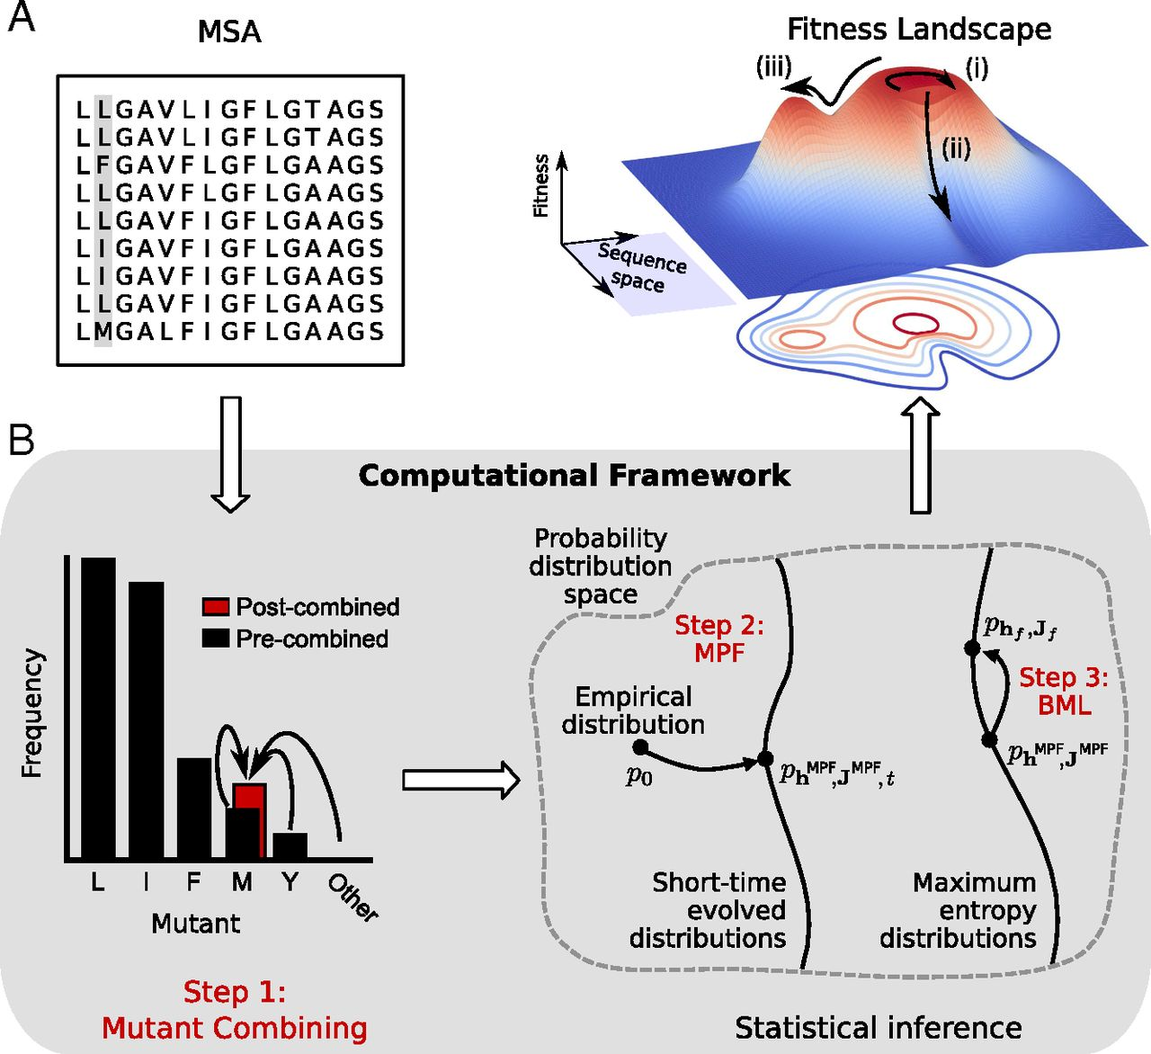
Notes:
we introduce a computational framework (Fig. 2B) that efficiently and accurately calculates the parameters of a maximum-entropy model for the gp160 fitness landscape. We validate the inferred fitness landscape by testing predictions of fitness against in vitro measurements of the fitness of nearly 100 HIV strains bearing mutations in gp160, testing predictions of protein contacts against structural data, and showing that our fitness landscape is consistent with known escape mutations. The fitness landscape that we report can help guide the design of immunogens aimed toward eliciting bnAbs, the choice of bnAb combinations for passive therapy, and the choice of immunogens for the T cell component of a vaccine.

Slide 4
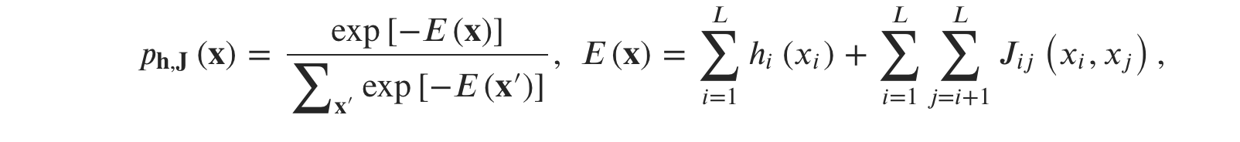
Computational method
They applied the computational framework to a MSA(a multiple sequence alignment) of HIV-1 clade B gp160 amino acid sequences downloaded from the Los Alamos National Laboratory (LANL) HIV sequence database (https://www.hiv.lanl.gov/). The MSA was processed to ensure both sequence and residue quality, resulting in L (amino acid) = 815 residues and 20,043 sequences belonging to 1,918 patients. These sequences were highly variable, involving an average pairwise Hamming distance of 0.1824, normalized by L.

Slide 5
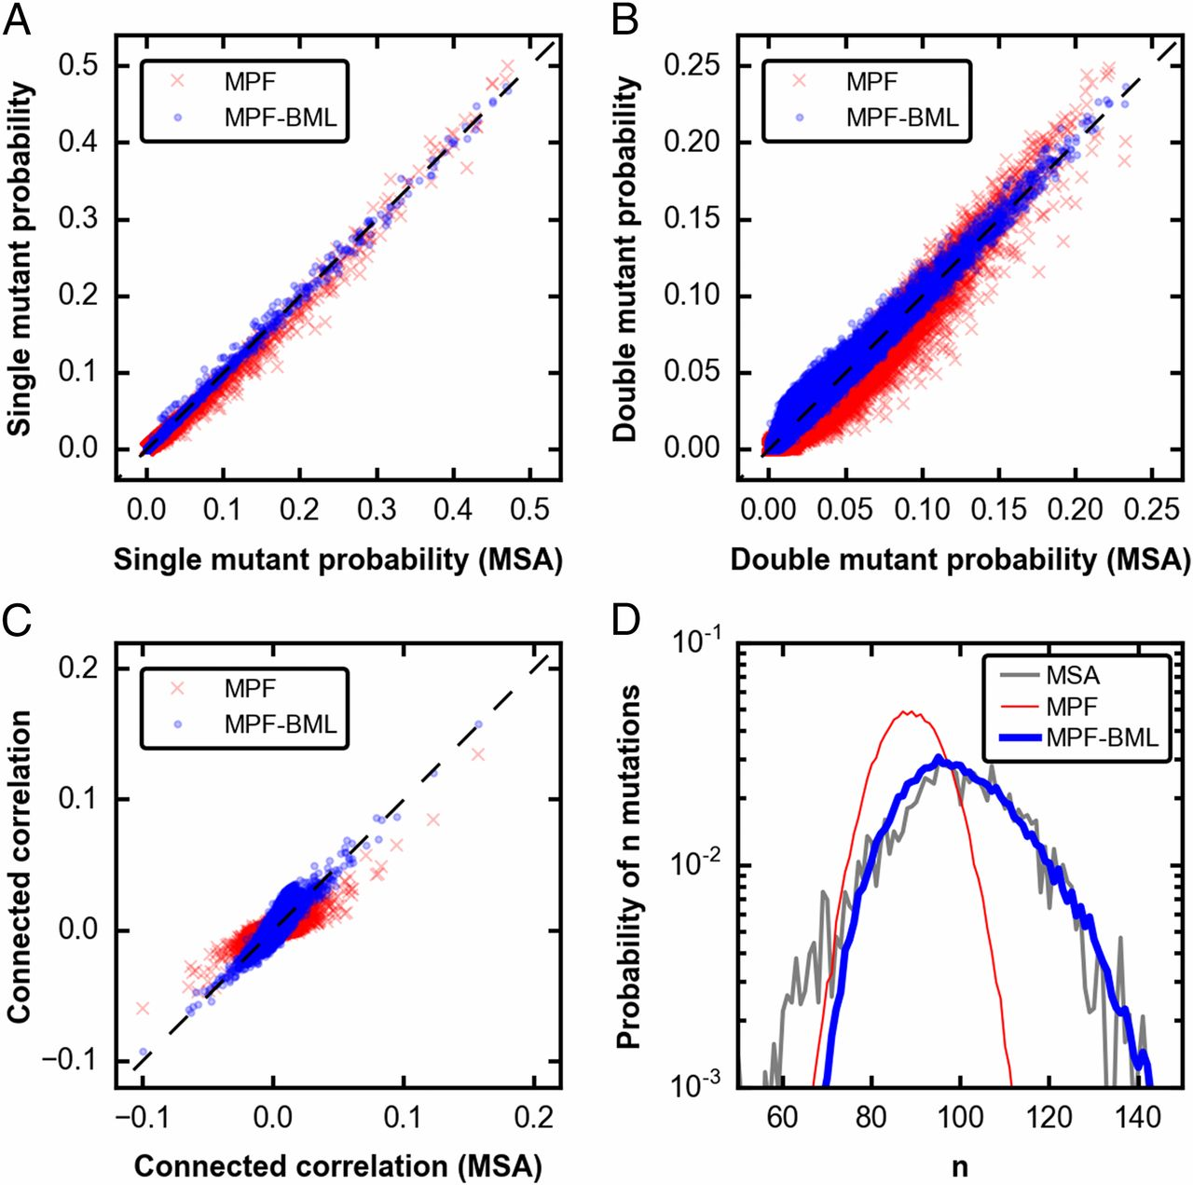
•Inferred model to capture fitness of different strains in the figure
•Compare in vitro measurements of HIV fitness
•Had 98 fitness measurements
Notes:
The inferred model accurately reproduced the single- and double-mutant probabilities observed. To assess the ability of the inferred model to capture the fitness of different strains of gp160, we compared predictions based on this model to in vitro measurements of HIV fitness

Slide 6
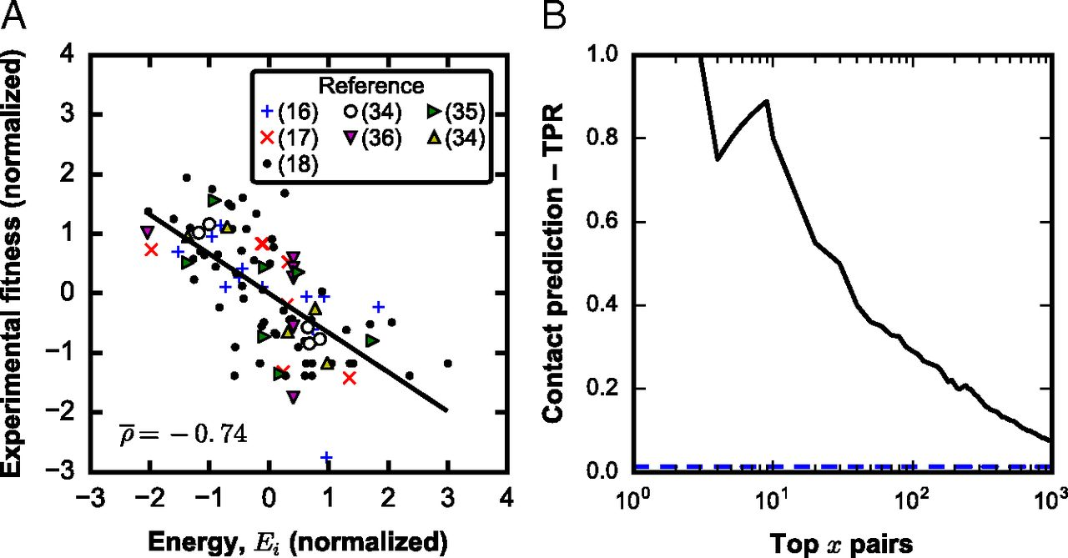
Notes:
The results demonstrate that demonstrate that the couplings in our inferred model are predictive of protein contacts for the gp160 trimeric spike of HIV. HIV proteins that have strong couplings are associated with compensatory mutations or those that interact synergistically to make the double mutant especially unfit. The data used was inferred.

Slide 7
Conclusion
Determining the fitness of the virus (ability to assemble, replicate, and propagate infection) as a function of the sequence of its proteins would help in this regard.
Fitness landscape can be clinically useful in the future for the selection of combination bnAb therapy
Because of the huge diversity of HLA genes in the population, very few regions of the HIV proteome are targeted by a significant fraction of humans.
If a mutation is forced by the immune response of a particular individual and it incurs a fitness cost, then upon infection of a new patient who does not target the same region, during chronic infection the first mutation will revert.
Unlike influenza, the HIV population has not been subjected to a few effective classes of natural or vaccine-induced immune responses by a significant fraction of humans across the world
The effects of phylogeny are better due to high rates of recombination

Slide 8
Thank You

