Slide 1
Dynamic Modeling of Non-Poisson Neurons
Ganchao Wei, Ian H. Stevenson
NMC4
December 2021

Slide 2
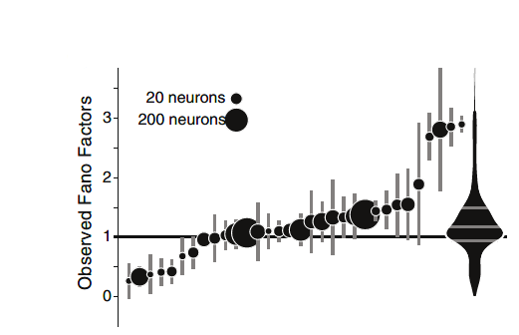
Neurons: Non-Poisson & Non-stationary
Fano Factor = var / mean
Poisson: mean = var?
Unrealistic!
Under- & over-dispersion
Naturally, neural activities will change along the time

Slide 3
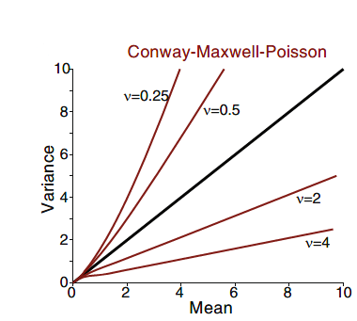
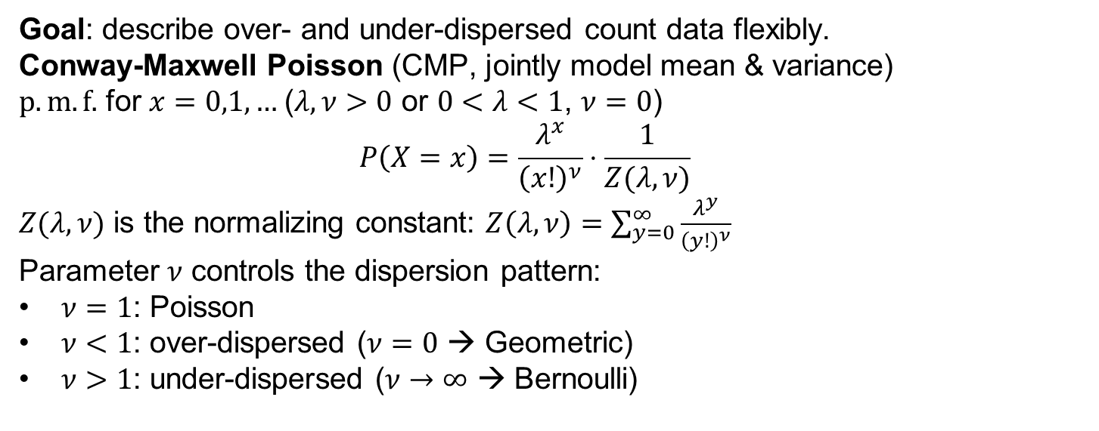
Method (1): Non-Poisson Neurons
Goal: describe over- and under-dispersed count data flexibly.
Conway-Maxwell Poisson (CMP, jointly model mean & variance)
$p.m.f.$ for $x=0,1,…$($λ,ν>0$ or $0<λ<1$, $ν=0$)
$$P\left(X=x\right)=\frac{λ^{x}}{{\left(x!\right)}^{ν}}⋅\frac{1}{Z(λ, ν)}$$
$Z(λ,ν)$ is the normalizing constant: $Z\left(λ,ν\right)=\sum_{y=0}^{∞}{\frac{λ^{y}}{{\left(y!\right)}^{ν}}}$
Parameter $ν$ controls the dispersion pattern:
$ν=1$: Poisson
$ν<1$: over-dispersed ($ν=0$ → Geometric)
$ν>1$: under-dispersed ($ν→∞$ → Bernoulli)

Slide 4
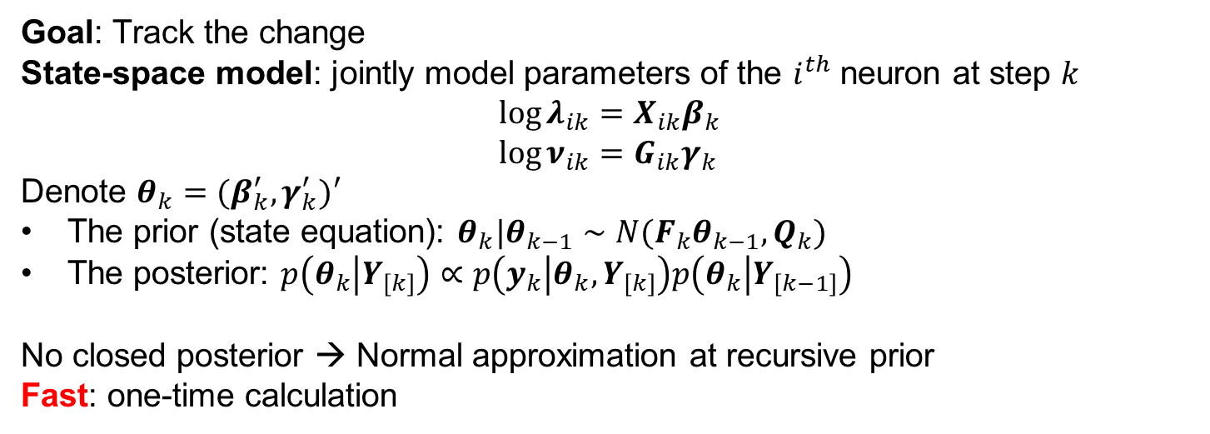
Method (2): Non-stationary Neurons
Goal: Track the change
State-space model: jointly model parameters of the $i^{th}$ neuron at step $k$
$$\log{λ_{ik}}=X_{ik}β_{k} \\ \log{ν_{ik}}=G_{ik}γ_{k}$$
Denote $θ_{k}=(β_{k}^{′},γ_{k}^{′})′$
The prior (state equation): $θ_{k}|θ_{k−1}∼N(F_{k}θ_{k−1},Q_{k})$
The posterior: $p\left(θ_{k} | Y_{\left[k\right]}\right)∝p\left(y_{k} | θ_{k}, Y_{\left[k\right]}\right)p\left(θ_{k} | Y_{\left[k−1\right]}\right)$
No closed posterior → Normal approximation at recursive prior
Fast: one-time calculation

Slide 5
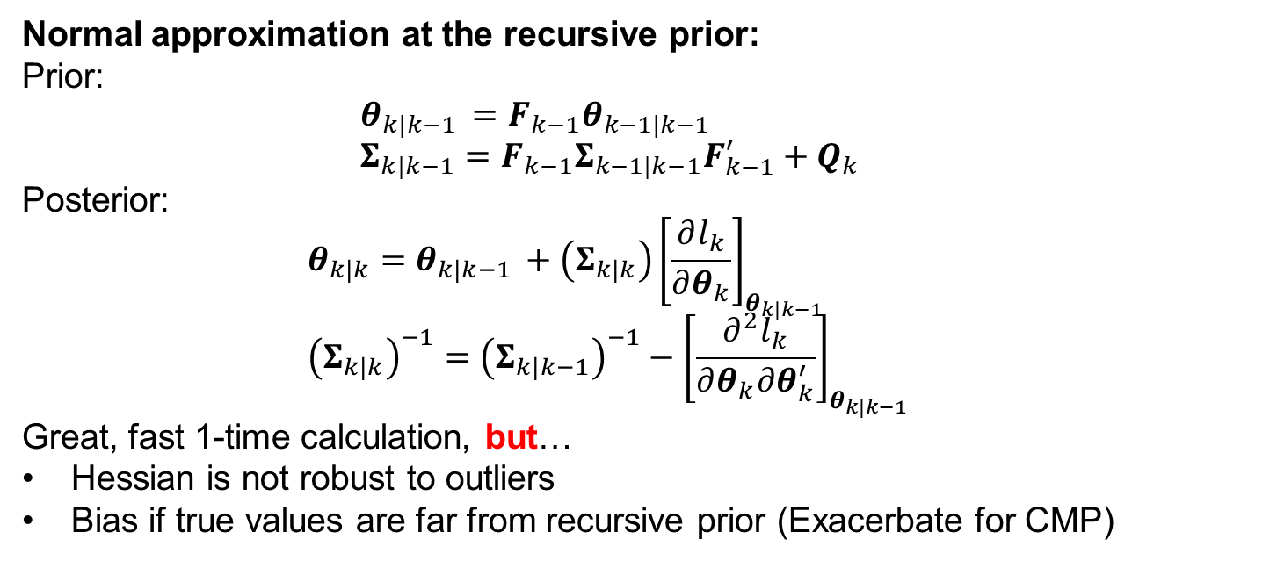
Method (2): Non-stationary Neurons
Normal approximation at the recursive prior:
Prior:
$$θ_{k|k−1 }=F_{k−1}θ_{k−1|k−1 } \\ Σ_{k|k−1}=F_{k−1}Σ_{k−1|k−1}F_{k−1}^{′}+Q_{k}$$
Posterior:
$$θ_{k|k}=θ_{k|k−1 }+\left(Σ_{k|k}\right){\left[\frac{∂l_{k}}{∂θ_{k}}\right]}_{θ_{k|k−1 }} \\ {\left(Σ_{k|k}\right)}^{−1}={\left(Σ_{k|k−1}\right)}^{−1}−{\left[\frac{∂^{2}l_{k}}{∂θ_{k}∂θ_{k}^{′}}\right]}_{θ_{k|k−1 }}$$
Great, fast 1-time calculation, but…
Hessian is not robust to outliers
Bias if true values are far from recursive prior (Exacerbate for CMP)

Slide 6
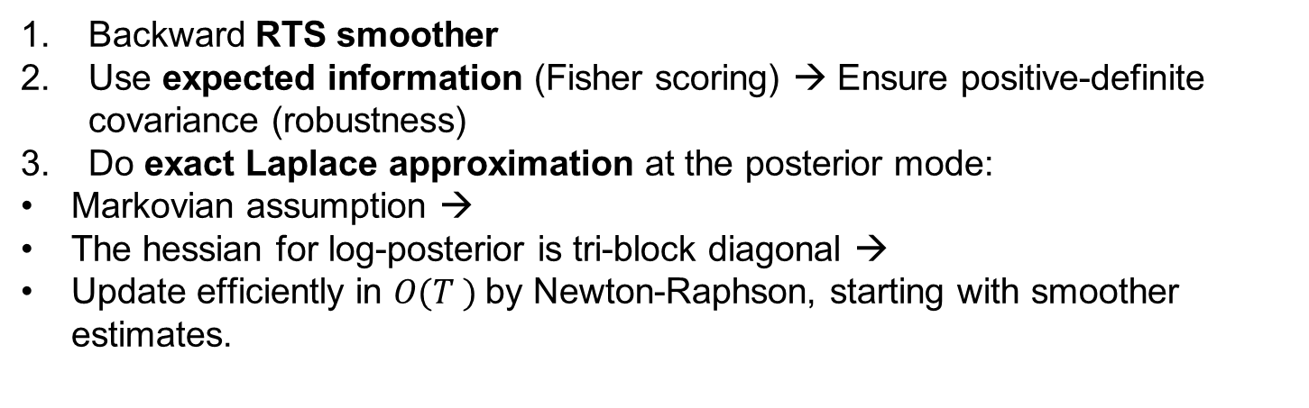
Method (3): Improvements
Backward RTS smoother
Use expected information (Fisher scoring) → Ensure positive-definite covariance (robustness)
Do exact Laplace approximation at the posterior mode:
Markovian assumption →
The hessian for log-posterior is tri-block diagonal →
Update efficiently in $O(T )$by Newton-Raphson, starting with smoother estimates.

Slide 7
Application (1): Hippocampus Data

Slide 8
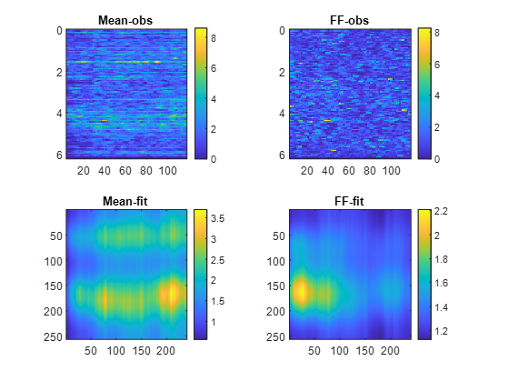
Application (2): V1 data
Use half data in each trial
Results for 71 neurons

