Slide 1
Adaptive modeling of neural spike count data with non-Poisson variability
Ganchao Wei
Department of Statistics
University of Connecticut
ganchao.wei@uconn.edu
Ian H. Stevenson
Department of Psychological Science and Biomedical Engineering
University of Connecticut
ian.stevenson@uconn.edu

Slide 2
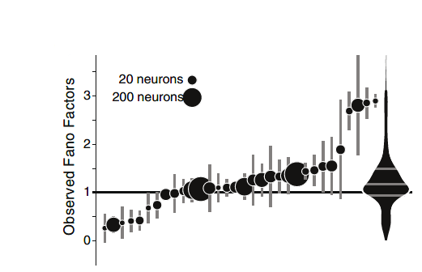
Problem & Motivation– V1 data
non-stationary mean firing rate & noise (variance)
Change in mean & variance contains information
Poisson: mean = var, inappropriate
track time-varying mean and variance simultaneously.

Slide 3
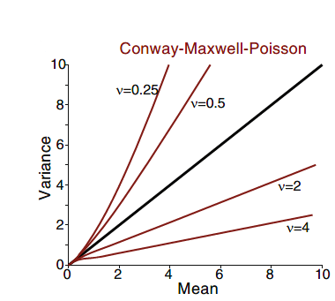
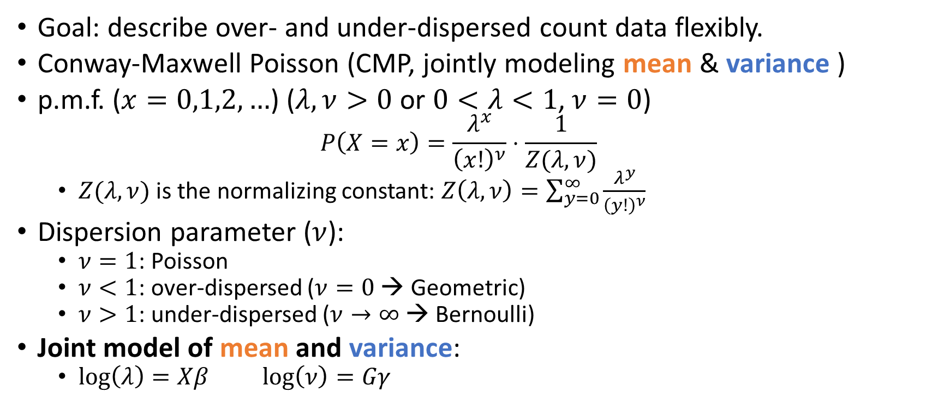
Method (1): Distribution
Goal: describe over- and under-dispersed count data flexibly.
Conway-Maxwell Poisson (CMP, jointly modeling mean & variance )
p.m.f. ($x=0,1,2,…$) ($λ,ν>0$ or $0<λ<1$, $ν=0$)
$$P\left(X=x\right)=\frac{λ^{x}}{{\left(x!\right)}^{ν}}⋅\frac{1}{Z(λ, ν)}$$
$Z(λ,ν)$ is the normalizing constant: $Z\left(λ,ν\right)=\sum_{y=0}^{∞}{\frac{λ^{y}}{{\left(y!\right)}^{ν}}}$
Dispersion parameter ($ν$):
$ν=1$: Poisson
$ν<1$: over-dispersed ($ν=0$ → Geometric)
$ν>1$: under-dispersed ($ν→∞$ → Bernoulli)
Joint model of mean and variance:
$\log\left(λ\right)=Xβ$ $\log\left(ν\right)=Gγ$

Slide 4
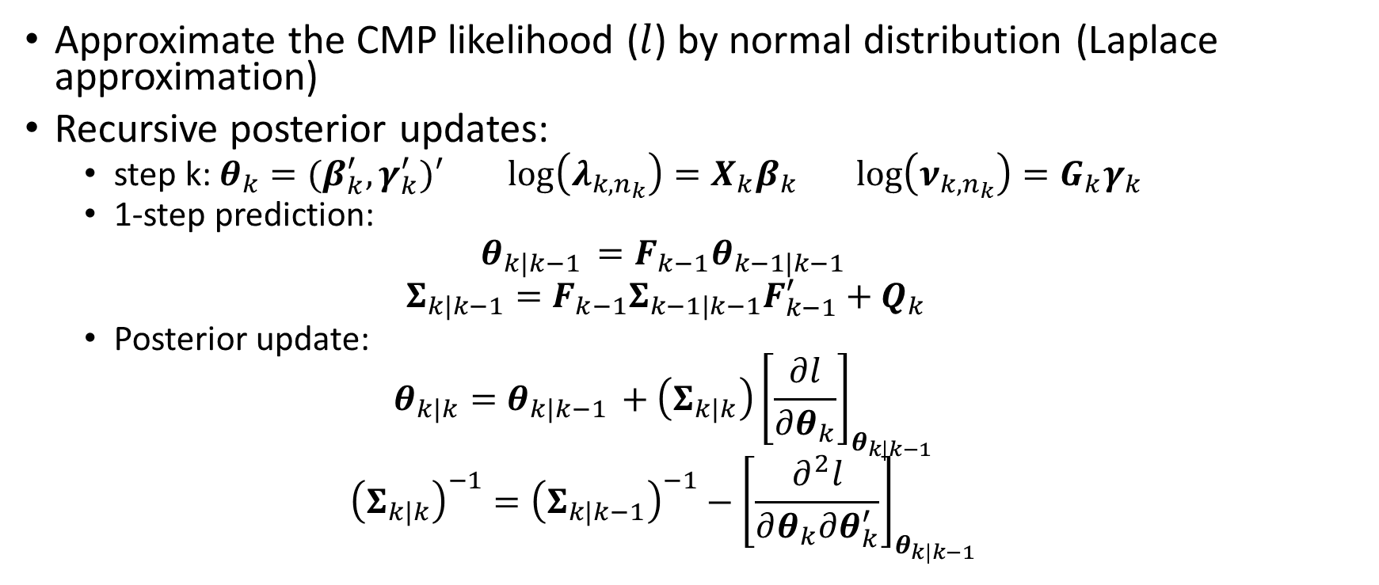
Method (2): Adaptive Filter
Approximate the CMP likelihood ($l$) by normal distribution (Laplace approximation)
Recursive posterior updates:
step k: $θ_{k}=(β_{k}^{′},γ_{k}^{′})′$ $\log\left(λ_{k,n_{k}}\right)=X_{k}β_{k}$ $\log\left(ν_{k,n_{k}}\right)=G_{k}γ_{k}$
1-step prediction:
$$θ_{k|k−1 }=F_{k−1}θ_{k−1|k−1 }$$
$$Σ_{k|k−1}=F_{k−1}Σ_{k−1|k−1}F_{k−1}^{′}+Q_{k}$$
Posterior update:
$$θ_{k|k}=θ_{k|k−1 }+\left(Σ_{k|k}\right){\left[\frac{∂l}{∂θ_{k}}\right]}_{θ_{k|k−1 }}$$
$${\left(Σ_{k|k}\right)}^{−1}={\left(Σ_{k|k−1}\right)}^{−1}−{\left[\frac{∂^{2}l}{∂θ_{k}∂θ_{k}^{′}}\right]}_{θ_{k|k−1 }}$$

Slide 5
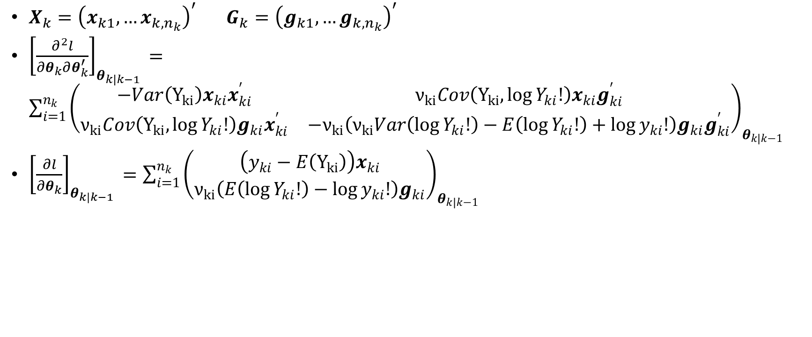
Method (2) cont.: Adaptive Filter
$X_{k}={\left(x_{k1},…x_{k,n_{k}}\right)}^{′}$ $G_{k}={\left(g_{k1},…g_{k,n_{k}}\right)}^{′}$
${\left[\frac{∂^{2}l}{∂θ_{k}∂θ_{k}^{′}}\right]}_{θ_{k|k−1 }}=\sum_{i=1}^{n_{k}}{{\left(\begin{matrix}{{−Var\left(Y_{ki}\right)x}_{ki}x}_{ki}^{′} & ν_{ki}Cov\left(Y_{ki}, \log{Y_{ki}!}\right)x_{ki}g_{ki}^{′} \\ ν_{ki}Cov\left(Y_{ki}, \log{Y_{ki}!}\right)g_{ki}x_{ki}^{′} & {−ν}_{ki}\left(ν_{ki}Var\left(\log{Y_{ki}!}\right)−E\left(\log{Y_{ki}!}\right)+\log{y_{ki}!}\right)g_{ki}g_{ki}^{′}\end{matrix}\right)}_{θ_{k|k−1}}}$
${\left[\frac{∂l}{∂θ_{k}}\right]}_{θ_{k|k−1 }}=\sum_{i=1}^{n_{k}}{{\left(\begin{matrix}{\left(y_{ki}−E\left(Y_{ki}\right)\right)x}_{ki} \\ {ν_{ki}\left(E\left(\log{Y_{ki}!}\right)−\log{y_{ki}!}\right)g}_{ki}\end{matrix}\right)}_{θ_{k|k−1}}}$

Slide 6
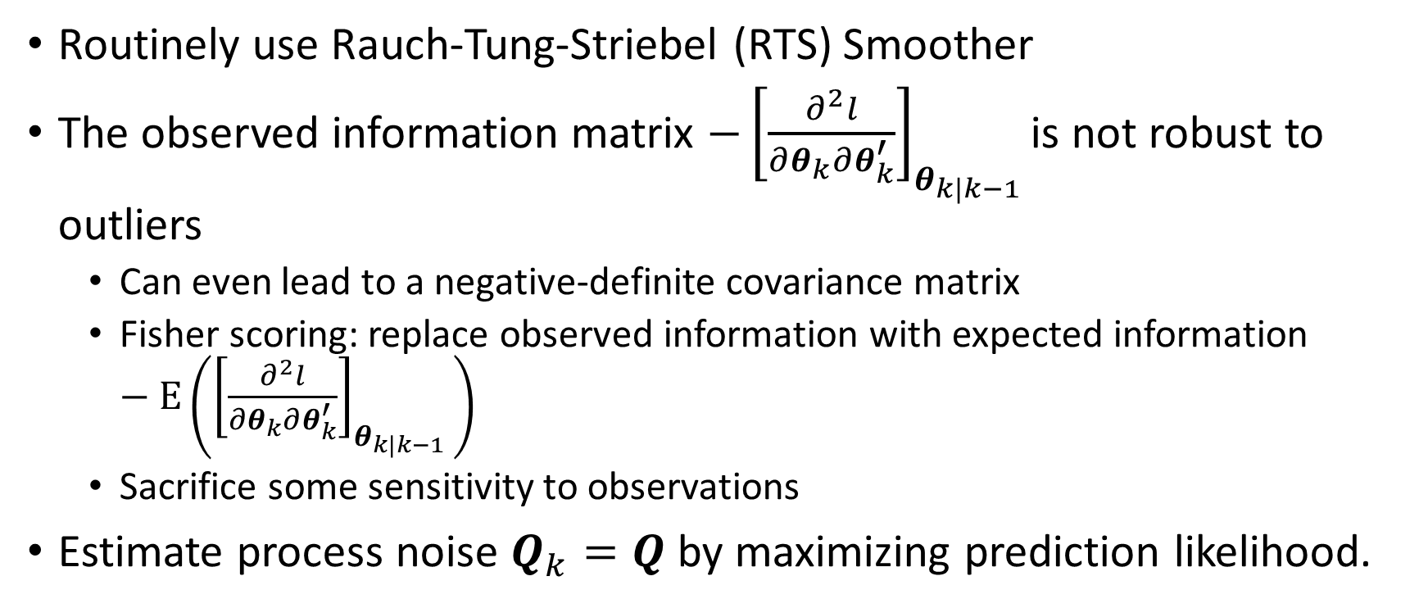
Method (3): improve adaptive filter
Routinely use Rauch-Tung-Striebel (RTS) Smoother
The observed information matrix $−{\left[\frac{∂^{2}l}{∂θ_{k}∂θ_{k}^{′}}\right]}_{θ_{k|k−1 }}$is not robust to outliers
Can even lead to a negative-definite covariance matrix
Fisher scoring: replace observed information with expected information $−E\left({\left[\frac{∂^{2}l}{∂θ_{k}∂θ_{k}^{′}}\right]}_{θ_{k|k−1 }}\right)$
Sacrifice some sensitivity to observations
Estimate process noise $Q_{k}=Q$ by maximizing prediction likelihood.

Slide 7
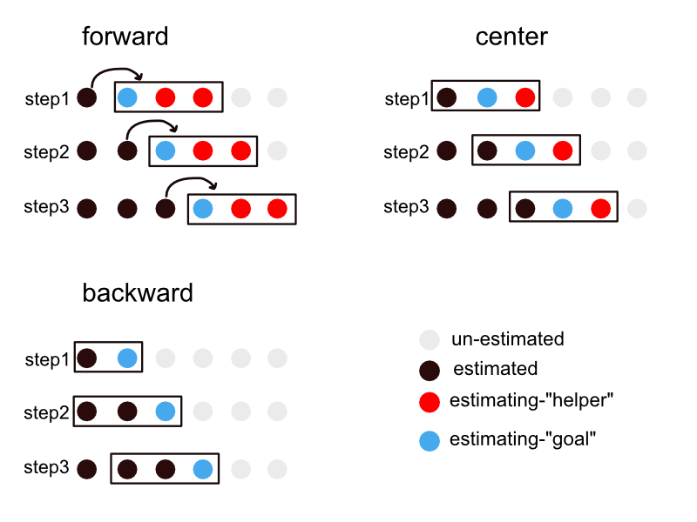
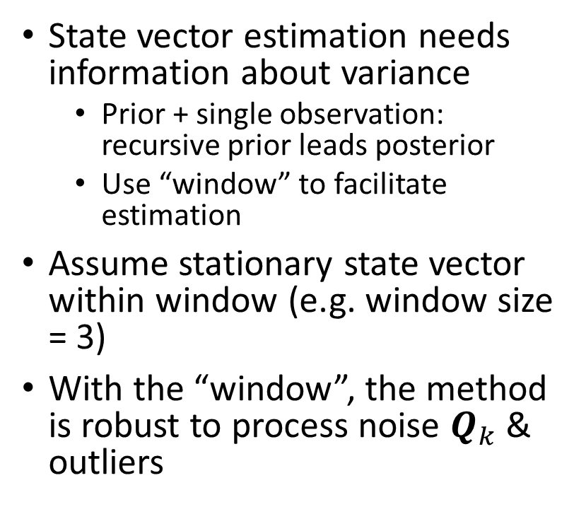
Method (3) cont.: improve adaptive filter
State vector estimation needs information about variance
Prior + single observation: recursive prior leads posterior
Use “window” to facilitate estimation
Assume stationary state vector within window (e.g. window size = 3)
With the “window”, the method is robust to process noise $Q_{k}$ & outliers

Slide 8
Simulation (1): method-drive example
Filtering: No window + observed information
smoothing: window + expected information

Slide 9
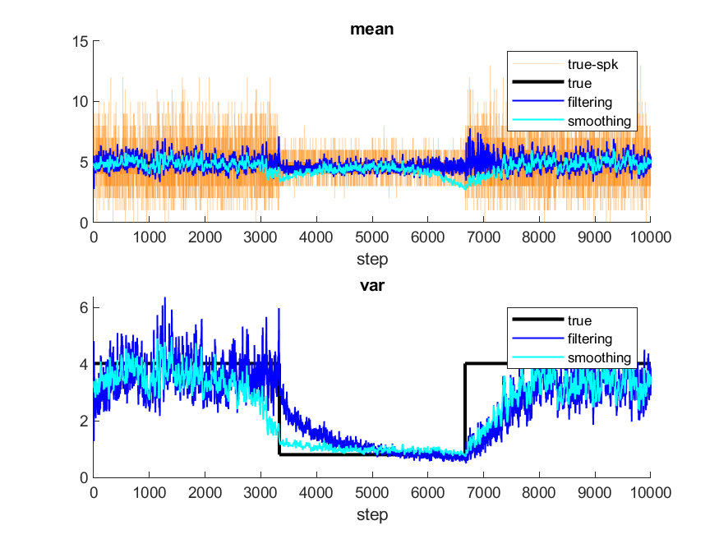
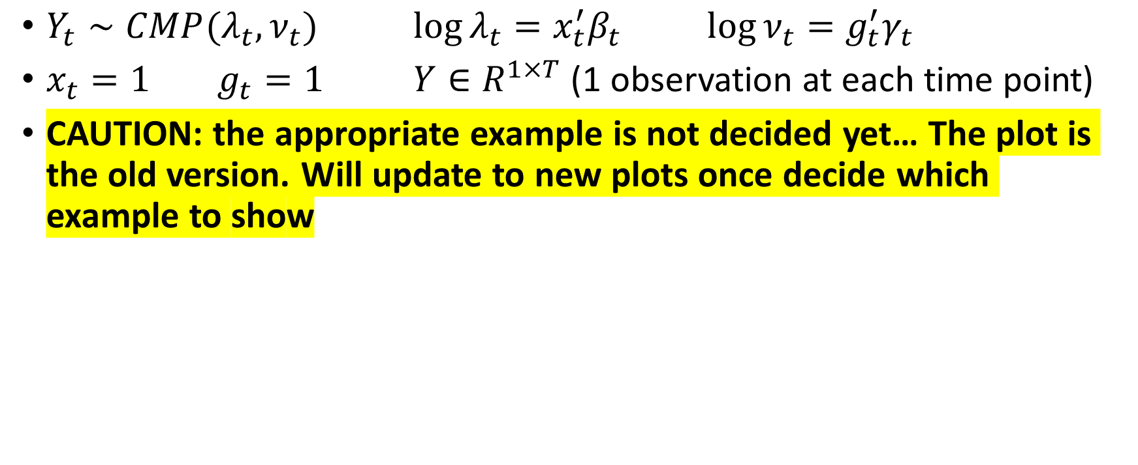
Simulation (2): problem-driven example
$Y_{t}∼CMP(λ_{t},ν_{t})$ $\log{λ_{t}}=x_{t}^{′}β_{t}$ $\log{ν_{t}=g_{t}^{′}γ_{t}}$
$x_{t}=1$ $g_{t}=1$ $Y∈R^{1×T}$ (1 observation at each time point)
CAUTION: the appropriate example is not decided yet… The plot is the old version. Will update to new plots once decide which example to show

Slide 10
Application: V1 data revisit
observation
Full sample
Half Sample

