Slide 1
Adaptive modeling of neural spike count data with non-Poisson variability
Ganchao Wei
Department of Statistics
University of Connecticut
ganchao.wei@uconn.edu
Ian H. Stevenson
Department of Psychological Science and Biomedical Engineering
University of Connecticut
ian.stevenson@uconn.edu

Slide 2
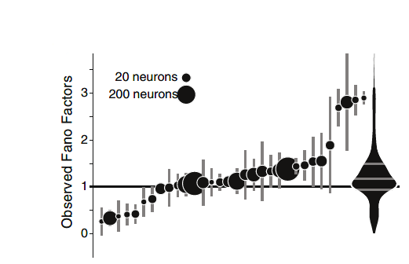
Problem & Motivation– V1 data
non-stationary mean firing rate & noise (variance)
Change in mean & variance contains information
Poisson: mean = var, inappropriate
track time-varying mean and variance simultaneously.

Slide 3
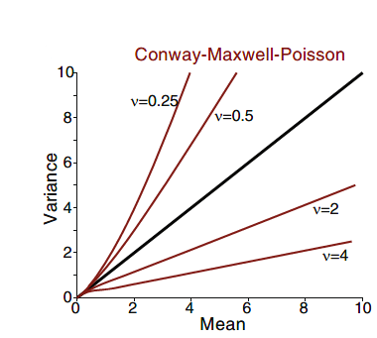
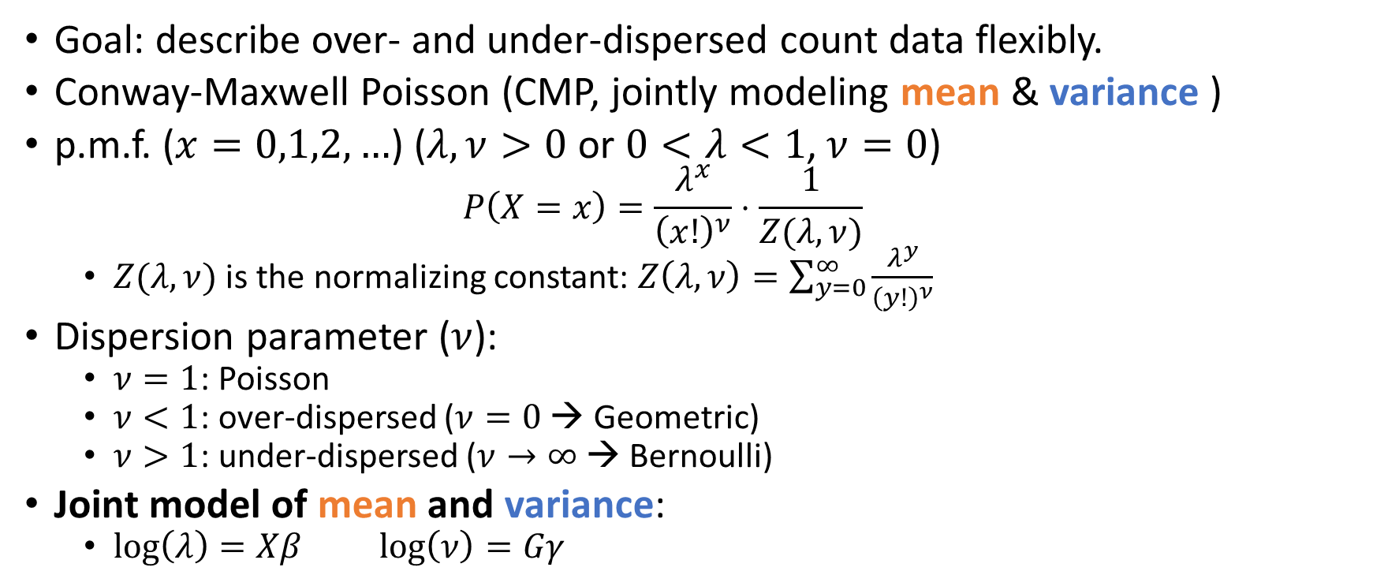
Method (1): Distribution
Goal: describe over- and under-dispersed count data flexibly.
Conway-Maxwell Poisson (CMP, jointly modeling mean & variance )
p.m.f. ($x=0,1,2,…$) ($λ,ν>0$ or $0<λ<1$, $ν=0$)
$$P\left(X=x\right)=\frac{λ^{x}}{{\left(x!\right)}^{ν}}⋅\frac{1}{Z(λ, ν)}$$
$Z(λ,ν)$ is the normalizing constant: $Z\left(λ,ν\right)=\sum_{y=0}^{∞}{\frac{λ^{y}}{{\left(y!\right)}^{ν}}}$
Dispersion parameter ($ν$):
$ν=1$: Poisson
$ν<1$: over-dispersed ($ν=0$ → Geometric)
$ν>1$: under-dispersed ($ν→∞$ → Bernoulli)
Joint model of mean and variance:
$\log\left(λ\right)=Xβ$ $\log\left(ν\right)=Gγ$

Slide 4
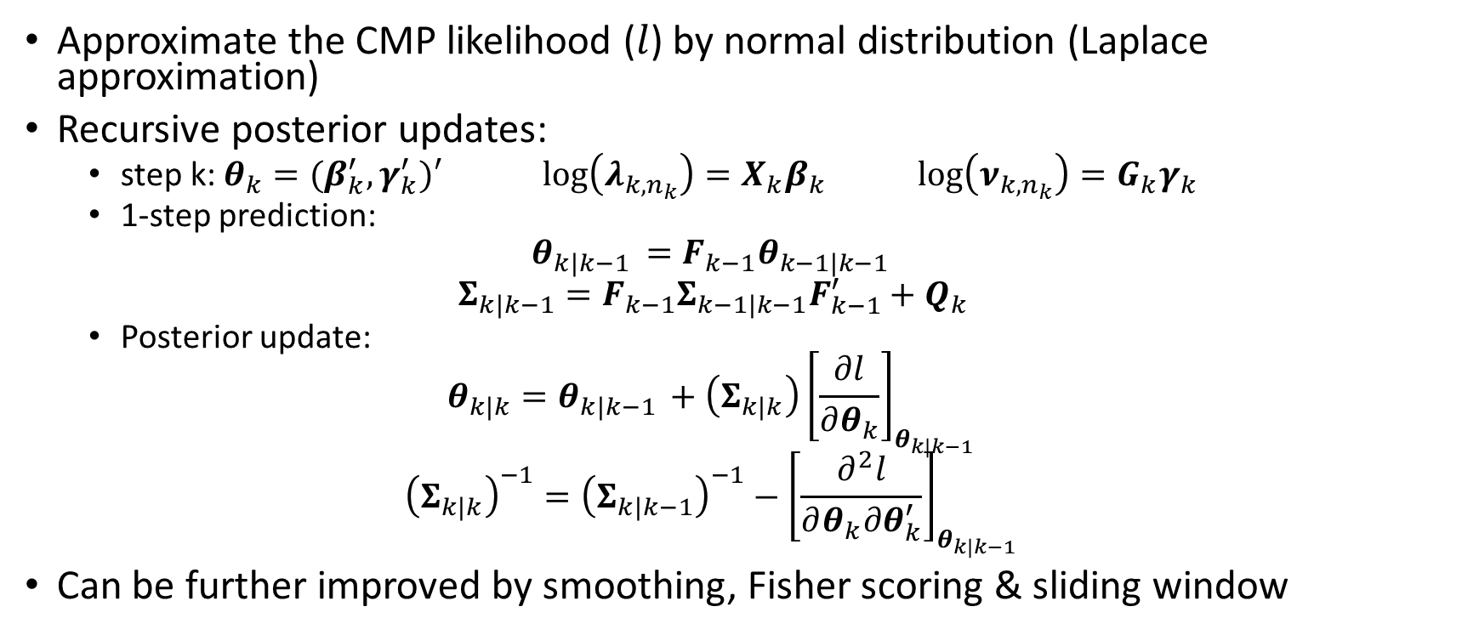
Method (2): Adaptive Filter
Approximate the CMP likelihood ($l$) by normal distribution (Laplace approximation)
Recursive posterior updates:
step k: $θ_{k}=(β_{k}^{′},γ_{k}^{′})′$ $\log\left(λ_{k,n_{k}}\right)=X_{k}β_{k}$ $\log\left(ν_{k,n_{k}}\right)=G_{k}γ_{k}$
1-step prediction:
$$θ_{k|k−1 }=F_{k−1}θ_{k−1|k−1 }$$
$$Σ_{k|k−1}=F_{k−1}Σ_{k−1|k−1}F_{k−1}^{′}+Q_{k}$$
Posterior update:
$$θ_{k|k}=θ_{k|k−1 }+\left(Σ_{k|k}\right){\left[\frac{∂l}{∂θ_{k}}\right]}_{θ_{k|k−1 }}$$
$${\left(Σ_{k|k}\right)}^{−1}={\left(Σ_{k|k−1}\right)}^{−1}−{\left[\frac{∂^{2}l}{∂θ_{k}∂θ_{k}^{′}}\right]}_{θ_{k|k−1 }}$$
Can be further improved by smoothing, Fisher scoring & sliding window

Slide 5
Simulation
Filtering: No window + observed information
smoothing: window + expected information

Slide 6
Application: revisit V1 data
observation
Full sample
Half Sample

