Slide 1

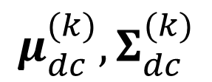
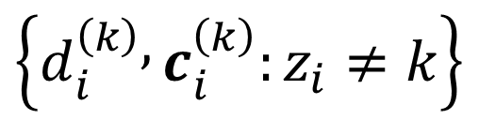
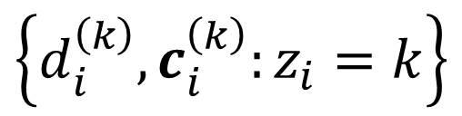
inference: step 1
$\left\{d_{i}^{\left(k\right)},c_{i}^{\left(k\right)}:z_{i}=k\right\}$
generating
process
$$μ_{dc}^{(k)},Σ_{dc}^{(k)}$$
$$d^{\left(k\right)},C^{\left(k\right)}$$
$$\left\{d_{i}^{\left(k\right)} , c_{i}^{\left(k\right)}:z_{i}≠k\right\}$$
inference: step 2

