Slide 1
Data Scientist Case Study – Milo Joronen
February 2026

Slide 2
Introduction
Overview of the HCP Dataset & Its Significance
Comprehensive episode-level dataset capturing hospital activity, clinical complexity and associated charges
Collected to support billing, funding reconciliation, contract compliance and financial reporting
Provides visibility into how clinical pathways translate into cost outcomes
Why It Matters to private hospitals
Ensures accurate billing and revenue capture
Enables benchmarking of service lines and clinical pathways
Identifies operational inefficiencies (e.g. LOS, theatre utilisation)
Supports evidence-based cost management and service planning
Why It Matters to Insurers
Validates claims against expected cost benchmarks
Enables risk-adjusted comparison across providers
Identifies cost variation and potential anomalies
Supports sustainable contract negotiation and pricing strategy
Why Cost Analysis Is Critical
Healthcare expenditure is highly variable and skewed
A small proportion of episodes drive disproportionate financial impact
Risk-adjusted cost analysis improves:
  Commercial outcomes (pricing, contracting, margin protection)
  Operational efficiency (pathway optimisation, resource allocation)
Shifts oversight from broad auditing to targeted, data-driven review

Slide 3
Structure of the presentation
Part I: Anomaly detection – summary of data quality issues and inconsistency. This is an important part of data governance and operational efficiency.
Part II: Exploratory Data Analysis – Focus on trends and patterns around Cost/Charge of an episode.
Part III: Advanced analytics – XGBOOST to predict episode cost – motivation, hypothesis, methodology, testing and performance
Part IV: Data-driven recommendations
Part V: After thought – Model limitations, financial impact, long term sustainability

Slide 4
HCP Data Quality & Billing Consistency Review
Part I
Summary of Identified Anomalies and Governance Recommendations

Slide 5
Overview of Anomaly Detection
Consistency checks performed across utilisation and billing fields.
  Focus: Alignment between recorded care intensity and charges.
  Objective: Identify potential revenue leakage and classification inconsistencies.

Slide 6
Key Findings: Theatre & Classification
9,510 cases: Theatre minutes recorded but no theatre charge.
5,536 cases: Same-day status but LOS > 1 day.
43 cases: Theatre charge recorded but no theatre minutes.
Recommendation: Review theatre billing allocation and SameDayStatus logic.

Slide 7
High-Acuity Care Inconsistencies
703 cases: CCU flag TRUE but no CCU charge.
69 cases: Palliative days recorded but inconsistent status.
24 cases: Palliative status indicates care but zero Palliative days recorded.
Recommendation: Targeted review of cardiac and palliative coding workflows.

Slide 8
Neonatal & Zero-Charge Episodes
314 cases: Neonatal flag TRUE but no qualified newborn days.
430 cases: LOS recorded but total charges = 0.
Potential causes: Non-chargeable episodes, bundling, extract timing issues.
Recommendation: Investigate to confirm revenue integrity and documentation compliance.

Slide 9
Strategic Recommendations
Implement automated monthly anomaly monitoring dashboard.
Flag high-acuity care without corresponding charges.
Strengthen integration between clinical and financial systems.
Embed anomaly checks prior to insurer submission.

Slide 10
PART II: Exploratory Data Analysis
Explore the trends and patterns in cost/charge of an episode
Provide recommendations based on findings

Slide 11
Cost Segmentation
Definition of Cost Segment in This Case Study
Cost segments were created to categorise episodes based on their total hospital charges, allowing analysis of cost variation across different levels of expenditure.
Episodes were grouped using percentile thresholds:
Low: ≤ 50th percentile of total charges
Medium: 50th–75th percentile
High: 75th–95th percentile
Very High: > 95th percentile
This segmentation enables:
Stratified analysis of cost behaviour
Identification of where outliers concentrate
Separation of routine, moderate and catastrophic cost episodes
More meaningful comparison of efficiency and financial risk

Slide 12
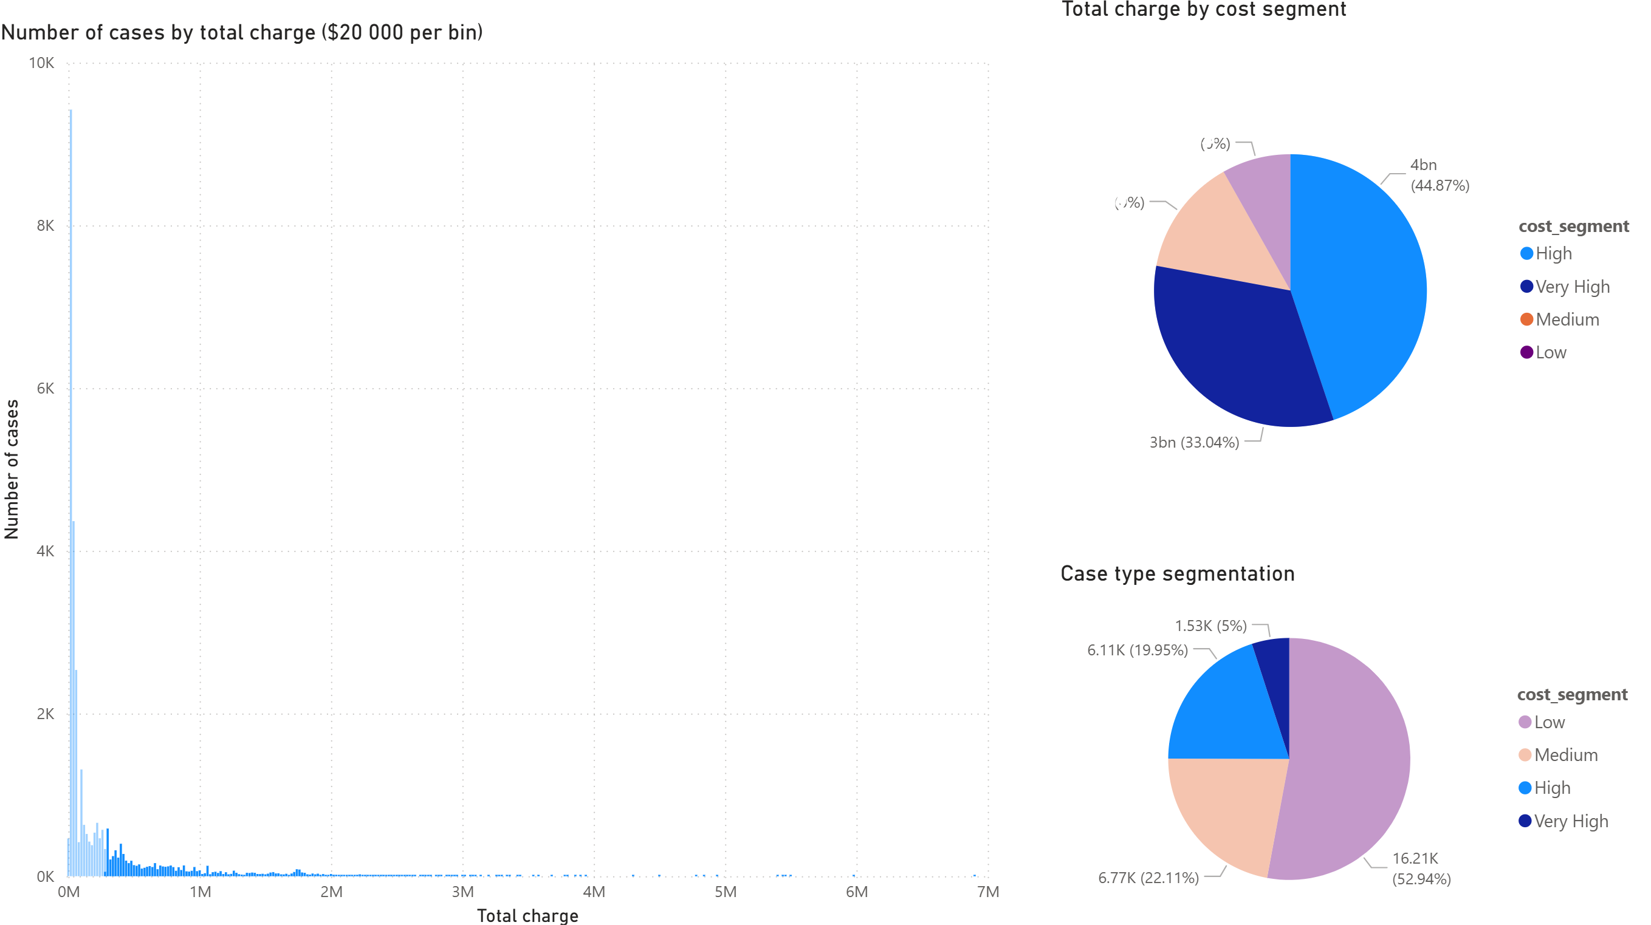
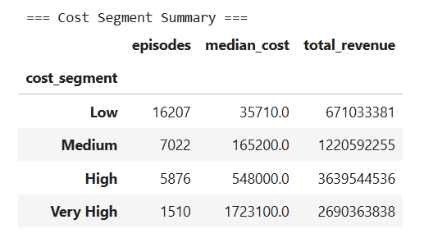
Pareto behaviour
- The distribution of episode costs demonstrates clear Pareto behaviour, where a relatively small proportion of cases generate a disproportionate share of total revenue.
- Approximately 25% of episodes, classified within the High and Very High cost segments, account for the majority of total hospital revenue (78%). In particular, the top 5% of cases represent extremely high-value, resource-intensive episodes that significantly influence overall financial performance.
- This concentration could reflect the nature of acute healthcare delivery, where high-acuity surgical and complex inpatient pathways drive substantial revenue and resource utilisation.
- From a strategic perspective, this finding highlights that financial risk, insurer scrutiny, and operational intensity are not evenly distributed across all episodes. Instead, they are concentrated within a relatively small group of high-value cases.
- Focusing governance, billing accuracy, contract compliance, and operational optimisation efforts on this segment will yield the greatest impact on revenue protection and performance stability.
Notes:
The Very High Segment Is Small but Material
Only 1,510 episodes:
Likely high-acuity
Likely ICU / CCU heavy
Likely prosthesis or major surgical cases
But they generate multi-billion revenue impact.
This is where:
Insurer disputes are highest risk
Documentation must be strongest
Coding precision matters most
Operational Implications
For Operations
The High and Very High segments:
Drive bed occupancy
Drive theatre time
Drive staffing intensity
Likely correlate with longer LOS
This is where:
Capacity planning matters most
Throughput bottlenecks matter most
Resource allocation decisions matter most
For Finance
The Very High group represents:
Revenue concentration risk
Contract sensitivity
Potential variance exposure
Most volatile cost base
If reimbursement rules change, this segment moves the most.
Governance Insight
If errors occur:
In Low segment → minimal impact
In Very High segment → extremely material impact
This suggests a governance strategy:
Apply stronger billing validation and anomaly checks to High and Very High segments.

Slide 13
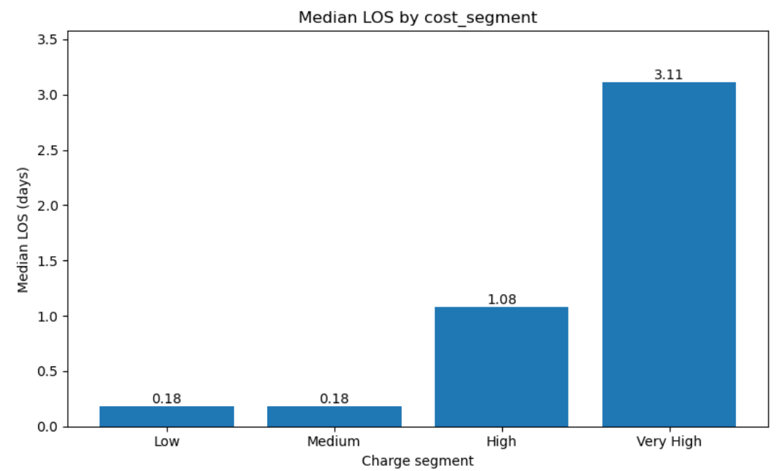
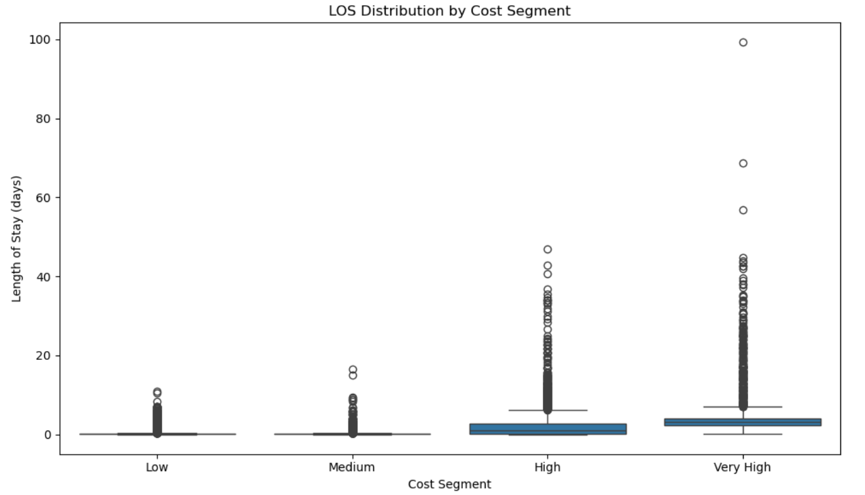
Length of stay analysis
There is a clear positive relationship between cost segment and length of stay. Very High-cost episodes are characterised by significantly longer and more variable admissions, including a heavy tail of extreme-stay cases. This indicates that prolonged inpatient pathways are a major structural driver of financial concentration and operational intensity.
Notes:
1- Median LOS by Cost Segment
Median LOS increases sharply across segments:
Low: 0.18 days
Medium: 0.18 days
High: 1.08 days
Very High: 3.11 days
What this means:
Low and Medium cases are overwhelmingly same-day or short-stay episodes.
High cases cross into multi-day inpatient territory.
Very High cases are clearly prolonged admissions.
There is a strong monotonic relationship:
As cost segment increases, median length of stay increases.
This suggests LOS is a key structural driver of cost.
2- LOS Distribution (Boxplot)
The boxplot adds depth:
A. Spread increases with cost
Low/Medium → tightly compressed around zero
High → wider distribution
Very High → significantly wider spread
This means:
Cost is not just higher — it is more variable.
Very High cases are operationally less predictable.
B. Heavy Right Tail in Very High
Very High shows:
Many long-stay outliers (20–40+ days)
Extreme cases approaching ~100 days
This indicates:
Complex inpatient pathways
Possibly delayed discharge
Complications
Rehabilitation or step-down waiting
High-acuity cases
This tail is important.
Because:
Extreme LOS cases likely drive disproportionate marginal cost.
3- Low & Medium Segments
They are:
Short stay
Operationally predictable
Likely procedural / day surgery driven
These are not your operational risk zones.
Operational Interpretation
Very High segment likely:
Drives bed occupancy pressure
Requires higher nursing intensity
Involves ICU / CCU exposure
Has higher discharge planning complexity
If hospital capacity is strained, this segment is where bottlenecks occur.
Financial Interpretation
LOS directly increases:
Accommodation charges
Nursing labour
Overheads
Resource consumption
But the tail suggests:
A small number of extreme LOS cases could distort margins
These may require targeted clinical review
Strategic Insight
Cost escalation is strongly associated with prolonged hospital stay.
Narrative A — Operational Efficiency
If LOS is reducible:
Improve discharge planning
Early rehab referral
Bed management optimisation
Narrative B — Case Complexity
If LOS reflects unavoidable clinical complexity:
Focus on reimbursement alignment
DRG review
Funding advocacy

Slide 14
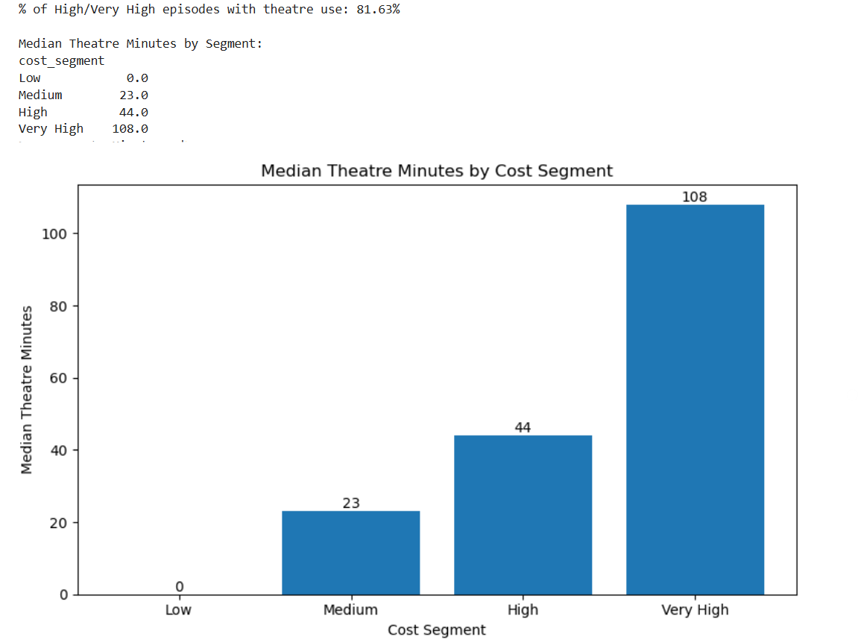
Theatre usage analysis
High and Very High-cost episodes are predominantly procedure-driven, with over 80% involving theatre use. Median theatre duration increases substantially across segments, indicating that cost concentration is closely tied to surgical complexity and intensity. When combined with longer lengths of stay, this suggests that procedural and post-operative resource utilisation are the primary structural drivers of financial concentration.
Notes:
1- 81.63% of High / Very High episodes involve theatre use
This is critical.
It tells us:
The majority of high-cost cases are procedure-driven.
High expenditure is not random.
It is largely associated with surgical intervention.
2 Median Theatre Minutes Increase Systematically
Median theatre minutes by segment:
Low: 0 minutes
Medium: 23 minutes
High: 44 minutes
Very High: 108 minutes
This shows a clear monotonic relationship:
As cost segment increases, procedural intensity increases.
Very High cases involve:
~2.5x theatre time compared to High
~5x theatre time compared to Medium
No theatre involvement in Low
That’s a powerful structural insight.
What This Means Operationally
Theatre utilisation is a major driver of cost concentration.
Specifically:
Low/Medium = mostly non-procedural or minor interventions
High = moderate procedures
Very High = long and complex procedures
Very High cases likely include:
Major orthopaedics
Complex cardiac surgery
Multi-hour procedures
Prosthesis-heavy interventions
This aligns with the Pareto pattern you showed earlier.
Operational Implications
Theatre capacity becomes a key performance lever.
If 25% of episodes drive most revenue AND 82% of them require theatre:
Theatre scheduling efficiency matters
Turnover time matters
Utilisation optimisation matters
Staffing mix matters
Revenue protection is tightly linked to theatre operations.
Financial Implications
Longer theatre time generally means:
Higher staffing cost
Higher consumable use
Higher prosthesis probability
Greater insurer scrutiny
Very High cases represent:
Higher margin volatility
Greater billing sensitivity
Greater contract dependency
Linking LOS + Theatre Together
previously showed:
Very High median LOS = 3.11 days
High median LOS = 1.08 days
Now show:
Very High median theatre = 108 mins
High median theatre = 44 mins
This suggests:
Cost escalation is driven by both procedural intensity AND longer inpatient stay.
This is a dual driver model:
Procedural intensity
Post-operative resource utilisation

Slide 15
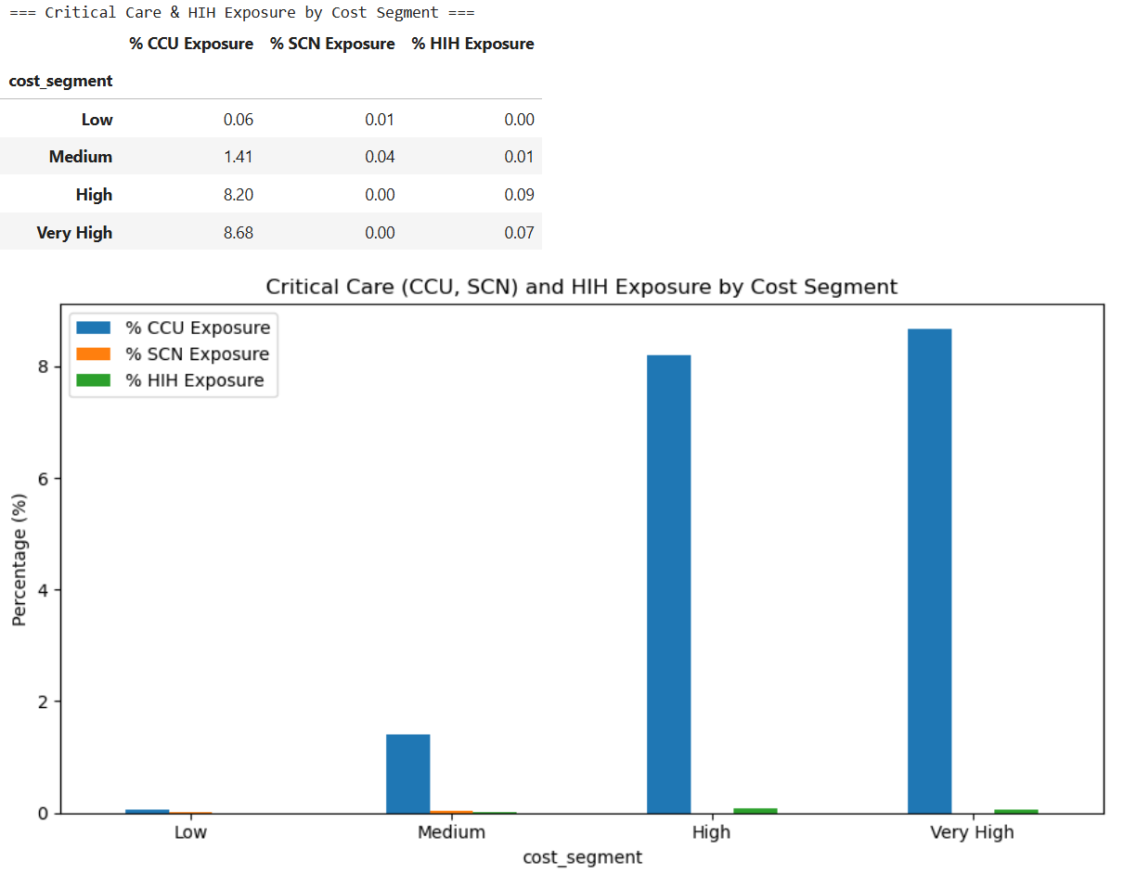
CCU / SCN / HIH Usage Analysis
High-cost episodes are associated with greater critical care exposure compared to lower-cost cases; however, the marginal increase between High and Very High segments is modest. This indicates that while acuity contributes to cost concentration, procedural intensity and length of stay appear to be stronger structural drivers of financial concentration.

Slide 16
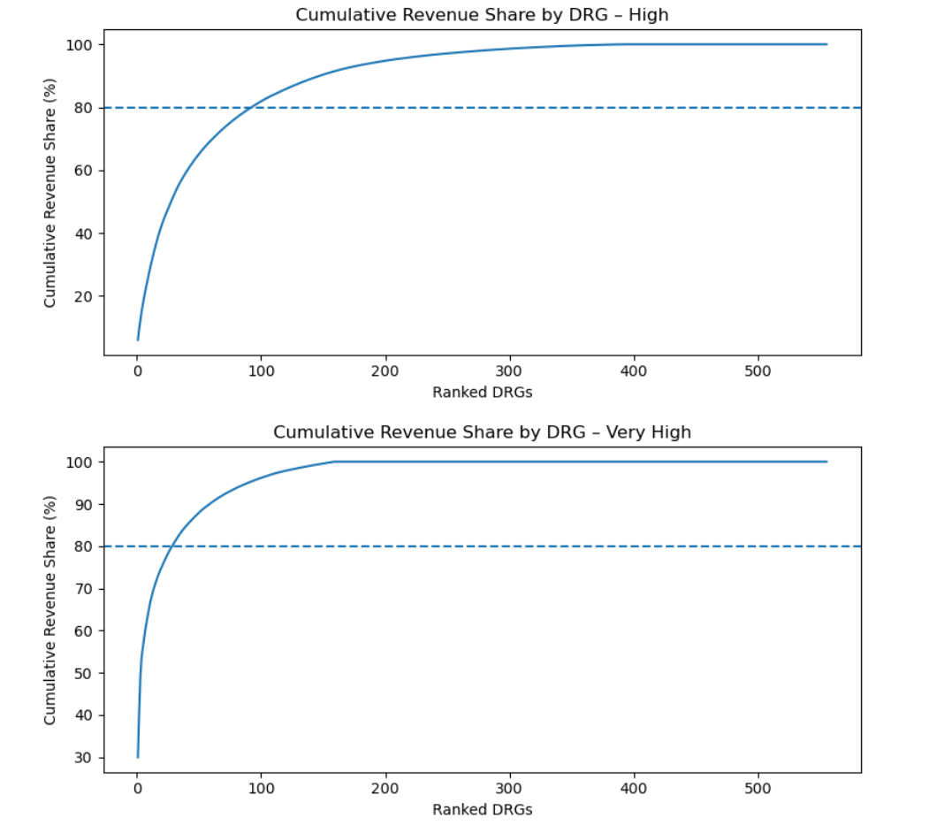
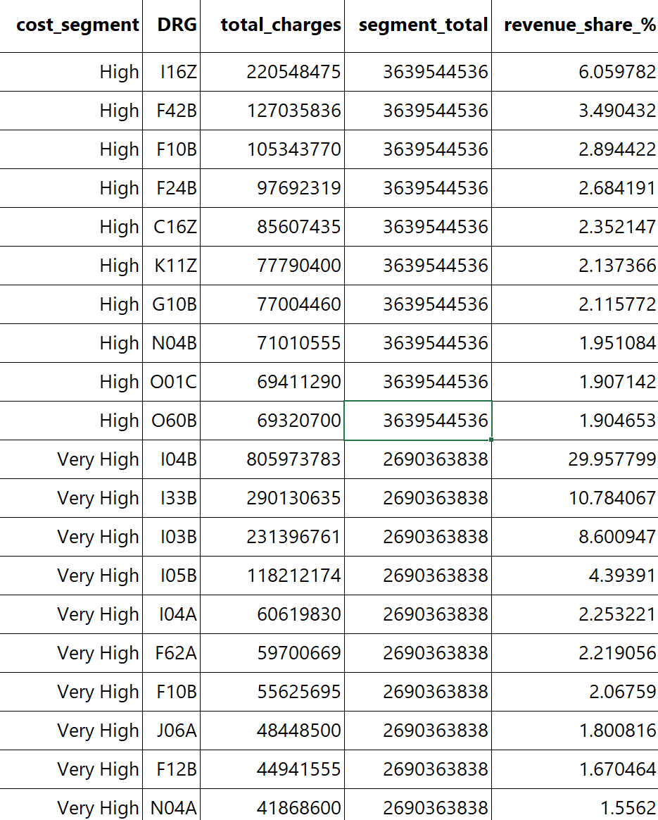
DRG Distribution
Very High episodes are financially concentrated in a small number of DRGs. The top 3 DRGs contribute ~50% of Very High revenue, indicating structural dependency on specific complex clinical pathways.
In contrast, High episodes are broadly distributed across many DRGs, reflecting a diversified surgical portfolio.
This suggests that financial risk, contract exposure, and operational pressure are disproportionately concentrated within a small set of high-complexity DRGs.
Focused governance, contract management, and operational optimisation in these pathways will deliver the greatest financial impact and risk protection.

Slide 17
DRG Distribution
High Segment – Interpretation
Very High Segment – Interpretation
Graph behaviour:
Curve rises steadily
Takes ~90–110 DRGs to reach ~80% revenue
Eventually flattens across ~500+ DRGs
What this means:
The High segment is:
  Moderately concentrated
  Revenue spread across many DRGs
  Not dependent on a single DRG
Looking at the table:
Top DRG (I16Z) contributes only ~6% of segment revenue
Top 10 DRGs contribute ~25–30% combined
So:
➡ High-cost cases are diversified
➡ Financial risk is spread
➡ Multiple service lines contribute
Graph behaviour:
Extremely steep initial rise
~1 DRG already ~30%
Top 3 DRGs ≈ 50%
~40–50 DRGs get you to 80%
Then completely flattens
This is strong concentration.
The Critical Finding In Very High:
Top DRG = I04B
Revenue share = ~30%
That is huge.
Top 3 DRGs:
I04B (~30%)
I33B (~11%)
I03B (~8.6%)
Together ≈ 50% of Very High revenue.
That means:
Half of the most expensive revenue comes from 3 DRGs.
Very High is:
More extreme financially
Driven by specific complex procedures
Likely cardiac / transplant / major surgical DRGs (based on I-codes)

Slide 18
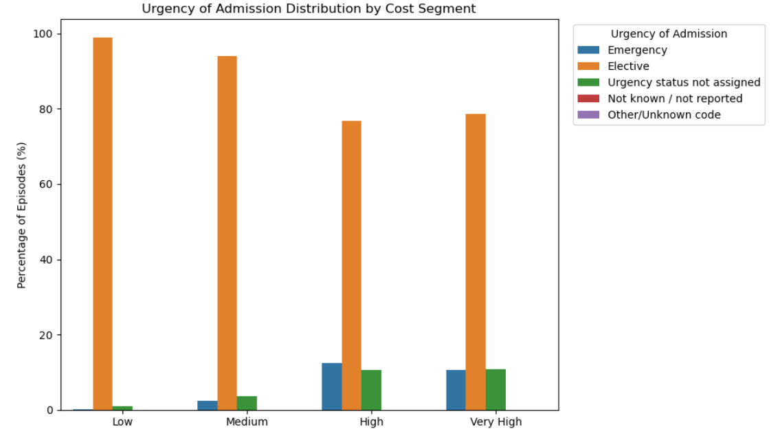
Urgency analysis
Emergency proportion increases sharply from:
0.16% → 12.5%
So complexity does rise with cost —
but the majority of revenue still comes from elective pathways.
High and Very High cost episodes are predominantly elective rather than emergency-driven.
This indicates that revenue concentration is driven by scheduled major procedures rather than acute complexity.
As a result, theatre capacity, specialist workforce, prosthesis management, and contract optimisation represent key strategic levers for financial performance.

Slide 19
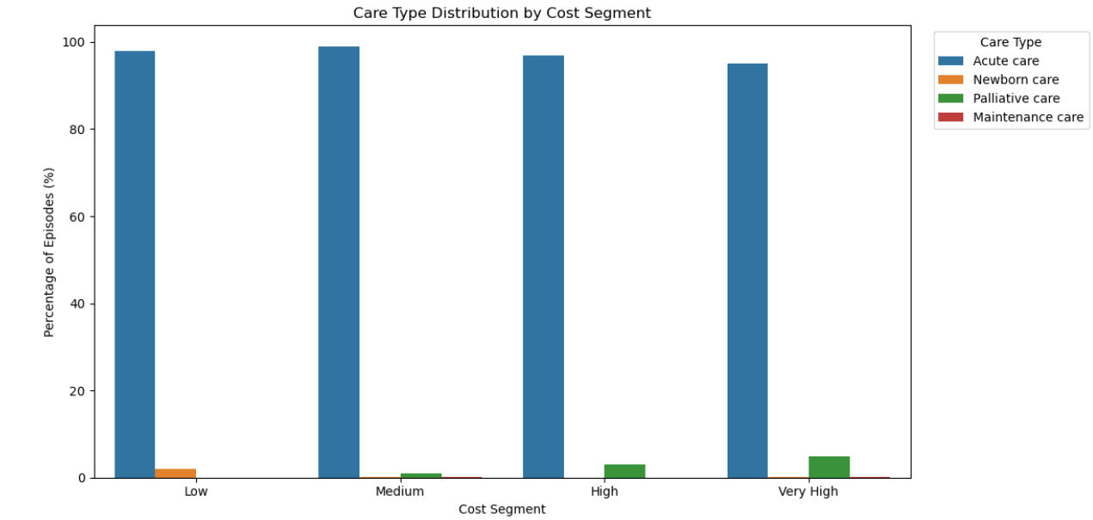
Care Type analysis
The high-cost concentration is almost entirely within acute admitted care pathways, with a small but increasing contribution from palliative episodes in the Very High segment.
This indicates that revenue concentration is driven by core hospital service lines rather than subacute or maintenance services.
Recommendation:
Investment focus should remain on acute service optimisation.
Palliative pathways in high-cost segments may require:
  LOS management
  Care coordination optimisation
  Appropriate billing validation
No evidence that rehab or maintenance is distorting cost distribution.

Slide 20
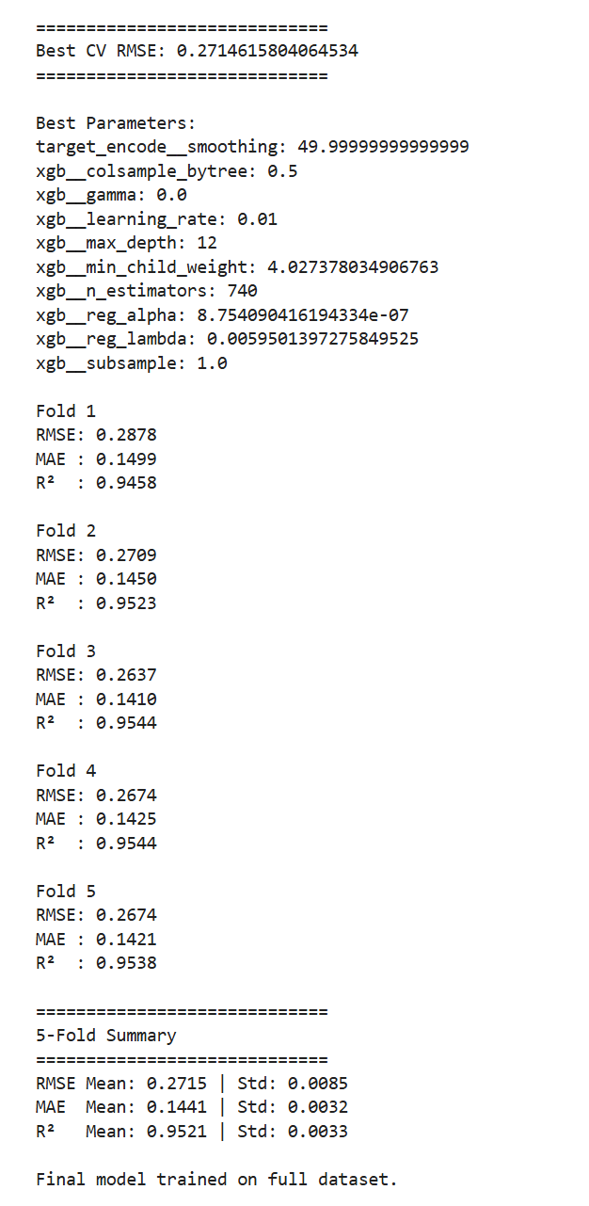
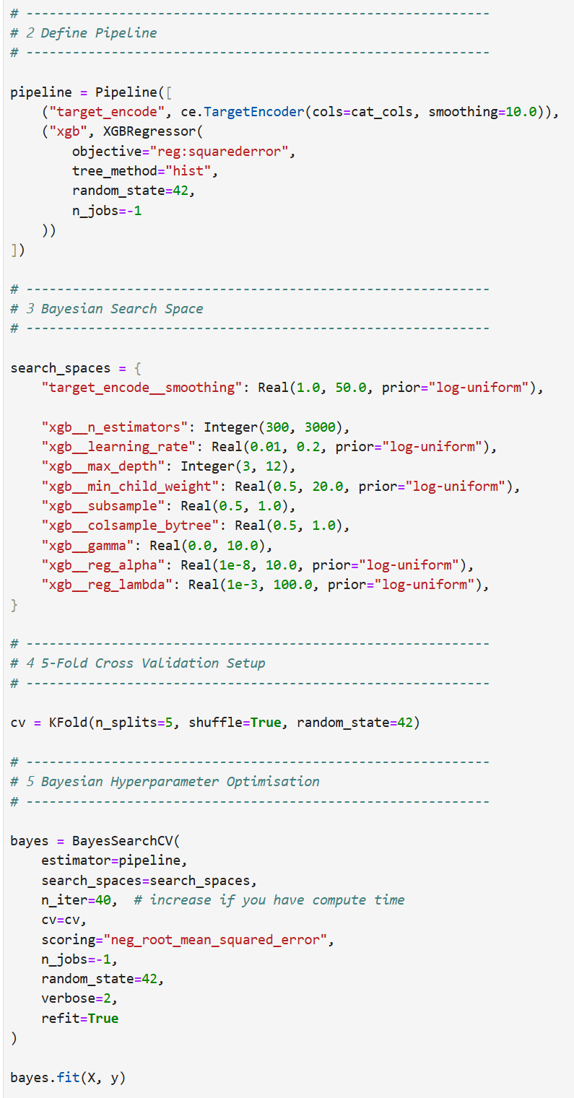
Part III: Advanced analytics -Modelling (XGBOOST): total charge prediction

Slide 21
Motivation
Motivation for a Predictive Episode Cost Model
Traditional reporting shows what was spent, but not whether it was expected
Hospital episode costs vary significantly, even within similar clinical groups
A small proportion of cases drive a disproportionate share of total expenditure
Raw cost comparison does not account for clinical complexity or case mix
Why a Predictive Model Is Needed
Establishes a risk-adjusted expected cost baseline
Enables fair comparison across sites and pathways
Distinguishes legitimate complexity from unexplained cost variation
Identifies high-cost outliers for targeted review
Strategic Objectives
Improve financial oversight and contract management
Support data-driven negotiation with insurers and providers
Highlight operational inefficiencies in moderate-acuity care
Shift from reactive auditing to proactive risk management

Slide 22
Hypotheses
Episode-level hospital charges can be accurately predicted using clinical and operational characteristics (e.g. DRG, procedures, theatre use, LOS).
A risk-adjusted predictive model will explain the majority of cost variation across episodes.
Episodes that materially exceed predicted cost represent statistically identifiable outliers.
High-cost outliers will be concentrated in high-complexity (Very High) segments.
Efficiency variation (low-cost outliers) will be more visible in moderate-acuity (Medium) segments.
Risk-adjusted benchmarking will provide more meaningful financial insight than raw cost comparison.

Slide 23
Methodology
~30,000 hospital episodes analysed
Episode-level data including DRG, procedures, theatre use, LOS, demographics
Target variable: total hospital charges (log-transformed for modelling stability)
Captures variation across low, medium, high and very high cost segments
XGBoost machine learning model used to predict expected episode cost based on clinical and operational characteristics
Enables risk-adjusted comparison of actual vs expected cost
Supports financial oversight, provider benchmarking and operational efficiency analysis
Forms the foundation for identifying cost outliers and variation patterns

Slide 24
Why This Model?
Hospital costs are non-linear and interaction-driven
XGBoost captures complex clinical interactions
Target encoding handles high-cardinality variables (e.g. DRG)
More robust than linear regression for structured healthcare data

Slide 25
How The Model Was Developed
Log-transformed total charges to stabilise variance
Removed leakage variables (cost-derived features)
5-fold cross-validation for generalisability
Bayesian optimisation for hyperparameter tuning
Final model retrained on full dataset

Slide 26
Model Performance
Cross-validated RMSE (log scale): 0.271
R²: 0.952 (explains 95% of variance)
Typical multiplicative error ≈ 30%
Median-like deviation ≈ 15%
Stable performance across folds
Notes:
What does 0.2715 mean in real terms?
Since we're predicting log(cost):
$$e^{0.2715}≈1.312$$
That means:
Average multiplicative error ≈ 31%
Interpretation:
If actual cost = $10,000
Typical prediction range ≈ $7,600 – $13,100
That is very reasonable for healthcare cost modelling.

Slide 27
Key Cost Drivers Identified
Theatre utilisation (strongest driver)
DRG classification
Same-day vs inpatient status
Number of procedures
Length of stay
Cost driven by clinical intensity, not seasonality

Slide 28
Strategic Value
Supports cost forecasting & budgeting
Identifies high-cost pathways
Enables scenario modelling
Improves financial planning & resource allocation

Slide 29
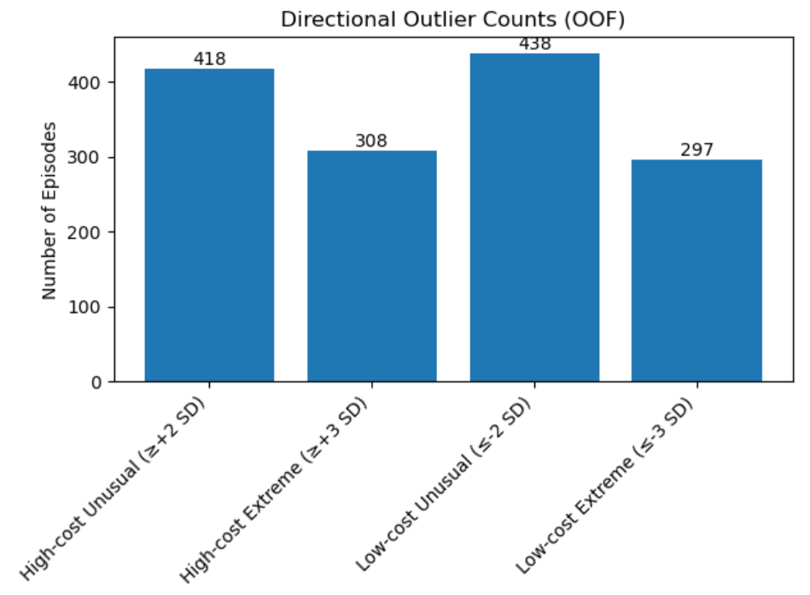
Use-case: detecting outliers that cost considerably more/less than expected
Outlier Detection Framework
1. Risk-Adjusted Model
(XGBoost)
Predict Expected Cost
  2. Compare
  Actual vs Expected
  Compute Residual
3. Standardise
Residual
Z-Score = Residual / Model SD
  4. Flag Outliers
  ≥ or < 2 SD = Unusual
  ≥ or < 3 SD = Extreme
Notes:
How the Model Was Used to Detect Outliers
A machine learning model (XGBoost with target encoding) was trained to predict expected hospital costs based on episode characteristics such as DRG, theatre utilisation, procedures, and length of stay.
To ensure fairness and avoid bias, out-of-fold cross-validation was used. This means each episode’s expected cost was generated by a model that was not trained on that episode.
For each case, we calculated:
Expected cost (risk-adjusted prediction)
Residual = Actual cost – Expected cost
Standardised residual (Z-score) = Residual relative to model error
Episodes were flagged as:
Unusual if ≥ 2 standard deviations above expected cost
Extreme if ≥ 3 standard deviations above expected cost
This approach allows identification of cases that cost materially more than would be expected given their clinical complexity.
In simple terms:
The model establishes a risk-adjusted benchmark, and outliers are cases that significantly exceed that benchmark.

Slide 30
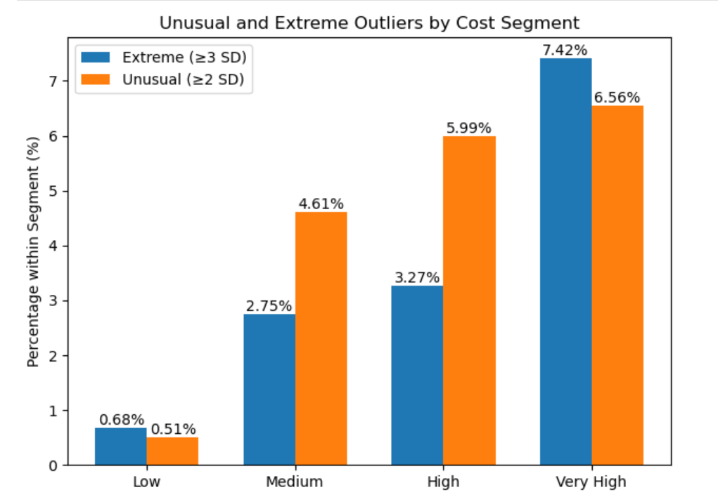
Outliers of cases that cost more than expected
Notes:
Low-cost episodes show strong model stability (<1% extreme cases)
Outlier rates increase with clinical complexity
Very High segment: 7.42% extreme (≥3 SD), ~11x higher than Low segment
86% of Very High cases remain within expected range

Slide 31
Key Findings – High-Cost Outliers
Interpretation
High-cost outliers increase progressively with cost segment severity.
Very High segment shows the greatest deviation:
    7.42% Extreme (≥3 SD)
    6.56% Unusual (≥2 SD)
Medium segment shows moderate variation:
    2.75% Extreme
    4.61% Unusual
Low-cost segment remains stable:
    <1% extreme deviation
What This Suggests
Indicates strong model alignment for low-acuity cases
Financial risk exposure is concentrated in the highest complexity episodes.
Cost variability is could be structurally linked to clinical intensity.
Extreme high-cost deviations are approximately 11x more frequent in the Very High segment compared to the Low segment.
Executive Implication
Financial volatility could increase materially with episode complexity.
High-acuity care may drive disproportionate cost risk.

Slide 32
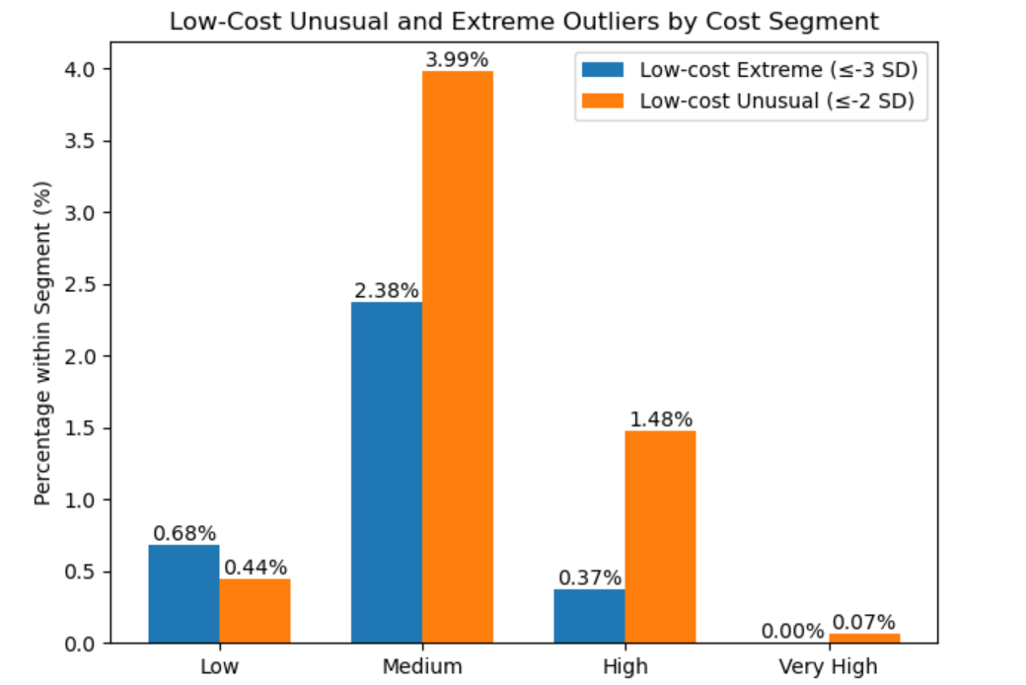
Outliers of cases that cost less than expected

Slide 33
Key Findings – Low-Cost Outliers
Interpretation
Low-cost outliers are not concentrated in the Very High segment.
Very High segment shows ~0% extreme low-cost cases, indicating structural cost intensity in catastrophic care.
Medium segment shows the highest low-cost deviation (2.38% extreme, 3.99% unusual).
Low segment shows minimal deviation (<1% extreme), indicating stable cost alignment in low-intensity cases.
What This Suggests
Medium cost segment represents mid-range expenditure episodes, which may reflect moderate clinical complexity.
This can be validated by examining LOS, procedure counts and ICU utilisation across segments.
Greater low-cost variation in this segment suggests higher operational variability in semi-standardised care pathways.
High-complexity (Very High) cases appear structurally constrained with limited room for cost compression.
The pattern differs from high-cost outliers, which increase with expenditure severity and clinical intensity.
Executive Implication
Financial risk concentrates in high-acuity care.
Efficiency opportunity likely concentrates in mid-range expenditure episodes.
Targeted operational review of medium-cost pathways may yield the greatest optimisation impact.

Slide 34
Part IV: Recommendation – High-cost outliers
Immediate Actions (0–3 Months)
Implement pre-submission review workflow for ≥3 SD episodes.
Flag extreme cases before insurer submission to minimise disputes.
  Legitimate clinical complexity → Document & defend
  Unwarranted operational variation → Improve pathway
Require secondary clinical validation for:
  Extended LOS
  ICU utilisation
  High theatre time
Establish escalation threshold (e.g. ≥ +3 SD = mandatory review).
Medium-Term Actions (3–12 Months)
Build DRG-level high-cost monitoring dashboard.
Track high-cost outlier rate by:
  Hospital
  Surgeon
  DRG
  Month
Identify repeat deviation patterns.
Conduct root cause reviews on top recurring drivers.
Long-Term Strategy
Integrate predictive expected-cost benchmarks into contracting discussions.
Negotiate complexity-adjusted pricing.
Incorporate outlier thresholds into commercial agreements.
Develop early-warning cost risk monitoring system.

Slide 35
Part IV: Recommendation – Low-cost outliers
Immediate Actions (0–3 Months)
Identify top 10 Medium-segment DRGs with:
  Highest low-cost deviation rate.
Compare LOS, procedure count, theatre minutes across sites.
Validate no adverse readmission or quality signal – Is quality of care compromised? Discharged too early?
Medium-Term Actions (3–12 Months)
Develop site-level efficiency benchmarking:
  Average residual by DRG.
Identify best-performing pathways.
Conduct pathway mapping to extract operational differences.
Standardise discharge planning protocols where appropriate.
Long-Term Strategy
Create “efficiency scorecard” for moderate-complexity care.
Share best-practice clinical pathways internally.
Align incentive structures with efficient care delivery.

Slide 36
Part IV: Recommendation - overall
Cross-Cutting Recommendation: Outliers Intelligence Dashboard
Develop a real-time Outliers Dashboard including:
  Expected vs Actual cost
Residual distribution
  % ≥ +2 SD and ≥ +3 SD
  % ≤ −2 SD and ≤ −3 SD
Segment-level comparison
DRG-level drill-down
Provider-level trend monitoring
Purpose:
  Shift from reactive auditing to predictive oversight.
  Enable early intervention.
  Provide executive visibility.

Slide 37
Part V: After thoughts - Model Limitations
Model Limitations & Considerations
Cost is influenced by contract pricing, not purely clinical intensity
Dataset reflects historical billing patterns
Quality metrics not fully incorporated (readmission validation pending)
Predictive model supports oversight, not clinical decision-making
Notes:
1 Cost is influenced by contract pricing, not purely clinical intensity
What this means:
Total hospital charges are not a perfect proxy for clinical complexity.
Charges are affected by:
Negotiated insurer-provider contracts
Bundled pricing structures
Prosthesis pricing agreements
Facility fee differentials
Private vs public pricing variation
Two clinically identical episodes can have different charges due to commercial terms.
Implication:
Some “outliers” may reflect pricing differences rather than inefficiency.
Interpretation should consider contract context.
Risk-adjusted expected cost does not fully isolate clinical intensity.
The model benchmarks financial performance, not clinical severity in isolation.
2 Dataset reflects historical billing patterns
What this means:
The model is trained on past episodes.
Therefore:
It learns historical billing behaviour.
It embeds existing practice patterns.
It may reflect past inefficiencies.
If historical patterns include systemic overcharging or undercharging,
the model may normalise that behaviour.
Implication:
Expected cost = historically typical cost, not necessarily optimal cost.
The model supports benchmarking relative to current system behaviour.
The model establishes a data-driven baseline based on observed practice, not an ideal cost benchmark.
3 Quality metrics not fully incorporated (readmission validation pending)
What this means:
The model predicts cost only.
It does not directly account for:
28-day readmission rates
Complication rates
Mortality
Patient outcomes
Clinical appropriateness
Low-cost episodes could reflect:
Efficiency
or
Premature discharge / under-treatment
Without integrating outcome data, cost interpretation is incomplete.
Implication:
Low-cost outliers must be validated against quality signals.
Efficiency must not compromise patient safety.
Executive framing:
Cost performance must be interpreted alongside clinical outcome indicators.
4 Predictive model supports oversight, not clinical decision-making
What this means:
The model:
Does not recommend treatment plans
Does not evaluate clinical appropriateness
Does not guide physician decision-making
It provides:
Financial benchmarking
Risk-adjusted monitoring
Governance insights
It is a cost intelligence tool, not a clinical tool.
Implication:
The model should not influence patient-level care decisions.
It should inform contract review and operational oversight only.

Slide 38
Part V: After thought - Financial impact
Financial Exposure – Very High-cost Segment
1,510 Very High episodes
7.42% extreme = ~112 cases
Median cost per case = $1.7M
Estimated excess per extreme (> 3SD) case ≈ $1.7M
Estimated Exposure:
  ~$190M in extreme high-cost cases
Impact Scenario:
  If proactive monitoring reduces extreme cases by 5%:
  ➜ ~6 cases avoided or better managed
  5% reduction = ~$10M in avoidable financial exposure or protected margin (eg: Unnecessary excess cost variation, Audit write-down exposure, Revenue leakage due to disputes, Inefficient resource use)
Notes:
Step 1 Extract Relevant Numbers
From summary:
Very High segment:
Episodes = 1,510
Median cost = $1,723,100
Total revenue = $2,690,363,838
From your chart:
Extreme (≥3 SD) = 7.42%
Step 2 Calculate Number of Extreme Cases $1,510×7.42\%≈112 \text{cases}$
So approximately:
~112 Very High extreme cases
Step 3 Estimate Excess Per Case
We do not yet know exact excess per case, but we can estimate conservatively.
Assume:
Median cost = $1,723,100
Extreme cases cost ~2× expected (conservative for ≥3 SD cases)
Then:
Expected cost ≈ $1,723,100
Actual cost ≈ $3,446,200
Excess per case ≈ $1,723,100
Step 4 Estimate Exposure $112×1,723,100≈193M$
Potential exposure ≈ $190M+ in extreme Very High cases alone
Even if we assume only 50% of that difference is actionable $\$95M$
Still material.
Step 5 Sensitivity Scenario
If:
A 5% reduction in extreme Very High cases
That’s 6 cases prevented $6×1.7M≈10M$
~$10M potential protection from a 5% improvement.

Slide 39
Part V: After thoughts – long term sustainability
From Insight to Institutional Capability
Establish a system-wide risk-adjusted cost benchmark across all episodes
Proactively manage financial exposure before claims disputes arise
Identify and scale high-performing operational pathways across sites and service lines
Transition from reactive claim auditing to continuous performance governance
Embed predictive analytics into routine financial oversight

