Slide 1
DSIF 4 Project 1
Members
Wei Hao
Weihan
Ivan

Slide 2
Problem Statement
You are a consultant hired by the College Board executives to evaluate the current SAT and ACT scores as metrics for college admission, and suggest ways to improve the current system.

Slide 3
Contents
Introduction
Socio-Economic factors influencing the standardized scores
Are standardized scores a good metric for academic achievement?
Suggestions and Conclusion
References

Slide 4

Introduction
SAT/ACT overview
Standardized tests typically taken in junior/senior year for college admissions
Gauge for a student’s readiness for college
Mandatory for admissions at many colleges across US
Notes:
SAT began in 1926; ACT-1959

Slide 5
Introduction
Growing criticism of SAT and ACT regarding access to higher education in US
Unfair advantage for wealthy families who can pay for prep tests, which can cost as high as $1000 an hour, and tuition classes
Able to obtain higher SAT/ACT scores and thus better chances of entering the best colleges/majors.

Slide 6
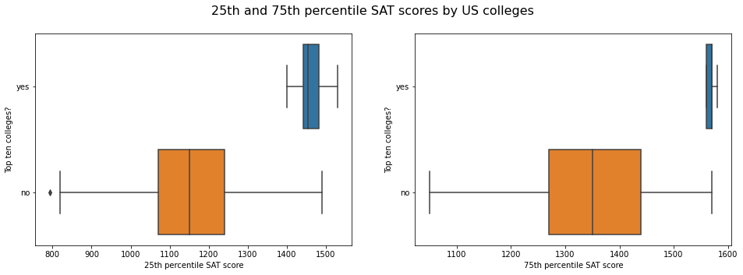
Introduction
Top 10 colleges in US according to QS World University Rankings (as viewed on 8 Jan 2022), which includes Massachusetts Institute of Technology, Stanford University, Harvard University, California Institute of Technology, University of Chicago, Princeton University, University of Pennsylvania, Yale University, Cornell University and Cornell University.

Slide 7
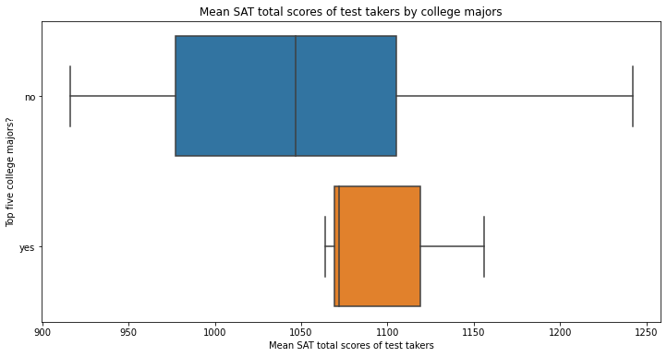
Introduction
Top 5 college majors according to The Princeton Review (as viewed on 8 Jan 2022), which includes Computer Science, Communications, Business, English Language and Literature, and Psychology.

Slide 8
Introduction
Subheader
Students graduating from top colleges and majors tend to have better career prospects
Raises and perpetuates class and race hierarchies and perpetuate wealth disparity
First SAT administered by Carl Brigham, a eugenicist
Notes:
Carl Brigham - professor at Princeton Dept of Psychology
Eugenics - the selection of desired heritable characteristics in order to improve future generations

Slide 9
Introduction
Subheader
Socio-economic factors may also have a role to play in the inequalities of the standardized testing as well
Ethnicity
Access to broadband
Parents’ household income
Notes:
Black and brown students score lower on both the SAT and AP exams than do whites.

Slide 10
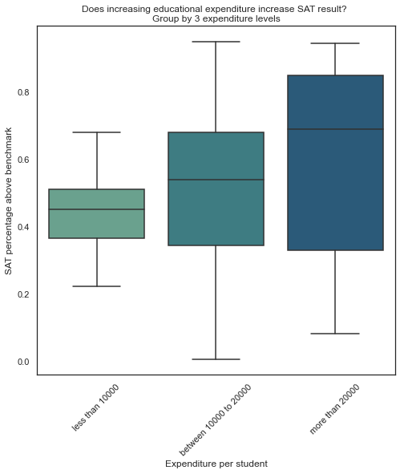
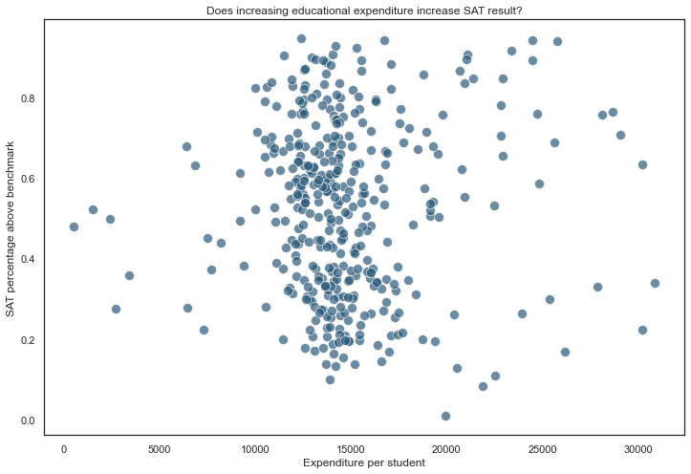
Socio-Economic factors
Can money buy results - Expenditure per student
0.028 - Correlation value
Yes… To an extend

Slide 11
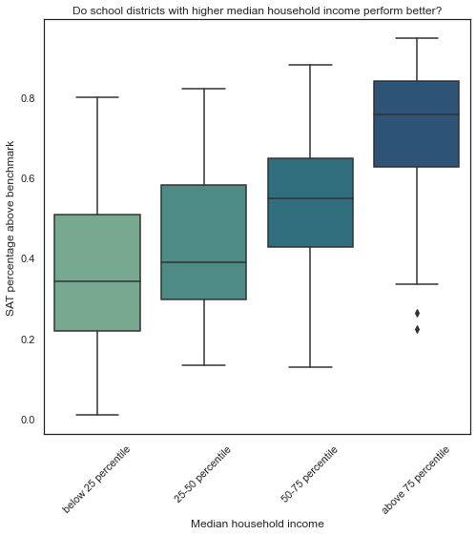
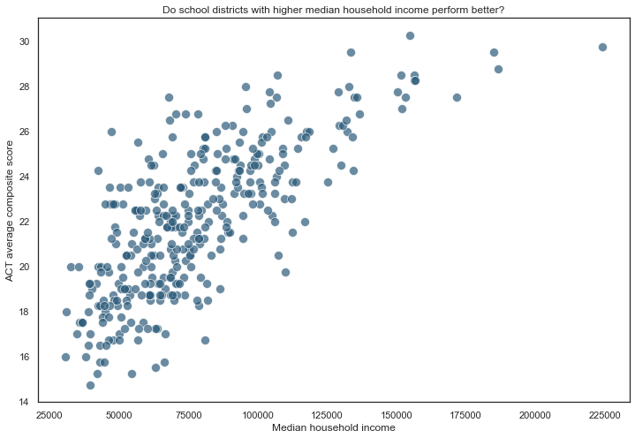
Socio-Economic factors
Can money buy results - Median household income
0.65 - Correlation value
Yes..A much stronger correlation

Slide 12
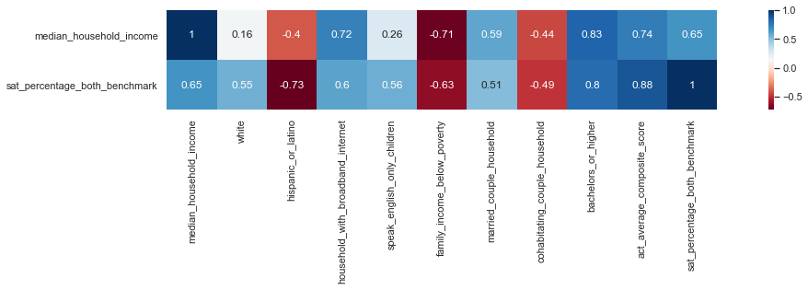
Socio-Economic factors
What are some other factors

Slide 13
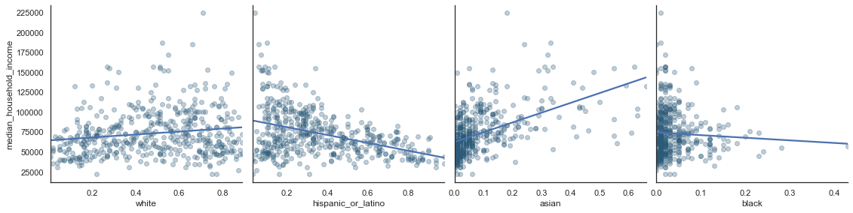
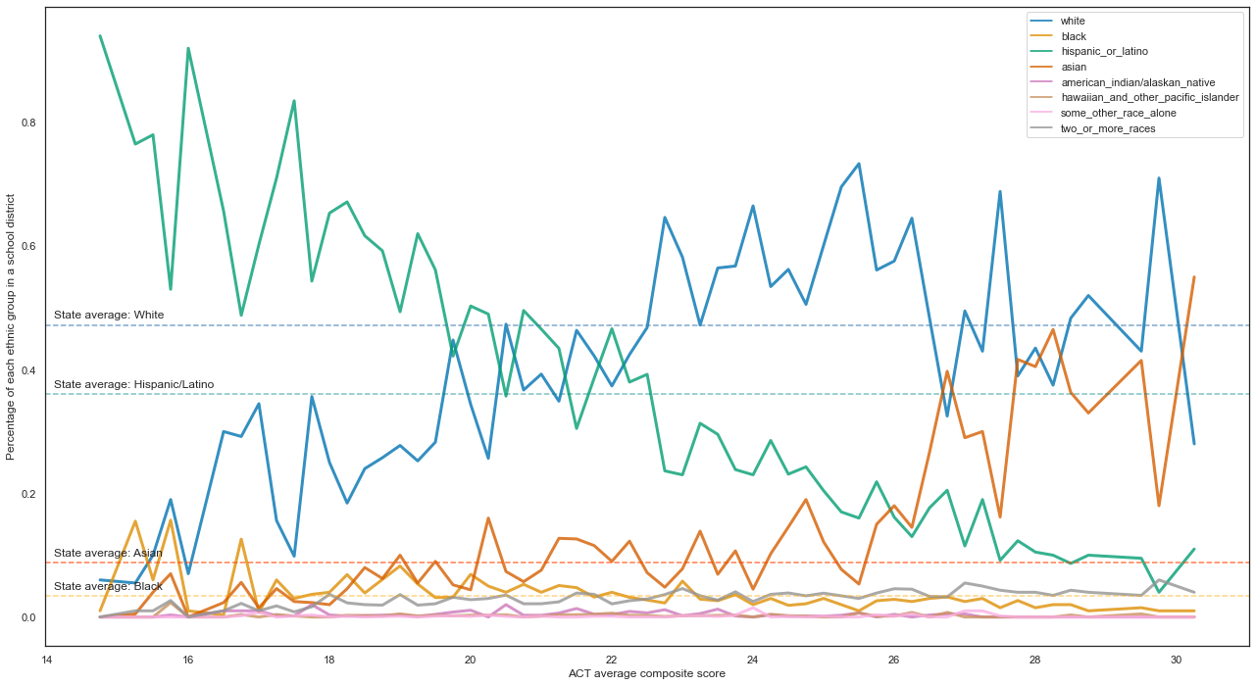
Socio-Economic factors
Ethnicity
Ethnic
group
and
Median
Household Income
Ethnic group and ACT score

Slide 14
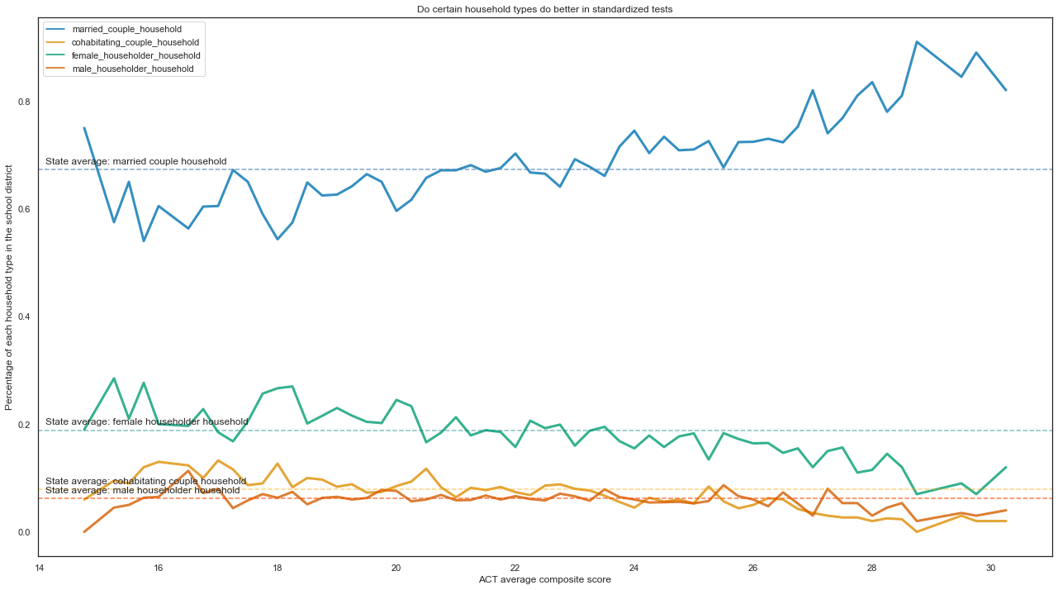
Socio-Economic factors
Type of household
Type of household and ACT score

Slide 15
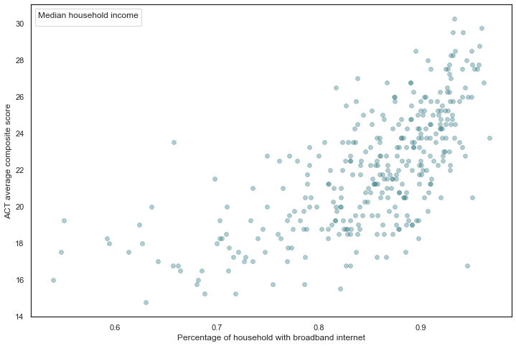
Socio-Economic factors
Broadband Access
Broadband Access with ACT score

Slide 16
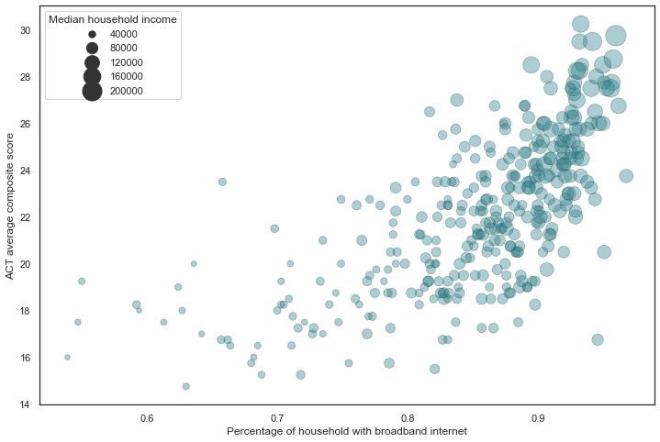
Socio-Economic factors
Broadband Access
Broadband Access with ACT score and income

Slide 17
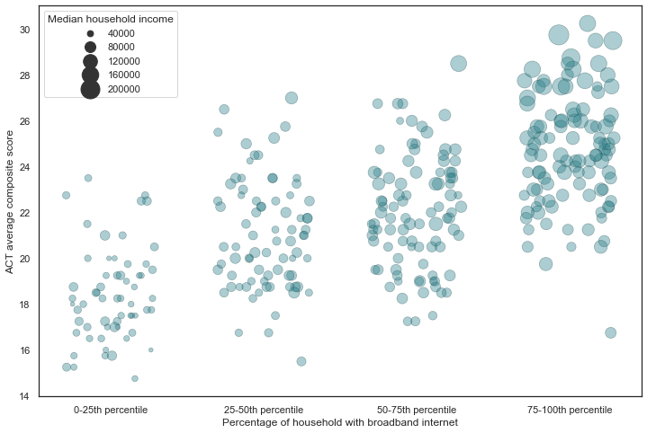
Socio-Economic factors
Broadband Access
Broadband Access with ACT score and income by percentile

Slide 18
Socio-Economic factors
Parents’ education level
Broadband Access with ACT score and income

Slide 19
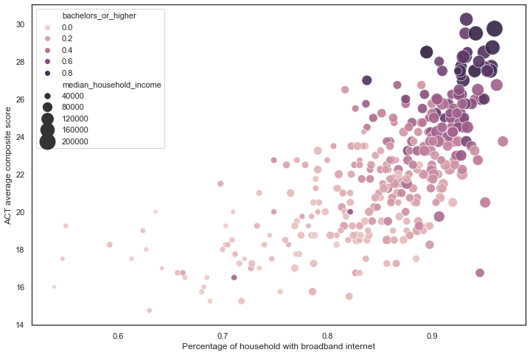
Socio-Economic factors
Parents’ education level
Broadband Access with ACT score and income and parents’ education level

Slide 20
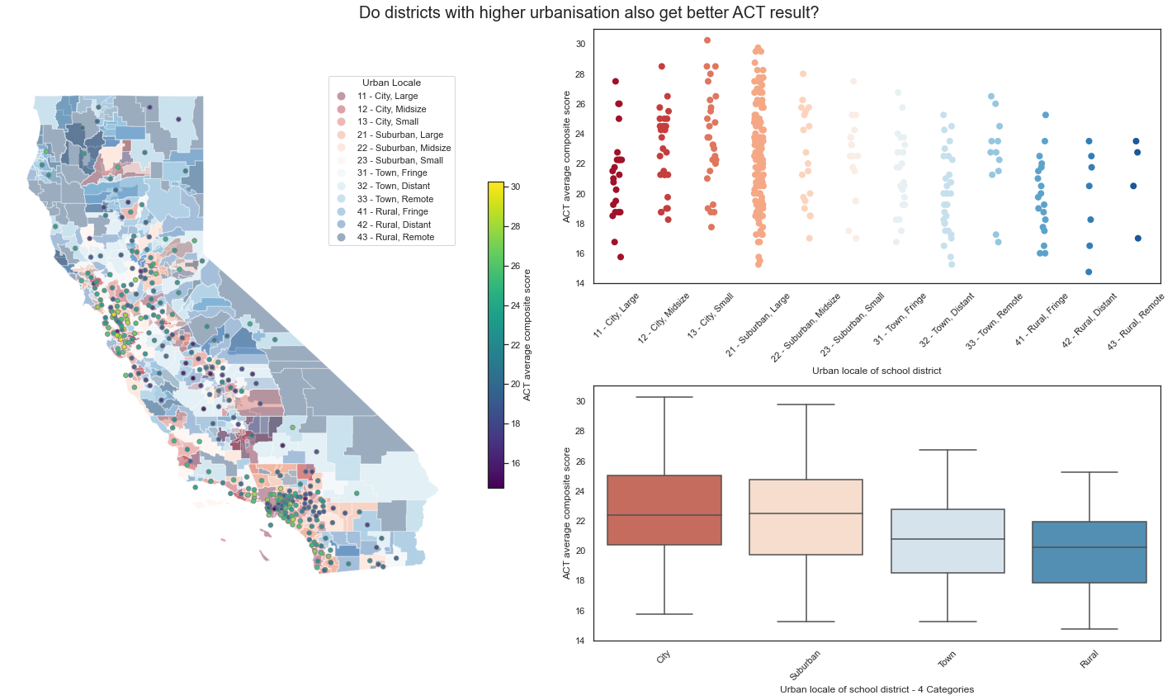
Socio-Economic factors
Geographical Distribution
San Francisco
Los Angeles
Geographical distribution of urbanisation and test scores

Slide 21
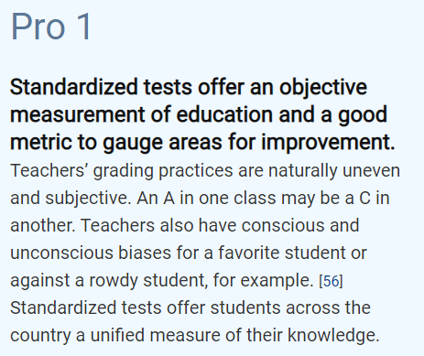
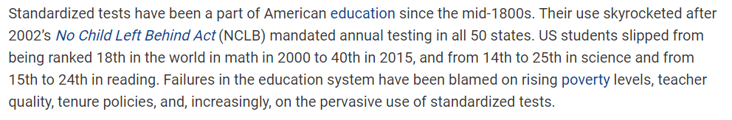
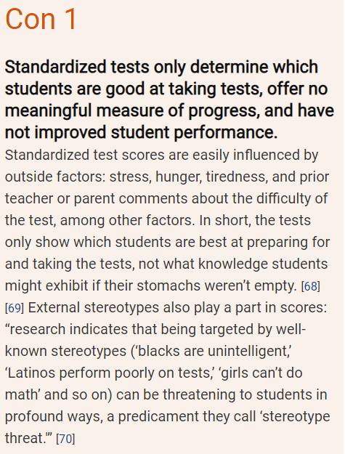
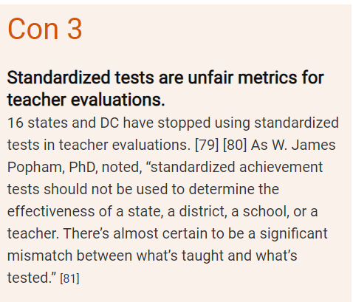
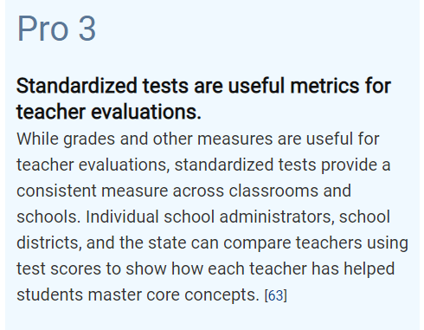
Other criticisms of standardized scores?
https://standardizedtests.procon.org/
Notes:
Adding on to the history of standardized tests. Since 2002, standardized tests have been mandated in all 50 US states. However, there are alot of arguments or studies debating that standardized tests only identify which students are good at taking tests but does not have meaningful measure of progress or performance. Some states/colleges have even stopped mandating standardized tests for evaluation due to the discovery of significant mismatch between what’s taught and what’s tested. Critics also say that the tests are too easily gamed by students who can pay thousands of dollars for private coaching and test prep.

Slide 22
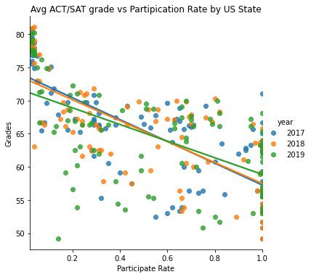
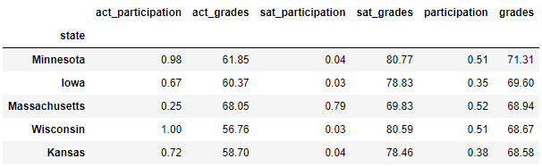
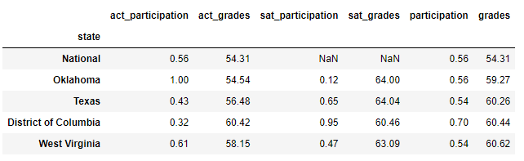
Other criticisms of standardized scores?
Top 5 States
Bottom 5 States
Notes:
Therefore, by looking at the data on SAT & ACT result by US states from 2017 to 2019, we are able to see not every states has 100% participation rate for both SAT/ACT tests which was due to the decision to drop the mandate of the standardized tests.
With that regard, we are able to observe the bia-ness between the average grade and the participation rate by looking at the graph plotted.
we can see from the scatter graph with the correlation coefficient, it is relatively negative correlated between the average grades and participation rate. In other word, the higher the participation rate, the lower the average SAT/ACT grades that the state has. This is because the raw SAT / ACT scores are terribly confounded with participation rates. The reason is simple, the best students in any state tend to be the most aggressive and driven about wanting to score for the test. Therefore, if a state’s participation rate is low, it means that the state did not mandate the standardized test and only motivated and driven students are taking the test, it will nevertheless drive the average grades artificially high and this barely qualify as an indicator for having a good educational system of the states. In contrast, if the state has 100% or high participation rate, this indicates that every students have been forced to take the test, so even students that do not have the interest for taking the tests will bring down the average grade of the state drastically.
Next, we take a look at the top 5 states and bottom 5 states based on the average grades to further illustrate our findings from the scatter graph. Looking at top 5 states, the participation rate range from 35% to 51%, whereas bottom 5 states range from 54% to 70% of participation rate which is consistent with the interpretation from the scatter graph.
In the nutshell, just by looking at the average standardized scores cannot determine the level of educational standard by states. However, we can put in more effort to level the participation rates as well as the quality of individual’s standardization score with the following suggestions that we have in the next slides.

Slide 23
Suggestions and Conclusion
Suggestions
Economic:
More education expenditure should be allocated especially to those districts with less than 10,000 USD
On the short term, more resources should be allocated to lower income families such as subsidies, bursaries or grants
Ethnic
More help should be focused on Hispanic/Latino as well as Black Americans
Over time, as results among these groups increase, it may help to counter existing stereotypes these groups cannot perform well in these tests
investigate what Asian American families are doing right to achieve higher standardized score
Notes:
We have grouped the suggestions into different aspect, first we will target the economic by allocating more expenditure to those poorer districts and in the short term, we can provide resources such as subsidies, bursaries or grants.
Next, we look at ethnic, research has shown that minorities such as hispanic/latino and blacks need more helps and people has been stereotyping this group of people as incapable performing well in these tests for the longest time. In contrast, we can do more research on Asian american families and understand how this families achieve higher score and maybe educate the minority families.

Slide 24
Suggestions and Conclusion
Suggestions
Broadband Access
provide subsidized broadband services to areas with low broadband penetration so that they will have access to education resource
Household type
Increase provision of career advice, counselling and after school care to areas with lower percentage of married households
Geographical
Focus help on town and rural areas, especially inland areas
Notes:
Next, we look at broadband access, based on research, we get to know that not all families have access to the internet where student can get more online learning which in return improve their knowledge. Thus, we suggest to provide subsidized rate for broadband in this case.
Next, household type, we recommend to broadcast assistance on career advice, counselling to areas with lower percentage of married households to spread awareness.
Last but not least, we previously talk about town and rural areas has lower grades compared to the ones that live in city area, we shall

Slide 25
Suggestions and Conclusion
Admission base on standardized scores should not perpetuate existing inequality in society

Slide 26
References
https://www.vox.com/the-goods/2019/3/28/18282453/sat-act-college-admission-testing-cost-price
https://www.forbes.com/sites/susanadams/2020/09/30/the-forbes-investigation-how-the-sat-failed-america/?sh=697ddfea53b5
https://www.topuniversities.com/university-rankings/world-university-rankings/2021
https://www.princetonreview.com/college-advice/top-ten-college-majors
https://standardizedtests.procon.org/

