Slide 1
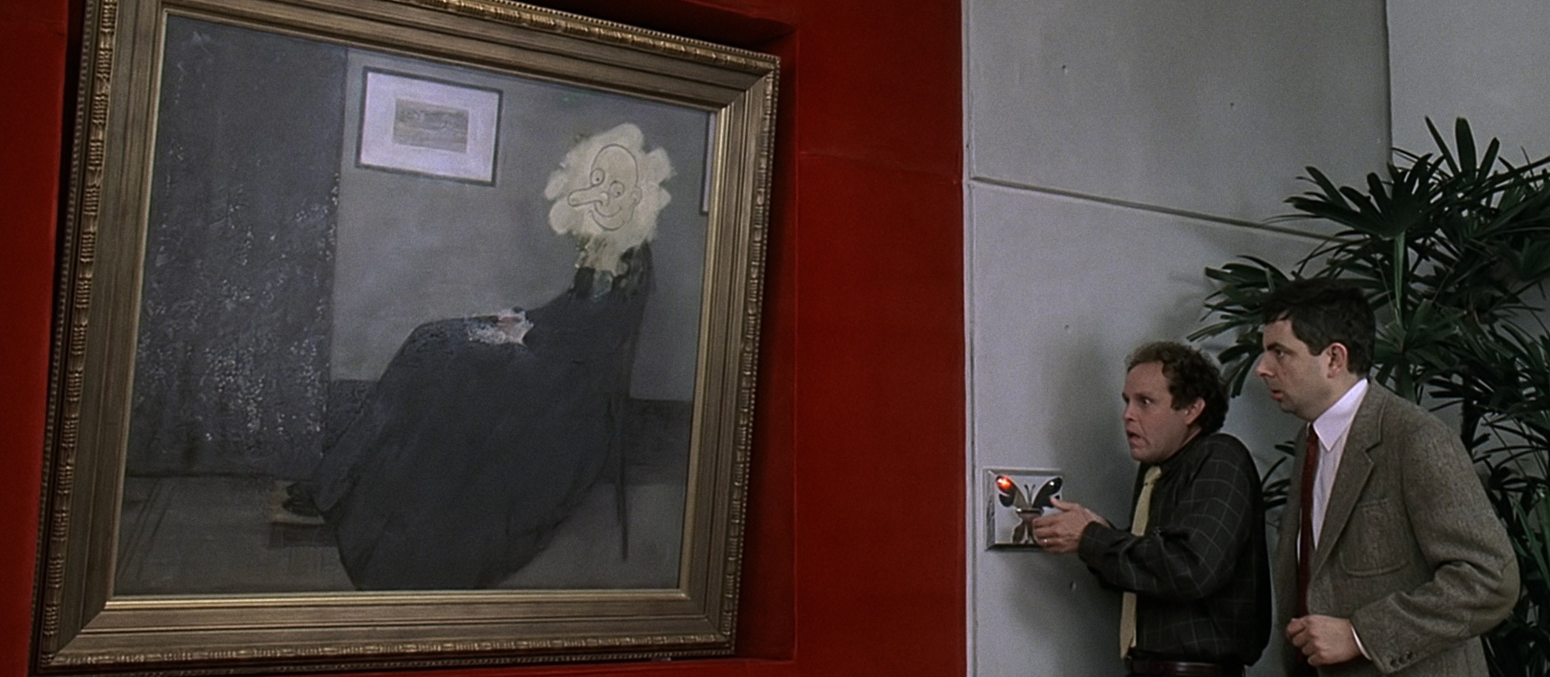
Profound or Not Profound?
Scene from Bean: The Movie
Analysing profoundness through classifying subreddits.
By: Feng Weihan
Notes:
This is a scene from the movie Mr Bean, you see that here, Mr Bean has drawn a crude but funny face on top of a world famous, and you can say ‘profound’ painting.
I thought it is quite an apt picture to illustrate my presentation, which is titled Profound or Not profound. And for this presentation I would take you through an analysis of profoundness by classifying subreddits

Slide 2
Profound or not profound?
Too often we enjoy the comfort of opinion without the discomfort of thought.

Slide 3
Profound or not profound?
Like most men my age, I'm 51.

Slide 4
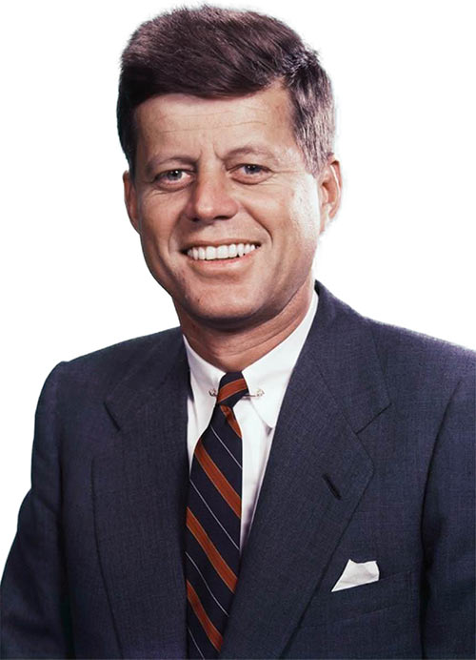
Profound or not profound?
Too often we enjoy the comfort of opinion without the discomfort of thought.
John. F. Kennedy

Slide 5

Profound or not profound?
Like most men my age, I'm 51.
- u/awesome_smokey

Slide 6
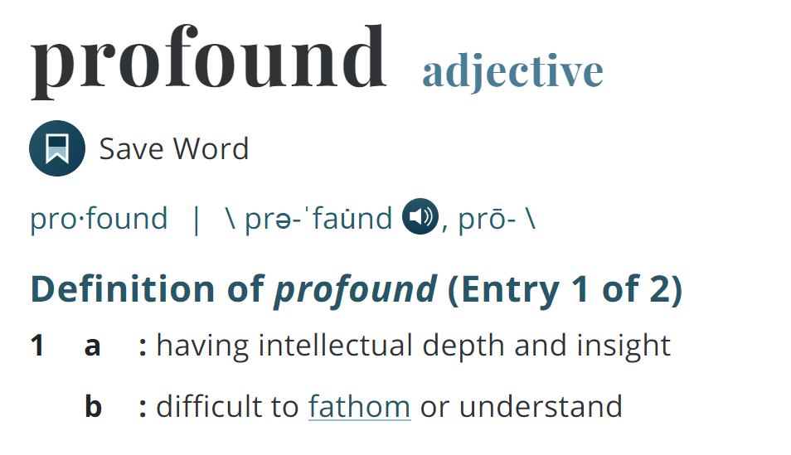
Problem Statement
1. Is there a pattern to profound sentence?
2. Can we develop a reliable subreddit classifier to classify statements from r/quotes vs r/ oneliners?
3. Can the classifier generalize to identify any profound statement?
This project seeks to analyse patterns of profound sentence, and develop a generalized classifier to recognise a profound statement, in order to enhance our understanding of this deeper end of the human ingenuity.

Slide 7
Subreddits
Profound
Not profound
29,718 (57%) posts from
22,479 (43%) posts from
r/quotes
r/oneliners
Current quotes, historic quotes, movie quotes, song lyric quotes, game quotes, book quotes, tv quotes or just your own personal gem of wisdom.
A oneliner is a succinct, funny or witty remark. The statement should fit into one sentence.
Notes:
We will take the sentences from r/quotes to be profound and sentences from r/oneliners to be not profound

Slide 8
Features Used
Features
Post Titles
Title Length
Average Word Length
Longest Word Length
Dale-Chall Readability Score
Flesch–Kincaid Reading Ease
Sentiment Score (VADER)
Part of Speech (POS) Tagging
Comments
Number of comments
Date posted
Self text

Slide 9
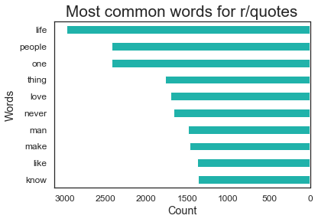
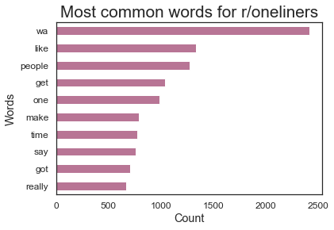
1. Is there a pattern to profound sentence?
Most Common Words
was
Notes:
To answer the first question, is there a pattern to profound sentence. Let us look at some of the features. It is quite interesting that when you compare the common words from both subreddits, some words from r/quotes stood out.

Slide 10
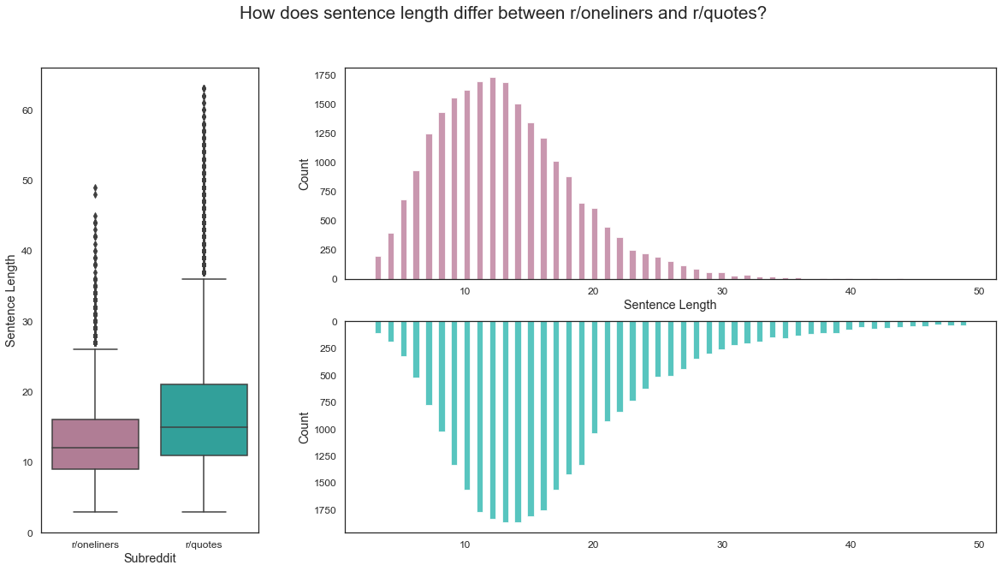
1. Is there a pattern to profound sentence?
Sentence Length
Notes:
For the other features, we will go through quickly due to time constraint and we can discuss further in the QnA.

Slide 11
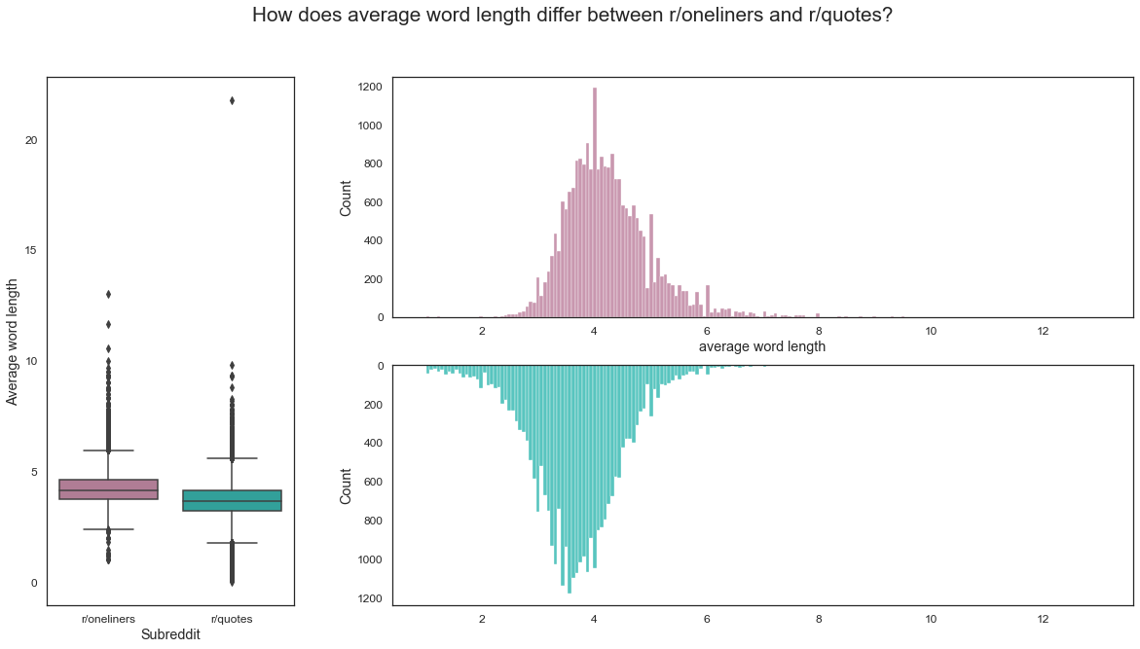
1. Is there a pattern to profound sentence?
Average Word Length

Slide 12
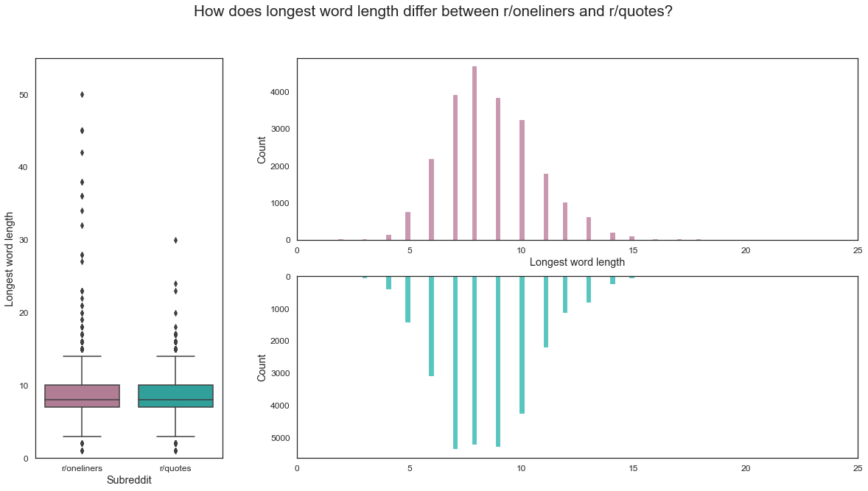
1. Is there a pattern to profound sentence?
Longest word Length

Slide 13
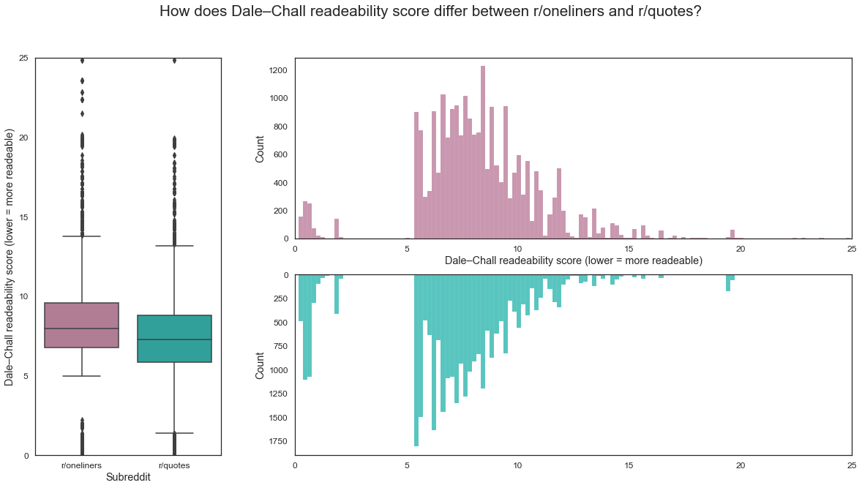
1. Is there a pattern to profound sentence?
Readability - Dale–Chall Readability Score
Function of percentage of difficult words and word length
Lower = More Readable
Notes:
Quite surprising at first to me, sentences from r/quotes generally have higher readability. But if you think about it, since the metric is function of difficult words, r/oneliners may contain more words such as internet slangs which are not included in the difficult words list.

Slide 14
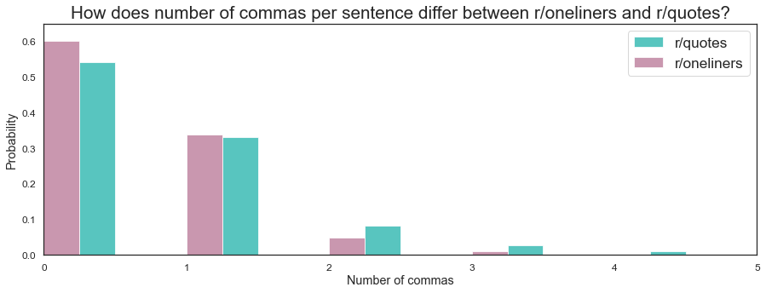
1. Is there a pattern to profound sentence?
Number of commas
r/quotes more commas
Notes:
Sentences from r/quotes tend to have a higher number of commas,

Slide 15
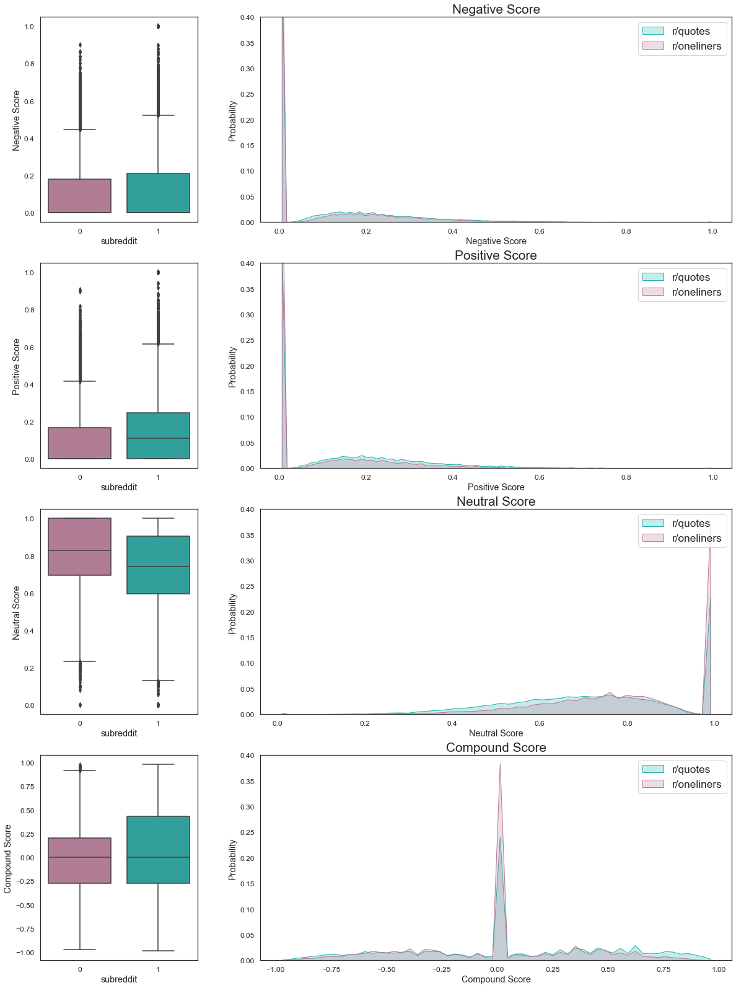
1. Is there a pattern to profound sentence?
Sentiments
r/quotes more positive, r/oneliners more neutral.

Slide 16
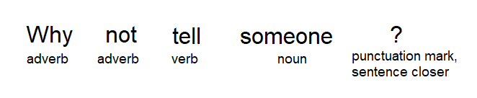
1. Is there a pattern to profound sentence?
Part of Speech (POS) Tagging
Adding tag/label to each word of a sentence.

Slide 17
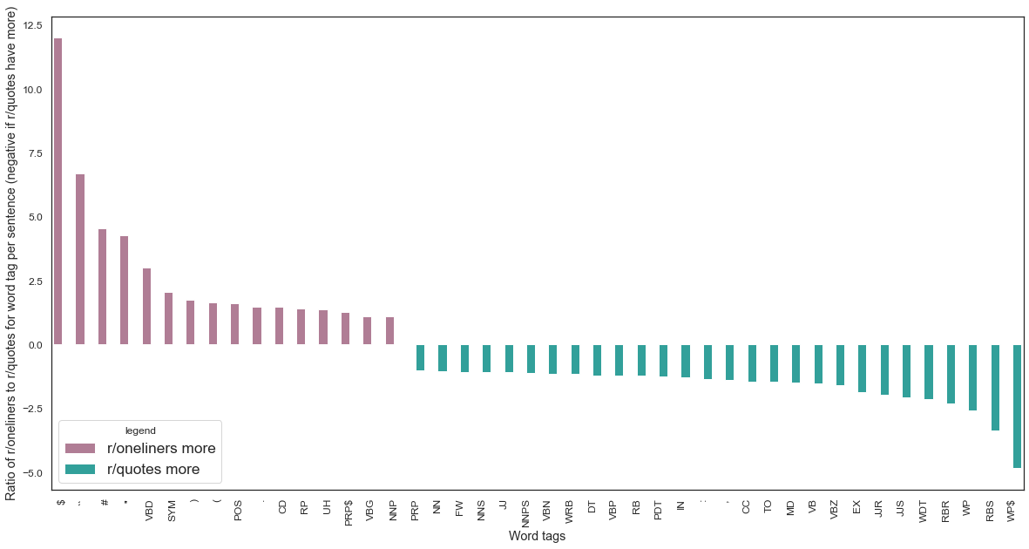
1. Is there a pattern to profound sentence?
Part of Speech (POS) Tagging
Notes:
Grouped according to the frequency of tag in each subreddit

Slide 18
1. Is there a pattern to profound sentence?
Part of Speech (POS) Tagging
r/quotes
Tags which increase sentence complexity
such as pronoun(i.e. whose, whom), conjunction(i.e. and, nor), and comparative adjective(i.e. best, bleaker)
r/oneliners
Tags which makes a sentence less “formal”
symbols(i.e. :,!) , numerals(i.e. 1,2,3), proper nouns (i.e. Escobar, Liverpool), as well as verbs with a time setting, such as past tense (i.e. made), and present participle (i.e. making) , as well as interjection like (i.e. oops, huh)

Slide 19
1. Is there a pattern to profound sentence?
Part of Speech (POS) Tagging
r/quotes
Tags which increase sentence complexity
r/oneliners
Tags which makes a sentence less “formal”

Slide 20
1. Is there a pattern to profound sentence?
Conclusion
Yes, profound quotes tend to have longer sentence length, more commas, less neutral, more complex in sentence structure and grammar.

Slide 21
2. Can we develop a reliable subreddit classifier ?
Features
Post Titles
Title Length
Average Word Length
Longest Word Length
Dale-Chall Readability Score
Flesch–Kincaid Reading Ease
Sentiment Score (VADER)
Part of Speech (POS) Tagging
Notes:
Next we move to the second question…

Slide 22
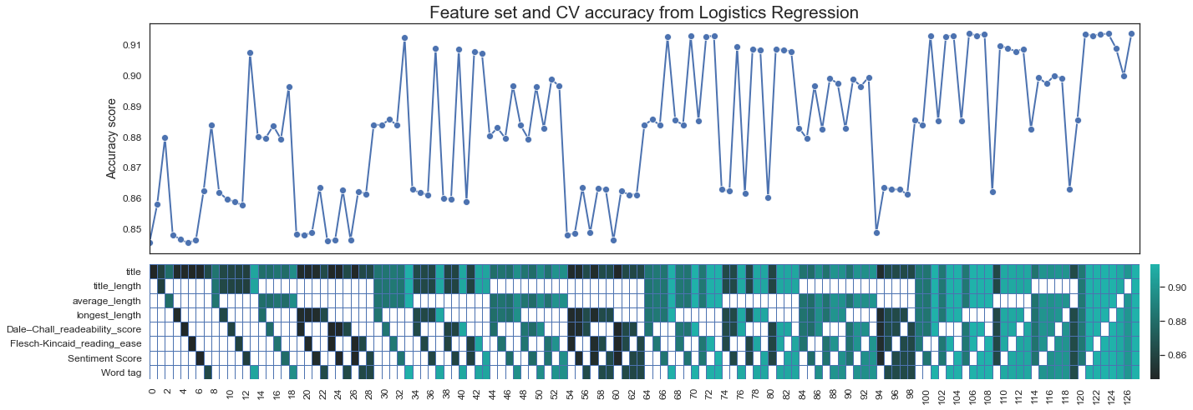
2. Can we develop a reliable subreddit classifier ?
Features
0.9123
0.9135
Feature Sets
Selected: Feature Set 33
Best: Feature Set 106
Notes:
So I created 128 feature sets. Each containing a different permutation of features.
By passing different combinations of our dataset through a classifier.
We see that the best feature is feature set 106, but in the end, selected feature set 33, which uses 2 less features.

Slide 23
2. Can we develop a reliable subreddit classifier ?
Features
Post Titles
Title Length
Average Word Length
Longest Word Length
Dale-Chall Readability Score
Flesch–Kincaid Reading Ease
Sentiment Score (VADER)
Part of Speech (POS) Tagging

Slide 24
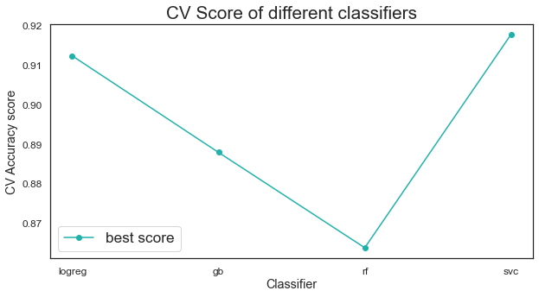
2. Can we develop a reliable subreddit classifier ?
Classifier Comparison
0.918

Slide 25
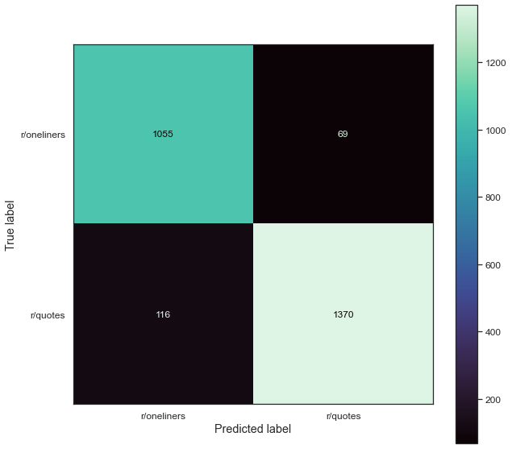
2. Can we develop a reliable subreddit classifier ?
Evaluation (Test data)
r/oneliners
Misclassification
Rate
r/quotes
Misclassification
Rate
r/oneliners has a higher misclassification rate
Could be due to r/oneliners containing profound quotes too
>
9.9%
4.8%
Notes:
When we analyse the individual misclassification rate of the subreddits, we see that r/oneliners has a higher misclassification rate. This could be due to more of the quotes in r/oneliners being profound as well.

Slide 26
2. Can we develop a reliable subreddit classifier ?
Evaluation (Test data)
Sample misclassifications from
r/quotes
r/oneliners
Life is like a fan, it keeps moving till someone shuts it off
Stalking is when two people go on a long romantic walk together but only one of them knows about it.
Well, i guess i'll have my flesh be replaced with bugs
A thing is a thing not what is said of that thing.
Authority will always resort to violence if ignored.
Your past and future can deceive you, but your present is always in the know
Golf is the only sport where the purpose of the game to to play less of it.
Duct tape is like the force, it has a light side and a dark side and it holds the universe together.
Notes:
From looking at the misclassified samples, we see that r/onelines has some statements which are actually quite profound.
r/quotes have some quotes which may be profound, but not expressed so formally.

Slide 27
3. Can the classifier generalize to identify any profound statement?
Evaluation (Twitter data) - generalizability
From @b0ringtweets
– Very very mundane texts
Samples
Retweet if you're sitting down.
I've been asleep but now I'm awake.
A man is being made the President.
Steve just texted back.
Accuracy = 98%
128/131

Slide 28
3. Can the classifier generalize to identify any profound statement?
Hands On Evaluation

Slide 29
Conclusion
Is there a pattern to profound sentence?
2. Can we develop a subreddit classifier to reliably classify statements from r/oneliners vs r/quotes?
3. Can the classifier generalize to identify any profound statement?
Yes, such as sentence length, word length, word tags
Yes, the classifier did rather well in terms of classifying subreddits.
Yes, to texts which are obviously not profound.
BUT…Can be quite easily fooled by a human.

Slide 30
Limitations and Future Directions
Cleaner data – samples which are correctly labelled
Word corpus – a corpus of profound terms or shallow words/internet slangs as reference for our classifier
Contextual analysis – Methods to understand context and relations

Slide 31
?

