Slide 1
An Empirical Study of Bugs in WebAssembly Compilers
Alan Romano
Xinyue Liu
Yonghwi Kwon
Weihang Wang
University at Buffalo, SUNY
University at Buffalo, SUNY
University of Virginia
University at Buffalo, SUNY

Slide 2

WebAssembly
Standard to build high-performance web applications
Defines bytecode format to use as compilation target
Compilers are required to compile source code in C, C++, Rust, etc… into WebAssembly binary modules

Slide 3

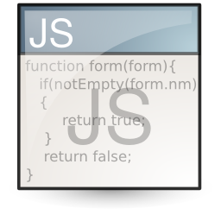
WebAssembly Development Flow
example.cpp
example.wasm
example.wat
bool isEven(int a){
int b = a % 2;
if(b == 0)
return true;
else
return false;
}
0x00 0061 736d 0100 0000 0186 8080 8000 0160 .asm...........`
0x10 017f 017f 0382 8080 8000 0100 0484 8080 ................
0x20 8000 0170 0000 0583 8080 8000 0100 0106 ...p............
0x30 8180 8080 0000 0797 8080 8000 0206 6d65 ..............me
0x40 6d6f 7279 0200 0a5f 5a36 6973 4576 656e mory..._Z6isEven
0x50 6900 000a 8e80 8080 0001 8880 8080 0000 i...............
(module (memory 1)
(func $isEven (param $p0 i32)
(result i32)
get_local $p0
i32.const 1
i32.and
i32.eqz
(1) Compile via Emscripten Compiler (emcc)
(3) Translate
via WebAssembly Binary Toolkit (WABT)
(a) C++ Source Program
(b) WebAssembly Binary Format
(d) WebAssembly Text Format
(2) Execute via JavaScript glue code to instantiate
WebAssembly.instantiateStreaming
(fetch("example.wasm",imports)).then
(o=>{o.instance.exports.isEven()})
(c) JavaScript Program
Website or Web Application (e.g., Extensions)

Slide 4
Motivation
Compilers face unique challenges compared with traditional compilers
Incompatible Data Type bugs account for 15.75% of the bugs inspected (Finding 1)
Porting synchronous C/C++ paradigm to event-loop causes a unique challenge (Finding 2)
Supporting linear memory management is challenging (Finding 3)
Changes of external infrastructures used in WebAssembly compilers lead to bugs (Finding $)
Platform differences can cause bugs, despite WebAssembly being platform independent (Finding 5)
Some bug reports fault to include critical information, prolonging debugging (Finding 6)
Understand how these challenges influence the types and quantity of bugs found in WebAssembly compilers

Slide 5
An Empirical Study of Bugs in WebAssembly Compilers
A qualitative study focused on investigating:
What new challenges exist in developing WebAssembly compilers and how many bugs do they introduce?
What are the root causes of these bugs?
How do WebAssembly compiler developers reproduce these bugs and what information is needed?
How do WebAssembly compiler developers fix bugs?
A quantitative study investigating
How long does it take to fix bugs in different compilers?
What are the impacts of the bugs in diverse compilers?

Slide 6
Choosing WebAssembly Compilers
Use curated awesome-wasm list to identify popular open-source WebAssembly compilers [1]
Prune out compilers:
Not focusing on general-purpose, high-level languages
Less than 100,000 lines of code
Less than 50 releases
Focus on three projects:
Emscripten
Rustc (w/ Wasm-Bindgen)
AssemblyScript

Slide 7



WebAssembly Compilers Studied
Emscripten
C/C++ to WebAssembly
Built on Clang and LLVM
Most widely-used WebAssembly compiler
Rustc
Rust to WebAssembly
Wasm-Bindgen provides necessary web bindings, so we include it in all counts
Relies on LLVM project for backend
AssemblyScript
Typescript-like code to WebAssembly
No any or undefined types
Four numeric types
No closures
Relies on Binaryen project for backend

Slide 8
Compiler Bug Collection
Use GitHub Search API and GitHub REST API to collect all issues and pull requests for three projects
Identify bugs using keywords “bug”, “defect”, “error”, and “fault” and labels including “bug”, “good first bug”, and “breaking changes”
Compiler | Bugs | Unique Bugs | Commits
AssemblyScript | 136 | 107 | 174
Emscripten | 711 | 430 | 1,460
Rustc/Wasm-Bindgen | 207 | 158 | 245
Totals | 1,054 | 695 | 1,879

Slide 9
First Study: Qualitative Study of Emscripten Issues
Focus on 146 unique closed bugs in Emscripten relevant to unique WebAssembly development challenges
Identify root cause by reading issue conversation to find what developers reported the cause to be
Identify bug fix by reading issue conversation to find what fix developers use
If not mentioned, inspect last commit before issue closing to infer bug fix strategy

Slide 10
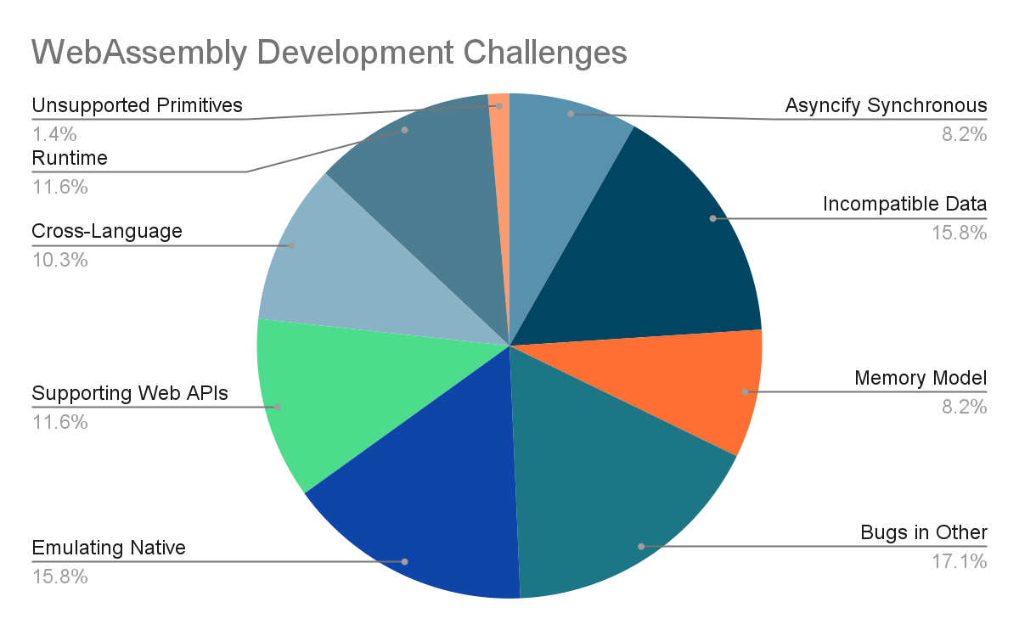
Bug Development Challenges
Inductive coding approach based on root cause descriptions
Asyncify Synchronous Code
Incompatible Data Types
Memory Model Differences
Bugs in Other Infrastructures
Emulating Native Environment
Supporting Web APIs
Cross-Language Optimizations
Runtime Implementation Discrepancy
Unsupported Primitives

Slide 11
Asyncify Synchronous Code
Basic operations in C/C++ expect fully synchronous execution
In browsers, execution follows an event-loop asynchronous paradigm
Emscripten provides tools to support converting synchronous blocking code into a model that fits the event-based browser environment

Slide 12
Asyncify Synchronous Code Bug: Issue #9823 [2]
In this issue, a user reports the behavior between Emterpreter and Asyncify is inconsistent
Emterpreter uses two tools to support converting sync code to async code
Each tools allows specifying a sleep callback to execute during a paused execution, but Asyncify does not call the callback
Emscripten’s SDL sound library relies on this sleep callback, so inconsistent behavior leads to sound distortion

Slide 13
Asyncify Synchronous Code Bug: Issue #9823 (cont.)
Fixed by updating Asyncify to accept callbacks and invoke them during paused execution
Behavior becomes consistent with Emterpreter
sleepCallbacks: [], // functions to call every time we sleep
handleSleep: function(startAsync) {
// Call all sleep callbacks now that the sleep-resume is all done.
Asyncify.sleepCallbacks.forEach(function(func) {
func();
})

Slide 14
Bug Reproducing Analysis
Manually inspect the bug reports and issue conversations to understand the challenges in reproducing bugs
Check if critical information is available in bug reports, including
Analyze bugs reports that require significant effort to reproduce
Program source code
Accompanying JavaScript code
Compiled WebAssembly output
Exception Stack Trace
Expected output value
Compiler options used
Compiler version used
Runtime environment

Slide 15
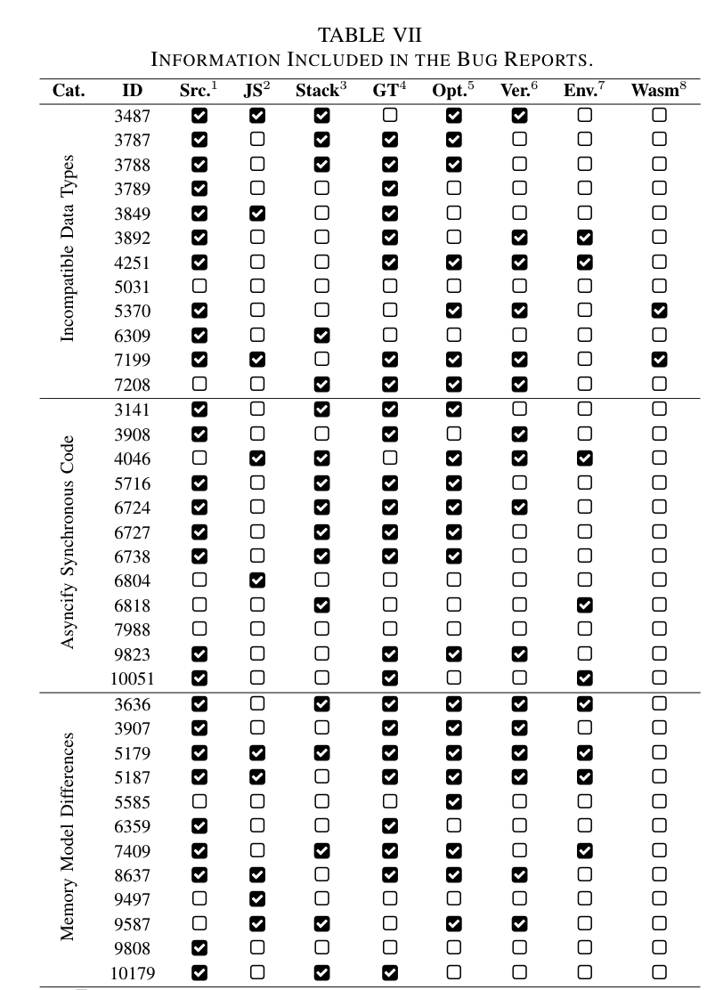
Bug Reproducing Analysis (cont.)
Among all inspected bug reports:
Most bug reports include the program source code, stack traces, expected value, and compiler options
Few include compiler versions and runtime environments
WebAssembly output is rarely included
Among bugs that are difficult to reproduce:
Compiler options and version not provided often
WebAssembly output never provided

Slide 16
Findings and Implications of First Study
Porting synchronous C/C++ paradigm to event-loop is a unique challenge | Programs supporting automated sync-to-async conversion require more extensive testing
Incompatible Data Type bugs account for 15.75% of the 146 bugs inspected | Interfaces passing values between WebAssembly and JavaScript require more attention
Emulating native memory constructs in linear memory management is challenging | Many memory bugs require a particular condition, calling for more comprehensive testing
Some bug reports fail to include critical information, prolonging debugging | Bug reporting practices can be improved, e.g., by automatically collecting critical information

Slide 17
Second Study: Quantitative Study of Compiler Issues
Analyze 1,054 bug reports from AssemblyScript, Emscripten and Rustc/Wasm-Bindgen
Focus on several dimensions
Lifecycle of the bugs
Impacts they have on compiled programs
Size of bug-inducing Inputs
Size of bug fixes applied

Slide 18
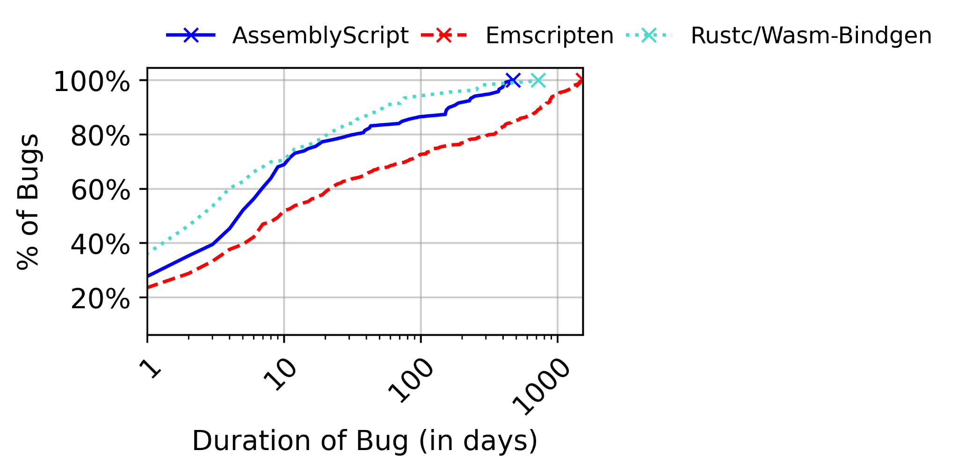
Lifecycle of Bugs
Analyze the duration between when a bug is reported and when it is closed
24.5% of bugs fixed within 1 day
Rustc/Wasm-Bindgen - 35.1%
AssemblyScript - 27.5%
Emscripten - 23.6%
56.3% of bugs fixed within 10 days
Rustc/Wasm-Bindgen - 70.3%
AssemblyScript - 67.3%
Emscripten - 48.4%

Slide 19
Impact of Bugs
Read issue report to identify the symptoms that the faulty program exhibited and where they occured
Develop categories using a deductive coding approach starting with categories from existing work [3]

Slide 20
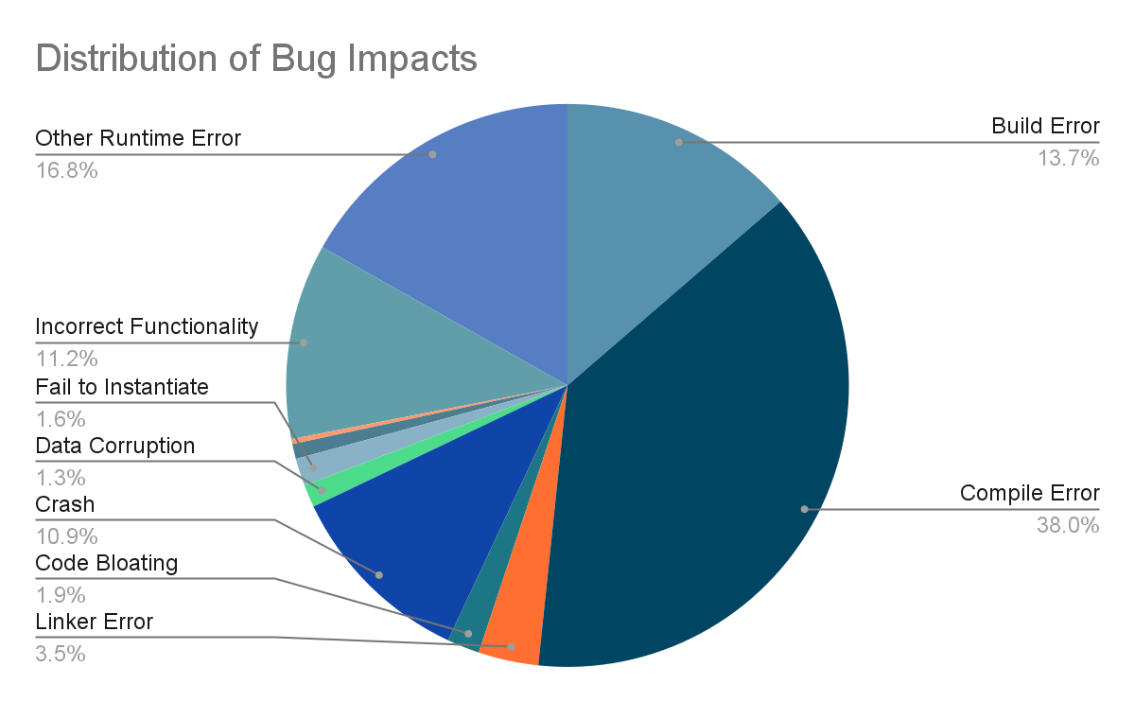
Impacts of Bugs (cont.)
Build-Time Error
Compile-Time Error
Compile Error
Linker Error
Code Bloating
Runtime Error
Crash
Data Corruption
Fail to Instantiate
Performance Drop
Hang
Incorrect Functionality
Other Runtime Error

Slide 21
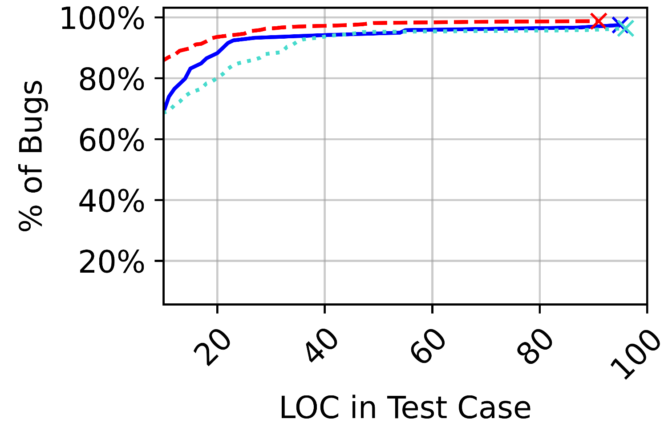
Size of Bug-Inducing Test Inputs
Only 340 issues include a bug-inducing input in their report
53.8% of issues with bug-inducing inputs have 10 LOC or fewer
Encounter several cases where bug-inducing input is reduced over several posts [4-6]

Slide 22
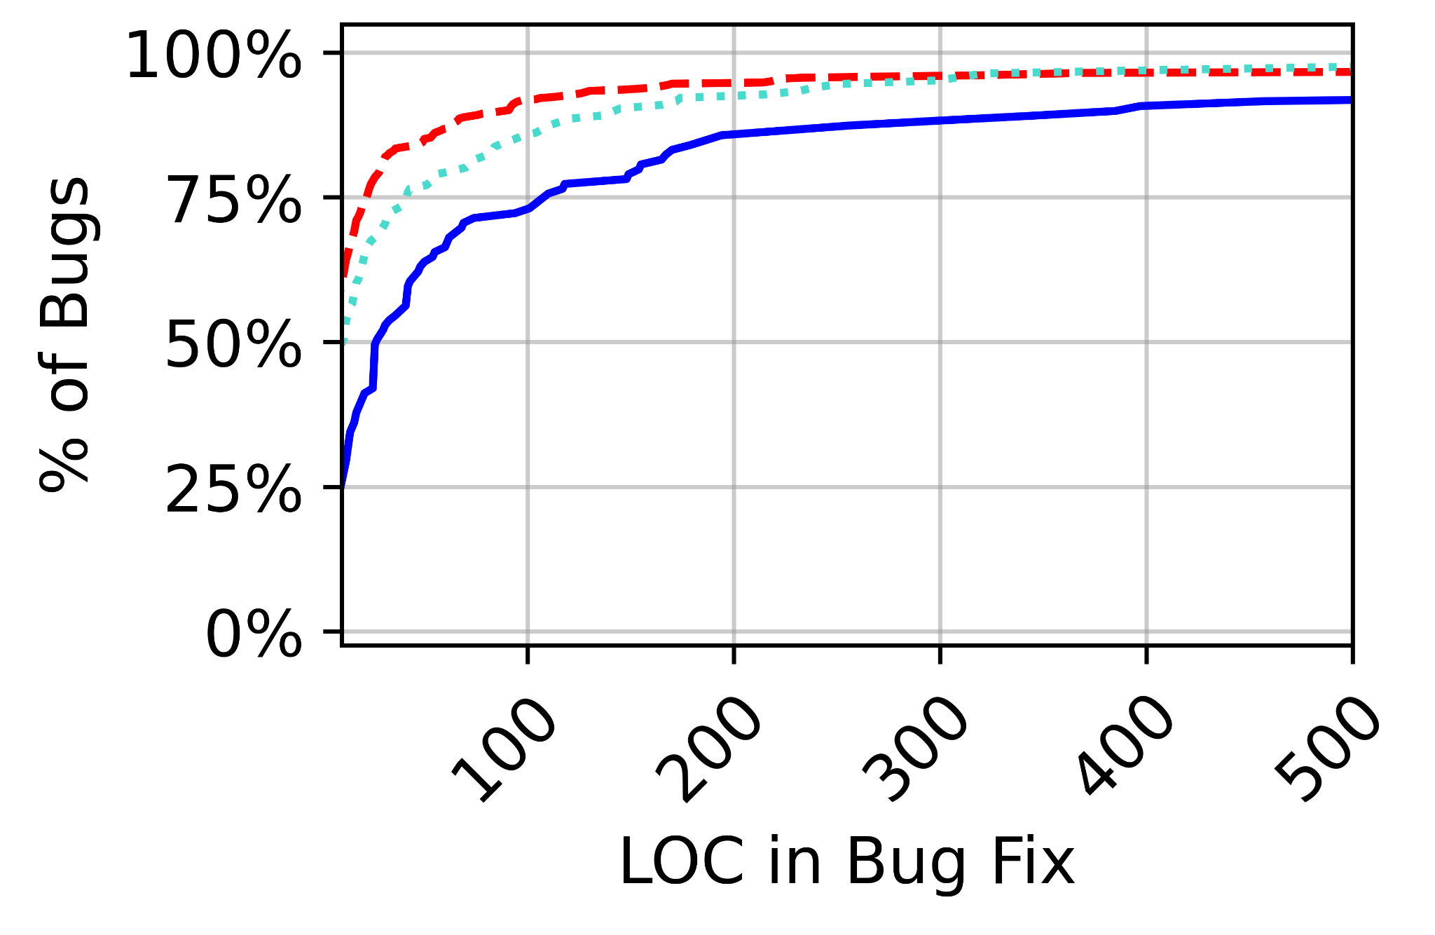
Size of Bug Fixes
Inspect code size in last commit made before closing issue
58.4% of all bugs are fixed with 10 LOC or less
Emscripten: 43.7%
Rustc/Wasm-Bindgen: 34.2%
AssemblyScript: 24.3%
Over 96% of all bugs are fixed with 100 LOC or less
Emscripten: 74.2%
Rustc/Wasm-Bindgen: 69%
AssemblyScript: 71%

Slide 23
Findings and Implications of Second Study
Bugs that manifest during runtime made up 43% of the bugs inspected. | Compiler developers should test emitted support modules in the test suites more exhaustively
77.1% of bug-inducing inputs were less than 20 LOC, and developers manually reduce the size of inputs | In many cases, bugs can be successfully reproduced by relatively small inputs. Automated bug-inducing input reduction techniques would be beneficial

Slide 24
Threats to Validity
Representativeness of chosen compilers
Choose three popular and actively-maintained compilers
Generalization of studied bugs
Use all bugs satisfying selection criteria
Exclude bugs irrelevant to WebAssembly
Correctness of analysis methodology
Automate quantitative analyses, aside from bug-inducing input size and bug impact
To mitigate against bias in manual inspections, three authors analyze bugs separately and discuss inconsistencies until a consensus is reached

Slide 25
Related Work
Empirical Studies on Software Defects
Tan et al. (2014) [7]
Eyolfson et al. (2014) [8]
Sun et al. (2016) [9]
WebAssembly Analysis Tools
Szanto et al. (2018) [10]
Fu et al. (2018) [11]
Jeong et al. (2018) [12]
Lehmann and Pradel. (2019) [13]
Romano and Wang. (2020) [14,15]
WebAssembly Prevalence and Security Studies
Renner et al. (2018) [16]
Konoth et al. (2018) [17]
Musch et al. (2019) [18]
Disselkoen et al. (2019) [19]
Kharraz et al. (2019) [20]
Lehmann et al. (2020) [21]
Romano et al. (2020) [22]
Narayan et al. (2021) [23]
Hilbig et al. (2021) [24]

Slide 26
Conclusion
Conduct two empirical studies on WebAssembly compiler bugs
First study focuses on qualitative characteristics of Emscripten bugs
Second study focuses on quantitative properties of Emscripten, AssemblyScript, and Rustc/Wasm-Bindgen bugs
Propose useful strategies to aid in debugging process of WebAssembly compilers

Slide 27
References
M. Basso, “mbasso/awesome-wasm,” 2019. [Online]. Available: https://github.com/mbasso/awesome-wasm
A. Guryanov, “Asyncify behaving differently then emterpreter·Issue #9823.” [Online]. Available: https://github.com/emscripten-core/emscripten/issues/9823
Z. Li, L. Tan, X. Wang, S. Lu, Y. Zhou, and C. Zhai, “Have things changed now?: An empirical study of bug characteristics in modern opensource software,” 01 2006, pp. 25–33.
B. Vibber, “error ”variable fs is undeclared” in 1.39.7 with closure compiler,”2020. [Online]. Available: https://github.com/emscripten-core/emscripten/issues/10385
A. Weissflog, “Code-gen bug related to 32-bit floats (actually: rand()),”2016. [Online]. Available: https://github.com/WebAssembly/binaryen/issues/817
Y. Delendik, “Dwarf information does not contain absolute file locations for generics,” 2018. [Online]. Available: https://github.com/rust-lang/rust/issues/54408
Lin Tan, Chen Liu, Zhenmin Li, Xuanhui Wang, Yuanyuan Zhou, and Chengxiang Zhai. 2014. Bug characteristics in open source software. Empirical Softw. Engg.19, 6 (December 2014), 1665–1705. DOI:https://doi.org/10.1007/s10664-013-9258-8
Eyolfson, Jon et al. “Correlations between bugginess and time-based commit characteristics.” Empirical Software Engineering 19 (2013): 1009-1039.
Chengnian Sun, Vu Le, Qirun Zhang, and Zhendong Su. 2016. Toward understanding compiler bugs in GCC and LLVM. In Proceedings of the 25th International Symposium on Software Testing and Analysis (ISSTA 2016). Association for Computing Machinery, New York, NY, USA, 294–305. DOI:https://doi.org/10.1145/2931037.2931074
Szanto, Aron et al. “Taint Tracking for WebAssembly.” ArXiv abs/1807.08349 (2018): n. Pag.
Fu, William et al. “TaintAssembly: Taint-Based Information Flow Control Tracking for WebAssembly.” ArXiv abs/1802.01050 (2018): n. Pag.
H. Jeong, J. Jeong, S. Park, and K. Kim, “Watt : A novel web-based toolkit to generate webassembly-based libraries and applications,” in2018 IEEE International Conference on Consumer Electronics (ICCE),Jan 2018, pp. 1–2.

Slide 28
References (cont.)
Daniel Lehmann and Michael Pradel. 2019. Wasabi: A Framework for Dynamically Analyzing WebAssembly. In Proceedings of the Twenty-Fourth International Conference on Architectural Support for Programming Languages and Operating Systems (ASPLOS '19). Association for Computing Machinery, New York, NY, USA, 1045–1058. DOI:https://doi.org/10.1145/3297858.3304068
Alan Romano and Weihang Wang. 2020. WasmView: visual testing for webassembly applications. In Proceedings of the ACM/IEEE 42nd International Conference on Software Engineering: Companion Proceedings (ICSE '20). Association for Computing Machinery, New York, NY, USA, 13–16. DOI:https://doi.org/10.1145/3377812.3382155
A. Romano and W. Wang, "WASim: Understanding WebAssembly Applications through Classification," 2020 35th IEEE/ACM International Conference on Automated Software Engineering (ASE), 2020, pp. 1321-1325.
J. Renner, S. Cauligi, and D. Stefan, “Constant-time WebAssembly,” in Principles of Secure Compilation (PriSC), January 2018.
Radhesh Krishnan Konoth, Emanuele Vineti, Veelasha Moonsamy, Martina Lindorfer, Christopher Kruegel, Herbert Bos, and Giovanni Vigna. 2018. MineSweeper: An In-depth Look into Drive-by Cryptocurrency Mining and Its Defense. In Proceedings of the 2018 ACM SIGSAC Conference on Computer and Communications Security (CCS '18). Association for Computing Machinery, New York, NY, USA, 1714–1730. DOI:https://doi.org/10.1145/3243734.3243858
M. Musch, C. Wressnegger, M. Johns, and K. Rieck, “New kid on the web: A study on the prevalence of webassembly in the wild,” in International Conference on Detection of Intrusions and Malware, and Vulnerability Assessment. Springer, 2019, pp. 23–42.
C. Disselkoen, J. Renner, C. Watt, T. Garfinkel, A. Levy, and D. Stefan,“Position paper: Bringing memory safety to WebAssembly,” in Hardware and Architectural Support for Security and Privacy (HASP).ACM,June 2019.

Slide 29
References (cont.)
Amin Kharraz, Zane Ma, Paul Murley, Charles Lever, Joshua Mason, Andrew Miller, Nikita Borisov, Manos Antonakakis, and Michael Bailey. 2019. Outguard: Detecting In-Browser Covert Cryptocurrency Mining in the Wild. In The World Wide Web Conference(WWW '19). Association for Computing Machinery, New York, NY, USA, 840–852. DOI:https://doi.org/10.1145/3308558.3313665
D. Lehmann, J. Kinder, and M. Pradel, “Everything old is new again:Binary security of webassembly,” in29th USENIX Security Symposium(USENIX Security 20).USENIX Association, Aug. 2020, pp. 217–234.
Alan Romano, Yunhui Zheng, and Weihang Wang. 2020. MinerRay: semantics-aware analysis for ever-evolving cryptojacking detection. In Proceedings of the 35th IEEE/ACM International Conference on Automated Software Engineering (ASE '20). Association for Computing Machinery, New York, NY, USA, 1129–1140. DOI:https://doi.org/10.1145/3324884.3416580
S. Narayan, C. Disselkoen, D. Moghimi, S. Cauligi, E. Johnson,Z. Gang, A. Vahldiek-Oberwagner, R. Sahita, H. Shacham, D. Tullsen,and D. Stefan, “Swivel: Hardening WebAssembly against Spectre,” in USENIX Security Symposium. USENIX, August 2021.
Aaron Hilbig, Daniel Lehmann, and Michael Pradel. 2021. An Empirical Study of Real-World WebAssembly Binaries: Security, Languages, Use Cases. In Proceedings of the Web Conference 2021(WWW '21). Association for Computing Machinery, New York, NY, USA, 2696–2708. DOI:https://doi.org/10.1145/3442381.3450138

Slide 30
Thank You!
Alan Romano
Xinyue Liu
Yonghwi Kwon
Weihang Wang
alanroma@buffalo.edu
xliu234@buffalo.edu
yongkwon@virginia.edu
weihangw@buffalo.edu

