Slide 1
ADHERE
Automated Detection and Repair of Intrusive Ads
ICSE 2023
Yutian Yan
University of Southern California
Yunhui Zheng
IBM T. J. Watson Research Center
Xinyue Liu
University at Buffalo,
SUNY
Nenad Medvidovic
University of Southern California
Weihang Wang
University of Southern California

Slide 2
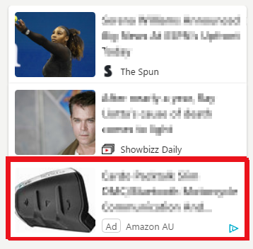
Online Advertisement
Every day an user can see 6,000 to 10,000 online advertisements^{[1]}
Online advertising has been the most critical revenue stream for over 3 million websites^{[2]}

Slide 3

Intrusive Advertisement
E.g. Pop-up Ads on getsongbpm.com

Slide 4
Intrusive Ads Impact
Intrusive ads upset users and turn users away from the website^{[1]}

Slide 5
Intrusive Ads Impact
Intrusive ads upset users and turn users away from the website^{[1]}
Bring in 0.10-0.80 USD per thousand impressions, while cost websites 1.53 USD per thousand impressions due to the downgraded user experience^{[3]}

Slide 6




Defining Intrusive Ads
68%
Visitors accept non-intrusive ads
Introducing Better Ads Standards^{[4]}

Slide 7
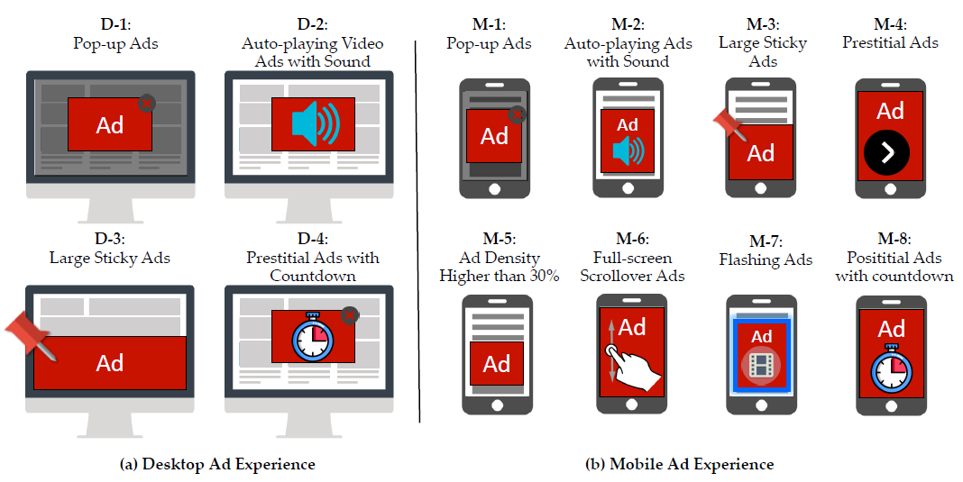
Intrusive Ads Definition – Better Ads Standards

Slide 8
Paper Goal
Use Better Ads Standards to detect intrusive ads on websites
Provide suggestions to web developers to fix intrusive ads

Slide 9
Existing Work
Google Ad Experience Report^{[5]}
Audit ads on websites and release the compliance results
Intrusive ads found: fix in 30 days, or Chrome will block all ads on websites
We conducted a preliminary study on Google Ad Experience Report

Slide 10
Limitations of Existing Work (1)
Low coverage
Among Alexa Top 1 Million Websites, Google only monitored 61,727 desktop websites (6.2%) and 54,237 (5.4%) mobile websites

Slide 11
Limitations of Existing Work (1)
Low coverage
Among Alexa Top 1 Million Websites, Google only monitored 61,727 desktop websites (6.2%) and 54,237 (5.4%) mobile websites
No code locations or fixing guidelines
Google doesn’t provide website developers detailed guidelines on where to locate the code of intrusive ads, nor to provide guidelines for fixing ads

Slide 12
Limitations of Existing Work (2)
Periodically performed and passive to websites
Information provided by Google may be out of date

Slide 13
Limitations of Existing Work (2)
Periodically performed and passive to websites
Information provided by Google may be out of date
Slow reaction (fix attempts) from website developers
Website owners are asked to repair all intrusive ads within 30 days, or Google Chrome will regardless filter out all ads
Among all websites being filtered, 96.2% have been filtered for over three months, and 32.5% have been filtered for over one year

Slide 14
AdHere
A technique that can
Detect any websites – Low Coverage
Automatically detect intrusive ads – No intrusive ad code locations
Execute locally at any time – Periodically performed
Suggest repair proposals – Slow reactions

Slide 15
Overview of AdHere
Collect website status
Pinpoint intrusive ads
Suggest repair proposals

Slide 16
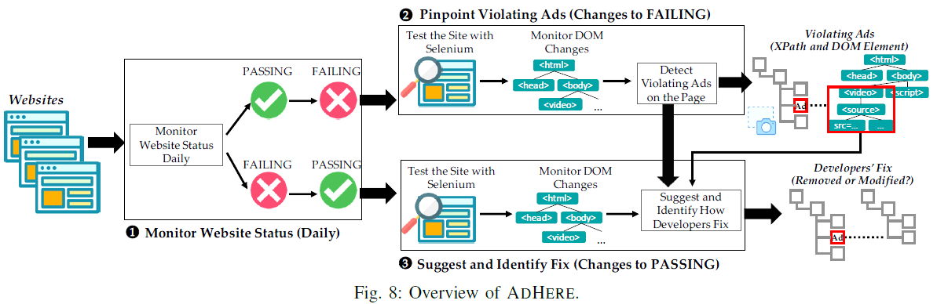
Overview of AdHere
Monitor website status

Slide 17
Overview of AdHere
Pinpoint intrusive ads

Slide 18
Overview of AdHere
Suggest repair proposals

Slide 19
AdHere - Detecting Intrusive Ads
Suggest repair proposals

Slide 20
Different Types of Desktop Intrusive Ads
Pop-up Ads
Block the main content of a web page deliberately
Auto-playing Video Ads with Sound
Automatically play disruptive videos and music
Large Sticky Ads
Remain constant at the bottom or the side edge
Prestitial Ads
Appear before the main content is loaded; require users to wait before closing

Slide 21
Pop-up Ads
Characteristics
CSS attribute ‘position’ is ‘absolute’ or ‘fixed’
CSS attribute ‘z-index’ is a positive integer

Slide 22
Pop-up Ads
Characteristics
CSS attribute ‘position’ is ‘absolute’ or ‘fixed’
CSS attribute ‘z-index’ is a positive integer
Detection
Scan all DOM elements in HTML after the page is fully loaded, and record elements with above attributes

Slide 23
Pop-up Ads
Characteristics
CSS attribute ‘position’ is ‘absolute’ or ‘fixed’
CSS attribute ‘z-index’ is a positive integer
Validation
Elements disappear after the ad blocker is applied

Slide 24
Pop-up Ads
Characteristics
CSS attribute ‘position’ is ‘absolute’ or ‘fixed’
CSS attribute ‘z-index’ is a positive integer
Fix
Modify ‘position’ to ‘relative’, or
Modify ‘z-index’ to zero or lower

Slide 25
Evaluation
Prevalence of intrusive ads
Comparison with Google
Suggesting fixes
Overhead of AdHere

Slide 26
Evaluation - Prevalence
Dataset
Alexa Top 1 Million Websites

Slide 27
Evaluation - Prevalence
Dataset
Alexa Top 1 Million Websites
Results
AdHere detected intrusive ads on 5,540 mobile websites and 4,601 desktop websites
Google detected 884 mobile and 690 desktop websites
AdHere has higher coverage

Slide 28
Evaluation - Comparison
Dataset
1,000 websites

Slide 29
Evaluation - Comparison
AdHere |  | Predicted
 |  | Neg. | Pos.
Actual | Neg. | 299 | 175
 | Pos. | 69 | 457
Google |  | Predicted
 |  | Neg. | Pos.
Actual | Neg. | 344 | 130
 | Pos. | 156 | 370
Dataset
1,000 websites

Slide 30
Evaluation - Comparison
AdHere |  | Predicted
 |  | Neg. | Pos.
Actual | Neg. | 299 | 175
 | Pos. | 69 | 457
Google |  | Predicted
 |  | Neg. | Pos.
Actual | Neg. | 344 | 130
 | Pos. | 156 | 370
Dataset
1,000 websites
AdHere generally performs better
Tool | Precision | Recall | Accuracy | F1-Score
AdHere | 72.3% | 86.9% | 75.6% | 78.9%
Google | 74.0% | 70.3% | 71.4% | 72.1%

Slide 31
Evaluation - Fixes
Dataset
97 fixed websites collected in the preliminary study
Only 4% of intrusive ads are fixed by modifying ad attributes; 96%: Removing ads

Slide 32
Evaluation - Fixes
Dataset
97 fixed websites collected in the preliminary study
Only 4% of intrusive ads are fixed by modifying ad attributes; 96%: Removing ads
AdHere provides attribute modification suggestions
Although not providing automatic fixes, based on the suggestions, we can fix 100% of these ads without removing them

Slide 33
Evaluation - Overhead
Dataset
1,000 websites

Slide 34
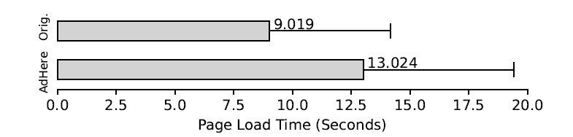
Evaluation - Overhead
Dataset
1,000 websites
44% (4.0 sec) overhead on average

Slide 35
Limitation
Web page crawling
May miss certain ads
Dynamic web page
Different results from Google and AdHere
Combined fix patterns
Intrusive ads modified and moved: Identified as removed

Slide 36
Takeaways
AdHere is a technique that can automatically detect intrusive ads and suggest repair proposals at any time and on any websites
Compared to the Google audit tool, AdHere detected 8,567 more websites with intrusive ads on one million websites
AdHere has a higher recall (+16.6%), accuracy (+4.2%), and F1-score (+6.8%) compared to Google

Slide 37
References
[1] https://instapage.com/blog/intrusive-advertising
[2] https://w3techs.com/technologies/overview/advertising/all
[3] D. G. Goldstein, S. Suri, R. P. McAfee, M. Ekstrand-Abueg, and F. Diaz, “The economic and cognitive costs of annoying display advertisements,” Journal of Marketing Research, vol. 51, no. 6, pp. 742–752, 2014.
[4] The Initial Better Ads Standards - Coalition for Better Ads. https://www.betterads.org/standards
[5] Google Ad Experience Report API. https://developers.google.com/ad-experience-report

Slide 38
THANK YOU Q & A
ADHERE
Automated Detection and Repair of Intrusive Ads
Yutian Yan Yunhui Zheng Xinyue Liu Nenad Medvidovic Weihang Wang
yutianya@usc.edu zheng16.cs@gmail.com xliu234@buffalo.edu neno@usc.edu weihangw@usc.edu

