Slide 1
Understanding the Performance of WebAssembly Applications
Yutian Yan, Tengfei Tu, Lijian Zhao, Yuchen Zhou, Weihang Wang
Internet Measurement Conference (IMC) 2021

Slide 2
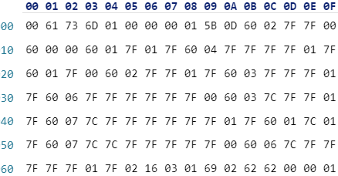
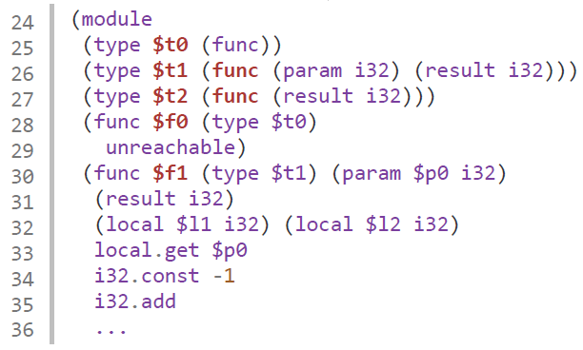






What is WebAssembly?
A new programming language first proposed in 2017^{[1]}
Fast, safe, portable low-level bytecode designed for the Web
Designed as a compilation target
Compiled from C, C++, Rust, etc.
Supported in major browsers^{[2]}
WebAssembly (Wasm) binary
WebAssembly (Wasm) text format

Slide 3


One of the Major Design Goals
WebAssembly is excepted to be fast and improve JavaScript performance
“
The kind of binary format being considered for WebAssembly can be natively decoded much faster than JavaScript can be parsed (experiments show more than 20× faster).
WebAssembly Official Website^{[3]}
”
FASTER

Slide 4
Counter-Intuitive Results in Practice
Sometimes, WebAssembly is slower than JavaScript
Samsung engineers observed that WebAssembly is 4.3x slower than JavaScript on the Samsung Internet browser when performing multiplications on matrices of certain sizes^{[4]}
According to a post on Stack Overflow^{[5]}, WebAssembly is 1.9x slower than the JavaScript when WebAssembly code is not well-optimized by the compiler
According to a blog^{[6]}, JavaScript runs 3.4x faster than WebAssembly when handling arrays

Slide 5
Existing Work
Performance of
WebAssembly, asm.js, and native C implementations^{[1]}
WebAssembly and C programs^{[7]}
WebAssembly applications performing sparse matrix-vector multiplications^{[8]}
WebAssembly and JavaScript programs when performing multiplications on matrices of certain sizes^{[6]}
By contrast, our study focuses on performance comparison of WebAssembly and generic JavaScript in diverse settings

Slide 6
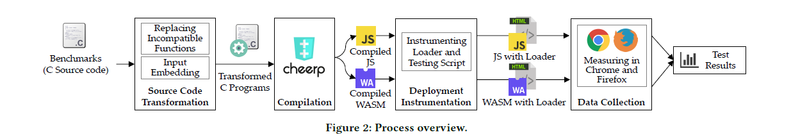
Evaluation Process
Step 1: Source Code Transformation
Resolving incompatible functions
Input embedding

Slide 7
Evaluation Process
Step 2: Compilation to WebAssembly/JavaScript
Compilation parameters
Handling library issues
Compiler we use: Cheerp (only one supporting WebAssembly and JavaScript)

Slide 8
Evaluation Process
Step 3: Deployment Instrumentation
Creating web page to load WebAssembly/JavaScript
Instrumenting to add timers

Slide 9
Evaluation Process
Step 4: Data Collection
Two metrics: page load time and memory usage
Execute five times and take the average

Slide 10
Evaluation
Subject Programs
41 WebAssembly binaries and 41 JavaScript programs
Compiled from 41 widely-used C benchmarks, 30 from PolyBenchC and 11 from CHStone
Line of Code: 423 to 33,933
Include scientific simulation, image/video editing, media/signal processing, encryption, platform simulation, and math-oriented applications
Experimental setup
Desktop: Intel Core i7 (4 cores), 16 GB memory, Ubuntu 18.04
Mobile: Qualcomm Snapdragon 835 (8 cores), 6 GB memory, Android 9.0

Slide 11
Metrics: Page Load Time and Memory Usage
With diverse program input sizes
Input size: the value of a program’s input that affects the amount of calculations
Five levels in our study: XS, S, M, L, and XL
‘Lu’ benchmark: XS: N=40 S: N=120 M: N=400 L: N=2000 XL: N=4000
Programs taking a larger input
Typically would lead to more calculations
Have higher chances to be better benefited from optimization techniques

Slide 12
Metrics: Page Load Time and Memory Usage
With JIT optimizations enabled vs. disabled
The JavaScript engines in modern browsers leverage JIT compilation to improve the performance of the frequently executed code in JavaScript/WebAssembly programs
Disable JIT for Wasm
(Chrome) chrome –js-flags="–liftoff –no-wasm-tier-up" –incognito
(Firefox) In about:config, set "javascript.options.wasm_ionjit" as false

Slide 13
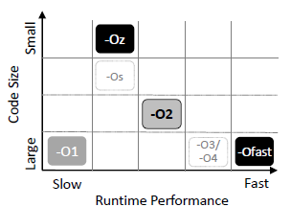
Metrics: Page Load Time and Memory Usage
With multiple compiler optimizations
Cheerp supports various optimization levels
Four levels in our study: O1, O2, Ofast, and Oz
Expected order
Page load time: Ofast < O2 < Oz < O1
Code size: Oz < O2 < O1 and Ofast
Large Small
Expected code size
Large Small
Expected page load time

Slide 14


Metrics: Page Load Time and Memory Usage
On different browsers and platforms
Six deployment settings
 | Chrome | Firefox | Edge
Desktop
Mobile

Slide 15
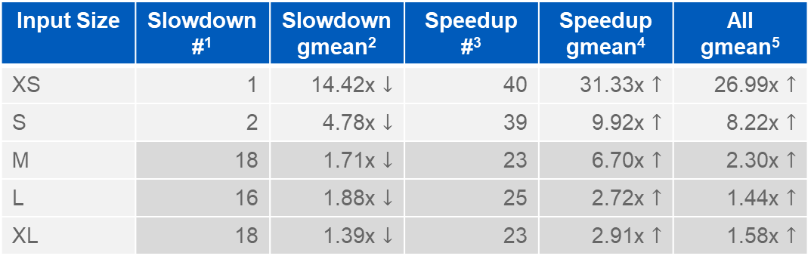
Input Size
Page load time
XS and S: Wasm is faster
M, L, and XL: Wasm is still faster, but JavaScript sometimes outperforms Wasm
Page load time statistics
Input Size | Slowdown #¹ | Slowdown gmean² | Speedup #³ | Speedup gmean⁴ | All gmean⁵
XS | 1 | 14.42x $↓$ | 40 | 31.33x $↑$ | 26.99x $↑$
S | 2 | 4.78x $↓$ | 39 | 9.92x $↑$ | 8.22x $↑$
M | 18 | 1.71x $↓$ | 23 | 6.70x $↑$ | 2.30x $↑$
L | 16 | 1.88x $↓$ | 25 | 2.72x $↑$ | 1.44x $↑$
XL | 18 | 1.39x $↓$ | 23 | 2.91x $↑$ | 1.58x $↑$

Slide 16
Input Size
Page load time
XS and S: Wasm is faster
M, L, and XL: Wasm is still faster, but JavaScript sometimes outperforms Wasm
Memory
JavaScript: similar memory usage
Wasm: more than JavaScript, more memory when the input size increases
Memory usages (in KB)
Input Size | JavaScript | WebAssembly
XS | 879.41 | 2,001.54
S | 878.73 | 2,077.27
M | 880.54 | 2,985.78
L | 883.10 | 26,991.05
XL | 889.20 | 100,943.88

Slide 17
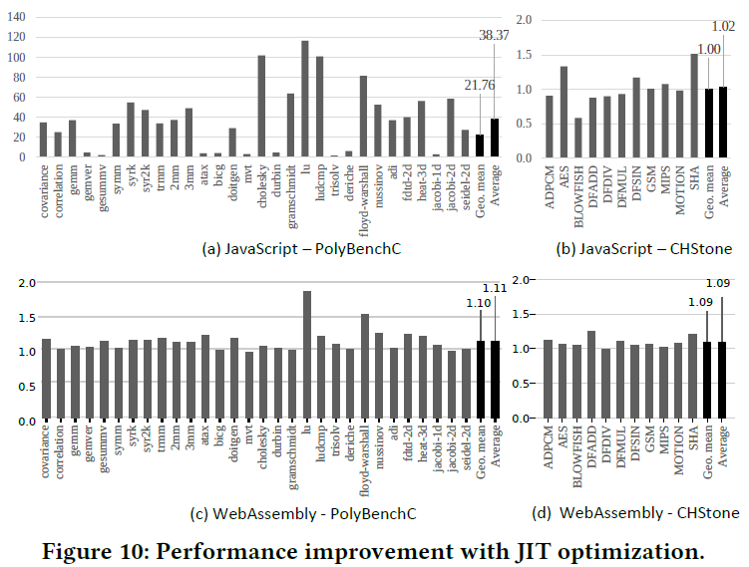
JIT Optimization: JS and Wasm
On desktop Chrome
JavaScript
Significantly affected by JIT
CHStone affected less than PolyBenchC
Geo. Mean: 21.76x
Average: 38.37x
Geo. Mean: 1.00x
Average: 1.02x
JavaScript performance improvement with JIT optimization

Slide 18
JIT Optimization: JS and Wasm
On desktop Chrome
JavaScript
Significantly affected by JIT
CHStone affected less than PolyBenchC
WebAssembly
No significant performance difference
Geo. Mean: 1.10x
Average: 1.11x
Geo. Mean: 1.10x
Average: 1.11x
WebAssembly performance improvement with JIT optimization

Slide 19
JIT Optimization: Chrome vs Firefox
Wasm Binary
Both desktop Chrome and Firefox have a two-layer compiler structure for WebAssembly
Basic compiler
‘LiftOff’ in Chrome and ‘Baseline’ in Firefox
Quick compilation but less effective code
Optimizing compiler
‘TurboFan’ in Chrome and ‘Ion’ in Firefox
Slower compilation but performs JIT compilation to generate high-performance code
By default, both compilers are enabled
Basic Compiler
Un-opt Code
Optimizing Compiler
Optimized Code

Slide 20
JIT Optimization: Chrome vs Firefox
Three settings
Only enabling basic compiler
Only enabling optimizing compiler
Default (enabling both compilers)
Page load time ratio (smaller is faster)
Default is the baseline: ratio is 1
Optimizing Only < Default < Basic Only
WASM performance improvement with JIT on Chrome vs. Firefox
(number less than 1 means it is faster than default)
Benchmark | Metric | Basic Only |  | Optimizing Only
 |  | Chrome LiftOff | Firefox Baseline | Chrome TurboFan | Firefox Ion
PolyBenchC | Geo. mean | 1.10x | 1.15x | 0.88x | 0.90x
 | Average | 1.11x | 1.20x | 0.90x | 0.90x
CHStone | Geo. mean | 1.09x | 1.03x | 1.07x | 0.92x
 | Average | 1.09x | 1.04x | 1.07x | 0.93x
Overall | Geo. mean | 1.09x | 1.12x | 0.93x | 0.91x
 | Average | 1.10x | 1.16x | 0.95x | 0.91x

Slide 21
Compiler Optimization: Background (1)
Small
-Oz
Legend
-Os
- Ox
Baseline (Moderate)
Code Size
-Ox
Conservative
-O2
-Ox
Aggressive
Figure: Optimization levels supported by Emscripten and
Cheerp
O0 and debug-purpose levels (like Og) are not included
O0: No opt, default
‘-g2’ in Emscripten: preserve function names in compiled code
O1: Basic optimizations
Example added pass: -globalopt
Large
-O1
-O3/
-O4
-Ofast
-Ox
Not included
Slow
Fast
Runtime Performance

Slide 22
Compiler Optimization: Background (2)
Small
-Oz
Legend
-Os
- Ox
Baseline (Moderate)
Code Size
-Ox
Conservative
-O2
-Ox
Aggressive
O2: O1 and more optimizations
Balances the running time, code size and compilation
time of produced code
Baseline for most experiments in this study
Example added pass: -vectorize-loops
O3/O4: O2 and optimizations that need more time to compile,
or increase code size to reduce code running time
Example added pass: -argpromotion
Large
-O1
-O3/
-O4
-Ofast
-Ox
Not included
Slow
Fast
Runtime Performance
// Before the pass
for (i = 0; i < 1024; i++) { C[i] = A[i]*B[i]; }
// after the pass
for (i = 0; i < 1024; i+=4) { C[i:i+3] = A[i:i+3]*B[i:i+3]; }
// Before the pass
void foo (int *a) // a is not written in foo
// after the pass
void foo (int b) // where b is a’s value

Slide 23
Compiler Optimization: Background (3)
Small
-Oz
Legend
-Os
- Ox
Baseline (Moderate)
Code Size
-Ox
Conservative
-O2
-Ox
Aggressive
Ofast: Aims for generating the fastest code
O2 and more aggressive optimizations such as
inaccurate math calculations are used to further reduce execution time
Example added pass: -fno-signed-zeros
Os: O2 with further optimizations for decreasing code size and the removal of optimizations that increase code size
Example removed pass: -libcalls-shrinkwrap
• Oz: Reduce code size even more. Oz adds more aggressive
optimizations and eliminates certain optimizations from -Os
Example removed pass: -vectorize-loops
Large
-O1
-O3/
-O4
-Ofast
-Ox
Not included
Slow
Fast
Runtime Performance
// Before the pass
sqrt(val); // where val is never used
// After the pass
if (val < 0) { sqrt(val); }

Slide 24
Compiler Optimization: Results
Geometric means of compiler optimization results
(number less than 1 means it is faster/smaller than O2)
Expected order
Page load time: Ofast < O2 < Oz < O1
Code size: Oz < O2 < O1 and Ofast
Native environment (x86)
Page load time: Ofast < O2 < Oz < O1
Code size: Oz < O2 = O1 < Ofast
Metrics | Targets | JS | Wasm | x86
Page Load Time | O1/O2 | 0.95x | 0.88x | 1.36x
 | Ofast/O2 | 0.99x* | 0.96x* | 0.97x
 | Oz/O2 | 0.94x# | 0.86x# | 1.22x
Code Size | O1/O2 | 0.99x | 1.00x | 1.00x
 | Ofast/O2 | 1.00x | 1.00x | 1.11x
 | Oz/O2 | 0.99x | 0.99x | 0.99x
Memory | O1/O2 | 1.00x | 1.00x | -
 | Ofast/O2 | 1.00x | 1.00x | -
 | Oz/O2 | 1.01x | 1.00x | -

Slide 25
Compiler Optimization
Geometric means of compiler optimization results (number less than 1 means it is faster/smaller than O2)
Native environment (x86)
Page load time: Ofast < O2 < Oz < O1
Code size: Oz < O2 = O1 < Ofast
WebAssembly and JavaScript: counter-intuitive
Page load time: Oz# < O1 < Ofast* < O2
Code size: almost identical
Memory: almost identical
Metrics | Targets | JS | Wasm | x86
Page Load Time | O1/O2 | 0.95x | 0.88x | 1.36x
 | Ofast/O2 | 0.99x* | 0.96x* | 0.97x
 | Oz/O2 | 0.94x# | 0.86x# | 1.22x
Code Size | O1/O2 | 0.99x | 1.00x | 1.00x
 | Ofast/O2 | 1.00x | 1.00x | 1.11x
 | Oz/O2 | 0.99x | 0.99x | 0.99x
Memory | O1/O2 | 1.00x | 1.00x | -
 | Ofast/O2 | 1.00x | 1.00x | -
 | Oz/O2 | 1.01x | 1.00x | -

Slide 26
Browsers and Platforms
Arithmetic average statistics of page load time and memory on different platforms
 | JavaScript |  |  | WebAssembly
 | Chrome | Firefox | Edge | Chrome | Firefox | Edge
Desktop Page Load Time (ms) | 45.57 | 48.26 | 63.62 | 65.23 | 39.65 | 83.53
Mobile Page Load Time (ms) | 249.60 | 167.03 | 201.68 | 233.08 | 345.98 | 192.87
Desktop Memory (KB) | 885.10 | 505.41 | 871.27 | 2,999.63 | 2,493.02 | 2,996.20
Mobile Memory (KB) | 406.71 | 692.63 | 966.80 | 2,522.37 | 2,894.20 | 3,087.24
Browsers with the shortest page load time
Desktop JavaScript: Chrome
Desktop WebAssembly: Firefox
Mobile JavaScript: Firefox
Mobile WebAssembly: Edge

Slide 27
Browsers and Platforms
Arithmetic average statistics of page load time and memory on different platforms
 | JavaScript |  |  | WebAssembly
 | Chrome | Firefox | Edge | Chrome | Firefox | Edge
Desktop Page Load Time (ms) | 45.57 | 48.26 | 63.62 | 65.23 | 39.65 | 83.53
Mobile Page Load Time (ms) | 249.60 | 167.03 | 201.68 | 233.08 | 345.98 | 192.87
Desktop Memory (KB) | 885.10 | 505.41 | 871.27 | 2,999.63 | 2,493.02 | 2,996.20
Mobile Memory (KB) | 406.71 | 692.63 | 966.80 | 2,522.37 | 2,894.20 | 3,087.24
Desktop Chrome vs. desktop Firefox and mobile Chrome vs. mobile Firefox
Firefox for desktop uses the Gecko web engine
Firefox for mobile uses the GeckoView web engine

Slide 28
Browsers and Platforms
Arithmetic average statistics of page load time and memory on different platforms
 | JavaScript |  |  | WebAssembly
 | Chrome | Firefox | Edge | Chrome | Firefox | Edge
Desktop Page Load Time (ms) | 45.57 | 48.26 | 63.62 | 65.23 | 39.65 | 83.53
Mobile Page Load Time (ms) | 249.60 | 167.03 | 201.68 | 233.08 | 345.98 | 192.87
Desktop Memory (KB) | 885.10 | 505.41 | 871.27 | 2,999.63 | 2,493.02 | 2,996.20
Mobile Memory (KB) | 406.71 | 692.63 | 966.80 | 2,522.37 | 2,894.20 | 3,087.24
Browsers with the least memory usage
Desktop JavaScript: Firefox
Desktop WebAssembly: Firefox
Mobile JavaScript: Chrome
Mobile WebAssembly: Chrome

Slide 29
Manually-Written JS and Real-World Applications
We also analyze the impact of source programs
9 manually-written JavaScript programs
Chosen from PolyBenchC and CHStone
3 real-world applications
Natively provides both WebAssembly and JavaScript implementations

Slide 30
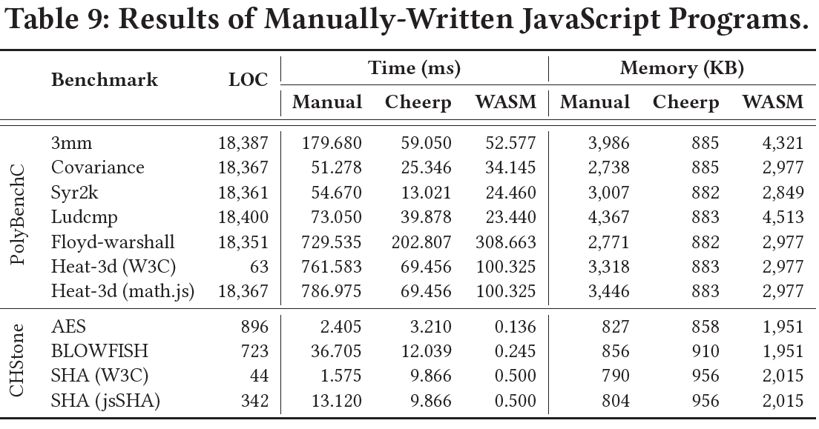
Manually-Written JavaScript
Compared to Cheerp-generated JavaScript versions, most manually written programs have more page load time (2.31x) and consume more memory (2.23x)
Compared to Cheerp-generated Wasm versions, most manually written programs have more page load time (6.64x) but consume less memory (0.72x)

Slide 31
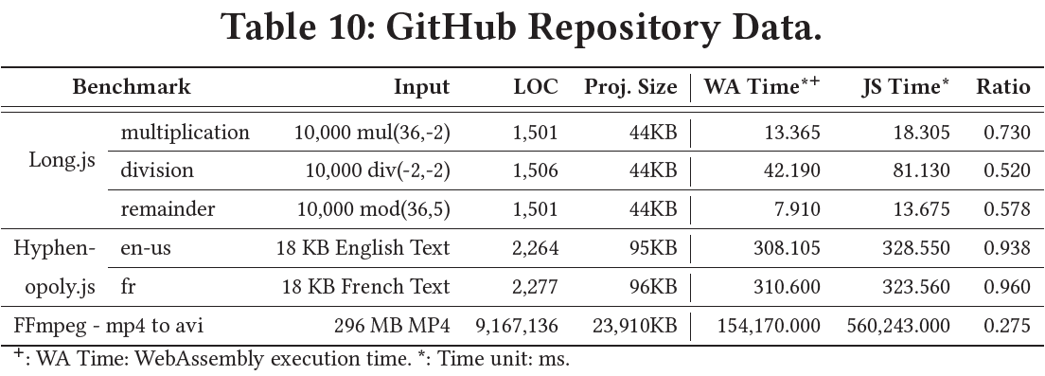
Real-world Applications
WebAssembly outperforms JavaScript for all three real-world applications

Slide 32
Takeaways
JIT optimization has a significant impact on JavaScript performance. However, no substantial performance increase for WebAssembly with JIT on both Chrome and Firefox.
WebAssembly uses significantly more memory than JavaScript on Chrome, Firefox, and Edge.
WebAssembly compilers’ optimizations are not tailored for WebAssembly. These optimizations often become ineffective for WebAssembly, leading to counter-intuitive results.
The runtime performance of WebAssembly on Chrome, Firefox, and Edge browsers varies between desktop or mobile platforms. On desktop, Firefox executes WebAssembly faster than other browsers. On mobile devices, Edge outperforms other browsers for WebAssembly.

Slide 33
Limitation and Future Work
Threats to validity
Representativeness of benchmarks: limited to PolyBenchC and CHStone
Generalization of results: limited to specific browser versions
Future work
Extend to more complex benchmarks: requiring support of compilers
Improve optimization techniques on Wasm: optimizations of browsers and compilers

Slide 34
References
[1] Andreas Haas et al. 2017. Bringing the web up to speed with WebAssembly. PLDI 2017. Association for Computing Machinery, New York, NY, USA, 185–200.
[2] https://webassembly.org/
[3] https://w3techs.com/technologies/overview/client_side_language
[4] https://medium.com/samsung-internet-dev/performance-testing-web-assembly-vs-javascript-e07506fd5875
[5] https://stackoverflow.com/questions/46331830/why-is-my-webassembly-function-slower-than-the-javascript-equivalent/46500236#46500236
[6] https://blog.sqreen.com/webassembly-performance/
[7] Abhinav Jangda et al. 2019. Not so fast: analyzing the performance of webassembly vs. native code. In 2019 {USENIX} Annual Technical Conference ({USENIX} {ATC} 19). 107–120.
[8] Prabhjot Sandhu et al. 2018. Sparse matrices on the web: Characterizing the performance and optimal format selection of sparse matrix-vector multiplication in JavaScript and WebAssembly. In Proceedings of the 15th International Conference on Managed Languages & Runtimes. 1–13.

Slide 35
THANK YOU FOR WATCHING!
Q & A

