Slide 1
Blockchain Diagram
Fade in and move up
Zoom in
Block_x
Block_x
Block_x
Block_x
Fade in and move up
Block_x
zoom in / zoom out
horizontal scroll
contextmenu: basic info
Addr code
From
To
Detail: route to detail page, traditional tx detail page.

Slide 2
Blockchain info Table
On the right of Blockchain Diagram
Maybe not a table, just a form layout content?
Height:
Fork:
Last update:
more...
80
0
2022-08-31/09:18
...

Slide 3
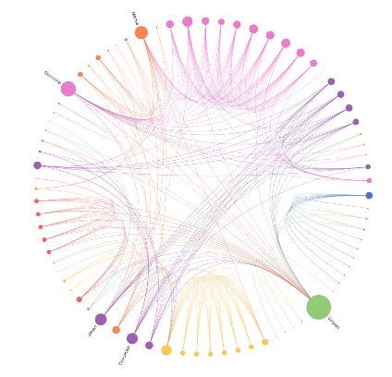
Swarm Diagram
At the bottom of Blockchain Diagram
Tx、AFW、cochain, three kinds of block
Default
Multiple(three with ...) `clusters` under Blockchain Diagram
Multiple lines trailing betweens nodes
Generate block to the blockchain
Zoom in
Default: Slow mode available.
Slow mode
New messages in a queue
Trailing slowly.
Single block mode available.
Reset: to default
Single block mode
Emphasis a random block’s all message, present an animation.
tx

Slide 4
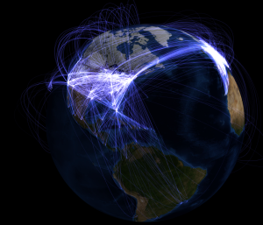
Network Diagram
A new Page
Gray background, simple globe.
Drag to rotate

Slide 5
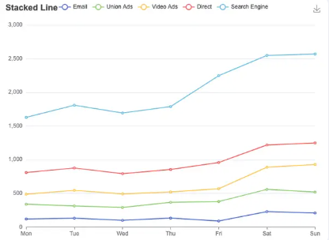
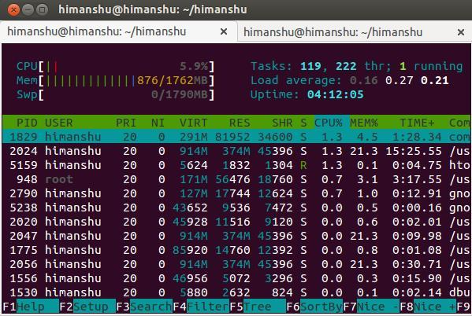
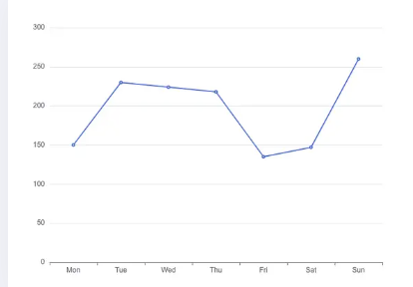
Network Performance Charts
HTop table or Stacked line chart : On the right of the Network Diagram
Multiple line charts: a new Page
or
stack line chart
or
multiple line charts?

Slide 6
Draft page 1
Height:
Fork:
Last update:
more...
80
0
2022-08-31/09:18
...
……

Slide 7
Draft page 2

