Slide 1
W3 POC

Slide 2
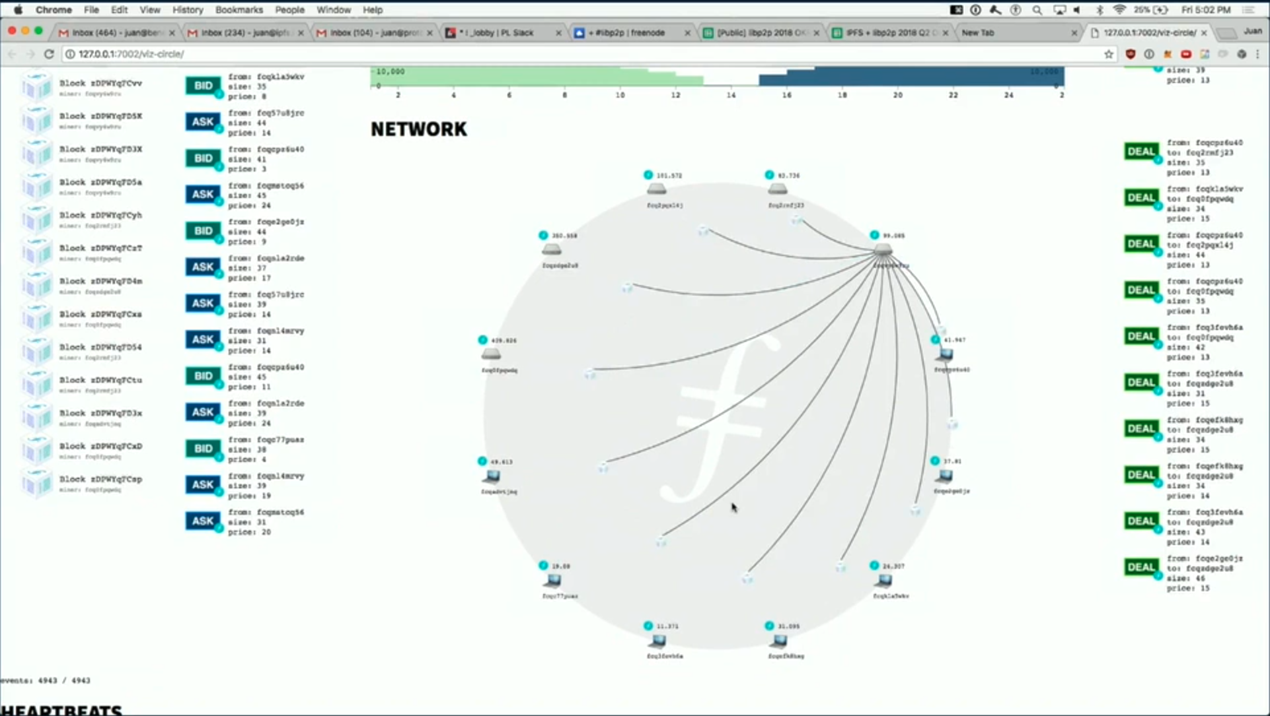
⭐️POC可视化实现重点页
In W3, we defeat this by introduce a two-stages mint process. Instead of making a node solely by a node in a traditional blockchain , each block of W3 is made by multiple randomly selected nodes in two stages – the collecting stage and the witness and mint stage.
In the collecting stage a randomly selected node collects enough transactions and the broadcast a block proposal with them to the network, and then the randomly selected witnesses verify the block proposal, maybe in multiple rounds by the protocol's definition, finally the valid block proposal will be minted into a block appended to the blockchain.
Chain
Block
Network
BP
【Screen video shows W3 POC‘s simulation of a two-stage mint process, with a PPT animation of tx → bp → block → chain 】
Swarm Diagram + Blockchain Diagram

Slide 3
⭐️POC可视化实现重点页
Chain
Block
Network
BP
In W3, we defeat this by introduce a two-stages mint process. Instead of making a node solely by a node in a traditional blockchain , each block of W3 is made by multiple randomly selected nodes in two stages – the collecting stage and the witness and mint stage.
In the collecting stage a randomly selected node collects enough transactions and the broadcast a block proposal with them to the network, and then the randomly selected witnesses verify the block proposal, maybe in multiple rounds by the protocol's definition, finally the valid block proposal will be minted into a block appended to the blockchain.
【Screen video shows W3 POC‘s simulation of a two-stage mint process, with a PPT animation of tx → bp → block → chain 】
Swarm Diagram + Blockchain Diagram

Slide 4
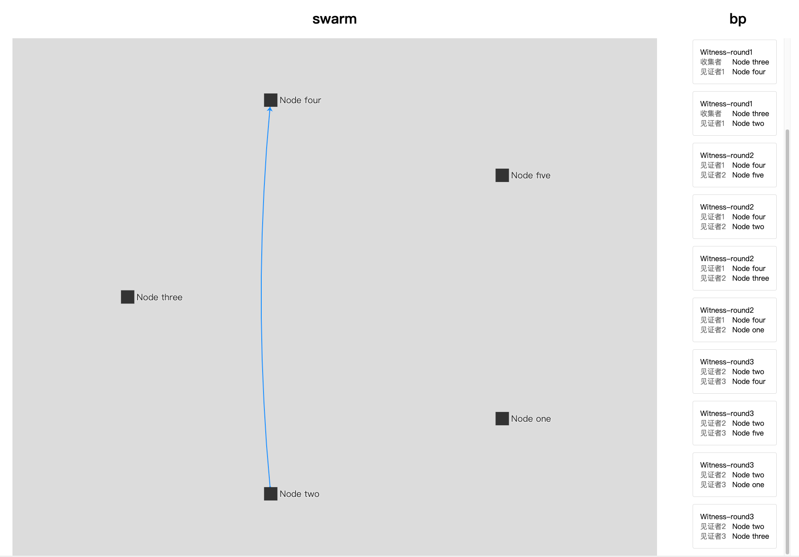
TX
TX
TX
BP
TX
BP
BP
Bk
Bk
Fk
Fk
BP
TX

Slide 5


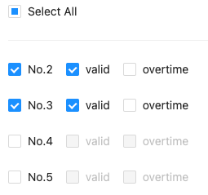



Control Simulator
Network
Type
From
To
Verify
Chain
Event

Slide 6
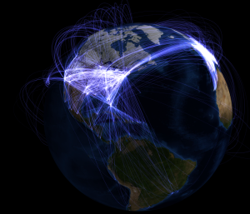
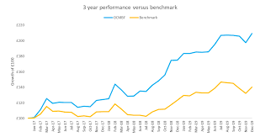
⭐️POC可视化实现重点页
Network
配置面板：节点数、TPS……
We can setup the testnet with the scale of the Ethereum, that is 1,000+ nodes, and its latency within a page swarm is 20ms, and 100ms among page swarms. If we feed it with a 15 TPS transactions throughput, we can see the blocks minted and the chain is getting longer. The memory, cpu time and energy consumption are also showing and compared.
Performance
【Screenshot video shows a large-scale testnet】
Network Diagram + Performance Chart （多页构成大网络, zoom-in 主页面）
配置网络
启动网络
观察网链性能（链生成一个新块）：tx TPS、block BPS、fork changes FP 录制加速（生成一个块 1000txs，大约要1分钟）
观察资源消耗：cpu、memory、bandwidth、energy（PPT和enthereum的对比）

Slide 7
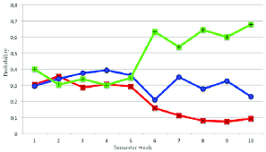
⭐️POC可视化实现重点页
Network
配置面板：节点数、TPS、attack……
On the security tab of W3 POC we can simulate different kinds of attacks to verify the security of the W3 protocol.
Theoretically a W3 chain should be immune from a race or finney attack , and very unlikely be a victim of a sybil attack. ,
We are still working on this, let's issue a sybil attack to the testnet with about 30% forged accounts, and the result show the probability of success is 10^-15, and that means if the bad guy attacks a W3 network with size like Ethereum network, he may have a success in about 1.4 billion years. , .....
Attack
Performance
【Screenshot video shows a large-scale testnet】
Network Diagram + Attack Chart（faked ratio of messages/tx/bp/bp_w1/bp_w2/block, fork_height distribution, Probability of Attack Success）
展示攻击窗口（选择攻击类型，配置发起攻击）
发起Sybil攻击
观察Attack Chart
强调PAS in years（1.4billion）或许用PPT动画

Slide 8
Blockchain Diagram: 两阶段铸造
功能
显示两阶段铸造（chain）
链：block（收集者、见证者、通知者/采纳者数量）、fork
链的变化（fork，changeFork）
block浏览器：浏览block详情

Slide 9
Network Diagram: 性能与资源消耗
功能
显示两阶段铸造（chain）
链：block（收集者、见证者、通知者/采纳者数量）、fork
链的变化（fork，changeFork）
block浏览器：浏览block详情

