Slide 1
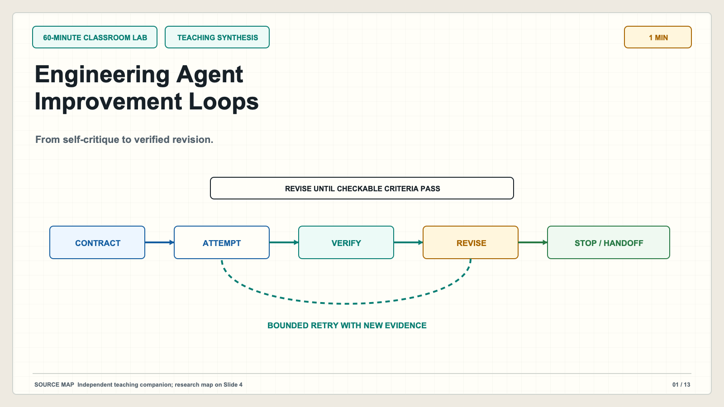
Notes:
# Slide 1: Engineering Agent Improvement Loops ## Production method Original 1600x900 local SVG rendered to PNG for exact text fidelity. ## Claim calibration - Claim type: TEACHING SYNTHESIS - Evidence map: Independent teaching companion; research map on Slide 4 - This is an independent teaching companion, not a reproduction of a paper figure. ## On-slide content - Stage: 60-minute classroom lab - Headline: Engineering Agent Improvement Loops - Subtitle: From self-critique to verified revision. - Class time: 1 min ## Teaching objective Establish the lesson promise and the evidence-first principle. ## Accessibility description A bounded loop moves from contract to attempt, verification, revision, and human handoff. Labels repeat all color-coded meaning. ## Speaker notes (1 min) Today we will not learn a magic prompt. We will learn how to decide whether an agent should iterate at all, how to make errors visible, and how to stop. The viral idea is to ask a model to revise until it awards itself 95 points. That can produce a more polished answer, but the score is not proof. Our replacement principle is simple: revise until externally checkable criteria pass, or hand the task to a person when evidence or authority runs out. The first twenty-eight minutes build the framework and one worked case. The next twenty-two minutes compare three workflows. The final ten minutes assess the evidence and transfer the pattern to a new task.

Slide 2
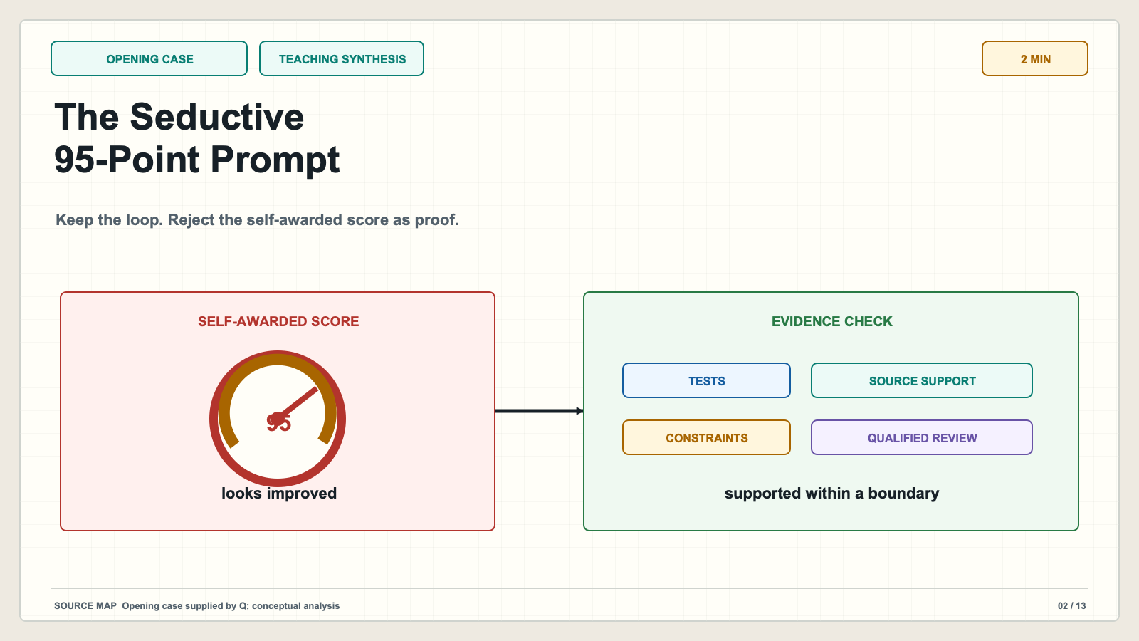
Notes:
# Slide 2: The Seductive 95-Point Prompt ## Production method Original 1600x900 local SVG rendered to PNG for exact text fidelity. ## Claim calibration - Claim type: TEACHING SYNTHESIS - Evidence map: Opening case supplied by Q; conceptual analysis - This is an independent teaching companion, not a reproduction of a paper figure. ## On-slide content - Stage: opening case - Headline: The Seductive 95-Point Prompt - Subtitle: Keep the loop. Reject the self-awarded score as proof. - Class time: 2 min ## Teaching objective Separate useful iterative revision from unsupported certification. ## Accessibility description A self-score gauge is contrasted with an evidence checklist. Labels repeat all color-coded meaning. ## Speaker notes (2 min) The prompt contains a real design pattern: define criteria, draft, critique, revise, and repeat. The weak part is the stopping signal. A model can raise its own score because wording improved, because it adapted to its rubric, or simply because the prompt asks for progress. None of those outcomes establishes truth. Treat self-critique as a way to propose defects. Treat tests, source support, calculations, explicit constraints, and qualified review as evidence. The important distinction is between an output that looks better and an output whose relevant claims or behavior have been checked.

Slide 3
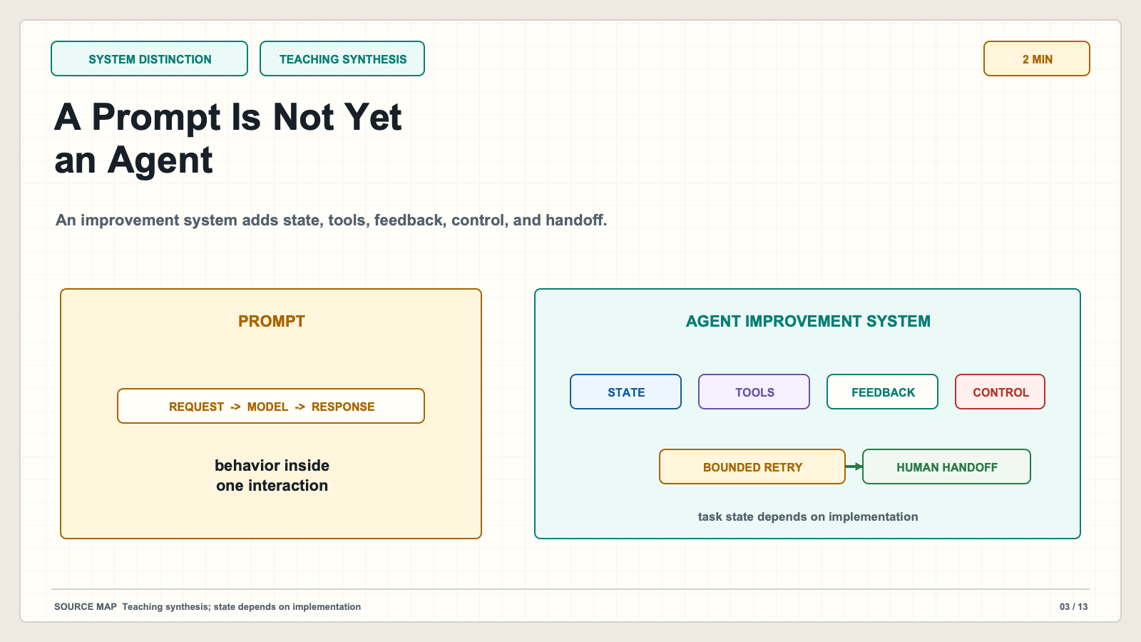
Notes:
# Slide 3: A Prompt Is Not Yet an Agent ## Production method Original 1600x900 local SVG rendered to PNG for exact text fidelity. ## Claim calibration - Claim type: TEACHING SYNTHESIS - Evidence map: Teaching synthesis; state depends on implementation - This is an independent teaching companion, not a reproduction of a paper figure. ## On-slide content - Stage: system distinction - Headline: A Prompt Is Not Yet an Agent - Subtitle: An improvement system adds state, tools, feedback, control, and handoff. - Class time: 2 min ## Teaching objective Define the system properties that turn a request into a bounded agent loop. ## Accessibility description One-shot prompt flow beside a multi-step agent system with optional task state. Labels repeat all color-coded meaning. ## Speaker notes (2 min) A prompt requests behavior within an interaction. An agent system may preserve task or session state across steps through files, traces, orchestration, tool context, or memory. It can take actions, observe results, and follow software-owned stopping and handoff rules. State is not automatic, and persistence across sessions is a separate design choice. The benefit is not autonomy by itself. The benefit is that the system can collect better evidence, connect feedback to a specific defect, and control what happens next.

Slide 4
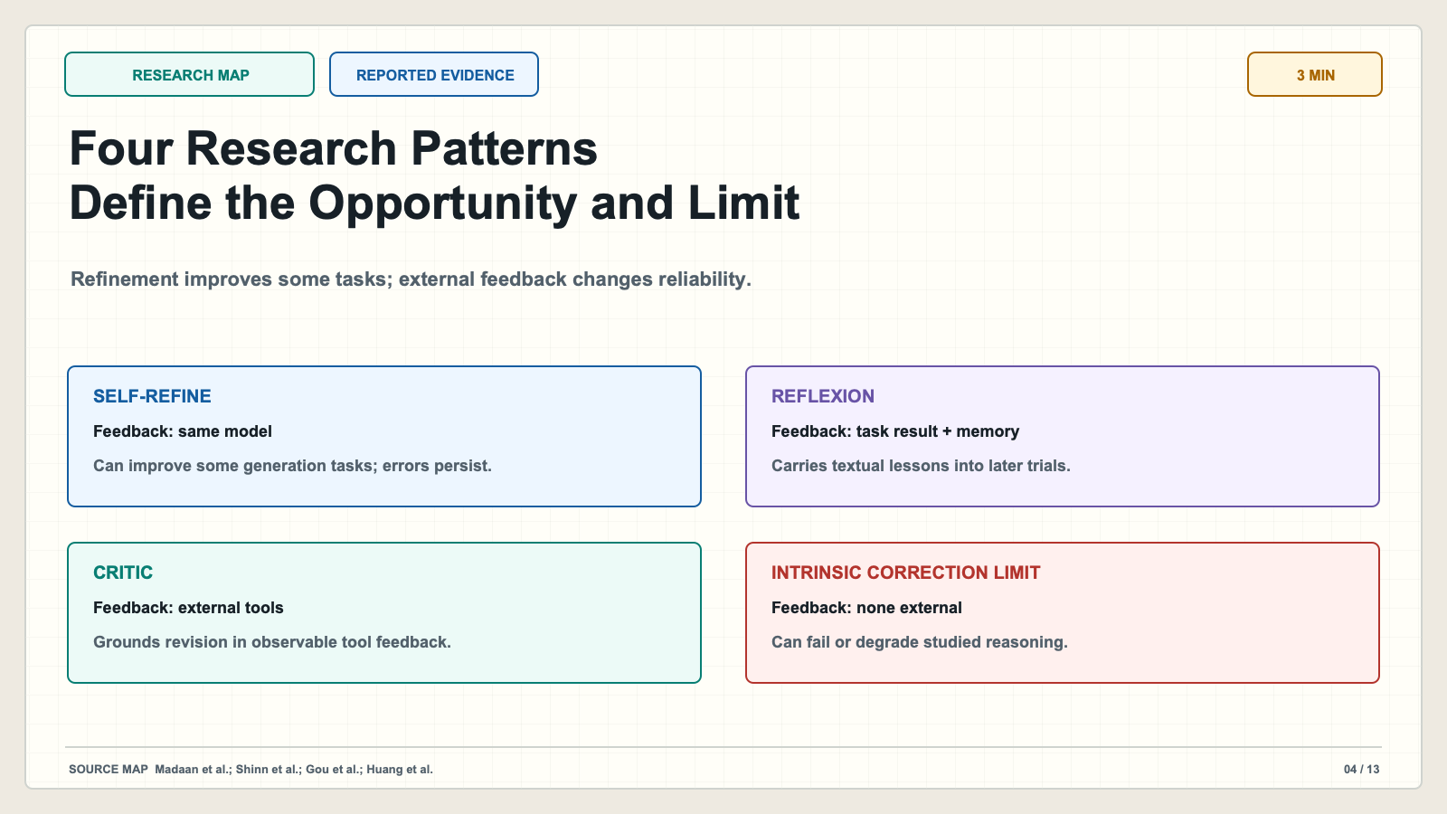
Notes:
# Slide 4: Four Research Patterns Define the Opportunity and Limit ## Production method Original 1600x900 local SVG rendered to PNG for exact text fidelity. ## Claim calibration - Claim type: REPORTED EVIDENCE - Evidence map: Madaan et al.; Shinn et al.; Gou et al.; Huang et al. - This is an independent teaching companion, not a reproduction of a paper figure. ## On-slide content - Stage: research map - Headline: Four Research Patterns Define the Opportunity and Limit - Subtitle: Refinement improves some tasks; external feedback changes reliability. - Class time: 3 min ## Teaching objective Ground the teaching pattern in primary research without overgeneralizing. ## Accessibility description Four research cards compare feedback source, persistence, and main lesson. Labels repeat all color-coded meaning. ## Speaker notes (3 min) Self-Refine uses the same model to generate, critique, and revise. The paper reported improvements on several preference and constrained-generation tasks, but almost no math gain in its reported table; external oracle feedback helped more. Reflexion converts task feedback into a textual lesson retained for later trials. CRITIC uses external tools to provide stronger verification signals. Huang and colleagues studied intrinsic self-correction and found that reconsideration without external feedback did not reliably improve reasoning and could degrade it. These are results from particular models and benchmarks. They do not guarantee classroom or high-stakes performance.

Slide 5
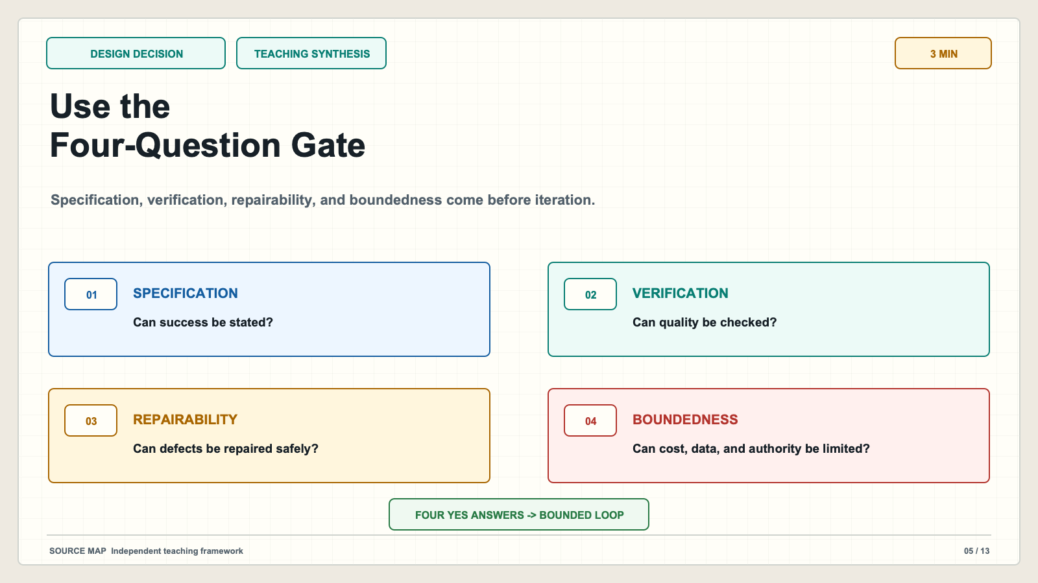
Notes:
# Slide 5: Use the Four-Question Gate ## Production method Original 1600x900 local SVG rendered to PNG for exact text fidelity. ## Claim calibration - Claim type: TEACHING SYNTHESIS - Evidence map: Independent teaching framework - This is an independent teaching companion, not a reproduction of a paper figure. ## On-slide content - Stage: design decision - Headline: Use the Four-Question Gate - Subtitle: Specification, verification, repairability, and boundedness come before iteration. - Class time: 3 min ## Teaching objective Give students a preflight decision for whether an agent loop is appropriate. ## Accessibility description Four labeled gates lead either to a bounded loop or human-led assistance. Labels repeat all color-coded meaning. ## Speaker notes (3 min) Before building the loop, ask four questions. Can the desired result be specified? Can quality be checked independently of the draft's confidence? Can a detected defect be repaired safely? Can attempts, cost, data exposure, and authority be bounded? If specification or verification is weak, the agent may assist exploration but should not certify completion. If repairability or boundedness is weak, narrow the task and keep a person in control. This gate prevents us from treating every difficult problem as a request for more autonomous retries.

Slide 6
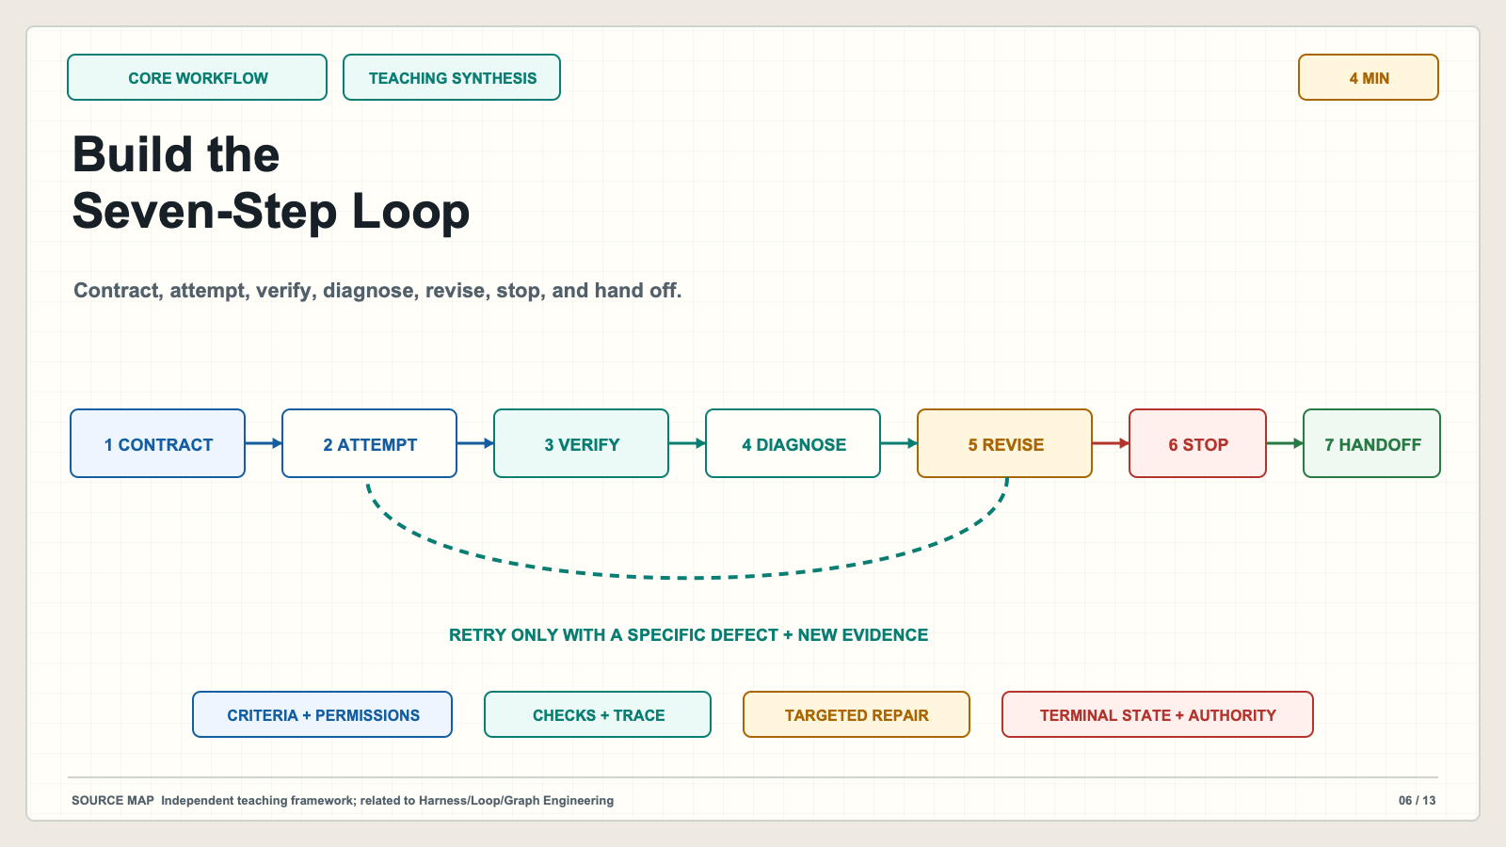
Notes:
# Slide 6: Build the Seven-Step Loop ## Production method Original 1600x900 local SVG rendered to PNG for exact text fidelity. ## Claim calibration - Claim type: TEACHING SYNTHESIS - Evidence map: Independent teaching framework; related to Harness/Loop/Graph Engineering - This is an independent teaching companion, not a reproduction of a paper figure. ## On-slide content - Stage: core workflow - Headline: Build the Seven-Step Loop - Subtitle: Contract, attempt, verify, diagnose, revise, stop, and hand off. - Class time: 4 min ## Teaching objective Teach the complete workflow and the evidence carried across each transition. ## Accessibility description Seven nodes form a bounded improvement trajectory with one retry edge. Labels repeat all color-coded meaning. ## Speaker notes (4 min) First, the contract defines the goal, constraints, allowed tools, evidence, budget, and human authority. Second, the agent produces an inspectable attempt. Third, verification runs checks that can reveal task-relevant defects. Fourth, diagnosis ties each failure to evidence and a location. Fifth, revision changes only defects supported by that audit. Sixth, the system stops when checks pass, budget ends, progress stalls, evidence conflicts, or risk rises. Seventh, a person interprets ambiguity and authorizes consequential action. Preserve the criteria, attempt, checks, revision log, costs, unresolved uncertainty, and final decision. Without that trace, students cannot tell whether the loop improved the work or merely rewrote it.

Slide 7
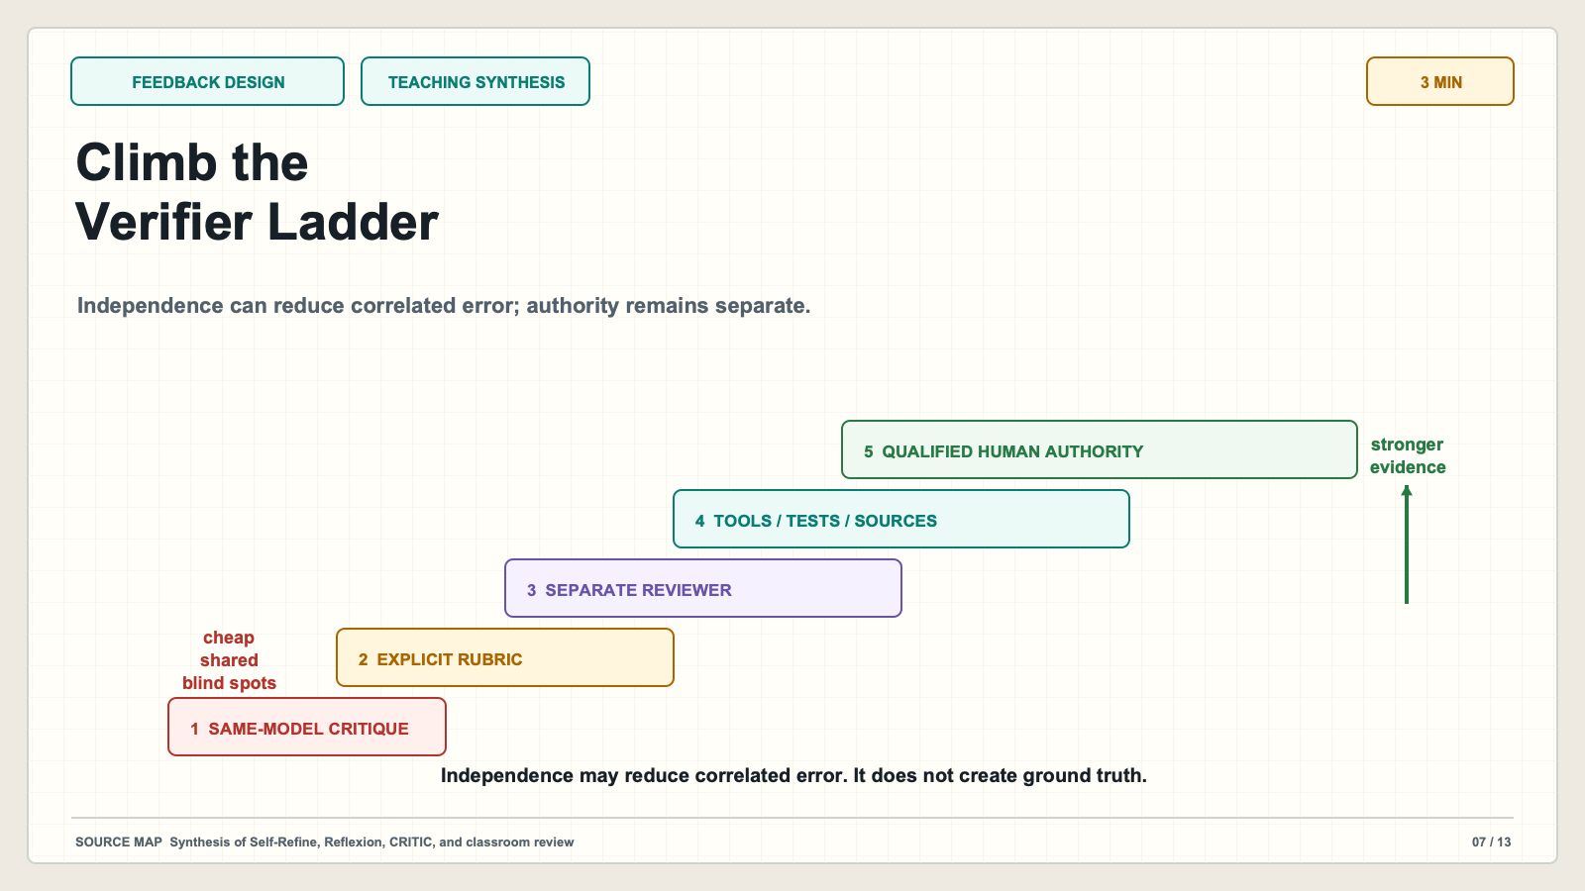
Notes:
# Slide 7: Climb the Verifier Ladder ## Production method Original 1600x900 local SVG rendered to PNG for exact text fidelity. ## Claim calibration - Claim type: TEACHING SYNTHESIS - Evidence map: Synthesis of Self-Refine, Reflexion, CRITIC, and classroom review - This is an independent teaching companion, not a reproduction of a paper figure. ## On-slide content - Stage: feedback design - Headline: Climb the Verifier Ladder - Subtitle: Independence can reduce correlated error; authority remains separate. - Class time: 3 min ## Teaching objective Match evidence strength to task risk and distinguish independence from authority. ## Accessibility description Five ascending verification levels from self-critique to qualified human authority. Labels repeat all color-coded meaning. ## Speaker notes (3 min) The cheapest verifier is same-model self-critique. It can catch omissions but shares blind spots. An explicit instructor rubric makes expectations concrete. A separate reviewer role or model adds another perspective, but independence is not truth; models can share assumptions and training biases. External tools, tests, calculations, and primary sources provide observable evidence, although their specifications may still be incomplete. Qualified human review interprets context and owns decisions. Strong workflows combine levels. The verifier should be chosen by the defect it must detect, not by how impressive the reviewer sounds.

Slide 8
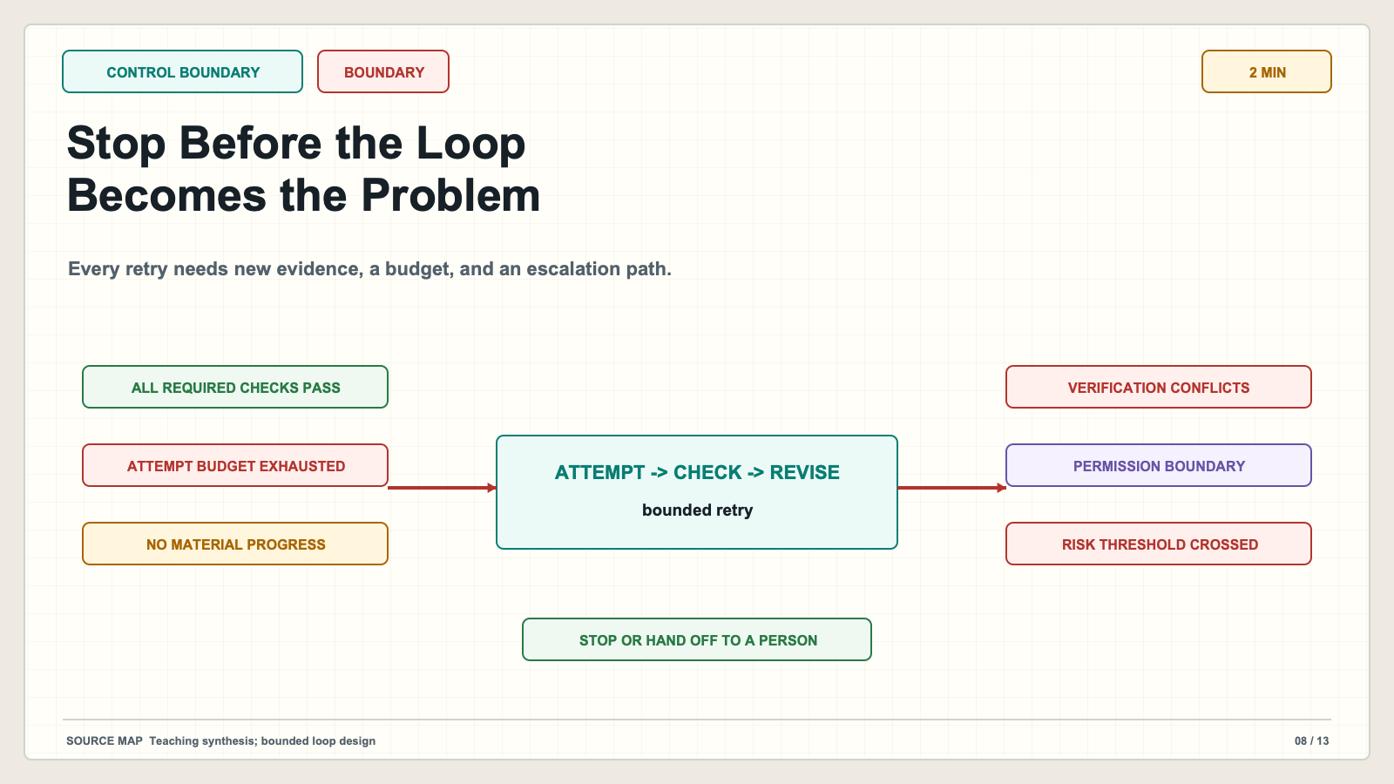
Notes:
# Slide 8: Stop Before the Loop Becomes the Problem ## Production method Original 1600x900 local SVG rendered to PNG for exact text fidelity. ## Claim calibration - Claim type: BOUNDARY - Evidence map: Teaching synthesis; bounded loop design - This is an independent teaching companion, not a reproduction of a paper figure. ## On-slide content - Stage: control boundary - Headline: Stop Before the Loop Becomes the Problem - Subtitle: Every retry needs new evidence, a budget, and an escalation path. - Class time: 2 min ## Teaching objective Make terminal conditions and human authority explicit. ## Accessibility description A retry loop is surrounded by five stop conditions and a human authority gate. Labels repeat all color-coded meaning. ## Speaker notes (2 min) More iterations can add cost and introduce new defects. Stop when all required checks pass, the attempt budget ends, the latest cycle creates no material improvement, verification signals conflict, or the next action crosses a permission or risk boundary. The loop should hand off before publishing, grading, spending money, contacting people, or changing consequential records unless explicit authority was granted. A numerical self-score is not an adequate terminal state unless the scoring system has been independently calibrated for this task.

Slide 9
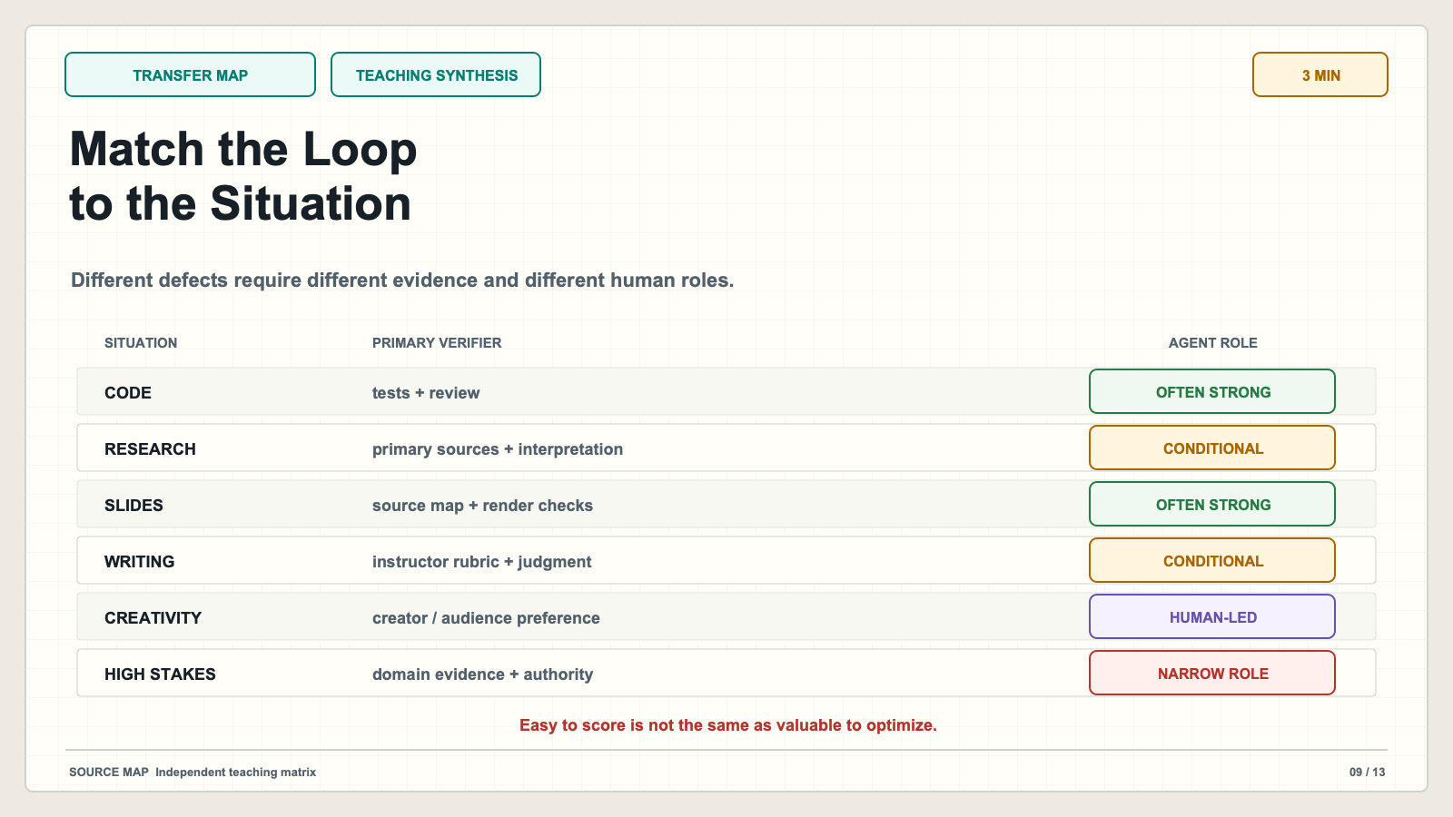
Notes:
# Slide 9: Match the Loop to the Situation ## Production method Original 1600x900 local SVG rendered to PNG for exact text fidelity. ## Claim calibration - Claim type: TEACHING SYNTHESIS - Evidence map: Independent teaching matrix - This is an independent teaching companion, not a reproduction of a paper figure. ## On-slide content - Stage: transfer map - Headline: Match the Loop to the Situation - Subtitle: Different defects require different evidence and different human roles. - Class time: 3 min ## Teaching objective Show where verified iteration is strong, conditional, or inappropriate for autonomous use. ## Accessibility description A six-row matrix covers code, research, slides, writing, creativity, and high-stakes decisions. Labels repeat all color-coded meaning. ## Speaker notes (3 min) Code is often a strong fit because executable tests expose behavior, although tests can be incomplete. Research summaries need primary-source checks and human interpretation of source quality. Slides can use source mapping, link checks, dimensions, and render inspection. Structured writing uses an instructor rubric but still needs judgment about meaning and voice. Creativity can benefit from alternatives and critique, but the creator retains taste and authorship. Sensitive or high-stakes decisions should keep the agent in a narrow analytical role under domain evidence and qualified human authority.

Slide 10
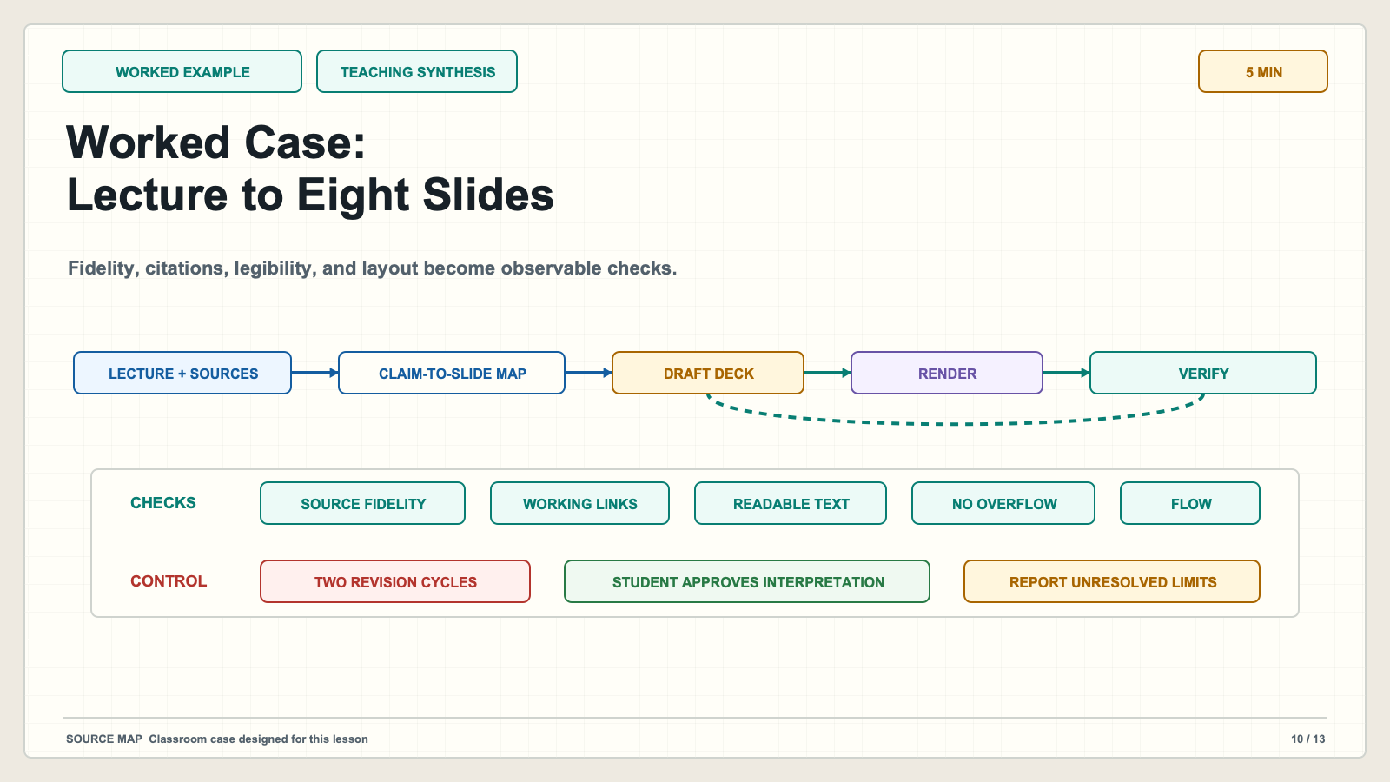
Notes:
# Slide 10: Worked Case: Lecture to Eight Slides ## Production method Original 1600x900 local SVG rendered to PNG for exact text fidelity. ## Claim calibration - Claim type: TEACHING SYNTHESIS - Evidence map: Classroom case designed for this lesson - This is an independent teaching companion, not a reproduction of a paper figure. ## On-slide content - Stage: worked example - Headline: Worked Case: Lecture to Eight Slides - Subtitle: Fidelity, citations, legibility, and layout become observable checks. - Class time: 5 min ## Teaching objective Trace one complete agent loop with realistic evidence and limits. ## Accessibility description A source-to-slide production pipeline with verification checkpoints and a two-cycle limit. Labels repeat all color-coded meaning. ## Speaker notes (5 min) The contract requires eight slides, source fidelity, coherent flow, working citations, readable text, and no overflow. The agent extracts claims, builds a source-to-slide map, drafts the narrative, renders the deck, then checks claims, links, dimensions, and visual collisions. Every failed criterion is recorded with a slide number and evidence. Only failed slides are revised, then rendered and inspected again. The loop stops when required checks pass or after two cycles. The student approves the final educational interpretation because no layout checker can determine whether the teaching argument is appropriate. Source checks reduce unsupported claims but do not guarantee complete or high-quality interpretation.

Slide 11
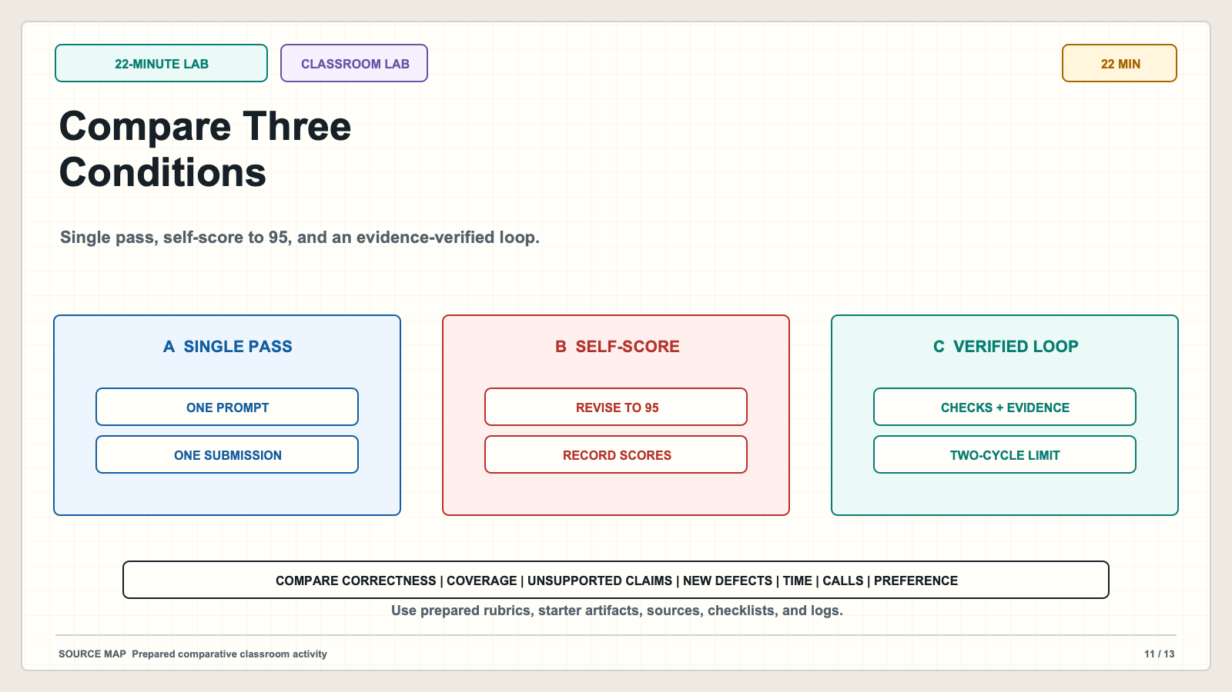
Notes:
# Slide 11: Compare Three Conditions ## Production method Original 1600x900 local SVG rendered to PNG for exact text fidelity. ## Claim calibration - Claim type: CLASSROOM LAB - Evidence map: Prepared comparative classroom activity - This is an independent teaching companion, not a reproduction of a paper figure. ## On-slide content - Stage: 22-minute lab - Headline: Compare Three Conditions - Subtitle: Single pass, self-score to 95, and an evidence-verified loop. - Class time: 22 min ## Teaching objective Let students measure the pattern rather than accept it on authority. ## Accessibility description Three experimental lanes feed one common evidence table and timeline. Labels repeat all color-coded meaning. ## Speaker notes (22 min) Teams receive the same task, source packet, rubric, starter artifact, checklist, and log template. Condition A submits one model response. Condition B uses the self-score-to-95 pattern and records each score and revision. Condition C uses the contract, evidence checks, targeted revision, two-cycle limit, and handoff. Compare objective correctness where ground truth exists, rubric coverage, unsupported claims, new defects, iterations, elapsed time, model or tool calls, and human preference. Do not assume Condition C wins. A simple task may not justify verification overhead, and an honest negative result is part of the lesson.

Slide 12
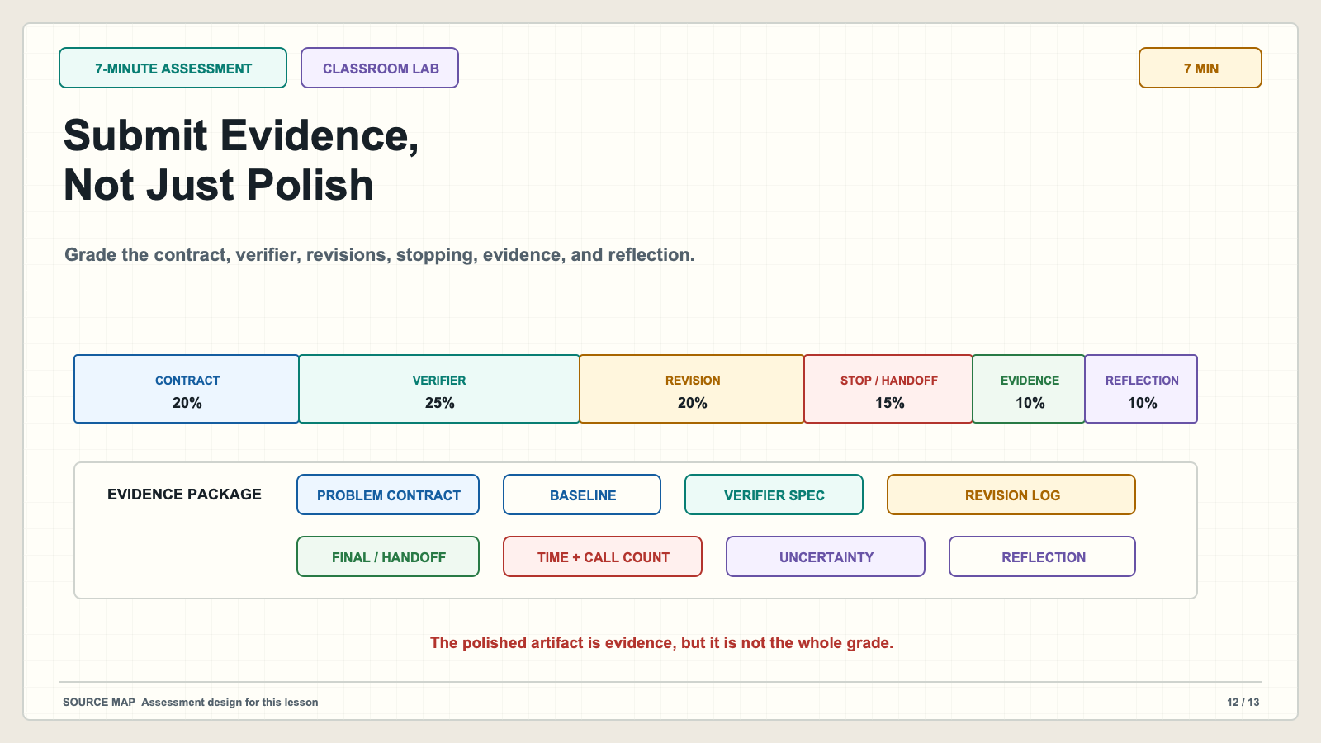
Notes:
# Slide 12: Submit Evidence, Not Just Polish ## Production method Original 1600x900 local SVG rendered to PNG for exact text fidelity. ## Claim calibration - Claim type: CLASSROOM LAB - Evidence map: Assessment design for this lesson - This is an independent teaching companion, not a reproduction of a paper figure. ## On-slide content - Stage: 7-minute assessment - Headline: Submit Evidence, Not Just Polish - Subtitle: Grade the contract, verifier, revisions, stopping, evidence, and reflection. - Class time: 7 min ## Teaching objective Make the student deliverables and grading priorities explicit. ## Accessibility description A weighted rubric and seven-item evidence package replace final-output-only grading. Labels repeat all color-coded meaning. ## Speaker notes (7 min) Students submit the problem contract, initial output, verifier specification, evidence, revision log, final result or handoff decision, cost and iteration counts, and reflection. The rubric assigns twenty percent to the contract, twenty-five to verifier design, twenty to revision discipline, fifteen to stop and handoff rules, ten to evaluation evidence, and ten to reflection. The final artifact matters, but it does not dominate the grade. Students should distinguish improved appearance from supported correctness and identify one situation where their loop should not be used.

Slide 13
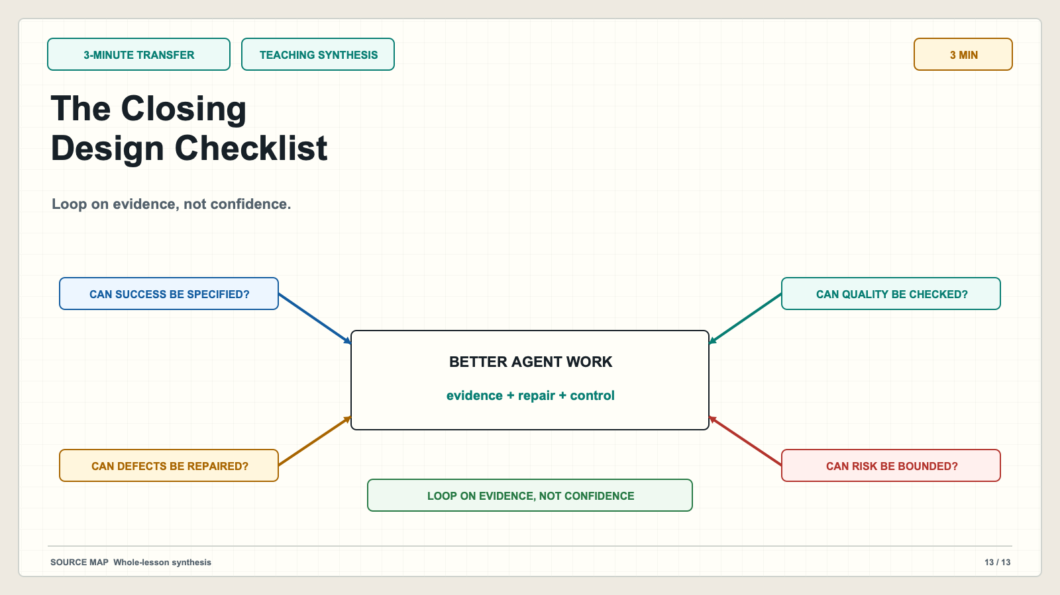
Notes:
# Slide 13: The Closing Design Checklist ## Production method Original 1600x900 local SVG rendered to PNG for exact text fidelity. ## Claim calibration - Claim type: TEACHING SYNTHESIS - Evidence map: Whole-lesson synthesis - This is an independent teaching companion, not a reproduction of a paper figure. ## On-slide content - Stage: 3-minute transfer - Headline: The Closing Design Checklist - Subtitle: Loop on evidence, not confidence. - Class time: 3 min ## Teaching objective Give students a reusable design and reflection checklist. ## Accessibility description Four suitability questions surround the evidence-first improvement equation. Labels repeat all color-coded meaning. ## Speaker notes (3 min) Before using an agent improvement loop, ask whether the result is specifiable, independently checkable, safely repairable, and bounded in cost, data, attempts, and authority. Then inspect the system: what evidence can expose defects, what changes after a failed check, when does the loop stop, and who owns the final decision? Better agent work comes from a clear contract, useful attempts, discriminating feedback, targeted repair, explicit stopping, and appropriate human authority. The transferable lesson is not to make an agent try harder. It is to engineer feedback that can prove something relevant and control what happens when it cannot.

