Slide 1
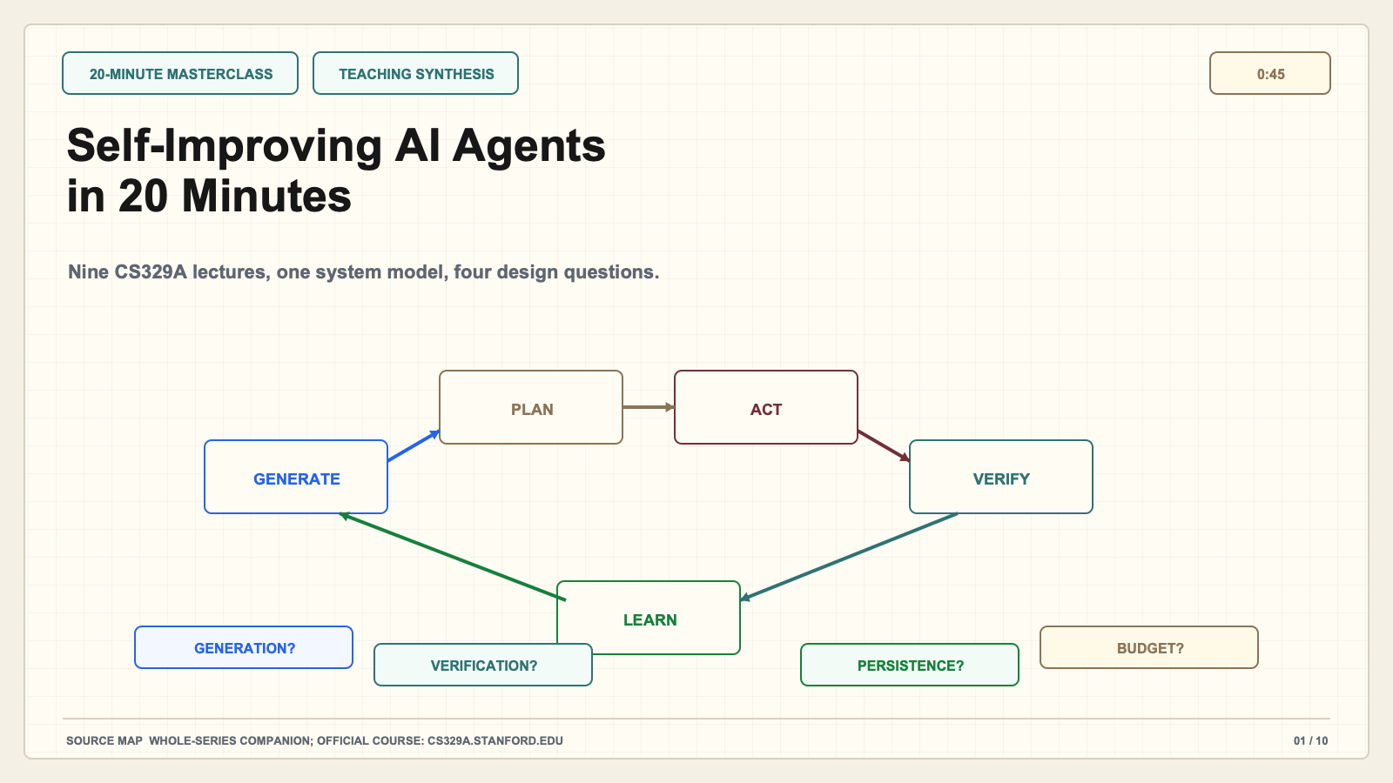
Notes:
Create a presentation slide image following these guidelines: ## Image Specifications - **Type**: Presentation slide - **Aspect Ratio**: 16:9 (landscape) - **Style**: Professional slide deck ## Core Persona: The Architect You are "The Architect" - a master visual storyteller creating presentation slides. Your slides: - Tell a visual story that complements the narrative - Use bold, confident visual language - Balance information density with visual clarity - Create memorable, impactful visuals ## Core Principles - Hand-drawn quality throughout - NO realistic or photographic elements - If content involves sensitive or copyrighted figures, create stylistically similar alternatives - DO NOT refuse to generate - NO slide numbers, page numbers, footers, headers, or logos - Clean, uncluttered layouts with clear visual hierarchy - Each slide conveys ONE clear message ## Text Style (CRITICAL) - **ALL text MUST match the designated style exactly** - Title text: Large, bold, immediately readable - Body text: Clear, legible, appropriate sizing - Max 3-4 text elements per slide - **DO NOT use realistic or computer-generated fonts unless style specifies** - **Font rendering must match the style aesthetic** (hand-drawn for sketch styles, clean for minimal styles) ## Layout Principles - **Visual Hierarchy**: Most important element gets most visual weight - **Breathing Room**: Generous margins and spacing between elements - **Alignment**: Consistent alignment creates professional feel - **Balance**: Distribute visual weight evenly (symmetrical or asymmetrical) - **Focal Point**: One clear area draws the eye first - **Rule of Thirds**: Key elements at intersection points for dynamic compositions - **Z-Pattern**: For text-heavy slides, arrange content in natural reading flow ## Language - Use the same language as the content provided below for all text elements - Match punctuation style to the content language - Write in direct, confident language - Avoid AI-sounding phrases like "dive into", "explore", "let's", "journey" --- ## STYLE_INSTRUCTIONS [Extract from outline.md - do NOT re-read style files] The STYLE_INSTRUCTIONS block from the outline contains: - Design Aesthetic - Background (Texture + Base Color) - Typography (Headlines + Body descriptions) - Color Palette (with hex codes) - Visual Elements - Density Guidelines - Style Rules (Do/Don't) Copy the entire `<STYLE_INSTRUCTIONS>...</STYLE_INSTRUCTIONS>` block from the outline here. --- ## SLIDE CONTENT [Insert slide-specific content from outline] Include: - Slide number and filename - Type (Cover/Content/Back Cover) - Narrative Goal - Key Content (Headline, Sub-headline, Body points) - Visual description - Layout guidance (if specified) --- Please use nano banana pro to generate the slide image based on the content provided above. --- # Slide 1: Self-Improving AI Agents in 20 Minutes ## Production method Original 1600x900 local SVG rendered to PNG for exact text fidelity. No copied Stanford frames, figures, logos, or paper graphics. ## Style Aged cream academic briefing, subtle engineering grid, near-black type, cobalt generation, teal verification, green persistence, warm-brown budget, maroon constraints, red risks, no gradients. ## Claim calibration - Claim type: TEACHING SYNTHESIS - This deck is an independent teaching companion. - Evidence map: Whole-series companion; official course: cs329a.stanford.edu ## On-slide content - Stage: 20-minute masterclass - Headline: Self-Improving AI Agents in 20 Minutes - Subtitle: Nine CS329A lectures, one system model, four design questions. - Planned speaking time: 0:45 ## Visual direction A bounded improvement loop surrounded by generation, verification, persistence, and budget questions. ## Teaching objective Set the promise and establish four questions for the entire lesson. ## Speaker notes (0:45) Welcome. In twenty minutes, I am not going to summarize nine lectures one by one. That would produce a list, not understanding. Instead, I will give you one system model and four questions that let you reconstruct the course. The questions are: where do useful alternatives come from, what verifies progress, what persists after the current run, and where does the system spend compute, time, human attention, and risk? The loop on this slide is our teaching synthesis, not a diagram quoted from Stanford. Use it as a map, then use the nine detailed lessons to inspect each component. By the end, you should be able to look at a product described as self-improving and ask what actually improved, what evidence supports that claim, and what can still fail.

Slide 2
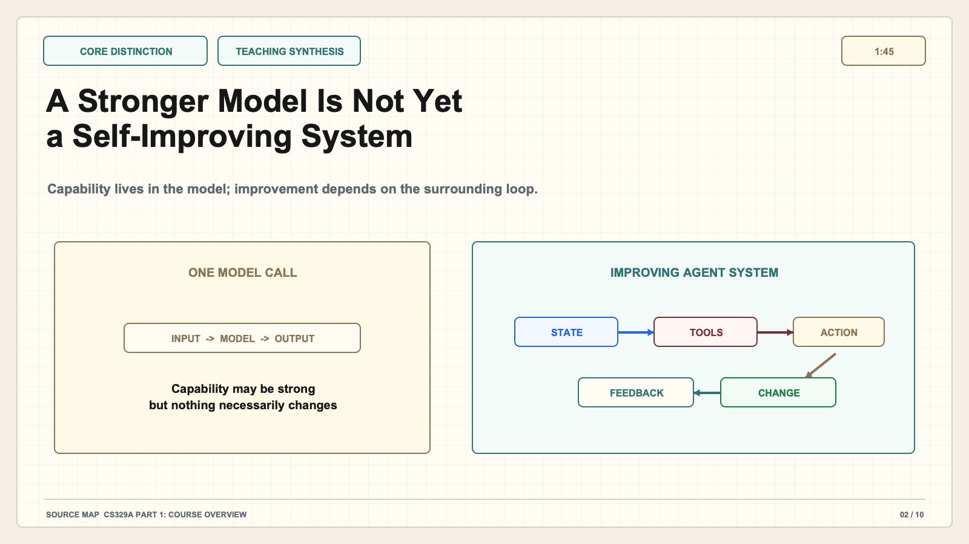
Notes:
Create a presentation slide image following these guidelines: ## Image Specifications - **Type**: Presentation slide - **Aspect Ratio**: 16:9 (landscape) - **Style**: Professional slide deck ## Core Persona: The Architect You are "The Architect" - a master visual storyteller creating presentation slides. Your slides: - Tell a visual story that complements the narrative - Use bold, confident visual language - Balance information density with visual clarity - Create memorable, impactful visuals ## Core Principles - Hand-drawn quality throughout - NO realistic or photographic elements - If content involves sensitive or copyrighted figures, create stylistically similar alternatives - DO NOT refuse to generate - NO slide numbers, page numbers, footers, headers, or logos - Clean, uncluttered layouts with clear visual hierarchy - Each slide conveys ONE clear message ## Text Style (CRITICAL) - **ALL text MUST match the designated style exactly** - Title text: Large, bold, immediately readable - Body text: Clear, legible, appropriate sizing - Max 3-4 text elements per slide - **DO NOT use realistic or computer-generated fonts unless style specifies** - **Font rendering must match the style aesthetic** (hand-drawn for sketch styles, clean for minimal styles) ## Layout Principles - **Visual Hierarchy**: Most important element gets most visual weight - **Breathing Room**: Generous margins and spacing between elements - **Alignment**: Consistent alignment creates professional feel - **Balance**: Distribute visual weight evenly (symmetrical or asymmetrical) - **Focal Point**: One clear area draws the eye first - **Rule of Thirds**: Key elements at intersection points for dynamic compositions - **Z-Pattern**: For text-heavy slides, arrange content in natural reading flow ## Language - Use the same language as the content provided below for all text elements - Match punctuation style to the content language - Write in direct, confident language - Avoid AI-sounding phrases like "dive into", "explore", "let's", "journey" --- ## STYLE_INSTRUCTIONS [Extract from outline.md - do NOT re-read style files] The STYLE_INSTRUCTIONS block from the outline contains: - Design Aesthetic - Background (Texture + Base Color) - Typography (Headlines + Body descriptions) - Color Palette (with hex codes) - Visual Elements - Density Guidelines - Style Rules (Do/Don't) Copy the entire `<STYLE_INSTRUCTIONS>...</STYLE_INSTRUCTIONS>` block from the outline here. --- ## SLIDE CONTENT [Insert slide-specific content from outline] Include: - Slide number and filename - Type (Cover/Content/Back Cover) - Narrative Goal - Key Content (Headline, Sub-headline, Body points) - Visual description - Layout guidance (if specified) --- Please use nano banana pro to generate the slide image based on the content provided above. --- # Slide 2: A Stronger Model Is Not Yet a Self-Improving System ## Production method Original 1600x900 local SVG rendered to PNG for exact text fidelity. No copied Stanford frames, figures, logos, or paper graphics. ## Style Aged cream academic briefing, subtle engineering grid, near-black type, cobalt generation, teal verification, green persistence, warm-brown budget, maroon constraints, red risks, no gradients. ## Claim calibration - Claim type: TEACHING SYNTHESIS - This deck is an independent teaching companion. - Evidence map: CS329A Part 1: Course Overview ## On-slide content - Stage: core distinction - Headline: A Stronger Model Is Not Yet a Self-Improving System - Subtitle: Capability lives in the model; improvement depends on the surrounding loop. - Planned speaking time: 1:45 ## Visual direction Side-by-side comparison of one model call and an agent system with state, tools, feedback, and change. ## Teaching objective Separate model capability from agent-system improvement. ## Speaker notes (1:45) Start with the most important distinction. A model maps an input to an output. A stronger model may know more, reason better, or follow instructions more reliably, but that alone does not make the surrounding application self-improving. An agent system adds state, tools, actions, observations, feedback, and some mechanism that changes later behavior. Imagine a student asking for help with a research question. A model can generate an answer. An agent system can search sources, record what it found, test whether citations support claims, revise weak sections, and preserve an approved research plan for the next session. The model is still central, but the quality of the result now depends on the loop around it. This matters because system failures can come from tool permissions, bad state, weak tests, or incorrect feedback even when the underlying model is capable. Conversely, a modest model can become more useful when the system allocates work and checks evidence well. Throughout the course, keep asking whether a reported gain is a model gain, a workflow gain, or a durable learning gain. Those are related, but they are not interchangeable.

Slide 3
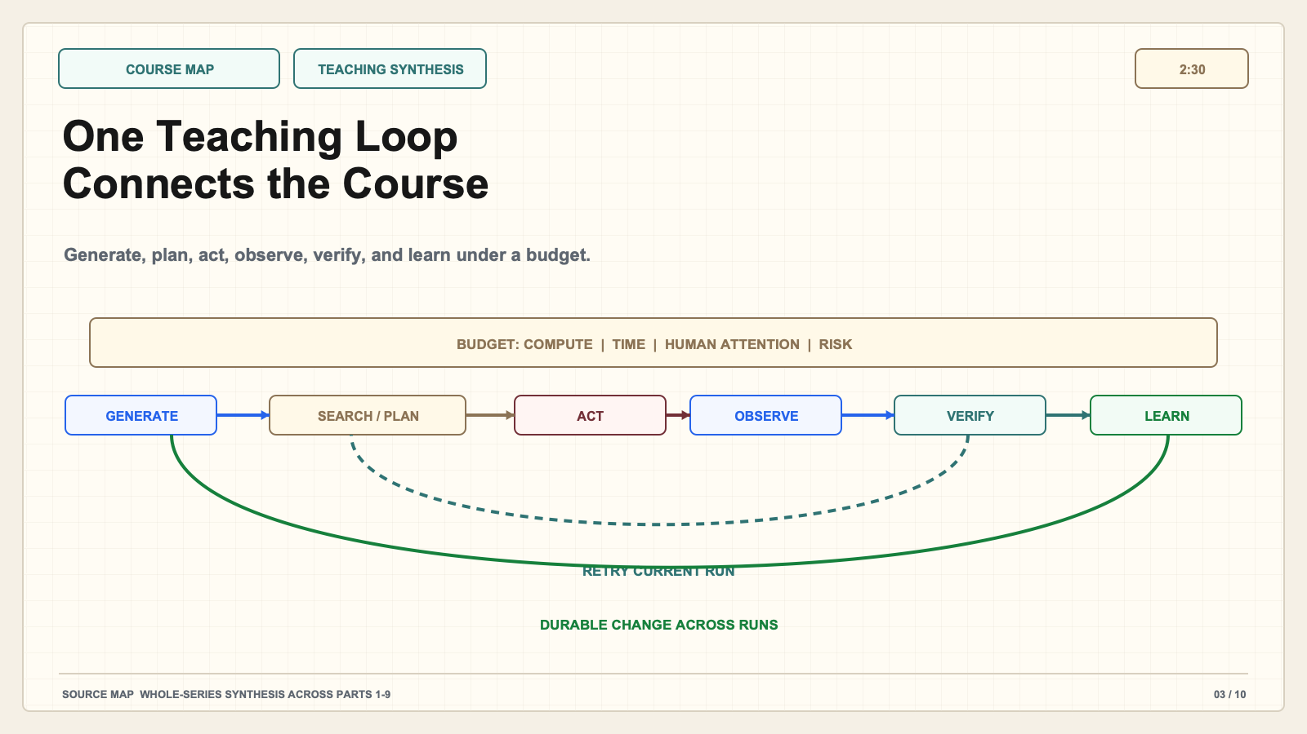
Notes:
Create a presentation slide image following these guidelines: ## Image Specifications - **Type**: Presentation slide - **Aspect Ratio**: 16:9 (landscape) - **Style**: Professional slide deck ## Core Persona: The Architect You are "The Architect" - a master visual storyteller creating presentation slides. Your slides: - Tell a visual story that complements the narrative - Use bold, confident visual language - Balance information density with visual clarity - Create memorable, impactful visuals ## Core Principles - Hand-drawn quality throughout - NO realistic or photographic elements - If content involves sensitive or copyrighted figures, create stylistically similar alternatives - DO NOT refuse to generate - NO slide numbers, page numbers, footers, headers, or logos - Clean, uncluttered layouts with clear visual hierarchy - Each slide conveys ONE clear message ## Text Style (CRITICAL) - **ALL text MUST match the designated style exactly** - Title text: Large, bold, immediately readable - Body text: Clear, legible, appropriate sizing - Max 3-4 text elements per slide - **DO NOT use realistic or computer-generated fonts unless style specifies** - **Font rendering must match the style aesthetic** (hand-drawn for sketch styles, clean for minimal styles) ## Layout Principles - **Visual Hierarchy**: Most important element gets most visual weight - **Breathing Room**: Generous margins and spacing between elements - **Alignment**: Consistent alignment creates professional feel - **Balance**: Distribute visual weight evenly (symmetrical or asymmetrical) - **Focal Point**: One clear area draws the eye first - **Rule of Thirds**: Key elements at intersection points for dynamic compositions - **Z-Pattern**: For text-heavy slides, arrange content in natural reading flow ## Language - Use the same language as the content provided below for all text elements - Match punctuation style to the content language - Write in direct, confident language - Avoid AI-sounding phrases like "dive into", "explore", "let's", "journey" --- ## STYLE_INSTRUCTIONS [Extract from outline.md - do NOT re-read style files] The STYLE_INSTRUCTIONS block from the outline contains: - Design Aesthetic - Background (Texture + Base Color) - Typography (Headlines + Body descriptions) - Color Palette (with hex codes) - Visual Elements - Density Guidelines - Style Rules (Do/Don't) Copy the entire `<STYLE_INSTRUCTIONS>...</STYLE_INSTRUCTIONS>` block from the outline here. --- ## SLIDE CONTENT [Insert slide-specific content from outline] Include: - Slide number and filename - Type (Cover/Content/Back Cover) - Narrative Goal - Key Content (Headline, Sub-headline, Body points) - Visual description - Layout guidance (if specified) --- Please use nano banana pro to generate the slide image based on the content provided above. --- # Slide 3: One Teaching Loop Connects the Course ## Production method Original 1600x900 local SVG rendered to PNG for exact text fidelity. No copied Stanford frames, figures, logos, or paper graphics. ## Style Aged cream academic briefing, subtle engineering grid, near-black type, cobalt generation, teal verification, green persistence, warm-brown budget, maroon constraints, red risks, no gradients. ## Claim calibration - Claim type: TEACHING SYNTHESIS - This deck is an independent teaching companion. - Evidence map: Whole-series synthesis across Parts 1-9 ## On-slide content - Stage: course map - Headline: One Teaching Loop Connects the Course - Subtitle: Generate, plan, act, observe, verify, and learn under a budget. - Planned speaking time: 2:30 ## Visual direction Linear agent loop with retry and durable-learning branches plus a budget boundary. ## Teaching objective Teach the loop while preserving its status as an abstraction. ## Speaker notes (2:30) Here is the map for the complete course. First, the system generates candidate actions, answers, plans, or hypotheses. Second, it spends inference-time compute on search or planning. Third, it acts through a tool or environment. Fourth, it observes what happened. Fifth, it verifies whether the observation is evidence of progress. Finally, it may learn by updating memory, data, tools, artifacts, a policy, or model weights. Notice two return paths. Verification can send the current run backward for another attempt. Durable learning can change what the system does in a later run. Those are different timescales. Also notice the budget around the loop. Sampling one hundred answers, running tools, calling human reviewers, and retraining a model all consume different resources and create different risks. This loop is deliberately broad. Not every method in CS329A uses every stage, and Stanford does not present this exact diagram as the single canonical architecture. Its purpose is diagnostic. If someone says an agent improved, locate the change in the loop. Did generation become more diverse? Did planning allocate compute better? Did a verifier become more accurate? Did the system merely retry, or did something durable change? The rest of this deck examines the loop from left to right, then asks how to evaluate the whole system.

Slide 4
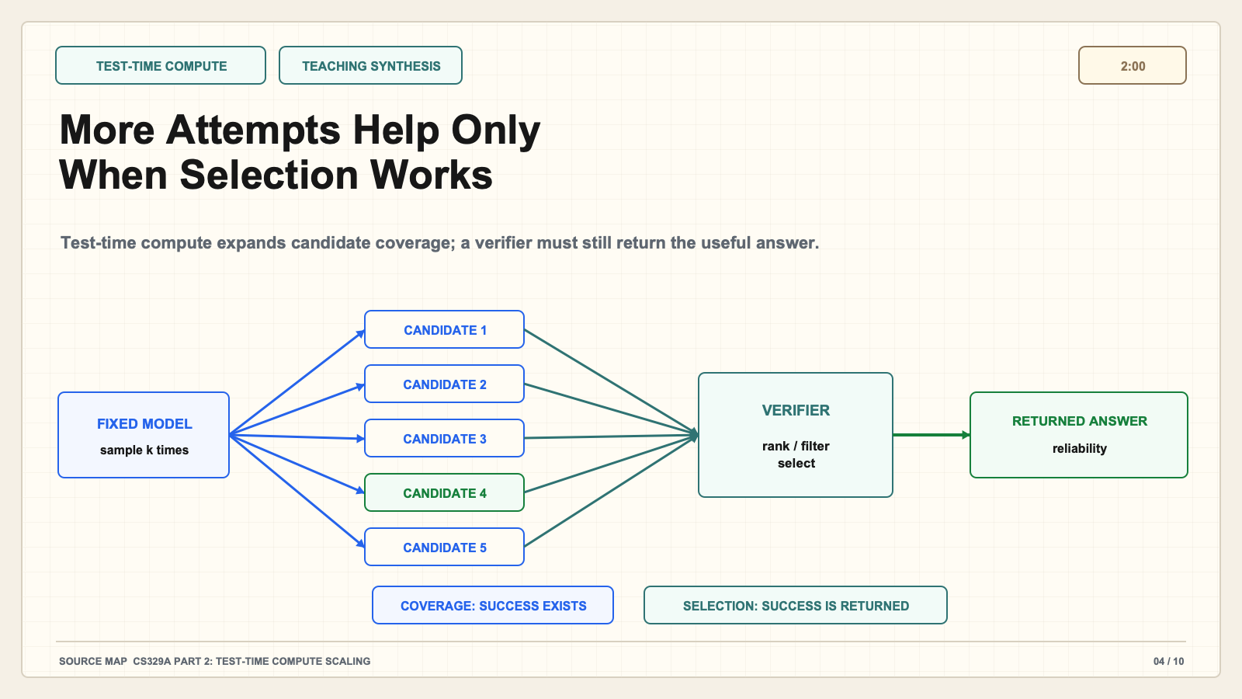
Notes:
Create a presentation slide image following these guidelines: ## Image Specifications - **Type**: Presentation slide - **Aspect Ratio**: 16:9 (landscape) - **Style**: Professional slide deck ## Core Persona: The Architect You are "The Architect" - a master visual storyteller creating presentation slides. Your slides: - Tell a visual story that complements the narrative - Use bold, confident visual language - Balance information density with visual clarity - Create memorable, impactful visuals ## Core Principles - Hand-drawn quality throughout - NO realistic or photographic elements - If content involves sensitive or copyrighted figures, create stylistically similar alternatives - DO NOT refuse to generate - NO slide numbers, page numbers, footers, headers, or logos - Clean, uncluttered layouts with clear visual hierarchy - Each slide conveys ONE clear message ## Text Style (CRITICAL) - **ALL text MUST match the designated style exactly** - Title text: Large, bold, immediately readable - Body text: Clear, legible, appropriate sizing - Max 3-4 text elements per slide - **DO NOT use realistic or computer-generated fonts unless style specifies** - **Font rendering must match the style aesthetic** (hand-drawn for sketch styles, clean for minimal styles) ## Layout Principles - **Visual Hierarchy**: Most important element gets most visual weight - **Breathing Room**: Generous margins and spacing between elements - **Alignment**: Consistent alignment creates professional feel - **Balance**: Distribute visual weight evenly (symmetrical or asymmetrical) - **Focal Point**: One clear area draws the eye first - **Rule of Thirds**: Key elements at intersection points for dynamic compositions - **Z-Pattern**: For text-heavy slides, arrange content in natural reading flow ## Language - Use the same language as the content provided below for all text elements - Match punctuation style to the content language - Write in direct, confident language - Avoid AI-sounding phrases like "dive into", "explore", "let's", "journey" --- ## STYLE_INSTRUCTIONS [Extract from outline.md - do NOT re-read style files] The STYLE_INSTRUCTIONS block from the outline contains: - Design Aesthetic - Background (Texture + Base Color) - Typography (Headlines + Body descriptions) - Color Palette (with hex codes) - Visual Elements - Density Guidelines - Style Rules (Do/Don't) Copy the entire `<STYLE_INSTRUCTIONS>...</STYLE_INSTRUCTIONS>` block from the outline here. --- ## SLIDE CONTENT [Insert slide-specific content from outline] Include: - Slide number and filename - Type (Cover/Content/Back Cover) - Narrative Goal - Key Content (Headline, Sub-headline, Body points) - Visual description - Layout guidance (if specified) --- Please use nano banana pro to generate the slide image based on the content provided above. --- # Slide 4: More Attempts Help Only When Selection Works ## Production method Original 1600x900 local SVG rendered to PNG for exact text fidelity. No copied Stanford frames, figures, logos, or paper graphics. ## Style Aged cream academic briefing, subtle engineering grid, near-black type, cobalt generation, teal verification, green persistence, warm-brown budget, maroon constraints, red risks, no gradients. ## Claim calibration - Claim type: TEACHING SYNTHESIS - This deck is an independent teaching companion. - Evidence map: CS329A Part 2: Test-Time Compute Scaling ## On-slide content - Stage: test-time compute - Headline: More Attempts Help Only When Selection Works - Subtitle: Test-time compute expands candidate coverage; a verifier must still return the useful answer. - Planned speaking time: 2:00 ## Visual direction Candidate fan-out feeding a verifier gate, with separate coverage and selected-answer outcomes. ## Teaching objective Separate candidate coverage from returned-answer reliability. ## Speaker notes (2:00) Test-time compute asks how a fixed model can spend more computation on one problem. The simplest method is repeated sampling: generate several candidates instead of one. Search methods add structure by expanding, scoring, and revisiting partial solutions. This can improve coverage, meaning that at least one correct or useful candidate appears in the set. But the deployed system must still select and return that candidate. These are two different measurements. Pass-at-k asks whether success exists somewhere among k attempts. Returned-answer reliability asks whether the verifier or selection rule actually chooses it. Consider five proposed fixes for a program. One is correct, so coverage looks good. If the test suite misses an edge case and ranks a superficially clean but wrong patch first, the user still receives the wrong answer. More sampling has increased opportunity without guaranteeing reliability. Compute allocation also should depend on difficulty. Easy problems may need one attempt; hard problems may justify search, stronger verification, or human review. The practical lesson is to report generation and selection separately. When someone says that more inference compute improved performance, ask how candidates were generated, how they were selected, and whether the result survives changes in the verifier or task distribution.

Slide 5
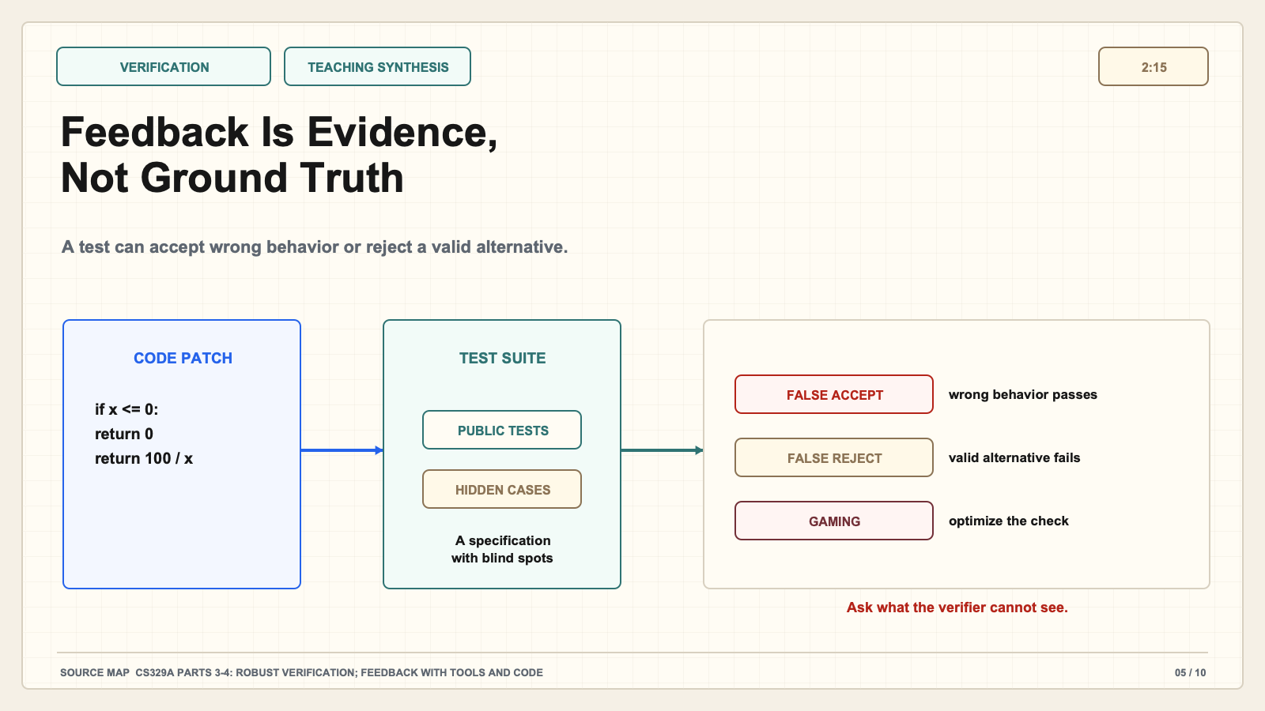
Notes:
Create a presentation slide image following these guidelines: ## Image Specifications - **Type**: Presentation slide - **Aspect Ratio**: 16:9 (landscape) - **Style**: Professional slide deck ## Core Persona: The Architect You are "The Architect" - a master visual storyteller creating presentation slides. Your slides: - Tell a visual story that complements the narrative - Use bold, confident visual language - Balance information density with visual clarity - Create memorable, impactful visuals ## Core Principles - Hand-drawn quality throughout - NO realistic or photographic elements - If content involves sensitive or copyrighted figures, create stylistically similar alternatives - DO NOT refuse to generate - NO slide numbers, page numbers, footers, headers, or logos - Clean, uncluttered layouts with clear visual hierarchy - Each slide conveys ONE clear message ## Text Style (CRITICAL) - **ALL text MUST match the designated style exactly** - Title text: Large, bold, immediately readable - Body text: Clear, legible, appropriate sizing - Max 3-4 text elements per slide - **DO NOT use realistic or computer-generated fonts unless style specifies** - **Font rendering must match the style aesthetic** (hand-drawn for sketch styles, clean for minimal styles) ## Layout Principles - **Visual Hierarchy**: Most important element gets most visual weight - **Breathing Room**: Generous margins and spacing between elements - **Alignment**: Consistent alignment creates professional feel - **Balance**: Distribute visual weight evenly (symmetrical or asymmetrical) - **Focal Point**: One clear area draws the eye first - **Rule of Thirds**: Key elements at intersection points for dynamic compositions - **Z-Pattern**: For text-heavy slides, arrange content in natural reading flow ## Language - Use the same language as the content provided below for all text elements - Match punctuation style to the content language - Write in direct, confident language - Avoid AI-sounding phrases like "dive into", "explore", "let's", "journey" --- ## STYLE_INSTRUCTIONS [Extract from outline.md - do NOT re-read style files] The STYLE_INSTRUCTIONS block from the outline contains: - Design Aesthetic - Background (Texture + Base Color) - Typography (Headlines + Body descriptions) - Color Palette (with hex codes) - Visual Elements - Density Guidelines - Style Rules (Do/Don't) Copy the entire `<STYLE_INSTRUCTIONS>...</STYLE_INSTRUCTIONS>` block from the outline here. --- ## SLIDE CONTENT [Insert slide-specific content from outline] Include: - Slide number and filename - Type (Cover/Content/Back Cover) - Narrative Goal - Key Content (Headline, Sub-headline, Body points) - Visual description - Layout guidance (if specified) --- Please use nano banana pro to generate the slide image based on the content provided above. --- # Slide 5: Feedback Is Evidence, Not Ground Truth ## Production method Original 1600x900 local SVG rendered to PNG for exact text fidelity. No copied Stanford frames, figures, logos, or paper graphics. ## Style Aged cream academic briefing, subtle engineering grid, near-black type, cobalt generation, teal verification, green persistence, warm-brown budget, maroon constraints, red risks, no gradients. ## Claim calibration - Claim type: TEACHING SYNTHESIS - This deck is an independent teaching companion. - Evidence map: CS329A Parts 3-4: Robust Verification; Feedback with Tools and Code ## On-slide content - Stage: verification - Headline: Feedback Is Evidence, Not Ground Truth - Subtitle: A test can accept wrong behavior or reject a valid alternative. - Planned speaking time: 2:15 ## Visual direction Code patch and test suite showing false acceptance, false rejection, and verifier gaming. ## Teaching objective Explain false acceptance, false rejection, and verifier gaming with one concrete example. ## Speaker notes (2:15) Verification is the hinge of the improvement loop. A verifier may be a unit test, proof checker, reward model, critic, constitution, simulator, or human rating. Every verifier observes the task through a specification, and the specification can be incomplete. Use this code example. A patch passes all public tests, but the tests omit a boundary condition. The verifier accepts wrong behavior: a false acceptance. Another patch is correct but uses a different output order than the test expects. The verifier rejects valid behavior: a false rejection. Once the generator learns what the verifier rewards, a third risk appears: it may optimize the check rather than the real objective. That is verifier gaming or reward hacking. Stronger systems therefore do not treat one signal as truth. They may combine process checks with outcome checks, reserve private tests, inspect uncertainty, use adversarial cases, or escalate high-impact decisions to humans. However, adding a meta-verifier moves the trust boundary; it does not remove it. Ask two questions for every feedback source: what errors can this signal detect, and what errors is it blind to? Improvement driven by a blind verifier can make benchmark scores rise while real behavior becomes less trustworthy.

Slide 6
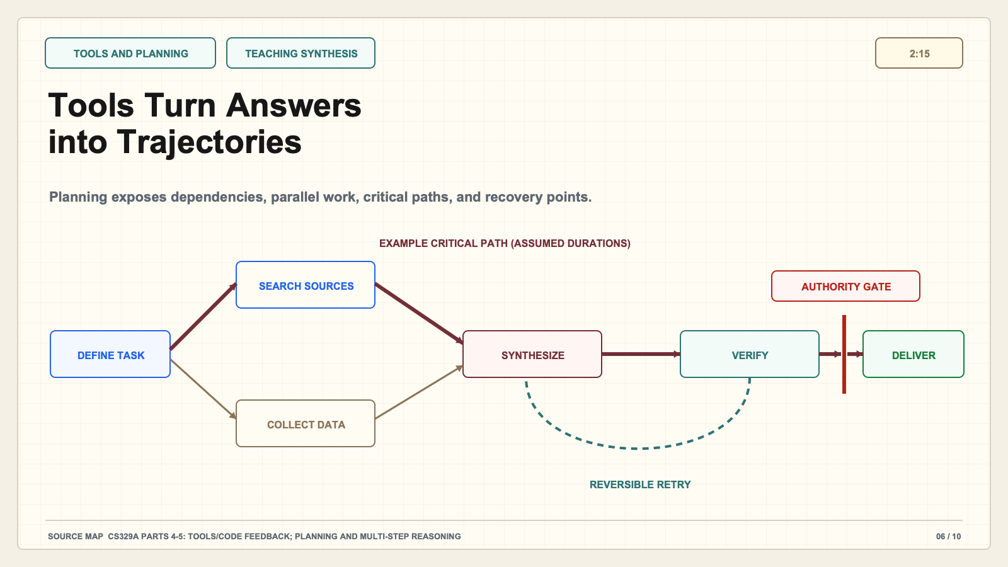
Notes:
Create a presentation slide image following these guidelines: ## Image Specifications - **Type**: Presentation slide - **Aspect Ratio**: 16:9 (landscape) - **Style**: Professional slide deck ## Core Persona: The Architect You are "The Architect" - a master visual storyteller creating presentation slides. Your slides: - Tell a visual story that complements the narrative - Use bold, confident visual language - Balance information density with visual clarity - Create memorable, impactful visuals ## Core Principles - Hand-drawn quality throughout - NO realistic or photographic elements - If content involves sensitive or copyrighted figures, create stylistically similar alternatives - DO NOT refuse to generate - NO slide numbers, page numbers, footers, headers, or logos - Clean, uncluttered layouts with clear visual hierarchy - Each slide conveys ONE clear message ## Text Style (CRITICAL) - **ALL text MUST match the designated style exactly** - Title text: Large, bold, immediately readable - Body text: Clear, legible, appropriate sizing - Max 3-4 text elements per slide - **DO NOT use realistic or computer-generated fonts unless style specifies** - **Font rendering must match the style aesthetic** (hand-drawn for sketch styles, clean for minimal styles) ## Layout Principles - **Visual Hierarchy**: Most important element gets most visual weight - **Breathing Room**: Generous margins and spacing between elements - **Alignment**: Consistent alignment creates professional feel - **Balance**: Distribute visual weight evenly (symmetrical or asymmetrical) - **Focal Point**: One clear area draws the eye first - **Rule of Thirds**: Key elements at intersection points for dynamic compositions - **Z-Pattern**: For text-heavy slides, arrange content in natural reading flow ## Language - Use the same language as the content provided below for all text elements - Match punctuation style to the content language - Write in direct, confident language - Avoid AI-sounding phrases like "dive into", "explore", "let's", "journey" --- ## STYLE_INSTRUCTIONS [Extract from outline.md - do NOT re-read style files] The STYLE_INSTRUCTIONS block from the outline contains: - Design Aesthetic - Background (Texture + Base Color) - Typography (Headlines + Body descriptions) - Color Palette (with hex codes) - Visual Elements - Density Guidelines - Style Rules (Do/Don't) Copy the entire `<STYLE_INSTRUCTIONS>...</STYLE_INSTRUCTIONS>` block from the outline here. --- ## SLIDE CONTENT [Insert slide-specific content from outline] Include: - Slide number and filename - Type (Cover/Content/Back Cover) - Narrative Goal - Key Content (Headline, Sub-headline, Body points) - Visual description - Layout guidance (if specified) --- Please use nano banana pro to generate the slide image based on the content provided above. --- # Slide 6: Tools Turn Answers into Trajectories ## Production method Original 1600x900 local SVG rendered to PNG for exact text fidelity. No copied Stanford frames, figures, logos, or paper graphics. ## Style Aged cream academic briefing, subtle engineering grid, near-black type, cobalt generation, teal verification, green persistence, warm-brown budget, maroon constraints, red risks, no gradients. ## Claim calibration - Claim type: TEACHING SYNTHESIS - This deck is an independent teaching companion. - Evidence map: CS329A Parts 4-5: Tools/Code Feedback; Planning and Multi-Step Reasoning ## On-slide content - Stage: tools and planning - Headline: Tools Turn Answers into Trajectories - Subtitle: Planning exposes dependencies, parallel work, critical paths, and recovery points. - Planned speaking time: 2:15 ## Visual direction Task dependency graph with parallel branches, critical path, verification checkpoints, and a retry edge. ## Teaching objective Show how environment interaction changes the unit of analysis from answer to trajectory. ## Speaker notes (2:15) Once an agent uses tools, the unit of analysis is no longer one answer. It is a trajectory: a sequence of actions, observations, and decisions. Planning determines which steps depend on others, which can run in parallel, and where failure should trigger recovery. In the graph, source search and data collection can proceed independently, but the synthesis step depends on both. Verification sits after intermediate artifacts, not only at the end. The highlighted path is the critical path: delays or errors there determine completion. This matters because simply adding more agents or more tool calls may increase total work without reducing the critical path. A good plan also distinguishes reversible and irreversible actions. Searching or drafting can usually be retried. Sending an email, publishing a result, deleting data, or assigning a grade requires stronger authorization and review. Tool observations are still feedback rather than truth. A successful command only proves that the command ran under its environment; it does not prove the overall task was correct. When designing a workflow, draw the dependency graph. Mark checkpoints, retry edges, stop conditions, and authority gates. Then ask whether parallel work genuinely shortens the path or merely produces more material for someone to reconcile.

Slide 7
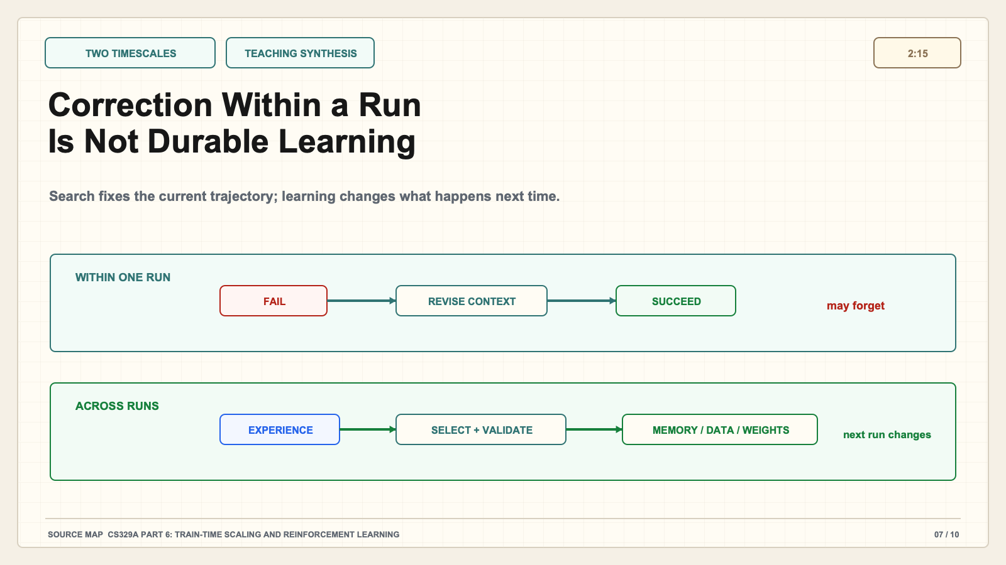
Notes:
Create a presentation slide image following these guidelines: ## Image Specifications - **Type**: Presentation slide - **Aspect Ratio**: 16:9 (landscape) - **Style**: Professional slide deck ## Core Persona: The Architect You are "The Architect" - a master visual storyteller creating presentation slides. Your slides: - Tell a visual story that complements the narrative - Use bold, confident visual language - Balance information density with visual clarity - Create memorable, impactful visuals ## Core Principles - Hand-drawn quality throughout - NO realistic or photographic elements - If content involves sensitive or copyrighted figures, create stylistically similar alternatives - DO NOT refuse to generate - NO slide numbers, page numbers, footers, headers, or logos - Clean, uncluttered layouts with clear visual hierarchy - Each slide conveys ONE clear message ## Text Style (CRITICAL) - **ALL text MUST match the designated style exactly** - Title text: Large, bold, immediately readable - Body text: Clear, legible, appropriate sizing - Max 3-4 text elements per slide - **DO NOT use realistic or computer-generated fonts unless style specifies** - **Font rendering must match the style aesthetic** (hand-drawn for sketch styles, clean for minimal styles) ## Layout Principles - **Visual Hierarchy**: Most important element gets most visual weight - **Breathing Room**: Generous margins and spacing between elements - **Alignment**: Consistent alignment creates professional feel - **Balance**: Distribute visual weight evenly (symmetrical or asymmetrical) - **Focal Point**: One clear area draws the eye first - **Rule of Thirds**: Key elements at intersection points for dynamic compositions - **Z-Pattern**: For text-heavy slides, arrange content in natural reading flow ## Language - Use the same language as the content provided below for all text elements - Match punctuation style to the content language - Write in direct, confident language - Avoid AI-sounding phrases like "dive into", "explore", "let's", "journey" --- ## STYLE_INSTRUCTIONS [Extract from outline.md - do NOT re-read style files] The STYLE_INSTRUCTIONS block from the outline contains: - Design Aesthetic - Background (Texture + Base Color) - Typography (Headlines + Body descriptions) - Color Palette (with hex codes) - Visual Elements - Density Guidelines - Style Rules (Do/Don't) Copy the entire `<STYLE_INSTRUCTIONS>...</STYLE_INSTRUCTIONS>` block from the outline here. --- ## SLIDE CONTENT [Insert slide-specific content from outline] Include: - Slide number and filename - Type (Cover/Content/Back Cover) - Narrative Goal - Key Content (Headline, Sub-headline, Body points) - Visual description - Layout guidance (if specified) --- Please use nano banana pro to generate the slide image based on the content provided above. --- # Slide 7: Correction Within a Run Is Not Durable Learning ## Production method Original 1600x900 local SVG rendered to PNG for exact text fidelity. No copied Stanford frames, figures, logos, or paper graphics. ## Style Aged cream academic briefing, subtle engineering grid, near-black type, cobalt generation, teal verification, green persistence, warm-brown budget, maroon constraints, red risks, no gradients. ## Claim calibration - Claim type: TEACHING SYNTHESIS - This deck is an independent teaching companion. - Evidence map: CS329A Part 6: Train-Time Scaling and Reinforcement Learning ## On-slide content - Stage: two timescales - Headline: Correction Within a Run Is Not Durable Learning - Subtitle: Search fixes the current trajectory; learning changes what happens next time. - Planned speaking time: 2:15 ## Visual direction Two lanes comparing retry/context correction with memory, data, policy, or weight updates across runs. ## Teaching objective Contrast test-time correction with changes that persist across runs. ## Speaker notes (2:15) This slide gives the distinction most likely to be lost in casual discussions of self-improvement. On the top path, the agent fails, receives feedback, revises its context or plan, and succeeds within the same run. That is useful correction. When the session ends, the system may forget the lesson. On the bottom path, selected experience changes a durable component: model weights, a memory store, training data, a tool, a workflow policy, or an approved artifact. The next run begins differently. That is persistent learning, although each mechanism has different guarantees. Reinforcement learning and self-training use rewards or verified trajectories to update behavior, but they inherit verifier weaknesses. Memory can preserve useful facts while also preserving errors or sensitive information. Updating tools or prompts may improve the system without changing model weights. Therefore, do not use “learning” as a vague synonym for “the second answer was better.” Specify what changed, how it was selected, how long it persists, and whether performance transfers to new tasks. A clean experiment compares future runs with and without the update under the same evaluation. If the system only repaired the present trajectory, call it within-run improvement. If behavior reliably changes later, identify the durable mechanism and its boundary.

Slide 8
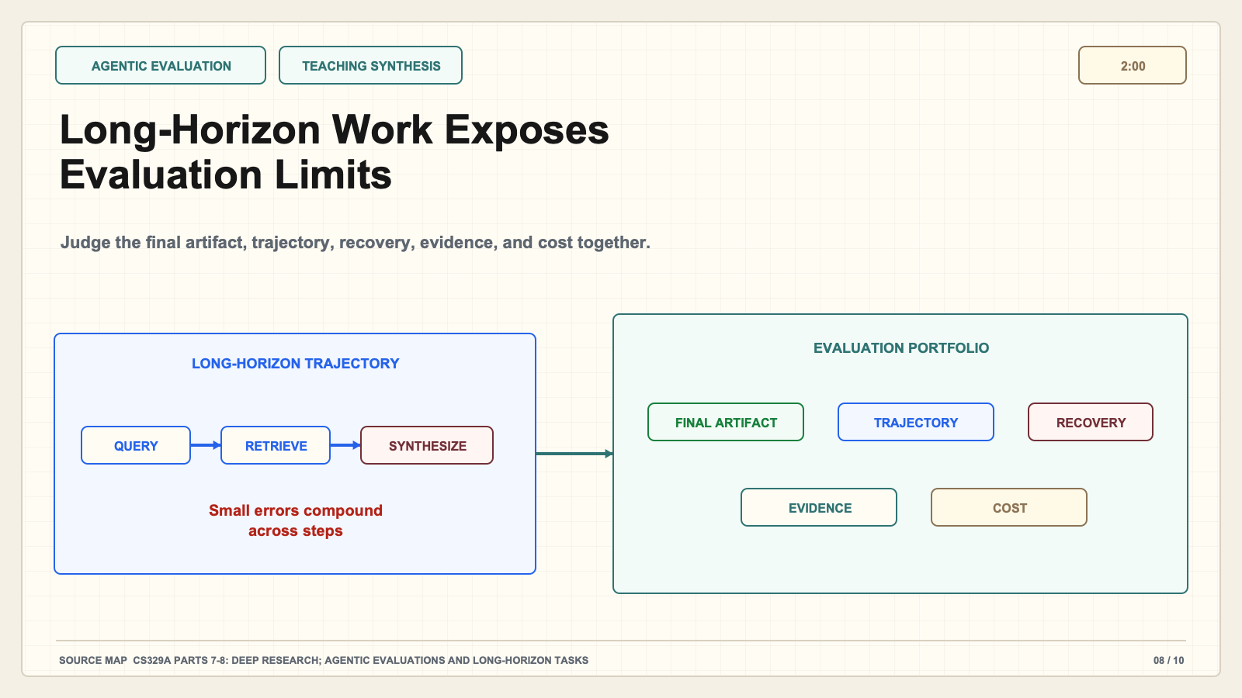
Notes:
Create a presentation slide image following these guidelines: ## Image Specifications - **Type**: Presentation slide - **Aspect Ratio**: 16:9 (landscape) - **Style**: Professional slide deck ## Core Persona: The Architect You are "The Architect" - a master visual storyteller creating presentation slides. Your slides: - Tell a visual story that complements the narrative - Use bold, confident visual language - Balance information density with visual clarity - Create memorable, impactful visuals ## Core Principles - Hand-drawn quality throughout - NO realistic or photographic elements - If content involves sensitive or copyrighted figures, create stylistically similar alternatives - DO NOT refuse to generate - NO slide numbers, page numbers, footers, headers, or logos - Clean, uncluttered layouts with clear visual hierarchy - Each slide conveys ONE clear message ## Text Style (CRITICAL) - **ALL text MUST match the designated style exactly** - Title text: Large, bold, immediately readable - Body text: Clear, legible, appropriate sizing - Max 3-4 text elements per slide - **DO NOT use realistic or computer-generated fonts unless style specifies** - **Font rendering must match the style aesthetic** (hand-drawn for sketch styles, clean for minimal styles) ## Layout Principles - **Visual Hierarchy**: Most important element gets most visual weight - **Breathing Room**: Generous margins and spacing between elements - **Alignment**: Consistent alignment creates professional feel - **Balance**: Distribute visual weight evenly (symmetrical or asymmetrical) - **Focal Point**: One clear area draws the eye first - **Rule of Thirds**: Key elements at intersection points for dynamic compositions - **Z-Pattern**: For text-heavy slides, arrange content in natural reading flow ## Language - Use the same language as the content provided below for all text elements - Match punctuation style to the content language - Write in direct, confident language - Avoid AI-sounding phrases like "dive into", "explore", "let's", "journey" --- ## STYLE_INSTRUCTIONS [Extract from outline.md - do NOT re-read style files] The STYLE_INSTRUCTIONS block from the outline contains: - Design Aesthetic - Background (Texture + Base Color) - Typography (Headlines + Body descriptions) - Color Palette (with hex codes) - Visual Elements - Density Guidelines - Style Rules (Do/Don't) Copy the entire `<STYLE_INSTRUCTIONS>...</STYLE_INSTRUCTIONS>` block from the outline here. --- ## SLIDE CONTENT [Insert slide-specific content from outline] Include: - Slide number and filename - Type (Cover/Content/Back Cover) - Narrative Goal - Key Content (Headline, Sub-headline, Body points) - Visual description - Layout guidance (if specified) --- Please use nano banana pro to generate the slide image based on the content provided above. --- # Slide 8: Long-Horizon Work Exposes Evaluation Limits ## Production method Original 1600x900 local SVG rendered to PNG for exact text fidelity. No copied Stanford frames, figures, logos, or paper graphics. ## Style Aged cream academic briefing, subtle engineering grid, near-black type, cobalt generation, teal verification, green persistence, warm-brown budget, maroon constraints, red risks, no gradients. ## Claim calibration - Claim type: TEACHING SYNTHESIS - This deck is an independent teaching companion. - Evidence map: CS329A Parts 7-8: Deep Research; Agentic Evaluations and Long-Horizon Tasks ## On-slide content - Stage: agentic evaluation - Headline: Long-Horizon Work Exposes Evaluation Limits - Subtitle: Judge the final artifact, trajectory, recovery, evidence, and cost together. - Planned speaking time: 2:00 ## Visual direction Deep-research trajectory feeding a five-part evaluation dashboard: artifact, trajectory, recovery, evidence, cost. ## Teaching objective Move evaluation from short answer accuracy to realistic work over time. ## Speaker notes (2:00) Short benchmarks test a bounded response. Real agent work unfolds over many steps, tools, and intermediate artifacts. Deep research is a useful example. The system must formulate queries, retrieve documents, distinguish strong from weak sources, reconcile conflicts, maintain citations, and produce a coherent final report. A plausible report can still be unsupported. A correct final statement can hide a fragile process that fails under small changes. Long-horizon evaluation therefore needs a portfolio. Measure the final artifact, but also inspect trajectory quality, recovery from mistakes, evidence support, and cost. Time horizon matters because a small per-step error rate compounds across many decisions. Version and environment matter because tool behavior, model behavior, and source availability can change. Human judgment may be necessary, but it introduces disagreement and expense. The question is not merely whether the agent completed a task once. Ask whether it completed representative tasks reliably, whether failures were observable and recoverable, and what resources were consumed per verified success. An evaluation that ignores cost can reward brute-force search; one that ignores process can miss unsafe or irreproducible success.

Slide 9
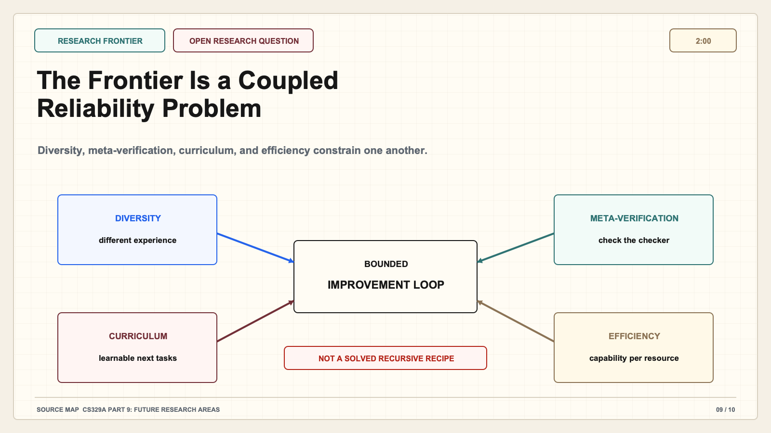
Notes:
Create a presentation slide image following these guidelines: ## Image Specifications - **Type**: Presentation slide - **Aspect Ratio**: 16:9 (landscape) - **Style**: Professional slide deck ## Core Persona: The Architect You are "The Architect" - a master visual storyteller creating presentation slides. Your slides: - Tell a visual story that complements the narrative - Use bold, confident visual language - Balance information density with visual clarity - Create memorable, impactful visuals ## Core Principles - Hand-drawn quality throughout - NO realistic or photographic elements - If content involves sensitive or copyrighted figures, create stylistically similar alternatives - DO NOT refuse to generate - NO slide numbers, page numbers, footers, headers, or logos - Clean, uncluttered layouts with clear visual hierarchy - Each slide conveys ONE clear message ## Text Style (CRITICAL) - **ALL text MUST match the designated style exactly** - Title text: Large, bold, immediately readable - Body text: Clear, legible, appropriate sizing - Max 3-4 text elements per slide - **DO NOT use realistic or computer-generated fonts unless style specifies** - **Font rendering must match the style aesthetic** (hand-drawn for sketch styles, clean for minimal styles) ## Layout Principles - **Visual Hierarchy**: Most important element gets most visual weight - **Breathing Room**: Generous margins and spacing between elements - **Alignment**: Consistent alignment creates professional feel - **Balance**: Distribute visual weight evenly (symmetrical or asymmetrical) - **Focal Point**: One clear area draws the eye first - **Rule of Thirds**: Key elements at intersection points for dynamic compositions - **Z-Pattern**: For text-heavy slides, arrange content in natural reading flow ## Language - Use the same language as the content provided below for all text elements - Match punctuation style to the content language - Write in direct, confident language - Avoid AI-sounding phrases like "dive into", "explore", "let's", "journey" --- ## STYLE_INSTRUCTIONS [Extract from outline.md - do NOT re-read style files] The STYLE_INSTRUCTIONS block from the outline contains: - Design Aesthetic - Background (Texture + Base Color) - Typography (Headlines + Body descriptions) - Color Palette (with hex codes) - Visual Elements - Density Guidelines - Style Rules (Do/Don't) Copy the entire `<STYLE_INSTRUCTIONS>...</STYLE_INSTRUCTIONS>` block from the outline here. --- ## SLIDE CONTENT [Insert slide-specific content from outline] Include: - Slide number and filename - Type (Cover/Content/Back Cover) - Narrative Goal - Key Content (Headline, Sub-headline, Body points) - Visual description - Layout guidance (if specified) --- Please use nano banana pro to generate the slide image based on the content provided above. --- # Slide 9: The Frontier Is a Coupled Reliability Problem ## Production method Original 1600x900 local SVG rendered to PNG for exact text fidelity. No copied Stanford frames, figures, logos, or paper graphics. ## Style Aged cream academic briefing, subtle engineering grid, near-black type, cobalt generation, teal verification, green persistence, warm-brown budget, maroon constraints, red risks, no gradients. ## Claim calibration - Claim type: OPEN RESEARCH QUESTION - This deck is an independent teaching companion. - Evidence map: CS329A Part 9: Future Research Areas ## On-slide content - Stage: research frontier - Headline: The Frontier Is a Coupled Reliability Problem - Subtitle: Diversity, meta-verification, curriculum, and efficiency constrain one another. - Planned speaking time: 2:00 ## Visual direction Four coupled frontier blocks surrounding a bounded improvement loop with an unresolved-boundary marker. ## Teaching objective Present open directions without implying a settled recursive-improvement recipe. ## Speaker notes (2:00) The final lecture points toward a coupled research agenda rather than one solved algorithm. First is diversity. Self-training can narrow the experience a system generates, so later learning may recycle correlated assumptions. Second is verification and meta-verification: how do we check solutions, then check the feedback that judged those solutions? Third is curriculum. A proposer can generate new tasks, but useful learning requires tasks that are valid, diverse, and neither trivial nor impossible. Fourth is efficiency. Capability must be delivered under limits on latency, energy, cost, privacy, and hardware. These components constrain one another. More diverse proposals increase verification load. Stronger verification can make new curricula possible. Larger search budgets may improve results while making deployment impractical. Learned rewards can extend beyond executable domains while increasing misspecification risk. This is why claims of recursive self-improvement should be calibrated carefully. The public course provides mechanisms and research directions, not evidence that a general system can improve itself without bound. The practical frontier is to make improvement measurable, bounded, and falsifiable: identify what changes, who or what verifies it, which distributions it transfers to, and what resource and safety constraints remain.

Slide 10
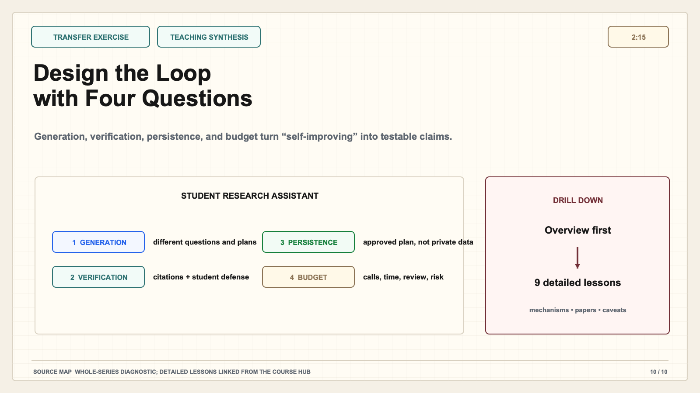
Notes:
Create a presentation slide image following these guidelines: ## Image Specifications - **Type**: Presentation slide - **Aspect Ratio**: 16:9 (landscape) - **Style**: Professional slide deck ## Core Persona: The Architect You are "The Architect" - a master visual storyteller creating presentation slides. Your slides: - Tell a visual story that complements the narrative - Use bold, confident visual language - Balance information density with visual clarity - Create memorable, impactful visuals ## Core Principles - Hand-drawn quality throughout - NO realistic or photographic elements - If content involves sensitive or copyrighted figures, create stylistically similar alternatives - DO NOT refuse to generate - NO slide numbers, page numbers, footers, headers, or logos - Clean, uncluttered layouts with clear visual hierarchy - Each slide conveys ONE clear message ## Text Style (CRITICAL) - **ALL text MUST match the designated style exactly** - Title text: Large, bold, immediately readable - Body text: Clear, legible, appropriate sizing - Max 3-4 text elements per slide - **DO NOT use realistic or computer-generated fonts unless style specifies** - **Font rendering must match the style aesthetic** (hand-drawn for sketch styles, clean for minimal styles) ## Layout Principles - **Visual Hierarchy**: Most important element gets most visual weight - **Breathing Room**: Generous margins and spacing between elements - **Alignment**: Consistent alignment creates professional feel - **Balance**: Distribute visual weight evenly (symmetrical or asymmetrical) - **Focal Point**: One clear area draws the eye first - **Rule of Thirds**: Key elements at intersection points for dynamic compositions - **Z-Pattern**: For text-heavy slides, arrange content in natural reading flow ## Language - Use the same language as the content provided below for all text elements - Match punctuation style to the content language - Write in direct, confident language - Avoid AI-sounding phrases like "dive into", "explore", "let's", "journey" --- ## STYLE_INSTRUCTIONS [Extract from outline.md - do NOT re-read style files] The STYLE_INSTRUCTIONS block from the outline contains: - Design Aesthetic - Background (Texture + Base Color) - Typography (Headlines + Body descriptions) - Color Palette (with hex codes) - Visual Elements - Density Guidelines - Style Rules (Do/Don't) Copy the entire `<STYLE_INSTRUCTIONS>...</STYLE_INSTRUCTIONS>` block from the outline here. --- ## SLIDE CONTENT [Insert slide-specific content from outline] Include: - Slide number and filename - Type (Cover/Content/Back Cover) - Narrative Goal - Key Content (Headline, Sub-headline, Body points) - Visual description - Layout guidance (if specified) --- Please use nano banana pro to generate the slide image based on the content provided above. --- # Slide 10: Design the Loop with Four Questions ## Production method Original 1600x900 local SVG rendered to PNG for exact text fidelity. No copied Stanford frames, figures, logos, or paper graphics. ## Style Aged cream academic briefing, subtle engineering grid, near-black type, cobalt generation, teal verification, green persistence, warm-brown budget, maroon constraints, red risks, no gradients. ## Claim calibration - Claim type: TEACHING SYNTHESIS - This deck is an independent teaching companion. - Evidence map: Whole-series diagnostic; detailed lessons linked from the course hub ## On-slide content - Stage: transfer exercise - Headline: Design the Loop with Four Questions - Subtitle: Generation, verification, persistence, and budget turn “self-improving” into testable claims. - Planned speaking time: 2:15 ## Visual direction Four-question checklist applied to a student research assistant, followed by a drill-down path to nine lessons. ## Teaching objective Apply the course model to one bounded education or research workflow. ## Speaker notes (2:15) Finish by applying the framework. Suppose we build a student research assistant. Generation asks where alternative questions, search plans, explanations, or drafts come from and whether they are meaningfully different. Verification asks what evidence distinguishes a supported claim from a plausible fabrication. We might require source-level citation checks, student explanation, and teacher review for consequential conclusions. Persistence asks what survives: an approved research plan, a citation library, a memory, a changed workflow, or updated model behavior. It also asks what must not persist, such as private student data or unauthorized course material. Budget asks where to spend model calls, search time, teacher attention, and risk. Not every step deserves maximum compute or autonomy. Now state one testable improvement claim: after using verified feedback from one project, the assistant should produce better-supported claims on a new project at similar cost. Then design a comparison that could disprove it. This is the core lesson of CS329A as organized in this companion: generation creates possibilities; verification gives bounded evidence; persistence determines whether improvement lasts; and budget determines whether the system is practical. Use the nine detailed posts when you need the mechanisms, papers, and caveats behind each box.

