Slide 1
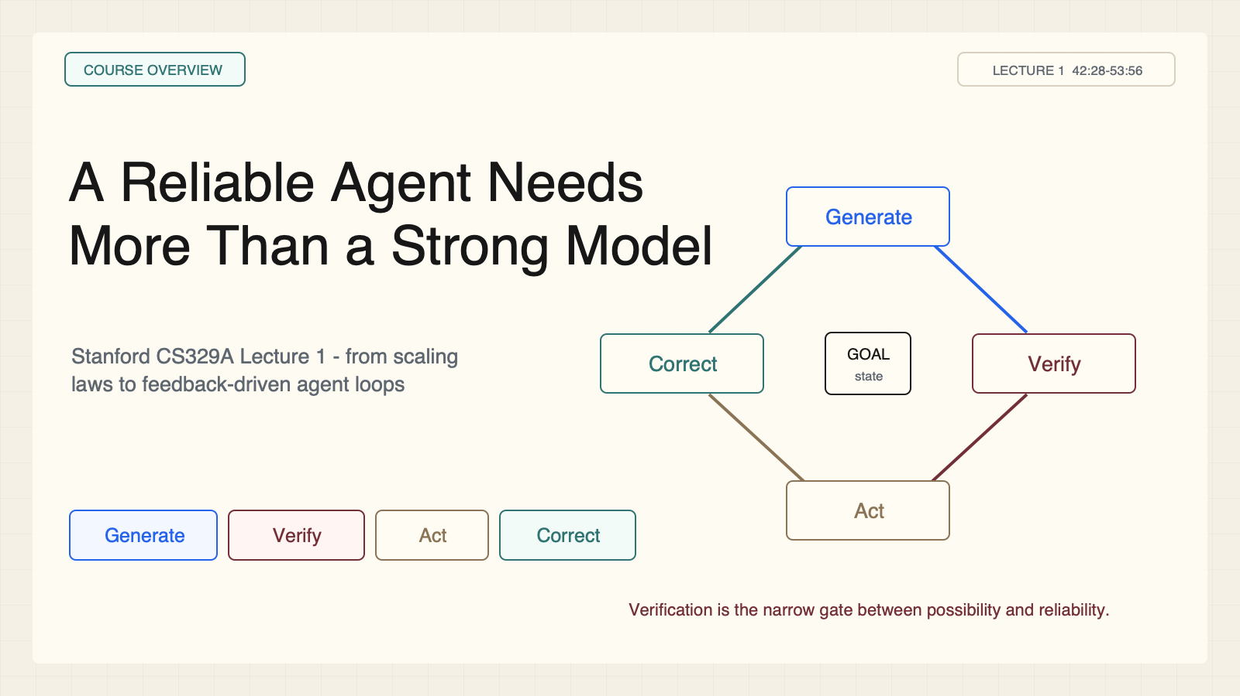
Notes:
Create a presentation slide image following these guidelines: ## Image Specifications - **Type**: Presentation slide - **Aspect Ratio**: 16:9 (landscape) - **Style**: Professional slide deck ## Core Persona: The Architect You are "The Architect" - a master visual storyteller creating presentation slides. Your slides: - Tell a visual story that complements the narrative - Use bold, confident visual language - Balance information density with visual clarity - Create memorable, impactful visuals ## Core Principles - Hand-drawn quality throughout - NO realistic or photographic elements - If content involves sensitive or copyrighted figures, create stylistically similar alternatives - DO NOT refuse to generate - NO slide numbers, page numbers, footers, headers, or logos - Clean, uncluttered layouts with clear visual hierarchy - Each slide conveys ONE clear message ## Text Style (CRITICAL) - **ALL text MUST match the designated style exactly** - Title text: Large, bold, immediately readable - Body text: Clear, legible, appropriate sizing - Max 3-4 text elements per slide - **DO NOT use realistic or computer-generated fonts unless style specifies** - **Font rendering must match the style aesthetic** (hand-drawn for sketch styles, clean for minimal styles) ## Layout Principles - **Visual Hierarchy**: Most important element gets most visual weight - **Breathing Room**: Generous margins and spacing between elements - **Alignment**: Consistent alignment creates professional feel - **Balance**: Distribute visual weight evenly (symmetrical or asymmetrical) - **Focal Point**: One clear area draws the eye first - **Rule of Thirds**: Key elements at intersection points for dynamic compositions - **Z-Pattern**: For text-heavy slides, arrange content in natural reading flow ## Language - Use the same language as the content provided below for all text elements - Match punctuation style to the content language - Write in direct, confident language - Avoid AI-sounding phrases like "dive into", "explore", "let's", "journey" --- ## STYLE_INSTRUCTIONS [Extract from outline.md - do NOT re-read style files] The STYLE_INSTRUCTIONS block from the outline contains: - Design Aesthetic - Background (Texture + Base Color) - Typography (Headlines + Body descriptions) - Color Palette (with hex codes) - Visual Elements - Density Guidelines - Style Rules (Do/Don't) Copy the entire `<STYLE_INSTRUCTIONS>...</STYLE_INSTRUCTIONS>` block from the outline here. --- ## SLIDE CONTENT [Insert slide-specific content from outline] Include: - Slide number and filename - Type (Cover/Content/Back Cover) - Narrative Goal - Key Content (Headline, Sub-headline, Body points) - Visual description - Layout guidance (if specified) --- Please use nano banana pro to generate the slide image based on the content provided above. --- # Slide 1: A Reliable Agent Needs More Than a Strong Model ## Production method Rendered locally as an original 1600x900 SVG for exact text fidelity, then converted to PNG. Do not reproduce Stanford course frames or logos. ## Style Aged-cream academic technical briefing, faint engineering grid, crisp vector diagrams, near-black type, teal feedback paths, cobalt generation, maroon constraints, 8px card corners, no gradients, no decorative imagery. ## On-slide content - Stage: course overview - Headline: A Reliable Agent Needs More Than a Strong Model - Subtitle: Stanford CS329A Lecture 1 - from scaling laws to feedback-driven agent loops - Supporting labels: Generate; Verify; Act; Correct - Evidence: Lecture 1, 42:28-53:56 ## Visual direction A four-stage feedback loop around a central goal, with verification shown as the narrow reliability gate. ## Teaching objective State why a strong generator is not yet a reliable agent. ## Speaker notes Generation and reliability are different system properties. A model may contain useful capability but expose it inconsistently. An agent needs a loop that tests actions, observes consequences, and recovers. Ask Q: What part of the loop turns a plausible answer into a trustworthy action?

Slide 2
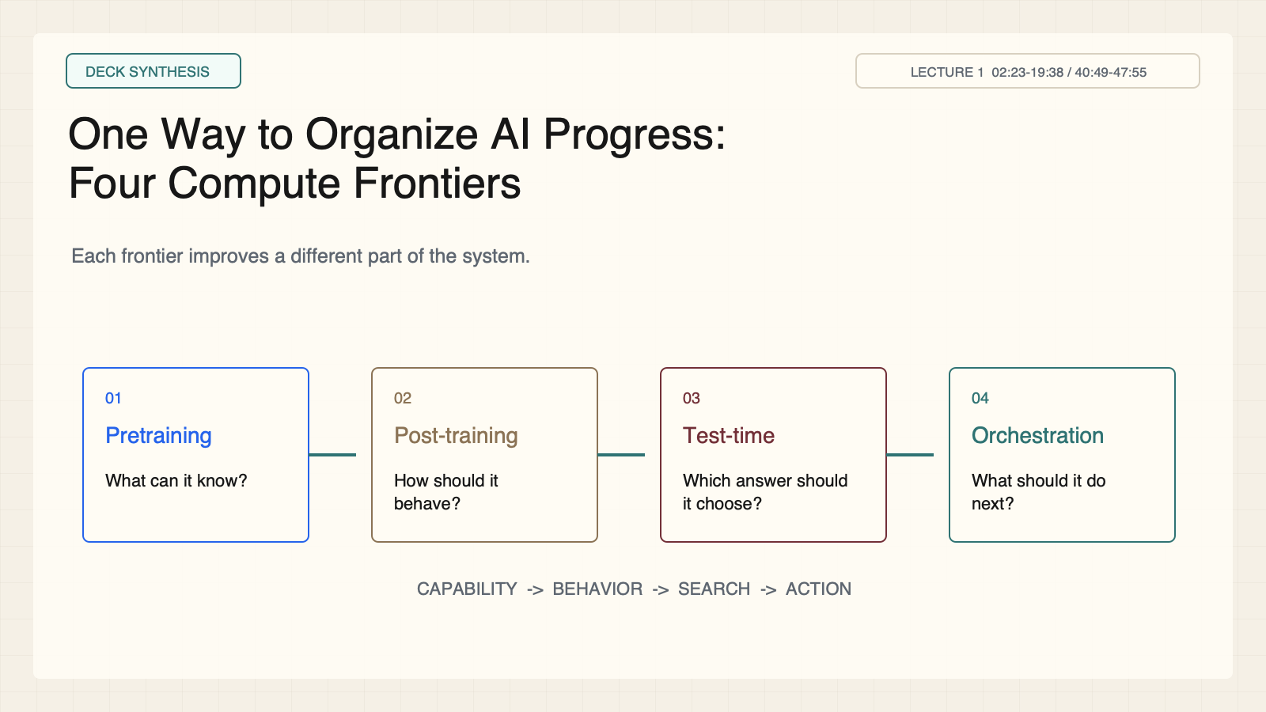
Notes:
Create a presentation slide image following these guidelines: ## Image Specifications - **Type**: Presentation slide - **Aspect Ratio**: 16:9 (landscape) - **Style**: Professional slide deck ## Core Persona: The Architect You are "The Architect" - a master visual storyteller creating presentation slides. Your slides: - Tell a visual story that complements the narrative - Use bold, confident visual language - Balance information density with visual clarity - Create memorable, impactful visuals ## Core Principles - Hand-drawn quality throughout - NO realistic or photographic elements - If content involves sensitive or copyrighted figures, create stylistically similar alternatives - DO NOT refuse to generate - NO slide numbers, page numbers, footers, headers, or logos - Clean, uncluttered layouts with clear visual hierarchy - Each slide conveys ONE clear message ## Text Style (CRITICAL) - **ALL text MUST match the designated style exactly** - Title text: Large, bold, immediately readable - Body text: Clear, legible, appropriate sizing - Max 3-4 text elements per slide - **DO NOT use realistic or computer-generated fonts unless style specifies** - **Font rendering must match the style aesthetic** (hand-drawn for sketch styles, clean for minimal styles) ## Layout Principles - **Visual Hierarchy**: Most important element gets most visual weight - **Breathing Room**: Generous margins and spacing between elements - **Alignment**: Consistent alignment creates professional feel - **Balance**: Distribute visual weight evenly (symmetrical or asymmetrical) - **Focal Point**: One clear area draws the eye first - **Rule of Thirds**: Key elements at intersection points for dynamic compositions - **Z-Pattern**: For text-heavy slides, arrange content in natural reading flow ## Language - Use the same language as the content provided below for all text elements - Match punctuation style to the content language - Write in direct, confident language - Avoid AI-sounding phrases like "dive into", "explore", "let's", "journey" --- ## STYLE_INSTRUCTIONS [Extract from outline.md - do NOT re-read style files] The STYLE_INSTRUCTIONS block from the outline contains: - Design Aesthetic - Background (Texture + Base Color) - Typography (Headlines + Body descriptions) - Color Palette (with hex codes) - Visual Elements - Density Guidelines - Style Rules (Do/Don't) Copy the entire `<STYLE_INSTRUCTIONS>...</STYLE_INSTRUCTIONS>` block from the outline here. --- ## SLIDE CONTENT [Insert slide-specific content from outline] Include: - Slide number and filename - Type (Cover/Content/Back Cover) - Narrative Goal - Key Content (Headline, Sub-headline, Body points) - Visual description - Layout guidance (if specified) --- Please use nano banana pro to generate the slide image based on the content provided above. --- # Slide 2: One Way to Organize AI Progress: Four Compute Frontiers ## Production method Rendered locally as an original 1600x900 SVG for exact text fidelity, then converted to PNG. Do not reproduce Stanford course frames or logos. ## Style Aged-cream academic technical briefing, faint engineering grid, crisp vector diagrams, near-black type, teal feedback paths, cobalt generation, maroon constraints, 8px card corners, no gradients, no decorative imagery. ## On-slide content - Stage: deck synthesis - Headline: One Way to Organize AI Progress: Four Compute Frontiers - Subtitle: Each frontier improves a different part of the system. - Supporting labels: Pretraining; Post-training; Test-time compute; Agent orchestration - Evidence: Lecture 1, 02:23-19:38 / 40:49-47:55 ## Visual direction Four connected stages, each paired with the question it answers. ## Teaching objective Distinguish pretraining, post-training, test-time computation, and agent orchestration. ## Speaker notes Walk left to right. Pretraining builds broad capability. Post-training shapes useful behavior. Test-time compute searches possible solutions. Orchestration closes the action-feedback loop. These layers complement rather than replace one another.

Slide 3
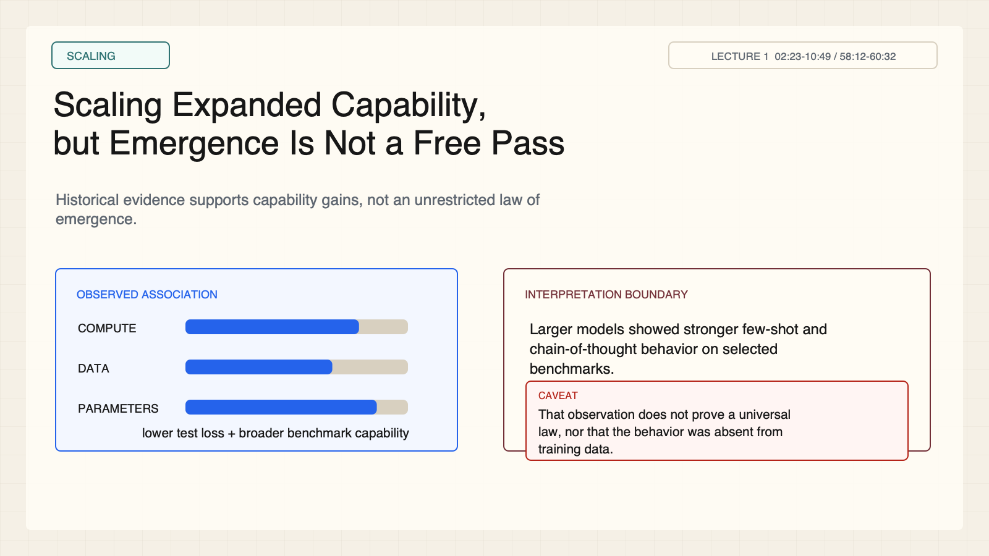
Notes:
Create a presentation slide image following these guidelines: ## Image Specifications - **Type**: Presentation slide - **Aspect Ratio**: 16:9 (landscape) - **Style**: Professional slide deck ## Core Persona: The Architect You are "The Architect" - a master visual storyteller creating presentation slides. Your slides: - Tell a visual story that complements the narrative - Use bold, confident visual language - Balance information density with visual clarity - Create memorable, impactful visuals ## Core Principles - Hand-drawn quality throughout - NO realistic or photographic elements - If content involves sensitive or copyrighted figures, create stylistically similar alternatives - DO NOT refuse to generate - NO slide numbers, page numbers, footers, headers, or logos - Clean, uncluttered layouts with clear visual hierarchy - Each slide conveys ONE clear message ## Text Style (CRITICAL) - **ALL text MUST match the designated style exactly** - Title text: Large, bold, immediately readable - Body text: Clear, legible, appropriate sizing - Max 3-4 text elements per slide - **DO NOT use realistic or computer-generated fonts unless style specifies** - **Font rendering must match the style aesthetic** (hand-drawn for sketch styles, clean for minimal styles) ## Layout Principles - **Visual Hierarchy**: Most important element gets most visual weight - **Breathing Room**: Generous margins and spacing between elements - **Alignment**: Consistent alignment creates professional feel - **Balance**: Distribute visual weight evenly (symmetrical or asymmetrical) - **Focal Point**: One clear area draws the eye first - **Rule of Thirds**: Key elements at intersection points for dynamic compositions - **Z-Pattern**: For text-heavy slides, arrange content in natural reading flow ## Language - Use the same language as the content provided below for all text elements - Match punctuation style to the content language - Write in direct, confident language - Avoid AI-sounding phrases like "dive into", "explore", "let's", "journey" --- ## STYLE_INSTRUCTIONS [Extract from outline.md - do NOT re-read style files] The STYLE_INSTRUCTIONS block from the outline contains: - Design Aesthetic - Background (Texture + Base Color) - Typography (Headlines + Body descriptions) - Color Palette (with hex codes) - Visual Elements - Density Guidelines - Style Rules (Do/Don't) Copy the entire `<STYLE_INSTRUCTIONS>...</STYLE_INSTRUCTIONS>` block from the outline here. --- ## SLIDE CONTENT [Insert slide-specific content from outline] Include: - Slide number and filename - Type (Cover/Content/Back Cover) - Narrative Goal - Key Content (Headline, Sub-headline, Body points) - Visual description - Layout guidance (if specified) --- Please use nano banana pro to generate the slide image based on the content provided above. --- # Slide 3: Scaling Expanded Capability, but Emergence Is Not a Free Pass ## Production method Rendered locally as an original 1600x900 SVG for exact text fidelity, then converted to PNG. Do not reproduce Stanford course frames or logos. ## Style Aged-cream academic technical briefing, faint engineering grid, crisp vector diagrams, near-black type, teal feedback paths, cobalt generation, maroon constraints, 8px card corners, no gradients, no decorative imagery. ## On-slide content - Stage: scaling - Headline: Scaling Expanded Capability, but Emergence Is Not a Free Pass - Subtitle: Historical evidence supports capability gains, not an unrestricted law of emergence. - Supporting labels: More compute; More data; More parameters - Evidence: Lecture 1, 02:23-10:49 / 58:12-60:32 ## Visual direction Three scaling dials feed a capability meter beside an observation-versus-interpretation boundary. ## Teaching objective Describe what scaling evidence supports and what it does not establish. ## Speaker notes Scaling was associated with lower test loss and stronger few-shot and chain-of-thought benchmark behavior. Modern reasoning is also deliberately shaped by data and reinforcement. Challenge Q: If a behavior appears only in a larger model, does that prove it was absent from the training data?

Slide 4
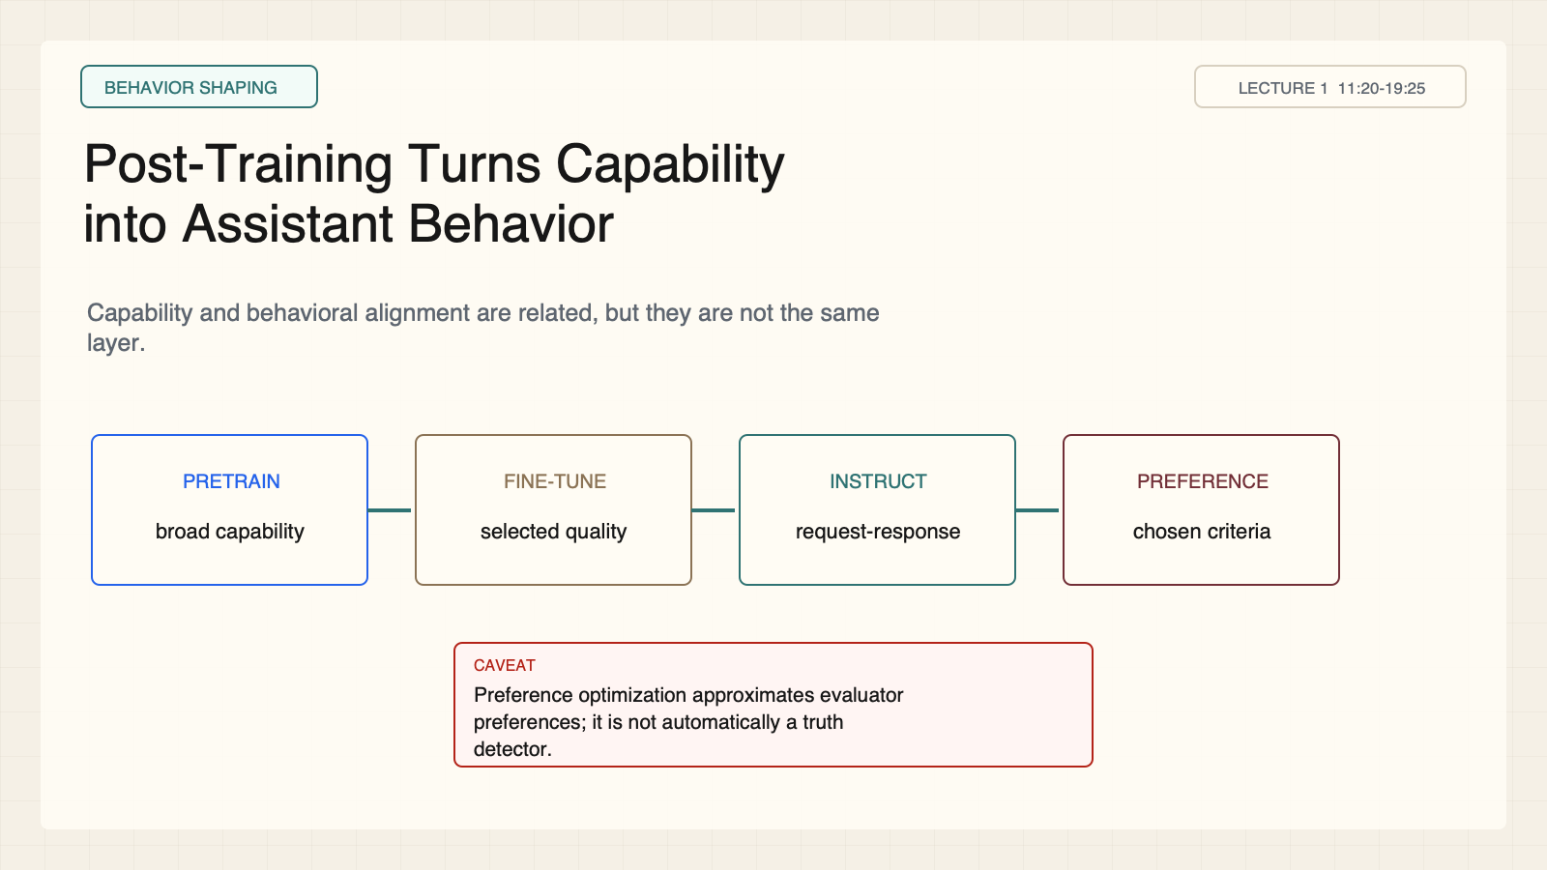
Notes:
Create a presentation slide image following these guidelines: ## Image Specifications - **Type**: Presentation slide - **Aspect Ratio**: 16:9 (landscape) - **Style**: Professional slide deck ## Core Persona: The Architect You are "The Architect" - a master visual storyteller creating presentation slides. Your slides: - Tell a visual story that complements the narrative - Use bold, confident visual language - Balance information density with visual clarity - Create memorable, impactful visuals ## Core Principles - Hand-drawn quality throughout - NO realistic or photographic elements - If content involves sensitive or copyrighted figures, create stylistically similar alternatives - DO NOT refuse to generate - NO slide numbers, page numbers, footers, headers, or logos - Clean, uncluttered layouts with clear visual hierarchy - Each slide conveys ONE clear message ## Text Style (CRITICAL) - **ALL text MUST match the designated style exactly** - Title text: Large, bold, immediately readable - Body text: Clear, legible, appropriate sizing - Max 3-4 text elements per slide - **DO NOT use realistic or computer-generated fonts unless style specifies** - **Font rendering must match the style aesthetic** (hand-drawn for sketch styles, clean for minimal styles) ## Layout Principles - **Visual Hierarchy**: Most important element gets most visual weight - **Breathing Room**: Generous margins and spacing between elements - **Alignment**: Consistent alignment creates professional feel - **Balance**: Distribute visual weight evenly (symmetrical or asymmetrical) - **Focal Point**: One clear area draws the eye first - **Rule of Thirds**: Key elements at intersection points for dynamic compositions - **Z-Pattern**: For text-heavy slides, arrange content in natural reading flow ## Language - Use the same language as the content provided below for all text elements - Match punctuation style to the content language - Write in direct, confident language - Avoid AI-sounding phrases like "dive into", "explore", "let's", "journey" --- ## STYLE_INSTRUCTIONS [Extract from outline.md - do NOT re-read style files] The STYLE_INSTRUCTIONS block from the outline contains: - Design Aesthetic - Background (Texture + Base Color) - Typography (Headlines + Body descriptions) - Color Palette (with hex codes) - Visual Elements - Density Guidelines - Style Rules (Do/Don't) Copy the entire `<STYLE_INSTRUCTIONS>...</STYLE_INSTRUCTIONS>` block from the outline here. --- ## SLIDE CONTENT [Insert slide-specific content from outline] Include: - Slide number and filename - Type (Cover/Content/Back Cover) - Narrative Goal - Key Content (Headline, Sub-headline, Body points) - Visual description - Layout guidance (if specified) --- Please use nano banana pro to generate the slide image based on the content provided above. --- # Slide 4: Post-Training Turns Capability into Assistant Behavior ## Production method Rendered locally as an original 1600x900 SVG for exact text fidelity, then converted to PNG. Do not reproduce Stanford course frames or logos. ## Style Aged-cream academic technical briefing, faint engineering grid, crisp vector diagrams, near-black type, teal feedback paths, cobalt generation, maroon constraints, 8px card corners, no gradients, no decorative imagery. ## On-slide content - Stage: behavior shaping - Headline: Post-Training Turns Capability into Assistant Behavior - Subtitle: Capability and behavioral alignment are related, but they are not the same layer. - Supporting labels: Fine-tune; Instruction tune; Preference optimize - Evidence: Lecture 1, 11:20-19:25 ## Visual direction A four-stage pipeline from pretrained capability to assistant behavior. ## Teaching objective Explain the role of fine-tuning, instruction tuning, and preference optimization. ## Speaker notes Pretraining develops broad capability. Fine-tuning sharpens it on selected data. Instruction tuning teaches request-response patterns. Preference optimization rewards selected evaluator criteria. A preference model is not automatically a truth detector.

Slide 5
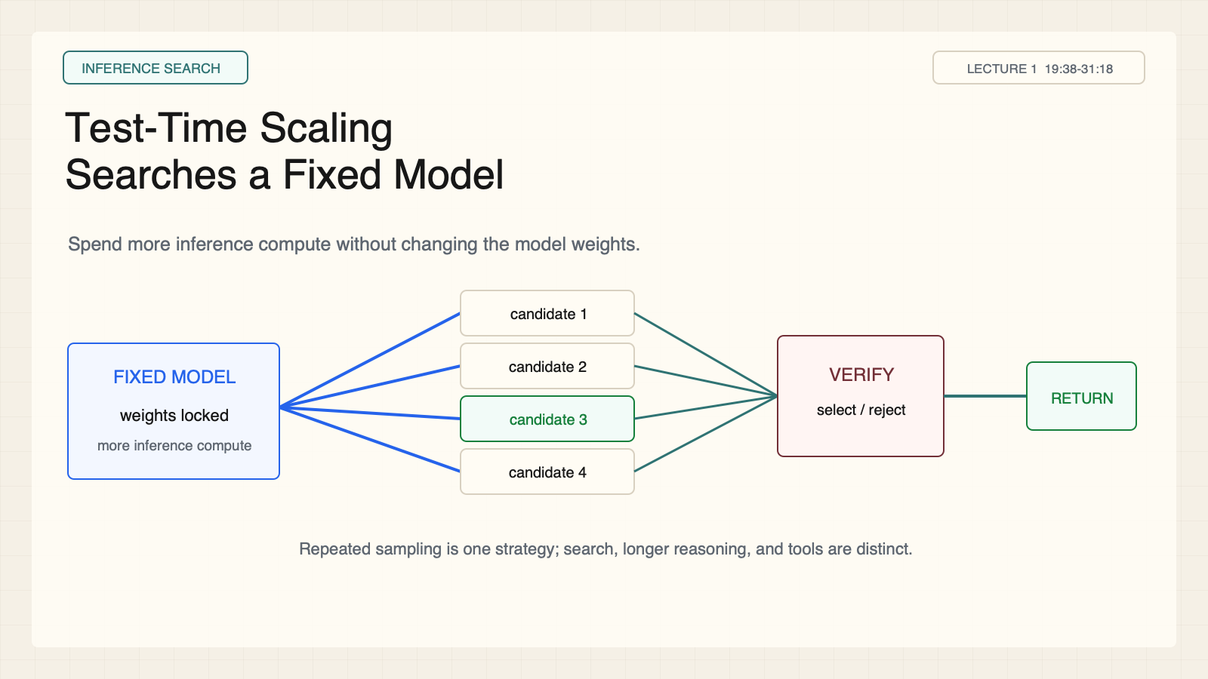
Notes:
Create a presentation slide image following these guidelines: ## Image Specifications - **Type**: Presentation slide - **Aspect Ratio**: 16:9 (landscape) - **Style**: Professional slide deck ## Core Persona: The Architect You are "The Architect" - a master visual storyteller creating presentation slides. Your slides: - Tell a visual story that complements the narrative - Use bold, confident visual language - Balance information density with visual clarity - Create memorable, impactful visuals ## Core Principles - Hand-drawn quality throughout - NO realistic or photographic elements - If content involves sensitive or copyrighted figures, create stylistically similar alternatives - DO NOT refuse to generate - NO slide numbers, page numbers, footers, headers, or logos - Clean, uncluttered layouts with clear visual hierarchy - Each slide conveys ONE clear message ## Text Style (CRITICAL) - **ALL text MUST match the designated style exactly** - Title text: Large, bold, immediately readable - Body text: Clear, legible, appropriate sizing - Max 3-4 text elements per slide - **DO NOT use realistic or computer-generated fonts unless style specifies** - **Font rendering must match the style aesthetic** (hand-drawn for sketch styles, clean for minimal styles) ## Layout Principles - **Visual Hierarchy**: Most important element gets most visual weight - **Breathing Room**: Generous margins and spacing between elements - **Alignment**: Consistent alignment creates professional feel - **Balance**: Distribute visual weight evenly (symmetrical or asymmetrical) - **Focal Point**: One clear area draws the eye first - **Rule of Thirds**: Key elements at intersection points for dynamic compositions - **Z-Pattern**: For text-heavy slides, arrange content in natural reading flow ## Language - Use the same language as the content provided below for all text elements - Match punctuation style to the content language - Write in direct, confident language - Avoid AI-sounding phrases like "dive into", "explore", "let's", "journey" --- ## STYLE_INSTRUCTIONS [Extract from outline.md - do NOT re-read style files] The STYLE_INSTRUCTIONS block from the outline contains: - Design Aesthetic - Background (Texture + Base Color) - Typography (Headlines + Body descriptions) - Color Palette (with hex codes) - Visual Elements - Density Guidelines - Style Rules (Do/Don't) Copy the entire `<STYLE_INSTRUCTIONS>...</STYLE_INSTRUCTIONS>` block from the outline here. --- ## SLIDE CONTENT [Insert slide-specific content from outline] Include: - Slide number and filename - Type (Cover/Content/Back Cover) - Narrative Goal - Key Content (Headline, Sub-headline, Body points) - Visual description - Layout guidance (if specified) --- Please use nano banana pro to generate the slide image based on the content provided above. --- # Slide 5: Test-Time Scaling Searches a Fixed Model ## Production method Rendered locally as an original 1600x900 SVG for exact text fidelity, then converted to PNG. Do not reproduce Stanford course frames or logos. ## Style Aged-cream academic technical briefing, faint engineering grid, crisp vector diagrams, near-black type, teal feedback paths, cobalt generation, maroon constraints, 8px card corners, no gradients, no decorative imagery. ## On-slide content - Stage: inference search - Headline: Test-Time Scaling Searches a Fixed Model - Subtitle: Spend more inference compute without changing the model weights. - Supporting labels: Sample; Search; Use tools; Select - Evidence: Lecture 1, 19:38-31:18 ## Visual direction One locked model fans into candidate paths and then narrows through a verification gate. ## Teaching objective Recognize repeated sampling as one test-time strategy among several. ## Speaker notes The weights remain unchanged during the task. The system can sample repeatedly, reason longer, search, or use tools. A verifier or selector then decides what reaches the user. Do not collapse all of these methods into repeated sampling.

Slide 6
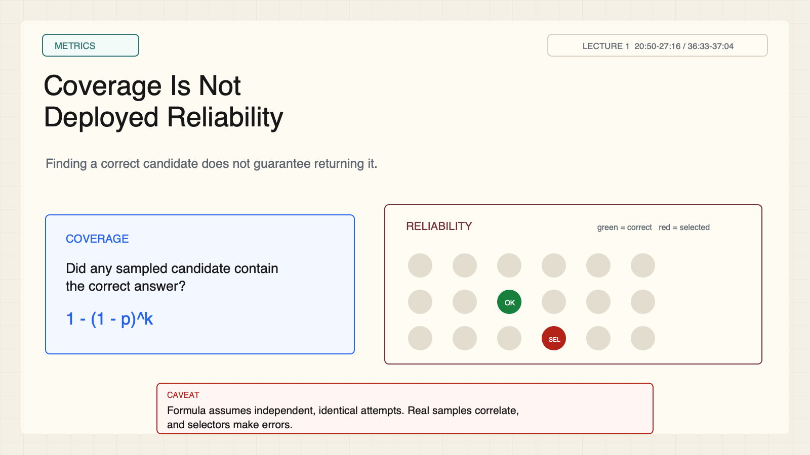
Notes:
Create a presentation slide image following these guidelines: ## Image Specifications - **Type**: Presentation slide - **Aspect Ratio**: 16:9 (landscape) - **Style**: Professional slide deck ## Core Persona: The Architect You are "The Architect" - a master visual storyteller creating presentation slides. Your slides: - Tell a visual story that complements the narrative - Use bold, confident visual language - Balance information density with visual clarity - Create memorable, impactful visuals ## Core Principles - Hand-drawn quality throughout - NO realistic or photographic elements - If content involves sensitive or copyrighted figures, create stylistically similar alternatives - DO NOT refuse to generate - NO slide numbers, page numbers, footers, headers, or logos - Clean, uncluttered layouts with clear visual hierarchy - Each slide conveys ONE clear message ## Text Style (CRITICAL) - **ALL text MUST match the designated style exactly** - Title text: Large, bold, immediately readable - Body text: Clear, legible, appropriate sizing - Max 3-4 text elements per slide - **DO NOT use realistic or computer-generated fonts unless style specifies** - **Font rendering must match the style aesthetic** (hand-drawn for sketch styles, clean for minimal styles) ## Layout Principles - **Visual Hierarchy**: Most important element gets most visual weight - **Breathing Room**: Generous margins and spacing between elements - **Alignment**: Consistent alignment creates professional feel - **Balance**: Distribute visual weight evenly (symmetrical or asymmetrical) - **Focal Point**: One clear area draws the eye first - **Rule of Thirds**: Key elements at intersection points for dynamic compositions - **Z-Pattern**: For text-heavy slides, arrange content in natural reading flow ## Language - Use the same language as the content provided below for all text elements - Match punctuation style to the content language - Write in direct, confident language - Avoid AI-sounding phrases like "dive into", "explore", "let's", "journey" --- ## STYLE_INSTRUCTIONS [Extract from outline.md - do NOT re-read style files] The STYLE_INSTRUCTIONS block from the outline contains: - Design Aesthetic - Background (Texture + Base Color) - Typography (Headlines + Body descriptions) - Color Palette (with hex codes) - Visual Elements - Density Guidelines - Style Rules (Do/Don't) Copy the entire `<STYLE_INSTRUCTIONS>...</STYLE_INSTRUCTIONS>` block from the outline here. --- ## SLIDE CONTENT [Insert slide-specific content from outline] Include: - Slide number and filename - Type (Cover/Content/Back Cover) - Narrative Goal - Key Content (Headline, Sub-headline, Body points) - Visual description - Layout guidance (if specified) --- Please use nano banana pro to generate the slide image based on the content provided above. --- # Slide 6: Coverage Is Not Deployed Reliability ## Production method Rendered locally as an original 1600x900 SVG for exact text fidelity, then converted to PNG. Do not reproduce Stanford course frames or logos. ## Style Aged-cream academic technical briefing, faint engineering grid, crisp vector diagrams, near-black type, teal feedback paths, cobalt generation, maroon constraints, 8px card corners, no gradients, no decorative imagery. ## On-slide content - Stage: metrics - Headline: Coverage Is Not Deployed Reliability - Subtitle: Finding a correct candidate does not guarantee returning it. - Supporting labels: Coverage: any candidate is correct; Reliability: returned answer is correct - Evidence: Lecture 1, 20:50-27:16 / 36:33-37:04 ## Visual direction Two metric cards and a candidate field where the correct candidate exists but is not selected. ## Teaching objective Separate candidate coverage from deployed reliability. ## Speaker notes The probability formula is intuition under independent identical attempts. Real samples are correlated, and selectors are imperfect. Ask Q: If 100 candidates contain one correct answer but the selector misses it, which metric improved?

Slide 7
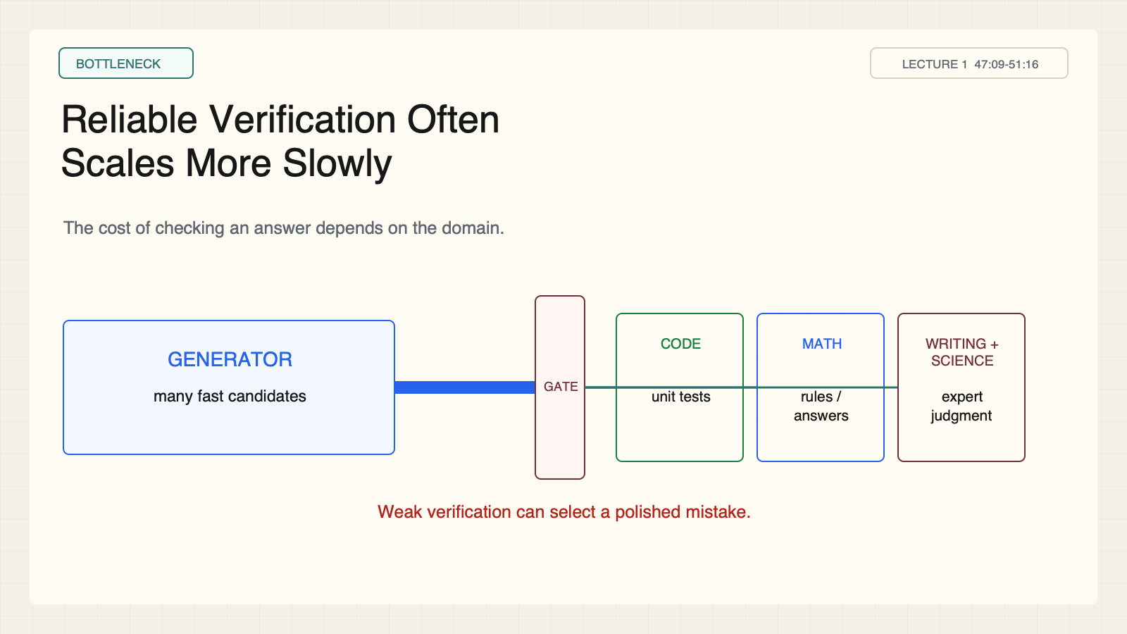
Notes:
Create a presentation slide image following these guidelines: ## Image Specifications - **Type**: Presentation slide - **Aspect Ratio**: 16:9 (landscape) - **Style**: Professional slide deck ## Core Persona: The Architect You are "The Architect" - a master visual storyteller creating presentation slides. Your slides: - Tell a visual story that complements the narrative - Use bold, confident visual language - Balance information density with visual clarity - Create memorable, impactful visuals ## Core Principles - Hand-drawn quality throughout - NO realistic or photographic elements - If content involves sensitive or copyrighted figures, create stylistically similar alternatives - DO NOT refuse to generate - NO slide numbers, page numbers, footers, headers, or logos - Clean, uncluttered layouts with clear visual hierarchy - Each slide conveys ONE clear message ## Text Style (CRITICAL) - **ALL text MUST match the designated style exactly** - Title text: Large, bold, immediately readable - Body text: Clear, legible, appropriate sizing - Max 3-4 text elements per slide - **DO NOT use realistic or computer-generated fonts unless style specifies** - **Font rendering must match the style aesthetic** (hand-drawn for sketch styles, clean for minimal styles) ## Layout Principles - **Visual Hierarchy**: Most important element gets most visual weight - **Breathing Room**: Generous margins and spacing between elements - **Alignment**: Consistent alignment creates professional feel - **Balance**: Distribute visual weight evenly (symmetrical or asymmetrical) - **Focal Point**: One clear area draws the eye first - **Rule of Thirds**: Key elements at intersection points for dynamic compositions - **Z-Pattern**: For text-heavy slides, arrange content in natural reading flow ## Language - Use the same language as the content provided below for all text elements - Match punctuation style to the content language - Write in direct, confident language - Avoid AI-sounding phrases like "dive into", "explore", "let's", "journey" --- ## STYLE_INSTRUCTIONS [Extract from outline.md - do NOT re-read style files] The STYLE_INSTRUCTIONS block from the outline contains: - Design Aesthetic - Background (Texture + Base Color) - Typography (Headlines + Body descriptions) - Color Palette (with hex codes) - Visual Elements - Density Guidelines - Style Rules (Do/Don't) Copy the entire `<STYLE_INSTRUCTIONS>...</STYLE_INSTRUCTIONS>` block from the outline here. --- ## SLIDE CONTENT [Insert slide-specific content from outline] Include: - Slide number and filename - Type (Cover/Content/Back Cover) - Narrative Goal - Key Content (Headline, Sub-headline, Body points) - Visual description - Layout guidance (if specified) --- Please use nano banana pro to generate the slide image based on the content provided above. --- # Slide 7: Reliable Verification Often Scales More Slowly ## Production method Rendered locally as an original 1600x900 SVG for exact text fidelity, then converted to PNG. Do not reproduce Stanford course frames or logos. ## Style Aged-cream academic technical briefing, faint engineering grid, crisp vector diagrams, near-black type, teal feedback paths, cobalt generation, maroon constraints, 8px card corners, no gradients, no decorative imagery. ## On-slide content - Stage: bottleneck - Headline: Reliable Verification Often Scales More Slowly - Subtitle: The cost of checking an answer depends on the domain. - Supporting labels: Code: executable tests; Math: rules or known answers; Writing and science: expert judgment - Evidence: Lecture 1, 47:09-51:16 ## Visual direction A broad generator feeds a narrow verifier, with domain cards showing increasing feedback cost. ## Teaching objective Explain why verification difficulty changes by domain. ## Speaker notes Code and mathematics often provide executable or rule-based checks. Open-ended writing, science, medicine, and policy rely on incomplete evaluators or expensive experts. Weak verification can select a polished mistake. Ask Q which tasks in their work have cheap verifiers.

Slide 8
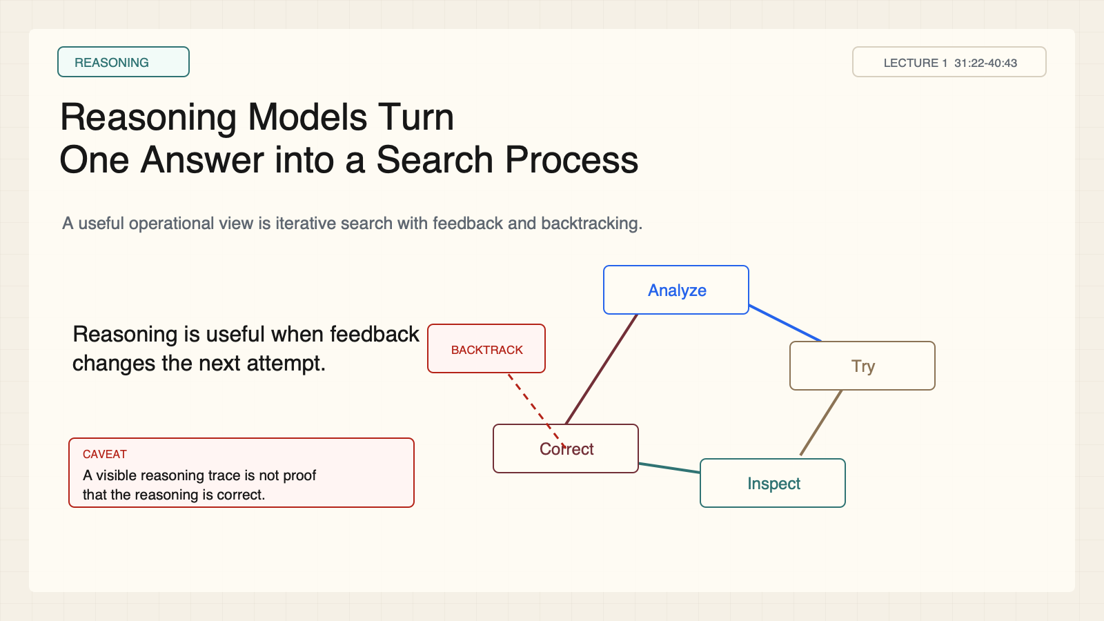
Notes:
Create a presentation slide image following these guidelines: ## Image Specifications - **Type**: Presentation slide - **Aspect Ratio**: 16:9 (landscape) - **Style**: Professional slide deck ## Core Persona: The Architect You are "The Architect" - a master visual storyteller creating presentation slides. Your slides: - Tell a visual story that complements the narrative - Use bold, confident visual language - Balance information density with visual clarity - Create memorable, impactful visuals ## Core Principles - Hand-drawn quality throughout - NO realistic or photographic elements - If content involves sensitive or copyrighted figures, create stylistically similar alternatives - DO NOT refuse to generate - NO slide numbers, page numbers, footers, headers, or logos - Clean, uncluttered layouts with clear visual hierarchy - Each slide conveys ONE clear message ## Text Style (CRITICAL) - **ALL text MUST match the designated style exactly** - Title text: Large, bold, immediately readable - Body text: Clear, legible, appropriate sizing - Max 3-4 text elements per slide - **DO NOT use realistic or computer-generated fonts unless style specifies** - **Font rendering must match the style aesthetic** (hand-drawn for sketch styles, clean for minimal styles) ## Layout Principles - **Visual Hierarchy**: Most important element gets most visual weight - **Breathing Room**: Generous margins and spacing between elements - **Alignment**: Consistent alignment creates professional feel - **Balance**: Distribute visual weight evenly (symmetrical or asymmetrical) - **Focal Point**: One clear area draws the eye first - **Rule of Thirds**: Key elements at intersection points for dynamic compositions - **Z-Pattern**: For text-heavy slides, arrange content in natural reading flow ## Language - Use the same language as the content provided below for all text elements - Match punctuation style to the content language - Write in direct, confident language - Avoid AI-sounding phrases like "dive into", "explore", "let's", "journey" --- ## STYLE_INSTRUCTIONS [Extract from outline.md - do NOT re-read style files] The STYLE_INSTRUCTIONS block from the outline contains: - Design Aesthetic - Background (Texture + Base Color) - Typography (Headlines + Body descriptions) - Color Palette (with hex codes) - Visual Elements - Density Guidelines - Style Rules (Do/Don't) Copy the entire `<STYLE_INSTRUCTIONS>...</STYLE_INSTRUCTIONS>` block from the outline here. --- ## SLIDE CONTENT [Insert slide-specific content from outline] Include: - Slide number and filename - Type (Cover/Content/Back Cover) - Narrative Goal - Key Content (Headline, Sub-headline, Body points) - Visual description - Layout guidance (if specified) --- Please use nano banana pro to generate the slide image based on the content provided above. --- # Slide 8: Reasoning Models Turn One Answer into a Search Process ## Production method Rendered locally as an original 1600x900 SVG for exact text fidelity, then converted to PNG. Do not reproduce Stanford course frames or logos. ## Style Aged-cream academic technical briefing, faint engineering grid, crisp vector diagrams, near-black type, teal feedback paths, cobalt generation, maroon constraints, 8px card corners, no gradients, no decorative imagery. ## On-slide content - Stage: reasoning - Headline: Reasoning Models Turn One Answer into a Search Process - Subtitle: A useful operational view is iterative search with feedback and backtracking. - Supporting labels: Analyze; Try; Inspect; Correct or backtrack - Evidence: Lecture 1, 31:22-40:43 ## Visual direction A circular reasoning loop with a clearly visible backtrack branch. ## Teaching objective Identify the feedback operations inside a reasoning model. ## Speaker notes Reasoning can be viewed as analysis, decomposition, action, feedback, correction, and alternative proposal. The visible reasoning trace is not proof that the process is correct; evaluation still matters.

Slide 9
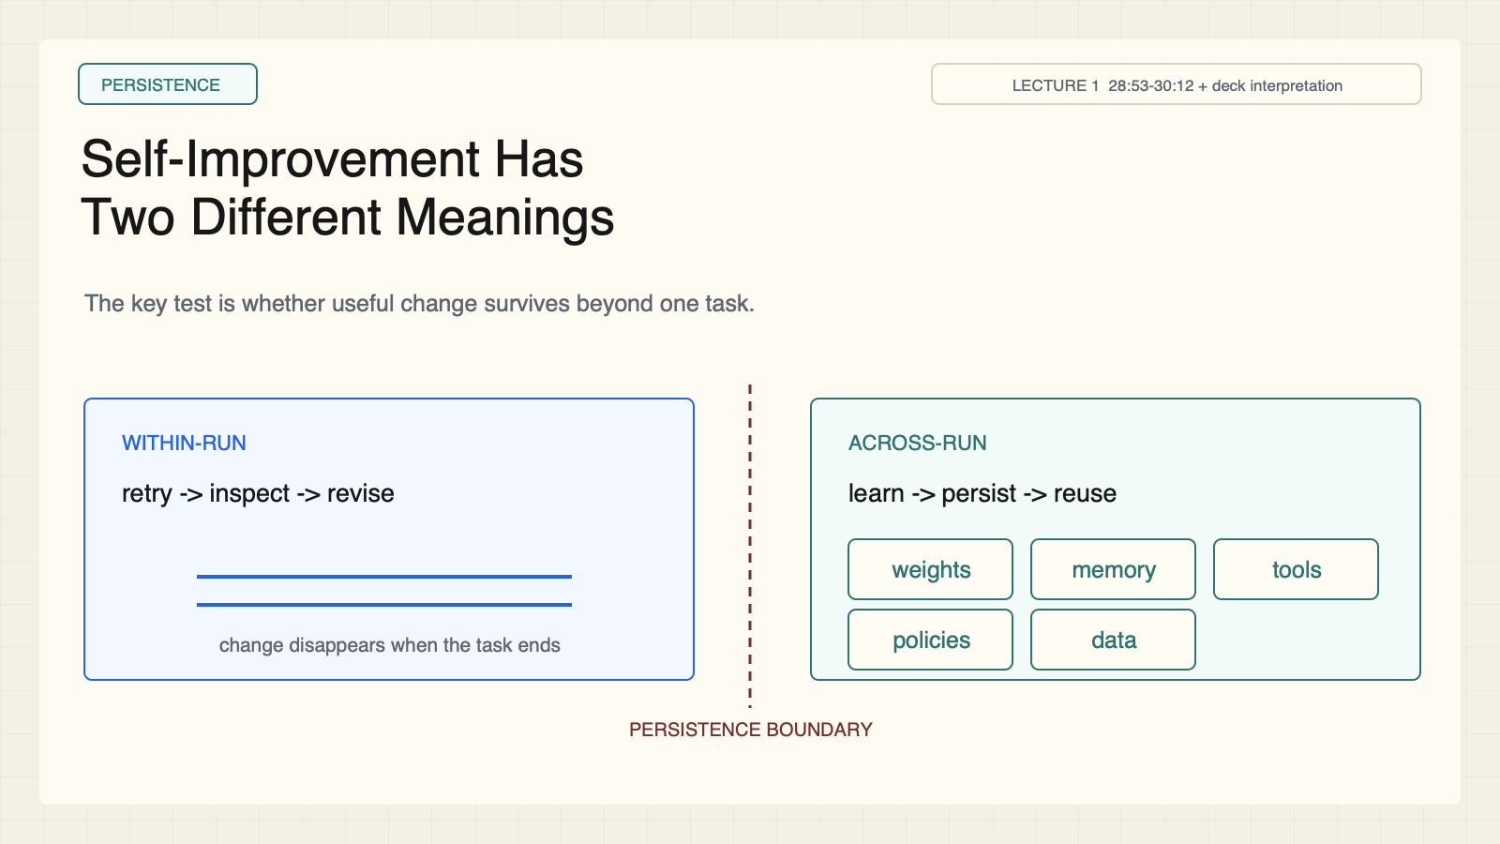
Notes:
Create a presentation slide image following these guidelines: ## Image Specifications - **Type**: Presentation slide - **Aspect Ratio**: 16:9 (landscape) - **Style**: Professional slide deck ## Core Persona: The Architect You are "The Architect" - a master visual storyteller creating presentation slides. Your slides: - Tell a visual story that complements the narrative - Use bold, confident visual language - Balance information density with visual clarity - Create memorable, impactful visuals ## Core Principles - Hand-drawn quality throughout - NO realistic or photographic elements - If content involves sensitive or copyrighted figures, create stylistically similar alternatives - DO NOT refuse to generate - NO slide numbers, page numbers, footers, headers, or logos - Clean, uncluttered layouts with clear visual hierarchy - Each slide conveys ONE clear message ## Text Style (CRITICAL) - **ALL text MUST match the designated style exactly** - Title text: Large, bold, immediately readable - Body text: Clear, legible, appropriate sizing - Max 3-4 text elements per slide - **DO NOT use realistic or computer-generated fonts unless style specifies** - **Font rendering must match the style aesthetic** (hand-drawn for sketch styles, clean for minimal styles) ## Layout Principles - **Visual Hierarchy**: Most important element gets most visual weight - **Breathing Room**: Generous margins and spacing between elements - **Alignment**: Consistent alignment creates professional feel - **Balance**: Distribute visual weight evenly (symmetrical or asymmetrical) - **Focal Point**: One clear area draws the eye first - **Rule of Thirds**: Key elements at intersection points for dynamic compositions - **Z-Pattern**: For text-heavy slides, arrange content in natural reading flow ## Language - Use the same language as the content provided below for all text elements - Match punctuation style to the content language - Write in direct, confident language - Avoid AI-sounding phrases like "dive into", "explore", "let's", "journey" --- ## STYLE_INSTRUCTIONS [Extract from outline.md - do NOT re-read style files] The STYLE_INSTRUCTIONS block from the outline contains: - Design Aesthetic - Background (Texture + Base Color) - Typography (Headlines + Body descriptions) - Color Palette (with hex codes) - Visual Elements - Density Guidelines - Style Rules (Do/Don't) Copy the entire `<STYLE_INSTRUCTIONS>...</STYLE_INSTRUCTIONS>` block from the outline here. --- ## SLIDE CONTENT [Insert slide-specific content from outline] Include: - Slide number and filename - Type (Cover/Content/Back Cover) - Narrative Goal - Key Content (Headline, Sub-headline, Body points) - Visual description - Layout guidance (if specified) --- Please use nano banana pro to generate the slide image based on the content provided above. --- # Slide 9: Self-Improvement Has Two Different Meanings ## Production method Rendered locally as an original 1600x900 SVG for exact text fidelity, then converted to PNG. Do not reproduce Stanford course frames or logos. ## Style Aged-cream academic technical briefing, faint engineering grid, crisp vector diagrams, near-black type, teal feedback paths, cobalt generation, maroon constraints, 8px card corners, no gradients, no decorative imagery. ## On-slide content - Stage: persistence - Headline: Self-Improvement Has Two Different Meanings - Subtitle: The key test is whether useful change survives beyond one task. - Supporting labels: Within-run correction; Across-run learning - Evidence: Lecture 1, 28:53-30:12 + deck interpretation ## Visual direction Two side-by-side loops separated by a persistence boundary. ## Teaching objective Determine whether an improvement survives beyond one task. ## Speaker notes Within-run correction includes retrying, searching, and revising during one task. Across-run learning persists change in weights, memory, tools, policies, data, or artifacts. Ask Q: If the agent fixes a mistake and forgets it next session, in what sense did it improve?

Slide 10
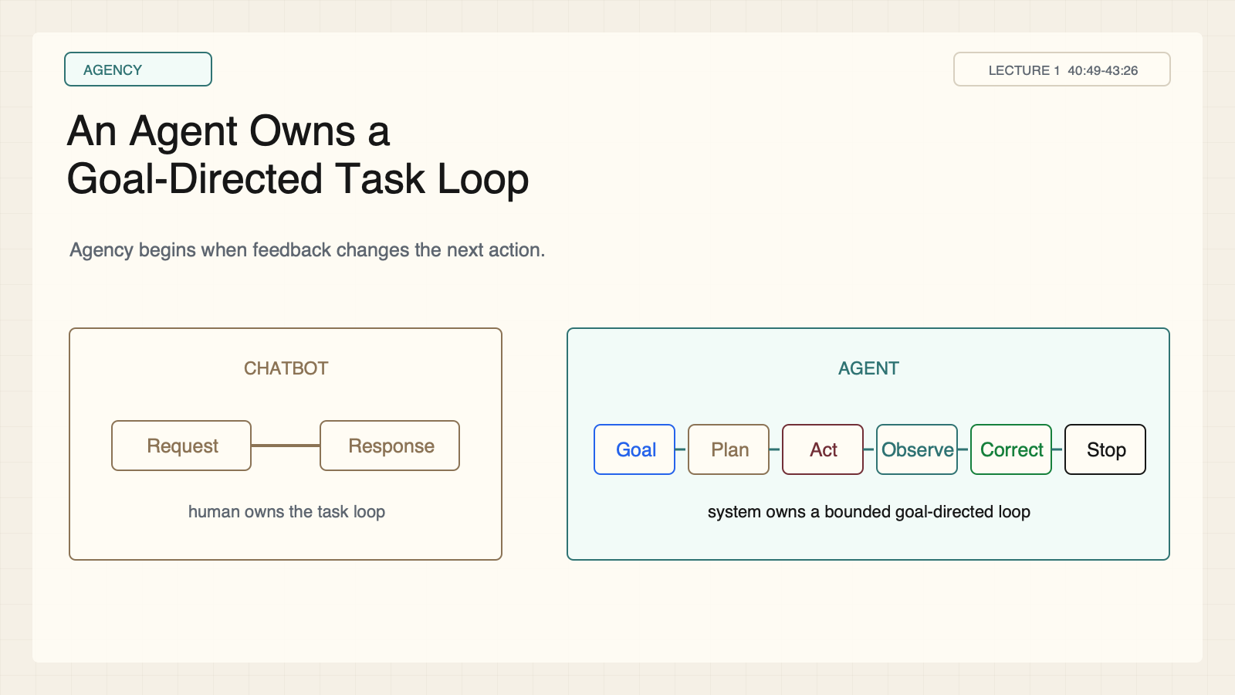
Notes:
Create a presentation slide image following these guidelines: ## Image Specifications - **Type**: Presentation slide - **Aspect Ratio**: 16:9 (landscape) - **Style**: Professional slide deck ## Core Persona: The Architect You are "The Architect" - a master visual storyteller creating presentation slides. Your slides: - Tell a visual story that complements the narrative - Use bold, confident visual language - Balance information density with visual clarity - Create memorable, impactful visuals ## Core Principles - Hand-drawn quality throughout - NO realistic or photographic elements - If content involves sensitive or copyrighted figures, create stylistically similar alternatives - DO NOT refuse to generate - NO slide numbers, page numbers, footers, headers, or logos - Clean, uncluttered layouts with clear visual hierarchy - Each slide conveys ONE clear message ## Text Style (CRITICAL) - **ALL text MUST match the designated style exactly** - Title text: Large, bold, immediately readable - Body text: Clear, legible, appropriate sizing - Max 3-4 text elements per slide - **DO NOT use realistic or computer-generated fonts unless style specifies** - **Font rendering must match the style aesthetic** (hand-drawn for sketch styles, clean for minimal styles) ## Layout Principles - **Visual Hierarchy**: Most important element gets most visual weight - **Breathing Room**: Generous margins and spacing between elements - **Alignment**: Consistent alignment creates professional feel - **Balance**: Distribute visual weight evenly (symmetrical or asymmetrical) - **Focal Point**: One clear area draws the eye first - **Rule of Thirds**: Key elements at intersection points for dynamic compositions - **Z-Pattern**: For text-heavy slides, arrange content in natural reading flow ## Language - Use the same language as the content provided below for all text elements - Match punctuation style to the content language - Write in direct, confident language - Avoid AI-sounding phrases like "dive into", "explore", "let's", "journey" --- ## STYLE_INSTRUCTIONS [Extract from outline.md - do NOT re-read style files] The STYLE_INSTRUCTIONS block from the outline contains: - Design Aesthetic - Background (Texture + Base Color) - Typography (Headlines + Body descriptions) - Color Palette (with hex codes) - Visual Elements - Density Guidelines - Style Rules (Do/Don't) Copy the entire `<STYLE_INSTRUCTIONS>...</STYLE_INSTRUCTIONS>` block from the outline here. --- ## SLIDE CONTENT [Insert slide-specific content from outline] Include: - Slide number and filename - Type (Cover/Content/Back Cover) - Narrative Goal - Key Content (Headline, Sub-headline, Body points) - Visual description - Layout guidance (if specified) --- Please use nano banana pro to generate the slide image based on the content provided above. --- # Slide 10: An Agent Owns a Goal-Directed Task Loop ## Production method Rendered locally as an original 1600x900 SVG for exact text fidelity, then converted to PNG. Do not reproduce Stanford course frames or logos. ## Style Aged-cream academic technical briefing, faint engineering grid, crisp vector diagrams, near-black type, teal feedback paths, cobalt generation, maroon constraints, 8px card corners, no gradients, no decorative imagery. ## On-slide content - Stage: agency - Headline: An Agent Owns a Goal-Directed Task Loop - Subtitle: Agency begins when feedback changes the next action. - Supporting labels: State; Tools; Feedback; Stopping rule - Evidence: Lecture 1, 40:49-43:26 ## Visual direction Request-response on the left versus a goal-plan-act-observe-correct-stop loop on the right. ## Teaching objective Distinguish a chatbot response from an agent task loop. ## Speaker notes A chatbot mainly returns information. An agent manages task state, acts through tools, observes consequences, and decides whether to continue, stop, or escalate. Autonomy can still be bounded by approval gates.

Slide 11
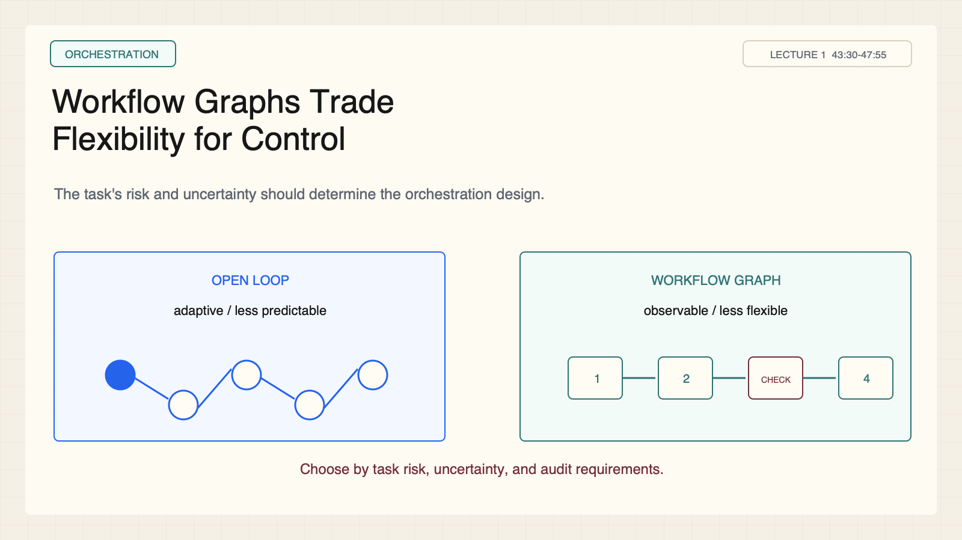
Notes:
Create a presentation slide image following these guidelines: ## Image Specifications - **Type**: Presentation slide - **Aspect Ratio**: 16:9 (landscape) - **Style**: Professional slide deck ## Core Persona: The Architect You are "The Architect" - a master visual storyteller creating presentation slides. Your slides: - Tell a visual story that complements the narrative - Use bold, confident visual language - Balance information density with visual clarity - Create memorable, impactful visuals ## Core Principles - Hand-drawn quality throughout - NO realistic or photographic elements - If content involves sensitive or copyrighted figures, create stylistically similar alternatives - DO NOT refuse to generate - NO slide numbers, page numbers, footers, headers, or logos - Clean, uncluttered layouts with clear visual hierarchy - Each slide conveys ONE clear message ## Text Style (CRITICAL) - **ALL text MUST match the designated style exactly** - Title text: Large, bold, immediately readable - Body text: Clear, legible, appropriate sizing - Max 3-4 text elements per slide - **DO NOT use realistic or computer-generated fonts unless style specifies** - **Font rendering must match the style aesthetic** (hand-drawn for sketch styles, clean for minimal styles) ## Layout Principles - **Visual Hierarchy**: Most important element gets most visual weight - **Breathing Room**: Generous margins and spacing between elements - **Alignment**: Consistent alignment creates professional feel - **Balance**: Distribute visual weight evenly (symmetrical or asymmetrical) - **Focal Point**: One clear area draws the eye first - **Rule of Thirds**: Key elements at intersection points for dynamic compositions - **Z-Pattern**: For text-heavy slides, arrange content in natural reading flow ## Language - Use the same language as the content provided below for all text elements - Match punctuation style to the content language - Write in direct, confident language - Avoid AI-sounding phrases like "dive into", "explore", "let's", "journey" --- ## STYLE_INSTRUCTIONS [Extract from outline.md - do NOT re-read style files] The STYLE_INSTRUCTIONS block from the outline contains: - Design Aesthetic - Background (Texture + Base Color) - Typography (Headlines + Body descriptions) - Color Palette (with hex codes) - Visual Elements - Density Guidelines - Style Rules (Do/Don't) Copy the entire `<STYLE_INSTRUCTIONS>...</STYLE_INSTRUCTIONS>` block from the outline here. --- ## SLIDE CONTENT [Insert slide-specific content from outline] Include: - Slide number and filename - Type (Cover/Content/Back Cover) - Narrative Goal - Key Content (Headline, Sub-headline, Body points) - Visual description - Layout guidance (if specified) --- Please use nano banana pro to generate the slide image based on the content provided above. --- # Slide 11: Workflow Graphs Trade Flexibility for Control ## Production method Rendered locally as an original 1600x900 SVG for exact text fidelity, then converted to PNG. Do not reproduce Stanford course frames or logos. ## Style Aged-cream academic technical briefing, faint engineering grid, crisp vector diagrams, near-black type, teal feedback paths, cobalt generation, maroon constraints, 8px card corners, no gradients, no decorative imagery. ## On-slide content - Stage: orchestration - Headline: Workflow Graphs Trade Flexibility for Control - Subtitle: The task's risk and uncertainty should determine the orchestration design. - Supporting labels: Open loop: adaptive; Workflow graph: observable; Neither is universally better - Evidence: Lecture 1, 43:30-47:55 ## Visual direction Two equal-weight system diagrams linked by a flexibility-control tradeoff beam. ## Teaching objective Compare flexibility, control, observability, and reliability. ## Speaker notes Open loops adapt to unexpected states but are harder to audit. Workflow graphs constrain routes and checks, improving observability while reducing flexibility. Connect this to Q's harness and graph engineering work.

Slide 12
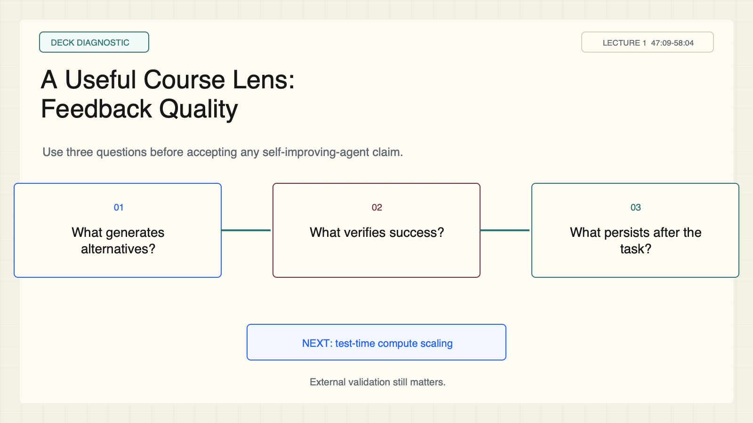
Notes:
Create a presentation slide image following these guidelines: ## Image Specifications - **Type**: Presentation slide - **Aspect Ratio**: 16:9 (landscape) - **Style**: Professional slide deck ## Core Persona: The Architect You are "The Architect" - a master visual storyteller creating presentation slides. Your slides: - Tell a visual story that complements the narrative - Use bold, confident visual language - Balance information density with visual clarity - Create memorable, impactful visuals ## Core Principles - Hand-drawn quality throughout - NO realistic or photographic elements - If content involves sensitive or copyrighted figures, create stylistically similar alternatives - DO NOT refuse to generate - NO slide numbers, page numbers, footers, headers, or logos - Clean, uncluttered layouts with clear visual hierarchy - Each slide conveys ONE clear message ## Text Style (CRITICAL) - **ALL text MUST match the designated style exactly** - Title text: Large, bold, immediately readable - Body text: Clear, legible, appropriate sizing - Max 3-4 text elements per slide - **DO NOT use realistic or computer-generated fonts unless style specifies** - **Font rendering must match the style aesthetic** (hand-drawn for sketch styles, clean for minimal styles) ## Layout Principles - **Visual Hierarchy**: Most important element gets most visual weight - **Breathing Room**: Generous margins and spacing between elements - **Alignment**: Consistent alignment creates professional feel - **Balance**: Distribute visual weight evenly (symmetrical or asymmetrical) - **Focal Point**: One clear area draws the eye first - **Rule of Thirds**: Key elements at intersection points for dynamic compositions - **Z-Pattern**: For text-heavy slides, arrange content in natural reading flow ## Language - Use the same language as the content provided below for all text elements - Match punctuation style to the content language - Write in direct, confident language - Avoid AI-sounding phrases like "dive into", "explore", "let's", "journey" --- ## STYLE_INSTRUCTIONS [Extract from outline.md - do NOT re-read style files] The STYLE_INSTRUCTIONS block from the outline contains: - Design Aesthetic - Background (Texture + Base Color) - Typography (Headlines + Body descriptions) - Color Palette (with hex codes) - Visual Elements - Density Guidelines - Style Rules (Do/Don't) Copy the entire `<STYLE_INSTRUCTIONS>...</STYLE_INSTRUCTIONS>` block from the outline here. --- ## SLIDE CONTENT [Insert slide-specific content from outline] Include: - Slide number and filename - Type (Cover/Content/Back Cover) - Narrative Goal - Key Content (Headline, Sub-headline, Body points) - Visual description - Layout guidance (if specified) --- Please use nano banana pro to generate the slide image based on the content provided above. --- # Slide 12: A Useful Course Lens: Feedback Quality ## Production method Rendered locally as an original 1600x900 SVG for exact text fidelity, then converted to PNG. Do not reproduce Stanford course frames or logos. ## Style Aged-cream academic technical briefing, faint engineering grid, crisp vector diagrams, near-black type, teal feedback paths, cobalt generation, maroon constraints, 8px card corners, no gradients, no decorative imagery. ## On-slide content - Stage: deck diagnostic - Headline: A Useful Course Lens: Feedback Quality - Subtitle: Use three questions before accepting any self-improving-agent claim. - Supporting labels: What generates alternatives?; What verifies success?; What persists after the task? - Evidence: Lecture 1, 47:09-58:04 ## Visual direction Three diagnostic questions arranged around a feedback signal, with a bridge to Lecture 2. ## Teaching objective Apply the framework to a new system before accepting the self-improvement label. ## Speaker notes Close with the three-question diagnostic. Apply it to coding, support, research synthesis, or AI-scientist-style assistance. Assistance and automation do not remove the need for external validation. Bridge to Lecture 2 on test-time compute scaling.

