Slide 1
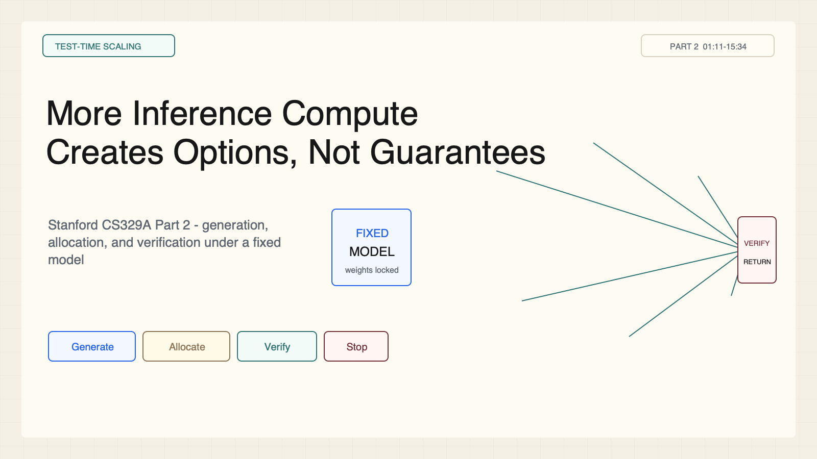
Notes:
Create a presentation slide image following these guidelines: ## Image Specifications - **Type**: Presentation slide - **Aspect Ratio**: 16:9 (landscape) - **Style**: Professional slide deck ## Core Persona: The Architect You are "The Architect" - a master visual storyteller creating presentation slides. Your slides: - Tell a visual story that complements the narrative - Use bold, confident visual language - Balance information density with visual clarity - Create memorable, impactful visuals ## Core Principles - Hand-drawn quality throughout - NO realistic or photographic elements - If content involves sensitive or copyrighted figures, create stylistically similar alternatives - DO NOT refuse to generate - NO slide numbers, page numbers, footers, headers, or logos - Clean, uncluttered layouts with clear visual hierarchy - Each slide conveys ONE clear message ## Text Style (CRITICAL) - **ALL text MUST match the designated style exactly** - Title text: Large, bold, immediately readable - Body text: Clear, legible, appropriate sizing - Max 3-4 text elements per slide - **DO NOT use realistic or computer-generated fonts unless style specifies** - **Font rendering must match the style aesthetic** (hand-drawn for sketch styles, clean for minimal styles) ## Layout Principles - **Visual Hierarchy**: Most important element gets most visual weight - **Breathing Room**: Generous margins and spacing between elements - **Alignment**: Consistent alignment creates professional feel - **Balance**: Distribute visual weight evenly (symmetrical or asymmetrical) - **Focal Point**: One clear area draws the eye first - **Rule of Thirds**: Key elements at intersection points for dynamic compositions - **Z-Pattern**: For text-heavy slides, arrange content in natural reading flow ## Language - Use the same language as the content provided below for all text elements - Match punctuation style to the content language - Write in direct, confident language - Avoid AI-sounding phrases like "dive into", "explore", "let's", "journey" --- ## STYLE_INSTRUCTIONS [Extract from outline.md - do NOT re-read style files] The STYLE_INSTRUCTIONS block from the outline contains: - Design Aesthetic - Background (Texture + Base Color) - Typography (Headlines + Body descriptions) - Color Palette (with hex codes) - Visual Elements - Density Guidelines - Style Rules (Do/Don't) Copy the entire `<STYLE_INSTRUCTIONS>...</STYLE_INSTRUCTIONS>` block from the outline here. --- ## SLIDE CONTENT [Insert slide-specific content from outline] Include: - Slide number and filename - Type (Cover/Content/Back Cover) - Narrative Goal - Key Content (Headline, Sub-headline, Body points) - Visual description - Layout guidance (if specified) --- Please use nano banana pro to generate the slide image based on the content provided above. --- # Slide 1: More Inference Compute Creates Options, Not Guarantees ## Production method Rendered locally as an original 1600x900 SVG for exact text fidelity, then converted to PNG. Do not reproduce Stanford course frames or logos. ## Style Aged-cream academic technical briefing, faint engineering grid, crisp vector diagrams, near-black type, teal verification, cobalt generation, warm-brown budget, maroon constraints, 8px card corners, no gradients, no decorative imagery. ## On-slide content - Stage: test-time scaling - Headline: More Inference Compute Creates Options, Not Guarantees - Subtitle: Stanford CS329A Part 2 - generation, allocation, and verification under a fixed model - Supporting labels: Generate; Allocate; Verify; Stop - Evidence: CS329A Part 2, 01:11-15:34 ## Visual direction A fixed model fans into candidates, a budget router controls the branches, and a narrow verifier gate returns one answer. ## Teaching objective State why extra inference compute is not itself a reliability guarantee. ## Speaker notes More attempts can expose a good candidate that one-shot decoding misses. The deployed system must still allocate its budget and identify success. Ask Q: If one of 100 candidates is correct but a wrong answer is returned, what improved and what did not?

Slide 2
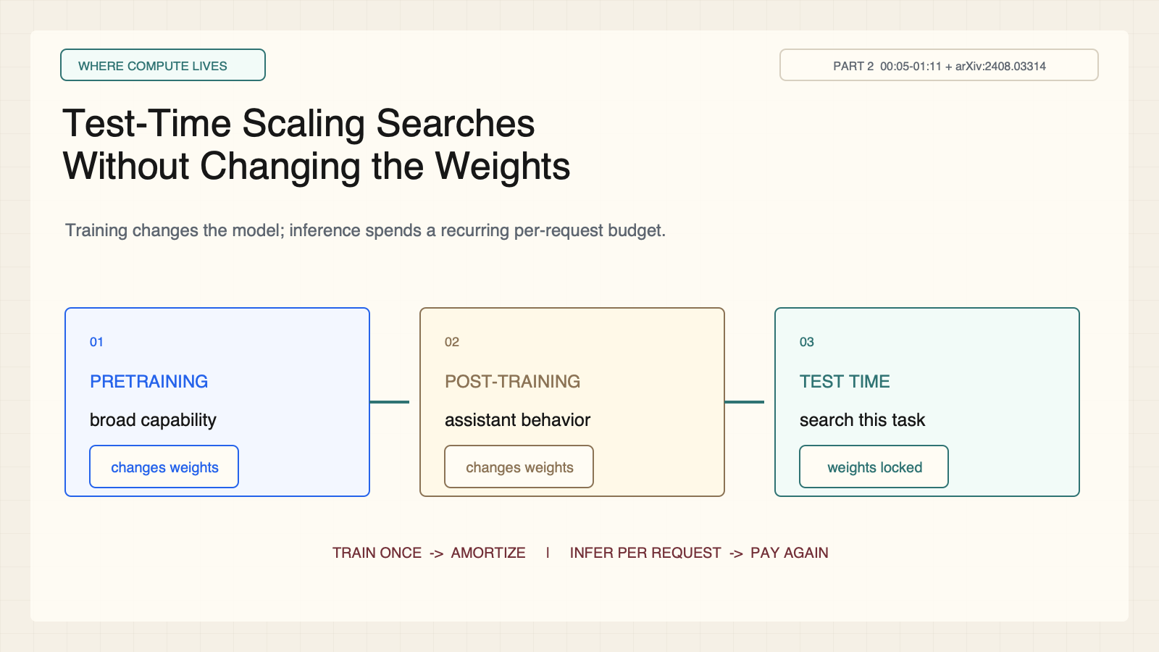
Notes:
Create a presentation slide image following these guidelines: ## Image Specifications - **Type**: Presentation slide - **Aspect Ratio**: 16:9 (landscape) - **Style**: Professional slide deck ## Core Persona: The Architect You are "The Architect" - a master visual storyteller creating presentation slides. Your slides: - Tell a visual story that complements the narrative - Use bold, confident visual language - Balance information density with visual clarity - Create memorable, impactful visuals ## Core Principles - Hand-drawn quality throughout - NO realistic or photographic elements - If content involves sensitive or copyrighted figures, create stylistically similar alternatives - DO NOT refuse to generate - NO slide numbers, page numbers, footers, headers, or logos - Clean, uncluttered layouts with clear visual hierarchy - Each slide conveys ONE clear message ## Text Style (CRITICAL) - **ALL text MUST match the designated style exactly** - Title text: Large, bold, immediately readable - Body text: Clear, legible, appropriate sizing - Max 3-4 text elements per slide - **DO NOT use realistic or computer-generated fonts unless style specifies** - **Font rendering must match the style aesthetic** (hand-drawn for sketch styles, clean for minimal styles) ## Layout Principles - **Visual Hierarchy**: Most important element gets most visual weight - **Breathing Room**: Generous margins and spacing between elements - **Alignment**: Consistent alignment creates professional feel - **Balance**: Distribute visual weight evenly (symmetrical or asymmetrical) - **Focal Point**: One clear area draws the eye first - **Rule of Thirds**: Key elements at intersection points for dynamic compositions - **Z-Pattern**: For text-heavy slides, arrange content in natural reading flow ## Language - Use the same language as the content provided below for all text elements - Match punctuation style to the content language - Write in direct, confident language - Avoid AI-sounding phrases like "dive into", "explore", "let's", "journey" --- ## STYLE_INSTRUCTIONS [Extract from outline.md - do NOT re-read style files] The STYLE_INSTRUCTIONS block from the outline contains: - Design Aesthetic - Background (Texture + Base Color) - Typography (Headlines + Body descriptions) - Color Palette (with hex codes) - Visual Elements - Density Guidelines - Style Rules (Do/Don't) Copy the entire `<STYLE_INSTRUCTIONS>...</STYLE_INSTRUCTIONS>` block from the outline here. --- ## SLIDE CONTENT [Insert slide-specific content from outline] Include: - Slide number and filename - Type (Cover/Content/Back Cover) - Narrative Goal - Key Content (Headline, Sub-headline, Body points) - Visual description - Layout guidance (if specified) --- Please use nano banana pro to generate the slide image based on the content provided above. --- # Slide 2: Test-Time Scaling Searches Without Changing the Weights ## Production method Rendered locally as an original 1600x900 SVG for exact text fidelity, then converted to PNG. Do not reproduce Stanford course frames or logos. ## Style Aged-cream academic technical briefing, faint engineering grid, crisp vector diagrams, near-black type, teal verification, cobalt generation, warm-brown budget, maroon constraints, 8px card corners, no gradients, no decorative imagery. ## On-slide content - Stage: where compute lives - Headline: Test-Time Scaling Searches Without Changing the Weights - Subtitle: Training changes the model; inference spends a recurring per-request budget. - Supporting labels: Pretraining; Post-training; Test time - Evidence: CS329A Part 2, 00:05-01:11 + arXiv:2408.03314 ## Visual direction Three connected compute stages with the test-time model visibly locked. ## Teaching objective Distinguish pretraining, post-training, and test-time compute. ## Speaker notes Pretraining builds broad capability. Post-training shapes behavior. Test-time scaling keeps the weights fixed and spends compute on the current task. Training cost can be amortized; inference cost recurs per request.

Slide 3
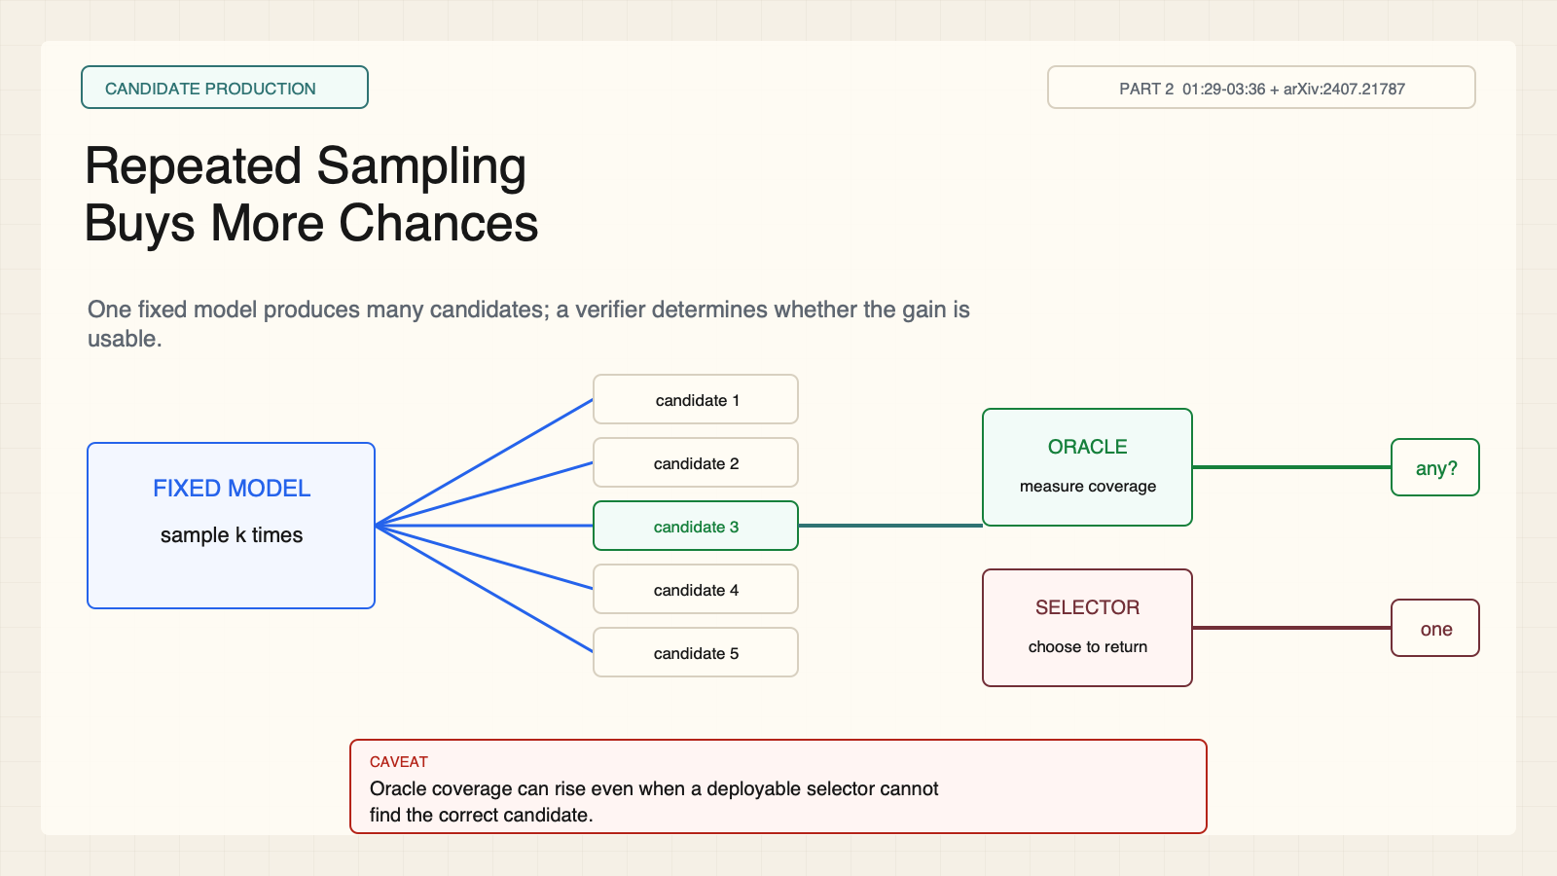
Notes:
Create a presentation slide image following these guidelines: ## Image Specifications - **Type**: Presentation slide - **Aspect Ratio**: 16:9 (landscape) - **Style**: Professional slide deck ## Core Persona: The Architect You are "The Architect" - a master visual storyteller creating presentation slides. Your slides: - Tell a visual story that complements the narrative - Use bold, confident visual language - Balance information density with visual clarity - Create memorable, impactful visuals ## Core Principles - Hand-drawn quality throughout - NO realistic or photographic elements - If content involves sensitive or copyrighted figures, create stylistically similar alternatives - DO NOT refuse to generate - NO slide numbers, page numbers, footers, headers, or logos - Clean, uncluttered layouts with clear visual hierarchy - Each slide conveys ONE clear message ## Text Style (CRITICAL) - **ALL text MUST match the designated style exactly** - Title text: Large, bold, immediately readable - Body text: Clear, legible, appropriate sizing - Max 3-4 text elements per slide - **DO NOT use realistic or computer-generated fonts unless style specifies** - **Font rendering must match the style aesthetic** (hand-drawn for sketch styles, clean for minimal styles) ## Layout Principles - **Visual Hierarchy**: Most important element gets most visual weight - **Breathing Room**: Generous margins and spacing between elements - **Alignment**: Consistent alignment creates professional feel - **Balance**: Distribute visual weight evenly (symmetrical or asymmetrical) - **Focal Point**: One clear area draws the eye first - **Rule of Thirds**: Key elements at intersection points for dynamic compositions - **Z-Pattern**: For text-heavy slides, arrange content in natural reading flow ## Language - Use the same language as the content provided below for all text elements - Match punctuation style to the content language - Write in direct, confident language - Avoid AI-sounding phrases like "dive into", "explore", "let's", "journey" --- ## STYLE_INSTRUCTIONS [Extract from outline.md - do NOT re-read style files] The STYLE_INSTRUCTIONS block from the outline contains: - Design Aesthetic - Background (Texture + Base Color) - Typography (Headlines + Body descriptions) - Color Palette (with hex codes) - Visual Elements - Density Guidelines - Style Rules (Do/Don't) Copy the entire `<STYLE_INSTRUCTIONS>...</STYLE_INSTRUCTIONS>` block from the outline here. --- ## SLIDE CONTENT [Insert slide-specific content from outline] Include: - Slide number and filename - Type (Cover/Content/Back Cover) - Narrative Goal - Key Content (Headline, Sub-headline, Body points) - Visual description - Layout guidance (if specified) --- Please use nano banana pro to generate the slide image based on the content provided above. --- # Slide 3: Repeated Sampling Buys More Chances ## Production method Rendered locally as an original 1600x900 SVG for exact text fidelity, then converted to PNG. Do not reproduce Stanford course frames or logos. ## Style Aged-cream academic technical briefing, faint engineering grid, crisp vector diagrams, near-black type, teal verification, cobalt generation, warm-brown budget, maroon constraints, 8px card corners, no gradients, no decorative imagery. ## On-slide content - Stage: candidate production - Headline: Repeated Sampling Buys More Chances - Subtitle: One fixed model produces many candidates; a verifier determines whether the gain is usable. - Supporting labels: Fixed model; k candidates; Oracle coverage; Deployable selector - Evidence: CS329A Part 2, 01:29-03:36 + arXiv:2407.21787 ## Visual direction A model fans into eight candidates, then passes through separate oracle and deployable gates. ## Teaching objective Explain repeated sampling and the role of a verifier. ## Speaker notes Repeated sampling is the simplest test-time strategy. An oracle verifier can measure whether any candidate is correct, but a deployable selector may not know which candidate is right. Ask which tasks provide executable verification.

Slide 4
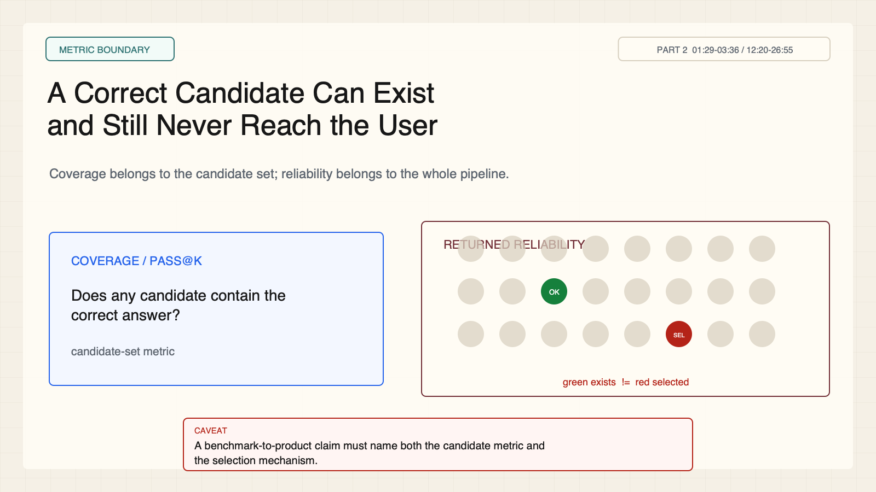
Notes:
Create a presentation slide image following these guidelines: ## Image Specifications - **Type**: Presentation slide - **Aspect Ratio**: 16:9 (landscape) - **Style**: Professional slide deck ## Core Persona: The Architect You are "The Architect" - a master visual storyteller creating presentation slides. Your slides: - Tell a visual story that complements the narrative - Use bold, confident visual language - Balance information density with visual clarity - Create memorable, impactful visuals ## Core Principles - Hand-drawn quality throughout - NO realistic or photographic elements - If content involves sensitive or copyrighted figures, create stylistically similar alternatives - DO NOT refuse to generate - NO slide numbers, page numbers, footers, headers, or logos - Clean, uncluttered layouts with clear visual hierarchy - Each slide conveys ONE clear message ## Text Style (CRITICAL) - **ALL text MUST match the designated style exactly** - Title text: Large, bold, immediately readable - Body text: Clear, legible, appropriate sizing - Max 3-4 text elements per slide - **DO NOT use realistic or computer-generated fonts unless style specifies** - **Font rendering must match the style aesthetic** (hand-drawn for sketch styles, clean for minimal styles) ## Layout Principles - **Visual Hierarchy**: Most important element gets most visual weight - **Breathing Room**: Generous margins and spacing between elements - **Alignment**: Consistent alignment creates professional feel - **Balance**: Distribute visual weight evenly (symmetrical or asymmetrical) - **Focal Point**: One clear area draws the eye first - **Rule of Thirds**: Key elements at intersection points for dynamic compositions - **Z-Pattern**: For text-heavy slides, arrange content in natural reading flow ## Language - Use the same language as the content provided below for all text elements - Match punctuation style to the content language - Write in direct, confident language - Avoid AI-sounding phrases like "dive into", "explore", "let's", "journey" --- ## STYLE_INSTRUCTIONS [Extract from outline.md - do NOT re-read style files] The STYLE_INSTRUCTIONS block from the outline contains: - Design Aesthetic - Background (Texture + Base Color) - Typography (Headlines + Body descriptions) - Color Palette (with hex codes) - Visual Elements - Density Guidelines - Style Rules (Do/Don't) Copy the entire `<STYLE_INSTRUCTIONS>...</STYLE_INSTRUCTIONS>` block from the outline here. --- ## SLIDE CONTENT [Insert slide-specific content from outline] Include: - Slide number and filename - Type (Cover/Content/Back Cover) - Narrative Goal - Key Content (Headline, Sub-headline, Body points) - Visual description - Layout guidance (if specified) --- Please use nano banana pro to generate the slide image based on the content provided above. --- # Slide 4: A Correct Candidate Can Exist and Still Never Reach the User ## Production method Rendered locally as an original 1600x900 SVG for exact text fidelity, then converted to PNG. Do not reproduce Stanford course frames or logos. ## Style Aged-cream academic technical briefing, faint engineering grid, crisp vector diagrams, near-black type, teal verification, cobalt generation, warm-brown budget, maroon constraints, 8px card corners, no gradients, no decorative imagery. ## On-slide content - Stage: metric boundary - Headline: A Correct Candidate Can Exist and Still Never Reach the User - Subtitle: Coverage belongs to the candidate set; reliability belongs to the whole pipeline. - Supporting labels: coverage / pass@k; returned answer; selector error - Evidence: CS329A Part 2, 01:29-03:36 / 12:20-26:55 ## Visual direction A candidate grid contains a correct answer while a separate wrong answer is selected. ## Teaching objective Separate candidate coverage from returned-answer reliability. ## Speaker notes A green candidate in the set improves coverage. If the selector returns a red candidate, deployed reliability did not improve. This is the key benchmark-to-product distinction.

Slide 5
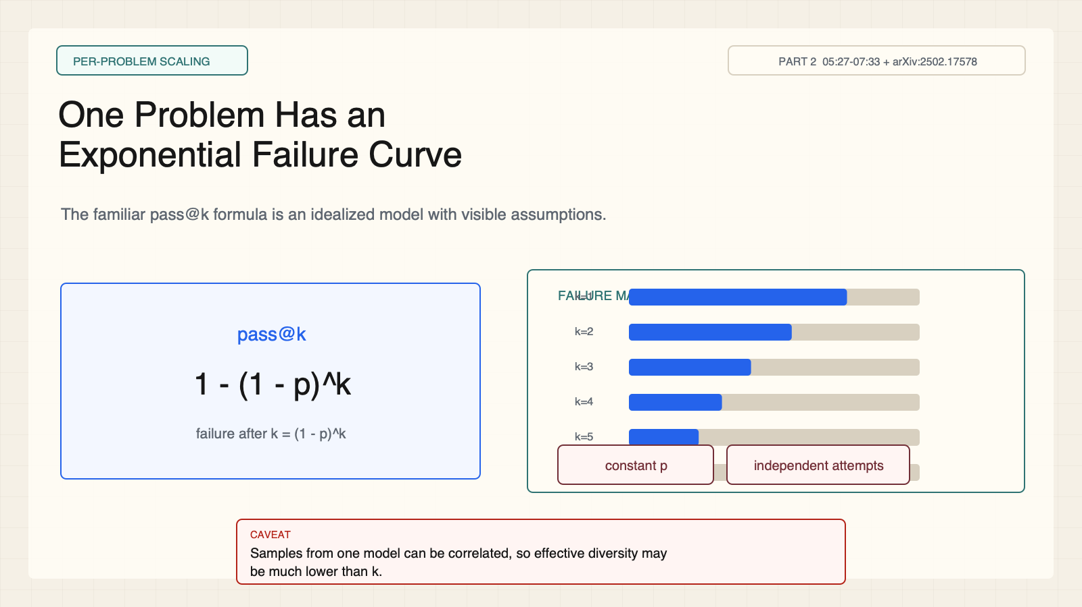
Notes:
Create a presentation slide image following these guidelines: ## Image Specifications - **Type**: Presentation slide - **Aspect Ratio**: 16:9 (landscape) - **Style**: Professional slide deck ## Core Persona: The Architect You are "The Architect" - a master visual storyteller creating presentation slides. Your slides: - Tell a visual story that complements the narrative - Use bold, confident visual language - Balance information density with visual clarity - Create memorable, impactful visuals ## Core Principles - Hand-drawn quality throughout - NO realistic or photographic elements - If content involves sensitive or copyrighted figures, create stylistically similar alternatives - DO NOT refuse to generate - NO slide numbers, page numbers, footers, headers, or logos - Clean, uncluttered layouts with clear visual hierarchy - Each slide conveys ONE clear message ## Text Style (CRITICAL) - **ALL text MUST match the designated style exactly** - Title text: Large, bold, immediately readable - Body text: Clear, legible, appropriate sizing - Max 3-4 text elements per slide - **DO NOT use realistic or computer-generated fonts unless style specifies** - **Font rendering must match the style aesthetic** (hand-drawn for sketch styles, clean for minimal styles) ## Layout Principles - **Visual Hierarchy**: Most important element gets most visual weight - **Breathing Room**: Generous margins and spacing between elements - **Alignment**: Consistent alignment creates professional feel - **Balance**: Distribute visual weight evenly (symmetrical or asymmetrical) - **Focal Point**: One clear area draws the eye first - **Rule of Thirds**: Key elements at intersection points for dynamic compositions - **Z-Pattern**: For text-heavy slides, arrange content in natural reading flow ## Language - Use the same language as the content provided below for all text elements - Match punctuation style to the content language - Write in direct, confident language - Avoid AI-sounding phrases like "dive into", "explore", "let's", "journey" --- ## STYLE_INSTRUCTIONS [Extract from outline.md - do NOT re-read style files] The STYLE_INSTRUCTIONS block from the outline contains: - Design Aesthetic - Background (Texture + Base Color) - Typography (Headlines + Body descriptions) - Color Palette (with hex codes) - Visual Elements - Density Guidelines - Style Rules (Do/Don't) Copy the entire `<STYLE_INSTRUCTIONS>...</STYLE_INSTRUCTIONS>` block from the outline here. --- ## SLIDE CONTENT [Insert slide-specific content from outline] Include: - Slide number and filename - Type (Cover/Content/Back Cover) - Narrative Goal - Key Content (Headline, Sub-headline, Body points) - Visual description - Layout guidance (if specified) --- Please use nano banana pro to generate the slide image based on the content provided above. --- # Slide 5: One Problem Has an Exponential Failure Curve ## Production method Rendered locally as an original 1600x900 SVG for exact text fidelity, then converted to PNG. Do not reproduce Stanford course frames or logos. ## Style Aged-cream academic technical briefing, faint engineering grid, crisp vector diagrams, near-black type, teal verification, cobalt generation, warm-brown budget, maroon constraints, 8px card corners, no gradients, no decorative imagery. ## On-slide content - Stage: per-problem scaling - Headline: One Problem Has an Exponential Failure Curve - Subtitle: The familiar pass@k formula is an idealized model with visible assumptions. - Supporting labels: pass@k = 1 - (1-p)^k; constant p; independent attempts - Evidence: CS329A Part 2, 05:27-07:33 + arXiv:2502.17578 ## Visual direction A formula card and a sequence of shrinking failure bars across attempts. ## Teaching objective Derive the per-problem pass@k intuition and name its assumptions. ## Speaker notes Under independent attempts with constant success probability p, failure after k attempts is (1-p)^k. Samples from one model can fail in correlated ways, so the formula is an intuition, not a deployment guarantee.

Slide 6
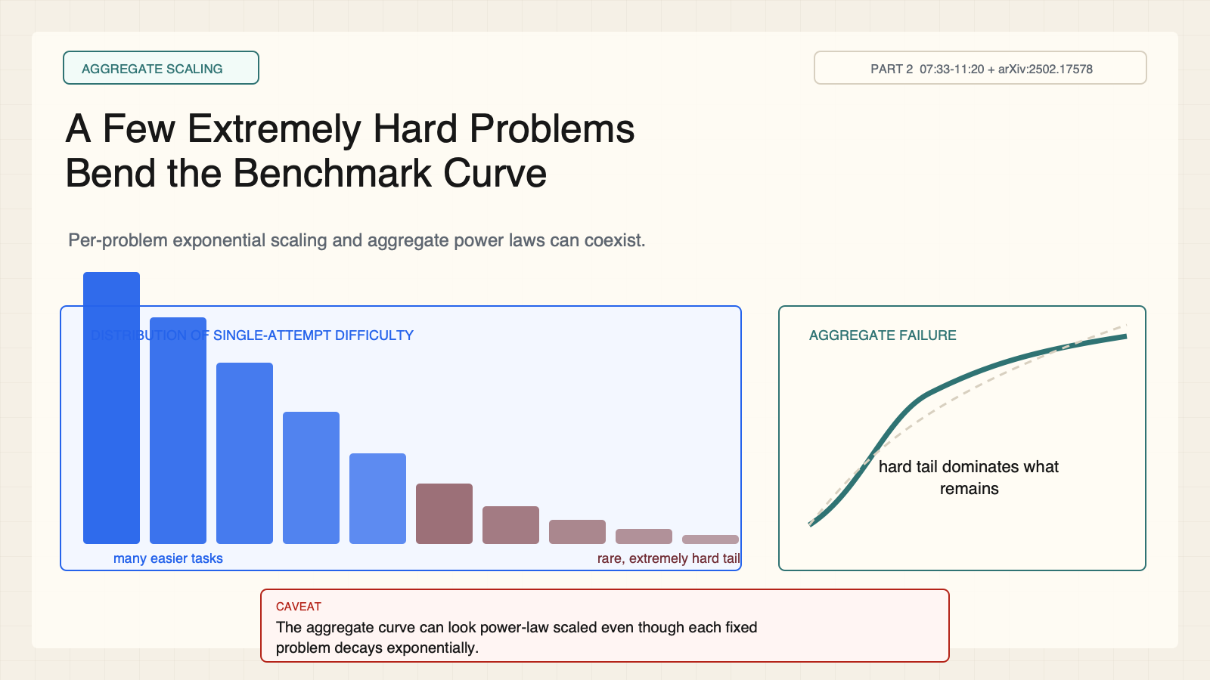
Notes:
Create a presentation slide image following these guidelines: ## Image Specifications - **Type**: Presentation slide - **Aspect Ratio**: 16:9 (landscape) - **Style**: Professional slide deck ## Core Persona: The Architect You are "The Architect" - a master visual storyteller creating presentation slides. Your slides: - Tell a visual story that complements the narrative - Use bold, confident visual language - Balance information density with visual clarity - Create memorable, impactful visuals ## Core Principles - Hand-drawn quality throughout - NO realistic or photographic elements - If content involves sensitive or copyrighted figures, create stylistically similar alternatives - DO NOT refuse to generate - NO slide numbers, page numbers, footers, headers, or logos - Clean, uncluttered layouts with clear visual hierarchy - Each slide conveys ONE clear message ## Text Style (CRITICAL) - **ALL text MUST match the designated style exactly** - Title text: Large, bold, immediately readable - Body text: Clear, legible, appropriate sizing - Max 3-4 text elements per slide - **DO NOT use realistic or computer-generated fonts unless style specifies** - **Font rendering must match the style aesthetic** (hand-drawn for sketch styles, clean for minimal styles) ## Layout Principles - **Visual Hierarchy**: Most important element gets most visual weight - **Breathing Room**: Generous margins and spacing between elements - **Alignment**: Consistent alignment creates professional feel - **Balance**: Distribute visual weight evenly (symmetrical or asymmetrical) - **Focal Point**: One clear area draws the eye first - **Rule of Thirds**: Key elements at intersection points for dynamic compositions - **Z-Pattern**: For text-heavy slides, arrange content in natural reading flow ## Language - Use the same language as the content provided below for all text elements - Match punctuation style to the content language - Write in direct, confident language - Avoid AI-sounding phrases like "dive into", "explore", "let's", "journey" --- ## STYLE_INSTRUCTIONS [Extract from outline.md - do NOT re-read style files] The STYLE_INSTRUCTIONS block from the outline contains: - Design Aesthetic - Background (Texture + Base Color) - Typography (Headlines + Body descriptions) - Color Palette (with hex codes) - Visual Elements - Density Guidelines - Style Rules (Do/Don't) Copy the entire `<STYLE_INSTRUCTIONS>...</STYLE_INSTRUCTIONS>` block from the outline here. --- ## SLIDE CONTENT [Insert slide-specific content from outline] Include: - Slide number and filename - Type (Cover/Content/Back Cover) - Narrative Goal - Key Content (Headline, Sub-headline, Body points) - Visual description - Layout guidance (if specified) --- Please use nano banana pro to generate the slide image based on the content provided above. --- # Slide 6: A Few Extremely Hard Problems Bend the Benchmark Curve ## Production method Rendered locally as an original 1600x900 SVG for exact text fidelity, then converted to PNG. Do not reproduce Stanford course frames or logos. ## Style Aged-cream academic technical briefing, faint engineering grid, crisp vector diagrams, near-black type, teal verification, cobalt generation, warm-brown budget, maroon constraints, 8px card corners, no gradients, no decorative imagery. ## On-slide content - Stage: aggregate scaling - Headline: A Few Extremely Hard Problems Bend the Benchmark Curve - Subtitle: Per-problem exponential scaling and aggregate power laws can coexist. - Supporting labels: many easy; some medium; rare extreme tail; aggregate curve - Evidence: CS329A Part 2, 07:33-11:20 + arXiv:2502.17578 ## Visual direction A heavy-tailed distribution of problem difficulty feeding an aggregate scaling curve. ## Teaching objective Explain why a benchmark average can look power-law scaled. ## Speaker notes Easy problems leave the failure pool quickly. A long tail of tasks with tiny single-attempt success probabilities dominates what remains. The power-law observation is aggregate, not a claim that each problem follows a power law.

Slide 7
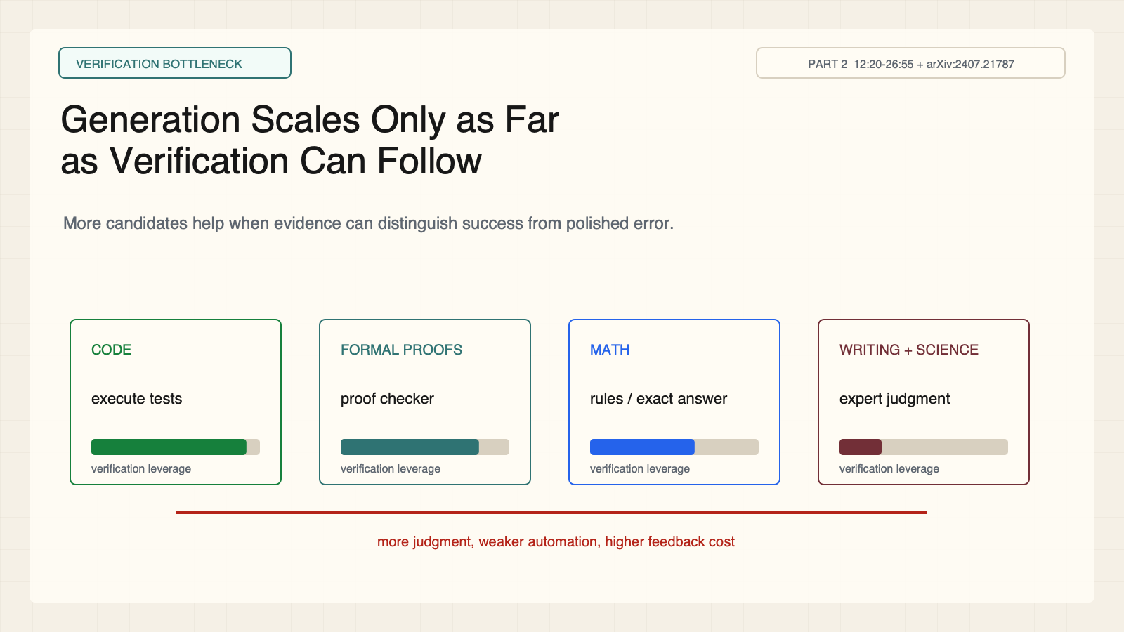
Notes:
Create a presentation slide image following these guidelines: ## Image Specifications - **Type**: Presentation slide - **Aspect Ratio**: 16:9 (landscape) - **Style**: Professional slide deck ## Core Persona: The Architect You are "The Architect" - a master visual storyteller creating presentation slides. Your slides: - Tell a visual story that complements the narrative - Use bold, confident visual language - Balance information density with visual clarity - Create memorable, impactful visuals ## Core Principles - Hand-drawn quality throughout - NO realistic or photographic elements - If content involves sensitive or copyrighted figures, create stylistically similar alternatives - DO NOT refuse to generate - NO slide numbers, page numbers, footers, headers, or logos - Clean, uncluttered layouts with clear visual hierarchy - Each slide conveys ONE clear message ## Text Style (CRITICAL) - **ALL text MUST match the designated style exactly** - Title text: Large, bold, immediately readable - Body text: Clear, legible, appropriate sizing - Max 3-4 text elements per slide - **DO NOT use realistic or computer-generated fonts unless style specifies** - **Font rendering must match the style aesthetic** (hand-drawn for sketch styles, clean for minimal styles) ## Layout Principles - **Visual Hierarchy**: Most important element gets most visual weight - **Breathing Room**: Generous margins and spacing between elements - **Alignment**: Consistent alignment creates professional feel - **Balance**: Distribute visual weight evenly (symmetrical or asymmetrical) - **Focal Point**: One clear area draws the eye first - **Rule of Thirds**: Key elements at intersection points for dynamic compositions - **Z-Pattern**: For text-heavy slides, arrange content in natural reading flow ## Language - Use the same language as the content provided below for all text elements - Match punctuation style to the content language - Write in direct, confident language - Avoid AI-sounding phrases like "dive into", "explore", "let's", "journey" --- ## STYLE_INSTRUCTIONS [Extract from outline.md - do NOT re-read style files] The STYLE_INSTRUCTIONS block from the outline contains: - Design Aesthetic - Background (Texture + Base Color) - Typography (Headlines + Body descriptions) - Color Palette (with hex codes) - Visual Elements - Density Guidelines - Style Rules (Do/Don't) Copy the entire `<STYLE_INSTRUCTIONS>...</STYLE_INSTRUCTIONS>` block from the outline here. --- ## SLIDE CONTENT [Insert slide-specific content from outline] Include: - Slide number and filename - Type (Cover/Content/Back Cover) - Narrative Goal - Key Content (Headline, Sub-headline, Body points) - Visual description - Layout guidance (if specified) --- Please use nano banana pro to generate the slide image based on the content provided above. --- # Slide 7: Generation Scales Only as Far as Verification Can Follow ## Production method Rendered locally as an original 1600x900 SVG for exact text fidelity, then converted to PNG. Do not reproduce Stanford course frames or logos. ## Style Aged-cream academic technical briefing, faint engineering grid, crisp vector diagrams, near-black type, teal verification, cobalt generation, warm-brown budget, maroon constraints, 8px card corners, no gradients, no decorative imagery. ## On-slide content - Stage: verification bottleneck - Headline: Generation Scales Only as Far as Verification Can Follow - Subtitle: More candidates help when evidence can distinguish success from polished error. - Supporting labels: Code tests; Proof checker; Exact answers; Expert judgment - Evidence: CS329A Part 2, 12:20-26:55 + arXiv:2407.21787 ## Visual direction A verification ladder from executable checks to open-ended expert judgment beside a widening gap. ## Teaching objective Compare verification cost and completeness across domains. ## Speaker notes Executable tests can cheaply reject candidates that violate specified checks; they do not prove general correctness. Proof assistants can check formalized proofs. Writing, policy, and science depend on incomplete evaluators or expensive experts. Learned selectors can plateau even while coverage rises.

Slide 8
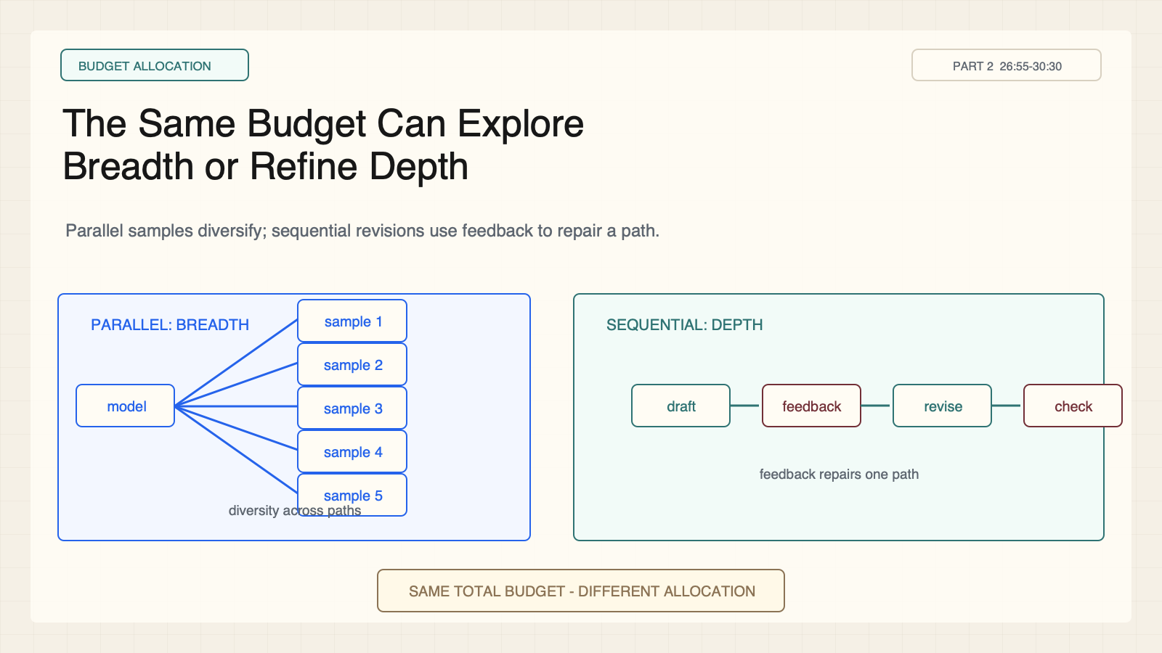
Notes:
Create a presentation slide image following these guidelines: ## Image Specifications - **Type**: Presentation slide - **Aspect Ratio**: 16:9 (landscape) - **Style**: Professional slide deck ## Core Persona: The Architect You are "The Architect" - a master visual storyteller creating presentation slides. Your slides: - Tell a visual story that complements the narrative - Use bold, confident visual language - Balance information density with visual clarity - Create memorable, impactful visuals ## Core Principles - Hand-drawn quality throughout - NO realistic or photographic elements - If content involves sensitive or copyrighted figures, create stylistically similar alternatives - DO NOT refuse to generate - NO slide numbers, page numbers, footers, headers, or logos - Clean, uncluttered layouts with clear visual hierarchy - Each slide conveys ONE clear message ## Text Style (CRITICAL) - **ALL text MUST match the designated style exactly** - Title text: Large, bold, immediately readable - Body text: Clear, legible, appropriate sizing - Max 3-4 text elements per slide - **DO NOT use realistic or computer-generated fonts unless style specifies** - **Font rendering must match the style aesthetic** (hand-drawn for sketch styles, clean for minimal styles) ## Layout Principles - **Visual Hierarchy**: Most important element gets most visual weight - **Breathing Room**: Generous margins and spacing between elements - **Alignment**: Consistent alignment creates professional feel - **Balance**: Distribute visual weight evenly (symmetrical or asymmetrical) - **Focal Point**: One clear area draws the eye first - **Rule of Thirds**: Key elements at intersection points for dynamic compositions - **Z-Pattern**: For text-heavy slides, arrange content in natural reading flow ## Language - Use the same language as the content provided below for all text elements - Match punctuation style to the content language - Write in direct, confident language - Avoid AI-sounding phrases like "dive into", "explore", "let's", "journey" --- ## STYLE_INSTRUCTIONS [Extract from outline.md - do NOT re-read style files] The STYLE_INSTRUCTIONS block from the outline contains: - Design Aesthetic - Background (Texture + Base Color) - Typography (Headlines + Body descriptions) - Color Palette (with hex codes) - Visual Elements - Density Guidelines - Style Rules (Do/Don't) Copy the entire `<STYLE_INSTRUCTIONS>...</STYLE_INSTRUCTIONS>` block from the outline here. --- ## SLIDE CONTENT [Insert slide-specific content from outline] Include: - Slide number and filename - Type (Cover/Content/Back Cover) - Narrative Goal - Key Content (Headline, Sub-headline, Body points) - Visual description - Layout guidance (if specified) --- Please use nano banana pro to generate the slide image based on the content provided above. --- # Slide 8: The Same Budget Can Explore Breadth or Refine Depth ## Production method Rendered locally as an original 1600x900 SVG for exact text fidelity, then converted to PNG. Do not reproduce Stanford course frames or logos. ## Style Aged-cream academic technical briefing, faint engineering grid, crisp vector diagrams, near-black type, teal verification, cobalt generation, warm-brown budget, maroon constraints, 8px card corners, no gradients, no decorative imagery. ## On-slide content - Stage: budget allocation - Headline: The Same Budget Can Explore Breadth or Refine Depth - Subtitle: Parallel samples diversify; sequential revisions use feedback to repair a path. - Supporting labels: Parallel; Sequential; same token budget - Evidence: CS329A Part 2, 26:55-30:30 ## Visual direction Equal budget meters feed a broad candidate fan and a deep revision chain. ## Teaching objective Compare parallel sampling with sequential revision. ## Speaker notes Parallel sampling spreads compute across multiple stochastic candidates, whose failures can remain correlated. Sequential revision follows one or more paths and uses feedback. Neither dominates universally; correlation, feedback quality, and difficulty determine the useful mix.

Slide 9
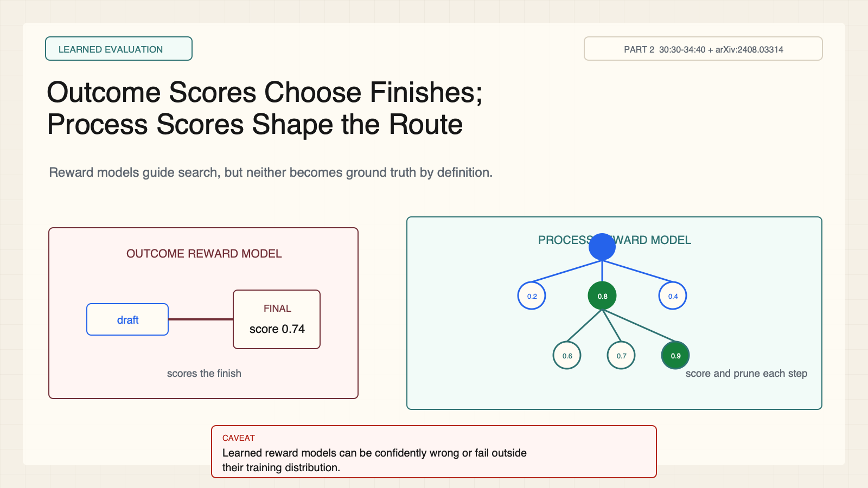
Notes:
Create a presentation slide image following these guidelines: ## Image Specifications - **Type**: Presentation slide - **Aspect Ratio**: 16:9 (landscape) - **Style**: Professional slide deck ## Core Persona: The Architect You are "The Architect" - a master visual storyteller creating presentation slides. Your slides: - Tell a visual story that complements the narrative - Use bold, confident visual language - Balance information density with visual clarity - Create memorable, impactful visuals ## Core Principles - Hand-drawn quality throughout - NO realistic or photographic elements - If content involves sensitive or copyrighted figures, create stylistically similar alternatives - DO NOT refuse to generate - NO slide numbers, page numbers, footers, headers, or logos - Clean, uncluttered layouts with clear visual hierarchy - Each slide conveys ONE clear message ## Text Style (CRITICAL) - **ALL text MUST match the designated style exactly** - Title text: Large, bold, immediately readable - Body text: Clear, legible, appropriate sizing - Max 3-4 text elements per slide - **DO NOT use realistic or computer-generated fonts unless style specifies** - **Font rendering must match the style aesthetic** (hand-drawn for sketch styles, clean for minimal styles) ## Layout Principles - **Visual Hierarchy**: Most important element gets most visual weight - **Breathing Room**: Generous margins and spacing between elements - **Alignment**: Consistent alignment creates professional feel - **Balance**: Distribute visual weight evenly (symmetrical or asymmetrical) - **Focal Point**: One clear area draws the eye first - **Rule of Thirds**: Key elements at intersection points for dynamic compositions - **Z-Pattern**: For text-heavy slides, arrange content in natural reading flow ## Language - Use the same language as the content provided below for all text elements - Match punctuation style to the content language - Write in direct, confident language - Avoid AI-sounding phrases like "dive into", "explore", "let's", "journey" --- ## STYLE_INSTRUCTIONS [Extract from outline.md - do NOT re-read style files] The STYLE_INSTRUCTIONS block from the outline contains: - Design Aesthetic - Background (Texture + Base Color) - Typography (Headlines + Body descriptions) - Color Palette (with hex codes) - Visual Elements - Density Guidelines - Style Rules (Do/Don't) Copy the entire `<STYLE_INSTRUCTIONS>...</STYLE_INSTRUCTIONS>` block from the outline here. --- ## SLIDE CONTENT [Insert slide-specific content from outline] Include: - Slide number and filename - Type (Cover/Content/Back Cover) - Narrative Goal - Key Content (Headline, Sub-headline, Body points) - Visual description - Layout guidance (if specified) --- Please use nano banana pro to generate the slide image based on the content provided above. --- # Slide 9: Outcome Scores Choose Finishes; Process Scores Shape the Route ## Production method Rendered locally as an original 1600x900 SVG for exact text fidelity, then converted to PNG. Do not reproduce Stanford course frames or logos. ## Style Aged-cream academic technical briefing, faint engineering grid, crisp vector diagrams, near-black type, teal verification, cobalt generation, warm-brown budget, maroon constraints, 8px card corners, no gradients, no decorative imagery. ## On-slide content - Stage: learned evaluation - Headline: Outcome Scores Choose Finishes; Process Scores Shape the Route - Subtitle: Reward models guide search, but neither becomes ground truth by definition. - Supporting labels: ORM: final answer; PRM: each step; beam search - Evidence: CS329A Part 2, 30:30-34:40 + arXiv:2408.03314 ## Visual direction A final-only scorecard beside a tree whose intermediate nodes receive scores and pruning marks. ## Teaching objective Distinguish outcome and process reward models. ## Speaker notes An ORM scores the final answer. A PRM scores intermediate steps and can guide beam search. Both are learned evaluators that can be wrong or fail outside their training distribution.

Slide 10
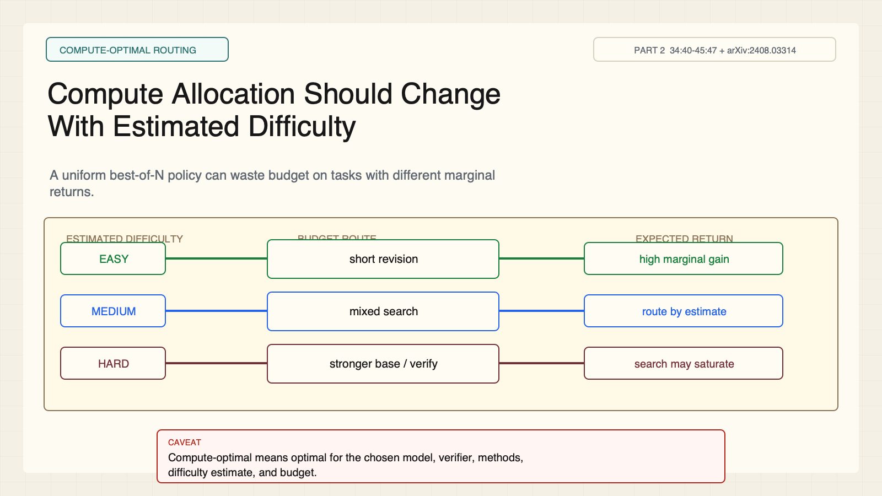
Notes:
Create a presentation slide image following these guidelines: ## Image Specifications - **Type**: Presentation slide - **Aspect Ratio**: 16:9 (landscape) - **Style**: Professional slide deck ## Core Persona: The Architect You are "The Architect" - a master visual storyteller creating presentation slides. Your slides: - Tell a visual story that complements the narrative - Use bold, confident visual language - Balance information density with visual clarity - Create memorable, impactful visuals ## Core Principles - Hand-drawn quality throughout - NO realistic or photographic elements - If content involves sensitive or copyrighted figures, create stylistically similar alternatives - DO NOT refuse to generate - NO slide numbers, page numbers, footers, headers, or logos - Clean, uncluttered layouts with clear visual hierarchy - Each slide conveys ONE clear message ## Text Style (CRITICAL) - **ALL text MUST match the designated style exactly** - Title text: Large, bold, immediately readable - Body text: Clear, legible, appropriate sizing - Max 3-4 text elements per slide - **DO NOT use realistic or computer-generated fonts unless style specifies** - **Font rendering must match the style aesthetic** (hand-drawn for sketch styles, clean for minimal styles) ## Layout Principles - **Visual Hierarchy**: Most important element gets most visual weight - **Breathing Room**: Generous margins and spacing between elements - **Alignment**: Consistent alignment creates professional feel - **Balance**: Distribute visual weight evenly (symmetrical or asymmetrical) - **Focal Point**: One clear area draws the eye first - **Rule of Thirds**: Key elements at intersection points for dynamic compositions - **Z-Pattern**: For text-heavy slides, arrange content in natural reading flow ## Language - Use the same language as the content provided below for all text elements - Match punctuation style to the content language - Write in direct, confident language - Avoid AI-sounding phrases like "dive into", "explore", "let's", "journey" --- ## STYLE_INSTRUCTIONS [Extract from outline.md - do NOT re-read style files] The STYLE_INSTRUCTIONS block from the outline contains: - Design Aesthetic - Background (Texture + Base Color) - Typography (Headlines + Body descriptions) - Color Palette (with hex codes) - Visual Elements - Density Guidelines - Style Rules (Do/Don't) Copy the entire `<STYLE_INSTRUCTIONS>...</STYLE_INSTRUCTIONS>` block from the outline here. --- ## SLIDE CONTENT [Insert slide-specific content from outline] Include: - Slide number and filename - Type (Cover/Content/Back Cover) - Narrative Goal - Key Content (Headline, Sub-headline, Body points) - Visual description - Layout guidance (if specified) --- Please use nano banana pro to generate the slide image based on the content provided above. --- # Slide 10: Compute Allocation Should Change With Estimated Difficulty ## Production method Rendered locally as an original 1600x900 SVG for exact text fidelity, then converted to PNG. Do not reproduce Stanford course frames or logos. ## Style Aged-cream academic technical briefing, faint engineering grid, crisp vector diagrams, near-black type, teal verification, cobalt generation, warm-brown budget, maroon constraints, 8px card corners, no gradients, no decorative imagery. ## On-slide content - Stage: compute-optimal routing - Headline: Compute Allocation Should Change With Estimated Difficulty - Subtitle: A uniform best-of-N policy can waste budget on tasks with different marginal returns. - Supporting labels: Easy; Medium; Hard; setup-specific - Evidence: CS329A Part 2, 34:40-45:47 + arXiv:2408.03314 ## Visual direction A difficulty router sends tasks into different parallel-versus-sequential mixes. ## Teaching objective Explain difficulty-aware allocation without universalizing the experiment. ## Speaker notes The studied setup routes difficulty bands to different search mixes. Extremely hard tasks may gain little from more search if the base model rarely reaches a promising path. Compute optimal means optimal under a chosen model, verifier, methods, and budget.

Slide 11
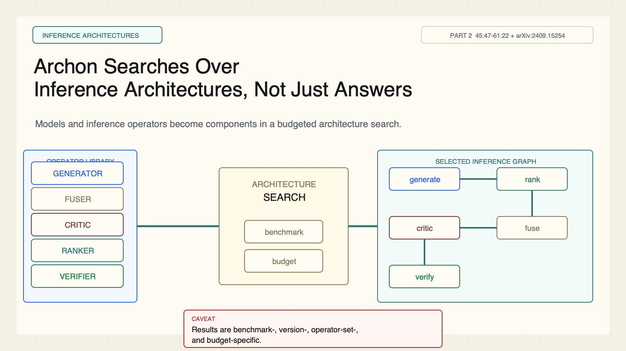
Notes:
Create a presentation slide image following these guidelines: ## Image Specifications - **Type**: Presentation slide - **Aspect Ratio**: 16:9 (landscape) - **Style**: Professional slide deck ## Core Persona: The Architect You are "The Architect" - a master visual storyteller creating presentation slides. Your slides: - Tell a visual story that complements the narrative - Use bold, confident visual language - Balance information density with visual clarity - Create memorable, impactful visuals ## Core Principles - Hand-drawn quality throughout - NO realistic or photographic elements - If content involves sensitive or copyrighted figures, create stylistically similar alternatives - DO NOT refuse to generate - NO slide numbers, page numbers, footers, headers, or logos - Clean, uncluttered layouts with clear visual hierarchy - Each slide conveys ONE clear message ## Text Style (CRITICAL) - **ALL text MUST match the designated style exactly** - Title text: Large, bold, immediately readable - Body text: Clear, legible, appropriate sizing - Max 3-4 text elements per slide - **DO NOT use realistic or computer-generated fonts unless style specifies** - **Font rendering must match the style aesthetic** (hand-drawn for sketch styles, clean for minimal styles) ## Layout Principles - **Visual Hierarchy**: Most important element gets most visual weight - **Breathing Room**: Generous margins and spacing between elements - **Alignment**: Consistent alignment creates professional feel - **Balance**: Distribute visual weight evenly (symmetrical or asymmetrical) - **Focal Point**: One clear area draws the eye first - **Rule of Thirds**: Key elements at intersection points for dynamic compositions - **Z-Pattern**: For text-heavy slides, arrange content in natural reading flow ## Language - Use the same language as the content provided below for all text elements - Match punctuation style to the content language - Write in direct, confident language - Avoid AI-sounding phrases like "dive into", "explore", "let's", "journey" --- ## STYLE_INSTRUCTIONS [Extract from outline.md - do NOT re-read style files] The STYLE_INSTRUCTIONS block from the outline contains: - Design Aesthetic - Background (Texture + Base Color) - Typography (Headlines + Body descriptions) - Color Palette (with hex codes) - Visual Elements - Density Guidelines - Style Rules (Do/Don't) Copy the entire `<STYLE_INSTRUCTIONS>...</STYLE_INSTRUCTIONS>` block from the outline here. --- ## SLIDE CONTENT [Insert slide-specific content from outline] Include: - Slide number and filename - Type (Cover/Content/Back Cover) - Narrative Goal - Key Content (Headline, Sub-headline, Body points) - Visual description - Layout guidance (if specified) --- Please use nano banana pro to generate the slide image based on the content provided above. --- # Slide 11: Archon Searches Over Inference Architectures, Not Just Answers ## Production method Rendered locally as an original 1600x900 SVG for exact text fidelity, then converted to PNG. Do not reproduce Stanford course frames or logos. ## Style Aged-cream academic technical briefing, faint engineering grid, crisp vector diagrams, near-black type, teal verification, cobalt generation, warm-brown budget, maroon constraints, 8px card corners, no gradients, no decorative imagery. ## On-slide content - Stage: inference architectures - Headline: Archon Searches Over Inference Architectures, Not Just Answers - Subtitle: Models and inference operators become components in a budgeted architecture search. - Supporting labels: Generators; Fusers; Critics; Rankers; Verifiers - Evidence: CS329A Part 2, 45:47-61:22 + arXiv:2409.15254 ## Visual direction An operator library enters a search controller that outputs a multi-stage inference graph. ## Teaching objective Describe Archon's inputs, operators, and architecture-search output. ## Speaker notes Archon takes a benchmark, budget, available models, and operator library, then searches for a composition. Results are benchmark, version, operator-set, and budget specific; do not treat a headline percentage as universal superiority.

Slide 12
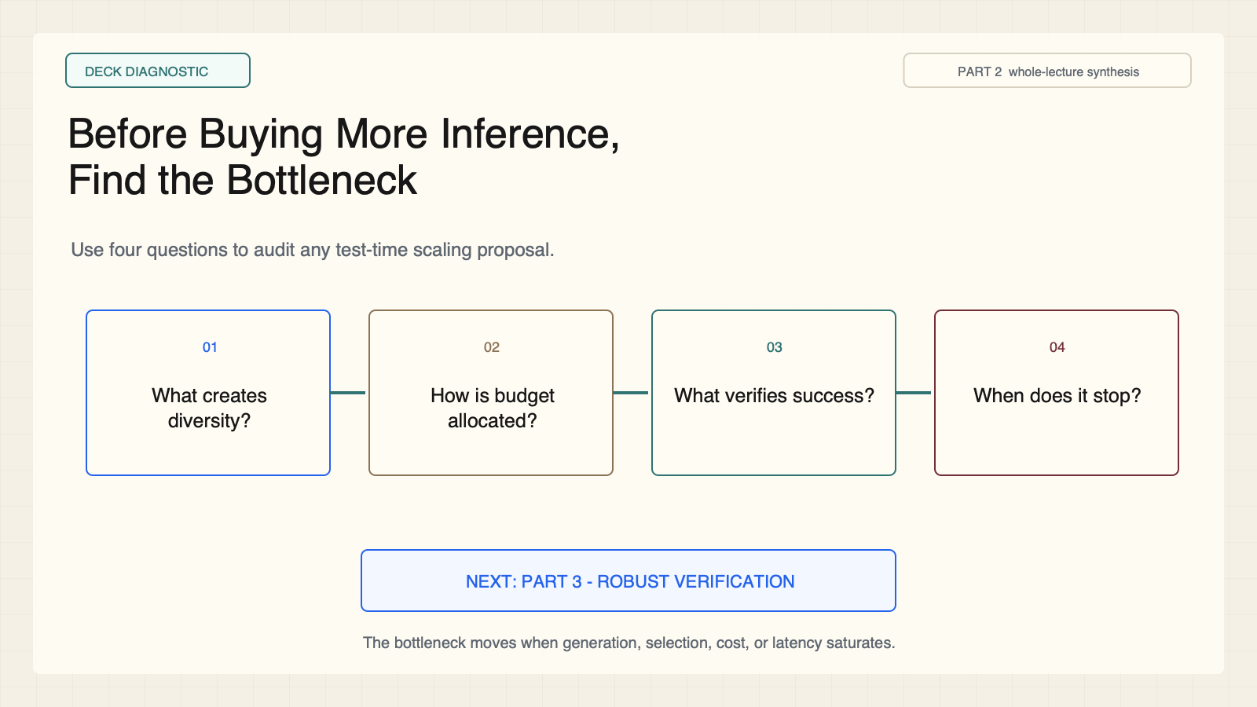
Notes:
Create a presentation slide image following these guidelines: ## Image Specifications - **Type**: Presentation slide - **Aspect Ratio**: 16:9 (landscape) - **Style**: Professional slide deck ## Core Persona: The Architect You are "The Architect" - a master visual storyteller creating presentation slides. Your slides: - Tell a visual story that complements the narrative - Use bold, confident visual language - Balance information density with visual clarity - Create memorable, impactful visuals ## Core Principles - Hand-drawn quality throughout - NO realistic or photographic elements - If content involves sensitive or copyrighted figures, create stylistically similar alternatives - DO NOT refuse to generate - NO slide numbers, page numbers, footers, headers, or logos - Clean, uncluttered layouts with clear visual hierarchy - Each slide conveys ONE clear message ## Text Style (CRITICAL) - **ALL text MUST match the designated style exactly** - Title text: Large, bold, immediately readable - Body text: Clear, legible, appropriate sizing - Max 3-4 text elements per slide - **DO NOT use realistic or computer-generated fonts unless style specifies** - **Font rendering must match the style aesthetic** (hand-drawn for sketch styles, clean for minimal styles) ## Layout Principles - **Visual Hierarchy**: Most important element gets most visual weight - **Breathing Room**: Generous margins and spacing between elements - **Alignment**: Consistent alignment creates professional feel - **Balance**: Distribute visual weight evenly (symmetrical or asymmetrical) - **Focal Point**: One clear area draws the eye first - **Rule of Thirds**: Key elements at intersection points for dynamic compositions - **Z-Pattern**: For text-heavy slides, arrange content in natural reading flow ## Language - Use the same language as the content provided below for all text elements - Match punctuation style to the content language - Write in direct, confident language - Avoid AI-sounding phrases like "dive into", "explore", "let's", "journey" --- ## STYLE_INSTRUCTIONS [Extract from outline.md - do NOT re-read style files] The STYLE_INSTRUCTIONS block from the outline contains: - Design Aesthetic - Background (Texture + Base Color) - Typography (Headlines + Body descriptions) - Color Palette (with hex codes) - Visual Elements - Density Guidelines - Style Rules (Do/Don't) Copy the entire `<STYLE_INSTRUCTIONS>...</STYLE_INSTRUCTIONS>` block from the outline here. --- ## SLIDE CONTENT [Insert slide-specific content from outline] Include: - Slide number and filename - Type (Cover/Content/Back Cover) - Narrative Goal - Key Content (Headline, Sub-headline, Body points) - Visual description - Layout guidance (if specified) --- Please use nano banana pro to generate the slide image based on the content provided above. --- # Slide 12: Before Buying More Inference, Find the Bottleneck ## Production method Rendered locally as an original 1600x900 SVG for exact text fidelity, then converted to PNG. Do not reproduce Stanford course frames or logos. ## Style Aged-cream academic technical briefing, faint engineering grid, crisp vector diagrams, near-black type, teal verification, cobalt generation, warm-brown budget, maroon constraints, 8px card corners, no gradients, no decorative imagery. ## On-slide content - Stage: deck diagnostic - Headline: Before Buying More Inference, Find the Bottleneck - Subtitle: Use four questions to audit any test-time scaling proposal. - Supporting labels: Diversity; Allocation; Verification; Stopping - Evidence: CS329A Part 2, whole-lecture synthesis ## Visual direction Four diagnostic cards around a bounded compute meter with a bridge to robust verification. ## Teaching objective Apply a four-question diagnostic to a new system. ## Speaker notes Ask what creates diverse candidates, how the finite budget is allocated, what verifies success, and when the system stops. Bridge to Part 3: robust verification makes generation gains usable.

