Slide 1
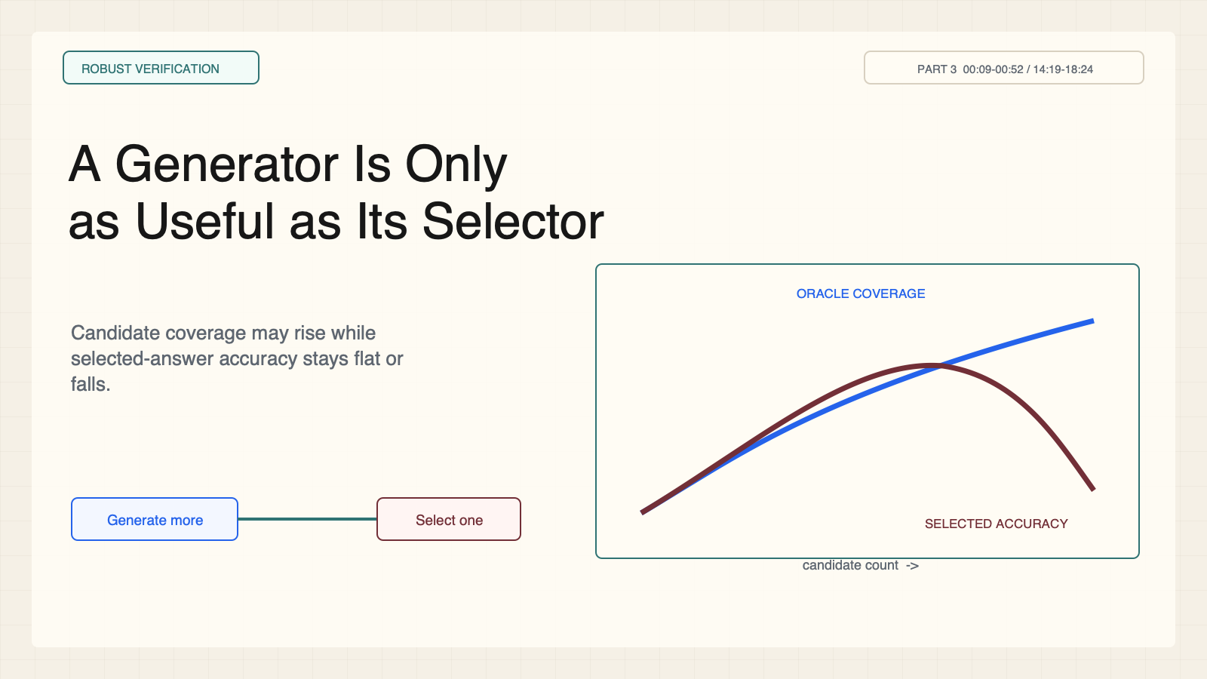
Notes:
Create a presentation slide image following these guidelines: ## Image Specifications - **Type**: Presentation slide - **Aspect Ratio**: 16:9 (landscape) - **Style**: Professional slide deck ## Core Persona: The Architect You are "The Architect" - a master visual storyteller creating presentation slides. Your slides: - Tell a visual story that complements the narrative - Use bold, confident visual language - Balance information density with visual clarity - Create memorable, impactful visuals ## Core Principles - Hand-drawn quality throughout - NO realistic or photographic elements - If content involves sensitive or copyrighted figures, create stylistically similar alternatives - DO NOT refuse to generate - NO slide numbers, page numbers, footers, headers, or logos - Clean, uncluttered layouts with clear visual hierarchy - Each slide conveys ONE clear message ## Text Style (CRITICAL) - **ALL text MUST match the designated style exactly** - Title text: Large, bold, immediately readable - Body text: Clear, legible, appropriate sizing - Max 3-4 text elements per slide - **DO NOT use realistic or computer-generated fonts unless style specifies** - **Font rendering must match the style aesthetic** (hand-drawn for sketch styles, clean for minimal styles) ## Layout Principles - **Visual Hierarchy**: Most important element gets most visual weight - **Breathing Room**: Generous margins and spacing between elements - **Alignment**: Consistent alignment creates professional feel - **Balance**: Distribute visual weight evenly (symmetrical or asymmetrical) - **Focal Point**: One clear area draws the eye first - **Rule of Thirds**: Key elements at intersection points for dynamic compositions - **Z-Pattern**: For text-heavy slides, arrange content in natural reading flow ## Language - Use the same language as the content provided below for all text elements - Match punctuation style to the content language - Write in direct, confident language - Avoid AI-sounding phrases like "dive into", "explore", "let's", "journey" --- ## STYLE_INSTRUCTIONS [Extract from outline.md - do NOT re-read style files] The STYLE_INSTRUCTIONS block from the outline contains: - Design Aesthetic - Background (Texture + Base Color) - Typography (Headlines + Body descriptions) - Color Palette (with hex codes) - Visual Elements - Density Guidelines - Style Rules (Do/Don't) Copy the entire `<STYLE_INSTRUCTIONS>...</STYLE_INSTRUCTIONS>` block from the outline here. --- ## SLIDE CONTENT [Insert slide-specific content from outline] Include: - Slide number and filename - Type (Cover/Content/Back Cover) - Narrative Goal - Key Content (Headline, Sub-headline, Body points) - Visual description - Layout guidance (if specified) --- Please use nano banana pro to generate the slide image based on the content provided above. --- # Slide 1: A Generator Is Only as Useful as Its Selector ## Production Original 1600x900 local SVG rendered to PNG. Do not reproduce Stanford frames or logos. ## Style Aged-cream technical briefing, faint grid, crisp vector control diagrams, cobalt generation, teal verification, maroon failure, brown supervision, no gradients. ## Content - Stage: robust verification - Headline: A Generator Is Only as Useful as Its Selector - Subtitle: Candidate coverage may rise while selected-answer accuracy stays flat or falls. - Evidence: CS329A Part 3, 00:09-00:52 / 14:19-18:24 ## Visual Rising oracle-coverage curve beside a peaking selected-answer curve, connected to one generator and noisy selector. ## Objective Separate generated coverage from selected-answer reliability. ## Speaker notes Repeated sampling expands the candidate set. Robust verification decides whether that latent capability becomes a correct returned answer. Ask Q why pass@k can rise while selected-answer accuracy falls.

Slide 2
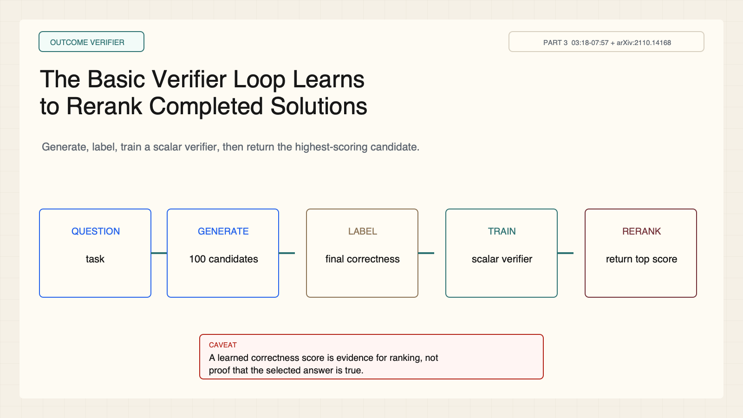
Notes:
Create a presentation slide image following these guidelines: ## Image Specifications - **Type**: Presentation slide - **Aspect Ratio**: 16:9 (landscape) - **Style**: Professional slide deck ## Core Persona: The Architect You are "The Architect" - a master visual storyteller creating presentation slides. Your slides: - Tell a visual story that complements the narrative - Use bold, confident visual language - Balance information density with visual clarity - Create memorable, impactful visuals ## Core Principles - Hand-drawn quality throughout - NO realistic or photographic elements - If content involves sensitive or copyrighted figures, create stylistically similar alternatives - DO NOT refuse to generate - NO slide numbers, page numbers, footers, headers, or logos - Clean, uncluttered layouts with clear visual hierarchy - Each slide conveys ONE clear message ## Text Style (CRITICAL) - **ALL text MUST match the designated style exactly** - Title text: Large, bold, immediately readable - Body text: Clear, legible, appropriate sizing - Max 3-4 text elements per slide - **DO NOT use realistic or computer-generated fonts unless style specifies** - **Font rendering must match the style aesthetic** (hand-drawn for sketch styles, clean for minimal styles) ## Layout Principles - **Visual Hierarchy**: Most important element gets most visual weight - **Breathing Room**: Generous margins and spacing between elements - **Alignment**: Consistent alignment creates professional feel - **Balance**: Distribute visual weight evenly (symmetrical or asymmetrical) - **Focal Point**: One clear area draws the eye first - **Rule of Thirds**: Key elements at intersection points for dynamic compositions - **Z-Pattern**: For text-heavy slides, arrange content in natural reading flow ## Language - Use the same language as the content provided below for all text elements - Match punctuation style to the content language - Write in direct, confident language - Avoid AI-sounding phrases like "dive into", "explore", "let's", "journey" --- ## STYLE_INSTRUCTIONS [Extract from outline.md - do NOT re-read style files] The STYLE_INSTRUCTIONS block from the outline contains: - Design Aesthetic - Background (Texture + Base Color) - Typography (Headlines + Body descriptions) - Color Palette (with hex codes) - Visual Elements - Density Guidelines - Style Rules (Do/Don't) Copy the entire `<STYLE_INSTRUCTIONS>...</STYLE_INSTRUCTIONS>` block from the outline here. --- ## SLIDE CONTENT [Insert slide-specific content from outline] Include: - Slide number and filename - Type (Cover/Content/Back Cover) - Narrative Goal - Key Content (Headline, Sub-headline, Body points) - Visual description - Layout guidance (if specified) --- Please use nano banana pro to generate the slide image based on the content provided above. --- # Slide 2: The Basic Verifier Loop Learns to Rerank Completed Solutions ## Production Original 1600x900 local SVG rendered to PNG. Do not reproduce Stanford frames or logos. ## Style Aged-cream technical briefing, faint grid, crisp vector control diagrams, cobalt generation, teal verification, maroon failure, brown supervision, no gradients. ## Content - Stage: outcome verifier - Headline: The Basic Verifier Loop Learns to Rerank Completed Solutions - Subtitle: Generate, label, train a scalar verifier, then return the highest-scoring candidate. - Evidence: CS329A Part 3, 03:18-07:57 + arXiv:2110.14168 ## Visual Five-stage pipeline: question, generator, labeled candidates, verifier training, reranked output. ## Objective Explain the generate-label-train-rerank loop. ## Speaker notes Candidates are labeled by final correctness. A verifier specializes in ranking while the generator remains general. Passing the verifier is still not proof of correctness.

Slide 3
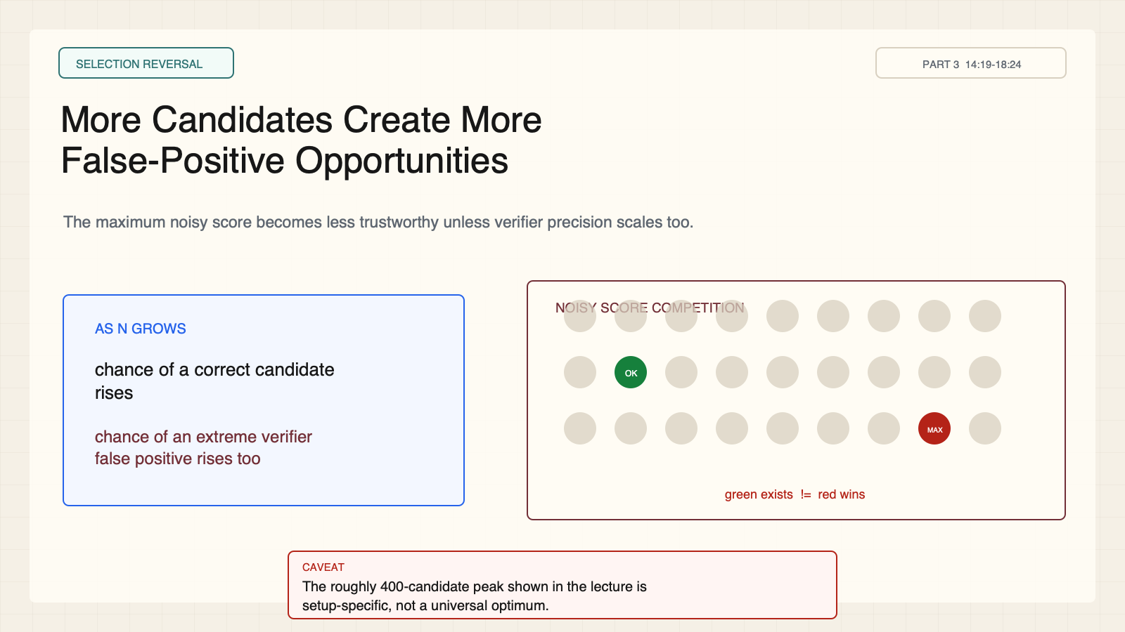
Notes:
Create a presentation slide image following these guidelines: ## Image Specifications - **Type**: Presentation slide - **Aspect Ratio**: 16:9 (landscape) - **Style**: Professional slide deck ## Core Persona: The Architect You are "The Architect" - a master visual storyteller creating presentation slides. Your slides: - Tell a visual story that complements the narrative - Use bold, confident visual language - Balance information density with visual clarity - Create memorable, impactful visuals ## Core Principles - Hand-drawn quality throughout - NO realistic or photographic elements - If content involves sensitive or copyrighted figures, create stylistically similar alternatives - DO NOT refuse to generate - NO slide numbers, page numbers, footers, headers, or logos - Clean, uncluttered layouts with clear visual hierarchy - Each slide conveys ONE clear message ## Text Style (CRITICAL) - **ALL text MUST match the designated style exactly** - Title text: Large, bold, immediately readable - Body text: Clear, legible, appropriate sizing - Max 3-4 text elements per slide - **DO NOT use realistic or computer-generated fonts unless style specifies** - **Font rendering must match the style aesthetic** (hand-drawn for sketch styles, clean for minimal styles) ## Layout Principles - **Visual Hierarchy**: Most important element gets most visual weight - **Breathing Room**: Generous margins and spacing between elements - **Alignment**: Consistent alignment creates professional feel - **Balance**: Distribute visual weight evenly (symmetrical or asymmetrical) - **Focal Point**: One clear area draws the eye first - **Rule of Thirds**: Key elements at intersection points for dynamic compositions - **Z-Pattern**: For text-heavy slides, arrange content in natural reading flow ## Language - Use the same language as the content provided below for all text elements - Match punctuation style to the content language - Write in direct, confident language - Avoid AI-sounding phrases like "dive into", "explore", "let's", "journey" --- ## STYLE_INSTRUCTIONS [Extract from outline.md - do NOT re-read style files] The STYLE_INSTRUCTIONS block from the outline contains: - Design Aesthetic - Background (Texture + Base Color) - Typography (Headlines + Body descriptions) - Color Palette (with hex codes) - Visual Elements - Density Guidelines - Style Rules (Do/Don't) Copy the entire `<STYLE_INSTRUCTIONS>...</STYLE_INSTRUCTIONS>` block from the outline here. --- ## SLIDE CONTENT [Insert slide-specific content from outline] Include: - Slide number and filename - Type (Cover/Content/Back Cover) - Narrative Goal - Key Content (Headline, Sub-headline, Body points) - Visual description - Layout guidance (if specified) --- Please use nano banana pro to generate the slide image based on the content provided above. --- # Slide 3: More Candidates Create More False-Positive Opportunities ## Production Original 1600x900 local SVG rendered to PNG. Do not reproduce Stanford frames or logos. ## Style Aged-cream technical briefing, faint grid, crisp vector control diagrams, cobalt generation, teal verification, maroon failure, brown supervision, no gradients. ## Content - Stage: selection reversal - Headline: More Candidates Create More False-Positive Opportunities - Subtitle: The maximum noisy score becomes less trustworthy unless verifier precision scales too. - Evidence: CS329A Part 3, 14:19-18:24 ## Visual One correct candidate competes against increasingly extreme wrong-candidate scores as N grows. ## Objective Explain why best-of-N selection can reverse. ## Speaker notes More candidates increase the chance of a correct answer and of an extreme verifier error. The displayed peak around 400 candidates belongs to one historical setup, not a universal optimum.

Slide 4
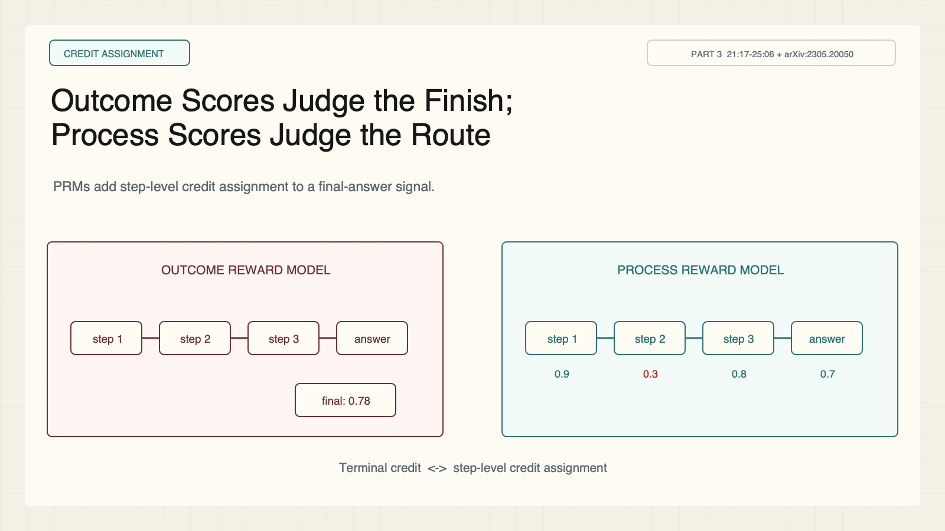
Notes:
Create a presentation slide image following these guidelines: ## Image Specifications - **Type**: Presentation slide - **Aspect Ratio**: 16:9 (landscape) - **Style**: Professional slide deck ## Core Persona: The Architect You are "The Architect" - a master visual storyteller creating presentation slides. Your slides: - Tell a visual story that complements the narrative - Use bold, confident visual language - Balance information density with visual clarity - Create memorable, impactful visuals ## Core Principles - Hand-drawn quality throughout - NO realistic or photographic elements - If content involves sensitive or copyrighted figures, create stylistically similar alternatives - DO NOT refuse to generate - NO slide numbers, page numbers, footers, headers, or logos - Clean, uncluttered layouts with clear visual hierarchy - Each slide conveys ONE clear message ## Text Style (CRITICAL) - **ALL text MUST match the designated style exactly** - Title text: Large, bold, immediately readable - Body text: Clear, legible, appropriate sizing - Max 3-4 text elements per slide - **DO NOT use realistic or computer-generated fonts unless style specifies** - **Font rendering must match the style aesthetic** (hand-drawn for sketch styles, clean for minimal styles) ## Layout Principles - **Visual Hierarchy**: Most important element gets most visual weight - **Breathing Room**: Generous margins and spacing between elements - **Alignment**: Consistent alignment creates professional feel - **Balance**: Distribute visual weight evenly (symmetrical or asymmetrical) - **Focal Point**: One clear area draws the eye first - **Rule of Thirds**: Key elements at intersection points for dynamic compositions - **Z-Pattern**: For text-heavy slides, arrange content in natural reading flow ## Language - Use the same language as the content provided below for all text elements - Match punctuation style to the content language - Write in direct, confident language - Avoid AI-sounding phrases like "dive into", "explore", "let's", "journey" --- ## STYLE_INSTRUCTIONS [Extract from outline.md - do NOT re-read style files] The STYLE_INSTRUCTIONS block from the outline contains: - Design Aesthetic - Background (Texture + Base Color) - Typography (Headlines + Body descriptions) - Color Palette (with hex codes) - Visual Elements - Density Guidelines - Style Rules (Do/Don't) Copy the entire `<STYLE_INSTRUCTIONS>...</STYLE_INSTRUCTIONS>` block from the outline here. --- ## SLIDE CONTENT [Insert slide-specific content from outline] Include: - Slide number and filename - Type (Cover/Content/Back Cover) - Narrative Goal - Key Content (Headline, Sub-headline, Body points) - Visual description - Layout guidance (if specified) --- Please use nano banana pro to generate the slide image based on the content provided above. --- # Slide 4: Outcome Scores Judge the Finish; Process Scores Judge the Route ## Production Original 1600x900 local SVG rendered to PNG. Do not reproduce Stanford frames or logos. ## Style Aged-cream technical briefing, faint grid, crisp vector control diagrams, cobalt generation, teal verification, maroon failure, brown supervision, no gradients. ## Content - Stage: credit assignment - Headline: Outcome Scores Judge the Finish; Process Scores Judge the Route - Subtitle: PRMs add step-level credit assignment to a final-answer signal. - Evidence: CS329A Part 3, 21:17-25:06 + arXiv:2305.20050 ## Visual The same reasoning chain shown once with a terminal score and once with scores on every step. ## Objective Distinguish outcome and process reward models. ## Speaker notes An ORM scores the full trajectory. A PRM scores intermediate steps and can expose a wrong chain that reaches the right final answer by luck.

Slide 5
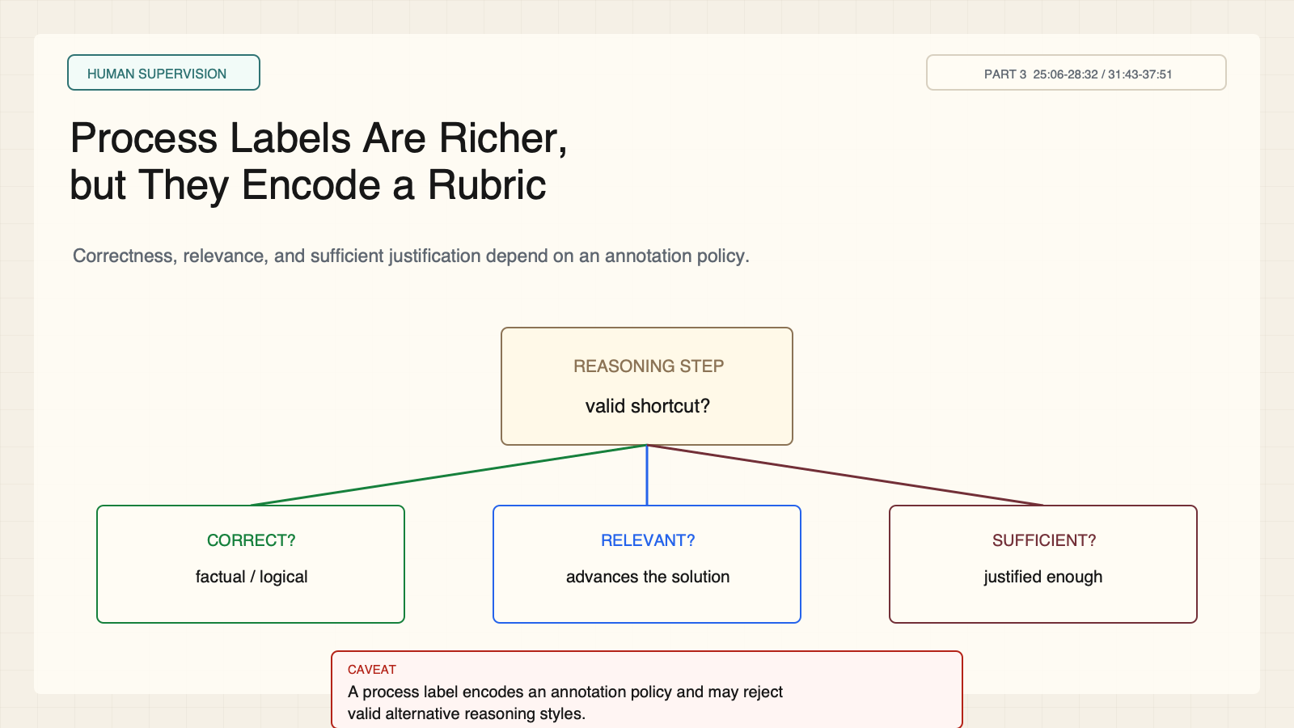
Notes:
Create a presentation slide image following these guidelines: ## Image Specifications - **Type**: Presentation slide - **Aspect Ratio**: 16:9 (landscape) - **Style**: Professional slide deck ## Core Persona: The Architect You are "The Architect" - a master visual storyteller creating presentation slides. Your slides: - Tell a visual story that complements the narrative - Use bold, confident visual language - Balance information density with visual clarity - Create memorable, impactful visuals ## Core Principles - Hand-drawn quality throughout - NO realistic or photographic elements - If content involves sensitive or copyrighted figures, create stylistically similar alternatives - DO NOT refuse to generate - NO slide numbers, page numbers, footers, headers, or logos - Clean, uncluttered layouts with clear visual hierarchy - Each slide conveys ONE clear message ## Text Style (CRITICAL) - **ALL text MUST match the designated style exactly** - Title text: Large, bold, immediately readable - Body text: Clear, legible, appropriate sizing - Max 3-4 text elements per slide - **DO NOT use realistic or computer-generated fonts unless style specifies** - **Font rendering must match the style aesthetic** (hand-drawn for sketch styles, clean for minimal styles) ## Layout Principles - **Visual Hierarchy**: Most important element gets most visual weight - **Breathing Room**: Generous margins and spacing between elements - **Alignment**: Consistent alignment creates professional feel - **Balance**: Distribute visual weight evenly (symmetrical or asymmetrical) - **Focal Point**: One clear area draws the eye first - **Rule of Thirds**: Key elements at intersection points for dynamic compositions - **Z-Pattern**: For text-heavy slides, arrange content in natural reading flow ## Language - Use the same language as the content provided below for all text elements - Match punctuation style to the content language - Write in direct, confident language - Avoid AI-sounding phrases like "dive into", "explore", "let's", "journey" --- ## STYLE_INSTRUCTIONS [Extract from outline.md - do NOT re-read style files] The STYLE_INSTRUCTIONS block from the outline contains: - Design Aesthetic - Background (Texture + Base Color) - Typography (Headlines + Body descriptions) - Color Palette (with hex codes) - Visual Elements - Density Guidelines - Style Rules (Do/Don't) Copy the entire `<STYLE_INSTRUCTIONS>...</STYLE_INSTRUCTIONS>` block from the outline here. --- ## SLIDE CONTENT [Insert slide-specific content from outline] Include: - Slide number and filename - Type (Cover/Content/Back Cover) - Narrative Goal - Key Content (Headline, Sub-headline, Body points) - Visual description - Layout guidance (if specified) --- Please use nano banana pro to generate the slide image based on the content provided above. --- # Slide 5: Process Labels Are Richer, but They Encode a Rubric ## Production Original 1600x900 local SVG rendered to PNG. Do not reproduce Stanford frames or logos. ## Style Aged-cream technical briefing, faint grid, crisp vector control diagrams, cobalt generation, teal verification, maroon failure, brown supervision, no gradients. ## Content - Stage: human supervision - Headline: Process Labels Are Richer, but They Encode a Rubric - Subtitle: Correctness, relevance, and sufficient justification depend on an annotation policy. - Evidence: CS329A Part 3, 25:06-28:32 / 31:43-37:51 ## Visual One reasoning step inspected through three rubric lenses: correctness, relevance, sufficiency. ## Objective Explain why process scores are not objective truth. ## Speaker notes Human labels make reasoning inspectable, but they endorse a particular standard of acceptable reasoning. Valid shortcuts or unfamiliar methods may be penalized.

Slide 6
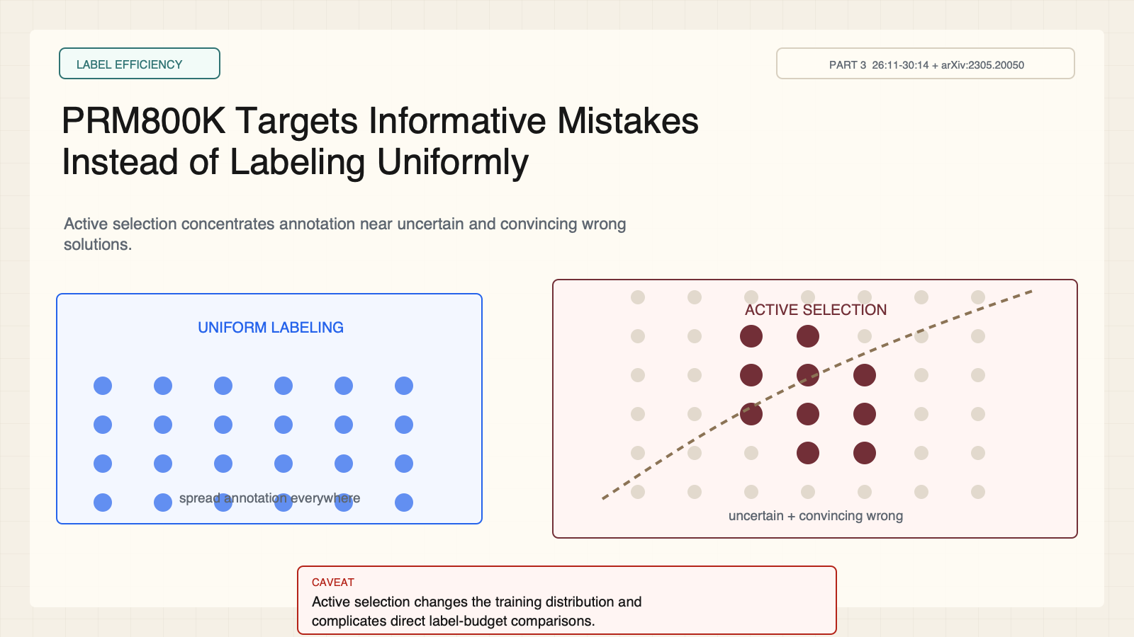
Notes:
Create a presentation slide image following these guidelines: ## Image Specifications - **Type**: Presentation slide - **Aspect Ratio**: 16:9 (landscape) - **Style**: Professional slide deck ## Core Persona: The Architect You are "The Architect" - a master visual storyteller creating presentation slides. Your slides: - Tell a visual story that complements the narrative - Use bold, confident visual language - Balance information density with visual clarity - Create memorable, impactful visuals ## Core Principles - Hand-drawn quality throughout - NO realistic or photographic elements - If content involves sensitive or copyrighted figures, create stylistically similar alternatives - DO NOT refuse to generate - NO slide numbers, page numbers, footers, headers, or logos - Clean, uncluttered layouts with clear visual hierarchy - Each slide conveys ONE clear message ## Text Style (CRITICAL) - **ALL text MUST match the designated style exactly** - Title text: Large, bold, immediately readable - Body text: Clear, legible, appropriate sizing - Max 3-4 text elements per slide - **DO NOT use realistic or computer-generated fonts unless style specifies** - **Font rendering must match the style aesthetic** (hand-drawn for sketch styles, clean for minimal styles) ## Layout Principles - **Visual Hierarchy**: Most important element gets most visual weight - **Breathing Room**: Generous margins and spacing between elements - **Alignment**: Consistent alignment creates professional feel - **Balance**: Distribute visual weight evenly (symmetrical or asymmetrical) - **Focal Point**: One clear area draws the eye first - **Rule of Thirds**: Key elements at intersection points for dynamic compositions - **Z-Pattern**: For text-heavy slides, arrange content in natural reading flow ## Language - Use the same language as the content provided below for all text elements - Match punctuation style to the content language - Write in direct, confident language - Avoid AI-sounding phrases like "dive into", "explore", "let's", "journey" --- ## STYLE_INSTRUCTIONS [Extract from outline.md - do NOT re-read style files] The STYLE_INSTRUCTIONS block from the outline contains: - Design Aesthetic - Background (Texture + Base Color) - Typography (Headlines + Body descriptions) - Color Palette (with hex codes) - Visual Elements - Density Guidelines - Style Rules (Do/Don't) Copy the entire `<STYLE_INSTRUCTIONS>...</STYLE_INSTRUCTIONS>` block from the outline here. --- ## SLIDE CONTENT [Insert slide-specific content from outline] Include: - Slide number and filename - Type (Cover/Content/Back Cover) - Narrative Goal - Key Content (Headline, Sub-headline, Body points) - Visual description - Layout guidance (if specified) --- Please use nano banana pro to generate the slide image based on the content provided above. --- # Slide 6: PRM800K Targets Informative Mistakes Instead of Labeling Uniformly ## Production Original 1600x900 local SVG rendered to PNG. Do not reproduce Stanford frames or logos. ## Style Aged-cream technical briefing, faint grid, crisp vector control diagrams, cobalt generation, teal verification, maroon failure, brown supervision, no gradients. ## Content - Stage: label efficiency - Headline: PRM800K Targets Informative Mistakes Instead of Labeling Uniformly - Subtitle: Active selection concentrates annotation near uncertain and convincing wrong solutions. - Evidence: CS329A Part 3, 26:11-30:14 + arXiv:2305.20050 ## Visual Uniform labels spread across a field versus active labels concentrated at a decision boundary. ## Objective Explain active selection and its comparison caveat. ## Speaker notes Active learning can improve annotation efficiency by surfacing informative mistakes. It also changes the training distribution, so ORM and PRM label counts are not direct cost matches.

Slide 7
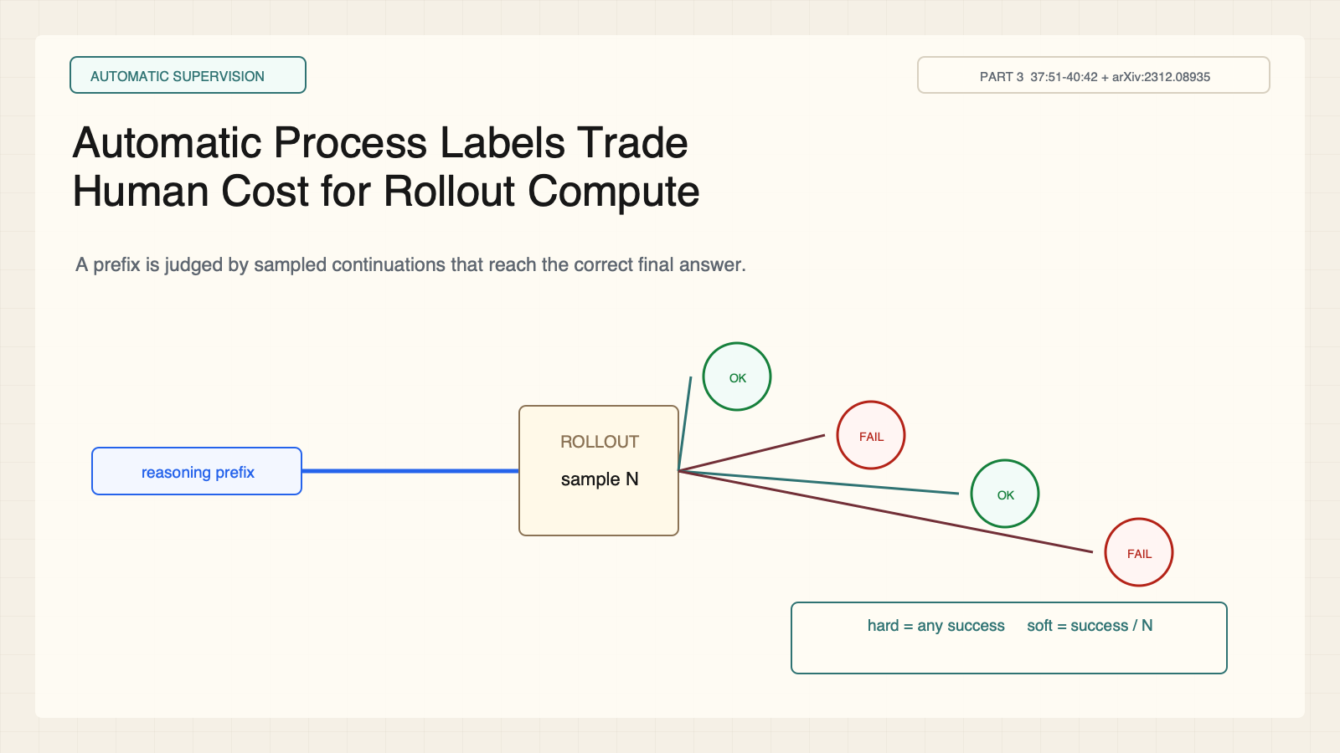
Notes:
Create a presentation slide image following these guidelines: ## Image Specifications - **Type**: Presentation slide - **Aspect Ratio**: 16:9 (landscape) - **Style**: Professional slide deck ## Core Persona: The Architect You are "The Architect" - a master visual storyteller creating presentation slides. Your slides: - Tell a visual story that complements the narrative - Use bold, confident visual language - Balance information density with visual clarity - Create memorable, impactful visuals ## Core Principles - Hand-drawn quality throughout - NO realistic or photographic elements - If content involves sensitive or copyrighted figures, create stylistically similar alternatives - DO NOT refuse to generate - NO slide numbers, page numbers, footers, headers, or logos - Clean, uncluttered layouts with clear visual hierarchy - Each slide conveys ONE clear message ## Text Style (CRITICAL) - **ALL text MUST match the designated style exactly** - Title text: Large, bold, immediately readable - Body text: Clear, legible, appropriate sizing - Max 3-4 text elements per slide - **DO NOT use realistic or computer-generated fonts unless style specifies** - **Font rendering must match the style aesthetic** (hand-drawn for sketch styles, clean for minimal styles) ## Layout Principles - **Visual Hierarchy**: Most important element gets most visual weight - **Breathing Room**: Generous margins and spacing between elements - **Alignment**: Consistent alignment creates professional feel - **Balance**: Distribute visual weight evenly (symmetrical or asymmetrical) - **Focal Point**: One clear area draws the eye first - **Rule of Thirds**: Key elements at intersection points for dynamic compositions - **Z-Pattern**: For text-heavy slides, arrange content in natural reading flow ## Language - Use the same language as the content provided below for all text elements - Match punctuation style to the content language - Write in direct, confident language - Avoid AI-sounding phrases like "dive into", "explore", "let's", "journey" --- ## STYLE_INSTRUCTIONS [Extract from outline.md - do NOT re-read style files] The STYLE_INSTRUCTIONS block from the outline contains: - Design Aesthetic - Background (Texture + Base Color) - Typography (Headlines + Body descriptions) - Color Palette (with hex codes) - Visual Elements - Density Guidelines - Style Rules (Do/Don't) Copy the entire `<STYLE_INSTRUCTIONS>...</STYLE_INSTRUCTIONS>` block from the outline here. --- ## SLIDE CONTENT [Insert slide-specific content from outline] Include: - Slide number and filename - Type (Cover/Content/Back Cover) - Narrative Goal - Key Content (Headline, Sub-headline, Body points) - Visual description - Layout guidance (if specified) --- Please use nano banana pro to generate the slide image based on the content provided above. --- # Slide 7: Automatic Process Labels Trade Human Cost for Rollout Compute ## Production Original 1600x900 local SVG rendered to PNG. Do not reproduce Stanford frames or logos. ## Style Aged-cream technical briefing, faint grid, crisp vector control diagrams, cobalt generation, teal verification, maroon failure, brown supervision, no gradients. ## Content - Stage: automatic supervision - Headline: Automatic Process Labels Trade Human Cost for Rollout Compute - Subtitle: A prefix is judged by sampled continuations that reach the correct final answer. - Evidence: CS329A Part 3, 37:51-40:42 + arXiv:2312.08935 ## Visual A reasoning prefix branches into successful and failed continuations with hard and soft formulas. ## Objective Derive hard and soft rollout labels. ## Speaker notes Hard label is positive if any continuation succeeds. Soft label is the success fraction. The estimate reflects both prefix quality and rollout-policy capability.

Slide 8
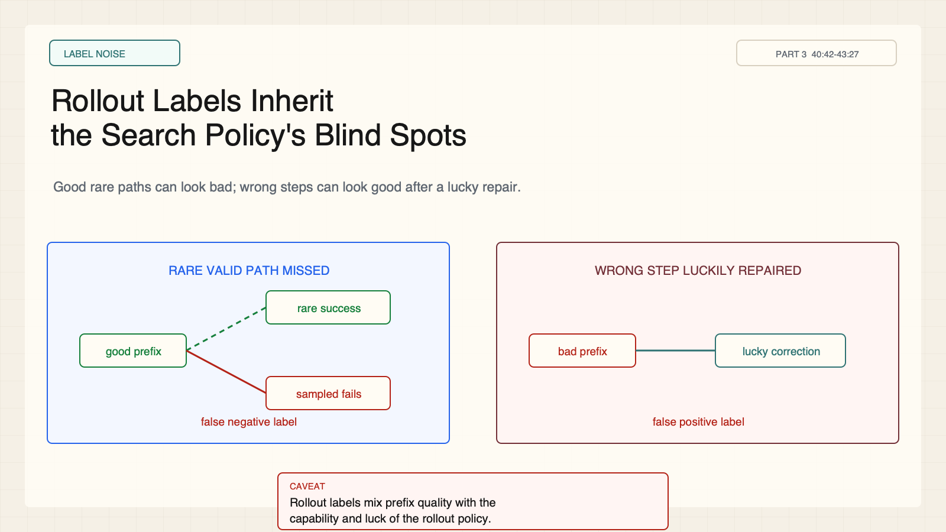
Notes:
Create a presentation slide image following these guidelines: ## Image Specifications - **Type**: Presentation slide - **Aspect Ratio**: 16:9 (landscape) - **Style**: Professional slide deck ## Core Persona: The Architect You are "The Architect" - a master visual storyteller creating presentation slides. Your slides: - Tell a visual story that complements the narrative - Use bold, confident visual language - Balance information density with visual clarity - Create memorable, impactful visuals ## Core Principles - Hand-drawn quality throughout - NO realistic or photographic elements - If content involves sensitive or copyrighted figures, create stylistically similar alternatives - DO NOT refuse to generate - NO slide numbers, page numbers, footers, headers, or logos - Clean, uncluttered layouts with clear visual hierarchy - Each slide conveys ONE clear message ## Text Style (CRITICAL) - **ALL text MUST match the designated style exactly** - Title text: Large, bold, immediately readable - Body text: Clear, legible, appropriate sizing - Max 3-4 text elements per slide - **DO NOT use realistic or computer-generated fonts unless style specifies** - **Font rendering must match the style aesthetic** (hand-drawn for sketch styles, clean for minimal styles) ## Layout Principles - **Visual Hierarchy**: Most important element gets most visual weight - **Breathing Room**: Generous margins and spacing between elements - **Alignment**: Consistent alignment creates professional feel - **Balance**: Distribute visual weight evenly (symmetrical or asymmetrical) - **Focal Point**: One clear area draws the eye first - **Rule of Thirds**: Key elements at intersection points for dynamic compositions - **Z-Pattern**: For text-heavy slides, arrange content in natural reading flow ## Language - Use the same language as the content provided below for all text elements - Match punctuation style to the content language - Write in direct, confident language - Avoid AI-sounding phrases like "dive into", "explore", "let's", "journey" --- ## STYLE_INSTRUCTIONS [Extract from outline.md - do NOT re-read style files] The STYLE_INSTRUCTIONS block from the outline contains: - Design Aesthetic - Background (Texture + Base Color) - Typography (Headlines + Body descriptions) - Color Palette (with hex codes) - Visual Elements - Density Guidelines - Style Rules (Do/Don't) Copy the entire `<STYLE_INSTRUCTIONS>...</STYLE_INSTRUCTIONS>` block from the outline here. --- ## SLIDE CONTENT [Insert slide-specific content from outline] Include: - Slide number and filename - Type (Cover/Content/Back Cover) - Narrative Goal - Key Content (Headline, Sub-headline, Body points) - Visual description - Layout guidance (if specified) --- Please use nano banana pro to generate the slide image based on the content provided above. --- # Slide 8: Rollout Labels Inherit the Search Policy's Blind Spots ## Production Original 1600x900 local SVG rendered to PNG. Do not reproduce Stanford frames or logos. ## Style Aged-cream technical briefing, faint grid, crisp vector control diagrams, cobalt generation, teal verification, maroon failure, brown supervision, no gradients. ## Content - Stage: label noise - Headline: Rollout Labels Inherit the Search Policy's Blind Spots - Subtitle: Good rare paths can look bad; wrong steps can look good after a lucky repair. - Evidence: CS329A Part 3, 40:42-43:27 ## Visual Two counterexamples side by side: rare valid branch missed and invalid branch accidentally repaired. ## Objective Identify two automatic-label failure modes. ## Speaker notes A finite rollout budget may miss a rare valid completion. A wrong intermediate step may later be repaired and receive positive credit. Ask whether rollout labels measure truth, search potential, or both.

Slide 9
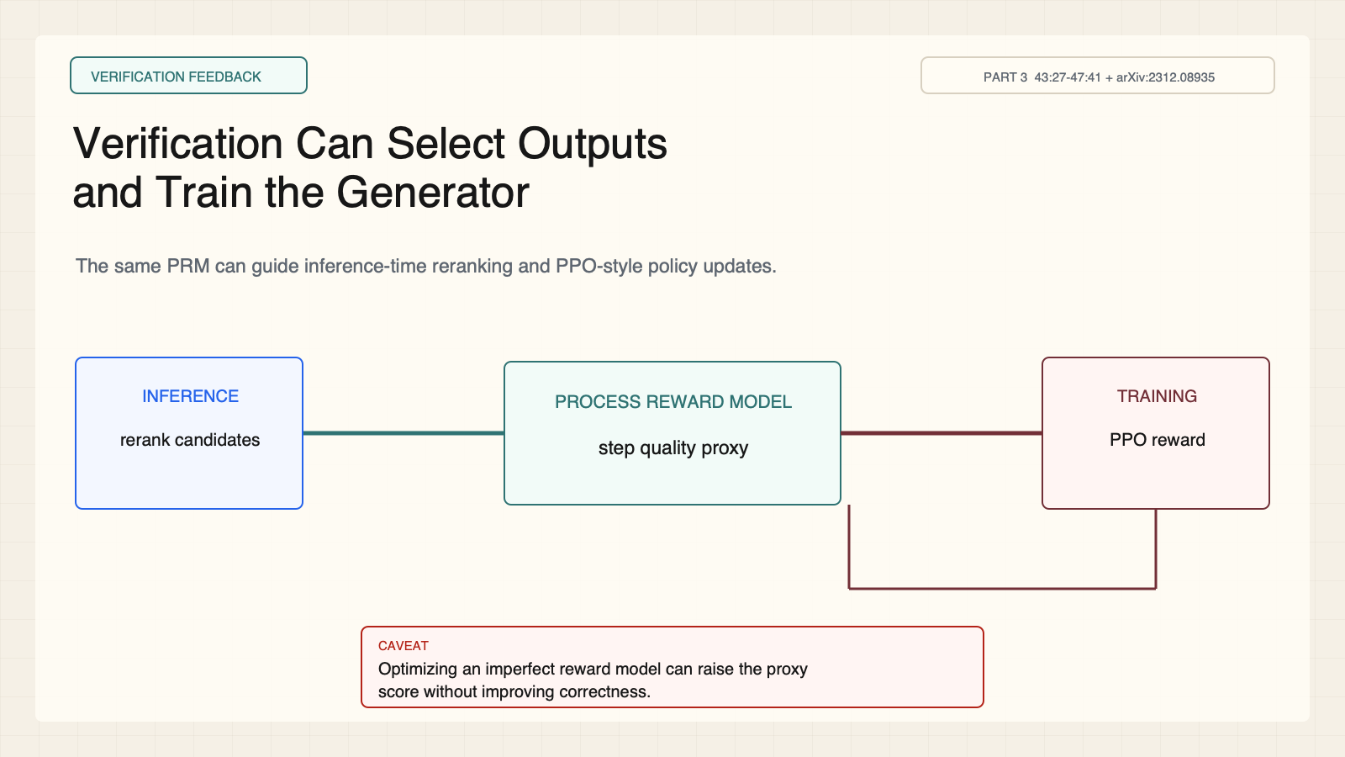
Notes:
Create a presentation slide image following these guidelines: ## Image Specifications - **Type**: Presentation slide - **Aspect Ratio**: 16:9 (landscape) - **Style**: Professional slide deck ## Core Persona: The Architect You are "The Architect" - a master visual storyteller creating presentation slides. Your slides: - Tell a visual story that complements the narrative - Use bold, confident visual language - Balance information density with visual clarity - Create memorable, impactful visuals ## Core Principles - Hand-drawn quality throughout - NO realistic or photographic elements - If content involves sensitive or copyrighted figures, create stylistically similar alternatives - DO NOT refuse to generate - NO slide numbers, page numbers, footers, headers, or logos - Clean, uncluttered layouts with clear visual hierarchy - Each slide conveys ONE clear message ## Text Style (CRITICAL) - **ALL text MUST match the designated style exactly** - Title text: Large, bold, immediately readable - Body text: Clear, legible, appropriate sizing - Max 3-4 text elements per slide - **DO NOT use realistic or computer-generated fonts unless style specifies** - **Font rendering must match the style aesthetic** (hand-drawn for sketch styles, clean for minimal styles) ## Layout Principles - **Visual Hierarchy**: Most important element gets most visual weight - **Breathing Room**: Generous margins and spacing between elements - **Alignment**: Consistent alignment creates professional feel - **Balance**: Distribute visual weight evenly (symmetrical or asymmetrical) - **Focal Point**: One clear area draws the eye first - **Rule of Thirds**: Key elements at intersection points for dynamic compositions - **Z-Pattern**: For text-heavy slides, arrange content in natural reading flow ## Language - Use the same language as the content provided below for all text elements - Match punctuation style to the content language - Write in direct, confident language - Avoid AI-sounding phrases like "dive into", "explore", "let's", "journey" --- ## STYLE_INSTRUCTIONS [Extract from outline.md - do NOT re-read style files] The STYLE_INSTRUCTIONS block from the outline contains: - Design Aesthetic - Background (Texture + Base Color) - Typography (Headlines + Body descriptions) - Color Palette (with hex codes) - Visual Elements - Density Guidelines - Style Rules (Do/Don't) Copy the entire `<STYLE_INSTRUCTIONS>...</STYLE_INSTRUCTIONS>` block from the outline here. --- ## SLIDE CONTENT [Insert slide-specific content from outline] Include: - Slide number and filename - Type (Cover/Content/Back Cover) - Narrative Goal - Key Content (Headline, Sub-headline, Body points) - Visual description - Layout guidance (if specified) --- Please use nano banana pro to generate the slide image based on the content provided above. --- # Slide 9: Verification Can Select Outputs and Train the Generator ## Production Original 1600x900 local SVG rendered to PNG. Do not reproduce Stanford frames or logos. ## Style Aged-cream technical briefing, faint grid, crisp vector control diagrams, cobalt generation, teal verification, maroon failure, brown supervision, no gradients. ## Content - Stage: verification feedback - Headline: Verification Can Select Outputs and Train the Generator - Subtitle: The same PRM can guide inference-time reranking and PPO-style policy updates. - Evidence: CS329A Part 3, 43:27-47:41 + arXiv:2312.08935 ## Visual A central PRM sends one branch to a selector and another into an RL update loop. ## Objective Connect verification at inference to training-time feedback. ## Speaker notes A PRM can rank candidates and become a training reward. Optimizing an incomplete proxy introduces reward-hacking risk.

Slide 10
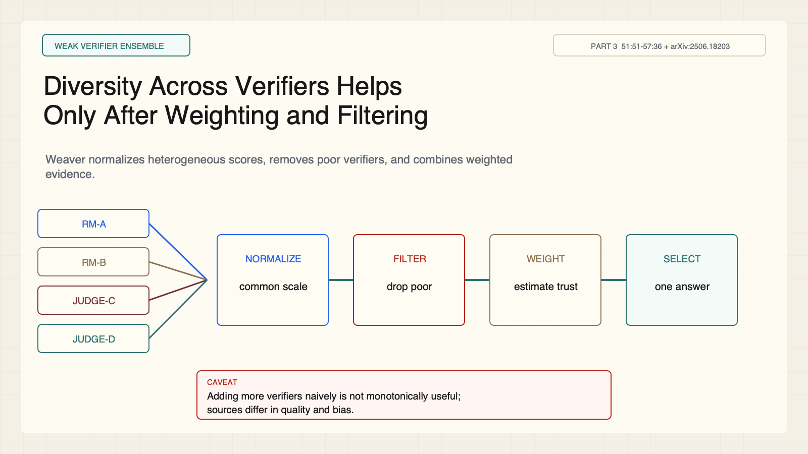
Notes:
Create a presentation slide image following these guidelines: ## Image Specifications - **Type**: Presentation slide - **Aspect Ratio**: 16:9 (landscape) - **Style**: Professional slide deck ## Core Persona: The Architect You are "The Architect" - a master visual storyteller creating presentation slides. Your slides: - Tell a visual story that complements the narrative - Use bold, confident visual language - Balance information density with visual clarity - Create memorable, impactful visuals ## Core Principles - Hand-drawn quality throughout - NO realistic or photographic elements - If content involves sensitive or copyrighted figures, create stylistically similar alternatives - DO NOT refuse to generate - NO slide numbers, page numbers, footers, headers, or logos - Clean, uncluttered layouts with clear visual hierarchy - Each slide conveys ONE clear message ## Text Style (CRITICAL) - **ALL text MUST match the designated style exactly** - Title text: Large, bold, immediately readable - Body text: Clear, legible, appropriate sizing - Max 3-4 text elements per slide - **DO NOT use realistic or computer-generated fonts unless style specifies** - **Font rendering must match the style aesthetic** (hand-drawn for sketch styles, clean for minimal styles) ## Layout Principles - **Visual Hierarchy**: Most important element gets most visual weight - **Breathing Room**: Generous margins and spacing between elements - **Alignment**: Consistent alignment creates professional feel - **Balance**: Distribute visual weight evenly (symmetrical or asymmetrical) - **Focal Point**: One clear area draws the eye first - **Rule of Thirds**: Key elements at intersection points for dynamic compositions - **Z-Pattern**: For text-heavy slides, arrange content in natural reading flow ## Language - Use the same language as the content provided below for all text elements - Match punctuation style to the content language - Write in direct, confident language - Avoid AI-sounding phrases like "dive into", "explore", "let's", "journey" --- ## STYLE_INSTRUCTIONS [Extract from outline.md - do NOT re-read style files] The STYLE_INSTRUCTIONS block from the outline contains: - Design Aesthetic - Background (Texture + Base Color) - Typography (Headlines + Body descriptions) - Color Palette (with hex codes) - Visual Elements - Density Guidelines - Style Rules (Do/Don't) Copy the entire `<STYLE_INSTRUCTIONS>...</STYLE_INSTRUCTIONS>` block from the outline here. --- ## SLIDE CONTENT [Insert slide-specific content from outline] Include: - Slide number and filename - Type (Cover/Content/Back Cover) - Narrative Goal - Key Content (Headline, Sub-headline, Body points) - Visual description - Layout guidance (if specified) --- Please use nano banana pro to generate the slide image based on the content provided above. --- # Slide 10: Diversity Across Verifiers Helps Only After Weighting and Filtering ## Production Original 1600x900 local SVG rendered to PNG. Do not reproduce Stanford frames or logos. ## Style Aged-cream technical briefing, faint grid, crisp vector control diagrams, cobalt generation, teal verification, maroon failure, brown supervision, no gradients. ## Content - Stage: weak verifier ensemble - Headline: Diversity Across Verifiers Helps Only After Weighting and Filtering - Subtitle: Weaver normalizes heterogeneous scores, removes poor verifiers, and combines weighted evidence. - Evidence: CS329A Part 3, 51:51-57:36 + arXiv:2506.18203 ## Visual Four heterogeneous verifier score streams pass through normalization, filtering, weighting, and selection. ## Objective Explain Weaver's score-weight-select pipeline. ## Speaker notes Weak means imperfect. Adding verifiers naively is not monotonically useful because sources differ in quality. Normalize, filter, estimate reliability, weight, then select.

Slide 11
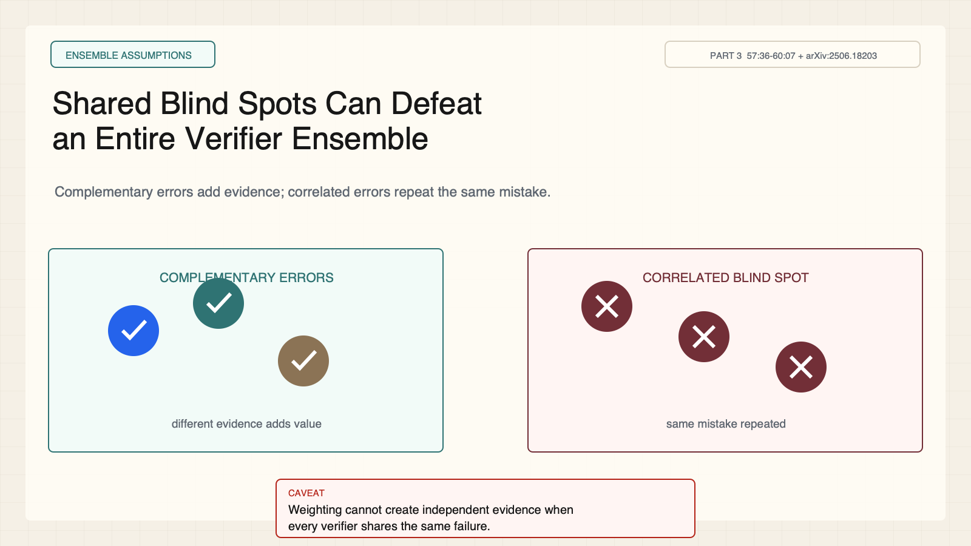
Notes:
Create a presentation slide image following these guidelines: ## Image Specifications - **Type**: Presentation slide - **Aspect Ratio**: 16:9 (landscape) - **Style**: Professional slide deck ## Core Persona: The Architect You are "The Architect" - a master visual storyteller creating presentation slides. Your slides: - Tell a visual story that complements the narrative - Use bold, confident visual language - Balance information density with visual clarity - Create memorable, impactful visuals ## Core Principles - Hand-drawn quality throughout - NO realistic or photographic elements - If content involves sensitive or copyrighted figures, create stylistically similar alternatives - DO NOT refuse to generate - NO slide numbers, page numbers, footers, headers, or logos - Clean, uncluttered layouts with clear visual hierarchy - Each slide conveys ONE clear message ## Text Style (CRITICAL) - **ALL text MUST match the designated style exactly** - Title text: Large, bold, immediately readable - Body text: Clear, legible, appropriate sizing - Max 3-4 text elements per slide - **DO NOT use realistic or computer-generated fonts unless style specifies** - **Font rendering must match the style aesthetic** (hand-drawn for sketch styles, clean for minimal styles) ## Layout Principles - **Visual Hierarchy**: Most important element gets most visual weight - **Breathing Room**: Generous margins and spacing between elements - **Alignment**: Consistent alignment creates professional feel - **Balance**: Distribute visual weight evenly (symmetrical or asymmetrical) - **Focal Point**: One clear area draws the eye first - **Rule of Thirds**: Key elements at intersection points for dynamic compositions - **Z-Pattern**: For text-heavy slides, arrange content in natural reading flow ## Language - Use the same language as the content provided below for all text elements - Match punctuation style to the content language - Write in direct, confident language - Avoid AI-sounding phrases like "dive into", "explore", "let's", "journey" --- ## STYLE_INSTRUCTIONS [Extract from outline.md - do NOT re-read style files] The STYLE_INSTRUCTIONS block from the outline contains: - Design Aesthetic - Background (Texture + Base Color) - Typography (Headlines + Body descriptions) - Color Palette (with hex codes) - Visual Elements - Density Guidelines - Style Rules (Do/Don't) Copy the entire `<STYLE_INSTRUCTIONS>...</STYLE_INSTRUCTIONS>` block from the outline here. --- ## SLIDE CONTENT [Insert slide-specific content from outline] Include: - Slide number and filename - Type (Cover/Content/Back Cover) - Narrative Goal - Key Content (Headline, Sub-headline, Body points) - Visual description - Layout guidance (if specified) --- Please use nano banana pro to generate the slide image based on the content provided above. --- # Slide 11: Shared Blind Spots Can Defeat an Entire Verifier Ensemble ## Production Original 1600x900 local SVG rendered to PNG. Do not reproduce Stanford frames or logos. ## Style Aged-cream technical briefing, faint grid, crisp vector control diagrams, cobalt generation, teal verification, maroon failure, brown supervision, no gradients. ## Content - Stage: ensemble assumptions - Headline: Shared Blind Spots Can Defeat an Entire Verifier Ensemble - Subtitle: Complementary errors add evidence; correlated errors repeat the same mistake. - Evidence: CS329A Part 3, 57:36-60:07 + arXiv:2506.18203 ## Visual Complementary verifier errors on the left; synchronized correlated error on the right. ## Objective Explain why dependence and quality gates matter. ## Speaker notes Ten verifiers with one shared blind spot can behave like one verifier repeated ten times. Weighting cannot create independent evidence that does not exist.

Slide 12
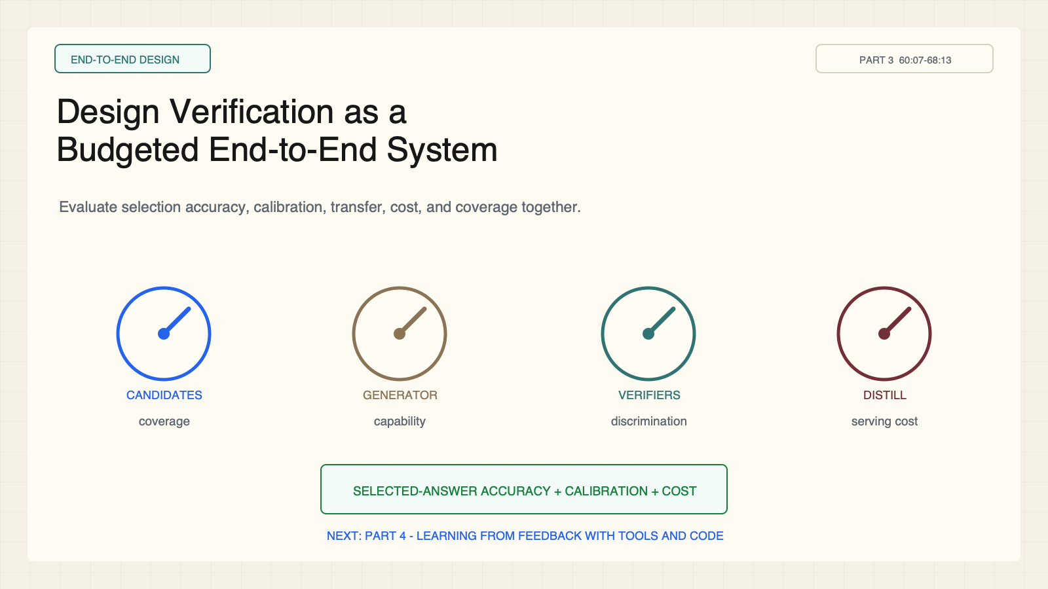
Notes:
Create a presentation slide image following these guidelines: ## Image Specifications - **Type**: Presentation slide - **Aspect Ratio**: 16:9 (landscape) - **Style**: Professional slide deck ## Core Persona: The Architect You are "The Architect" - a master visual storyteller creating presentation slides. Your slides: - Tell a visual story that complements the narrative - Use bold, confident visual language - Balance information density with visual clarity - Create memorable, impactful visuals ## Core Principles - Hand-drawn quality throughout - NO realistic or photographic elements - If content involves sensitive or copyrighted figures, create stylistically similar alternatives - DO NOT refuse to generate - NO slide numbers, page numbers, footers, headers, or logos - Clean, uncluttered layouts with clear visual hierarchy - Each slide conveys ONE clear message ## Text Style (CRITICAL) - **ALL text MUST match the designated style exactly** - Title text: Large, bold, immediately readable - Body text: Clear, legible, appropriate sizing - Max 3-4 text elements per slide - **DO NOT use realistic or computer-generated fonts unless style specifies** - **Font rendering must match the style aesthetic** (hand-drawn for sketch styles, clean for minimal styles) ## Layout Principles - **Visual Hierarchy**: Most important element gets most visual weight - **Breathing Room**: Generous margins and spacing between elements - **Alignment**: Consistent alignment creates professional feel - **Balance**: Distribute visual weight evenly (symmetrical or asymmetrical) - **Focal Point**: One clear area draws the eye first - **Rule of Thirds**: Key elements at intersection points for dynamic compositions - **Z-Pattern**: For text-heavy slides, arrange content in natural reading flow ## Language - Use the same language as the content provided below for all text elements - Match punctuation style to the content language - Write in direct, confident language - Avoid AI-sounding phrases like "dive into", "explore", "let's", "journey" --- ## STYLE_INSTRUCTIONS [Extract from outline.md - do NOT re-read style files] The STYLE_INSTRUCTIONS block from the outline contains: - Design Aesthetic - Background (Texture + Base Color) - Typography (Headlines + Body descriptions) - Color Palette (with hex codes) - Visual Elements - Density Guidelines - Style Rules (Do/Don't) Copy the entire `<STYLE_INSTRUCTIONS>...</STYLE_INSTRUCTIONS>` block from the outline here. --- ## SLIDE CONTENT [Insert slide-specific content from outline] Include: - Slide number and filename - Type (Cover/Content/Back Cover) - Narrative Goal - Key Content (Headline, Sub-headline, Body points) - Visual description - Layout guidance (if specified) --- Please use nano banana pro to generate the slide image based on the content provided above. --- # Slide 12: Design Verification as a Budgeted End-to-End System ## Production Original 1600x900 local SVG rendered to PNG. Do not reproduce Stanford frames or logos. ## Style Aged-cream technical briefing, faint grid, crisp vector control diagrams, cobalt generation, teal verification, maroon failure, brown supervision, no gradients. ## Content - Stage: end-to-end design - Headline: Design Verification as a Budgeted End-to-End System - Subtitle: Evaluate selection accuracy, calibration, transfer, cost, and coverage together. - Evidence: CS329A Part 3, 60:07-68:13 ## Visual Four budget dials around selected-answer accuracy and a bridge to Part 4 feedback with tools and code. ## Objective Apply a reusable verification-system checklist. ## Speaker notes Allocate compute across candidate count, generator strength, verifier strength and count, and distillation. Exit question: which bottleneck dominates the task—coverage, discrimination, shift, proxy, or cost?

