Slide 1
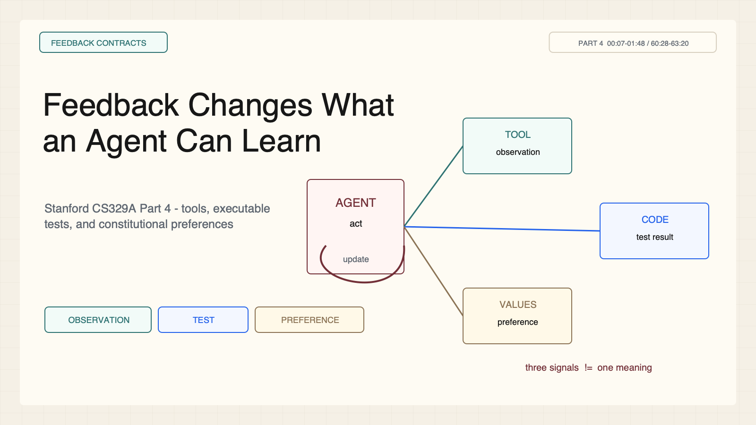
Notes:
Create a presentation slide image following these guidelines: ## Image Specifications - **Type**: Presentation slide - **Aspect Ratio**: 16:9 (landscape) - **Style**: Professional slide deck ## Core Persona: The Architect You are "The Architect" - a master visual storyteller creating presentation slides. Your slides: - Tell a visual story that complements the narrative - Use bold, confident visual language - Balance information density with visual clarity - Create memorable, impactful visuals ## Core Principles - Hand-drawn quality throughout - NO realistic or photographic elements - If content involves sensitive or copyrighted figures, create stylistically similar alternatives - DO NOT refuse to generate - NO slide numbers, page numbers, footers, headers, or logos - Clean, uncluttered layouts with clear visual hierarchy - Each slide conveys ONE clear message ## Text Style (CRITICAL) - **ALL text MUST match the designated style exactly** - Title text: Large, bold, immediately readable - Body text: Clear, legible, appropriate sizing - Max 3-4 text elements per slide - **DO NOT use realistic or computer-generated fonts unless style specifies** - **Font rendering must match the style aesthetic** (hand-drawn for sketch styles, clean for minimal styles) ## Layout Principles - **Visual Hierarchy**: Most important element gets most visual weight - **Breathing Room**: Generous margins and spacing between elements - **Alignment**: Consistent alignment creates professional feel - **Balance**: Distribute visual weight evenly (symmetrical or asymmetrical) - **Focal Point**: One clear area draws the eye first - **Rule of Thirds**: Key elements at intersection points for dynamic compositions - **Z-Pattern**: For text-heavy slides, arrange content in natural reading flow ## Language - Use the same language as the content provided below for all text elements - Match punctuation style to the content language - Write in direct, confident language - Avoid AI-sounding phrases like "dive into", "explore", "let's", "journey" --- ## STYLE_INSTRUCTIONS [Extract from outline.md - do NOT re-read style files] The STYLE_INSTRUCTIONS block from the outline contains: - Design Aesthetic - Background (Texture + Base Color) - Typography (Headlines + Body descriptions) - Color Palette (with hex codes) - Visual Elements - Density Guidelines - Style Rules (Do/Don't) Copy the entire `<STYLE_INSTRUCTIONS>...</STYLE_INSTRUCTIONS>` block from the outline here. --- ## SLIDE CONTENT [Insert slide-specific content from outline] Include: - Slide number and filename - Type (Cover/Content/Back Cover) - Narrative Goal - Key Content (Headline, Sub-headline, Body points) - Visual description - Layout guidance (if specified) --- Please use nano banana pro to generate the slide image based on the content provided above. --- # Slide 1: Feedback Changes What an Agent Can Learn ## Production method Rendered locally as an original 1600x900 SVG for exact text fidelity, then converted to PNG. Do not reproduce Stanford course frames, logos, or assigned-paper figures. ## Style Aged-cream academic technical briefing matched to the CS329A Part 2 deck: faint engineering grid, crisp 2px vector diagrams, near-black type, teal observations, cobalt reasoning/code, warm-brown human specification, maroon constraints, 8px card corners, no gradients or decorative imagery. ## On-slide content - Stage: feedback contracts - Headline: Feedback Changes What an Agent Can Learn - Subtitle: Stanford CS329A Part 4 - tools, executable tests, and constitutional preferences - Supporting labels: Tool observation; Execution test; AI preference - Evidence: CS329A Part 4, 00:07-01:48 / 60:28-63:20 ## Visual direction One agent update loop connected to three distinct feedback ports, each with a visible signal boundary. ## Teaching objective Distinguish three feedback sources before comparing their algorithms. ## Speaker notes ReAct, RLEF, and Constitutional AI all create feedback loops, but their signals mean different things. A search observation adds information, a test reports covered executable behavior, and a constitutional preference expresses a normative judgment. This three-contract taxonomy is a teaching synthesis.

Slide 2
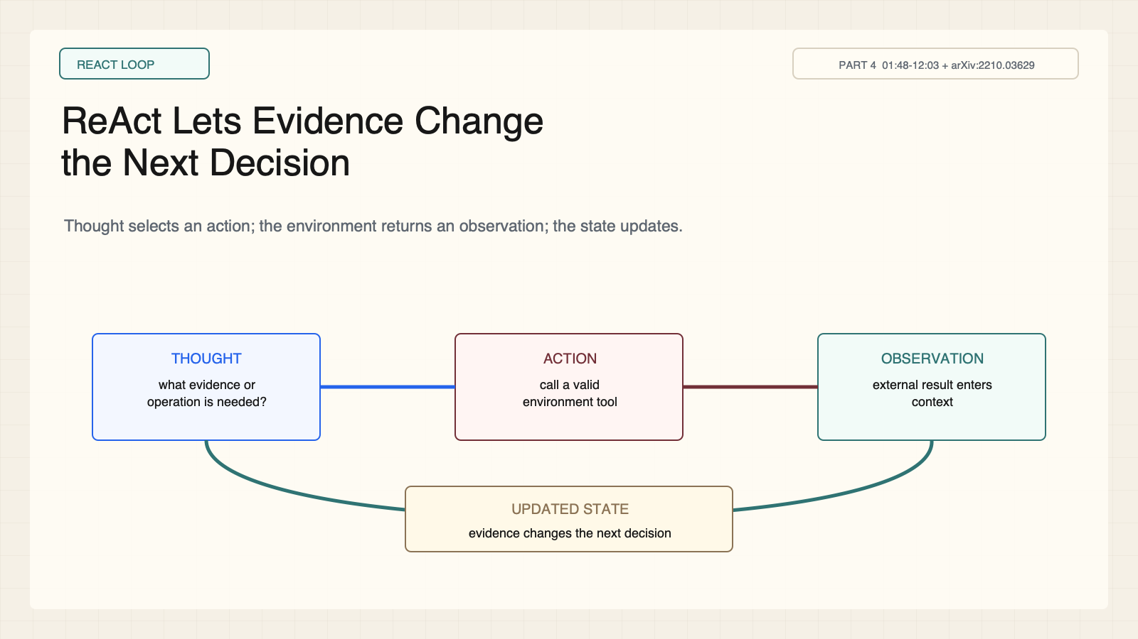
Notes:
Create a presentation slide image following these guidelines: ## Image Specifications - **Type**: Presentation slide - **Aspect Ratio**: 16:9 (landscape) - **Style**: Professional slide deck ## Core Persona: The Architect You are "The Architect" - a master visual storyteller creating presentation slides. Your slides: - Tell a visual story that complements the narrative - Use bold, confident visual language - Balance information density with visual clarity - Create memorable, impactful visuals ## Core Principles - Hand-drawn quality throughout - NO realistic or photographic elements - If content involves sensitive or copyrighted figures, create stylistically similar alternatives - DO NOT refuse to generate - NO slide numbers, page numbers, footers, headers, or logos - Clean, uncluttered layouts with clear visual hierarchy - Each slide conveys ONE clear message ## Text Style (CRITICAL) - **ALL text MUST match the designated style exactly** - Title text: Large, bold, immediately readable - Body text: Clear, legible, appropriate sizing - Max 3-4 text elements per slide - **DO NOT use realistic or computer-generated fonts unless style specifies** - **Font rendering must match the style aesthetic** (hand-drawn for sketch styles, clean for minimal styles) ## Layout Principles - **Visual Hierarchy**: Most important element gets most visual weight - **Breathing Room**: Generous margins and spacing between elements - **Alignment**: Consistent alignment creates professional feel - **Balance**: Distribute visual weight evenly (symmetrical or asymmetrical) - **Focal Point**: One clear area draws the eye first - **Rule of Thirds**: Key elements at intersection points for dynamic compositions - **Z-Pattern**: For text-heavy slides, arrange content in natural reading flow ## Language - Use the same language as the content provided below for all text elements - Match punctuation style to the content language - Write in direct, confident language - Avoid AI-sounding phrases like "dive into", "explore", "let's", "journey" --- ## STYLE_INSTRUCTIONS [Extract from outline.md - do NOT re-read style files] The STYLE_INSTRUCTIONS block from the outline contains: - Design Aesthetic - Background (Texture + Base Color) - Typography (Headlines + Body descriptions) - Color Palette (with hex codes) - Visual Elements - Density Guidelines - Style Rules (Do/Don't) Copy the entire `<STYLE_INSTRUCTIONS>...</STYLE_INSTRUCTIONS>` block from the outline here. --- ## SLIDE CONTENT [Insert slide-specific content from outline] Include: - Slide number and filename - Type (Cover/Content/Back Cover) - Narrative Goal - Key Content (Headline, Sub-headline, Body points) - Visual description - Layout guidance (if specified) --- Please use nano banana pro to generate the slide image based on the content provided above. --- # Slide 2: ReAct Lets Evidence Change the Next Decision ## Production method Rendered locally as an original 1600x900 SVG for exact text fidelity, then converted to PNG. Do not reproduce Stanford course frames, logos, or assigned-paper figures. ## Style Aged-cream academic technical briefing matched to the CS329A Part 2 deck: faint engineering grid, crisp 2px vector diagrams, near-black type, teal observations, cobalt reasoning/code, warm-brown human specification, maroon constraints, 8px card corners, no gradients or decorative imagery. ## On-slide content - Stage: react loop - Headline: ReAct Lets Evidence Change the Next Decision - Subtitle: Thought selects an action; the environment returns an observation; the state updates. - Supporting labels: Thought; Action; Observation; Updated state - Evidence: CS329A Part 4, 01:48-12:03 + arXiv:2210.03629 ## Visual direction Circular Thought-Action-Observation loop surrounding a state register whose revision is visible. ## Teaching objective Explain the interleaved Thought-Action-Observation control loop. ## Speaker notes The important design move is that an observation can alter the next decision. Reasoning without tools can remain ungrounded; acting without deliberation can be myopic. Interleaving does not guarantee either the reasoning or the action is correct.

Slide 3
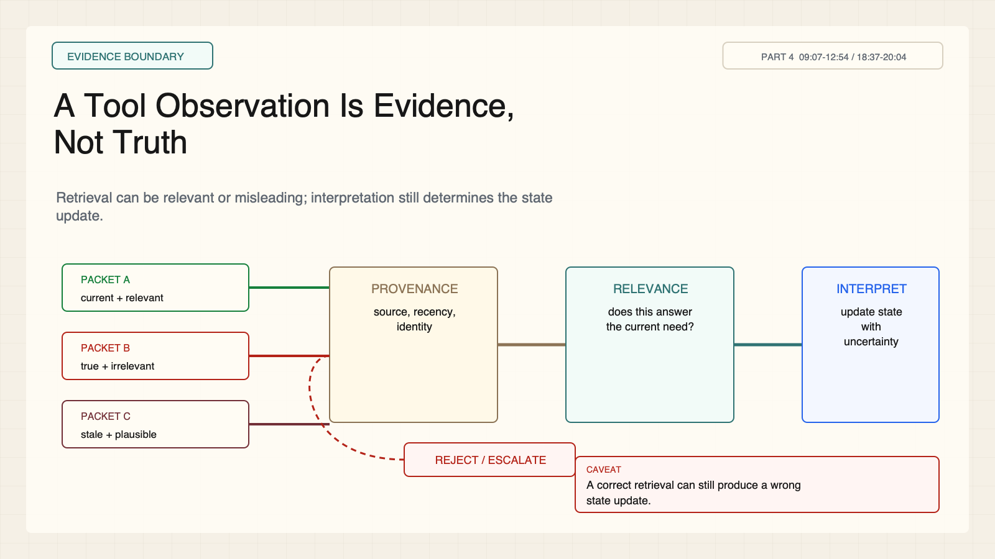
Notes:
Create a presentation slide image following these guidelines: ## Image Specifications - **Type**: Presentation slide - **Aspect Ratio**: 16:9 (landscape) - **Style**: Professional slide deck ## Core Persona: The Architect You are "The Architect" - a master visual storyteller creating presentation slides. Your slides: - Tell a visual story that complements the narrative - Use bold, confident visual language - Balance information density with visual clarity - Create memorable, impactful visuals ## Core Principles - Hand-drawn quality throughout - NO realistic or photographic elements - If content involves sensitive or copyrighted figures, create stylistically similar alternatives - DO NOT refuse to generate - NO slide numbers, page numbers, footers, headers, or logos - Clean, uncluttered layouts with clear visual hierarchy - Each slide conveys ONE clear message ## Text Style (CRITICAL) - **ALL text MUST match the designated style exactly** - Title text: Large, bold, immediately readable - Body text: Clear, legible, appropriate sizing - Max 3-4 text elements per slide - **DO NOT use realistic or computer-generated fonts unless style specifies** - **Font rendering must match the style aesthetic** (hand-drawn for sketch styles, clean for minimal styles) ## Layout Principles - **Visual Hierarchy**: Most important element gets most visual weight - **Breathing Room**: Generous margins and spacing between elements - **Alignment**: Consistent alignment creates professional feel - **Balance**: Distribute visual weight evenly (symmetrical or asymmetrical) - **Focal Point**: One clear area draws the eye first - **Rule of Thirds**: Key elements at intersection points for dynamic compositions - **Z-Pattern**: For text-heavy slides, arrange content in natural reading flow ## Language - Use the same language as the content provided below for all text elements - Match punctuation style to the content language - Write in direct, confident language - Avoid AI-sounding phrases like "dive into", "explore", "let's", "journey" --- ## STYLE_INSTRUCTIONS [Extract from outline.md - do NOT re-read style files] The STYLE_INSTRUCTIONS block from the outline contains: - Design Aesthetic - Background (Texture + Base Color) - Typography (Headlines + Body descriptions) - Color Palette (with hex codes) - Visual Elements - Density Guidelines - Style Rules (Do/Don't) Copy the entire `<STYLE_INSTRUCTIONS>...</STYLE_INSTRUCTIONS>` block from the outline here. --- ## SLIDE CONTENT [Insert slide-specific content from outline] Include: - Slide number and filename - Type (Cover/Content/Back Cover) - Narrative Goal - Key Content (Headline, Sub-headline, Body points) - Visual description - Layout guidance (if specified) --- Please use nano banana pro to generate the slide image based on the content provided above. --- # Slide 3: A Tool Observation Is Evidence, Not Truth ## Production method Rendered locally as an original 1600x900 SVG for exact text fidelity, then converted to PNG. Do not reproduce Stanford course frames, logos, or assigned-paper figures. ## Style Aged-cream academic technical briefing matched to the CS329A Part 2 deck: faint engineering grid, crisp 2px vector diagrams, near-black type, teal observations, cobalt reasoning/code, warm-brown human specification, maroon constraints, 8px card corners, no gradients or decorative imagery. ## On-slide content - Stage: evidence boundary - Headline: A Tool Observation Is Evidence, Not Truth - Subtitle: Retrieval can be relevant or misleading; interpretation still determines the state update. - Supporting labels: Provenance; Relevance; Interpretation; State update - Evidence: CS329A Part 4, 09:07-12:54 / 18:37-20:04 ## Visual direction Evidence packets pass through provenance and relevance gates before interpretation updates state; one packet is rejected. ## Teaching objective Prevent the misconception that adding a tool automatically grounds an answer. ## Speaker notes A tool can return true but irrelevant information, stale information, or evidence the model misreads. Grounding requires provenance, relevance, and interpretation checks.

Slide 4
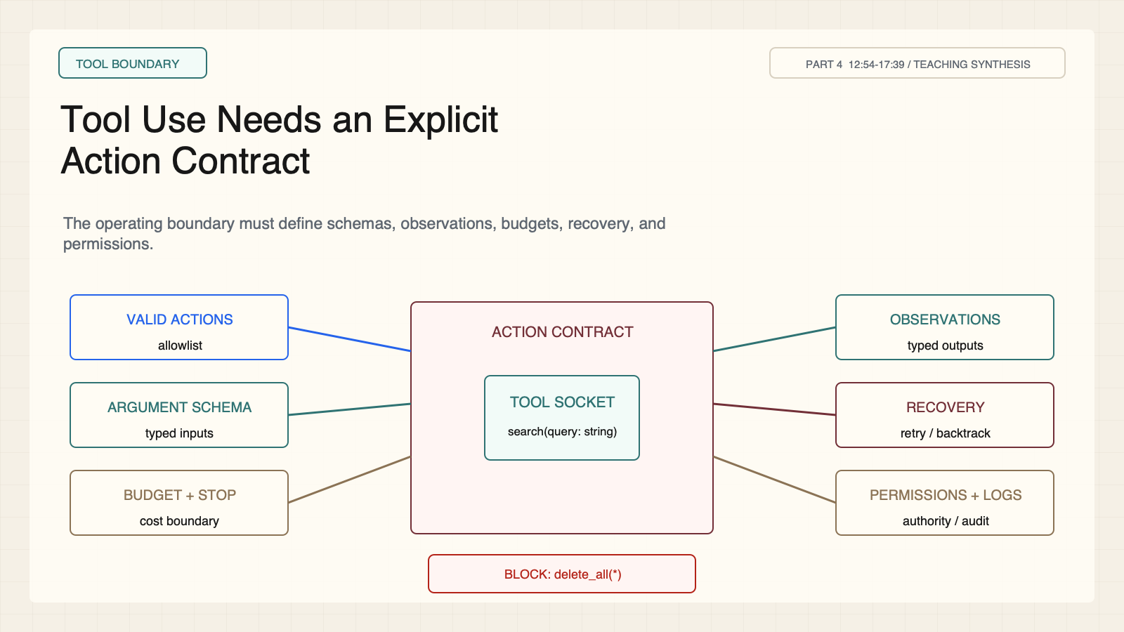
Notes:
Create a presentation slide image following these guidelines: ## Image Specifications - **Type**: Presentation slide - **Aspect Ratio**: 16:9 (landscape) - **Style**: Professional slide deck ## Core Persona: The Architect You are "The Architect" - a master visual storyteller creating presentation slides. Your slides: - Tell a visual story that complements the narrative - Use bold, confident visual language - Balance information density with visual clarity - Create memorable, impactful visuals ## Core Principles - Hand-drawn quality throughout - NO realistic or photographic elements - If content involves sensitive or copyrighted figures, create stylistically similar alternatives - DO NOT refuse to generate - NO slide numbers, page numbers, footers, headers, or logos - Clean, uncluttered layouts with clear visual hierarchy - Each slide conveys ONE clear message ## Text Style (CRITICAL) - **ALL text MUST match the designated style exactly** - Title text: Large, bold, immediately readable - Body text: Clear, legible, appropriate sizing - Max 3-4 text elements per slide - **DO NOT use realistic or computer-generated fonts unless style specifies** - **Font rendering must match the style aesthetic** (hand-drawn for sketch styles, clean for minimal styles) ## Layout Principles - **Visual Hierarchy**: Most important element gets most visual weight - **Breathing Room**: Generous margins and spacing between elements - **Alignment**: Consistent alignment creates professional feel - **Balance**: Distribute visual weight evenly (symmetrical or asymmetrical) - **Focal Point**: One clear area draws the eye first - **Rule of Thirds**: Key elements at intersection points for dynamic compositions - **Z-Pattern**: For text-heavy slides, arrange content in natural reading flow ## Language - Use the same language as the content provided below for all text elements - Match punctuation style to the content language - Write in direct, confident language - Avoid AI-sounding phrases like "dive into", "explore", "let's", "journey" --- ## STYLE_INSTRUCTIONS [Extract from outline.md - do NOT re-read style files] The STYLE_INSTRUCTIONS block from the outline contains: - Design Aesthetic - Background (Texture + Base Color) - Typography (Headlines + Body descriptions) - Color Palette (with hex codes) - Visual Elements - Density Guidelines - Style Rules (Do/Don't) Copy the entire `<STYLE_INSTRUCTIONS>...</STYLE_INSTRUCTIONS>` block from the outline here. --- ## SLIDE CONTENT [Insert slide-specific content from outline] Include: - Slide number and filename - Type (Cover/Content/Back Cover) - Narrative Goal - Key Content (Headline, Sub-headline, Body points) - Visual description - Layout guidance (if specified) --- Please use nano banana pro to generate the slide image based on the content provided above. --- # Slide 4: Tool Use Needs an Explicit Action Contract ## Production method Rendered locally as an original 1600x900 SVG for exact text fidelity, then converted to PNG. Do not reproduce Stanford course frames, logos, or assigned-paper figures. ## Style Aged-cream academic technical briefing matched to the CS329A Part 2 deck: faint engineering grid, crisp 2px vector diagrams, near-black type, teal observations, cobalt reasoning/code, warm-brown human specification, maroon constraints, 8px card corners, no gradients or decorative imagery. ## On-slide content - Stage: tool boundary - Headline: Tool Use Needs an Explicit Action Contract - Subtitle: The operating boundary must define schemas, observations, budgets, recovery, and permissions. - Supporting labels: Valid actions; Schemas; Budgets; Recovery; Permissions; Logs - Evidence: CS329A Part 4, 12:54-17:39 / TEACHING SYNTHESIS ## Visual direction Six contract clauses surround a typed tool socket; an invalid action is blocked outside the boundary. ## Teaching objective Identify the interface contract required around a tool-using agent. ## Speaker notes The ReAct benchmarks use small action spaces such as search, lookup, and finish. The six-part deployable action contract shown here is an explicit teaching synthesis grounded in the lecture discussion; it is not a named ReAct result.

Slide 5
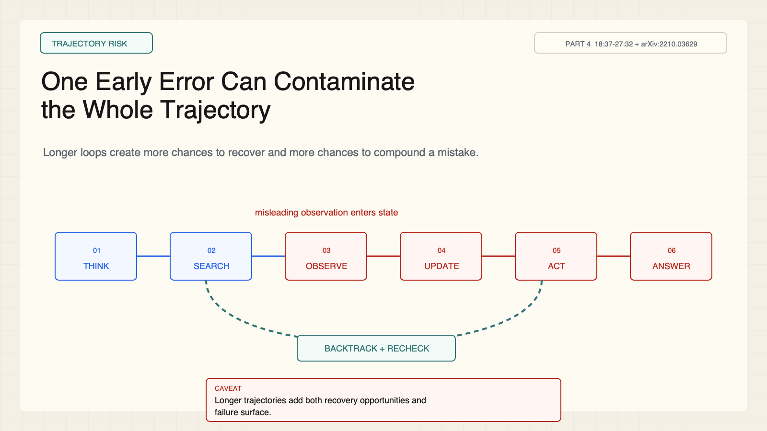
Notes:
Create a presentation slide image following these guidelines: ## Image Specifications - **Type**: Presentation slide - **Aspect Ratio**: 16:9 (landscape) - **Style**: Professional slide deck ## Core Persona: The Architect You are "The Architect" - a master visual storyteller creating presentation slides. Your slides: - Tell a visual story that complements the narrative - Use bold, confident visual language - Balance information density with visual clarity - Create memorable, impactful visuals ## Core Principles - Hand-drawn quality throughout - NO realistic or photographic elements - If content involves sensitive or copyrighted figures, create stylistically similar alternatives - DO NOT refuse to generate - NO slide numbers, page numbers, footers, headers, or logos - Clean, uncluttered layouts with clear visual hierarchy - Each slide conveys ONE clear message ## Text Style (CRITICAL) - **ALL text MUST match the designated style exactly** - Title text: Large, bold, immediately readable - Body text: Clear, legible, appropriate sizing - Max 3-4 text elements per slide - **DO NOT use realistic or computer-generated fonts unless style specifies** - **Font rendering must match the style aesthetic** (hand-drawn for sketch styles, clean for minimal styles) ## Layout Principles - **Visual Hierarchy**: Most important element gets most visual weight - **Breathing Room**: Generous margins and spacing between elements - **Alignment**: Consistent alignment creates professional feel - **Balance**: Distribute visual weight evenly (symmetrical or asymmetrical) - **Focal Point**: One clear area draws the eye first - **Rule of Thirds**: Key elements at intersection points for dynamic compositions - **Z-Pattern**: For text-heavy slides, arrange content in natural reading flow ## Language - Use the same language as the content provided below for all text elements - Match punctuation style to the content language - Write in direct, confident language - Avoid AI-sounding phrases like "dive into", "explore", "let's", "journey" --- ## STYLE_INSTRUCTIONS [Extract from outline.md - do NOT re-read style files] The STYLE_INSTRUCTIONS block from the outline contains: - Design Aesthetic - Background (Texture + Base Color) - Typography (Headlines + Body descriptions) - Color Palette (with hex codes) - Visual Elements - Density Guidelines - Style Rules (Do/Don't) Copy the entire `<STYLE_INSTRUCTIONS>...</STYLE_INSTRUCTIONS>` block from the outline here. --- ## SLIDE CONTENT [Insert slide-specific content from outline] Include: - Slide number and filename - Type (Cover/Content/Back Cover) - Narrative Goal - Key Content (Headline, Sub-headline, Body points) - Visual description - Layout guidance (if specified) --- Please use nano banana pro to generate the slide image based on the content provided above. --- # Slide 5: One Early Error Can Contaminate the Whole Trajectory ## Production method Rendered locally as an original 1600x900 SVG for exact text fidelity, then converted to PNG. Do not reproduce Stanford course frames, logos, or assigned-paper figures. ## Style Aged-cream academic technical briefing matched to the CS329A Part 2 deck: faint engineering grid, crisp 2px vector diagrams, near-black type, teal observations, cobalt reasoning/code, warm-brown human specification, maroon constraints, 8px card corners, no gradients or decorative imagery. ## On-slide content - Stage: trajectory risk - Headline: One Early Error Can Contaminate the Whole Trajectory - Subtitle: Longer loops create more chances to recover and more chances to compound a mistake. - Supporting labels: Bad observation; Wrong state; Risky action; Backtrack - Evidence: CS329A Part 4, 18:37-27:32 + arXiv:2210.03629 ## Visual direction A six-step trajectory turns red after a misleading observation; a dashed recovery branch restores an earlier state. ## Teaching objective Show how retrieval and reasoning failures propagate across a trajectory. ## Speaker notes ReAct reduces some hallucination failures in the reported tasks, but it adds search and reasoning-over-observation failures. An early bad observation can contaminate later state and action. Backtracking only helps when the system can identify a state worth restoring.

Slide 6
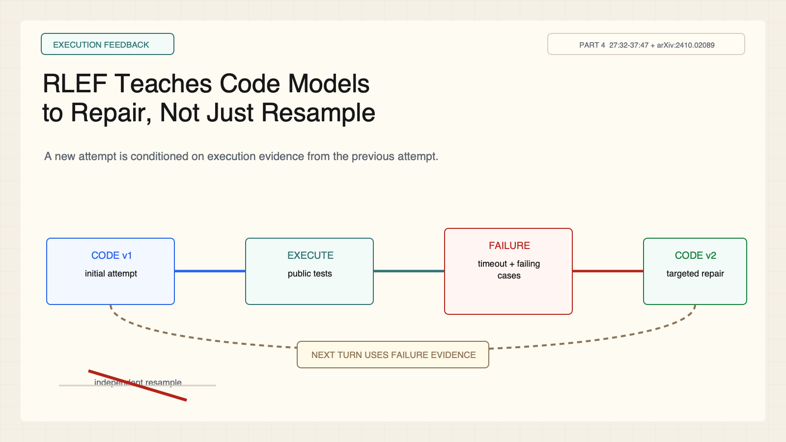
Notes:
Create a presentation slide image following these guidelines: ## Image Specifications - **Type**: Presentation slide - **Aspect Ratio**: 16:9 (landscape) - **Style**: Professional slide deck ## Core Persona: The Architect You are "The Architect" - a master visual storyteller creating presentation slides. Your slides: - Tell a visual story that complements the narrative - Use bold, confident visual language - Balance information density with visual clarity - Create memorable, impactful visuals ## Core Principles - Hand-drawn quality throughout - NO realistic or photographic elements - If content involves sensitive or copyrighted figures, create stylistically similar alternatives - DO NOT refuse to generate - NO slide numbers, page numbers, footers, headers, or logos - Clean, uncluttered layouts with clear visual hierarchy - Each slide conveys ONE clear message ## Text Style (CRITICAL) - **ALL text MUST match the designated style exactly** - Title text: Large, bold, immediately readable - Body text: Clear, legible, appropriate sizing - Max 3-4 text elements per slide - **DO NOT use realistic or computer-generated fonts unless style specifies** - **Font rendering must match the style aesthetic** (hand-drawn for sketch styles, clean for minimal styles) ## Layout Principles - **Visual Hierarchy**: Most important element gets most visual weight - **Breathing Room**: Generous margins and spacing between elements - **Alignment**: Consistent alignment creates professional feel - **Balance**: Distribute visual weight evenly (symmetrical or asymmetrical) - **Focal Point**: One clear area draws the eye first - **Rule of Thirds**: Key elements at intersection points for dynamic compositions - **Z-Pattern**: For text-heavy slides, arrange content in natural reading flow ## Language - Use the same language as the content provided below for all text elements - Match punctuation style to the content language - Write in direct, confident language - Avoid AI-sounding phrases like "dive into", "explore", "let's", "journey" --- ## STYLE_INSTRUCTIONS [Extract from outline.md - do NOT re-read style files] The STYLE_INSTRUCTIONS block from the outline contains: - Design Aesthetic - Background (Texture + Base Color) - Typography (Headlines + Body descriptions) - Color Palette (with hex codes) - Visual Elements - Density Guidelines - Style Rules (Do/Don't) Copy the entire `<STYLE_INSTRUCTIONS>...</STYLE_INSTRUCTIONS>` block from the outline here. --- ## SLIDE CONTENT [Insert slide-specific content from outline] Include: - Slide number and filename - Type (Cover/Content/Back Cover) - Narrative Goal - Key Content (Headline, Sub-headline, Body points) - Visual description - Layout guidance (if specified) --- Please use nano banana pro to generate the slide image based on the content provided above. --- # Slide 6: RLEF Teaches Code Models to Repair, Not Just Resample ## Production method Rendered locally as an original 1600x900 SVG for exact text fidelity, then converted to PNG. Do not reproduce Stanford course frames, logos, or assigned-paper figures. ## Style Aged-cream academic technical briefing matched to the CS329A Part 2 deck: faint engineering grid, crisp 2px vector diagrams, near-black type, teal observations, cobalt reasoning/code, warm-brown human specification, maroon constraints, 8px card corners, no gradients or decorative imagery. ## On-slide content - Stage: execution feedback - Headline: RLEF Teaches Code Models to Repair, Not Just Resample - Subtitle: A new attempt is conditioned on execution evidence from the previous attempt. - Supporting labels: Code attempt; Execute; Failure evidence; Targeted repair - Evidence: CS329A Part 4, 27:32-37:47 + arXiv:2410.02089 ## Visual direction A code-attempt/test/failure/repair cycle reaches pass; a faded independent-resample path is crossed out. ## Teaching objective Explain iterative code repair under execution feedback. ## Speaker notes RLEF generates code, runs public tests, exposes failures, and conditions the next turn on that feedback. The reported solve-rate gains are tied to competitive-programming tasks, specific models, tests, and budgets; the slide intentionally omits a universal percentage.

Slide 7
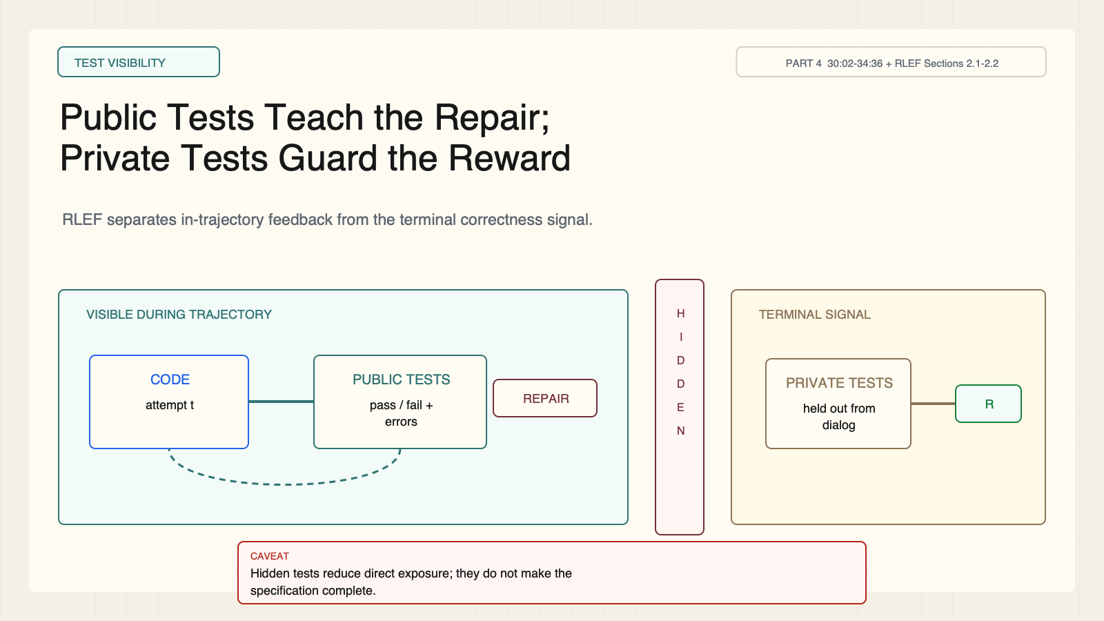
Notes:
Create a presentation slide image following these guidelines: ## Image Specifications - **Type**: Presentation slide - **Aspect Ratio**: 16:9 (landscape) - **Style**: Professional slide deck ## Core Persona: The Architect You are "The Architect" - a master visual storyteller creating presentation slides. Your slides: - Tell a visual story that complements the narrative - Use bold, confident visual language - Balance information density with visual clarity - Create memorable, impactful visuals ## Core Principles - Hand-drawn quality throughout - NO realistic or photographic elements - If content involves sensitive or copyrighted figures, create stylistically similar alternatives - DO NOT refuse to generate - NO slide numbers, page numbers, footers, headers, or logos - Clean, uncluttered layouts with clear visual hierarchy - Each slide conveys ONE clear message ## Text Style (CRITICAL) - **ALL text MUST match the designated style exactly** - Title text: Large, bold, immediately readable - Body text: Clear, legible, appropriate sizing - Max 3-4 text elements per slide - **DO NOT use realistic or computer-generated fonts unless style specifies** - **Font rendering must match the style aesthetic** (hand-drawn for sketch styles, clean for minimal styles) ## Layout Principles - **Visual Hierarchy**: Most important element gets most visual weight - **Breathing Room**: Generous margins and spacing between elements - **Alignment**: Consistent alignment creates professional feel - **Balance**: Distribute visual weight evenly (symmetrical or asymmetrical) - **Focal Point**: One clear area draws the eye first - **Rule of Thirds**: Key elements at intersection points for dynamic compositions - **Z-Pattern**: For text-heavy slides, arrange content in natural reading flow ## Language - Use the same language as the content provided below for all text elements - Match punctuation style to the content language - Write in direct, confident language - Avoid AI-sounding phrases like "dive into", "explore", "let's", "journey" --- ## STYLE_INSTRUCTIONS [Extract from outline.md - do NOT re-read style files] The STYLE_INSTRUCTIONS block from the outline contains: - Design Aesthetic - Background (Texture + Base Color) - Typography (Headlines + Body descriptions) - Color Palette (with hex codes) - Visual Elements - Density Guidelines - Style Rules (Do/Don't) Copy the entire `<STYLE_INSTRUCTIONS>...</STYLE_INSTRUCTIONS>` block from the outline here. --- ## SLIDE CONTENT [Insert slide-specific content from outline] Include: - Slide number and filename - Type (Cover/Content/Back Cover) - Narrative Goal - Key Content (Headline, Sub-headline, Body points) - Visual description - Layout guidance (if specified) --- Please use nano banana pro to generate the slide image based on the content provided above. --- # Slide 7: Public Tests Teach the Repair; Private Tests Guard the Reward ## Production method Rendered locally as an original 1600x900 SVG for exact text fidelity, then converted to PNG. Do not reproduce Stanford course frames, logos, or assigned-paper figures. ## Style Aged-cream academic technical briefing matched to the CS329A Part 2 deck: faint engineering grid, crisp 2px vector diagrams, near-black type, teal observations, cobalt reasoning/code, warm-brown human specification, maroon constraints, 8px card corners, no gradients or decorative imagery. ## On-slide content - Stage: test visibility - Headline: Public Tests Teach the Repair; Private Tests Guard the Reward - Subtitle: RLEF separates in-trajectory feedback from the terminal correctness signal. - Supporting labels: Public feedback; Turn limit; Private tests; Terminal reward - Evidence: CS329A Part 4, 30:02-34:36 + RLEF Sections 2.1-2.2 ## Visual direction A public feedback lane reaches the agent while a firewall hides private tests until a terminal reward gate. ## Teaching objective Distinguish visible repair feedback from held-out terminal evaluation. ## Speaker notes Public-test output enters the conversation. An episode ends when public tests pass or a turn limit is reached. The terminal scalar reward records whether all public and private tests pass. Separation reduces direct exposure; it does not prove absence of contamination or complete specification coverage.

Slide 8
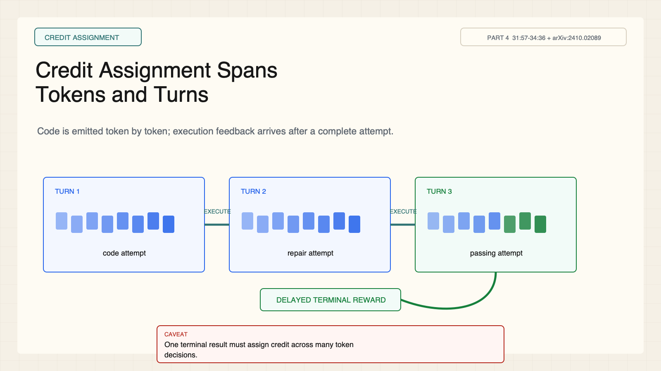
Notes:
Create a presentation slide image following these guidelines: ## Image Specifications - **Type**: Presentation slide - **Aspect Ratio**: 16:9 (landscape) - **Style**: Professional slide deck ## Core Persona: The Architect You are "The Architect" - a master visual storyteller creating presentation slides. Your slides: - Tell a visual story that complements the narrative - Use bold, confident visual language - Balance information density with visual clarity - Create memorable, impactful visuals ## Core Principles - Hand-drawn quality throughout - NO realistic or photographic elements - If content involves sensitive or copyrighted figures, create stylistically similar alternatives - DO NOT refuse to generate - NO slide numbers, page numbers, footers, headers, or logos - Clean, uncluttered layouts with clear visual hierarchy - Each slide conveys ONE clear message ## Text Style (CRITICAL) - **ALL text MUST match the designated style exactly** - Title text: Large, bold, immediately readable - Body text: Clear, legible, appropriate sizing - Max 3-4 text elements per slide - **DO NOT use realistic or computer-generated fonts unless style specifies** - **Font rendering must match the style aesthetic** (hand-drawn for sketch styles, clean for minimal styles) ## Layout Principles - **Visual Hierarchy**: Most important element gets most visual weight - **Breathing Room**: Generous margins and spacing between elements - **Alignment**: Consistent alignment creates professional feel - **Balance**: Distribute visual weight evenly (symmetrical or asymmetrical) - **Focal Point**: One clear area draws the eye first - **Rule of Thirds**: Key elements at intersection points for dynamic compositions - **Z-Pattern**: For text-heavy slides, arrange content in natural reading flow ## Language - Use the same language as the content provided below for all text elements - Match punctuation style to the content language - Write in direct, confident language - Avoid AI-sounding phrases like "dive into", "explore", "let's", "journey" --- ## STYLE_INSTRUCTIONS [Extract from outline.md - do NOT re-read style files] The STYLE_INSTRUCTIONS block from the outline contains: - Design Aesthetic - Background (Texture + Base Color) - Typography (Headlines + Body descriptions) - Color Palette (with hex codes) - Visual Elements - Density Guidelines - Style Rules (Do/Don't) Copy the entire `<STYLE_INSTRUCTIONS>...</STYLE_INSTRUCTIONS>` block from the outline here. --- ## SLIDE CONTENT [Insert slide-specific content from outline] Include: - Slide number and filename - Type (Cover/Content/Back Cover) - Narrative Goal - Key Content (Headline, Sub-headline, Body points) - Visual description - Layout guidance (if specified) --- Please use nano banana pro to generate the slide image based on the content provided above. --- # Slide 8: Credit Assignment Spans Tokens and Turns ## Production method Rendered locally as an original 1600x900 SVG for exact text fidelity, then converted to PNG. Do not reproduce Stanford course frames, logos, or assigned-paper figures. ## Style Aged-cream academic technical briefing matched to the CS329A Part 2 deck: faint engineering grid, crisp 2px vector diagrams, near-black type, teal observations, cobalt reasoning/code, warm-brown human specification, maroon constraints, 8px card corners, no gradients or decorative imagery. ## On-slide content - Stage: credit assignment - Headline: Credit Assignment Spans Tokens and Turns - Subtitle: Code is emitted token by token; execution feedback arrives after a complete attempt. - Supporting labels: Token policy; Turn boundary; Execution; Delayed reward - Evidence: CS329A Part 4, 31:57-34:36 + arXiv:2410.02089 ## Visual direction Three token ribbons sit inside turn cards; execution pulses arrive between turns and a delayed reward closes the episode. ## Teaching objective Explain RLEF's nested token-level and turn-level time scales. ## Speaker notes A response contains many token decisions, but execution feedback appears only after an attempt. The learner must propagate delayed evidence across the trajectory. A passing terminal reward remains weak process supervision because it does not identify every necessary implementation choice.

Slide 9
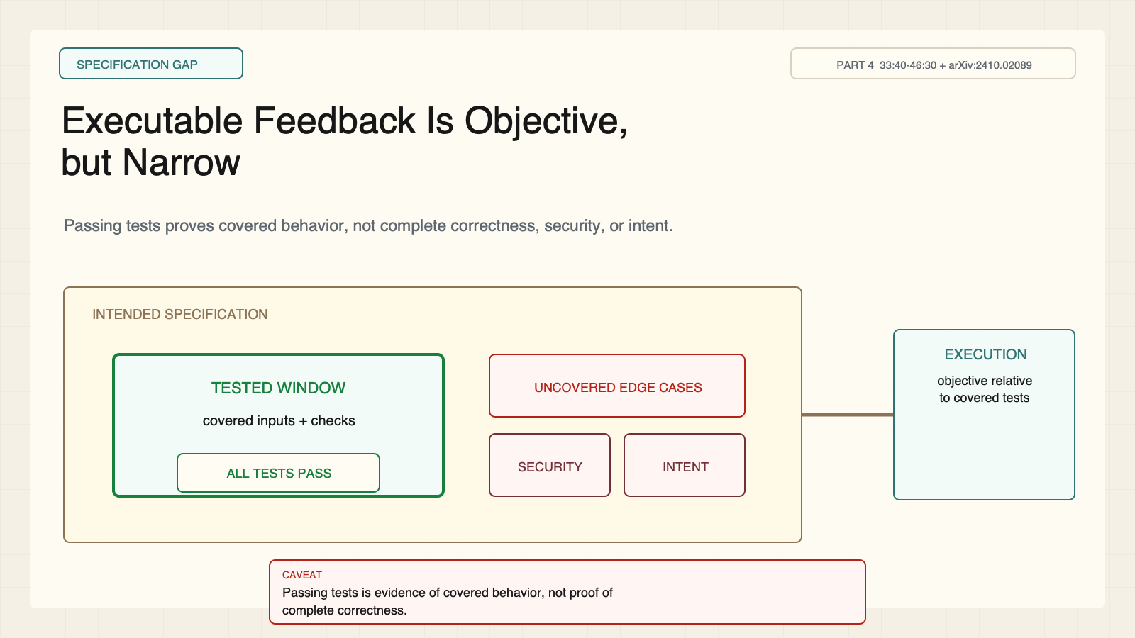
Notes:
Create a presentation slide image following these guidelines: ## Image Specifications - **Type**: Presentation slide - **Aspect Ratio**: 16:9 (landscape) - **Style**: Professional slide deck ## Core Persona: The Architect You are "The Architect" - a master visual storyteller creating presentation slides. Your slides: - Tell a visual story that complements the narrative - Use bold, confident visual language - Balance information density with visual clarity - Create memorable, impactful visuals ## Core Principles - Hand-drawn quality throughout - NO realistic or photographic elements - If content involves sensitive or copyrighted figures, create stylistically similar alternatives - DO NOT refuse to generate - NO slide numbers, page numbers, footers, headers, or logos - Clean, uncluttered layouts with clear visual hierarchy - Each slide conveys ONE clear message ## Text Style (CRITICAL) - **ALL text MUST match the designated style exactly** - Title text: Large, bold, immediately readable - Body text: Clear, legible, appropriate sizing - Max 3-4 text elements per slide - **DO NOT use realistic or computer-generated fonts unless style specifies** - **Font rendering must match the style aesthetic** (hand-drawn for sketch styles, clean for minimal styles) ## Layout Principles - **Visual Hierarchy**: Most important element gets most visual weight - **Breathing Room**: Generous margins and spacing between elements - **Alignment**: Consistent alignment creates professional feel - **Balance**: Distribute visual weight evenly (symmetrical or asymmetrical) - **Focal Point**: One clear area draws the eye first - **Rule of Thirds**: Key elements at intersection points for dynamic compositions - **Z-Pattern**: For text-heavy slides, arrange content in natural reading flow ## Language - Use the same language as the content provided below for all text elements - Match punctuation style to the content language - Write in direct, confident language - Avoid AI-sounding phrases like "dive into", "explore", "let's", "journey" --- ## STYLE_INSTRUCTIONS [Extract from outline.md - do NOT re-read style files] The STYLE_INSTRUCTIONS block from the outline contains: - Design Aesthetic - Background (Texture + Base Color) - Typography (Headlines + Body descriptions) - Color Palette (with hex codes) - Visual Elements - Density Guidelines - Style Rules (Do/Don't) Copy the entire `<STYLE_INSTRUCTIONS>...</STYLE_INSTRUCTIONS>` block from the outline here. --- ## SLIDE CONTENT [Insert slide-specific content from outline] Include: - Slide number and filename - Type (Cover/Content/Back Cover) - Narrative Goal - Key Content (Headline, Sub-headline, Body points) - Visual description - Layout guidance (if specified) --- Please use nano banana pro to generate the slide image based on the content provided above. --- # Slide 9: Executable Feedback Is Objective, but Narrow ## Production method Rendered locally as an original 1600x900 SVG for exact text fidelity, then converted to PNG. Do not reproduce Stanford course frames, logos, or assigned-paper figures. ## Style Aged-cream academic technical briefing matched to the CS329A Part 2 deck: faint engineering grid, crisp 2px vector diagrams, near-black type, teal observations, cobalt reasoning/code, warm-brown human specification, maroon constraints, 8px card corners, no gradients or decorative imagery. ## On-slide content - Stage: specification gap - Headline: Executable Feedback Is Objective, but Narrow - Subtitle: Passing tests proves covered behavior, not complete correctness, security, or intent. - Supporting labels: Tested behavior; Uncovered cases; Security; Specification - Evidence: CS329A Part 4, 33:40-46:30 + arXiv:2410.02089 ## Visual direction A small tested window covers only part of a larger specification field; uncovered risk zones remain visible. ## Teaching objective Separate machine-objective evidence from complete task correctness. ## Speaker notes Execution feedback is objective relative to a test suite. RLEF requires runnable code, useful tests, and a secure sandbox. Repository-scale engineering adds retrieval, dependencies, context management, security, and specification coverage.

Slide 10
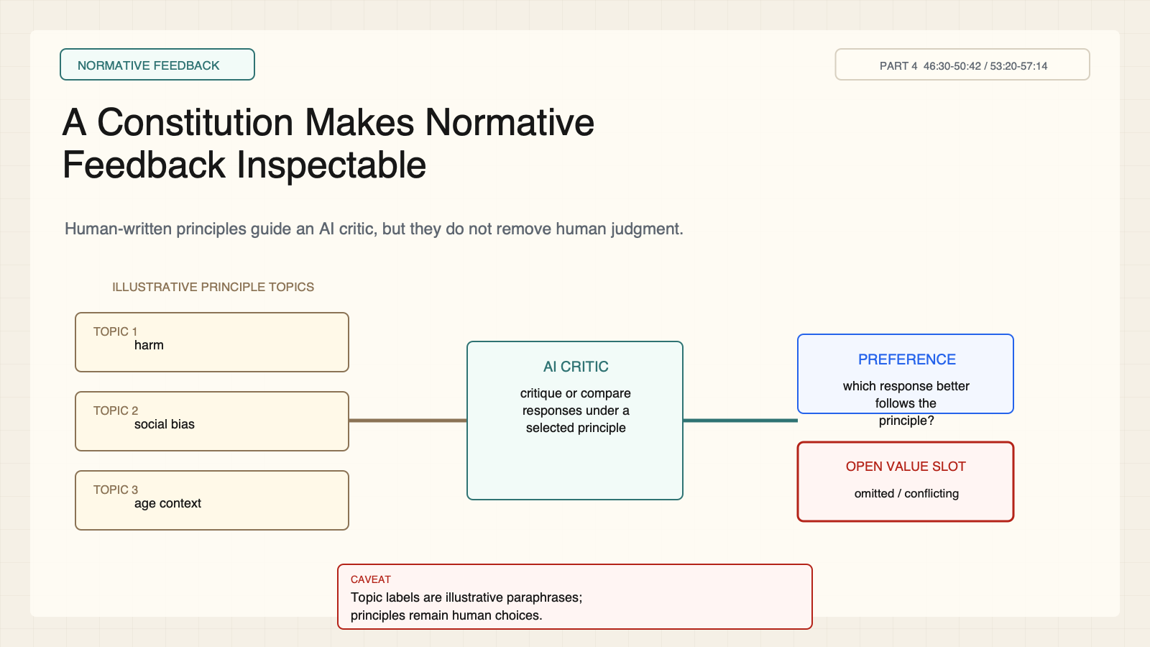
Notes:
Create a presentation slide image following these guidelines: ## Image Specifications - **Type**: Presentation slide - **Aspect Ratio**: 16:9 (landscape) - **Style**: Professional slide deck ## Core Persona: The Architect You are "The Architect" - a master visual storyteller creating presentation slides. Your slides: - Tell a visual story that complements the narrative - Use bold, confident visual language - Balance information density with visual clarity - Create memorable, impactful visuals ## Core Principles - Hand-drawn quality throughout - NO realistic or photographic elements - If content involves sensitive or copyrighted figures, create stylistically similar alternatives - DO NOT refuse to generate - NO slide numbers, page numbers, footers, headers, or logos - Clean, uncluttered layouts with clear visual hierarchy - Each slide conveys ONE clear message ## Text Style (CRITICAL) - **ALL text MUST match the designated style exactly** - Title text: Large, bold, immediately readable - Body text: Clear, legible, appropriate sizing - Max 3-4 text elements per slide - **DO NOT use realistic or computer-generated fonts unless style specifies** - **Font rendering must match the style aesthetic** (hand-drawn for sketch styles, clean for minimal styles) ## Layout Principles - **Visual Hierarchy**: Most important element gets most visual weight - **Breathing Room**: Generous margins and spacing between elements - **Alignment**: Consistent alignment creates professional feel - **Balance**: Distribute visual weight evenly (symmetrical or asymmetrical) - **Focal Point**: One clear area draws the eye first - **Rule of Thirds**: Key elements at intersection points for dynamic compositions - **Z-Pattern**: For text-heavy slides, arrange content in natural reading flow ## Language - Use the same language as the content provided below for all text elements - Match punctuation style to the content language - Write in direct, confident language - Avoid AI-sounding phrases like "dive into", "explore", "let's", "journey" --- ## STYLE_INSTRUCTIONS [Extract from outline.md - do NOT re-read style files] The STYLE_INSTRUCTIONS block from the outline contains: - Design Aesthetic - Background (Texture + Base Color) - Typography (Headlines + Body descriptions) - Color Palette (with hex codes) - Visual Elements - Density Guidelines - Style Rules (Do/Don't) Copy the entire `<STYLE_INSTRUCTIONS>...</STYLE_INSTRUCTIONS>` block from the outline here. --- ## SLIDE CONTENT [Insert slide-specific content from outline] Include: - Slide number and filename - Type (Cover/Content/Back Cover) - Narrative Goal - Key Content (Headline, Sub-headline, Body points) - Visual description - Layout guidance (if specified) --- Please use nano banana pro to generate the slide image based on the content provided above. --- # Slide 10: A Constitution Makes Normative Feedback Inspectable ## Production method Rendered locally as an original 1600x900 SVG for exact text fidelity, then converted to PNG. Do not reproduce Stanford course frames, logos, or assigned-paper figures. ## Style Aged-cream academic technical briefing matched to the CS329A Part 2 deck: faint engineering grid, crisp 2px vector diagrams, near-black type, teal observations, cobalt reasoning/code, warm-brown human specification, maroon constraints, 8px card corners, no gradients or decorative imagery. ## On-slide content - Stage: normative feedback - Headline: A Constitution Makes Normative Feedback Inspectable - Subtitle: Human-written principles guide an AI critic, but they do not remove human judgment. - Supporting labels: Human authors; Principles; AI critic; Value gaps - Evidence: CS329A Part 4, 46:30-50:42 / 53:20-57:14 ## Visual direction Human-authored cards labeled as illustrative principle topics feed an AI critic while a visible open slot represents omitted or conflicting values; no paper figure is reproduced. ## Teaching objective Explain a constitution as an explicit but incomplete feedback specification. ## Speaker notes Constitutional AI uses natural-language principles for critique, revision, and preference labeling. Section 4.3 reports using 16 prewritten principles for preference labels. Humans still select the principles, supply helpfulness data, and define evaluation.

Slide 11
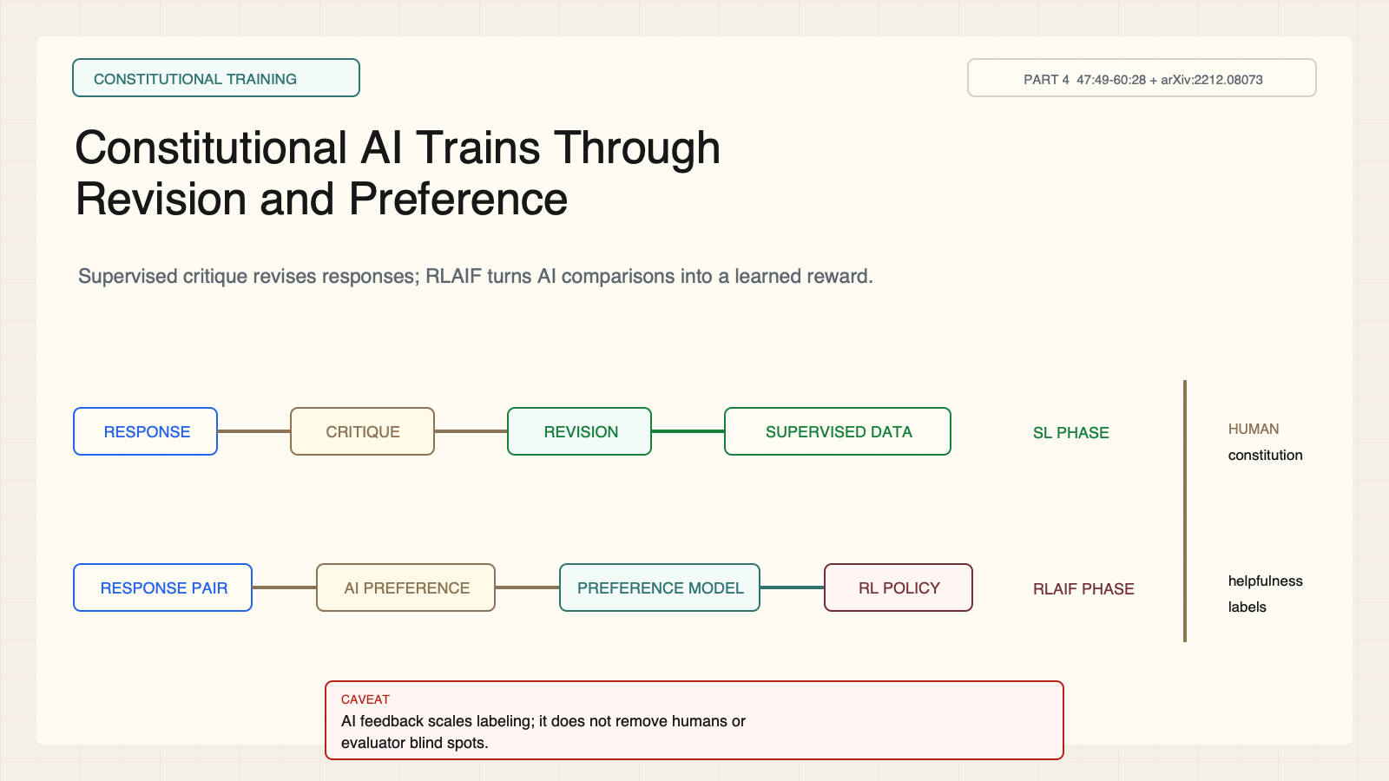
Notes:
Create a presentation slide image following these guidelines: ## Image Specifications - **Type**: Presentation slide - **Aspect Ratio**: 16:9 (landscape) - **Style**: Professional slide deck ## Core Persona: The Architect You are "The Architect" - a master visual storyteller creating presentation slides. Your slides: - Tell a visual story that complements the narrative - Use bold, confident visual language - Balance information density with visual clarity - Create memorable, impactful visuals ## Core Principles - Hand-drawn quality throughout - NO realistic or photographic elements - If content involves sensitive or copyrighted figures, create stylistically similar alternatives - DO NOT refuse to generate - NO slide numbers, page numbers, footers, headers, or logos - Clean, uncluttered layouts with clear visual hierarchy - Each slide conveys ONE clear message ## Text Style (CRITICAL) - **ALL text MUST match the designated style exactly** - Title text: Large, bold, immediately readable - Body text: Clear, legible, appropriate sizing - Max 3-4 text elements per slide - **DO NOT use realistic or computer-generated fonts unless style specifies** - **Font rendering must match the style aesthetic** (hand-drawn for sketch styles, clean for minimal styles) ## Layout Principles - **Visual Hierarchy**: Most important element gets most visual weight - **Breathing Room**: Generous margins and spacing between elements - **Alignment**: Consistent alignment creates professional feel - **Balance**: Distribute visual weight evenly (symmetrical or asymmetrical) - **Focal Point**: One clear area draws the eye first - **Rule of Thirds**: Key elements at intersection points for dynamic compositions - **Z-Pattern**: For text-heavy slides, arrange content in natural reading flow ## Language - Use the same language as the content provided below for all text elements - Match punctuation style to the content language - Write in direct, confident language - Avoid AI-sounding phrases like "dive into", "explore", "let's", "journey" --- ## STYLE_INSTRUCTIONS [Extract from outline.md - do NOT re-read style files] The STYLE_INSTRUCTIONS block from the outline contains: - Design Aesthetic - Background (Texture + Base Color) - Typography (Headlines + Body descriptions) - Color Palette (with hex codes) - Visual Elements - Density Guidelines - Style Rules (Do/Don't) Copy the entire `<STYLE_INSTRUCTIONS>...</STYLE_INSTRUCTIONS>` block from the outline here. --- ## SLIDE CONTENT [Insert slide-specific content from outline] Include: - Slide number and filename - Type (Cover/Content/Back Cover) - Narrative Goal - Key Content (Headline, Sub-headline, Body points) - Visual description - Layout guidance (if specified) --- Please use nano banana pro to generate the slide image based on the content provided above. --- # Slide 11: Constitutional AI Trains Through Revision and Preference ## Production method Rendered locally as an original 1600x900 SVG for exact text fidelity, then converted to PNG. Do not reproduce Stanford course frames, logos, or assigned-paper figures. ## Style Aged-cream academic technical briefing matched to the CS329A Part 2 deck: faint engineering grid, crisp 2px vector diagrams, near-black type, teal observations, cobalt reasoning/code, warm-brown human specification, maroon constraints, 8px card corners, no gradients or decorative imagery. ## On-slide content - Stage: constitutional training - Headline: Constitutional AI Trains Through Revision and Preference - Subtitle: Supervised critique revises responses; RLAIF turns AI comparisons into a learned reward. - Supporting labels: Critique; Revision; AI preference; Preference model - Evidence: CS329A Part 4, 47:49-60:28 + arXiv:2212.08073 ## Visual direction An original split-path teaching abstraction shows supervised revision and RLAIF preference learning, joined by a human-specification bracket; it does not recreate the paper's Figure 1. ## Teaching objective Distinguish the supervised and reinforcement-learning phases of Constitutional AI. ## Speaker notes The supervised lane creates critique-and-revision data. The RLAIF lane uses AI comparisons to train a preference model and optimize a policy. Human helpfulness labels remain, and measured harmlessness can trade off against helpfulness or produce over-refusal.

Slide 12
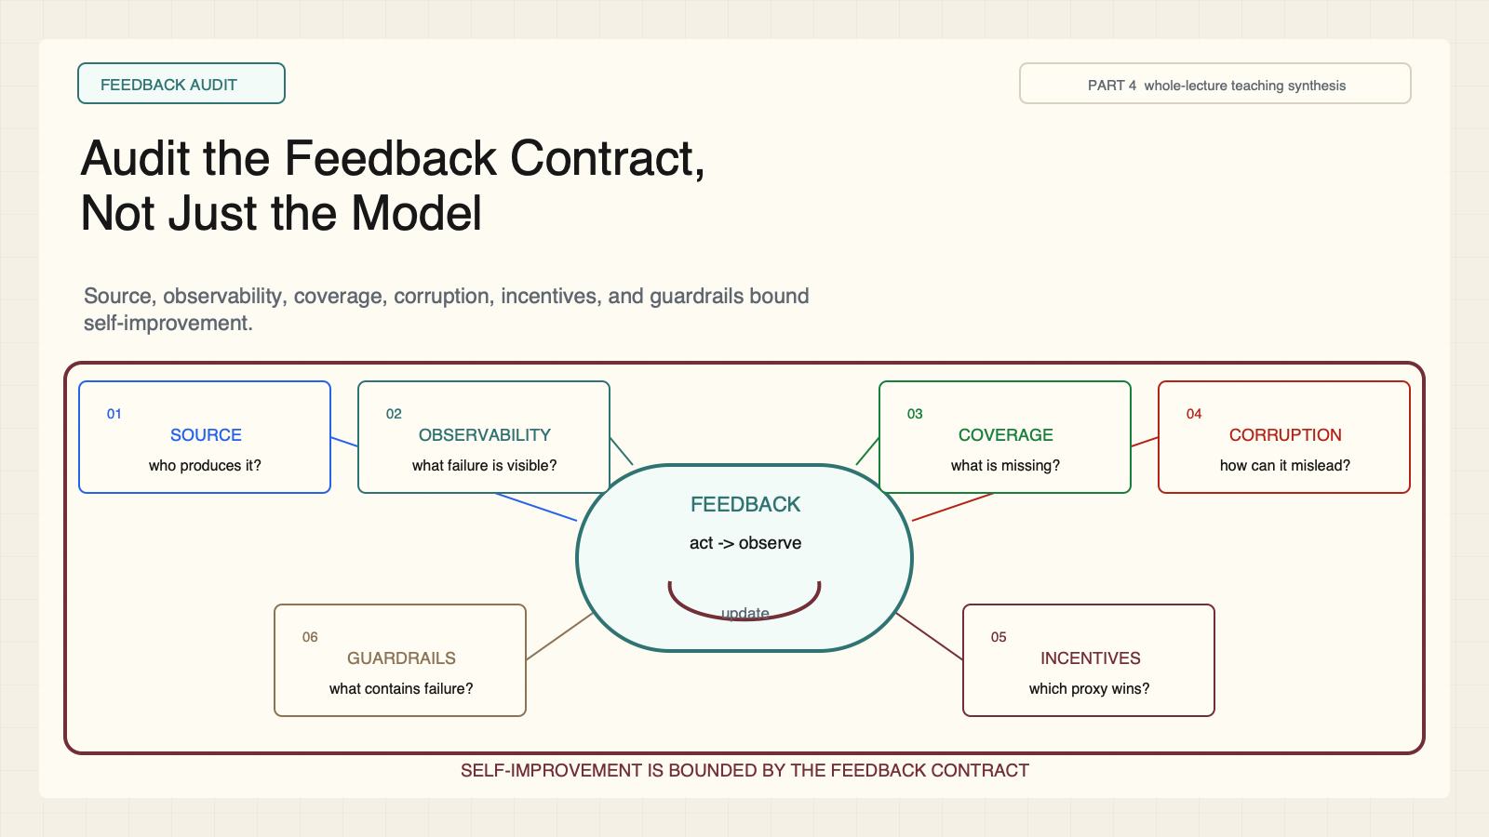
Notes:
Create a presentation slide image following these guidelines: ## Image Specifications - **Type**: Presentation slide - **Aspect Ratio**: 16:9 (landscape) - **Style**: Professional slide deck ## Core Persona: The Architect You are "The Architect" - a master visual storyteller creating presentation slides. Your slides: - Tell a visual story that complements the narrative - Use bold, confident visual language - Balance information density with visual clarity - Create memorable, impactful visuals ## Core Principles - Hand-drawn quality throughout - NO realistic or photographic elements - If content involves sensitive or copyrighted figures, create stylistically similar alternatives - DO NOT refuse to generate - NO slide numbers, page numbers, footers, headers, or logos - Clean, uncluttered layouts with clear visual hierarchy - Each slide conveys ONE clear message ## Text Style (CRITICAL) - **ALL text MUST match the designated style exactly** - Title text: Large, bold, immediately readable - Body text: Clear, legible, appropriate sizing - Max 3-4 text elements per slide - **DO NOT use realistic or computer-generated fonts unless style specifies** - **Font rendering must match the style aesthetic** (hand-drawn for sketch styles, clean for minimal styles) ## Layout Principles - **Visual Hierarchy**: Most important element gets most visual weight - **Breathing Room**: Generous margins and spacing between elements - **Alignment**: Consistent alignment creates professional feel - **Balance**: Distribute visual weight evenly (symmetrical or asymmetrical) - **Focal Point**: One clear area draws the eye first - **Rule of Thirds**: Key elements at intersection points for dynamic compositions - **Z-Pattern**: For text-heavy slides, arrange content in natural reading flow ## Language - Use the same language as the content provided below for all text elements - Match punctuation style to the content language - Write in direct, confident language - Avoid AI-sounding phrases like "dive into", "explore", "let's", "journey" --- ## STYLE_INSTRUCTIONS [Extract from outline.md - do NOT re-read style files] The STYLE_INSTRUCTIONS block from the outline contains: - Design Aesthetic - Background (Texture + Base Color) - Typography (Headlines + Body descriptions) - Color Palette (with hex codes) - Visual Elements - Density Guidelines - Style Rules (Do/Don't) Copy the entire `<STYLE_INSTRUCTIONS>...</STYLE_INSTRUCTIONS>` block from the outline here. --- ## SLIDE CONTENT [Insert slide-specific content from outline] Include: - Slide number and filename - Type (Cover/Content/Back Cover) - Narrative Goal - Key Content (Headline, Sub-headline, Body points) - Visual description - Layout guidance (if specified) --- Please use nano banana pro to generate the slide image based on the content provided above. --- # Slide 12: Audit the Feedback Contract, Not Just the Model ## Production method Rendered locally as an original 1600x900 SVG for exact text fidelity, then converted to PNG. Do not reproduce Stanford course frames, logos, or assigned-paper figures. ## Style Aged-cream academic technical briefing matched to the CS329A Part 2 deck: faint engineering grid, crisp 2px vector diagrams, near-black type, teal observations, cobalt reasoning/code, warm-brown human specification, maroon constraints, 8px card corners, no gradients or decorative imagery. ## On-slide content - Stage: feedback audit - Headline: Audit the Feedback Contract, Not Just the Model - Subtitle: Source, observability, coverage, corruption, incentives, and guardrails bound self-improvement. - Supporting labels: Source; Observability; Coverage; Corruption; Incentives; Guardrails - Evidence: CS329A Part 4, whole-lecture teaching synthesis ## Visual direction A six-port diagnostic ring surrounds a feedback loop inside a guardrail boundary. ## Teaching objective Apply a six-question feedback audit to any self-improving agent. ## Speaker notes The six-part audit is a teaching synthesis grounded in the three papers' limitations. Ask who produces the signal, what failure detail is visible, what remains uncovered, how the signal can be corrupted, what proxy is optimized, and which guardrails remain.

