Slide 1
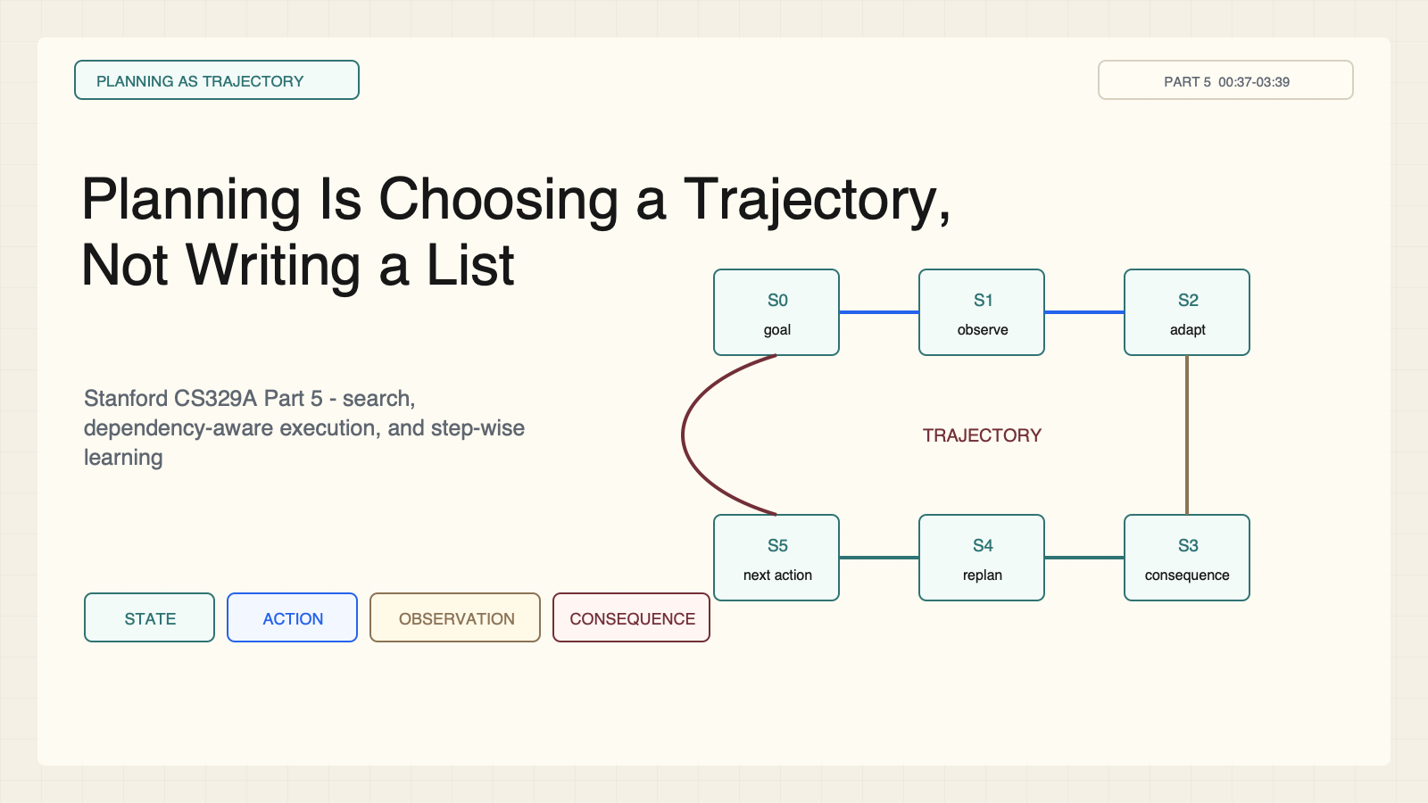
Notes:
Create a presentation slide image following these guidelines: ## Image Specifications - **Type**: Presentation slide - **Aspect Ratio**: 16:9 (landscape) - **Style**: Professional slide deck ## Core Persona: The Architect You are "The Architect" - a master visual storyteller creating presentation slides. Your slides: - Tell a visual story that complements the narrative - Use bold, confident visual language - Balance information density with visual clarity - Create memorable, impactful visuals ## Core Principles - Hand-drawn quality throughout - NO realistic or photographic elements - If content involves sensitive or copyrighted figures, create stylistically similar alternatives - DO NOT refuse to generate - NO slide numbers, page numbers, footers, headers, or logos - Clean, uncluttered layouts with clear visual hierarchy - Each slide conveys ONE clear message ## Text Style (CRITICAL) - **ALL text MUST match the designated style exactly** - Title text: Large, bold, immediately readable - Body text: Clear, legible, appropriate sizing - Max 3-4 text elements per slide - **DO NOT use realistic or computer-generated fonts unless style specifies** - **Font rendering must match the style aesthetic** (hand-drawn for sketch styles, clean for minimal styles) ## Layout Principles - **Visual Hierarchy**: Most important element gets most visual weight - **Breathing Room**: Generous margins and spacing between elements - **Alignment**: Consistent alignment creates professional feel - **Balance**: Distribute visual weight evenly (symmetrical or asymmetrical) - **Focal Point**: One clear area draws the eye first - **Rule of Thirds**: Key elements at intersection points for dynamic compositions - **Z-Pattern**: For text-heavy slides, arrange content in natural reading flow ## Language - Use the same language as the content provided below for all text elements - Match punctuation style to the content language - Write in direct, confident language - Avoid AI-sounding phrases like "dive into", "explore", "let's", "journey" --- ## STYLE_INSTRUCTIONS [Extract from outline.md - do NOT re-read style files] The STYLE_INSTRUCTIONS block from the outline contains: - Design Aesthetic - Background (Texture + Base Color) - Typography (Headlines + Body descriptions) - Color Palette (with hex codes) - Visual Elements - Density Guidelines - Style Rules (Do/Don't) Copy the entire `<STYLE_INSTRUCTIONS>...</STYLE_INSTRUCTIONS>` block from the outline here. --- ## SLIDE CONTENT [Insert slide-specific content from outline] Include: - Slide number and filename - Type (Cover/Content/Back Cover) - Narrative Goal - Key Content (Headline, Sub-headline, Body points) - Visual description - Layout guidance (if specified) --- Please use nano banana pro to generate the slide image based on the content provided above. --- # Slide 1: Planning Is Choosing a Trajectory, Not Writing a List ## Production method Rendered locally as an original 1600x900 SVG for exact text fidelity, then converted to PNG. Do not reproduce Stanford course frames, logos, or diagrams. ## Style Aged-cream academic technical briefing, faint engineering grid, crisp vector diagrams, near-black type, cobalt search/generation, teal verified or dependency-safe flow, warm-brown runtime/budget, maroon constraints, 8px card corners, no gradients, no decorative imagery. ## On-slide content - Stage: planning as trajectory - Headline: Planning Is Choosing a Trajectory, Not Writing a List - Subtitle: Stanford CS329A Part 5 - search, dependency-aware execution, and step-wise learning - Supporting labels: state; action; observation; consequence - Lecture evidence: CS329A Part 5, 00:37-03:39 - Primary-paper basis: LATS, arXiv:2310.04406 ## Visual direction A closed state-action-observation loop advances across a consequence trail toward a goal. ## Teaching objective Define planning as repeated action choice under feedback and downstream consequences. ## Speaker notes Lecture 00:37-03:39; LATS, arXiv:2310.04406. A checklist is fixed before execution. An agent trajectory changes after each observation, so planning must account for feedback and consequences. Ask: What changes after the first tool call fails?

Slide 2
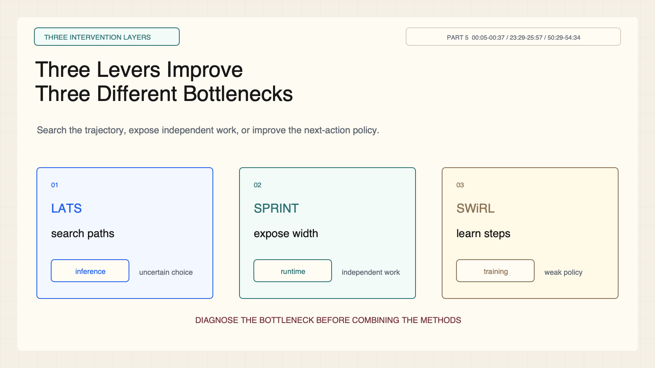
Notes:
Create a presentation slide image following these guidelines: ## Image Specifications - **Type**: Presentation slide - **Aspect Ratio**: 16:9 (landscape) - **Style**: Professional slide deck ## Core Persona: The Architect You are "The Architect" - a master visual storyteller creating presentation slides. Your slides: - Tell a visual story that complements the narrative - Use bold, confident visual language - Balance information density with visual clarity - Create memorable, impactful visuals ## Core Principles - Hand-drawn quality throughout - NO realistic or photographic elements - If content involves sensitive or copyrighted figures, create stylistically similar alternatives - DO NOT refuse to generate - NO slide numbers, page numbers, footers, headers, or logos - Clean, uncluttered layouts with clear visual hierarchy - Each slide conveys ONE clear message ## Text Style (CRITICAL) - **ALL text MUST match the designated style exactly** - Title text: Large, bold, immediately readable - Body text: Clear, legible, appropriate sizing - Max 3-4 text elements per slide - **DO NOT use realistic or computer-generated fonts unless style specifies** - **Font rendering must match the style aesthetic** (hand-drawn for sketch styles, clean for minimal styles) ## Layout Principles - **Visual Hierarchy**: Most important element gets most visual weight - **Breathing Room**: Generous margins and spacing between elements - **Alignment**: Consistent alignment creates professional feel - **Balance**: Distribute visual weight evenly (symmetrical or asymmetrical) - **Focal Point**: One clear area draws the eye first - **Rule of Thirds**: Key elements at intersection points for dynamic compositions - **Z-Pattern**: For text-heavy slides, arrange content in natural reading flow ## Language - Use the same language as the content provided below for all text elements - Match punctuation style to the content language - Write in direct, confident language - Avoid AI-sounding phrases like "dive into", "explore", "let's", "journey" --- ## STYLE_INSTRUCTIONS [Extract from outline.md - do NOT re-read style files] The STYLE_INSTRUCTIONS block from the outline contains: - Design Aesthetic - Background (Texture + Base Color) - Typography (Headlines + Body descriptions) - Color Palette (with hex codes) - Visual Elements - Density Guidelines - Style Rules (Do/Don't) Copy the entire `<STYLE_INSTRUCTIONS>...</STYLE_INSTRUCTIONS>` block from the outline here. --- ## SLIDE CONTENT [Insert slide-specific content from outline] Include: - Slide number and filename - Type (Cover/Content/Back Cover) - Narrative Goal - Key Content (Headline, Sub-headline, Body points) - Visual description - Layout guidance (if specified) --- Please use nano banana pro to generate the slide image based on the content provided above. --- # Slide 2: Three Levers Improve Three Different Bottlenecks ## Production method Rendered locally as an original 1600x900 SVG for exact text fidelity, then converted to PNG. Do not reproduce Stanford course frames, logos, or diagrams. ## Style Aged-cream academic technical briefing, faint engineering grid, crisp vector diagrams, near-black type, cobalt search/generation, teal verified or dependency-safe flow, warm-brown runtime/budget, maroon constraints, 8px card corners, no gradients, no decorative imagery. ## On-slide content - Stage: three intervention layers - Headline: Three Levers Improve Three Different Bottlenecks - Subtitle: Search the trajectory, expose independent work, or improve the next-action policy. - Supporting labels: LATS: search; SPRINT: schedule; SWiRL: learn - Lecture evidence: CS329A Part 5, 00:05-00:37 / 23:29-25:57 / 50:29-54:34 - Primary-paper basis: arXiv:2310.04406 / 2506.05745 / 2504.04736 ## Visual direction One agent trajectory passes through three distinct intervention layers with separate outputs. ## Teaching objective Separate search, dependency scheduling, and step-policy learning. ## Speaker notes Lecture 00:05-00:37, 23:29-25:57, and 50:29-54:34; LATS, SPRINT, and SWiRL primary papers. These methods intervene at different layers and are not interchangeable.

Slide 3
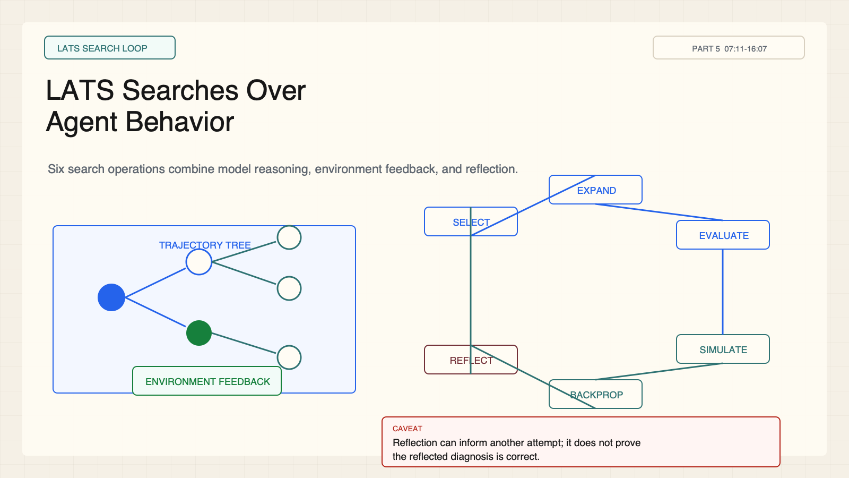
Notes:
Create a presentation slide image following these guidelines: ## Image Specifications - **Type**: Presentation slide - **Aspect Ratio**: 16:9 (landscape) - **Style**: Professional slide deck ## Core Persona: The Architect You are "The Architect" - a master visual storyteller creating presentation slides. Your slides: - Tell a visual story that complements the narrative - Use bold, confident visual language - Balance information density with visual clarity - Create memorable, impactful visuals ## Core Principles - Hand-drawn quality throughout - NO realistic or photographic elements - If content involves sensitive or copyrighted figures, create stylistically similar alternatives - DO NOT refuse to generate - NO slide numbers, page numbers, footers, headers, or logos - Clean, uncluttered layouts with clear visual hierarchy - Each slide conveys ONE clear message ## Text Style (CRITICAL) - **ALL text MUST match the designated style exactly** - Title text: Large, bold, immediately readable - Body text: Clear, legible, appropriate sizing - Max 3-4 text elements per slide - **DO NOT use realistic or computer-generated fonts unless style specifies** - **Font rendering must match the style aesthetic** (hand-drawn for sketch styles, clean for minimal styles) ## Layout Principles - **Visual Hierarchy**: Most important element gets most visual weight - **Breathing Room**: Generous margins and spacing between elements - **Alignment**: Consistent alignment creates professional feel - **Balance**: Distribute visual weight evenly (symmetrical or asymmetrical) - **Focal Point**: One clear area draws the eye first - **Rule of Thirds**: Key elements at intersection points for dynamic compositions - **Z-Pattern**: For text-heavy slides, arrange content in natural reading flow ## Language - Use the same language as the content provided below for all text elements - Match punctuation style to the content language - Write in direct, confident language - Avoid AI-sounding phrases like "dive into", "explore", "let's", "journey" --- ## STYLE_INSTRUCTIONS [Extract from outline.md - do NOT re-read style files] The STYLE_INSTRUCTIONS block from the outline contains: - Design Aesthetic - Background (Texture + Base Color) - Typography (Headlines + Body descriptions) - Color Palette (with hex codes) - Visual Elements - Density Guidelines - Style Rules (Do/Don't) Copy the entire `<STYLE_INSTRUCTIONS>...</STYLE_INSTRUCTIONS>` block from the outline here. --- ## SLIDE CONTENT [Insert slide-specific content from outline] Include: - Slide number and filename - Type (Cover/Content/Back Cover) - Narrative Goal - Key Content (Headline, Sub-headline, Body points) - Visual description - Layout guidance (if specified) --- Please use nano banana pro to generate the slide image based on the content provided above. --- # Slide 3: LATS Searches Over Agent Behavior ## Production method Rendered locally as an original 1600x900 SVG for exact text fidelity, then converted to PNG. Do not reproduce Stanford course frames, logos, or diagrams. ## Style Aged-cream academic technical briefing, faint engineering grid, crisp vector diagrams, near-black type, cobalt search/generation, teal verified or dependency-safe flow, warm-brown runtime/budget, maroon constraints, 8px card corners, no gradients, no decorative imagery. ## On-slide content - Stage: LATS search loop - Headline: LATS Searches Over Agent Behavior - Subtitle: Six search operations combine model reasoning, environment feedback, and reflection. - Supporting labels: select; expand; evaluate; simulate; backprop; reflect - Lecture evidence: CS329A Part 5, 07:11-16:07 - Primary-paper basis: LATS, arXiv:2310.04406 ## Visual direction A branching trajectory tree sits inside a six-stage circular search loop with a reflection memory card. ## Teaching objective Explain the six LATS operations and where environment feedback enters. ## Speaker notes Lecture 07:11-16:07; LATS, arXiv:2310.04406. Selection, expansion, evaluation, simulation, backpropagation, and reflection allocate search across possible trajectories. Reflection carries failure information forward.

Slide 4
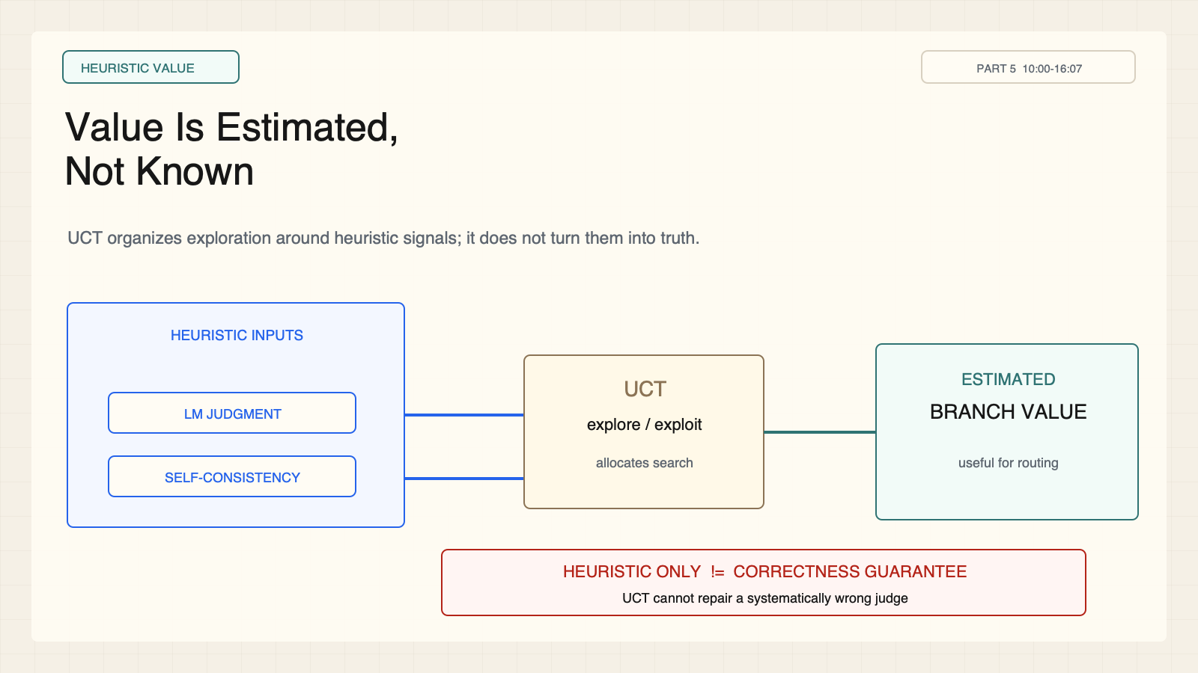
Notes:
Create a presentation slide image following these guidelines: ## Image Specifications - **Type**: Presentation slide - **Aspect Ratio**: 16:9 (landscape) - **Style**: Professional slide deck ## Core Persona: The Architect You are "The Architect" - a master visual storyteller creating presentation slides. Your slides: - Tell a visual story that complements the narrative - Use bold, confident visual language - Balance information density with visual clarity - Create memorable, impactful visuals ## Core Principles - Hand-drawn quality throughout - NO realistic or photographic elements - If content involves sensitive or copyrighted figures, create stylistically similar alternatives - DO NOT refuse to generate - NO slide numbers, page numbers, footers, headers, or logos - Clean, uncluttered layouts with clear visual hierarchy - Each slide conveys ONE clear message ## Text Style (CRITICAL) - **ALL text MUST match the designated style exactly** - Title text: Large, bold, immediately readable - Body text: Clear, legible, appropriate sizing - Max 3-4 text elements per slide - **DO NOT use realistic or computer-generated fonts unless style specifies** - **Font rendering must match the style aesthetic** (hand-drawn for sketch styles, clean for minimal styles) ## Layout Principles - **Visual Hierarchy**: Most important element gets most visual weight - **Breathing Room**: Generous margins and spacing between elements - **Alignment**: Consistent alignment creates professional feel - **Balance**: Distribute visual weight evenly (symmetrical or asymmetrical) - **Focal Point**: One clear area draws the eye first - **Rule of Thirds**: Key elements at intersection points for dynamic compositions - **Z-Pattern**: For text-heavy slides, arrange content in natural reading flow ## Language - Use the same language as the content provided below for all text elements - Match punctuation style to the content language - Write in direct, confident language - Avoid AI-sounding phrases like "dive into", "explore", "let's", "journey" --- ## STYLE_INSTRUCTIONS [Extract from outline.md - do NOT re-read style files] The STYLE_INSTRUCTIONS block from the outline contains: - Design Aesthetic - Background (Texture + Base Color) - Typography (Headlines + Body descriptions) - Color Palette (with hex codes) - Visual Elements - Density Guidelines - Style Rules (Do/Don't) Copy the entire `<STYLE_INSTRUCTIONS>...</STYLE_INSTRUCTIONS>` block from the outline here. --- ## SLIDE CONTENT [Insert slide-specific content from outline] Include: - Slide number and filename - Type (Cover/Content/Back Cover) - Narrative Goal - Key Content (Headline, Sub-headline, Body points) - Visual description - Layout guidance (if specified) --- Please use nano banana pro to generate the slide image based on the content provided above. --- # Slide 4: Value Is Estimated, Not Known ## Production method Rendered locally as an original 1600x900 SVG for exact text fidelity, then converted to PNG. Do not reproduce Stanford course frames, logos, or diagrams. ## Style Aged-cream academic technical briefing, faint engineering grid, crisp vector diagrams, near-black type, cobalt search/generation, teal verified or dependency-safe flow, warm-brown runtime/budget, maroon constraints, 8px card corners, no gradients, no decorative imagery. ## On-slide content - Stage: heuristic value - Headline: Value Is Estimated, Not Known - Subtitle: UCT organizes exploration around heuristic signals; it does not turn them into truth. - Supporting labels: LM judgment; self-consistency; UCT router; estimated value - Lecture evidence: CS329A Part 5, 10:00-16:07 - Primary-paper basis: LATS, arXiv:2310.04406 ## Visual direction Two warning-tagged heuristic gauges feed a UCT router; a red boundary separates estimate from correctness. ## Teaching objective Distinguish UCT search allocation from correctness verification. ## Speaker notes Lecture 10:00-16:07; LATS, arXiv:2310.04406. UCT is a search-selection rule. LM judgment and self-consistency provide heuristic value estimates. UCT cannot repair a systematically wrong judge, and agreement can reflect a shared misconception.

Slide 5
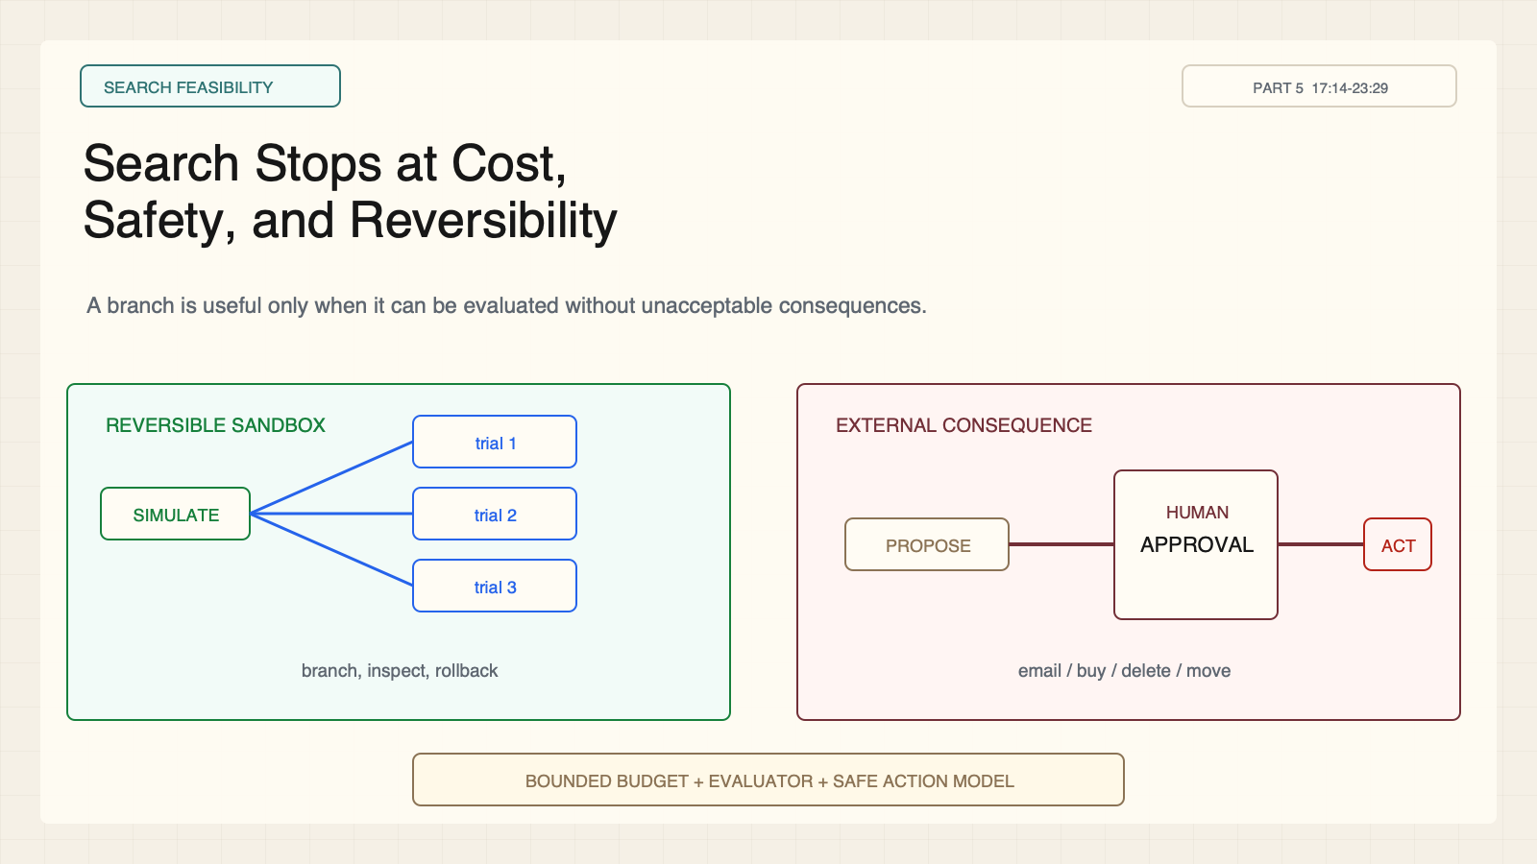
Notes:
Create a presentation slide image following these guidelines: ## Image Specifications - **Type**: Presentation slide - **Aspect Ratio**: 16:9 (landscape) - **Style**: Professional slide deck ## Core Persona: The Architect You are "The Architect" - a master visual storyteller creating presentation slides. Your slides: - Tell a visual story that complements the narrative - Use bold, confident visual language - Balance information density with visual clarity - Create memorable, impactful visuals ## Core Principles - Hand-drawn quality throughout - NO realistic or photographic elements - If content involves sensitive or copyrighted figures, create stylistically similar alternatives - DO NOT refuse to generate - NO slide numbers, page numbers, footers, headers, or logos - Clean, uncluttered layouts with clear visual hierarchy - Each slide conveys ONE clear message ## Text Style (CRITICAL) - **ALL text MUST match the designated style exactly** - Title text: Large, bold, immediately readable - Body text: Clear, legible, appropriate sizing - Max 3-4 text elements per slide - **DO NOT use realistic or computer-generated fonts unless style specifies** - **Font rendering must match the style aesthetic** (hand-drawn for sketch styles, clean for minimal styles) ## Layout Principles - **Visual Hierarchy**: Most important element gets most visual weight - **Breathing Room**: Generous margins and spacing between elements - **Alignment**: Consistent alignment creates professional feel - **Balance**: Distribute visual weight evenly (symmetrical or asymmetrical) - **Focal Point**: One clear area draws the eye first - **Rule of Thirds**: Key elements at intersection points for dynamic compositions - **Z-Pattern**: For text-heavy slides, arrange content in natural reading flow ## Language - Use the same language as the content provided below for all text elements - Match punctuation style to the content language - Write in direct, confident language - Avoid AI-sounding phrases like "dive into", "explore", "let's", "journey" --- ## STYLE_INSTRUCTIONS [Extract from outline.md - do NOT re-read style files] The STYLE_INSTRUCTIONS block from the outline contains: - Design Aesthetic - Background (Texture + Base Color) - Typography (Headlines + Body descriptions) - Color Palette (with hex codes) - Visual Elements - Density Guidelines - Style Rules (Do/Don't) Copy the entire `<STYLE_INSTRUCTIONS>...</STYLE_INSTRUCTIONS>` block from the outline here. --- ## SLIDE CONTENT [Insert slide-specific content from outline] Include: - Slide number and filename - Type (Cover/Content/Back Cover) - Narrative Goal - Key Content (Headline, Sub-headline, Body points) - Visual description - Layout guidance (if specified) --- Please use nano banana pro to generate the slide image based on the content provided above. --- # Slide 5: Search Stops at Cost, Safety, and Reversibility ## Production method Rendered locally as an original 1600x900 SVG for exact text fidelity, then converted to PNG. Do not reproduce Stanford course frames, logos, or diagrams. ## Style Aged-cream academic technical briefing, faint engineering grid, crisp vector diagrams, near-black type, cobalt search/generation, teal verified or dependency-safe flow, warm-brown runtime/budget, maroon constraints, 8px card corners, no gradients, no decorative imagery. ## On-slide content - Stage: search feasibility - Headline: Search Stops at Cost, Safety, and Reversibility - Subtitle: A branch is useful only when it can be evaluated without unacceptable consequences. - Supporting labels: sandbox; bounded budget; approval gate; irreversible action - Lecture evidence: CS329A Part 5, 17:14-23:29 - Primary-paper basis: LATS, arXiv:2310.04406 ## Visual direction A reversible sandbox contains branching trials while an external-action path stops at a human approval gate. ## Teaching objective Identify when trajectory search requires sandboxing or human approval. ## Speaker notes Lecture 17:14-23:29; LATS, arXiv:2310.04406. Search is expensive and assumes candidate actions can be explored. Email, purchases, deletions, and physical actions require a simulator, rollback, or approval gate.

Slide 6
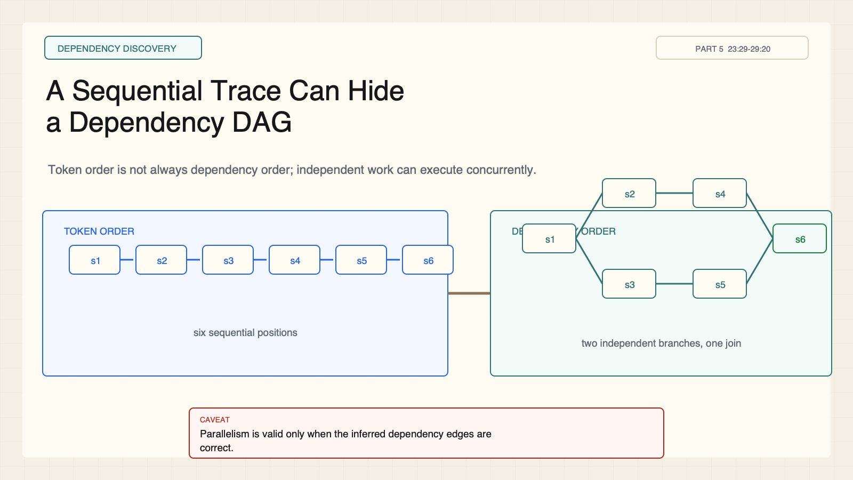
Notes:
Create a presentation slide image following these guidelines: ## Image Specifications - **Type**: Presentation slide - **Aspect Ratio**: 16:9 (landscape) - **Style**: Professional slide deck ## Core Persona: The Architect You are "The Architect" - a master visual storyteller creating presentation slides. Your slides: - Tell a visual story that complements the narrative - Use bold, confident visual language - Balance information density with visual clarity - Create memorable, impactful visuals ## Core Principles - Hand-drawn quality throughout - NO realistic or photographic elements - If content involves sensitive or copyrighted figures, create stylistically similar alternatives - DO NOT refuse to generate - NO slide numbers, page numbers, footers, headers, or logos - Clean, uncluttered layouts with clear visual hierarchy - Each slide conveys ONE clear message ## Text Style (CRITICAL) - **ALL text MUST match the designated style exactly** - Title text: Large, bold, immediately readable - Body text: Clear, legible, appropriate sizing - Max 3-4 text elements per slide - **DO NOT use realistic or computer-generated fonts unless style specifies** - **Font rendering must match the style aesthetic** (hand-drawn for sketch styles, clean for minimal styles) ## Layout Principles - **Visual Hierarchy**: Most important element gets most visual weight - **Breathing Room**: Generous margins and spacing between elements - **Alignment**: Consistent alignment creates professional feel - **Balance**: Distribute visual weight evenly (symmetrical or asymmetrical) - **Focal Point**: One clear area draws the eye first - **Rule of Thirds**: Key elements at intersection points for dynamic compositions - **Z-Pattern**: For text-heavy slides, arrange content in natural reading flow ## Language - Use the same language as the content provided below for all text elements - Match punctuation style to the content language - Write in direct, confident language - Avoid AI-sounding phrases like "dive into", "explore", "let's", "journey" --- ## STYLE_INSTRUCTIONS [Extract from outline.md - do NOT re-read style files] The STYLE_INSTRUCTIONS block from the outline contains: - Design Aesthetic - Background (Texture + Base Color) - Typography (Headlines + Body descriptions) - Color Palette (with hex codes) - Visual Elements - Density Guidelines - Style Rules (Do/Don't) Copy the entire `<STYLE_INSTRUCTIONS>...</STYLE_INSTRUCTIONS>` block from the outline here. --- ## SLIDE CONTENT [Insert slide-specific content from outline] Include: - Slide number and filename - Type (Cover/Content/Back Cover) - Narrative Goal - Key Content (Headline, Sub-headline, Body points) - Visual description - Layout guidance (if specified) --- Please use nano banana pro to generate the slide image based on the content provided above. --- # Slide 6: A Sequential Trace Can Hide a Dependency DAG ## Production method Rendered locally as an original 1600x900 SVG for exact text fidelity, then converted to PNG. Do not reproduce Stanford course frames, logos, or diagrams. ## Style Aged-cream academic technical briefing, faint engineering grid, crisp vector diagrams, near-black type, cobalt search/generation, teal verified or dependency-safe flow, warm-brown runtime/budget, maroon constraints, 8px card corners, no gradients, no decorative imagery. ## On-slide content - Stage: dependency discovery - Headline: A Sequential Trace Can Hide a Dependency DAG - Subtitle: Token order is not always dependency order; independent work can execute concurrently. - Supporting labels: linear trace; dependency edges; parallel width; join - Lecture evidence: CS329A Part 5, 23:29-29:20 - Primary-paper basis: SPRINT, arXiv:2506.05745 ## Visual direction A six-step linear chain unfolds into two independent branches that rejoin before the answer. ## Teaching objective Transform a sequential trace into a dependency graph and identify the critical path. ## Speaker notes Lecture 23:29-29:20; SPRINT, arXiv:2506.05745. A written trace is sequential, but some subproblems are independent. Parallel execution is valid only after true dependencies are explicit.

Slide 7
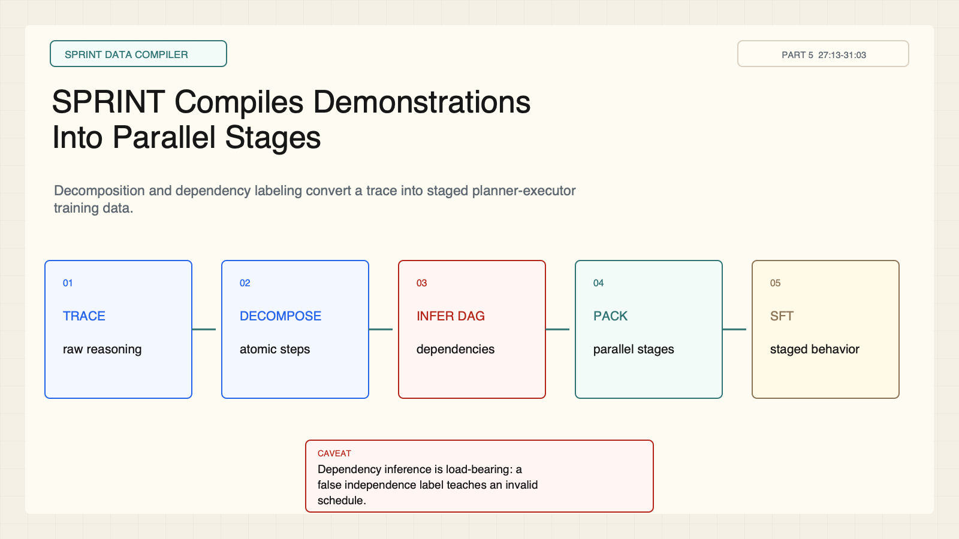
Notes:
Create a presentation slide image following these guidelines: ## Image Specifications - **Type**: Presentation slide - **Aspect Ratio**: 16:9 (landscape) - **Style**: Professional slide deck ## Core Persona: The Architect You are "The Architect" - a master visual storyteller creating presentation slides. Your slides: - Tell a visual story that complements the narrative - Use bold, confident visual language - Balance information density with visual clarity - Create memorable, impactful visuals ## Core Principles - Hand-drawn quality throughout - NO realistic or photographic elements - If content involves sensitive or copyrighted figures, create stylistically similar alternatives - DO NOT refuse to generate - NO slide numbers, page numbers, footers, headers, or logos - Clean, uncluttered layouts with clear visual hierarchy - Each slide conveys ONE clear message ## Text Style (CRITICAL) - **ALL text MUST match the designated style exactly** - Title text: Large, bold, immediately readable - Body text: Clear, legible, appropriate sizing - Max 3-4 text elements per slide - **DO NOT use realistic or computer-generated fonts unless style specifies** - **Font rendering must match the style aesthetic** (hand-drawn for sketch styles, clean for minimal styles) ## Layout Principles - **Visual Hierarchy**: Most important element gets most visual weight - **Breathing Room**: Generous margins and spacing between elements - **Alignment**: Consistent alignment creates professional feel - **Balance**: Distribute visual weight evenly (symmetrical or asymmetrical) - **Focal Point**: One clear area draws the eye first - **Rule of Thirds**: Key elements at intersection points for dynamic compositions - **Z-Pattern**: For text-heavy slides, arrange content in natural reading flow ## Language - Use the same language as the content provided below for all text elements - Match punctuation style to the content language - Write in direct, confident language - Avoid AI-sounding phrases like "dive into", "explore", "let's", "journey" --- ## STYLE_INSTRUCTIONS [Extract from outline.md - do NOT re-read style files] The STYLE_INSTRUCTIONS block from the outline contains: - Design Aesthetic - Background (Texture + Base Color) - Typography (Headlines + Body descriptions) - Color Palette (with hex codes) - Visual Elements - Density Guidelines - Style Rules (Do/Don't) Copy the entire `<STYLE_INSTRUCTIONS>...</STYLE_INSTRUCTIONS>` block from the outline here. --- ## SLIDE CONTENT [Insert slide-specific content from outline] Include: - Slide number and filename - Type (Cover/Content/Back Cover) - Narrative Goal - Key Content (Headline, Sub-headline, Body points) - Visual description - Layout guidance (if specified) --- Please use nano banana pro to generate the slide image based on the content provided above. --- # Slide 7: SPRINT Compiles Demonstrations Into Parallel Stages ## Production method Rendered locally as an original 1600x900 SVG for exact text fidelity, then converted to PNG. Do not reproduce Stanford course frames, logos, or diagrams. ## Style Aged-cream academic technical briefing, faint engineering grid, crisp vector diagrams, near-black type, cobalt search/generation, teal verified or dependency-safe flow, warm-brown runtime/budget, maroon constraints, 8px card corners, no gradients, no decorative imagery. ## On-slide content - Stage: SPRINT data compiler - Headline: SPRINT Compiles Demonstrations Into Parallel Stages - Subtitle: Decomposition and dependency labeling convert a trace into staged planner-executor training data. - Supporting labels: decompose; label; infer DAG; pack stages; SFT - Lecture evidence: CS329A Part 5, 27:13-31:03 - Primary-paper basis: SPRINT, arXiv:2506.05745 ## Visual direction A five-stage compiler pipeline with the dependency-inference stage highlighted as load-bearing. ## Teaching objective Explain SPRINT's synthetic training-data transformation. ## Speaker notes Lecture 27:13-31:03; SPRINT, arXiv:2506.05745. The pipeline decomposes a trace, labels planning versus execution, infers dependencies, packs independent work into stages, and fine-tunes. Dependency-label errors can teach invalid concurrency.

Slide 8
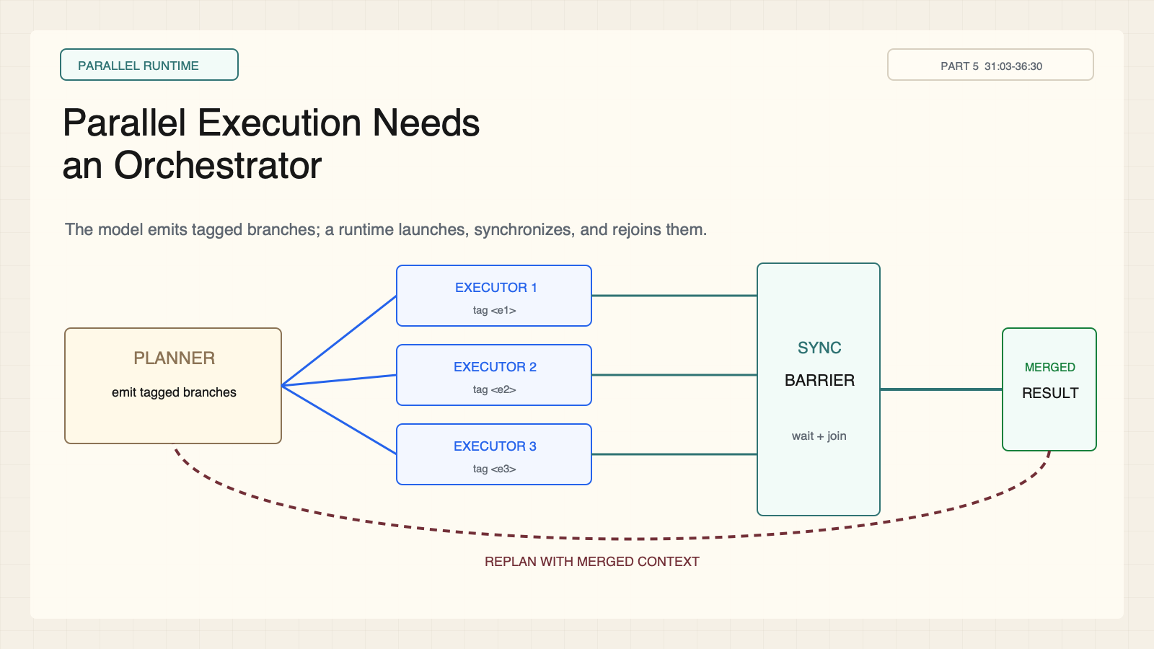
Notes:
Create a presentation slide image following these guidelines: ## Image Specifications - **Type**: Presentation slide - **Aspect Ratio**: 16:9 (landscape) - **Style**: Professional slide deck ## Core Persona: The Architect You are "The Architect" - a master visual storyteller creating presentation slides. Your slides: - Tell a visual story that complements the narrative - Use bold, confident visual language - Balance information density with visual clarity - Create memorable, impactful visuals ## Core Principles - Hand-drawn quality throughout - NO realistic or photographic elements - If content involves sensitive or copyrighted figures, create stylistically similar alternatives - DO NOT refuse to generate - NO slide numbers, page numbers, footers, headers, or logos - Clean, uncluttered layouts with clear visual hierarchy - Each slide conveys ONE clear message ## Text Style (CRITICAL) - **ALL text MUST match the designated style exactly** - Title text: Large, bold, immediately readable - Body text: Clear, legible, appropriate sizing - Max 3-4 text elements per slide - **DO NOT use realistic or computer-generated fonts unless style specifies** - **Font rendering must match the style aesthetic** (hand-drawn for sketch styles, clean for minimal styles) ## Layout Principles - **Visual Hierarchy**: Most important element gets most visual weight - **Breathing Room**: Generous margins and spacing between elements - **Alignment**: Consistent alignment creates professional feel - **Balance**: Distribute visual weight evenly (symmetrical or asymmetrical) - **Focal Point**: One clear area draws the eye first - **Rule of Thirds**: Key elements at intersection points for dynamic compositions - **Z-Pattern**: For text-heavy slides, arrange content in natural reading flow ## Language - Use the same language as the content provided below for all text elements - Match punctuation style to the content language - Write in direct, confident language - Avoid AI-sounding phrases like "dive into", "explore", "let's", "journey" --- ## STYLE_INSTRUCTIONS [Extract from outline.md - do NOT re-read style files] The STYLE_INSTRUCTIONS block from the outline contains: - Design Aesthetic - Background (Texture + Base Color) - Typography (Headlines + Body descriptions) - Color Palette (with hex codes) - Visual Elements - Density Guidelines - Style Rules (Do/Don't) Copy the entire `<STYLE_INSTRUCTIONS>...</STYLE_INSTRUCTIONS>` block from the outline here. --- ## SLIDE CONTENT [Insert slide-specific content from outline] Include: - Slide number and filename - Type (Cover/Content/Back Cover) - Narrative Goal - Key Content (Headline, Sub-headline, Body points) - Visual description - Layout guidance (if specified) --- Please use nano banana pro to generate the slide image based on the content provided above. --- # Slide 8: Parallel Execution Needs an Orchestrator ## Production method Rendered locally as an original 1600x900 SVG for exact text fidelity, then converted to PNG. Do not reproduce Stanford course frames, logos, or diagrams. ## Style Aged-cream academic technical briefing, faint engineering grid, crisp vector diagrams, near-black type, cobalt search/generation, teal verified or dependency-safe flow, warm-brown runtime/budget, maroon constraints, 8px card corners, no gradients, no decorative imagery. ## On-slide content - Stage: parallel runtime - Headline: Parallel Execution Needs an Orchestrator - Subtitle: The model emits tagged branches; a runtime launches, synchronizes, and rejoins them. - Supporting labels: planner tags; executors; barrier; replan - Lecture evidence: CS329A Part 5, 31:03-36:30 - Primary-paper basis: SPRINT, arXiv:2506.05745 ## Visual direction A planner fans into three executor lanes, converges at a synchronization barrier, and loops back for replanning. ## Teaching objective Locate concurrency in the external runtime rather than the autoregressive decoder. ## Speaker notes Lecture 31:03-36:30; SPRINT, arXiv:2506.05745. The decoder remains autoregressive. An external orchestrator interprets tags, launches independent executors, waits at barriers, merges results, and returns context for replanning.

Slide 9
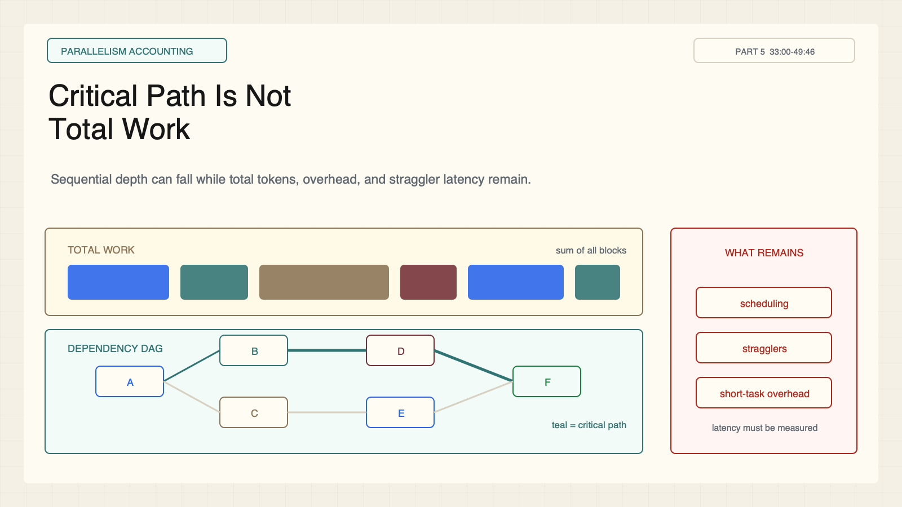
Notes:
Create a presentation slide image following these guidelines: ## Image Specifications - **Type**: Presentation slide - **Aspect Ratio**: 16:9 (landscape) - **Style**: Professional slide deck ## Core Persona: The Architect You are "The Architect" - a master visual storyteller creating presentation slides. Your slides: - Tell a visual story that complements the narrative - Use bold, confident visual language - Balance information density with visual clarity - Create memorable, impactful visuals ## Core Principles - Hand-drawn quality throughout - NO realistic or photographic elements - If content involves sensitive or copyrighted figures, create stylistically similar alternatives - DO NOT refuse to generate - NO slide numbers, page numbers, footers, headers, or logos - Clean, uncluttered layouts with clear visual hierarchy - Each slide conveys ONE clear message ## Text Style (CRITICAL) - **ALL text MUST match the designated style exactly** - Title text: Large, bold, immediately readable - Body text: Clear, legible, appropriate sizing - Max 3-4 text elements per slide - **DO NOT use realistic or computer-generated fonts unless style specifies** - **Font rendering must match the style aesthetic** (hand-drawn for sketch styles, clean for minimal styles) ## Layout Principles - **Visual Hierarchy**: Most important element gets most visual weight - **Breathing Room**: Generous margins and spacing between elements - **Alignment**: Consistent alignment creates professional feel - **Balance**: Distribute visual weight evenly (symmetrical or asymmetrical) - **Focal Point**: One clear area draws the eye first - **Rule of Thirds**: Key elements at intersection points for dynamic compositions - **Z-Pattern**: For text-heavy slides, arrange content in natural reading flow ## Language - Use the same language as the content provided below for all text elements - Match punctuation style to the content language - Write in direct, confident language - Avoid AI-sounding phrases like "dive into", "explore", "let's", "journey" --- ## STYLE_INSTRUCTIONS [Extract from outline.md - do NOT re-read style files] The STYLE_INSTRUCTIONS block from the outline contains: - Design Aesthetic - Background (Texture + Base Color) - Typography (Headlines + Body descriptions) - Color Palette (with hex codes) - Visual Elements - Density Guidelines - Style Rules (Do/Don't) Copy the entire `<STYLE_INSTRUCTIONS>...</STYLE_INSTRUCTIONS>` block from the outline here. --- ## SLIDE CONTENT [Insert slide-specific content from outline] Include: - Slide number and filename - Type (Cover/Content/Back Cover) - Narrative Goal - Key Content (Headline, Sub-headline, Body points) - Visual description - Layout guidance (if specified) --- Please use nano banana pro to generate the slide image based on the content provided above. --- # Slide 9: Critical Path Is Not Total Work ## Production method Rendered locally as an original 1600x900 SVG for exact text fidelity, then converted to PNG. Do not reproduce Stanford course frames, logos, or diagrams. ## Style Aged-cream academic technical briefing, faint engineering grid, crisp vector diagrams, near-black type, cobalt search/generation, teal verified or dependency-safe flow, warm-brown runtime/budget, maroon constraints, 8px card corners, no gradients, no decorative imagery. ## On-slide content - Stage: parallelism accounting - Headline: Critical Path Is Not Total Work - Subtitle: Sequential depth can fall while total tokens, overhead, and straggler latency remain. - Supporting labels: critical path; total work; overhead; straggler - Lecture evidence: CS329A Part 5, 33:00-49:46 - Primary-paper basis: SPRINT, arXiv:2506.05745 ## Visual direction The same task blocks appear in a total-work ledger and a DAG with only the critical chain highlighted. ## Teaching objective Separate sequential-token savings from total compute and measured wall-clock latency. ## Speaker notes Lecture 33:00-49:46; SPRINT, arXiv:2506.05745. SPRINT targets the dependency-constrained critical path. Total generated work need not fall. Scheduling, narrow graphs, synchronization, and stragglers can erase gains; short tasks can regress.

Slide 10
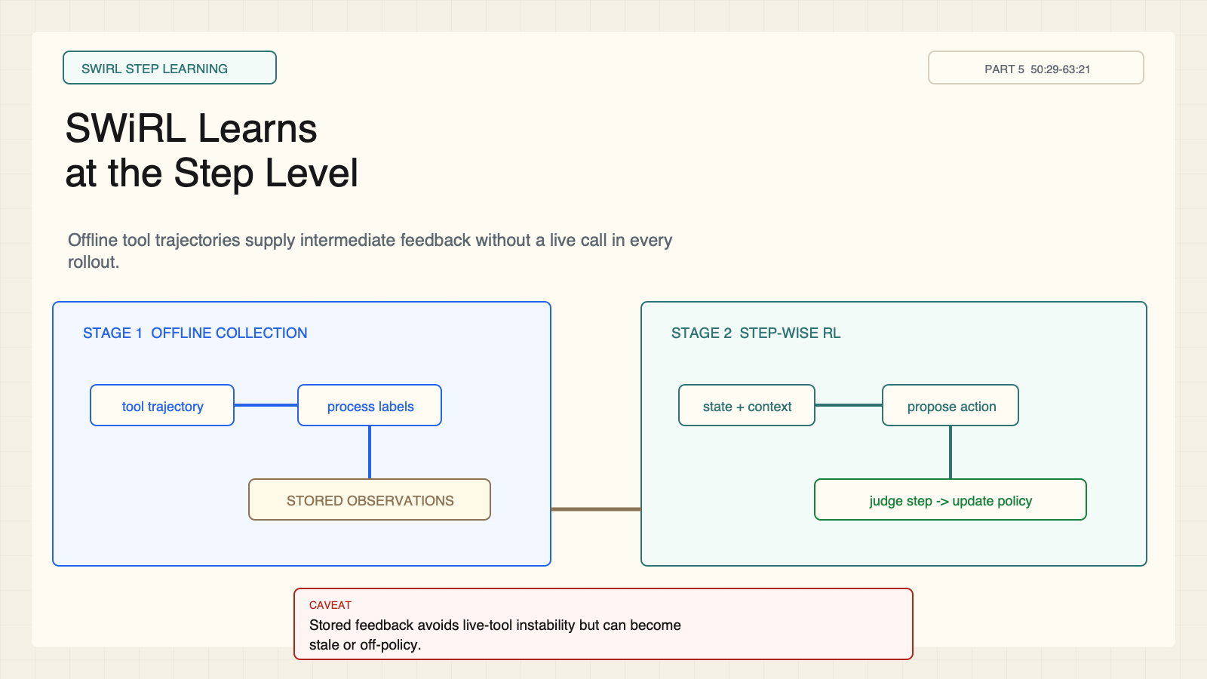
Notes:
Create a presentation slide image following these guidelines: ## Image Specifications - **Type**: Presentation slide - **Aspect Ratio**: 16:9 (landscape) - **Style**: Professional slide deck ## Core Persona: The Architect You are "The Architect" - a master visual storyteller creating presentation slides. Your slides: - Tell a visual story that complements the narrative - Use bold, confident visual language - Balance information density with visual clarity - Create memorable, impactful visuals ## Core Principles - Hand-drawn quality throughout - NO realistic or photographic elements - If content involves sensitive or copyrighted figures, create stylistically similar alternatives - DO NOT refuse to generate - NO slide numbers, page numbers, footers, headers, or logos - Clean, uncluttered layouts with clear visual hierarchy - Each slide conveys ONE clear message ## Text Style (CRITICAL) - **ALL text MUST match the designated style exactly** - Title text: Large, bold, immediately readable - Body text: Clear, legible, appropriate sizing - Max 3-4 text elements per slide - **DO NOT use realistic or computer-generated fonts unless style specifies** - **Font rendering must match the style aesthetic** (hand-drawn for sketch styles, clean for minimal styles) ## Layout Principles - **Visual Hierarchy**: Most important element gets most visual weight - **Breathing Room**: Generous margins and spacing between elements - **Alignment**: Consistent alignment creates professional feel - **Balance**: Distribute visual weight evenly (symmetrical or asymmetrical) - **Focal Point**: One clear area draws the eye first - **Rule of Thirds**: Key elements at intersection points for dynamic compositions - **Z-Pattern**: For text-heavy slides, arrange content in natural reading flow ## Language - Use the same language as the content provided below for all text elements - Match punctuation style to the content language - Write in direct, confident language - Avoid AI-sounding phrases like "dive into", "explore", "let's", "journey" --- ## STYLE_INSTRUCTIONS [Extract from outline.md - do NOT re-read style files] The STYLE_INSTRUCTIONS block from the outline contains: - Design Aesthetic - Background (Texture + Base Color) - Typography (Headlines + Body descriptions) - Color Palette (with hex codes) - Visual Elements - Density Guidelines - Style Rules (Do/Don't) Copy the entire `<STYLE_INSTRUCTIONS>...</STYLE_INSTRUCTIONS>` block from the outline here. --- ## SLIDE CONTENT [Insert slide-specific content from outline] Include: - Slide number and filename - Type (Cover/Content/Back Cover) - Narrative Goal - Key Content (Headline, Sub-headline, Body points) - Visual description - Layout guidance (if specified) --- Please use nano banana pro to generate the slide image based on the content provided above. --- # Slide 10: SWiRL Learns at the Step Level ## Production method Rendered locally as an original 1600x900 SVG for exact text fidelity, then converted to PNG. Do not reproduce Stanford course frames, logos, or diagrams. ## Style Aged-cream academic technical briefing, faint engineering grid, crisp vector diagrams, near-black type, cobalt search/generation, teal verified or dependency-safe flow, warm-brown runtime/budget, maroon constraints, 8px card corners, no gradients, no decorative imagery. ## On-slide content - Stage: SWiRL step learning - Headline: SWiRL Learns at the Step Level - Subtitle: Offline tool trajectories supply intermediate feedback without a live call in every rollout. - Supporting labels: synthetic trajectory; stored observation; process judge; step-wise RL - Lecture evidence: CS329A Part 5, 50:29-63:21 - Primary-paper basis: SWiRL, arXiv:2504.04736 ## Visual direction An offline collection lane feeds a step-wise RL loop through a stored-observation buffer. ## Teaching objective Explain SWiRL's two-stage offline collection and step-wise RL pipeline. ## Speaker notes Lecture 50:29-63:21; SWiRL, arXiv:2504.04736. Stage 1 builds and filters offline tool-use trajectories. Stage 2 proposes and judges the next action while reusing stored observations. This avoids live-tool instability but introduces stale or off-policy feedback risk.

Slide 11
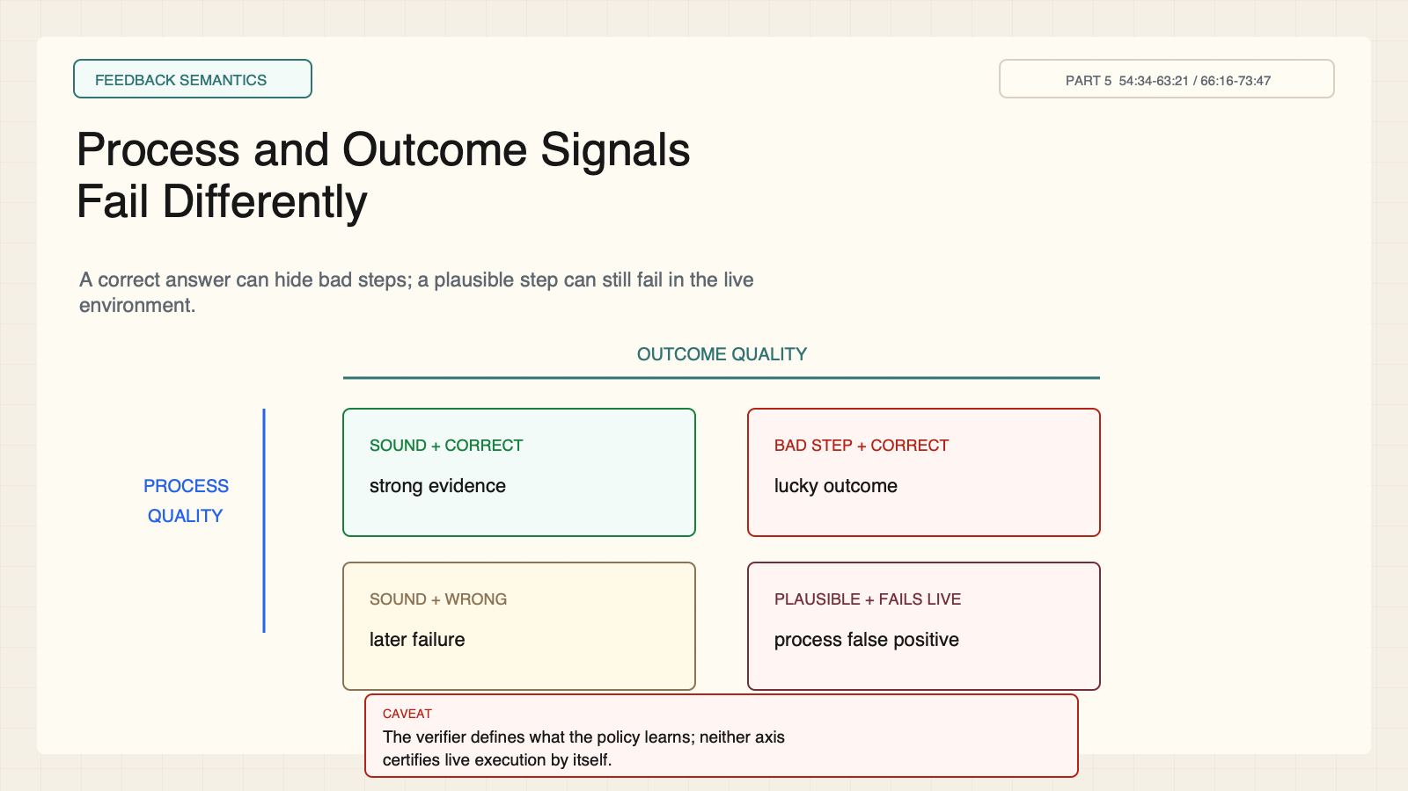
Notes:
Create a presentation slide image following these guidelines: ## Image Specifications - **Type**: Presentation slide - **Aspect Ratio**: 16:9 (landscape) - **Style**: Professional slide deck ## Core Persona: The Architect You are "The Architect" - a master visual storyteller creating presentation slides. Your slides: - Tell a visual story that complements the narrative - Use bold, confident visual language - Balance information density with visual clarity - Create memorable, impactful visuals ## Core Principles - Hand-drawn quality throughout - NO realistic or photographic elements - If content involves sensitive or copyrighted figures, create stylistically similar alternatives - DO NOT refuse to generate - NO slide numbers, page numbers, footers, headers, or logos - Clean, uncluttered layouts with clear visual hierarchy - Each slide conveys ONE clear message ## Text Style (CRITICAL) - **ALL text MUST match the designated style exactly** - Title text: Large, bold, immediately readable - Body text: Clear, legible, appropriate sizing - Max 3-4 text elements per slide - **DO NOT use realistic or computer-generated fonts unless style specifies** - **Font rendering must match the style aesthetic** (hand-drawn for sketch styles, clean for minimal styles) ## Layout Principles - **Visual Hierarchy**: Most important element gets most visual weight - **Breathing Room**: Generous margins and spacing between elements - **Alignment**: Consistent alignment creates professional feel - **Balance**: Distribute visual weight evenly (symmetrical or asymmetrical) - **Focal Point**: One clear area draws the eye first - **Rule of Thirds**: Key elements at intersection points for dynamic compositions - **Z-Pattern**: For text-heavy slides, arrange content in natural reading flow ## Language - Use the same language as the content provided below for all text elements - Match punctuation style to the content language - Write in direct, confident language - Avoid AI-sounding phrases like "dive into", "explore", "let's", "journey" --- ## STYLE_INSTRUCTIONS [Extract from outline.md - do NOT re-read style files] The STYLE_INSTRUCTIONS block from the outline contains: - Design Aesthetic - Background (Texture + Base Color) - Typography (Headlines + Body descriptions) - Color Palette (with hex codes) - Visual Elements - Density Guidelines - Style Rules (Do/Don't) Copy the entire `<STYLE_INSTRUCTIONS>...</STYLE_INSTRUCTIONS>` block from the outline here. --- ## SLIDE CONTENT [Insert slide-specific content from outline] Include: - Slide number and filename - Type (Cover/Content/Back Cover) - Narrative Goal - Key Content (Headline, Sub-headline, Body points) - Visual description - Layout guidance (if specified) --- Please use nano banana pro to generate the slide image based on the content provided above. --- # Slide 11: Process and Outcome Signals Fail Differently ## Production method Rendered locally as an original 1600x900 SVG for exact text fidelity, then converted to PNG. Do not reproduce Stanford course frames, logos, or diagrams. ## Style Aged-cream academic technical briefing, faint engineering grid, crisp vector diagrams, near-black type, cobalt search/generation, teal verified or dependency-safe flow, warm-brown runtime/budget, maroon constraints, 8px card corners, no gradients, no decorative imagery. ## On-slide content - Stage: feedback semantics - Headline: Process and Outcome Signals Fail Differently - Subtitle: A correct answer can hide bad steps; a plausible step can still fail in the live environment. - Supporting labels: sound step; correct outcome; lucky answer; live-tool failure - Lecture evidence: CS329A Part 5, 54:34-63:21 / 66:16-73:47 - Primary-paper basis: SWiRL, arXiv:2504.04736 ## Visual direction A process-by-outcome 2x2 matrix highlights lucky-answer and plausible-but-nonexecuting false positives. ## Teaching objective Compare what process and outcome feedback certify and miss. ## Speaker notes Lecture 54:34-63:21 and 66:16-73:47; SWiRL, arXiv:2504.04736. Outcome feedback can accept lucky answers reached through bad steps. Process feedback can approve a plausible query that a live tool rejects or executes unsafely. The verifier defines what is learned.

Slide 12
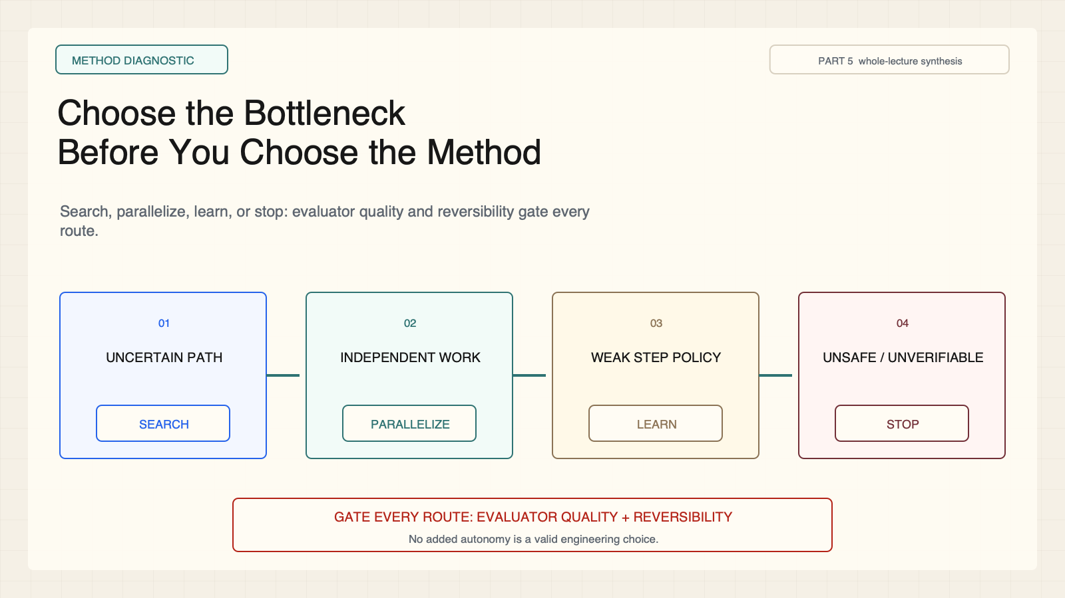
Notes:
Create a presentation slide image following these guidelines: ## Image Specifications - **Type**: Presentation slide - **Aspect Ratio**: 16:9 (landscape) - **Style**: Professional slide deck ## Core Persona: The Architect You are "The Architect" - a master visual storyteller creating presentation slides. Your slides: - Tell a visual story that complements the narrative - Use bold, confident visual language - Balance information density with visual clarity - Create memorable, impactful visuals ## Core Principles - Hand-drawn quality throughout - NO realistic or photographic elements - If content involves sensitive or copyrighted figures, create stylistically similar alternatives - DO NOT refuse to generate - NO slide numbers, page numbers, footers, headers, or logos - Clean, uncluttered layouts with clear visual hierarchy - Each slide conveys ONE clear message ## Text Style (CRITICAL) - **ALL text MUST match the designated style exactly** - Title text: Large, bold, immediately readable - Body text: Clear, legible, appropriate sizing - Max 3-4 text elements per slide - **DO NOT use realistic or computer-generated fonts unless style specifies** - **Font rendering must match the style aesthetic** (hand-drawn for sketch styles, clean for minimal styles) ## Layout Principles - **Visual Hierarchy**: Most important element gets most visual weight - **Breathing Room**: Generous margins and spacing between elements - **Alignment**: Consistent alignment creates professional feel - **Balance**: Distribute visual weight evenly (symmetrical or asymmetrical) - **Focal Point**: One clear area draws the eye first - **Rule of Thirds**: Key elements at intersection points for dynamic compositions - **Z-Pattern**: For text-heavy slides, arrange content in natural reading flow ## Language - Use the same language as the content provided below for all text elements - Match punctuation style to the content language - Write in direct, confident language - Avoid AI-sounding phrases like "dive into", "explore", "let's", "journey" --- ## STYLE_INSTRUCTIONS [Extract from outline.md - do NOT re-read style files] The STYLE_INSTRUCTIONS block from the outline contains: - Design Aesthetic - Background (Texture + Base Color) - Typography (Headlines + Body descriptions) - Color Palette (with hex codes) - Visual Elements - Density Guidelines - Style Rules (Do/Don't) Copy the entire `<STYLE_INSTRUCTIONS>...</STYLE_INSTRUCTIONS>` block from the outline here. --- ## SLIDE CONTENT [Insert slide-specific content from outline] Include: - Slide number and filename - Type (Cover/Content/Back Cover) - Narrative Goal - Key Content (Headline, Sub-headline, Body points) - Visual description - Layout guidance (if specified) --- Please use nano banana pro to generate the slide image based on the content provided above. --- # Slide 12: Choose the Bottleneck Before You Choose the Method ## Production method Rendered locally as an original 1600x900 SVG for exact text fidelity, then converted to PNG. Do not reproduce Stanford course frames, logos, or diagrams. ## Style Aged-cream academic technical briefing, faint engineering grid, crisp vector diagrams, near-black type, cobalt search/generation, teal verified or dependency-safe flow, warm-brown runtime/budget, maroon constraints, 8px card corners, no gradients, no decorative imagery. ## On-slide content - Stage: method diagnostic - Headline: Choose the Bottleneck Before You Choose the Method - Subtitle: Search, parallelize, learn, or stop: evaluator quality and reversibility gate every route. - Supporting labels: uncertain path; independent work; weak policy; unsafe / unverifiable - Lecture evidence: CS329A Part 5, whole-lecture synthesis - Primary-paper basis: LATS + SPRINT + SWiRL teaching synthesis ## Visual direction A diagnostic router sends four bottleneck types to search, parallelism, policy learning, or no added autonomy. ## Teaching objective Apply an integrated diagnostic without introducing assigned-only readings as taught content. ## Speaker notes Whole-lecture synthesis grounded only in the three taught methods: LATS, SPRINT, and SWiRL. Choose search for uncertain trajectories, parallelism for independent work, step learning for a weak policy, or no added autonomy when verification or reversibility is inadequate. ADaPT and AB-MCTS are not taught on this slide.

