Slide 1
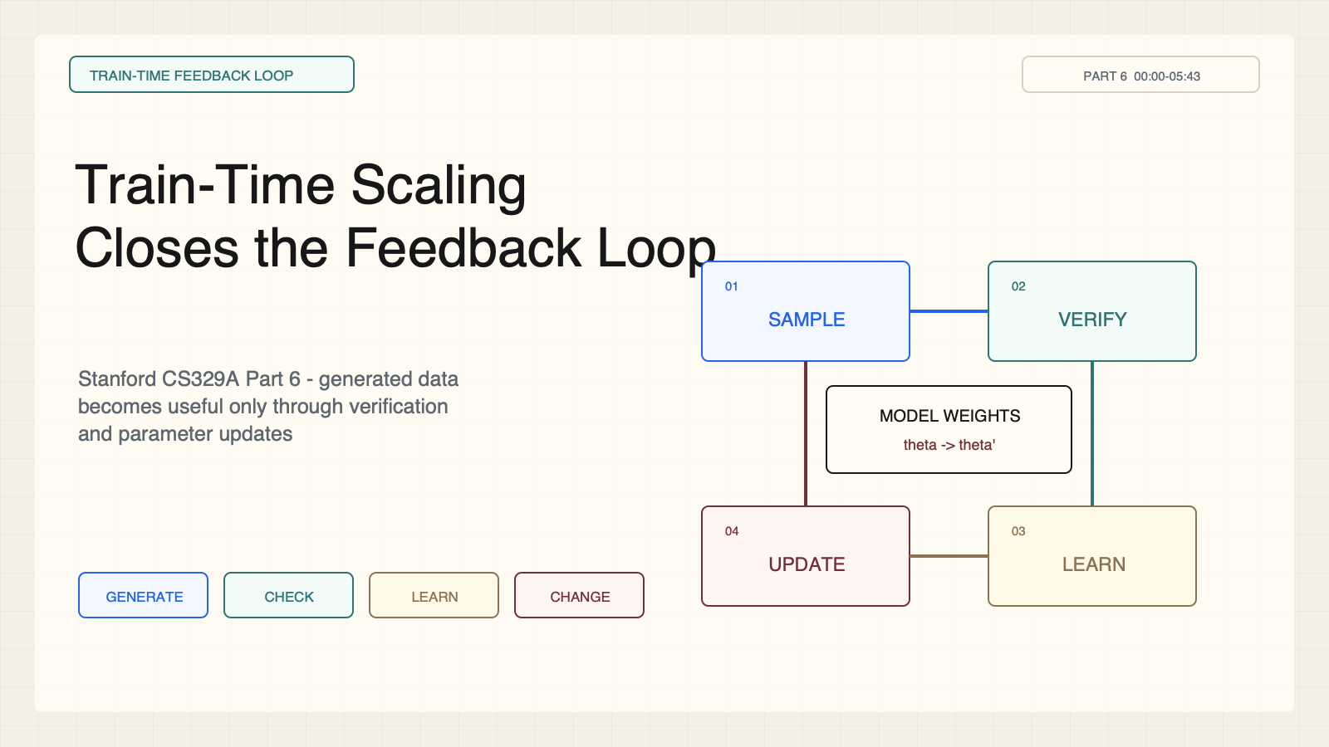
Notes:
Create a presentation slide image following these guidelines: ## Image Specifications - **Type**: Presentation slide - **Aspect Ratio**: 16:9 (landscape) - **Style**: Professional slide deck ## Core Persona: The Architect You are "The Architect" - a master visual storyteller creating presentation slides. Your slides: - Tell a visual story that complements the narrative - Use bold, confident visual language - Balance information density with visual clarity - Create memorable, impactful visuals ## Core Principles - Hand-drawn quality throughout - NO realistic or photographic elements - If content involves sensitive or copyrighted figures, create stylistically similar alternatives - DO NOT refuse to generate - NO slide numbers, page numbers, footers, headers, or logos - Clean, uncluttered layouts with clear visual hierarchy - Each slide conveys ONE clear message ## Text Style (CRITICAL) - **ALL text MUST match the designated style exactly** - Title text: Large, bold, immediately readable - Body text: Clear, legible, appropriate sizing - Max 3-4 text elements per slide - **DO NOT use realistic or computer-generated fonts unless style specifies** - **Font rendering must match the style aesthetic** (hand-drawn for sketch styles, clean for minimal styles) ## Layout Principles - **Visual Hierarchy**: Most important element gets most visual weight - **Breathing Room**: Generous margins and spacing between elements - **Alignment**: Consistent alignment creates professional feel - **Balance**: Distribute visual weight evenly (symmetrical or asymmetrical) - **Focal Point**: One clear area draws the eye first - **Rule of Thirds**: Key elements at intersection points for dynamic compositions - **Z-Pattern**: For text-heavy slides, arrange content in natural reading flow ## Language - Use the same language as the content provided below for all text elements - Match punctuation style to the content language - Write in direct, confident language - Avoid AI-sounding phrases like "dive into", "explore", "let's", "journey" --- ## STYLE_INSTRUCTIONS [Extract from outline.md - do NOT re-read style files] The STYLE_INSTRUCTIONS block from the outline contains: - Design Aesthetic - Background (Texture + Base Color) - Typography (Headlines + Body descriptions) - Color Palette (with hex codes) - Visual Elements - Density Guidelines - Style Rules (Do/Don't) Copy the entire `<STYLE_INSTRUCTIONS>...</STYLE_INSTRUCTIONS>` block from the outline here. --- ## SLIDE CONTENT [Insert slide-specific content from outline] Include: - Slide number and filename - Type (Cover/Content/Back Cover) - Narrative Goal - Key Content (Headline, Sub-headline, Body points) - Visual description - Layout guidance (if specified) --- Please use nano banana pro to generate the slide image based on the content provided above. --- # Slide 1: Train-Time Scaling Closes the Feedback Loop ## Production method Rendered locally as an original 1600x900 SVG for exact text fidelity, then converted to PNG. Do not reproduce Stanford course frames, logos, or diagrams. ## Style Aged-cream academic technical briefing, faint engineering grid, crisp vector diagrams, near-black type, cobalt generation, teal verification, warm-brown training, maroon constraints, 8px card corners, no gradients, no decorative imagery. ## On-slide content - Stage: train-time feedback loop - Headline: Train-Time Scaling Closes the Feedback Loop - Subtitle: Stanford CS329A Part 6 - generated data becomes useful only through verification and parameter updates - Supporting labels: sample; verify; learning signal; update - Lecture evidence: CS329A Part 6, 00:00-05:43 - Primary-paper basis: STaR, DeepSeekMath, and DAPO ## Visual direction A four-stage circular feedback loop wraps around a model-weight core. ## Teaching objective Define train-time self-improvement as a closed loop that changes model weights. ## Speaker notes Lecture 00:00-05:43; STaR, DeepSeekMath, and DAPO. Generation alone is not learning. The loop requires candidate generation, a verifier, a usable learning signal, and an update to model parameters.

Slide 2
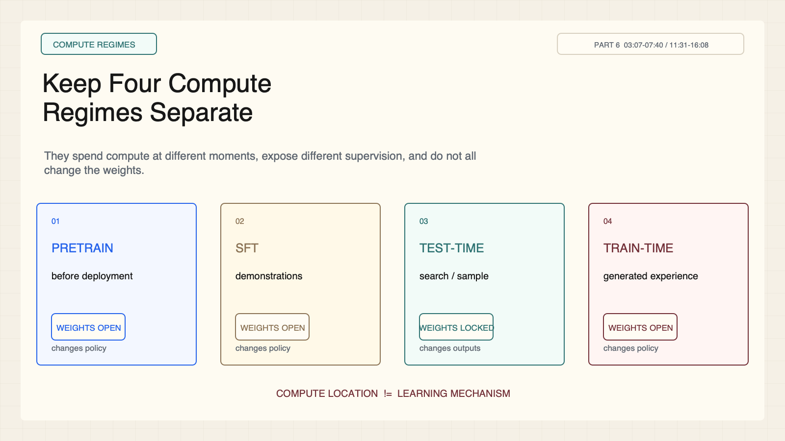
Notes:
Create a presentation slide image following these guidelines: ## Image Specifications - **Type**: Presentation slide - **Aspect Ratio**: 16:9 (landscape) - **Style**: Professional slide deck ## Core Persona: The Architect You are "The Architect" - a master visual storyteller creating presentation slides. Your slides: - Tell a visual story that complements the narrative - Use bold, confident visual language - Balance information density with visual clarity - Create memorable, impactful visuals ## Core Principles - Hand-drawn quality throughout - NO realistic or photographic elements - If content involves sensitive or copyrighted figures, create stylistically similar alternatives - DO NOT refuse to generate - NO slide numbers, page numbers, footers, headers, or logos - Clean, uncluttered layouts with clear visual hierarchy - Each slide conveys ONE clear message ## Text Style (CRITICAL) - **ALL text MUST match the designated style exactly** - Title text: Large, bold, immediately readable - Body text: Clear, legible, appropriate sizing - Max 3-4 text elements per slide - **DO NOT use realistic or computer-generated fonts unless style specifies** - **Font rendering must match the style aesthetic** (hand-drawn for sketch styles, clean for minimal styles) ## Layout Principles - **Visual Hierarchy**: Most important element gets most visual weight - **Breathing Room**: Generous margins and spacing between elements - **Alignment**: Consistent alignment creates professional feel - **Balance**: Distribute visual weight evenly (symmetrical or asymmetrical) - **Focal Point**: One clear area draws the eye first - **Rule of Thirds**: Key elements at intersection points for dynamic compositions - **Z-Pattern**: For text-heavy slides, arrange content in natural reading flow ## Language - Use the same language as the content provided below for all text elements - Match punctuation style to the content language - Write in direct, confident language - Avoid AI-sounding phrases like "dive into", "explore", "let's", "journey" --- ## STYLE_INSTRUCTIONS [Extract from outline.md - do NOT re-read style files] The STYLE_INSTRUCTIONS block from the outline contains: - Design Aesthetic - Background (Texture + Base Color) - Typography (Headlines + Body descriptions) - Color Palette (with hex codes) - Visual Elements - Density Guidelines - Style Rules (Do/Don't) Copy the entire `<STYLE_INSTRUCTIONS>...</STYLE_INSTRUCTIONS>` block from the outline here. --- ## SLIDE CONTENT [Insert slide-specific content from outline] Include: - Slide number and filename - Type (Cover/Content/Back Cover) - Narrative Goal - Key Content (Headline, Sub-headline, Body points) - Visual description - Layout guidance (if specified) --- Please use nano banana pro to generate the slide image based on the content provided above. --- # Slide 2: Keep Four Compute Regimes Separate ## Production method Rendered locally as an original 1600x900 SVG for exact text fidelity, then converted to PNG. Do not reproduce Stanford course frames, logos, or diagrams. ## Style Aged-cream academic technical briefing, faint engineering grid, crisp vector diagrams, near-black type, cobalt generation, teal verification, warm-brown training, maroon constraints, 8px card corners, no gradients, no decorative imagery. ## On-slide content - Stage: compute regimes - Headline: Keep Four Compute Regimes Separate - Subtitle: They spend compute at different moments, expose different supervision, and do not all change the weights. - Supporting labels: pretraining; SFT; test-time search; train-time improvement - Lecture evidence: CS329A Part 6, 03:07-07:40 / 11:31-16:08 - Primary-paper basis: Lecture taxonomy; STaR and DeepSeekMath examples ## Visual direction Four lifecycle cards mark when compute is spent and whether weights are open or locked. ## Teaching objective Distinguish pretraining, supervised fine-tuning, test-time search, and train-time self-improvement. ## Speaker notes Lecture 03:07-07:40 and 11:31-16:08. Pretraining and SFT update parameters from external corpora or demonstrations. Test-time search spends inference compute while weights stay locked. Train-time self-improvement uses generated experience to update parameters.

Slide 3
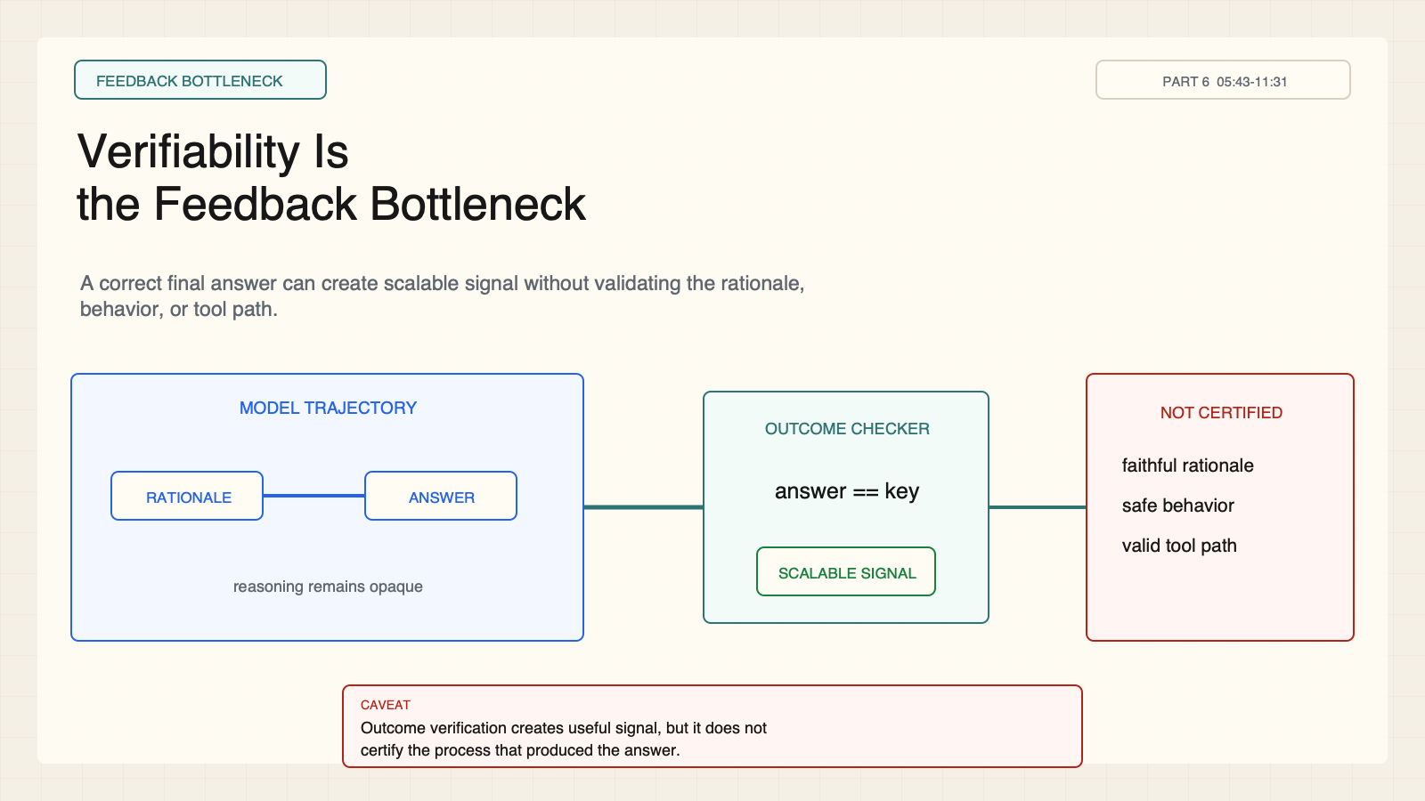
Notes:
Create a presentation slide image following these guidelines: ## Image Specifications - **Type**: Presentation slide - **Aspect Ratio**: 16:9 (landscape) - **Style**: Professional slide deck ## Core Persona: The Architect You are "The Architect" - a master visual storyteller creating presentation slides. Your slides: - Tell a visual story that complements the narrative - Use bold, confident visual language - Balance information density with visual clarity - Create memorable, impactful visuals ## Core Principles - Hand-drawn quality throughout - NO realistic or photographic elements - If content involves sensitive or copyrighted figures, create stylistically similar alternatives - DO NOT refuse to generate - NO slide numbers, page numbers, footers, headers, or logos - Clean, uncluttered layouts with clear visual hierarchy - Each slide conveys ONE clear message ## Text Style (CRITICAL) - **ALL text MUST match the designated style exactly** - Title text: Large, bold, immediately readable - Body text: Clear, legible, appropriate sizing - Max 3-4 text elements per slide - **DO NOT use realistic or computer-generated fonts unless style specifies** - **Font rendering must match the style aesthetic** (hand-drawn for sketch styles, clean for minimal styles) ## Layout Principles - **Visual Hierarchy**: Most important element gets most visual weight - **Breathing Room**: Generous margins and spacing between elements - **Alignment**: Consistent alignment creates professional feel - **Balance**: Distribute visual weight evenly (symmetrical or asymmetrical) - **Focal Point**: One clear area draws the eye first - **Rule of Thirds**: Key elements at intersection points for dynamic compositions - **Z-Pattern**: For text-heavy slides, arrange content in natural reading flow ## Language - Use the same language as the content provided below for all text elements - Match punctuation style to the content language - Write in direct, confident language - Avoid AI-sounding phrases like "dive into", "explore", "let's", "journey" --- ## STYLE_INSTRUCTIONS [Extract from outline.md - do NOT re-read style files] The STYLE_INSTRUCTIONS block from the outline contains: - Design Aesthetic - Background (Texture + Base Color) - Typography (Headlines + Body descriptions) - Color Palette (with hex codes) - Visual Elements - Density Guidelines - Style Rules (Do/Don't) Copy the entire `<STYLE_INSTRUCTIONS>...</STYLE_INSTRUCTIONS>` block from the outline here. --- ## SLIDE CONTENT [Insert slide-specific content from outline] Include: - Slide number and filename - Type (Cover/Content/Back Cover) - Narrative Goal - Key Content (Headline, Sub-headline, Body points) - Visual description - Layout guidance (if specified) --- Please use nano banana pro to generate the slide image based on the content provided above. --- # Slide 3: Verifiability Is the Feedback Bottleneck ## Production method Rendered locally as an original 1600x900 SVG for exact text fidelity, then converted to PNG. Do not reproduce Stanford course frames, logos, or diagrams. ## Style Aged-cream academic technical briefing, faint engineering grid, crisp vector diagrams, near-black type, cobalt generation, teal verification, warm-brown training, maroon constraints, 8px card corners, no gradients, no decorative imagery. ## On-slide content - Stage: feedback bottleneck - Headline: Verifiability Is the Feedback Bottleneck - Subtitle: A correct final answer can create scalable signal without validating the rationale, behavior, or tool path. - Supporting labels: answer checker; opaque rationale; outcome signal; uncertified process - Lecture evidence: CS329A Part 6, 05:43-11:31 - Primary-paper basis: STaR; DeepSeekMath; DAPO ## Visual direction An outcome checker accepts a final answer while an opaque reasoning channel remains outside its certification boundary. ## Teaching objective Separate outcome verifiability from process validity. ## Speaker notes Lecture 05:43-11:31; all three primary readings. Exact-answer tasks make outcome verification cheap. That checker does not establish that the chain of thought is faithful, safe, or causally responsible for the answer.

Slide 4
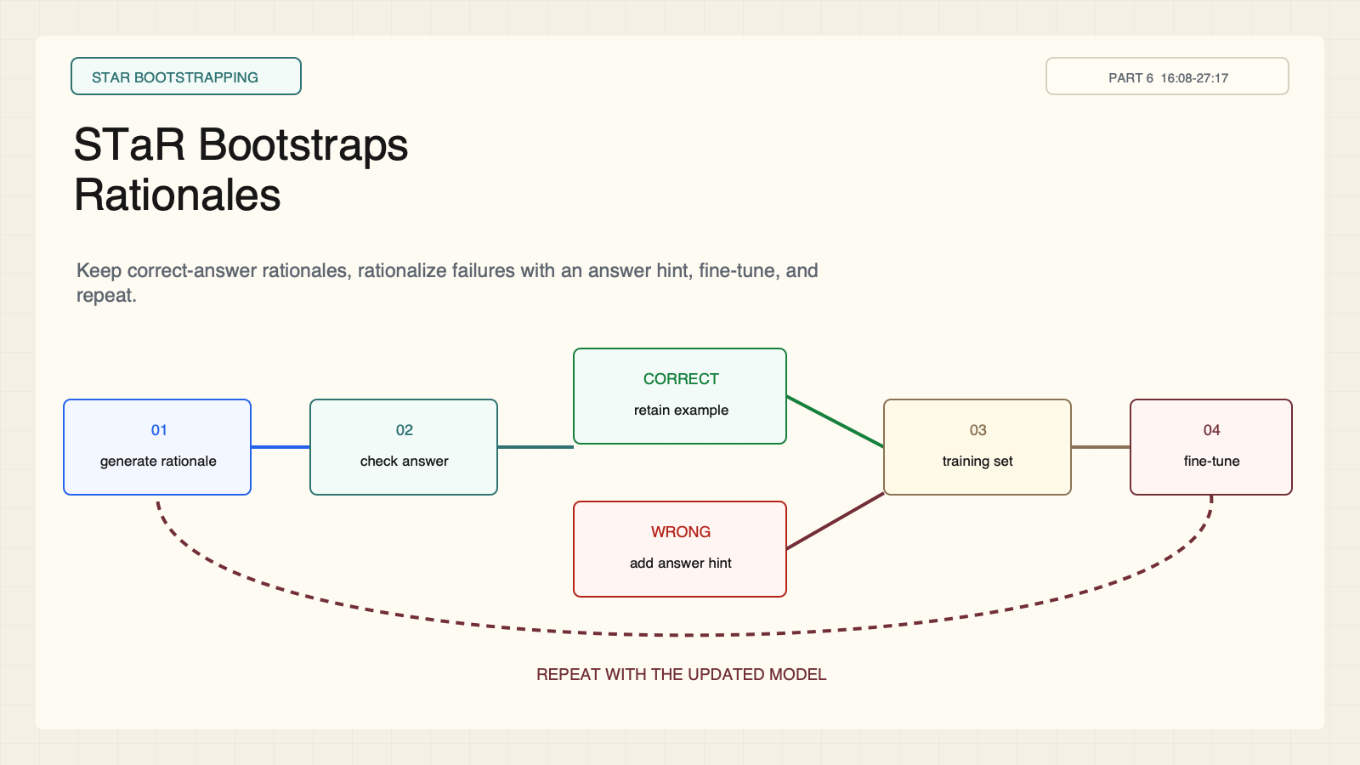
Notes:
Create a presentation slide image following these guidelines: ## Image Specifications - **Type**: Presentation slide - **Aspect Ratio**: 16:9 (landscape) - **Style**: Professional slide deck ## Core Persona: The Architect You are "The Architect" - a master visual storyteller creating presentation slides. Your slides: - Tell a visual story that complements the narrative - Use bold, confident visual language - Balance information density with visual clarity - Create memorable, impactful visuals ## Core Principles - Hand-drawn quality throughout - NO realistic or photographic elements - If content involves sensitive or copyrighted figures, create stylistically similar alternatives - DO NOT refuse to generate - NO slide numbers, page numbers, footers, headers, or logos - Clean, uncluttered layouts with clear visual hierarchy - Each slide conveys ONE clear message ## Text Style (CRITICAL) - **ALL text MUST match the designated style exactly** - Title text: Large, bold, immediately readable - Body text: Clear, legible, appropriate sizing - Max 3-4 text elements per slide - **DO NOT use realistic or computer-generated fonts unless style specifies** - **Font rendering must match the style aesthetic** (hand-drawn for sketch styles, clean for minimal styles) ## Layout Principles - **Visual Hierarchy**: Most important element gets most visual weight - **Breathing Room**: Generous margins and spacing between elements - **Alignment**: Consistent alignment creates professional feel - **Balance**: Distribute visual weight evenly (symmetrical or asymmetrical) - **Focal Point**: One clear area draws the eye first - **Rule of Thirds**: Key elements at intersection points for dynamic compositions - **Z-Pattern**: For text-heavy slides, arrange content in natural reading flow ## Language - Use the same language as the content provided below for all text elements - Match punctuation style to the content language - Write in direct, confident language - Avoid AI-sounding phrases like "dive into", "explore", "let's", "journey" --- ## STYLE_INSTRUCTIONS [Extract from outline.md - do NOT re-read style files] The STYLE_INSTRUCTIONS block from the outline contains: - Design Aesthetic - Background (Texture + Base Color) - Typography (Headlines + Body descriptions) - Color Palette (with hex codes) - Visual Elements - Density Guidelines - Style Rules (Do/Don't) Copy the entire `<STYLE_INSTRUCTIONS>...</STYLE_INSTRUCTIONS>` block from the outline here. --- ## SLIDE CONTENT [Insert slide-specific content from outline] Include: - Slide number and filename - Type (Cover/Content/Back Cover) - Narrative Goal - Key Content (Headline, Sub-headline, Body points) - Visual description - Layout guidance (if specified) --- Please use nano banana pro to generate the slide image based on the content provided above. --- # Slide 4: STaR Bootstraps Rationales ## Production method Rendered locally as an original 1600x900 SVG for exact text fidelity, then converted to PNG. Do not reproduce Stanford course frames, logos, or diagrams. ## Style Aged-cream academic technical briefing, faint engineering grid, crisp vector diagrams, near-black type, cobalt generation, teal verification, warm-brown training, maroon constraints, 8px card corners, no gradients, no decorative imagery. ## On-slide content - Stage: STaR bootstrapping - Headline: STaR Bootstraps Rationales - Subtitle: Keep correct-answer rationales, rationalize failures with an answer hint, fine-tune, and repeat. - Supporting labels: generate; filter; rationalize; fine-tune - Lecture evidence: CS329A Part 6, 16:08-27:17 - Primary-paper basis: STaR: Bootstrapping Reasoning With Reasoning, arXiv:2203.14465 ## Visual direction An outer training loop branches at a correctness filter into direct retention and answer-hint rationalization paths. ## Teaching objective Explain the two paths through the STaR data-generation loop. ## Speaker notes Lecture 16:08-27:17; STaR, arXiv:2203.14465. Correct-answer rationales enter the training set directly. Failed examples get another attempt conditioned on the known answer; successful rationalizations are added before fine-tuning and iteration.

Slide 5
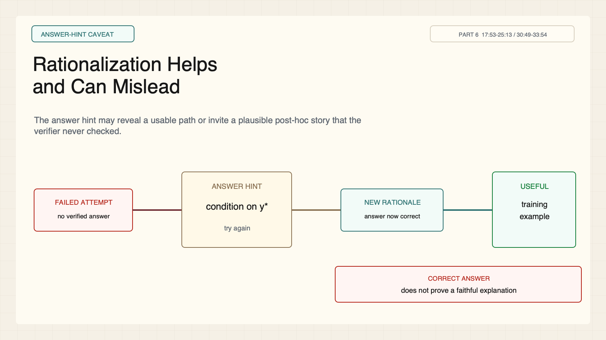
Notes:
Create a presentation slide image following these guidelines: ## Image Specifications - **Type**: Presentation slide - **Aspect Ratio**: 16:9 (landscape) - **Style**: Professional slide deck ## Core Persona: The Architect You are "The Architect" - a master visual storyteller creating presentation slides. Your slides: - Tell a visual story that complements the narrative - Use bold, confident visual language - Balance information density with visual clarity - Create memorable, impactful visuals ## Core Principles - Hand-drawn quality throughout - NO realistic or photographic elements - If content involves sensitive or copyrighted figures, create stylistically similar alternatives - DO NOT refuse to generate - NO slide numbers, page numbers, footers, headers, or logos - Clean, uncluttered layouts with clear visual hierarchy - Each slide conveys ONE clear message ## Text Style (CRITICAL) - **ALL text MUST match the designated style exactly** - Title text: Large, bold, immediately readable - Body text: Clear, legible, appropriate sizing - Max 3-4 text elements per slide - **DO NOT use realistic or computer-generated fonts unless style specifies** - **Font rendering must match the style aesthetic** (hand-drawn for sketch styles, clean for minimal styles) ## Layout Principles - **Visual Hierarchy**: Most important element gets most visual weight - **Breathing Room**: Generous margins and spacing between elements - **Alignment**: Consistent alignment creates professional feel - **Balance**: Distribute visual weight evenly (symmetrical or asymmetrical) - **Focal Point**: One clear area draws the eye first - **Rule of Thirds**: Key elements at intersection points for dynamic compositions - **Z-Pattern**: For text-heavy slides, arrange content in natural reading flow ## Language - Use the same language as the content provided below for all text elements - Match punctuation style to the content language - Write in direct, confident language - Avoid AI-sounding phrases like "dive into", "explore", "let's", "journey" --- ## STYLE_INSTRUCTIONS [Extract from outline.md - do NOT re-read style files] The STYLE_INSTRUCTIONS block from the outline contains: - Design Aesthetic - Background (Texture + Base Color) - Typography (Headlines + Body descriptions) - Color Palette (with hex codes) - Visual Elements - Density Guidelines - Style Rules (Do/Don't) Copy the entire `<STYLE_INSTRUCTIONS>...</STYLE_INSTRUCTIONS>` block from the outline here. --- ## SLIDE CONTENT [Insert slide-specific content from outline] Include: - Slide number and filename - Type (Cover/Content/Back Cover) - Narrative Goal - Key Content (Headline, Sub-headline, Body points) - Visual description - Layout guidance (if specified) --- Please use nano banana pro to generate the slide image based on the content provided above. --- # Slide 5: Rationalization Helps and Can Mislead ## Production method Rendered locally as an original 1600x900 SVG for exact text fidelity, then converted to PNG. Do not reproduce Stanford course frames, logos, or diagrams. ## Style Aged-cream academic technical briefing, faint engineering grid, crisp vector diagrams, near-black type, cobalt generation, teal verification, warm-brown training, maroon constraints, 8px card corners, no gradients, no decorative imagery. ## On-slide content - Stage: answer-hint caveat - Headline: Rationalization Helps and Can Mislead - Subtitle: The answer hint may reveal a usable path or invite a plausible post-hoc story that the verifier never checked. - Supporting labels: failed attempt; answer hint; new rationale; evidence gap - Lecture evidence: CS329A Part 6, 17:53-25:13 / 30:49-33:54 - Primary-paper basis: STaR, arXiv:2203.14465 ## Visual direction An answer-hint bridge connects failure to a new rationale, while a red broken-evidence boundary blocks an unwarranted faithfulness claim. ## Teaching objective Identify both the coverage benefit and the faithfulness risk of rationalization. ## Speaker notes Lecture 17:53-25:13 and 30:49-33:54; STaR, arXiv:2203.14465. Conditioning on the answer can recover training examples that sampling missed. Yet answer correctness alone does not validate the generated explanation as faithful reasoning.

Slide 6
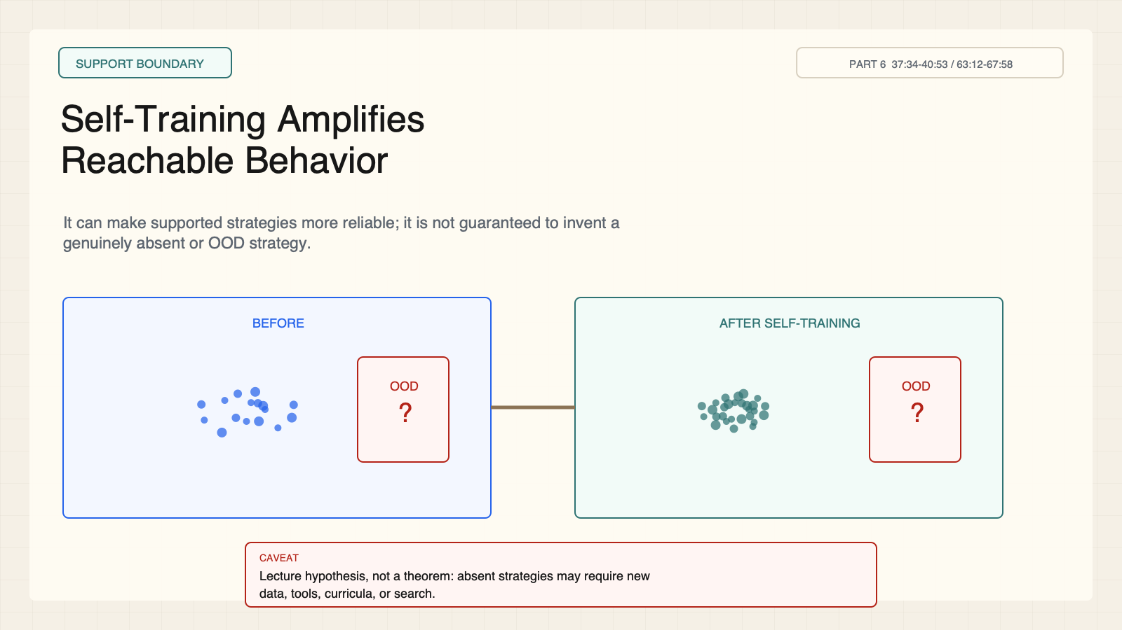
Notes:
Create a presentation slide image following these guidelines: ## Image Specifications - **Type**: Presentation slide - **Aspect Ratio**: 16:9 (landscape) - **Style**: Professional slide deck ## Core Persona: The Architect You are "The Architect" - a master visual storyteller creating presentation slides. Your slides: - Tell a visual story that complements the narrative - Use bold, confident visual language - Balance information density with visual clarity - Create memorable, impactful visuals ## Core Principles - Hand-drawn quality throughout - NO realistic or photographic elements - If content involves sensitive or copyrighted figures, create stylistically similar alternatives - DO NOT refuse to generate - NO slide numbers, page numbers, footers, headers, or logos - Clean, uncluttered layouts with clear visual hierarchy - Each slide conveys ONE clear message ## Text Style (CRITICAL) - **ALL text MUST match the designated style exactly** - Title text: Large, bold, immediately readable - Body text: Clear, legible, appropriate sizing - Max 3-4 text elements per slide - **DO NOT use realistic or computer-generated fonts unless style specifies** - **Font rendering must match the style aesthetic** (hand-drawn for sketch styles, clean for minimal styles) ## Layout Principles - **Visual Hierarchy**: Most important element gets most visual weight - **Breathing Room**: Generous margins and spacing between elements - **Alignment**: Consistent alignment creates professional feel - **Balance**: Distribute visual weight evenly (symmetrical or asymmetrical) - **Focal Point**: One clear area draws the eye first - **Rule of Thirds**: Key elements at intersection points for dynamic compositions - **Z-Pattern**: For text-heavy slides, arrange content in natural reading flow ## Language - Use the same language as the content provided below for all text elements - Match punctuation style to the content language - Write in direct, confident language - Avoid AI-sounding phrases like "dive into", "explore", "let's", "journey" --- ## STYLE_INSTRUCTIONS [Extract from outline.md - do NOT re-read style files] The STYLE_INSTRUCTIONS block from the outline contains: - Design Aesthetic - Background (Texture + Base Color) - Typography (Headlines + Body descriptions) - Color Palette (with hex codes) - Visual Elements - Density Guidelines - Style Rules (Do/Don't) Copy the entire `<STYLE_INSTRUCTIONS>...</STYLE_INSTRUCTIONS>` block from the outline here. --- ## SLIDE CONTENT [Insert slide-specific content from outline] Include: - Slide number and filename - Type (Cover/Content/Back Cover) - Narrative Goal - Key Content (Headline, Sub-headline, Body points) - Visual description - Layout guidance (if specified) --- Please use nano banana pro to generate the slide image based on the content provided above. --- # Slide 6: Self-Training Amplifies Reachable Behavior ## Production method Rendered locally as an original 1600x900 SVG for exact text fidelity, then converted to PNG. Do not reproduce Stanford course frames, logos, or diagrams. ## Style Aged-cream academic technical briefing, faint engineering grid, crisp vector diagrams, near-black type, cobalt generation, teal verification, warm-brown training, maroon constraints, 8px card corners, no gradients, no decorative imagery. ## On-slide content - Stage: support boundary - Headline: Self-Training Amplifies Reachable Behavior - Subtitle: It can make supported strategies more reliable; it is not guaranteed to invent a genuinely absent or OOD strategy. - Supporting labels: base support; higher density; unknown region; no guarantee - Lecture evidence: CS329A Part 6, 37:34-40:53 / 63:12-67:58 - Primary-paper basis: Lecture hypothesis and teaching synthesis ## Visual direction Before-and-after support distributions become denser in a reachable region while an out-of-distribution zone stays unclaimed. ## Teaching objective Frame a capability ceiling without overstating it as a theorem. ## Speaker notes Lecture 37:34-40:53 and 63:12-67:58. This is a lecture hypothesis and diagnostic synthesis, not a universal impossibility theorem. Self-training reliably exploits discoverable behavior; absent strategies may require new data, tools, curricula, or search.

Slide 7
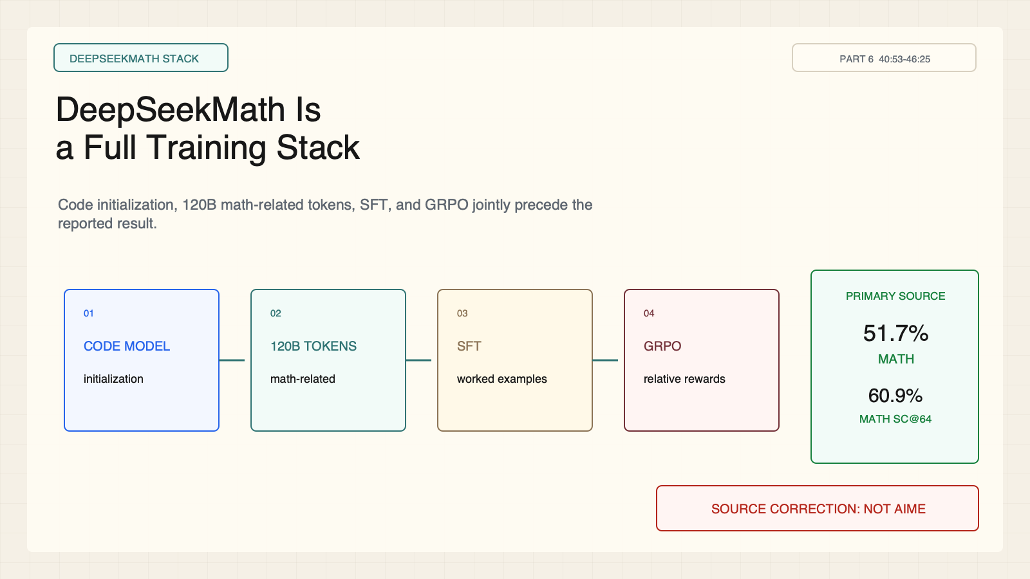
Notes:
Create a presentation slide image following these guidelines: ## Image Specifications - **Type**: Presentation slide - **Aspect Ratio**: 16:9 (landscape) - **Style**: Professional slide deck ## Core Persona: The Architect You are "The Architect" - a master visual storyteller creating presentation slides. Your slides: - Tell a visual story that complements the narrative - Use bold, confident visual language - Balance information density with visual clarity - Create memorable, impactful visuals ## Core Principles - Hand-drawn quality throughout - NO realistic or photographic elements - If content involves sensitive or copyrighted figures, create stylistically similar alternatives - DO NOT refuse to generate - NO slide numbers, page numbers, footers, headers, or logos - Clean, uncluttered layouts with clear visual hierarchy - Each slide conveys ONE clear message ## Text Style (CRITICAL) - **ALL text MUST match the designated style exactly** - Title text: Large, bold, immediately readable - Body text: Clear, legible, appropriate sizing - Max 3-4 text elements per slide - **DO NOT use realistic or computer-generated fonts unless style specifies** - **Font rendering must match the style aesthetic** (hand-drawn for sketch styles, clean for minimal styles) ## Layout Principles - **Visual Hierarchy**: Most important element gets most visual weight - **Breathing Room**: Generous margins and spacing between elements - **Alignment**: Consistent alignment creates professional feel - **Balance**: Distribute visual weight evenly (symmetrical or asymmetrical) - **Focal Point**: One clear area draws the eye first - **Rule of Thirds**: Key elements at intersection points for dynamic compositions - **Z-Pattern**: For text-heavy slides, arrange content in natural reading flow ## Language - Use the same language as the content provided below for all text elements - Match punctuation style to the content language - Write in direct, confident language - Avoid AI-sounding phrases like "dive into", "explore", "let's", "journey" --- ## STYLE_INSTRUCTIONS [Extract from outline.md - do NOT re-read style files] The STYLE_INSTRUCTIONS block from the outline contains: - Design Aesthetic - Background (Texture + Base Color) - Typography (Headlines + Body descriptions) - Color Palette (with hex codes) - Visual Elements - Density Guidelines - Style Rules (Do/Don't) Copy the entire `<STYLE_INSTRUCTIONS>...</STYLE_INSTRUCTIONS>` block from the outline here. --- ## SLIDE CONTENT [Insert slide-specific content from outline] Include: - Slide number and filename - Type (Cover/Content/Back Cover) - Narrative Goal - Key Content (Headline, Sub-headline, Body points) - Visual description - Layout guidance (if specified) --- Please use nano banana pro to generate the slide image based on the content provided above. --- # Slide 7: DeepSeekMath Is a Full Training Stack ## Production method Rendered locally as an original 1600x900 SVG for exact text fidelity, then converted to PNG. Do not reproduce Stanford course frames, logos, or diagrams. ## Style Aged-cream academic technical briefing, faint engineering grid, crisp vector diagrams, near-black type, cobalt generation, teal verification, warm-brown training, maroon constraints, 8px card corners, no gradients, no decorative imagery. ## On-slide content - Stage: DeepSeekMath stack - Headline: DeepSeekMath Is a Full Training Stack - Subtitle: Code initialization, 120B math-related tokens, SFT, and GRPO jointly precede the reported result. - Supporting labels: code base; 120B math tokens; SFT; GRPO - Lecture evidence: CS329A Part 6, 40:53-46:25 - Primary-paper basis: DeepSeekMath, arXiv:2402.03300 ## Visual direction A four-layer training stack terminates in a primary-source correction card with the two MATH metrics. ## Teaching objective Attribute the result to the complete stack and correct the lecture-slide benchmark label. ## Speaker notes Lecture 40:53-46:25; DeepSeekMath, arXiv:2402.03300. Primary-source correction: the paper reports 51.7% on MATH and 60.9% MATH self-consistency@64. The lecture slide's AIME label is incorrect; never cite 51.7% as an AIME result.

Slide 8
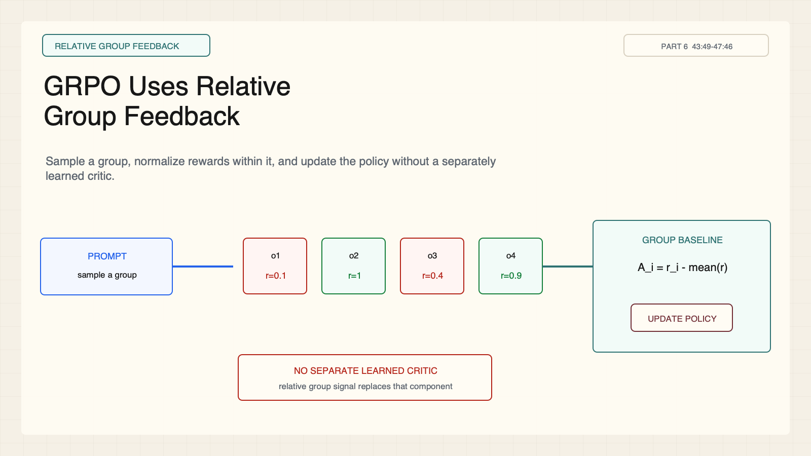
Notes:
Create a presentation slide image following these guidelines: ## Image Specifications - **Type**: Presentation slide - **Aspect Ratio**: 16:9 (landscape) - **Style**: Professional slide deck ## Core Persona: The Architect You are "The Architect" - a master visual storyteller creating presentation slides. Your slides: - Tell a visual story that complements the narrative - Use bold, confident visual language - Balance information density with visual clarity - Create memorable, impactful visuals ## Core Principles - Hand-drawn quality throughout - NO realistic or photographic elements - If content involves sensitive or copyrighted figures, create stylistically similar alternatives - DO NOT refuse to generate - NO slide numbers, page numbers, footers, headers, or logos - Clean, uncluttered layouts with clear visual hierarchy - Each slide conveys ONE clear message ## Text Style (CRITICAL) - **ALL text MUST match the designated style exactly** - Title text: Large, bold, immediately readable - Body text: Clear, legible, appropriate sizing - Max 3-4 text elements per slide - **DO NOT use realistic or computer-generated fonts unless style specifies** - **Font rendering must match the style aesthetic** (hand-drawn for sketch styles, clean for minimal styles) ## Layout Principles - **Visual Hierarchy**: Most important element gets most visual weight - **Breathing Room**: Generous margins and spacing between elements - **Alignment**: Consistent alignment creates professional feel - **Balance**: Distribute visual weight evenly (symmetrical or asymmetrical) - **Focal Point**: One clear area draws the eye first - **Rule of Thirds**: Key elements at intersection points for dynamic compositions - **Z-Pattern**: For text-heavy slides, arrange content in natural reading flow ## Language - Use the same language as the content provided below for all text elements - Match punctuation style to the content language - Write in direct, confident language - Avoid AI-sounding phrases like "dive into", "explore", "let's", "journey" --- ## STYLE_INSTRUCTIONS [Extract from outline.md - do NOT re-read style files] The STYLE_INSTRUCTIONS block from the outline contains: - Design Aesthetic - Background (Texture + Base Color) - Typography (Headlines + Body descriptions) - Color Palette (with hex codes) - Visual Elements - Density Guidelines - Style Rules (Do/Don't) Copy the entire `<STYLE_INSTRUCTIONS>...</STYLE_INSTRUCTIONS>` block from the outline here. --- ## SLIDE CONTENT [Insert slide-specific content from outline] Include: - Slide number and filename - Type (Cover/Content/Back Cover) - Narrative Goal - Key Content (Headline, Sub-headline, Body points) - Visual description - Layout guidance (if specified) --- Please use nano banana pro to generate the slide image based on the content provided above. --- # Slide 8: GRPO Uses Relative Group Feedback ## Production method Rendered locally as an original 1600x900 SVG for exact text fidelity, then converted to PNG. Do not reproduce Stanford course frames, logos, or diagrams. ## Style Aged-cream academic technical briefing, faint engineering grid, crisp vector diagrams, near-black type, cobalt generation, teal verification, warm-brown training, maroon constraints, 8px card corners, no gradients, no decorative imagery. ## On-slide content - Stage: relative group feedback - Headline: GRPO Uses Relative Group Feedback - Subtitle: Sample a group, normalize rewards within it, and update the policy without a separately learned critic. - Supporting labels: prompt; group samples; relative advantage; policy update - Lecture evidence: CS329A Part 6, 43:49-47:46 - Primary-paper basis: DeepSeekMath, arXiv:2402.03300 ## Visual direction A compact GRPO lane contrasts group-normalized rewards with a crossed-out standalone critic lane. ## Teaching objective Explain the operational distinction between GRPO and a critic-based PPO stack. ## Speaker notes Lecture 43:49-47:46; DeepSeekMath, arXiv:2402.03300. GRPO estimates a relative baseline from rewards within a sampled group, reducing the need for a separate value model. The signal depends on useful reward variation inside the group.

Slide 9
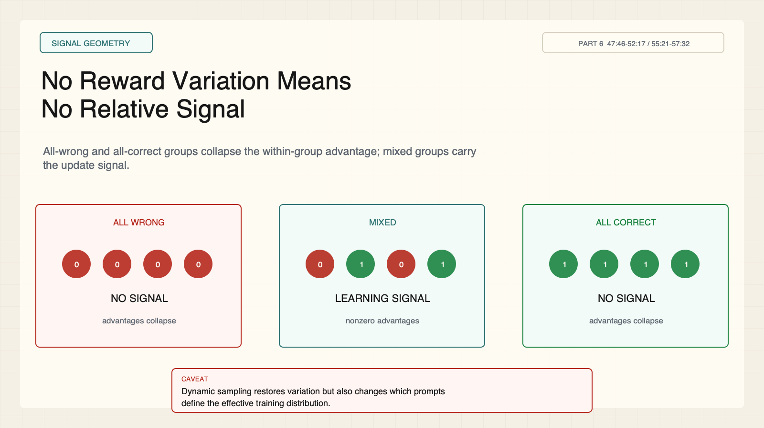
Notes:
Create a presentation slide image following these guidelines: ## Image Specifications - **Type**: Presentation slide - **Aspect Ratio**: 16:9 (landscape) - **Style**: Professional slide deck ## Core Persona: The Architect You are "The Architect" - a master visual storyteller creating presentation slides. Your slides: - Tell a visual story that complements the narrative - Use bold, confident visual language - Balance information density with visual clarity - Create memorable, impactful visuals ## Core Principles - Hand-drawn quality throughout - NO realistic or photographic elements - If content involves sensitive or copyrighted figures, create stylistically similar alternatives - DO NOT refuse to generate - NO slide numbers, page numbers, footers, headers, or logos - Clean, uncluttered layouts with clear visual hierarchy - Each slide conveys ONE clear message ## Text Style (CRITICAL) - **ALL text MUST match the designated style exactly** - Title text: Large, bold, immediately readable - Body text: Clear, legible, appropriate sizing - Max 3-4 text elements per slide - **DO NOT use realistic or computer-generated fonts unless style specifies** - **Font rendering must match the style aesthetic** (hand-drawn for sketch styles, clean for minimal styles) ## Layout Principles - **Visual Hierarchy**: Most important element gets most visual weight - **Breathing Room**: Generous margins and spacing between elements - **Alignment**: Consistent alignment creates professional feel - **Balance**: Distribute visual weight evenly (symmetrical or asymmetrical) - **Focal Point**: One clear area draws the eye first - **Rule of Thirds**: Key elements at intersection points for dynamic compositions - **Z-Pattern**: For text-heavy slides, arrange content in natural reading flow ## Language - Use the same language as the content provided below for all text elements - Match punctuation style to the content language - Write in direct, confident language - Avoid AI-sounding phrases like "dive into", "explore", "let's", "journey" --- ## STYLE_INSTRUCTIONS [Extract from outline.md - do NOT re-read style files] The STYLE_INSTRUCTIONS block from the outline contains: - Design Aesthetic - Background (Texture + Base Color) - Typography (Headlines + Body descriptions) - Color Palette (with hex codes) - Visual Elements - Density Guidelines - Style Rules (Do/Don't) Copy the entire `<STYLE_INSTRUCTIONS>...</STYLE_INSTRUCTIONS>` block from the outline here. --- ## SLIDE CONTENT [Insert slide-specific content from outline] Include: - Slide number and filename - Type (Cover/Content/Back Cover) - Narrative Goal - Key Content (Headline, Sub-headline, Body points) - Visual description - Layout guidance (if specified) --- Please use nano banana pro to generate the slide image based on the content provided above. --- # Slide 9: No Reward Variation Means No Relative Signal ## Production method Rendered locally as an original 1600x900 SVG for exact text fidelity, then converted to PNG. Do not reproduce Stanford course frames, logos, or diagrams. ## Style Aged-cream academic technical briefing, faint engineering grid, crisp vector diagrams, near-black type, cobalt generation, teal verification, warm-brown training, maroon constraints, 8px card corners, no gradients, no decorative imagery. ## On-slide content - Stage: signal geometry - Headline: No Reward Variation Means No Relative Signal - Subtitle: All-wrong and all-correct groups collapse the within-group advantage; mixed groups carry the update signal. - Supporting labels: all wrong; mixed; all correct; dynamic sampling - Lecture evidence: CS329A Part 6, 47:46-52:17 / 55:21-57:32 - Primary-paper basis: DeepSeekMath; DAPO, arXiv:2503.14476 ## Visual direction Three reward groups show zero, nonzero, and zero centered advantages; only the mixed group emits a learning signal. ## Teaching objective Show why reward diversity is load-bearing for group-relative optimization. ## Speaker notes Lecture 47:46-52:17 and 55:21-57:32; DeepSeekMath, arXiv:2402.03300, and DAPO, arXiv:2503.14476. If every sample receives the same reward, normalized relative advantages collapse. DAPO's dynamic sampling filters prompts without useful variation, which changes the effective training distribution and should not be treated as a neutral preprocessing step.

Slide 10
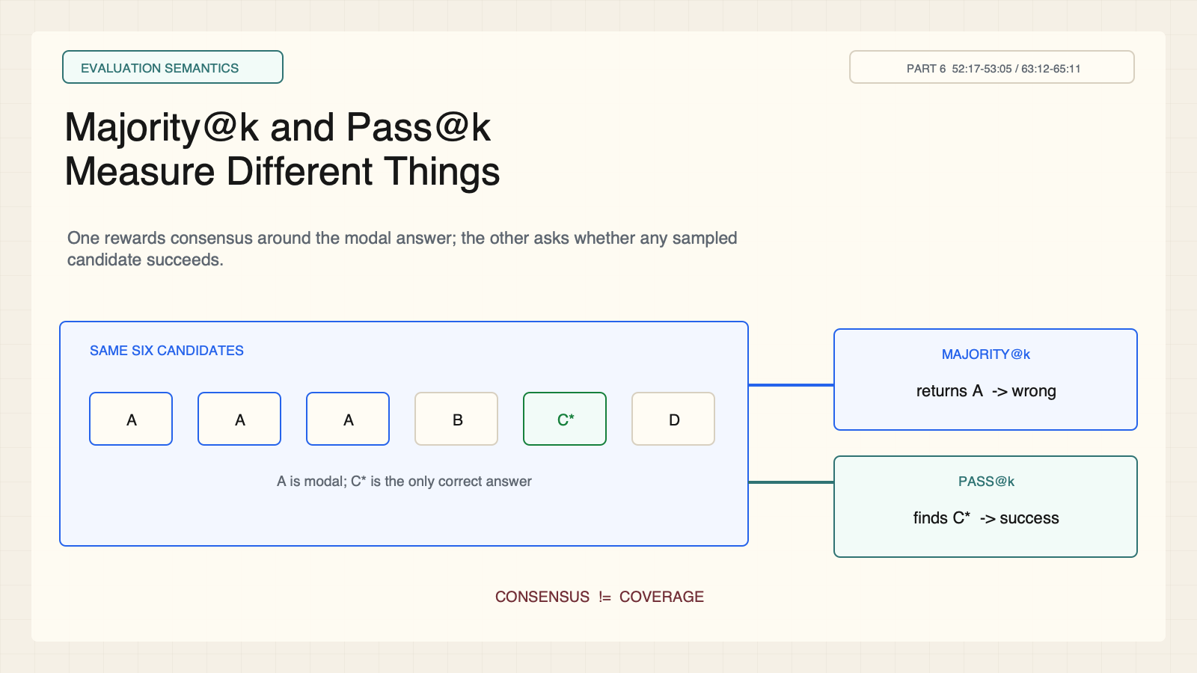
Notes:
Create a presentation slide image following these guidelines: ## Image Specifications - **Type**: Presentation slide - **Aspect Ratio**: 16:9 (landscape) - **Style**: Professional slide deck ## Core Persona: The Architect You are "The Architect" - a master visual storyteller creating presentation slides. Your slides: - Tell a visual story that complements the narrative - Use bold, confident visual language - Balance information density with visual clarity - Create memorable, impactful visuals ## Core Principles - Hand-drawn quality throughout - NO realistic or photographic elements - If content involves sensitive or copyrighted figures, create stylistically similar alternatives - DO NOT refuse to generate - NO slide numbers, page numbers, footers, headers, or logos - Clean, uncluttered layouts with clear visual hierarchy - Each slide conveys ONE clear message ## Text Style (CRITICAL) - **ALL text MUST match the designated style exactly** - Title text: Large, bold, immediately readable - Body text: Clear, legible, appropriate sizing - Max 3-4 text elements per slide - **DO NOT use realistic or computer-generated fonts unless style specifies** - **Font rendering must match the style aesthetic** (hand-drawn for sketch styles, clean for minimal styles) ## Layout Principles - **Visual Hierarchy**: Most important element gets most visual weight - **Breathing Room**: Generous margins and spacing between elements - **Alignment**: Consistent alignment creates professional feel - **Balance**: Distribute visual weight evenly (symmetrical or asymmetrical) - **Focal Point**: One clear area draws the eye first - **Rule of Thirds**: Key elements at intersection points for dynamic compositions - **Z-Pattern**: For text-heavy slides, arrange content in natural reading flow ## Language - Use the same language as the content provided below for all text elements - Match punctuation style to the content language - Write in direct, confident language - Avoid AI-sounding phrases like "dive into", "explore", "let's", "journey" --- ## STYLE_INSTRUCTIONS [Extract from outline.md - do NOT re-read style files] The STYLE_INSTRUCTIONS block from the outline contains: - Design Aesthetic - Background (Texture + Base Color) - Typography (Headlines + Body descriptions) - Color Palette (with hex codes) - Visual Elements - Density Guidelines - Style Rules (Do/Don't) Copy the entire `<STYLE_INSTRUCTIONS>...</STYLE_INSTRUCTIONS>` block from the outline here. --- ## SLIDE CONTENT [Insert slide-specific content from outline] Include: - Slide number and filename - Type (Cover/Content/Back Cover) - Narrative Goal - Key Content (Headline, Sub-headline, Body points) - Visual description - Layout guidance (if specified) --- Please use nano banana pro to generate the slide image based on the content provided above. --- # Slide 10: Majority@k and Pass@k Measure Different Things ## Production method Rendered locally as an original 1600x900 SVG for exact text fidelity, then converted to PNG. Do not reproduce Stanford course frames, logos, or diagrams. ## Style Aged-cream academic technical briefing, faint engineering grid, crisp vector diagrams, near-black type, cobalt generation, teal verification, warm-brown training, maroon constraints, 8px card corners, no gradients, no decorative imagery. ## On-slide content - Stage: evaluation semantics - Headline: Majority@k and Pass@k Measure Different Things - Subtitle: One rewards consensus around the modal answer; the other asks whether any sampled candidate succeeds. - Supporting labels: consensus; coverage; aggregation; oracle selection - Lecture evidence: CS329A Part 6, 52:17-53:05 / 63:12-65:11 - Primary-paper basis: Lecture metric comparison; DeepSeekMath context ## Visual direction The same candidate set feeds a voting box and an any-success oracle, producing different outcomes. ## Teaching objective Prevent interchangeable use of majority@k and pass@k. ## Speaker notes Lecture 52:17-53:05 and 63:12-65:11; DeepSeekMath, arXiv:2402.03300, provides the surrounding RL context. Majority@k aggregates samples by vote and can fail when a correct answer is rare. Pass@k measures whether at least one sampled candidate succeeds and assumes an oracle-like checker can identify it. They answer different evaluation questions.

Slide 11
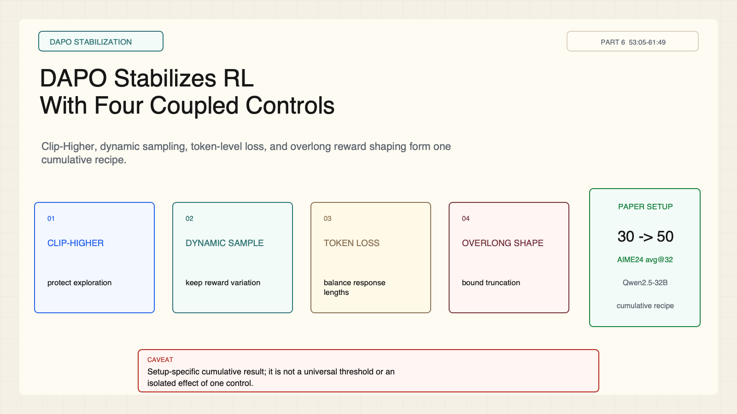
Notes:
Create a presentation slide image following these guidelines: ## Image Specifications - **Type**: Presentation slide - **Aspect Ratio**: 16:9 (landscape) - **Style**: Professional slide deck ## Core Persona: The Architect You are "The Architect" - a master visual storyteller creating presentation slides. Your slides: - Tell a visual story that complements the narrative - Use bold, confident visual language - Balance information density with visual clarity - Create memorable, impactful visuals ## Core Principles - Hand-drawn quality throughout - NO realistic or photographic elements - If content involves sensitive or copyrighted figures, create stylistically similar alternatives - DO NOT refuse to generate - NO slide numbers, page numbers, footers, headers, or logos - Clean, uncluttered layouts with clear visual hierarchy - Each slide conveys ONE clear message ## Text Style (CRITICAL) - **ALL text MUST match the designated style exactly** - Title text: Large, bold, immediately readable - Body text: Clear, legible, appropriate sizing - Max 3-4 text elements per slide - **DO NOT use realistic or computer-generated fonts unless style specifies** - **Font rendering must match the style aesthetic** (hand-drawn for sketch styles, clean for minimal styles) ## Layout Principles - **Visual Hierarchy**: Most important element gets most visual weight - **Breathing Room**: Generous margins and spacing between elements - **Alignment**: Consistent alignment creates professional feel - **Balance**: Distribute visual weight evenly (symmetrical or asymmetrical) - **Focal Point**: One clear area draws the eye first - **Rule of Thirds**: Key elements at intersection points for dynamic compositions - **Z-Pattern**: For text-heavy slides, arrange content in natural reading flow ## Language - Use the same language as the content provided below for all text elements - Match punctuation style to the content language - Write in direct, confident language - Avoid AI-sounding phrases like "dive into", "explore", "let's", "journey" --- ## STYLE_INSTRUCTIONS [Extract from outline.md - do NOT re-read style files] The STYLE_INSTRUCTIONS block from the outline contains: - Design Aesthetic - Background (Texture + Base Color) - Typography (Headlines + Body descriptions) - Color Palette (with hex codes) - Visual Elements - Density Guidelines - Style Rules (Do/Don't) Copy the entire `<STYLE_INSTRUCTIONS>...</STYLE_INSTRUCTIONS>` block from the outline here. --- ## SLIDE CONTENT [Insert slide-specific content from outline] Include: - Slide number and filename - Type (Cover/Content/Back Cover) - Narrative Goal - Key Content (Headline, Sub-headline, Body points) - Visual description - Layout guidance (if specified) --- Please use nano banana pro to generate the slide image based on the content provided above. --- # Slide 11: DAPO Stabilizes RL With Four Coupled Controls ## Production method Rendered locally as an original 1600x900 SVG for exact text fidelity, then converted to PNG. Do not reproduce Stanford course frames, logos, or diagrams. ## Style Aged-cream academic technical briefing, faint engineering grid, crisp vector diagrams, near-black type, cobalt generation, teal verification, warm-brown training, maroon constraints, 8px card corners, no gradients, no decorative imagery. ## On-slide content - Stage: DAPO stabilization - Headline: DAPO Stabilizes RL With Four Coupled Controls - Subtitle: Clip-Higher, dynamic sampling, token-level loss, and overlong reward shaping form one cumulative recipe. - Supporting labels: Clip-Higher; dynamic sampling; token loss; overlong shaping - Lecture evidence: CS329A Part 6, 53:05-61:49 - Primary-paper basis: DAPO, arXiv:2503.14476 ## Visual direction Four control modules stabilize a training loop beside a bounded setup-specific 30 -> 50 result card. ## Teaching objective Explain DAPO as a coupled recipe and bound its reported gain to the paper's setup. ## Speaker notes Lecture 53:05-61:49; DAPO, arXiv:2503.14476. The paper's cumulative ablation moves from about 30 to 50 AIME 2024 average@32 using a Qwen2.5-32B base model. This is setup-specific and does not establish a universal threshold or isolated effect for any single control.

Slide 12
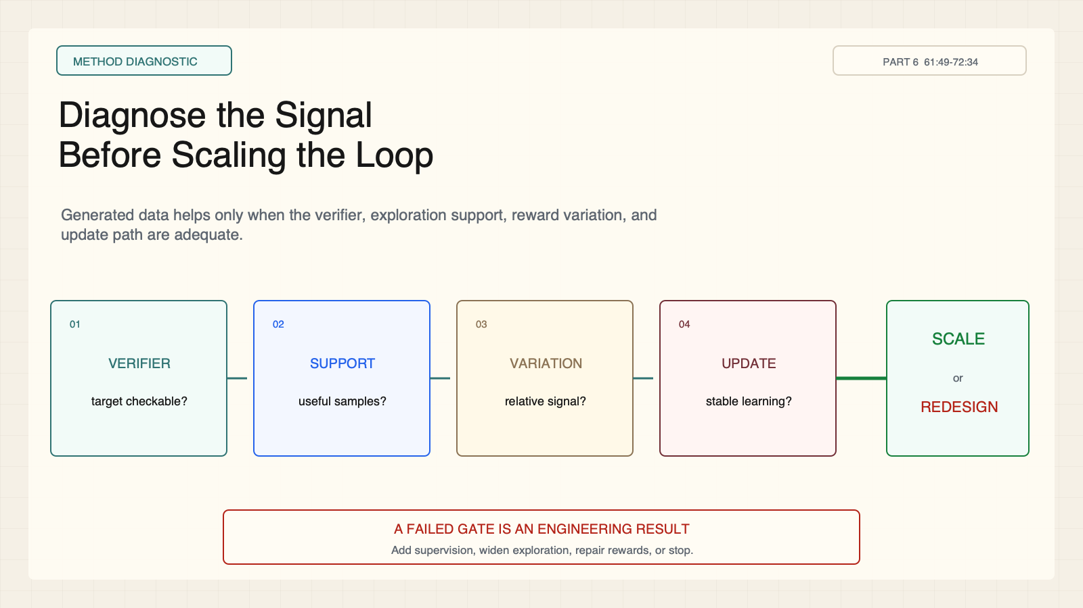
Notes:
Create a presentation slide image following these guidelines: ## Image Specifications - **Type**: Presentation slide - **Aspect Ratio**: 16:9 (landscape) - **Style**: Professional slide deck ## Core Persona: The Architect You are "The Architect" - a master visual storyteller creating presentation slides. Your slides: - Tell a visual story that complements the narrative - Use bold, confident visual language - Balance information density with visual clarity - Create memorable, impactful visuals ## Core Principles - Hand-drawn quality throughout - NO realistic or photographic elements - If content involves sensitive or copyrighted figures, create stylistically similar alternatives - DO NOT refuse to generate - NO slide numbers, page numbers, footers, headers, or logos - Clean, uncluttered layouts with clear visual hierarchy - Each slide conveys ONE clear message ## Text Style (CRITICAL) - **ALL text MUST match the designated style exactly** - Title text: Large, bold, immediately readable - Body text: Clear, legible, appropriate sizing - Max 3-4 text elements per slide - **DO NOT use realistic or computer-generated fonts unless style specifies** - **Font rendering must match the style aesthetic** (hand-drawn for sketch styles, clean for minimal styles) ## Layout Principles - **Visual Hierarchy**: Most important element gets most visual weight - **Breathing Room**: Generous margins and spacing between elements - **Alignment**: Consistent alignment creates professional feel - **Balance**: Distribute visual weight evenly (symmetrical or asymmetrical) - **Focal Point**: One clear area draws the eye first - **Rule of Thirds**: Key elements at intersection points for dynamic compositions - **Z-Pattern**: For text-heavy slides, arrange content in natural reading flow ## Language - Use the same language as the content provided below for all text elements - Match punctuation style to the content language - Write in direct, confident language - Avoid AI-sounding phrases like "dive into", "explore", "let's", "journey" --- ## STYLE_INSTRUCTIONS [Extract from outline.md - do NOT re-read style files] The STYLE_INSTRUCTIONS block from the outline contains: - Design Aesthetic - Background (Texture + Base Color) - Typography (Headlines + Body descriptions) - Color Palette (with hex codes) - Visual Elements - Density Guidelines - Style Rules (Do/Don't) Copy the entire `<STYLE_INSTRUCTIONS>...</STYLE_INSTRUCTIONS>` block from the outline here. --- ## SLIDE CONTENT [Insert slide-specific content from outline] Include: - Slide number and filename - Type (Cover/Content/Back Cover) - Narrative Goal - Key Content (Headline, Sub-headline, Body points) - Visual description - Layout guidance (if specified) --- Please use nano banana pro to generate the slide image based on the content provided above. --- # Slide 12: Diagnose the Signal Before Scaling the Loop ## Production method Rendered locally as an original 1600x900 SVG for exact text fidelity, then converted to PNG. Do not reproduce Stanford course frames, logos, or diagrams. ## Style Aged-cream academic technical briefing, faint engineering grid, crisp vector diagrams, near-black type, cobalt generation, teal verification, warm-brown training, maroon constraints, 8px card corners, no gradients, no decorative imagery. ## On-slide content - Stage: method diagnostic - Headline: Diagnose the Signal Before Scaling the Loop - Subtitle: Generated data helps only when the verifier, exploration support, reward variation, and update path are adequate. - Supporting labels: verifier; support; variation; update - Lecture evidence: CS329A Part 6, 61:49-72:34 - Primary-paper basis: STaR + DeepSeekMath + DAPO teaching synthesis ## Visual direction A four-gate diagnostic routes a proposed loop to scale, redesign, add supervision, or stop. ## Teaching objective Apply a four-gate diagnostic to a proposed self-improvement loop. ## Speaker notes Lecture 61:49-72:34; teaching synthesis grounded in STaR, DeepSeekMath, and DAPO. Ask four questions: Is the target verifiable? Can the current policy discover useful candidates? Do samples produce informative reward variation? Can the update improve behavior without destabilizing training? Stop or redesign when a gate fails.

