Slide 1
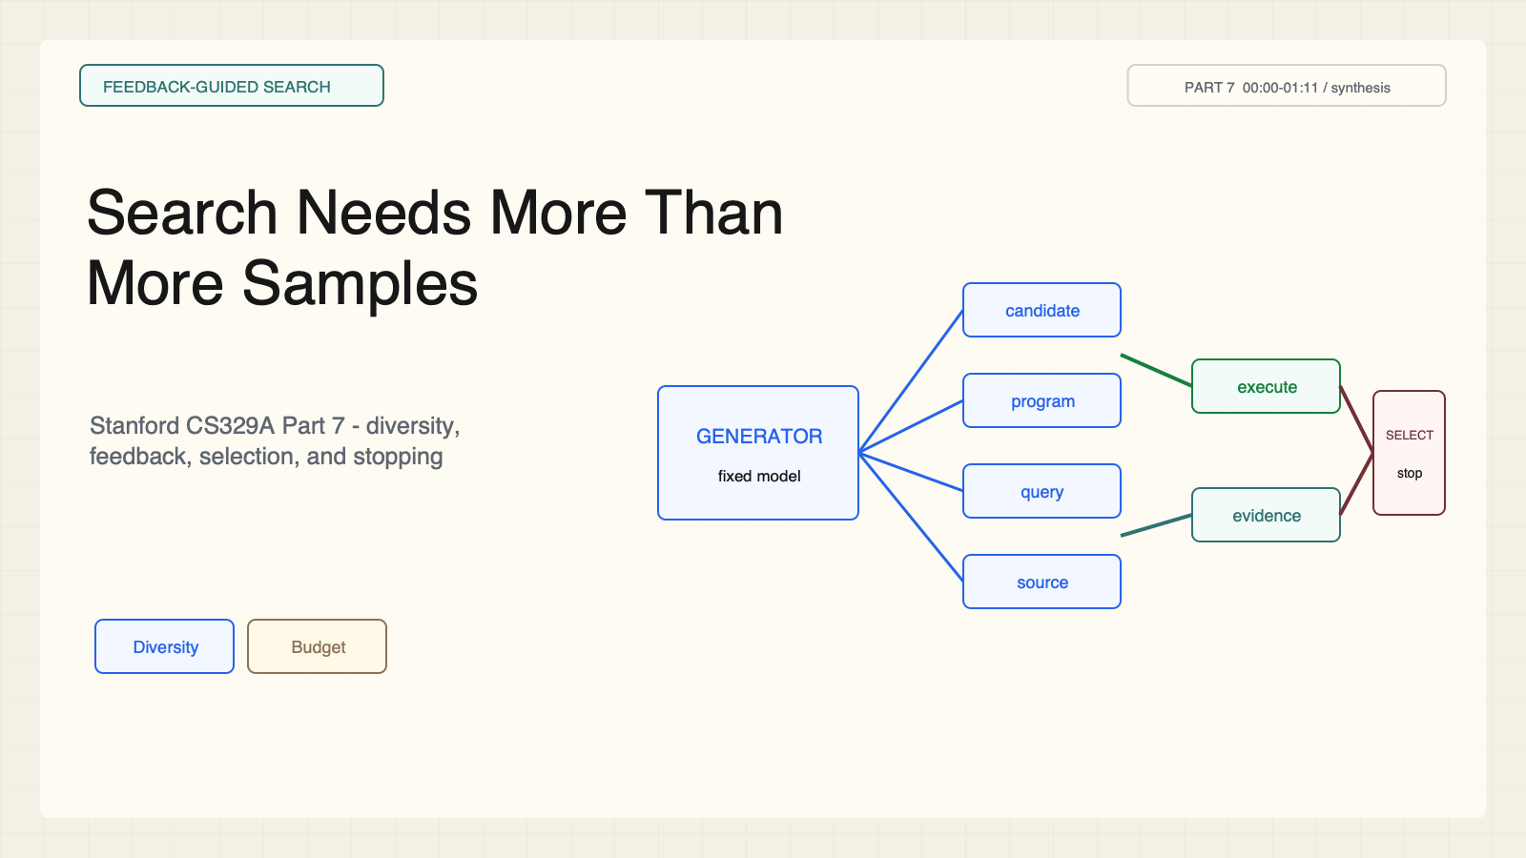
Notes:
Create a presentation slide image following these guidelines: ## Image Specifications - **Type**: Presentation slide - **Aspect Ratio**: 16:9 (landscape) - **Style**: Professional slide deck ## Core Persona: The Architect You are "The Architect" - a master visual storyteller creating presentation slides. Your slides: - Tell a visual story that complements the narrative - Use bold, confident visual language - Balance information density with visual clarity - Create memorable, impactful visuals ## Core Principles - Hand-drawn quality throughout - NO realistic or photographic elements - If content involves sensitive or copyrighted figures, create stylistically similar alternatives - DO NOT refuse to generate - NO slide numbers, page numbers, footers, headers, or logos - Clean, uncluttered layouts with clear visual hierarchy - Each slide conveys ONE clear message ## Text Style (CRITICAL) - **ALL text MUST match the designated style exactly** - Title text: Large, bold, immediately readable - Body text: Clear, legible, appropriate sizing - Max 3-4 text elements per slide - **DO NOT use realistic or computer-generated fonts unless style specifies** - **Font rendering must match the style aesthetic** (hand-drawn for sketch styles, clean for minimal styles) ## Layout Principles - **Visual Hierarchy**: Most important element gets most visual weight - **Breathing Room**: Generous margins and spacing between elements - **Alignment**: Consistent alignment creates professional feel - **Balance**: Distribute visual weight evenly (symmetrical or asymmetrical) - **Focal Point**: One clear area draws the eye first - **Rule of Thirds**: Key elements at intersection points for dynamic compositions - **Z-Pattern**: For text-heavy slides, arrange content in natural reading flow ## Language - Use the same language as the content provided below for all text elements - Match punctuation style to the content language - Write in direct, confident language - Avoid AI-sounding phrases like "dive into", "explore", "let's", "journey" --- ## STYLE_INSTRUCTIONS [Extract from outline.md - do NOT re-read style files] The STYLE_INSTRUCTIONS block from the outline contains: - Design Aesthetic - Background (Texture + Base Color) - Typography (Headlines + Body descriptions) - Color Palette (with hex codes) - Visual Elements - Density Guidelines - Style Rules (Do/Don't) Copy the entire `<STYLE_INSTRUCTIONS>...</STYLE_INSTRUCTIONS>` block from the outline here. --- ## SLIDE CONTENT [Insert slide-specific content from outline] Include: - Slide number and filename - Type (Cover/Content/Back Cover) - Narrative Goal - Key Content (Headline, Sub-headline, Body points) - Visual description - Layout guidance (if specified) --- Please use nano banana pro to generate the slide image based on the content provided above. --- # Slide 1: Search Needs More Than More Samples ## Production method Rendered locally as an original 1600x900 SVG for exact text fidelity, then converted to PNG. Do not reproduce Stanford frames, figures, or logos. ## Style Aged-cream academic technical briefing, faint engineering grid, crisp vector diagrams, near-black type, cobalt generation, teal verification, warm-brown budget, maroon constraints, 8px card corners, no gradients. ## On-slide content - Stage: feedback-guided search - Headline: Search Needs More Than More Samples - Subtitle: Stanford CS329A Part 7 - diversity, feedback, selection, and stopping - Supporting labels: Diversity; Feedback; Selection; Stop - Evidence: CS329A Part 7, 00:00-01:11 / synthesis ## Visual direction Candidate branches pass through distinct execution and evidence feedback paths into a bounded selector. ## Teaching objective Frame search as a controlled system rather than raw sampling. ## Speaker notes More candidates create opportunities, not a correctness guarantee. Code execution and document evidence are different feedback channels. Ask learners to identify the budget and stop condition.

Slide 2
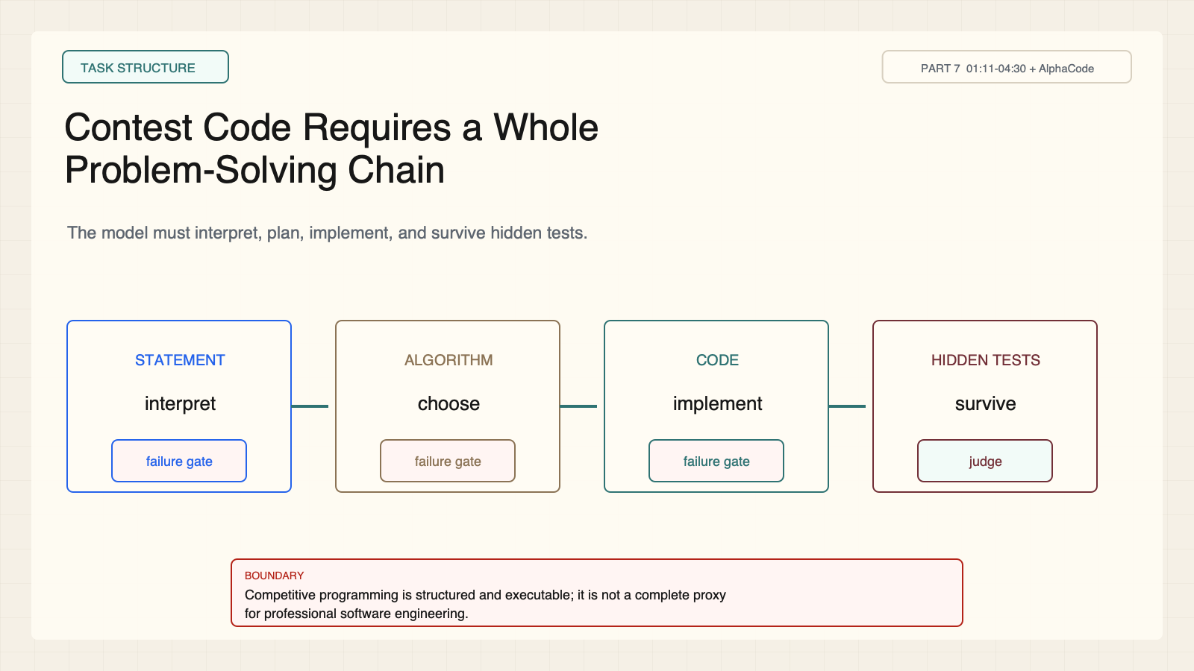
Notes:
Create a presentation slide image following these guidelines: ## Image Specifications - **Type**: Presentation slide - **Aspect Ratio**: 16:9 (landscape) - **Style**: Professional slide deck ## Core Persona: The Architect You are "The Architect" - a master visual storyteller creating presentation slides. Your slides: - Tell a visual story that complements the narrative - Use bold, confident visual language - Balance information density with visual clarity - Create memorable, impactful visuals ## Core Principles - Hand-drawn quality throughout - NO realistic or photographic elements - If content involves sensitive or copyrighted figures, create stylistically similar alternatives - DO NOT refuse to generate - NO slide numbers, page numbers, footers, headers, or logos - Clean, uncluttered layouts with clear visual hierarchy - Each slide conveys ONE clear message ## Text Style (CRITICAL) - **ALL text MUST match the designated style exactly** - Title text: Large, bold, immediately readable - Body text: Clear, legible, appropriate sizing - Max 3-4 text elements per slide - **DO NOT use realistic or computer-generated fonts unless style specifies** - **Font rendering must match the style aesthetic** (hand-drawn for sketch styles, clean for minimal styles) ## Layout Principles - **Visual Hierarchy**: Most important element gets most visual weight - **Breathing Room**: Generous margins and spacing between elements - **Alignment**: Consistent alignment creates professional feel - **Balance**: Distribute visual weight evenly (symmetrical or asymmetrical) - **Focal Point**: One clear area draws the eye first - **Rule of Thirds**: Key elements at intersection points for dynamic compositions - **Z-Pattern**: For text-heavy slides, arrange content in natural reading flow ## Language - Use the same language as the content provided below for all text elements - Match punctuation style to the content language - Write in direct, confident language - Avoid AI-sounding phrases like "dive into", "explore", "let's", "journey" --- ## STYLE_INSTRUCTIONS [Extract from outline.md - do NOT re-read style files] The STYLE_INSTRUCTIONS block from the outline contains: - Design Aesthetic - Background (Texture + Base Color) - Typography (Headlines + Body descriptions) - Color Palette (with hex codes) - Visual Elements - Density Guidelines - Style Rules (Do/Don't) Copy the entire `<STYLE_INSTRUCTIONS>...</STYLE_INSTRUCTIONS>` block from the outline here. --- ## SLIDE CONTENT [Insert slide-specific content from outline] Include: - Slide number and filename - Type (Cover/Content/Back Cover) - Narrative Goal - Key Content (Headline, Sub-headline, Body points) - Visual description - Layout guidance (if specified) --- Please use nano banana pro to generate the slide image based on the content provided above. --- # Slide 2: Contest Code Requires a Whole Problem-Solving Chain ## Production method Rendered locally as an original 1600x900 SVG for exact text fidelity, then converted to PNG. Do not reproduce Stanford frames, figures, or logos. ## Style Aged-cream academic technical briefing, faint engineering grid, crisp vector diagrams, near-black type, cobalt generation, teal verification, warm-brown budget, maroon constraints, 8px card corners, no gradients. ## On-slide content - Stage: task structure - Headline: Contest Code Requires a Whole Problem-Solving Chain - Subtitle: The model must interpret, plan, implement, and survive hidden tests. - Supporting labels: Statement; Algorithm; Code; Hidden tests - Evidence: CS329A Part 7, 01:11-04:30 + AlphaCode ## Visual direction Four-stage pipeline with an explicit failure gate after each stage. ## Teaching objective Contrast contest problem solving with short autocomplete. ## Speaker notes Competitive programming is structured and mechanically scored, but it still requires a longer chain than function completion. It is not the same as all professional software work.

Slide 3
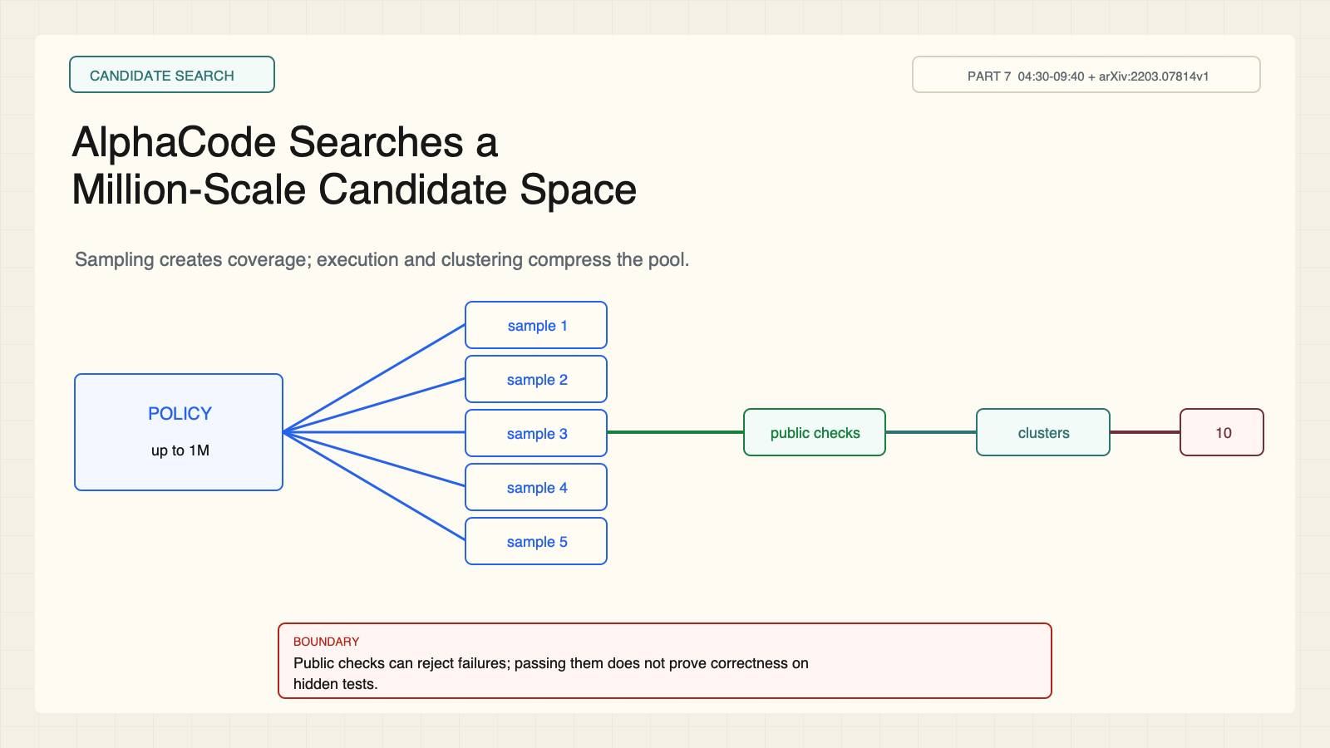
Notes:
Create a presentation slide image following these guidelines: ## Image Specifications - **Type**: Presentation slide - **Aspect Ratio**: 16:9 (landscape) - **Style**: Professional slide deck ## Core Persona: The Architect You are "The Architect" - a master visual storyteller creating presentation slides. Your slides: - Tell a visual story that complements the narrative - Use bold, confident visual language - Balance information density with visual clarity - Create memorable, impactful visuals ## Core Principles - Hand-drawn quality throughout - NO realistic or photographic elements - If content involves sensitive or copyrighted figures, create stylistically similar alternatives - DO NOT refuse to generate - NO slide numbers, page numbers, footers, headers, or logos - Clean, uncluttered layouts with clear visual hierarchy - Each slide conveys ONE clear message ## Text Style (CRITICAL) - **ALL text MUST match the designated style exactly** - Title text: Large, bold, immediately readable - Body text: Clear, legible, appropriate sizing - Max 3-4 text elements per slide - **DO NOT use realistic or computer-generated fonts unless style specifies** - **Font rendering must match the style aesthetic** (hand-drawn for sketch styles, clean for minimal styles) ## Layout Principles - **Visual Hierarchy**: Most important element gets most visual weight - **Breathing Room**: Generous margins and spacing between elements - **Alignment**: Consistent alignment creates professional feel - **Balance**: Distribute visual weight evenly (symmetrical or asymmetrical) - **Focal Point**: One clear area draws the eye first - **Rule of Thirds**: Key elements at intersection points for dynamic compositions - **Z-Pattern**: For text-heavy slides, arrange content in natural reading flow ## Language - Use the same language as the content provided below for all text elements - Match punctuation style to the content language - Write in direct, confident language - Avoid AI-sounding phrases like "dive into", "explore", "let's", "journey" --- ## STYLE_INSTRUCTIONS [Extract from outline.md - do NOT re-read style files] The STYLE_INSTRUCTIONS block from the outline contains: - Design Aesthetic - Background (Texture + Base Color) - Typography (Headlines + Body descriptions) - Color Palette (with hex codes) - Visual Elements - Density Guidelines - Style Rules (Do/Don't) Copy the entire `<STYLE_INSTRUCTIONS>...</STYLE_INSTRUCTIONS>` block from the outline here. --- ## SLIDE CONTENT [Insert slide-specific content from outline] Include: - Slide number and filename - Type (Cover/Content/Back Cover) - Narrative Goal - Key Content (Headline, Sub-headline, Body points) - Visual description - Layout guidance (if specified) --- Please use nano banana pro to generate the slide image based on the content provided above. --- # Slide 3: AlphaCode Searches a Million-Scale Candidate Space ## Production method Rendered locally as an original 1600x900 SVG for exact text fidelity, then converted to PNG. Do not reproduce Stanford frames, figures, or logos. ## Style Aged-cream academic technical briefing, faint engineering grid, crisp vector diagrams, near-black type, cobalt generation, teal verification, warm-brown budget, maroon constraints, 8px card corners, no gradients. ## On-slide content - Stage: candidate search - Headline: AlphaCode Searches a Million-Scale Candidate Space - Subtitle: Sampling creates coverage; execution and clustering compress the pool. - Supporting labels: Up to 1M; Public checks; Behavior clusters; 10 submissions - Evidence: CS329A Part 7, 04:30-09:40 + arXiv:2203.07814v1 ## Visual direction A large candidate fan narrows through execution filtering and behavioral clusters. ## Teaching objective Explain AlphaCode's generate-filter-cluster-select pipeline. ## Speaker notes The million-scale figure describes the reported system, not a recommended budget. Public examples reject some failures but cannot prove hidden-test correctness.

Slide 4
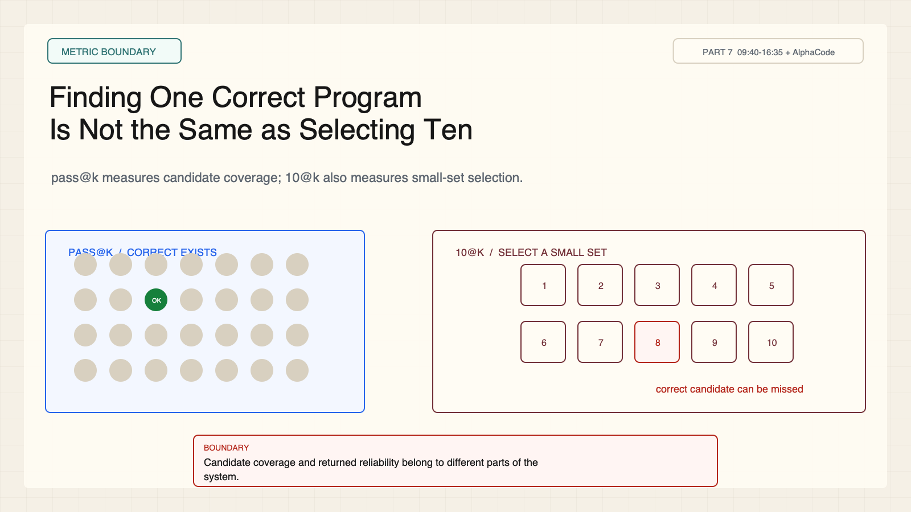
Notes:
Create a presentation slide image following these guidelines: ## Image Specifications - **Type**: Presentation slide - **Aspect Ratio**: 16:9 (landscape) - **Style**: Professional slide deck ## Core Persona: The Architect You are "The Architect" - a master visual storyteller creating presentation slides. Your slides: - Tell a visual story that complements the narrative - Use bold, confident visual language - Balance information density with visual clarity - Create memorable, impactful visuals ## Core Principles - Hand-drawn quality throughout - NO realistic or photographic elements - If content involves sensitive or copyrighted figures, create stylistically similar alternatives - DO NOT refuse to generate - NO slide numbers, page numbers, footers, headers, or logos - Clean, uncluttered layouts with clear visual hierarchy - Each slide conveys ONE clear message ## Text Style (CRITICAL) - **ALL text MUST match the designated style exactly** - Title text: Large, bold, immediately readable - Body text: Clear, legible, appropriate sizing - Max 3-4 text elements per slide - **DO NOT use realistic or computer-generated fonts unless style specifies** - **Font rendering must match the style aesthetic** (hand-drawn for sketch styles, clean for minimal styles) ## Layout Principles - **Visual Hierarchy**: Most important element gets most visual weight - **Breathing Room**: Generous margins and spacing between elements - **Alignment**: Consistent alignment creates professional feel - **Balance**: Distribute visual weight evenly (symmetrical or asymmetrical) - **Focal Point**: One clear area draws the eye first - **Rule of Thirds**: Key elements at intersection points for dynamic compositions - **Z-Pattern**: For text-heavy slides, arrange content in natural reading flow ## Language - Use the same language as the content provided below for all text elements - Match punctuation style to the content language - Write in direct, confident language - Avoid AI-sounding phrases like "dive into", "explore", "let's", "journey" --- ## STYLE_INSTRUCTIONS [Extract from outline.md - do NOT re-read style files] The STYLE_INSTRUCTIONS block from the outline contains: - Design Aesthetic - Background (Texture + Base Color) - Typography (Headlines + Body descriptions) - Color Palette (with hex codes) - Visual Elements - Density Guidelines - Style Rules (Do/Don't) Copy the entire `<STYLE_INSTRUCTIONS>...</STYLE_INSTRUCTIONS>` block from the outline here. --- ## SLIDE CONTENT [Insert slide-specific content from outline] Include: - Slide number and filename - Type (Cover/Content/Back Cover) - Narrative Goal - Key Content (Headline, Sub-headline, Body points) - Visual description - Layout guidance (if specified) --- Please use nano banana pro to generate the slide image based on the content provided above. --- # Slide 4: Finding One Correct Program Is Not the Same as Selecting Ten ## Production method Rendered locally as an original 1600x900 SVG for exact text fidelity, then converted to PNG. Do not reproduce Stanford frames, figures, or logos. ## Style Aged-cream academic technical briefing, faint engineering grid, crisp vector diagrams, near-black type, cobalt generation, teal verification, warm-brown budget, maroon constraints, 8px card corners, no gradients. ## On-slide content - Stage: metric boundary - Headline: Finding One Correct Program Is Not the Same as Selecting Ten - Subtitle: pass@k measures candidate coverage; 10@k also measures small-set selection. - Supporting labels: Correct exists; Pool size k; Select 10; Submit - Evidence: CS329A Part 7, 09:40-16:35 + AlphaCode ## Visual direction A candidate pool with one correct program beside a ten-slot selected tray that can miss it. ## Teaching objective Separate coverage from useful selection. ## Speaker notes A correct candidate can exist and never reach the submission tray. Formal metric definitions belong to the paper; the visual teaches the systems distinction.

Slide 5
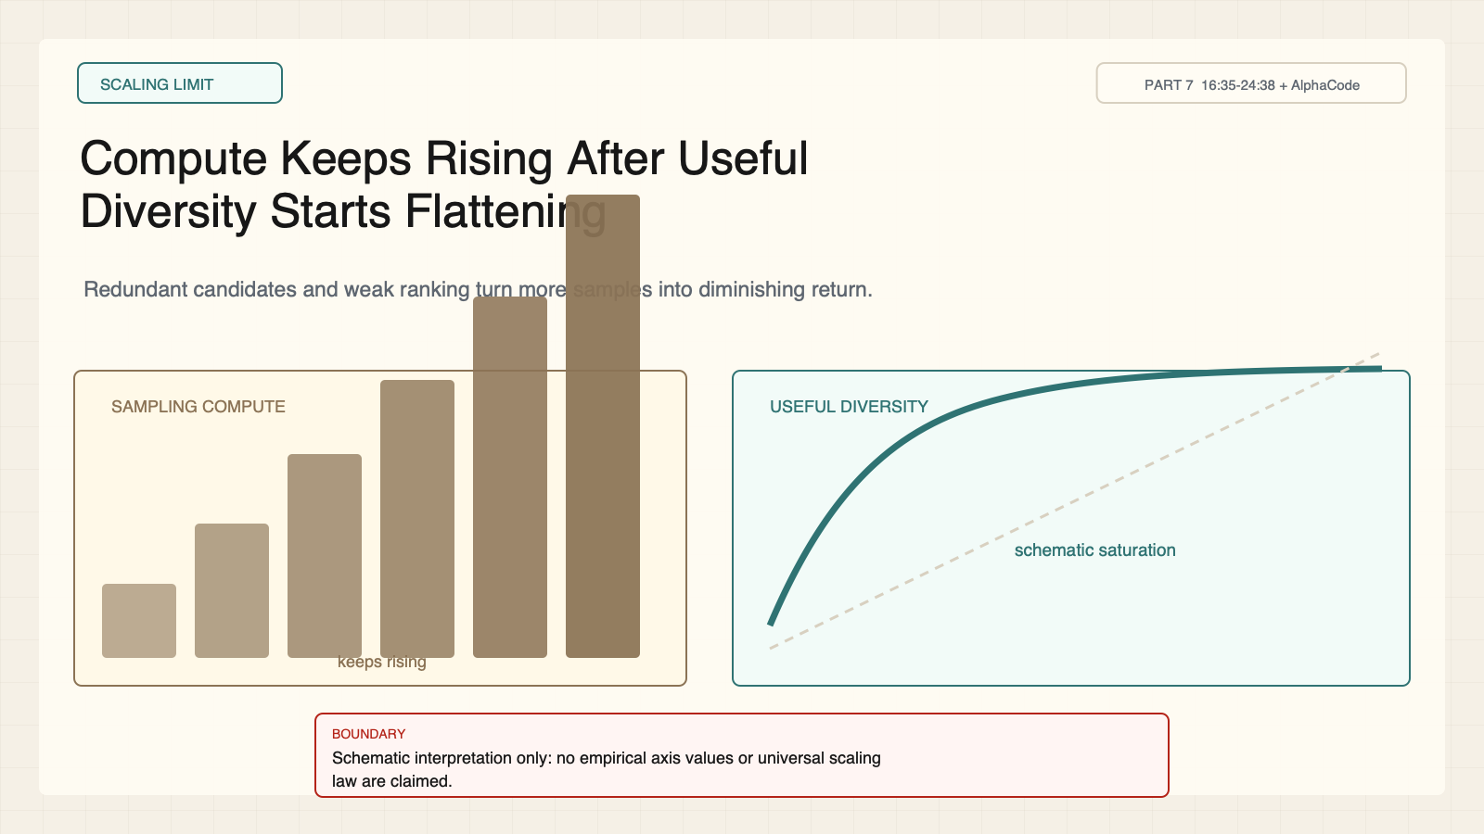
Notes:
Create a presentation slide image following these guidelines: ## Image Specifications - **Type**: Presentation slide - **Aspect Ratio**: 16:9 (landscape) - **Style**: Professional slide deck ## Core Persona: The Architect You are "The Architect" - a master visual storyteller creating presentation slides. Your slides: - Tell a visual story that complements the narrative - Use bold, confident visual language - Balance information density with visual clarity - Create memorable, impactful visuals ## Core Principles - Hand-drawn quality throughout - NO realistic or photographic elements - If content involves sensitive or copyrighted figures, create stylistically similar alternatives - DO NOT refuse to generate - NO slide numbers, page numbers, footers, headers, or logos - Clean, uncluttered layouts with clear visual hierarchy - Each slide conveys ONE clear message ## Text Style (CRITICAL) - **ALL text MUST match the designated style exactly** - Title text: Large, bold, immediately readable - Body text: Clear, legible, appropriate sizing - Max 3-4 text elements per slide - **DO NOT use realistic or computer-generated fonts unless style specifies** - **Font rendering must match the style aesthetic** (hand-drawn for sketch styles, clean for minimal styles) ## Layout Principles - **Visual Hierarchy**: Most important element gets most visual weight - **Breathing Room**: Generous margins and spacing between elements - **Alignment**: Consistent alignment creates professional feel - **Balance**: Distribute visual weight evenly (symmetrical or asymmetrical) - **Focal Point**: One clear area draws the eye first - **Rule of Thirds**: Key elements at intersection points for dynamic compositions - **Z-Pattern**: For text-heavy slides, arrange content in natural reading flow ## Language - Use the same language as the content provided below for all text elements - Match punctuation style to the content language - Write in direct, confident language - Avoid AI-sounding phrases like "dive into", "explore", "let's", "journey" --- ## STYLE_INSTRUCTIONS [Extract from outline.md - do NOT re-read style files] The STYLE_INSTRUCTIONS block from the outline contains: - Design Aesthetic - Background (Texture + Base Color) - Typography (Headlines + Body descriptions) - Color Palette (with hex codes) - Visual Elements - Density Guidelines - Style Rules (Do/Don't) Copy the entire `<STYLE_INSTRUCTIONS>...</STYLE_INSTRUCTIONS>` block from the outline here. --- ## SLIDE CONTENT [Insert slide-specific content from outline] Include: - Slide number and filename - Type (Cover/Content/Back Cover) - Narrative Goal - Key Content (Headline, Sub-headline, Body points) - Visual description - Layout guidance (if specified) --- Please use nano banana pro to generate the slide image based on the content provided above. --- # Slide 5: Compute Keeps Rising After Useful Diversity Starts Flattening ## Production method Rendered locally as an original 1600x900 SVG for exact text fidelity, then converted to PNG. Do not reproduce Stanford frames, figures, or logos. ## Style Aged-cream academic technical briefing, faint engineering grid, crisp vector diagrams, near-black type, cobalt generation, teal verification, warm-brown budget, maroon constraints, 8px card corners, no gradients. ## On-slide content - Stage: scaling limit - Headline: Compute Keeps Rising After Useful Diversity Starts Flattening - Subtitle: Redundant candidates and weak ranking turn more samples into diminishing return. - Supporting labels: Compute; Useful diversity; Redundancy; Selector load - Evidence: CS329A Part 7, 16:35-24:38 + AlphaCode ## Visual direction Rising compute bars next to a saturating diversity curve and growing selector queue. ## Teaching objective Show why sample count is not equivalent to independent opportunity. ## Speaker notes This is a sourced interpretation of the lecture and AlphaCode ablations, not a universal law. The curve is schematic and intentionally has no empirical axis values.

Slide 6
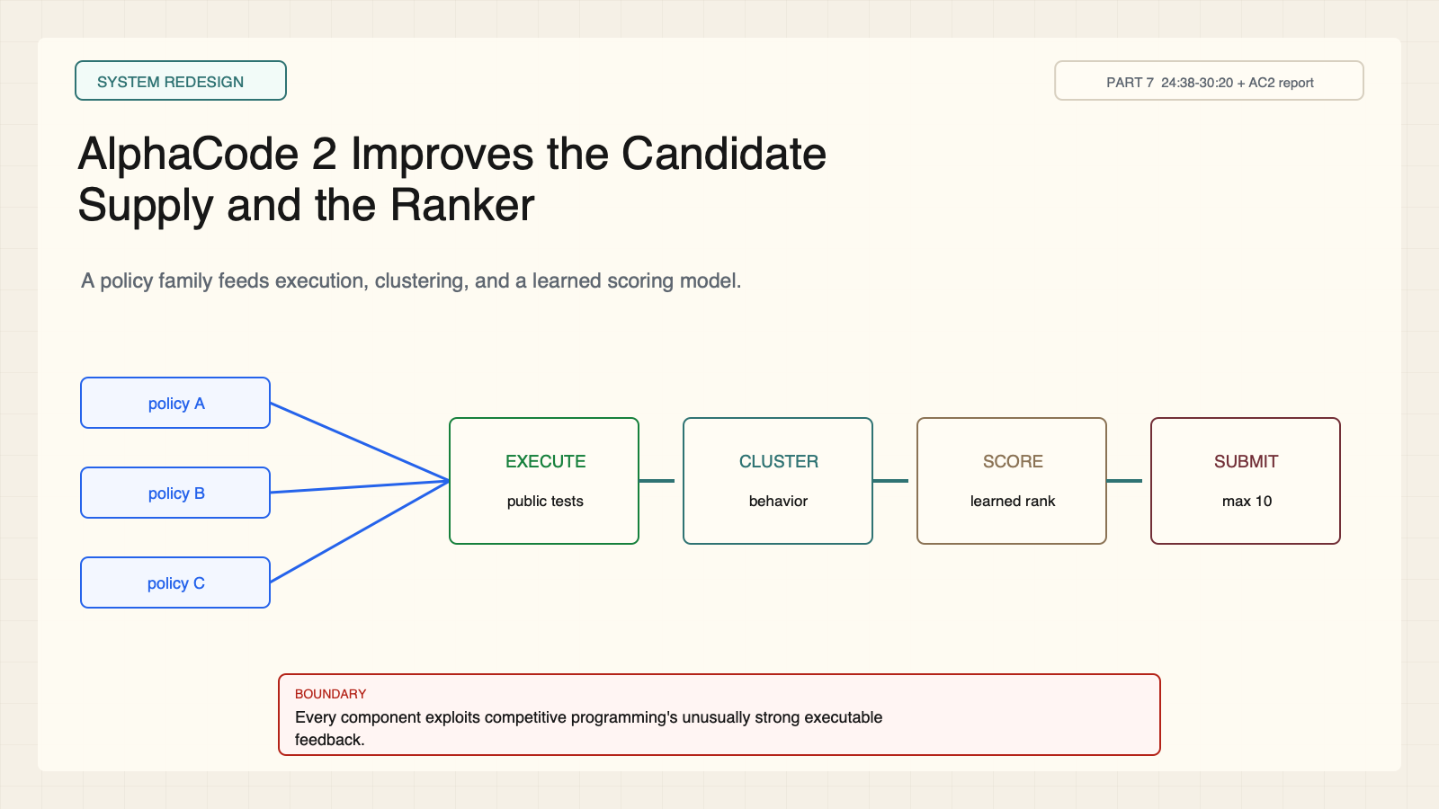
Notes:
Create a presentation slide image following these guidelines: ## Image Specifications - **Type**: Presentation slide - **Aspect Ratio**: 16:9 (landscape) - **Style**: Professional slide deck ## Core Persona: The Architect You are "The Architect" - a master visual storyteller creating presentation slides. Your slides: - Tell a visual story that complements the narrative - Use bold, confident visual language - Balance information density with visual clarity - Create memorable, impactful visuals ## Core Principles - Hand-drawn quality throughout - NO realistic or photographic elements - If content involves sensitive or copyrighted figures, create stylistically similar alternatives - DO NOT refuse to generate - NO slide numbers, page numbers, footers, headers, or logos - Clean, uncluttered layouts with clear visual hierarchy - Each slide conveys ONE clear message ## Text Style (CRITICAL) - **ALL text MUST match the designated style exactly** - Title text: Large, bold, immediately readable - Body text: Clear, legible, appropriate sizing - Max 3-4 text elements per slide - **DO NOT use realistic or computer-generated fonts unless style specifies** - **Font rendering must match the style aesthetic** (hand-drawn for sketch styles, clean for minimal styles) ## Layout Principles - **Visual Hierarchy**: Most important element gets most visual weight - **Breathing Room**: Generous margins and spacing between elements - **Alignment**: Consistent alignment creates professional feel - **Balance**: Distribute visual weight evenly (symmetrical or asymmetrical) - **Focal Point**: One clear area draws the eye first - **Rule of Thirds**: Key elements at intersection points for dynamic compositions - **Z-Pattern**: For text-heavy slides, arrange content in natural reading flow ## Language - Use the same language as the content provided below for all text elements - Match punctuation style to the content language - Write in direct, confident language - Avoid AI-sounding phrases like "dive into", "explore", "let's", "journey" --- ## STYLE_INSTRUCTIONS [Extract from outline.md - do NOT re-read style files] The STYLE_INSTRUCTIONS block from the outline contains: - Design Aesthetic - Background (Texture + Base Color) - Typography (Headlines + Body descriptions) - Color Palette (with hex codes) - Visual Elements - Density Guidelines - Style Rules (Do/Don't) Copy the entire `<STYLE_INSTRUCTIONS>...</STYLE_INSTRUCTIONS>` block from the outline here. --- ## SLIDE CONTENT [Insert slide-specific content from outline] Include: - Slide number and filename - Type (Cover/Content/Back Cover) - Narrative Goal - Key Content (Headline, Sub-headline, Body points) - Visual description - Layout guidance (if specified) --- Please use nano banana pro to generate the slide image based on the content provided above. --- # Slide 6: AlphaCode 2 Improves the Candidate Supply and the Ranker ## Production method Rendered locally as an original 1600x900 SVG for exact text fidelity, then converted to PNG. Do not reproduce Stanford frames, figures, or logos. ## Style Aged-cream academic technical briefing, faint engineering grid, crisp vector diagrams, near-black type, cobalt generation, teal verification, warm-brown budget, maroon constraints, 8px card corners, no gradients. ## On-slide content - Stage: system redesign - Headline: AlphaCode 2 Improves the Candidate Supply and the Ranker - Subtitle: A policy family feeds execution, clustering, and a learned scoring model. - Supporting labels: Policy A; Policy B; Policy C; Scorer - Evidence: CS329A Part 7, 24:38-30:20 + AC2 report ## Visual direction Three policy streams converge through filter, cluster, and score stages. ## Teaching objective Show how generator diversity and ranking are co-designed. ## Speaker notes The family of fine-tuned policies targets diversity. Filtering, clustering, and scoring are competitive-programming-specific components.

Slide 7
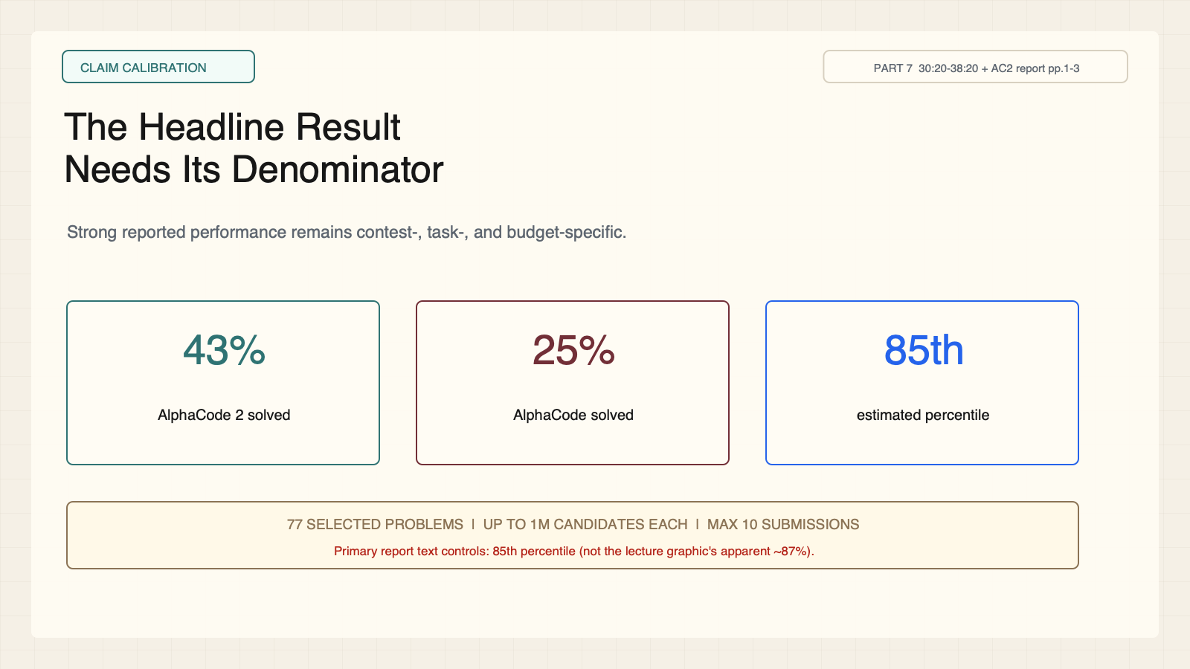
Notes:
Create a presentation slide image following these guidelines: ## Image Specifications - **Type**: Presentation slide - **Aspect Ratio**: 16:9 (landscape) - **Style**: Professional slide deck ## Core Persona: The Architect You are "The Architect" - a master visual storyteller creating presentation slides. Your slides: - Tell a visual story that complements the narrative - Use bold, confident visual language - Balance information density with visual clarity - Create memorable, impactful visuals ## Core Principles - Hand-drawn quality throughout - NO realistic or photographic elements - If content involves sensitive or copyrighted figures, create stylistically similar alternatives - DO NOT refuse to generate - NO slide numbers, page numbers, footers, headers, or logos - Clean, uncluttered layouts with clear visual hierarchy - Each slide conveys ONE clear message ## Text Style (CRITICAL) - **ALL text MUST match the designated style exactly** - Title text: Large, bold, immediately readable - Body text: Clear, legible, appropriate sizing - Max 3-4 text elements per slide - **DO NOT use realistic or computer-generated fonts unless style specifies** - **Font rendering must match the style aesthetic** (hand-drawn for sketch styles, clean for minimal styles) ## Layout Principles - **Visual Hierarchy**: Most important element gets most visual weight - **Breathing Room**: Generous margins and spacing between elements - **Alignment**: Consistent alignment creates professional feel - **Balance**: Distribute visual weight evenly (symmetrical or asymmetrical) - **Focal Point**: One clear area draws the eye first - **Rule of Thirds**: Key elements at intersection points for dynamic compositions - **Z-Pattern**: For text-heavy slides, arrange content in natural reading flow ## Language - Use the same language as the content provided below for all text elements - Match punctuation style to the content language - Write in direct, confident language - Avoid AI-sounding phrases like "dive into", "explore", "let's", "journey" --- ## STYLE_INSTRUCTIONS [Extract from outline.md - do NOT re-read style files] The STYLE_INSTRUCTIONS block from the outline contains: - Design Aesthetic - Background (Texture + Base Color) - Typography (Headlines + Body descriptions) - Color Palette (with hex codes) - Visual Elements - Density Guidelines - Style Rules (Do/Don't) Copy the entire `<STYLE_INSTRUCTIONS>...</STYLE_INSTRUCTIONS>` block from the outline here. --- ## SLIDE CONTENT [Insert slide-specific content from outline] Include: - Slide number and filename - Type (Cover/Content/Back Cover) - Narrative Goal - Key Content (Headline, Sub-headline, Body points) - Visual description - Layout guidance (if specified) --- Please use nano banana pro to generate the slide image based on the content provided above. --- # Slide 7: The Headline Result Needs Its Denominator ## Production method Rendered locally as an original 1600x900 SVG for exact text fidelity, then converted to PNG. Do not reproduce Stanford frames, figures, or logos. ## Style Aged-cream academic technical briefing, faint engineering grid, crisp vector diagrams, near-black type, cobalt generation, teal verification, warm-brown budget, maroon constraints, 8px card corners, no gradients. ## On-slide content - Stage: claim calibration - Headline: The Headline Result Needs Its Denominator - Subtitle: Strong reported performance remains contest-, task-, and budget-specific. - Supporting labels: 43% solved; 25% prior; 85th percentile; 77 problems - Evidence: CS329A Part 7, 30:20-38:20 + AC2 report pp.1-3 ## Visual direction Three metric cards anchored to a denominator strip with tasks, submissions, and candidate budget. ## Teaching objective Attach AlphaCode 2's result to its evaluation frame. ## Speaker notes The technical report text states 85th percentile; a lecture visual appears near 87. Use the primary report. Up to one million candidates were sampled per problem.

Slide 8
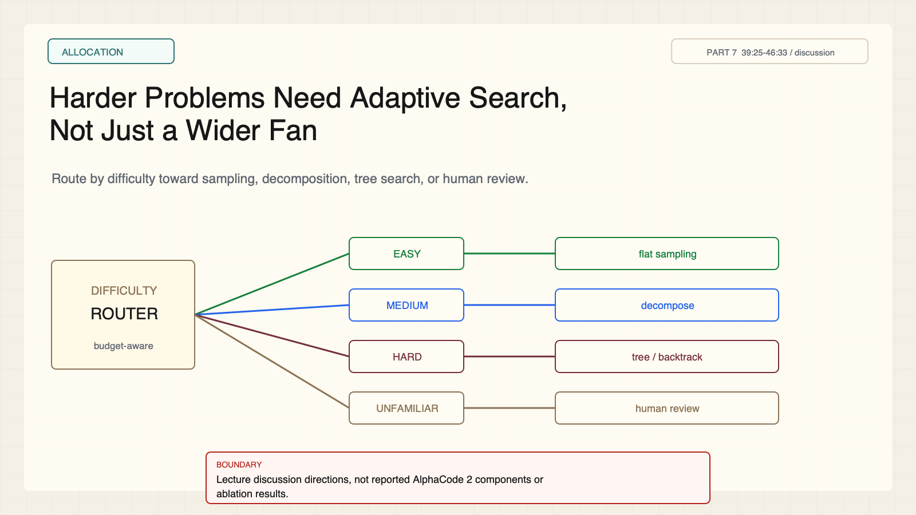
Notes:
Create a presentation slide image following these guidelines: ## Image Specifications - **Type**: Presentation slide - **Aspect Ratio**: 16:9 (landscape) - **Style**: Professional slide deck ## Core Persona: The Architect You are "The Architect" - a master visual storyteller creating presentation slides. Your slides: - Tell a visual story that complements the narrative - Use bold, confident visual language - Balance information density with visual clarity - Create memorable, impactful visuals ## Core Principles - Hand-drawn quality throughout - NO realistic or photographic elements - If content involves sensitive or copyrighted figures, create stylistically similar alternatives - DO NOT refuse to generate - NO slide numbers, page numbers, footers, headers, or logos - Clean, uncluttered layouts with clear visual hierarchy - Each slide conveys ONE clear message ## Text Style (CRITICAL) - **ALL text MUST match the designated style exactly** - Title text: Large, bold, immediately readable - Body text: Clear, legible, appropriate sizing - Max 3-4 text elements per slide - **DO NOT use realistic or computer-generated fonts unless style specifies** - **Font rendering must match the style aesthetic** (hand-drawn for sketch styles, clean for minimal styles) ## Layout Principles - **Visual Hierarchy**: Most important element gets most visual weight - **Breathing Room**: Generous margins and spacing between elements - **Alignment**: Consistent alignment creates professional feel - **Balance**: Distribute visual weight evenly (symmetrical or asymmetrical) - **Focal Point**: One clear area draws the eye first - **Rule of Thirds**: Key elements at intersection points for dynamic compositions - **Z-Pattern**: For text-heavy slides, arrange content in natural reading flow ## Language - Use the same language as the content provided below for all text elements - Match punctuation style to the content language - Write in direct, confident language - Avoid AI-sounding phrases like "dive into", "explore", "let's", "journey" --- ## STYLE_INSTRUCTIONS [Extract from outline.md - do NOT re-read style files] The STYLE_INSTRUCTIONS block from the outline contains: - Design Aesthetic - Background (Texture + Base Color) - Typography (Headlines + Body descriptions) - Color Palette (with hex codes) - Visual Elements - Density Guidelines - Style Rules (Do/Don't) Copy the entire `<STYLE_INSTRUCTIONS>...</STYLE_INSTRUCTIONS>` block from the outline here. --- ## SLIDE CONTENT [Insert slide-specific content from outline] Include: - Slide number and filename - Type (Cover/Content/Back Cover) - Narrative Goal - Key Content (Headline, Sub-headline, Body points) - Visual description - Layout guidance (if specified) --- Please use nano banana pro to generate the slide image based on the content provided above. --- # Slide 8: Harder Problems Need Adaptive Search, Not Just a Wider Fan ## Production method Rendered locally as an original 1600x900 SVG for exact text fidelity, then converted to PNG. Do not reproduce Stanford frames, figures, or logos. ## Style Aged-cream academic technical briefing, faint engineering grid, crisp vector diagrams, near-black type, cobalt generation, teal verification, warm-brown budget, maroon constraints, 8px card corners, no gradients. ## On-slide content - Stage: allocation - Headline: Harder Problems Need Adaptive Search, Not Just a Wider Fan - Subtitle: Route by difficulty toward sampling, decomposition, tree search, or human review. - Supporting labels: Easy; Medium; Hard; Unfamiliar - Evidence: CS329A Part 7, 39:25-46:33 / discussion ## Visual direction Difficulty bands route into four distinct search strategies. ## Teaching objective Generalize beyond flat sampling while preserving evidence labels. ## Speaker notes These are lecture discussion directions, not AlphaCode 2 evaluated components. The router is a teaching design.

Slide 9
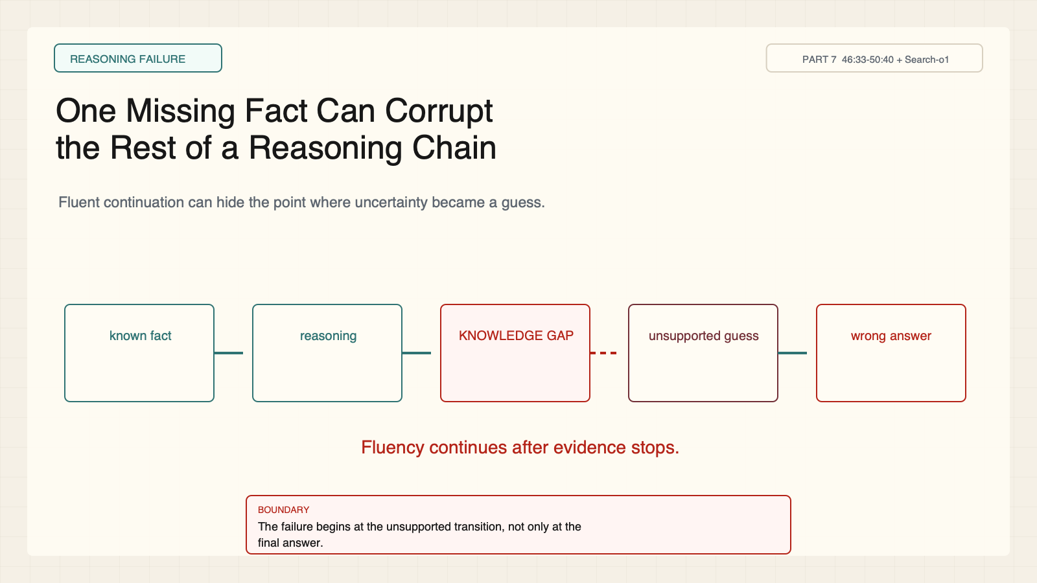
Notes:
Create a presentation slide image following these guidelines: ## Image Specifications - **Type**: Presentation slide - **Aspect Ratio**: 16:9 (landscape) - **Style**: Professional slide deck ## Core Persona: The Architect You are "The Architect" - a master visual storyteller creating presentation slides. Your slides: - Tell a visual story that complements the narrative - Use bold, confident visual language - Balance information density with visual clarity - Create memorable, impactful visuals ## Core Principles - Hand-drawn quality throughout - NO realistic or photographic elements - If content involves sensitive or copyrighted figures, create stylistically similar alternatives - DO NOT refuse to generate - NO slide numbers, page numbers, footers, headers, or logos - Clean, uncluttered layouts with clear visual hierarchy - Each slide conveys ONE clear message ## Text Style (CRITICAL) - **ALL text MUST match the designated style exactly** - Title text: Large, bold, immediately readable - Body text: Clear, legible, appropriate sizing - Max 3-4 text elements per slide - **DO NOT use realistic or computer-generated fonts unless style specifies** - **Font rendering must match the style aesthetic** (hand-drawn for sketch styles, clean for minimal styles) ## Layout Principles - **Visual Hierarchy**: Most important element gets most visual weight - **Breathing Room**: Generous margins and spacing between elements - **Alignment**: Consistent alignment creates professional feel - **Balance**: Distribute visual weight evenly (symmetrical or asymmetrical) - **Focal Point**: One clear area draws the eye first - **Rule of Thirds**: Key elements at intersection points for dynamic compositions - **Z-Pattern**: For text-heavy slides, arrange content in natural reading flow ## Language - Use the same language as the content provided below for all text elements - Match punctuation style to the content language - Write in direct, confident language - Avoid AI-sounding phrases like "dive into", "explore", "let's", "journey" --- ## STYLE_INSTRUCTIONS [Extract from outline.md - do NOT re-read style files] The STYLE_INSTRUCTIONS block from the outline contains: - Design Aesthetic - Background (Texture + Base Color) - Typography (Headlines + Body descriptions) - Color Palette (with hex codes) - Visual Elements - Density Guidelines - Style Rules (Do/Don't) Copy the entire `<STYLE_INSTRUCTIONS>...</STYLE_INSTRUCTIONS>` block from the outline here. --- ## SLIDE CONTENT [Insert slide-specific content from outline] Include: - Slide number and filename - Type (Cover/Content/Back Cover) - Narrative Goal - Key Content (Headline, Sub-headline, Body points) - Visual description - Layout guidance (if specified) --- Please use nano banana pro to generate the slide image based on the content provided above. --- # Slide 9: One Missing Fact Can Corrupt the Rest of a Reasoning Chain ## Production method Rendered locally as an original 1600x900 SVG for exact text fidelity, then converted to PNG. Do not reproduce Stanford frames, figures, or logos. ## Style Aged-cream academic technical briefing, faint engineering grid, crisp vector diagrams, near-black type, cobalt generation, teal verification, warm-brown budget, maroon constraints, 8px card corners, no gradients. ## On-slide content - Stage: reasoning failure - Headline: One Missing Fact Can Corrupt the Rest of a Reasoning Chain - Subtitle: Fluent continuation can hide the point where uncertainty became a guess. - Supporting labels: Known; Knowledge gap; Guess; Wrong answer - Evidence: CS329A Part 7, 46:33-50:40 + Search-o1 ## Visual direction A reasoning chain breaks at a red knowledge-gap node, then continues with inherited error. ## Teaching objective Locate the failure at the unsupported transition. ## Speaker notes The lecture uses a chemistry example. This original diagram abstracts the pattern and does not reproduce the course frame.

Slide 10
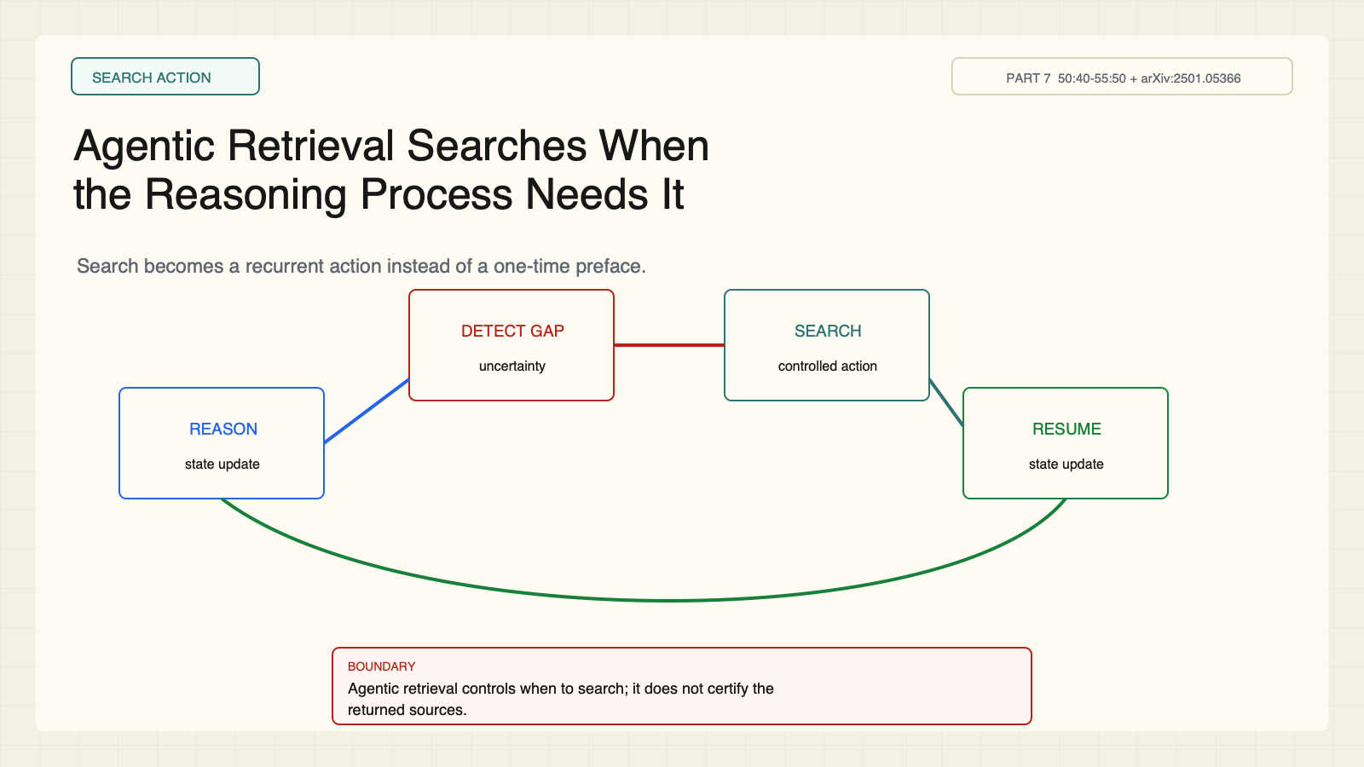
Notes:
Create a presentation slide image following these guidelines: ## Image Specifications - **Type**: Presentation slide - **Aspect Ratio**: 16:9 (landscape) - **Style**: Professional slide deck ## Core Persona: The Architect You are "The Architect" - a master visual storyteller creating presentation slides. Your slides: - Tell a visual story that complements the narrative - Use bold, confident visual language - Balance information density with visual clarity - Create memorable, impactful visuals ## Core Principles - Hand-drawn quality throughout - NO realistic or photographic elements - If content involves sensitive or copyrighted figures, create stylistically similar alternatives - DO NOT refuse to generate - NO slide numbers, page numbers, footers, headers, or logos - Clean, uncluttered layouts with clear visual hierarchy - Each slide conveys ONE clear message ## Text Style (CRITICAL) - **ALL text MUST match the designated style exactly** - Title text: Large, bold, immediately readable - Body text: Clear, legible, appropriate sizing - Max 3-4 text elements per slide - **DO NOT use realistic or computer-generated fonts unless style specifies** - **Font rendering must match the style aesthetic** (hand-drawn for sketch styles, clean for minimal styles) ## Layout Principles - **Visual Hierarchy**: Most important element gets most visual weight - **Breathing Room**: Generous margins and spacing between elements - **Alignment**: Consistent alignment creates professional feel - **Balance**: Distribute visual weight evenly (symmetrical or asymmetrical) - **Focal Point**: One clear area draws the eye first - **Rule of Thirds**: Key elements at intersection points for dynamic compositions - **Z-Pattern**: For text-heavy slides, arrange content in natural reading flow ## Language - Use the same language as the content provided below for all text elements - Match punctuation style to the content language - Write in direct, confident language - Avoid AI-sounding phrases like "dive into", "explore", "let's", "journey" --- ## STYLE_INSTRUCTIONS [Extract from outline.md - do NOT re-read style files] The STYLE_INSTRUCTIONS block from the outline contains: - Design Aesthetic - Background (Texture + Base Color) - Typography (Headlines + Body descriptions) - Color Palette (with hex codes) - Visual Elements - Density Guidelines - Style Rules (Do/Don't) Copy the entire `<STYLE_INSTRUCTIONS>...</STYLE_INSTRUCTIONS>` block from the outline here. --- ## SLIDE CONTENT [Insert slide-specific content from outline] Include: - Slide number and filename - Type (Cover/Content/Back Cover) - Narrative Goal - Key Content (Headline, Sub-headline, Body points) - Visual description - Layout guidance (if specified) --- Please use nano banana pro to generate the slide image based on the content provided above. --- # Slide 10: Agentic Retrieval Searches When the Reasoning Process Needs It ## Production method Rendered locally as an original 1600x900 SVG for exact text fidelity, then converted to PNG. Do not reproduce Stanford frames, figures, or logos. ## Style Aged-cream academic technical briefing, faint engineering grid, crisp vector diagrams, near-black type, cobalt generation, teal verification, warm-brown budget, maroon constraints, 8px card corners, no gradients. ## On-slide content - Stage: search action - Headline: Agentic Retrieval Searches When the Reasoning Process Needs It - Subtitle: Search becomes a recurrent action instead of a one-time preface. - Supporting labels: Reason; Detect gap; Search; Resume - Evidence: CS329A Part 7, 50:40-55:50 + arXiv:2501.05366 ## Visual direction A four-stage reasoning loop triggers search and returns evidence to the current state. ## Teaching objective Contrast static retrieval with recurrent retrieval control. ## Speaker notes Agentic here means the model can trigger a controlled search action. It does not imply unrestricted autonomy.

Slide 11
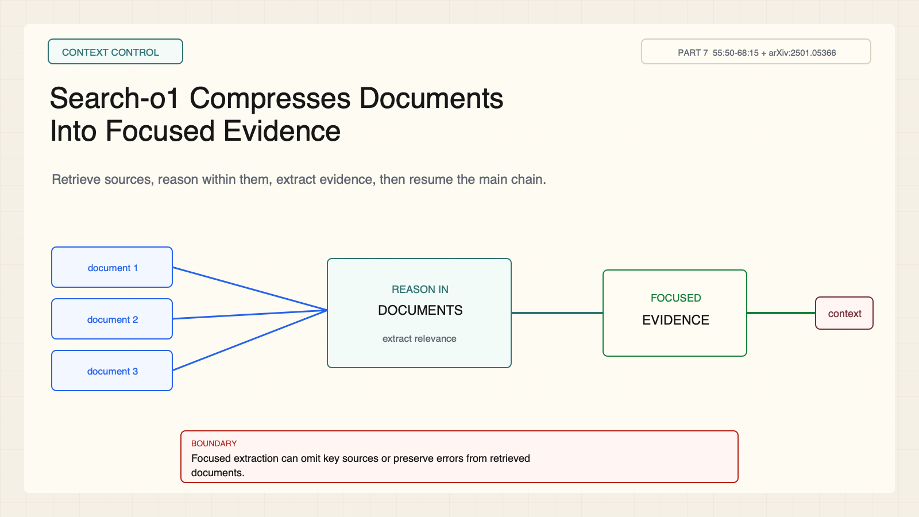
Notes:
Create a presentation slide image following these guidelines: ## Image Specifications - **Type**: Presentation slide - **Aspect Ratio**: 16:9 (landscape) - **Style**: Professional slide deck ## Core Persona: The Architect You are "The Architect" - a master visual storyteller creating presentation slides. Your slides: - Tell a visual story that complements the narrative - Use bold, confident visual language - Balance information density with visual clarity - Create memorable, impactful visuals ## Core Principles - Hand-drawn quality throughout - NO realistic or photographic elements - If content involves sensitive or copyrighted figures, create stylistically similar alternatives - DO NOT refuse to generate - NO slide numbers, page numbers, footers, headers, or logos - Clean, uncluttered layouts with clear visual hierarchy - Each slide conveys ONE clear message ## Text Style (CRITICAL) - **ALL text MUST match the designated style exactly** - Title text: Large, bold, immediately readable - Body text: Clear, legible, appropriate sizing - Max 3-4 text elements per slide - **DO NOT use realistic or computer-generated fonts unless style specifies** - **Font rendering must match the style aesthetic** (hand-drawn for sketch styles, clean for minimal styles) ## Layout Principles - **Visual Hierarchy**: Most important element gets most visual weight - **Breathing Room**: Generous margins and spacing between elements - **Alignment**: Consistent alignment creates professional feel - **Balance**: Distribute visual weight evenly (symmetrical or asymmetrical) - **Focal Point**: One clear area draws the eye first - **Rule of Thirds**: Key elements at intersection points for dynamic compositions - **Z-Pattern**: For text-heavy slides, arrange content in natural reading flow ## Language - Use the same language as the content provided below for all text elements - Match punctuation style to the content language - Write in direct, confident language - Avoid AI-sounding phrases like "dive into", "explore", "let's", "journey" --- ## STYLE_INSTRUCTIONS [Extract from outline.md - do NOT re-read style files] The STYLE_INSTRUCTIONS block from the outline contains: - Design Aesthetic - Background (Texture + Base Color) - Typography (Headlines + Body descriptions) - Color Palette (with hex codes) - Visual Elements - Density Guidelines - Style Rules (Do/Don't) Copy the entire `<STYLE_INSTRUCTIONS>...</STYLE_INSTRUCTIONS>` block from the outline here. --- ## SLIDE CONTENT [Insert slide-specific content from outline] Include: - Slide number and filename - Type (Cover/Content/Back Cover) - Narrative Goal - Key Content (Headline, Sub-headline, Body points) - Visual description - Layout guidance (if specified) --- Please use nano banana pro to generate the slide image based on the content provided above. --- # Slide 11: Search-o1 Compresses Documents Into Focused Evidence ## Production method Rendered locally as an original 1600x900 SVG for exact text fidelity, then converted to PNG. Do not reproduce Stanford frames, figures, or logos. ## Style Aged-cream academic technical briefing, faint engineering grid, crisp vector diagrams, near-black type, cobalt generation, teal verification, warm-brown budget, maroon constraints, 8px card corners, no gradients. ## On-slide content - Stage: context control - Headline: Search-o1 Compresses Documents Into Focused Evidence - Subtitle: Retrieve sources, reason within them, extract evidence, then resume the main chain. - Supporting labels: Documents; Reason in docs; Evidence; Main context - Evidence: CS329A Part 7, 55:50-68:15 + arXiv:2501.05366 ## Visual direction Three documents enter an evidence extractor before a compact evidence packet rejoins reasoning. ## Teaching objective Explain Reason-in-Documents and its boundary. ## Speaker notes Focused extraction can reduce context noise. It cannot guarantee that sources are correct, complete, or representative.

Slide 12
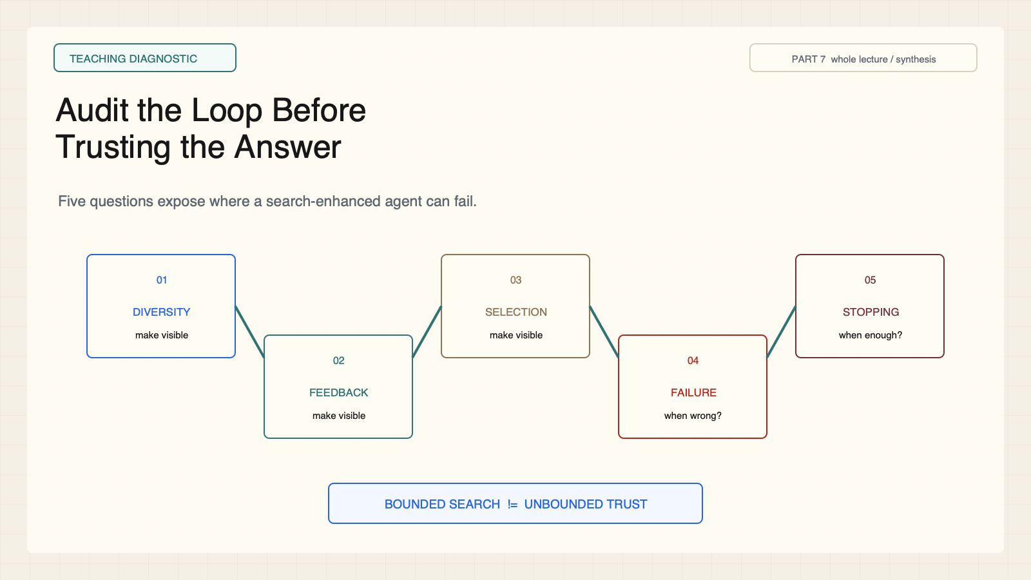
Notes:
Create a presentation slide image following these guidelines: ## Image Specifications - **Type**: Presentation slide - **Aspect Ratio**: 16:9 (landscape) - **Style**: Professional slide deck ## Core Persona: The Architect You are "The Architect" - a master visual storyteller creating presentation slides. Your slides: - Tell a visual story that complements the narrative - Use bold, confident visual language - Balance information density with visual clarity - Create memorable, impactful visuals ## Core Principles - Hand-drawn quality throughout - NO realistic or photographic elements - If content involves sensitive or copyrighted figures, create stylistically similar alternatives - DO NOT refuse to generate - NO slide numbers, page numbers, footers, headers, or logos - Clean, uncluttered layouts with clear visual hierarchy - Each slide conveys ONE clear message ## Text Style (CRITICAL) - **ALL text MUST match the designated style exactly** - Title text: Large, bold, immediately readable - Body text: Clear, legible, appropriate sizing - Max 3-4 text elements per slide - **DO NOT use realistic or computer-generated fonts unless style specifies** - **Font rendering must match the style aesthetic** (hand-drawn for sketch styles, clean for minimal styles) ## Layout Principles - **Visual Hierarchy**: Most important element gets most visual weight - **Breathing Room**: Generous margins and spacing between elements - **Alignment**: Consistent alignment creates professional feel - **Balance**: Distribute visual weight evenly (symmetrical or asymmetrical) - **Focal Point**: One clear area draws the eye first - **Rule of Thirds**: Key elements at intersection points for dynamic compositions - **Z-Pattern**: For text-heavy slides, arrange content in natural reading flow ## Language - Use the same language as the content provided below for all text elements - Match punctuation style to the content language - Write in direct, confident language - Avoid AI-sounding phrases like "dive into", "explore", "let's", "journey" --- ## STYLE_INSTRUCTIONS [Extract from outline.md - do NOT re-read style files] The STYLE_INSTRUCTIONS block from the outline contains: - Design Aesthetic - Background (Texture + Base Color) - Typography (Headlines + Body descriptions) - Color Palette (with hex codes) - Visual Elements - Density Guidelines - Style Rules (Do/Don't) Copy the entire `<STYLE_INSTRUCTIONS>...</STYLE_INSTRUCTIONS>` block from the outline here. --- ## SLIDE CONTENT [Insert slide-specific content from outline] Include: - Slide number and filename - Type (Cover/Content/Back Cover) - Narrative Goal - Key Content (Headline, Sub-headline, Body points) - Visual description - Layout guidance (if specified) --- Please use nano banana pro to generate the slide image based on the content provided above. --- # Slide 12: Audit the Loop Before Trusting the Answer ## Production method Rendered locally as an original 1600x900 SVG for exact text fidelity, then converted to PNG. Do not reproduce Stanford frames, figures, or logos. ## Style Aged-cream academic technical briefing, faint engineering grid, crisp vector diagrams, near-black type, cobalt generation, teal verification, warm-brown budget, maroon constraints, 8px card corners, no gradients. ## On-slide content - Stage: teaching diagnostic - Headline: Audit the Loop Before Trusting the Answer - Subtitle: Five questions expose where a search-enhanced agent can fail. - Supporting labels: Diversity; Feedback; Selection; Failure; Stopping - Evidence: CS329A Part 7, whole lecture / synthesis ## Visual direction Five diagnostic cards surround a bounded search loop with an uncertainty stop. ## Teaching objective Apply a reusable bounded-search diagnostic. ## Speaker notes Ask what creates diversity, what feedback is observed, how selection works, what happens when feedback is wrong, and when the system stops.

