Slide 1
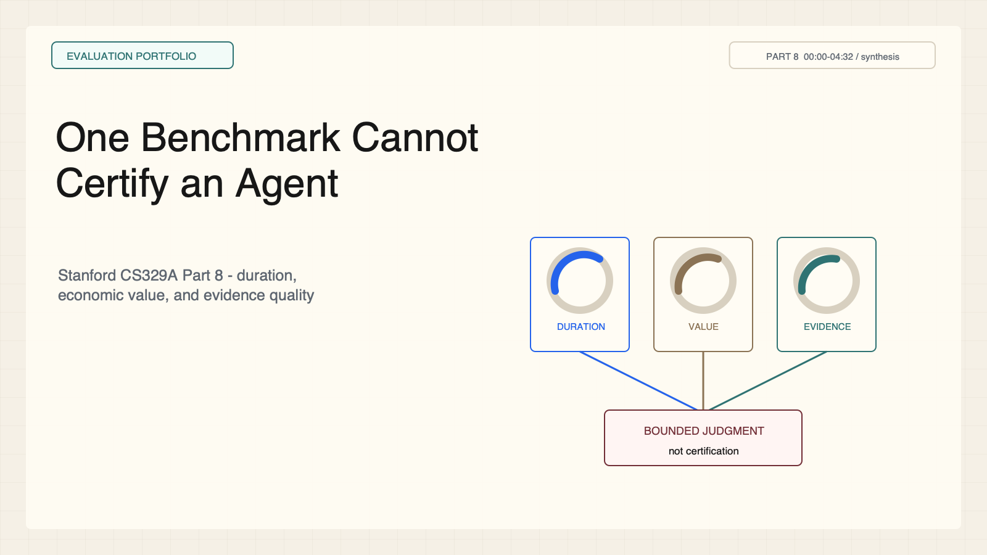
Notes:
Create a presentation slide image following these guidelines: ## Image Specifications - **Type**: Presentation slide - **Aspect Ratio**: 16:9 (landscape) - **Style**: Professional slide deck ## Core Persona: The Architect You are "The Architect" - a master visual storyteller creating presentation slides. Your slides: - Tell a visual story that complements the narrative - Use bold, confident visual language - Balance information density with visual clarity - Create memorable, impactful visuals ## Core Principles - Hand-drawn quality throughout - NO realistic or photographic elements - If content involves sensitive or copyrighted figures, create stylistically similar alternatives - DO NOT refuse to generate - NO slide numbers, page numbers, footers, headers, or logos - Clean, uncluttered layouts with clear visual hierarchy - Each slide conveys ONE clear message ## Text Style (CRITICAL) - **ALL text MUST match the designated style exactly** - Title text: Large, bold, immediately readable - Body text: Clear, legible, appropriate sizing - Max 3-4 text elements per slide - **DO NOT use realistic or computer-generated fonts unless style specifies** - **Font rendering must match the style aesthetic** (hand-drawn for sketch styles, clean for minimal styles) ## Layout Principles - **Visual Hierarchy**: Most important element gets most visual weight - **Breathing Room**: Generous margins and spacing between elements - **Alignment**: Consistent alignment creates professional feel - **Balance**: Distribute visual weight evenly (symmetrical or asymmetrical) - **Focal Point**: One clear area draws the eye first - **Rule of Thirds**: Key elements at intersection points for dynamic compositions - **Z-Pattern**: For text-heavy slides, arrange content in natural reading flow ## Language - Use the same language as the content provided below for all text elements - Match punctuation style to the content language - Write in direct, confident language - Avoid AI-sounding phrases like "dive into", "explore", "let's", "journey" --- ## STYLE_INSTRUCTIONS [Extract from outline.md - do NOT re-read style files] The STYLE_INSTRUCTIONS block from the outline contains: - Design Aesthetic - Background (Texture + Base Color) - Typography (Headlines + Body descriptions) - Color Palette (with hex codes) - Visual Elements - Density Guidelines - Style Rules (Do/Don't) Copy the entire `<STYLE_INSTRUCTIONS>...</STYLE_INSTRUCTIONS>` block from the outline here. --- ## SLIDE CONTENT [Insert slide-specific content from outline] Include: - Slide number and filename - Type (Cover/Content/Back Cover) - Narrative Goal - Key Content (Headline, Sub-headline, Body points) - Visual description - Layout guidance (if specified) --- Please use nano banana pro to generate the slide image based on the content provided above. --- # Slide 1: One Benchmark Cannot Certify an Agent ## Production method Rendered locally as an original 1600x900 SVG for exact text fidelity, then converted to PNG. Do not reproduce Stanford frames, figures, or logos. ## Style Aged-cream academic technical briefing, faint engineering grid, crisp vector diagrams, near-black type, cobalt generation, teal verification, warm-brown budget, maroon constraints, 8px card corners, no gradients. ## On-slide content - Stage: evaluation portfolio - Headline: One Benchmark Cannot Certify an Agent - Subtitle: Stanford CS329A Part 8 - duration, economic value, and evidence quality - Supporting labels: Duration; Value; Evidence - Evidence: CS329A Part 8, 00:00-04:32 / synthesis ## Visual direction Three independent gauges feed a bounded deployment judgment. ## Teaching objective Frame evaluation as a portfolio of distinct claims. ## Speaker notes A benchmark observes one task distribution under one protocol. Deployment adds context, cost, interaction, and long-tail failure. Ask which claim each test can actually support.

Slide 2
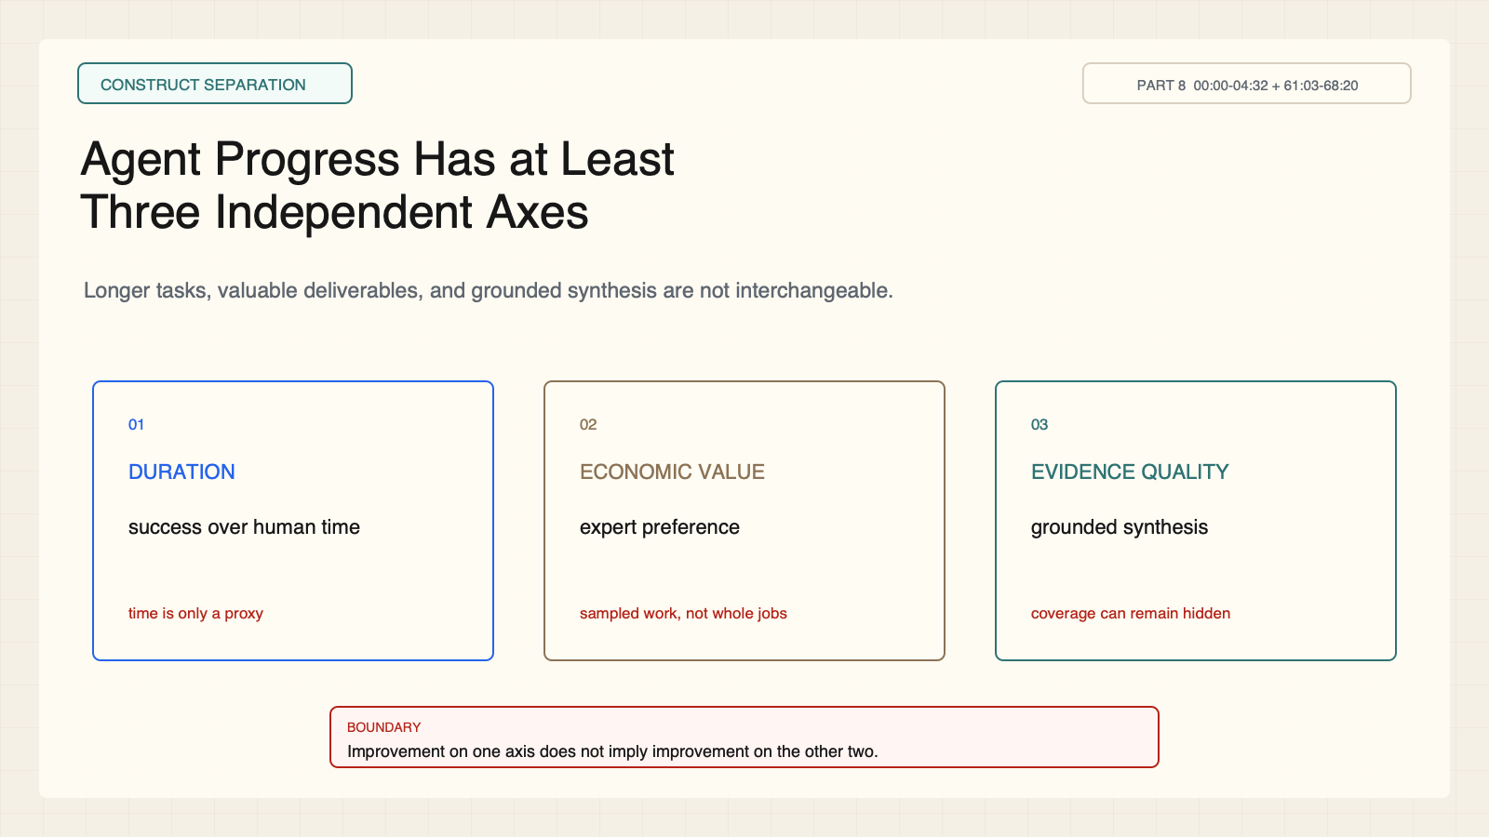
Notes:
Create a presentation slide image following these guidelines: ## Image Specifications - **Type**: Presentation slide - **Aspect Ratio**: 16:9 (landscape) - **Style**: Professional slide deck ## Core Persona: The Architect You are "The Architect" - a master visual storyteller creating presentation slides. Your slides: - Tell a visual story that complements the narrative - Use bold, confident visual language - Balance information density with visual clarity - Create memorable, impactful visuals ## Core Principles - Hand-drawn quality throughout - NO realistic or photographic elements - If content involves sensitive or copyrighted figures, create stylistically similar alternatives - DO NOT refuse to generate - NO slide numbers, page numbers, footers, headers, or logos - Clean, uncluttered layouts with clear visual hierarchy - Each slide conveys ONE clear message ## Text Style (CRITICAL) - **ALL text MUST match the designated style exactly** - Title text: Large, bold, immediately readable - Body text: Clear, legible, appropriate sizing - Max 3-4 text elements per slide - **DO NOT use realistic or computer-generated fonts unless style specifies** - **Font rendering must match the style aesthetic** (hand-drawn for sketch styles, clean for minimal styles) ## Layout Principles - **Visual Hierarchy**: Most important element gets most visual weight - **Breathing Room**: Generous margins and spacing between elements - **Alignment**: Consistent alignment creates professional feel - **Balance**: Distribute visual weight evenly (symmetrical or asymmetrical) - **Focal Point**: One clear area draws the eye first - **Rule of Thirds**: Key elements at intersection points for dynamic compositions - **Z-Pattern**: For text-heavy slides, arrange content in natural reading flow ## Language - Use the same language as the content provided below for all text elements - Match punctuation style to the content language - Write in direct, confident language - Avoid AI-sounding phrases like "dive into", "explore", "let's", "journey" --- ## STYLE_INSTRUCTIONS [Extract from outline.md - do NOT re-read style files] The STYLE_INSTRUCTIONS block from the outline contains: - Design Aesthetic - Background (Texture + Base Color) - Typography (Headlines + Body descriptions) - Color Palette (with hex codes) - Visual Elements - Density Guidelines - Style Rules (Do/Don't) Copy the entire `<STYLE_INSTRUCTIONS>...</STYLE_INSTRUCTIONS>` block from the outline here. --- ## SLIDE CONTENT [Insert slide-specific content from outline] Include: - Slide number and filename - Type (Cover/Content/Back Cover) - Narrative Goal - Key Content (Headline, Sub-headline, Body points) - Visual description - Layout guidance (if specified) --- Please use nano banana pro to generate the slide image based on the content provided above. --- # Slide 2: Agent Progress Has at Least Three Independent Axes ## Production method Rendered locally as an original 1600x900 SVG for exact text fidelity, then converted to PNG. Do not reproduce Stanford frames, figures, or logos. ## Style Aged-cream academic technical briefing, faint engineering grid, crisp vector diagrams, near-black type, cobalt generation, teal verification, warm-brown budget, maroon constraints, 8px card corners, no gradients. ## On-slide content - Stage: construct separation - Headline: Agent Progress Has at Least Three Independent Axes - Subtitle: Longer tasks, valuable deliverables, and grounded synthesis are not interchangeable. - Supporting labels: Duration; Economic value; Evidence quality - Evidence: CS329A Part 8, 00:00-04:32 + 61:03-68:20 ## Visual direction Three orthogonal measurement rulers with distinct observables and blind spots. ## Teaching objective Separate three evaluation constructs before discussing scores. ## Speaker notes A system may improve on one axis while remaining weak on another. Do not average these into a universal capability number.

Slide 3
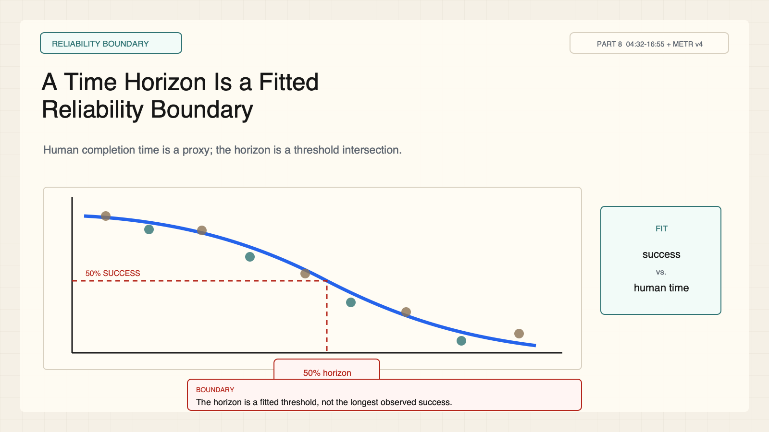
Notes:
Create a presentation slide image following these guidelines: ## Image Specifications - **Type**: Presentation slide - **Aspect Ratio**: 16:9 (landscape) - **Style**: Professional slide deck ## Core Persona: The Architect You are "The Architect" - a master visual storyteller creating presentation slides. Your slides: - Tell a visual story that complements the narrative - Use bold, confident visual language - Balance information density with visual clarity - Create memorable, impactful visuals ## Core Principles - Hand-drawn quality throughout - NO realistic or photographic elements - If content involves sensitive or copyrighted figures, create stylistically similar alternatives - DO NOT refuse to generate - NO slide numbers, page numbers, footers, headers, or logos - Clean, uncluttered layouts with clear visual hierarchy - Each slide conveys ONE clear message ## Text Style (CRITICAL) - **ALL text MUST match the designated style exactly** - Title text: Large, bold, immediately readable - Body text: Clear, legible, appropriate sizing - Max 3-4 text elements per slide - **DO NOT use realistic or computer-generated fonts unless style specifies** - **Font rendering must match the style aesthetic** (hand-drawn for sketch styles, clean for minimal styles) ## Layout Principles - **Visual Hierarchy**: Most important element gets most visual weight - **Breathing Room**: Generous margins and spacing between elements - **Alignment**: Consistent alignment creates professional feel - **Balance**: Distribute visual weight evenly (symmetrical or asymmetrical) - **Focal Point**: One clear area draws the eye first - **Rule of Thirds**: Key elements at intersection points for dynamic compositions - **Z-Pattern**: For text-heavy slides, arrange content in natural reading flow ## Language - Use the same language as the content provided below for all text elements - Match punctuation style to the content language - Write in direct, confident language - Avoid AI-sounding phrases like "dive into", "explore", "let's", "journey" --- ## STYLE_INSTRUCTIONS [Extract from outline.md - do NOT re-read style files] The STYLE_INSTRUCTIONS block from the outline contains: - Design Aesthetic - Background (Texture + Base Color) - Typography (Headlines + Body descriptions) - Color Palette (with hex codes) - Visual Elements - Density Guidelines - Style Rules (Do/Don't) Copy the entire `<STYLE_INSTRUCTIONS>...</STYLE_INSTRUCTIONS>` block from the outline here. --- ## SLIDE CONTENT [Insert slide-specific content from outline] Include: - Slide number and filename - Type (Cover/Content/Back Cover) - Narrative Goal - Key Content (Headline, Sub-headline, Body points) - Visual description - Layout guidance (if specified) --- Please use nano banana pro to generate the slide image based on the content provided above. --- # Slide 3: A Time Horizon Is a Fitted Reliability Boundary ## Production method Rendered locally as an original 1600x900 SVG for exact text fidelity, then converted to PNG. Do not reproduce Stanford frames, figures, or logos. ## Style Aged-cream academic technical briefing, faint engineering grid, crisp vector diagrams, near-black type, cobalt generation, teal verification, warm-brown budget, maroon constraints, 8px card corners, no gradients. ## On-slide content - Stage: reliability boundary - Headline: A Time Horizon Is a Fitted Reliability Boundary - Subtitle: Human completion time is a proxy; the horizon is a threshold intersection. - Supporting labels: Task duration; Success probability; 50% horizon - Evidence: CS329A Part 8, 04:32-16:55 + METR v4 ## Visual direction Task observations, descending fitted success curve, and a labeled 50 percent intersection. ## Teaching objective Explain how METR's time horizon is constructed. ## Speaker notes The horizon is not the longest task an agent happened to complete. It comes from a fitted success curve over tasks binned by skilled-human completion time.

Slide 4
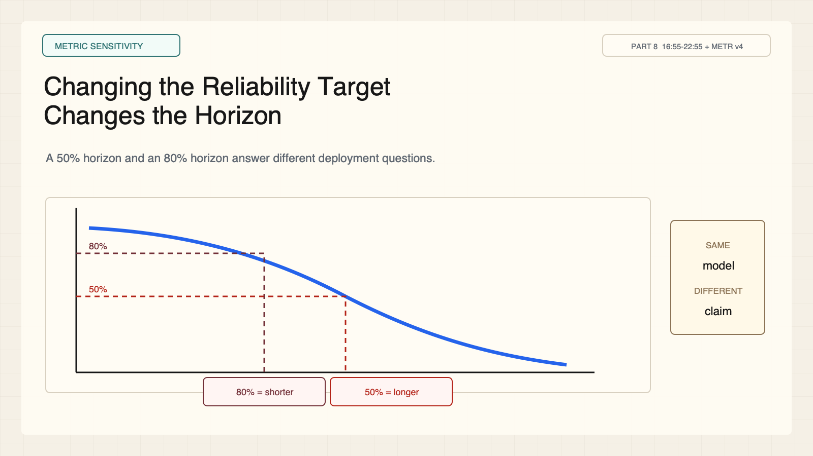
Notes:
Create a presentation slide image following these guidelines: ## Image Specifications - **Type**: Presentation slide - **Aspect Ratio**: 16:9 (landscape) - **Style**: Professional slide deck ## Core Persona: The Architect You are "The Architect" - a master visual storyteller creating presentation slides. Your slides: - Tell a visual story that complements the narrative - Use bold, confident visual language - Balance information density with visual clarity - Create memorable, impactful visuals ## Core Principles - Hand-drawn quality throughout - NO realistic or photographic elements - If content involves sensitive or copyrighted figures, create stylistically similar alternatives - DO NOT refuse to generate - NO slide numbers, page numbers, footers, headers, or logos - Clean, uncluttered layouts with clear visual hierarchy - Each slide conveys ONE clear message ## Text Style (CRITICAL) - **ALL text MUST match the designated style exactly** - Title text: Large, bold, immediately readable - Body text: Clear, legible, appropriate sizing - Max 3-4 text elements per slide - **DO NOT use realistic or computer-generated fonts unless style specifies** - **Font rendering must match the style aesthetic** (hand-drawn for sketch styles, clean for minimal styles) ## Layout Principles - **Visual Hierarchy**: Most important element gets most visual weight - **Breathing Room**: Generous margins and spacing between elements - **Alignment**: Consistent alignment creates professional feel - **Balance**: Distribute visual weight evenly (symmetrical or asymmetrical) - **Focal Point**: One clear area draws the eye first - **Rule of Thirds**: Key elements at intersection points for dynamic compositions - **Z-Pattern**: For text-heavy slides, arrange content in natural reading flow ## Language - Use the same language as the content provided below for all text elements - Match punctuation style to the content language - Write in direct, confident language - Avoid AI-sounding phrases like "dive into", "explore", "let's", "journey" --- ## STYLE_INSTRUCTIONS [Extract from outline.md - do NOT re-read style files] The STYLE_INSTRUCTIONS block from the outline contains: - Design Aesthetic - Background (Texture + Base Color) - Typography (Headlines + Body descriptions) - Color Palette (with hex codes) - Visual Elements - Density Guidelines - Style Rules (Do/Don't) Copy the entire `<STYLE_INSTRUCTIONS>...</STYLE_INSTRUCTIONS>` block from the outline here. --- ## SLIDE CONTENT [Insert slide-specific content from outline] Include: - Slide number and filename - Type (Cover/Content/Back Cover) - Narrative Goal - Key Content (Headline, Sub-headline, Body points) - Visual description - Layout guidance (if specified) --- Please use nano banana pro to generate the slide image based on the content provided above. --- # Slide 4: Changing the Reliability Target Changes the Horizon ## Production method Rendered locally as an original 1600x900 SVG for exact text fidelity, then converted to PNG. Do not reproduce Stanford frames, figures, or logos. ## Style Aged-cream academic technical briefing, faint engineering grid, crisp vector diagrams, near-black type, cobalt generation, teal verification, warm-brown budget, maroon constraints, 8px card corners, no gradients. ## On-slide content - Stage: metric sensitivity - Headline: Changing the Reliability Target Changes the Horizon - Subtitle: A 50% horizon and an 80% horizon answer different deployment questions. - Supporting labels: 50%; 80%; Same model; Different claim - Evidence: CS329A Part 8, 16:55-22:55 + METR v4 ## Visual direction One success curve crossed by two horizontal reliability lines at different durations. ## Teaching objective Make the success threshold visible as a policy choice. ## Speaker notes Higher required reliability produces a shorter horizon on the same fitted curve. Always state the threshold before comparing systems.

Slide 5
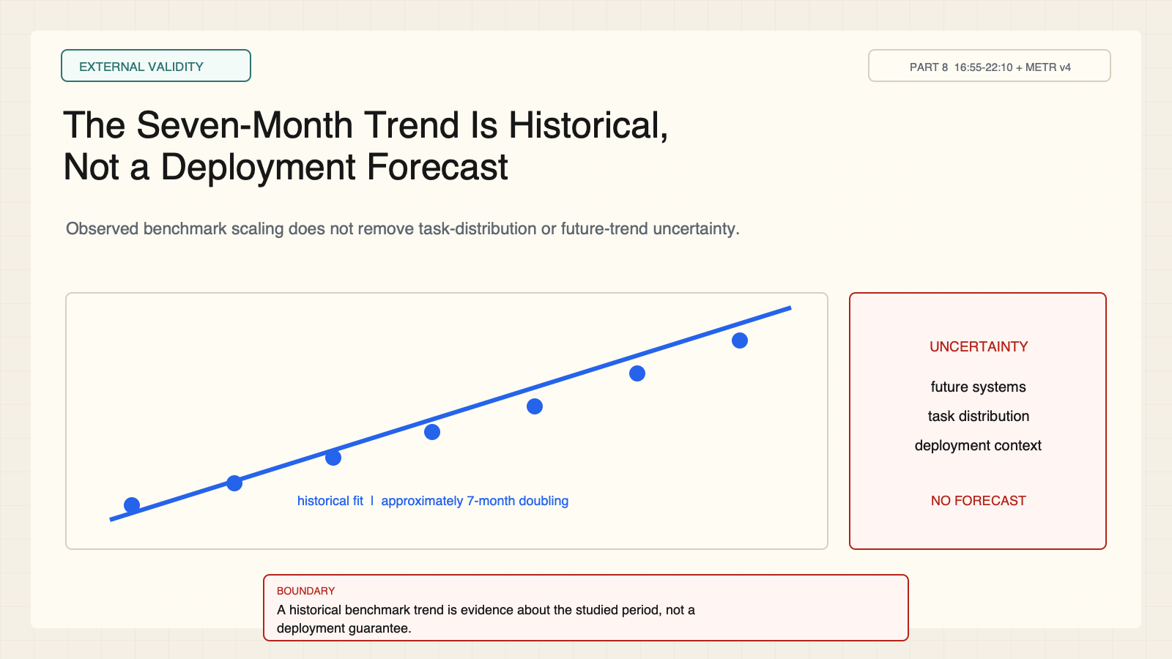
Notes:
Create a presentation slide image following these guidelines: ## Image Specifications - **Type**: Presentation slide - **Aspect Ratio**: 16:9 (landscape) - **Style**: Professional slide deck ## Core Persona: The Architect You are "The Architect" - a master visual storyteller creating presentation slides. Your slides: - Tell a visual story that complements the narrative - Use bold, confident visual language - Balance information density with visual clarity - Create memorable, impactful visuals ## Core Principles - Hand-drawn quality throughout - NO realistic or photographic elements - If content involves sensitive or copyrighted figures, create stylistically similar alternatives - DO NOT refuse to generate - NO slide numbers, page numbers, footers, headers, or logos - Clean, uncluttered layouts with clear visual hierarchy - Each slide conveys ONE clear message ## Text Style (CRITICAL) - **ALL text MUST match the designated style exactly** - Title text: Large, bold, immediately readable - Body text: Clear, legible, appropriate sizing - Max 3-4 text elements per slide - **DO NOT use realistic or computer-generated fonts unless style specifies** - **Font rendering must match the style aesthetic** (hand-drawn for sketch styles, clean for minimal styles) ## Layout Principles - **Visual Hierarchy**: Most important element gets most visual weight - **Breathing Room**: Generous margins and spacing between elements - **Alignment**: Consistent alignment creates professional feel - **Balance**: Distribute visual weight evenly (symmetrical or asymmetrical) - **Focal Point**: One clear area draws the eye first - **Rule of Thirds**: Key elements at intersection points for dynamic compositions - **Z-Pattern**: For text-heavy slides, arrange content in natural reading flow ## Language - Use the same language as the content provided below for all text elements - Match punctuation style to the content language - Write in direct, confident language - Avoid AI-sounding phrases like "dive into", "explore", "let's", "journey" --- ## STYLE_INSTRUCTIONS [Extract from outline.md - do NOT re-read style files] The STYLE_INSTRUCTIONS block from the outline contains: - Design Aesthetic - Background (Texture + Base Color) - Typography (Headlines + Body descriptions) - Color Palette (with hex codes) - Visual Elements - Density Guidelines - Style Rules (Do/Don't) Copy the entire `<STYLE_INSTRUCTIONS>...</STYLE_INSTRUCTIONS>` block from the outline here. --- ## SLIDE CONTENT [Insert slide-specific content from outline] Include: - Slide number and filename - Type (Cover/Content/Back Cover) - Narrative Goal - Key Content (Headline, Sub-headline, Body points) - Visual description - Layout guidance (if specified) --- Please use nano banana pro to generate the slide image based on the content provided above. --- # Slide 5: The Seven-Month Trend Is Historical, Not a Deployment Forecast ## Production method Rendered locally as an original 1600x900 SVG for exact text fidelity, then converted to PNG. Do not reproduce Stanford frames, figures, or logos. ## Style Aged-cream academic technical briefing, faint engineering grid, crisp vector diagrams, near-black type, cobalt generation, teal verification, warm-brown budget, maroon constraints, 8px card corners, no gradients. ## On-slide content - Stage: external validity - Headline: The Seven-Month Trend Is Historical, Not a Deployment Forecast - Subtitle: Observed benchmark scaling does not remove task-distribution or future-trend uncertainty. - Supporting labels: Historical fit; ~7 months; Not a forecast - Evidence: CS329A Part 8, 16:55-22:10 + METR v4 ## Visual direction Dated historical points and a fitted line ending at an uncertainty wall rather than extending as a forecast. ## Teaching objective Calibrate the interpretation of METR's historical doubling result. ## Speaker notes METR reports an approximately seven-month historical doubling in the 50 percent horizon for the studied software-task family. The paper explicitly discusses external-validity limitations.

Slide 6
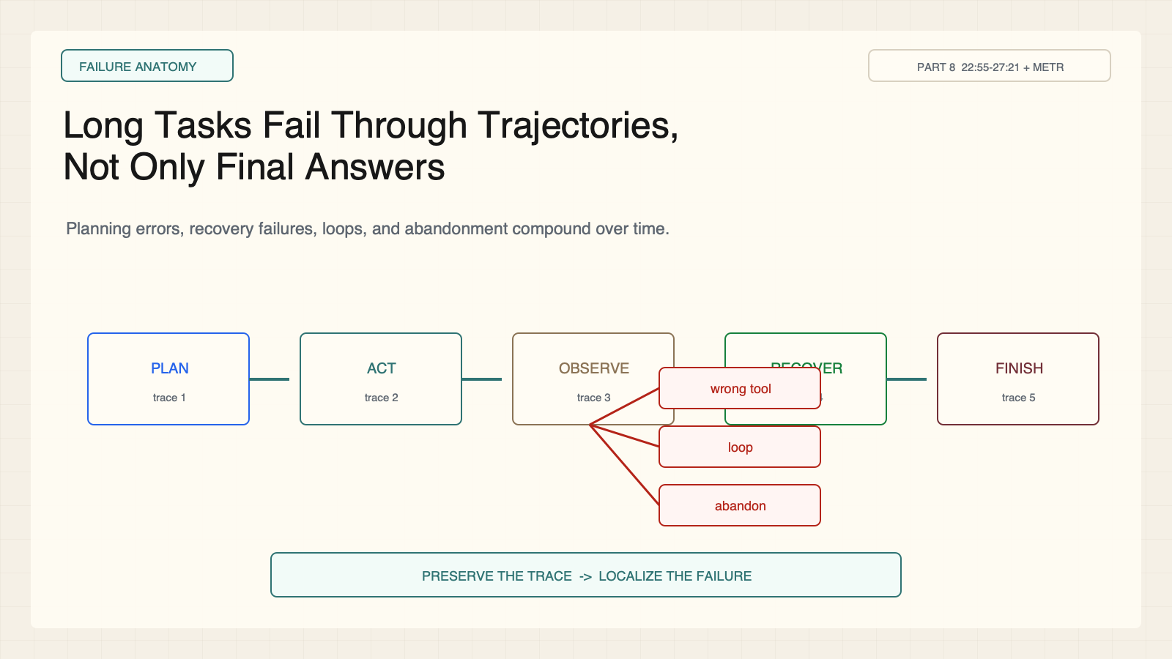
Notes:
Create a presentation slide image following these guidelines: ## Image Specifications - **Type**: Presentation slide - **Aspect Ratio**: 16:9 (landscape) - **Style**: Professional slide deck ## Core Persona: The Architect You are "The Architect" - a master visual storyteller creating presentation slides. Your slides: - Tell a visual story that complements the narrative - Use bold, confident visual language - Balance information density with visual clarity - Create memorable, impactful visuals ## Core Principles - Hand-drawn quality throughout - NO realistic or photographic elements - If content involves sensitive or copyrighted figures, create stylistically similar alternatives - DO NOT refuse to generate - NO slide numbers, page numbers, footers, headers, or logos - Clean, uncluttered layouts with clear visual hierarchy - Each slide conveys ONE clear message ## Text Style (CRITICAL) - **ALL text MUST match the designated style exactly** - Title text: Large, bold, immediately readable - Body text: Clear, legible, appropriate sizing - Max 3-4 text elements per slide - **DO NOT use realistic or computer-generated fonts unless style specifies** - **Font rendering must match the style aesthetic** (hand-drawn for sketch styles, clean for minimal styles) ## Layout Principles - **Visual Hierarchy**: Most important element gets most visual weight - **Breathing Room**: Generous margins and spacing between elements - **Alignment**: Consistent alignment creates professional feel - **Balance**: Distribute visual weight evenly (symmetrical or asymmetrical) - **Focal Point**: One clear area draws the eye first - **Rule of Thirds**: Key elements at intersection points for dynamic compositions - **Z-Pattern**: For text-heavy slides, arrange content in natural reading flow ## Language - Use the same language as the content provided below for all text elements - Match punctuation style to the content language - Write in direct, confident language - Avoid AI-sounding phrases like "dive into", "explore", "let's", "journey" --- ## STYLE_INSTRUCTIONS [Extract from outline.md - do NOT re-read style files] The STYLE_INSTRUCTIONS block from the outline contains: - Design Aesthetic - Background (Texture + Base Color) - Typography (Headlines + Body descriptions) - Color Palette (with hex codes) - Visual Elements - Density Guidelines - Style Rules (Do/Don't) Copy the entire `<STYLE_INSTRUCTIONS>...</STYLE_INSTRUCTIONS>` block from the outline here. --- ## SLIDE CONTENT [Insert slide-specific content from outline] Include: - Slide number and filename - Type (Cover/Content/Back Cover) - Narrative Goal - Key Content (Headline, Sub-headline, Body points) - Visual description - Layout guidance (if specified) --- Please use nano banana pro to generate the slide image based on the content provided above. --- # Slide 6: Long Tasks Fail Through Trajectories, Not Only Final Answers ## Production method Rendered locally as an original 1600x900 SVG for exact text fidelity, then converted to PNG. Do not reproduce Stanford frames, figures, or logos. ## Style Aged-cream academic technical briefing, faint engineering grid, crisp vector diagrams, near-black type, cobalt generation, teal verification, warm-brown budget, maroon constraints, 8px card corners, no gradients. ## On-slide content - Stage: failure anatomy - Headline: Long Tasks Fail Through Trajectories, Not Only Final Answers - Subtitle: Planning errors, recovery failures, loops, and abandonment compound over time. - Supporting labels: Plan; Act; Observe; Recover - Evidence: CS329A Part 8, 22:55-27:21 + METR ## Visual direction A task trace with branching failure points and an audit trail. ## Teaching objective Shift evaluation from endpoint correctness to trajectory diagnostics. ## Speaker notes Final success hides where the run failed. Long-horizon evaluation should preserve traces so evaluators can distinguish planning, execution, and recovery failures.

Slide 7
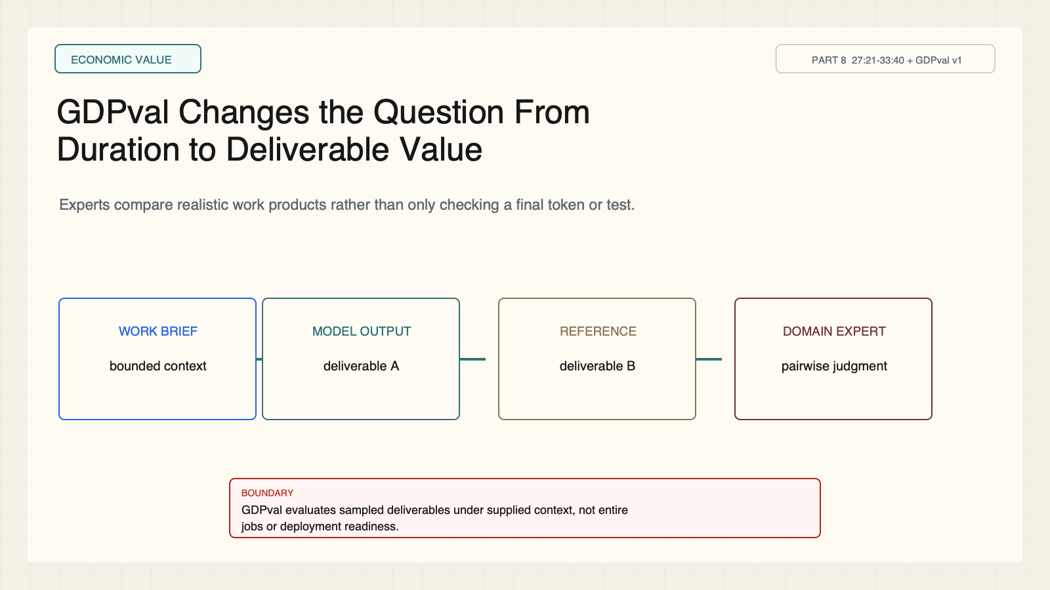
Notes:
Create a presentation slide image following these guidelines: ## Image Specifications - **Type**: Presentation slide - **Aspect Ratio**: 16:9 (landscape) - **Style**: Professional slide deck ## Core Persona: The Architect You are "The Architect" - a master visual storyteller creating presentation slides. Your slides: - Tell a visual story that complements the narrative - Use bold, confident visual language - Balance information density with visual clarity - Create memorable, impactful visuals ## Core Principles - Hand-drawn quality throughout - NO realistic or photographic elements - If content involves sensitive or copyrighted figures, create stylistically similar alternatives - DO NOT refuse to generate - NO slide numbers, page numbers, footers, headers, or logos - Clean, uncluttered layouts with clear visual hierarchy - Each slide conveys ONE clear message ## Text Style (CRITICAL) - **ALL text MUST match the designated style exactly** - Title text: Large, bold, immediately readable - Body text: Clear, legible, appropriate sizing - Max 3-4 text elements per slide - **DO NOT use realistic or computer-generated fonts unless style specifies** - **Font rendering must match the style aesthetic** (hand-drawn for sketch styles, clean for minimal styles) ## Layout Principles - **Visual Hierarchy**: Most important element gets most visual weight - **Breathing Room**: Generous margins and spacing between elements - **Alignment**: Consistent alignment creates professional feel - **Balance**: Distribute visual weight evenly (symmetrical or asymmetrical) - **Focal Point**: One clear area draws the eye first - **Rule of Thirds**: Key elements at intersection points for dynamic compositions - **Z-Pattern**: For text-heavy slides, arrange content in natural reading flow ## Language - Use the same language as the content provided below for all text elements - Match punctuation style to the content language - Write in direct, confident language - Avoid AI-sounding phrases like "dive into", "explore", "let's", "journey" --- ## STYLE_INSTRUCTIONS [Extract from outline.md - do NOT re-read style files] The STYLE_INSTRUCTIONS block from the outline contains: - Design Aesthetic - Background (Texture + Base Color) - Typography (Headlines + Body descriptions) - Color Palette (with hex codes) - Visual Elements - Density Guidelines - Style Rules (Do/Don't) Copy the entire `<STYLE_INSTRUCTIONS>...</STYLE_INSTRUCTIONS>` block from the outline here. --- ## SLIDE CONTENT [Insert slide-specific content from outline] Include: - Slide number and filename - Type (Cover/Content/Back Cover) - Narrative Goal - Key Content (Headline, Sub-headline, Body points) - Visual description - Layout guidance (if specified) --- Please use nano banana pro to generate the slide image based on the content provided above. --- # Slide 7: GDPval Changes the Question From Duration to Deliverable Value ## Production method Rendered locally as an original 1600x900 SVG for exact text fidelity, then converted to PNG. Do not reproduce Stanford frames, figures, or logos. ## Style Aged-cream academic technical briefing, faint engineering grid, crisp vector diagrams, near-black type, cobalt generation, teal verification, warm-brown budget, maroon constraints, 8px card corners, no gradients. ## On-slide content - Stage: economic value - Headline: GDPval Changes the Question From Duration to Deliverable Value - Subtitle: Experts compare realistic work products rather than only checking a final token or test. - Supporting labels: Work brief; Model deliverable; Reference; Expert judge - Evidence: CS329A Part 8, 27:21-33:40 + GDPval v1 ## Visual direction A brief produces two deliverables that are compared by a domain expert. ## Teaching objective Explain GDPval's pairwise expert-evaluation protocol. ## Speaker notes The evaluation asks whether a model can produce economically valuable work products under the benchmark context. It does not measure entire jobs or deployment readiness.

Slide 8
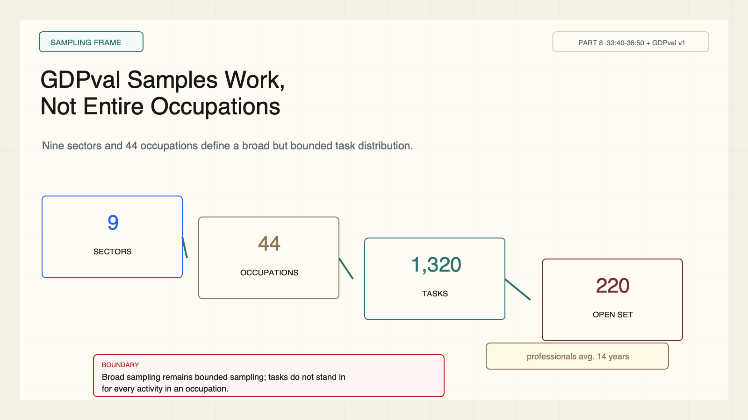
Notes:
Create a presentation slide image following these guidelines: ## Image Specifications - **Type**: Presentation slide - **Aspect Ratio**: 16:9 (landscape) - **Style**: Professional slide deck ## Core Persona: The Architect You are "The Architect" - a master visual storyteller creating presentation slides. Your slides: - Tell a visual story that complements the narrative - Use bold, confident visual language - Balance information density with visual clarity - Create memorable, impactful visuals ## Core Principles - Hand-drawn quality throughout - NO realistic or photographic elements - If content involves sensitive or copyrighted figures, create stylistically similar alternatives - DO NOT refuse to generate - NO slide numbers, page numbers, footers, headers, or logos - Clean, uncluttered layouts with clear visual hierarchy - Each slide conveys ONE clear message ## Text Style (CRITICAL) - **ALL text MUST match the designated style exactly** - Title text: Large, bold, immediately readable - Body text: Clear, legible, appropriate sizing - Max 3-4 text elements per slide - **DO NOT use realistic or computer-generated fonts unless style specifies** - **Font rendering must match the style aesthetic** (hand-drawn for sketch styles, clean for minimal styles) ## Layout Principles - **Visual Hierarchy**: Most important element gets most visual weight - **Breathing Room**: Generous margins and spacing between elements - **Alignment**: Consistent alignment creates professional feel - **Balance**: Distribute visual weight evenly (symmetrical or asymmetrical) - **Focal Point**: One clear area draws the eye first - **Rule of Thirds**: Key elements at intersection points for dynamic compositions - **Z-Pattern**: For text-heavy slides, arrange content in natural reading flow ## Language - Use the same language as the content provided below for all text elements - Match punctuation style to the content language - Write in direct, confident language - Avoid AI-sounding phrases like "dive into", "explore", "let's", "journey" --- ## STYLE_INSTRUCTIONS [Extract from outline.md - do NOT re-read style files] The STYLE_INSTRUCTIONS block from the outline contains: - Design Aesthetic - Background (Texture + Base Color) - Typography (Headlines + Body descriptions) - Color Palette (with hex codes) - Visual Elements - Density Guidelines - Style Rules (Do/Don't) Copy the entire `<STYLE_INSTRUCTIONS>...</STYLE_INSTRUCTIONS>` block from the outline here. --- ## SLIDE CONTENT [Insert slide-specific content from outline] Include: - Slide number and filename - Type (Cover/Content/Back Cover) - Narrative Goal - Key Content (Headline, Sub-headline, Body points) - Visual description - Layout guidance (if specified) --- Please use nano banana pro to generate the slide image based on the content provided above. --- # Slide 8: GDPval Samples Work, Not Entire Occupations ## Production method Rendered locally as an original 1600x900 SVG for exact text fidelity, then converted to PNG. Do not reproduce Stanford frames, figures, or logos. ## Style Aged-cream academic technical briefing, faint engineering grid, crisp vector diagrams, near-black type, cobalt generation, teal verification, warm-brown budget, maroon constraints, 8px card corners, no gradients. ## On-slide content - Stage: sampling frame - Headline: GDPval Samples Work, Not Entire Occupations - Subtitle: Nine sectors and 44 occupations define a broad but bounded task distribution. - Supporting labels: 9 sectors; 44 occupations; 1,320 tasks; 220 open tasks - Evidence: CS329A Part 8, 33:40-38:50 + GDPval v1 ## Visual direction A funnel from sectors to occupations to tasks to the open evaluation set. ## Teaching objective Attach GDPval findings to its task-sampling frame. ## Speaker notes The benchmark contains 1,320 tasks, with a 220-task open set. Professionals average 14 years of experience. These tasks are evidence about sampled deliverables, not full occupational replacement.

Slide 9
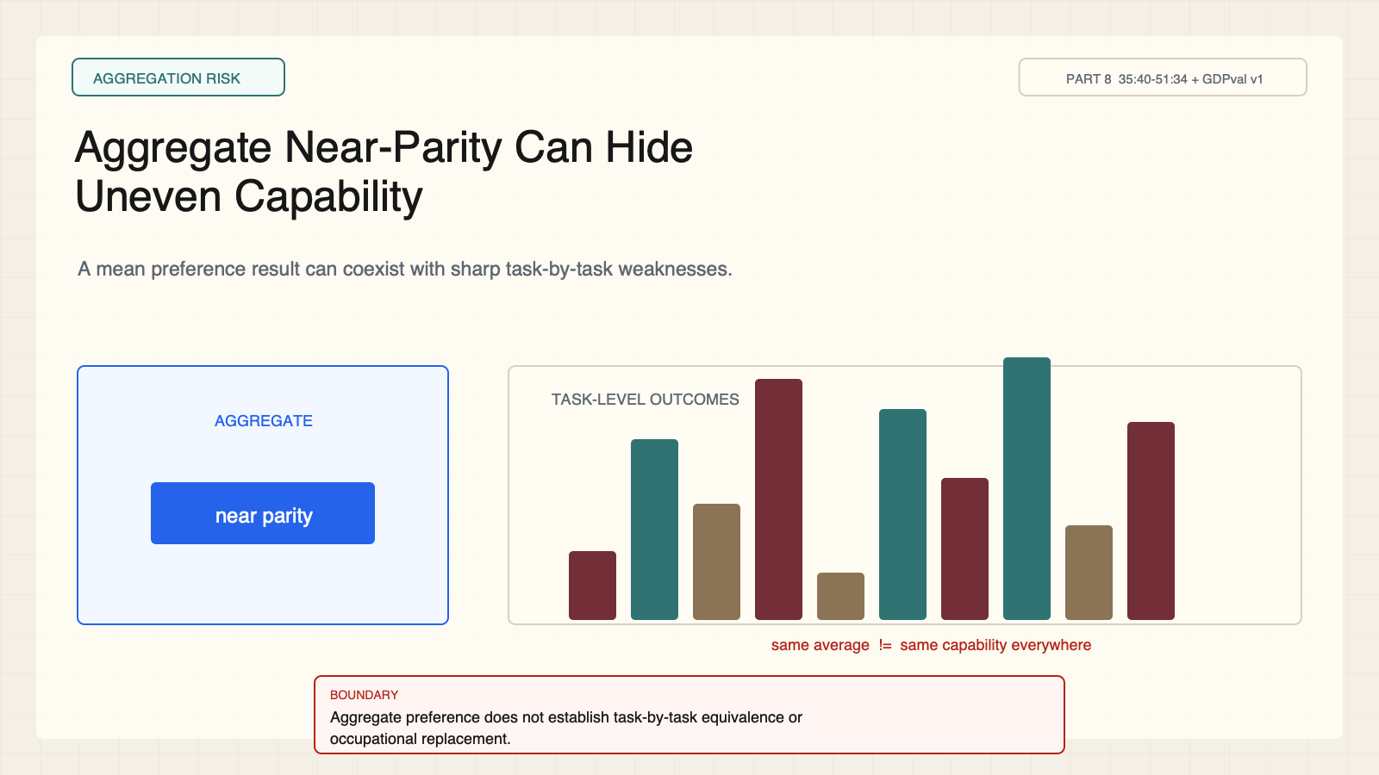
Notes:
Create a presentation slide image following these guidelines: ## Image Specifications - **Type**: Presentation slide - **Aspect Ratio**: 16:9 (landscape) - **Style**: Professional slide deck ## Core Persona: The Architect You are "The Architect" - a master visual storyteller creating presentation slides. Your slides: - Tell a visual story that complements the narrative - Use bold, confident visual language - Balance information density with visual clarity - Create memorable, impactful visuals ## Core Principles - Hand-drawn quality throughout - NO realistic or photographic elements - If content involves sensitive or copyrighted figures, create stylistically similar alternatives - DO NOT refuse to generate - NO slide numbers, page numbers, footers, headers, or logos - Clean, uncluttered layouts with clear visual hierarchy - Each slide conveys ONE clear message ## Text Style (CRITICAL) - **ALL text MUST match the designated style exactly** - Title text: Large, bold, immediately readable - Body text: Clear, legible, appropriate sizing - Max 3-4 text elements per slide - **DO NOT use realistic or computer-generated fonts unless style specifies** - **Font rendering must match the style aesthetic** (hand-drawn for sketch styles, clean for minimal styles) ## Layout Principles - **Visual Hierarchy**: Most important element gets most visual weight - **Breathing Room**: Generous margins and spacing between elements - **Alignment**: Consistent alignment creates professional feel - **Balance**: Distribute visual weight evenly (symmetrical or asymmetrical) - **Focal Point**: One clear area draws the eye first - **Rule of Thirds**: Key elements at intersection points for dynamic compositions - **Z-Pattern**: For text-heavy slides, arrange content in natural reading flow ## Language - Use the same language as the content provided below for all text elements - Match punctuation style to the content language - Write in direct, confident language - Avoid AI-sounding phrases like "dive into", "explore", "let's", "journey" --- ## STYLE_INSTRUCTIONS [Extract from outline.md - do NOT re-read style files] The STYLE_INSTRUCTIONS block from the outline contains: - Design Aesthetic - Background (Texture + Base Color) - Typography (Headlines + Body descriptions) - Color Palette (with hex codes) - Visual Elements - Density Guidelines - Style Rules (Do/Don't) Copy the entire `<STYLE_INSTRUCTIONS>...</STYLE_INSTRUCTIONS>` block from the outline here. --- ## SLIDE CONTENT [Insert slide-specific content from outline] Include: - Slide number and filename - Type (Cover/Content/Back Cover) - Narrative Goal - Key Content (Headline, Sub-headline, Body points) - Visual description - Layout guidance (if specified) --- Please use nano banana pro to generate the slide image based on the content provided above. --- # Slide 9: Aggregate Near-Parity Can Hide Uneven Capability ## Production method Rendered locally as an original 1600x900 SVG for exact text fidelity, then converted to PNG. Do not reproduce Stanford frames, figures, or logos. ## Style Aged-cream academic technical briefing, faint engineering grid, crisp vector diagrams, near-black type, cobalt generation, teal verification, warm-brown budget, maroon constraints, 8px card corners, no gradients. ## On-slide content - Stage: aggregation risk - Headline: Aggregate Near-Parity Can Hide Uneven Capability - Subtitle: A mean preference result can coexist with sharp task-by-task weaknesses. - Supporting labels: Aggregate; Occupation; Task; Context - Evidence: CS329A Part 8, 35:40-51:34 + GDPval v1 ## Visual direction One aggregate bar above a set of widely varying task-level bars. ## Teaching objective Prevent aggregate scores from becoming universal claims. ## Speaker notes GDPval reports aggregate comparisons, but capability is heterogeneous across tasks and models. A near-parity aggregate is not task-by-task equivalence or job replacement.

Slide 10
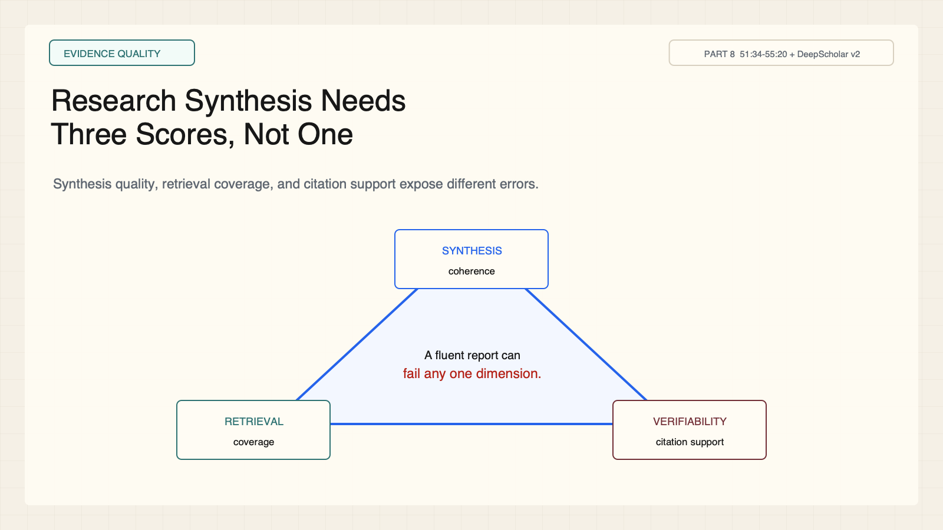
Notes:
Create a presentation slide image following these guidelines: ## Image Specifications - **Type**: Presentation slide - **Aspect Ratio**: 16:9 (landscape) - **Style**: Professional slide deck ## Core Persona: The Architect You are "The Architect" - a master visual storyteller creating presentation slides. Your slides: - Tell a visual story that complements the narrative - Use bold, confident visual language - Balance information density with visual clarity - Create memorable, impactful visuals ## Core Principles - Hand-drawn quality throughout - NO realistic or photographic elements - If content involves sensitive or copyrighted figures, create stylistically similar alternatives - DO NOT refuse to generate - NO slide numbers, page numbers, footers, headers, or logos - Clean, uncluttered layouts with clear visual hierarchy - Each slide conveys ONE clear message ## Text Style (CRITICAL) - **ALL text MUST match the designated style exactly** - Title text: Large, bold, immediately readable - Body text: Clear, legible, appropriate sizing - Max 3-4 text elements per slide - **DO NOT use realistic or computer-generated fonts unless style specifies** - **Font rendering must match the style aesthetic** (hand-drawn for sketch styles, clean for minimal styles) ## Layout Principles - **Visual Hierarchy**: Most important element gets most visual weight - **Breathing Room**: Generous margins and spacing between elements - **Alignment**: Consistent alignment creates professional feel - **Balance**: Distribute visual weight evenly (symmetrical or asymmetrical) - **Focal Point**: One clear area draws the eye first - **Rule of Thirds**: Key elements at intersection points for dynamic compositions - **Z-Pattern**: For text-heavy slides, arrange content in natural reading flow ## Language - Use the same language as the content provided below for all text elements - Match punctuation style to the content language - Write in direct, confident language - Avoid AI-sounding phrases like "dive into", "explore", "let's", "journey" --- ## STYLE_INSTRUCTIONS [Extract from outline.md - do NOT re-read style files] The STYLE_INSTRUCTIONS block from the outline contains: - Design Aesthetic - Background (Texture + Base Color) - Typography (Headlines + Body descriptions) - Color Palette (with hex codes) - Visual Elements - Density Guidelines - Style Rules (Do/Don't) Copy the entire `<STYLE_INSTRUCTIONS>...</STYLE_INSTRUCTIONS>` block from the outline here. --- ## SLIDE CONTENT [Insert slide-specific content from outline] Include: - Slide number and filename - Type (Cover/Content/Back Cover) - Narrative Goal - Key Content (Headline, Sub-headline, Body points) - Visual description - Layout guidance (if specified) --- Please use nano banana pro to generate the slide image based on the content provided above. --- # Slide 10: Research Synthesis Needs Three Scores, Not One ## Production method Rendered locally as an original 1600x900 SVG for exact text fidelity, then converted to PNG. Do not reproduce Stanford frames, figures, or logos. ## Style Aged-cream academic technical briefing, faint engineering grid, crisp vector diagrams, near-black type, cobalt generation, teal verification, warm-brown budget, maroon constraints, 8px card corners, no gradients. ## On-slide content - Stage: evidence quality - Headline: Research Synthesis Needs Three Scores, Not One - Subtitle: Synthesis quality, retrieval coverage, and citation support expose different errors. - Supporting labels: Synthesis; Retrieval; Verifiability - Evidence: CS329A Part 8, 51:34-55:20 + DeepScholar v2 ## Visual direction A triangle of synthesis, retrieval, and verifiability with different failure examples. ## Teaching objective Explain the multi-dimensional evaluation of deep-research systems. ## Speaker notes A fluent report can miss important sources or attach unsupported citations. These dimensions must stay separate to diagnose the failure.

Slide 11
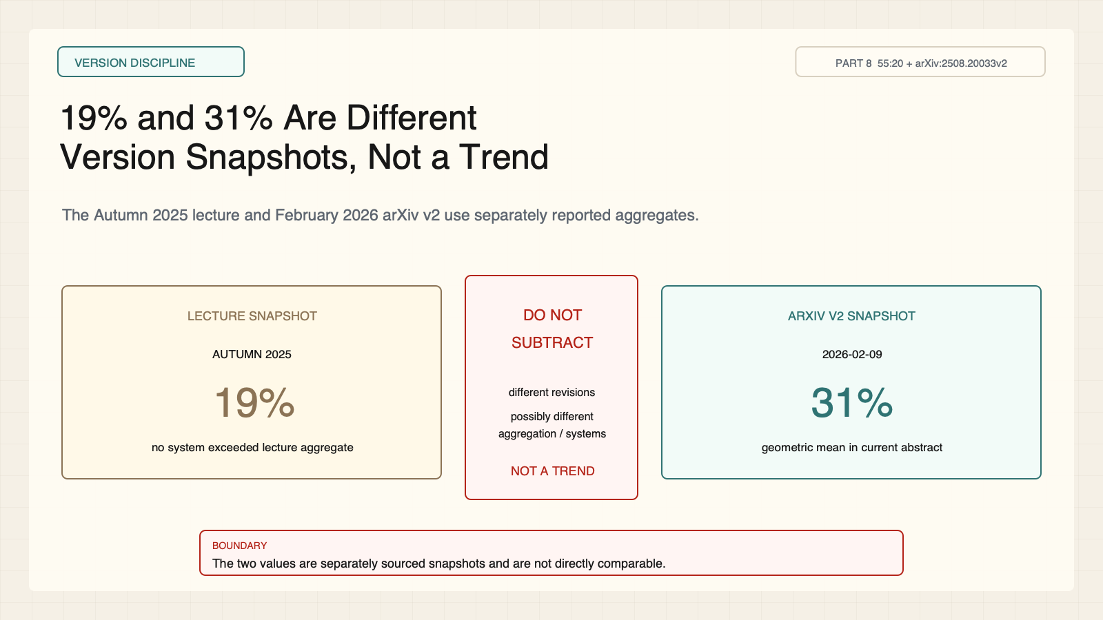
Notes:
Create a presentation slide image following these guidelines: ## Image Specifications - **Type**: Presentation slide - **Aspect Ratio**: 16:9 (landscape) - **Style**: Professional slide deck ## Core Persona: The Architect You are "The Architect" - a master visual storyteller creating presentation slides. Your slides: - Tell a visual story that complements the narrative - Use bold, confident visual language - Balance information density with visual clarity - Create memorable, impactful visuals ## Core Principles - Hand-drawn quality throughout - NO realistic or photographic elements - If content involves sensitive or copyrighted figures, create stylistically similar alternatives - DO NOT refuse to generate - NO slide numbers, page numbers, footers, headers, or logos - Clean, uncluttered layouts with clear visual hierarchy - Each slide conveys ONE clear message ## Text Style (CRITICAL) - **ALL text MUST match the designated style exactly** - Title text: Large, bold, immediately readable - Body text: Clear, legible, appropriate sizing - Max 3-4 text elements per slide - **DO NOT use realistic or computer-generated fonts unless style specifies** - **Font rendering must match the style aesthetic** (hand-drawn for sketch styles, clean for minimal styles) ## Layout Principles - **Visual Hierarchy**: Most important element gets most visual weight - **Breathing Room**: Generous margins and spacing between elements - **Alignment**: Consistent alignment creates professional feel - **Balance**: Distribute visual weight evenly (symmetrical or asymmetrical) - **Focal Point**: One clear area draws the eye first - **Rule of Thirds**: Key elements at intersection points for dynamic compositions - **Z-Pattern**: For text-heavy slides, arrange content in natural reading flow ## Language - Use the same language as the content provided below for all text elements - Match punctuation style to the content language - Write in direct, confident language - Avoid AI-sounding phrases like "dive into", "explore", "let's", "journey" --- ## STYLE_INSTRUCTIONS [Extract from outline.md - do NOT re-read style files] The STYLE_INSTRUCTIONS block from the outline contains: - Design Aesthetic - Background (Texture + Base Color) - Typography (Headlines + Body descriptions) - Color Palette (with hex codes) - Visual Elements - Density Guidelines - Style Rules (Do/Don't) Copy the entire `<STYLE_INSTRUCTIONS>...</STYLE_INSTRUCTIONS>` block from the outline here. --- ## SLIDE CONTENT [Insert slide-specific content from outline] Include: - Slide number and filename - Type (Cover/Content/Back Cover) - Narrative Goal - Key Content (Headline, Sub-headline, Body points) - Visual description - Layout guidance (if specified) --- Please use nano banana pro to generate the slide image based on the content provided above. --- # Slide 11: 19% and 31% Are Different Version Snapshots, Not a Trend ## Production method Rendered locally as an original 1600x900 SVG for exact text fidelity, then converted to PNG. Do not reproduce Stanford frames, figures, or logos. ## Style Aged-cream academic technical briefing, faint engineering grid, crisp vector diagrams, near-black type, cobalt generation, teal verification, warm-brown budget, maroon constraints, 8px card corners, no gradients. ## On-slide content - Stage: version discipline - Headline: 19% and 31% Are Different Version Snapshots, Not a Trend - Subtitle: The Autumn 2025 lecture and February 2026 arXiv v2 use separately reported aggregates. - Supporting labels: Lecture: 19%; arXiv v2: 31%; Do not subtract - Evidence: CS329A Part 8, 55:20 + arXiv:2508.20033v2 ## Visual direction Two dated snapshot cards separated by a red non-comparability wall. ## Teaching objective Preserve the DeepScholar-Bench version discrepancy without implying improvement. ## Speaker notes The lecture says no system exceeded 19 percent across all metrics. The current v2 abstract says no system exceeds 31 percent geometric mean. Revisions may change systems, metric definitions, or aggregation. Do not connect or subtract the values.

Slide 12
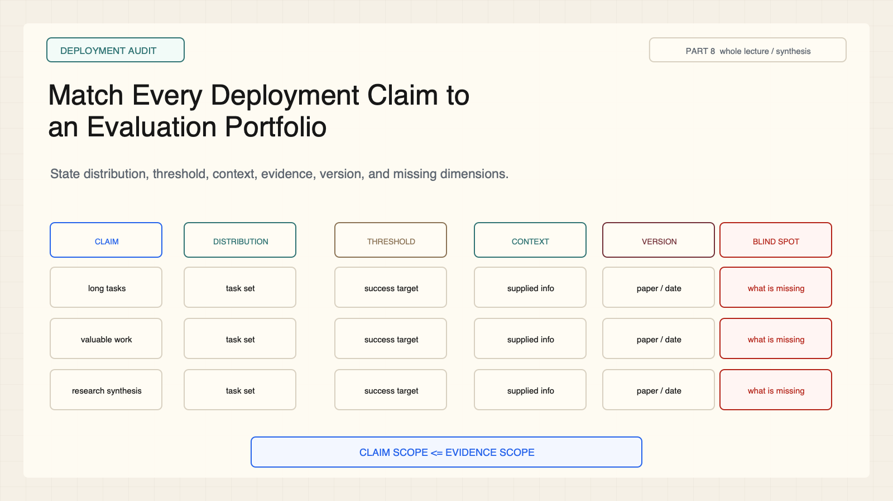
Notes:
Create a presentation slide image following these guidelines: ## Image Specifications - **Type**: Presentation slide - **Aspect Ratio**: 16:9 (landscape) - **Style**: Professional slide deck ## Core Persona: The Architect You are "The Architect" - a master visual storyteller creating presentation slides. Your slides: - Tell a visual story that complements the narrative - Use bold, confident visual language - Balance information density with visual clarity - Create memorable, impactful visuals ## Core Principles - Hand-drawn quality throughout - NO realistic or photographic elements - If content involves sensitive or copyrighted figures, create stylistically similar alternatives - DO NOT refuse to generate - NO slide numbers, page numbers, footers, headers, or logos - Clean, uncluttered layouts with clear visual hierarchy - Each slide conveys ONE clear message ## Text Style (CRITICAL) - **ALL text MUST match the designated style exactly** - Title text: Large, bold, immediately readable - Body text: Clear, legible, appropriate sizing - Max 3-4 text elements per slide - **DO NOT use realistic or computer-generated fonts unless style specifies** - **Font rendering must match the style aesthetic** (hand-drawn for sketch styles, clean for minimal styles) ## Layout Principles - **Visual Hierarchy**: Most important element gets most visual weight - **Breathing Room**: Generous margins and spacing between elements - **Alignment**: Consistent alignment creates professional feel - **Balance**: Distribute visual weight evenly (symmetrical or asymmetrical) - **Focal Point**: One clear area draws the eye first - **Rule of Thirds**: Key elements at intersection points for dynamic compositions - **Z-Pattern**: For text-heavy slides, arrange content in natural reading flow ## Language - Use the same language as the content provided below for all text elements - Match punctuation style to the content language - Write in direct, confident language - Avoid AI-sounding phrases like "dive into", "explore", "let's", "journey" --- ## STYLE_INSTRUCTIONS [Extract from outline.md - do NOT re-read style files] The STYLE_INSTRUCTIONS block from the outline contains: - Design Aesthetic - Background (Texture + Base Color) - Typography (Headlines + Body descriptions) - Color Palette (with hex codes) - Visual Elements - Density Guidelines - Style Rules (Do/Don't) Copy the entire `<STYLE_INSTRUCTIONS>...</STYLE_INSTRUCTIONS>` block from the outline here. --- ## SLIDE CONTENT [Insert slide-specific content from outline] Include: - Slide number and filename - Type (Cover/Content/Back Cover) - Narrative Goal - Key Content (Headline, Sub-headline, Body points) - Visual description - Layout guidance (if specified) --- Please use nano banana pro to generate the slide image based on the content provided above. --- # Slide 12: Match Every Deployment Claim to an Evaluation Portfolio ## Production method Rendered locally as an original 1600x900 SVG for exact text fidelity, then converted to PNG. Do not reproduce Stanford frames, figures, or logos. ## Style Aged-cream academic technical briefing, faint engineering grid, crisp vector diagrams, near-black type, cobalt generation, teal verification, warm-brown budget, maroon constraints, 8px card corners, no gradients. ## On-slide content - Stage: deployment audit - Headline: Match Every Deployment Claim to an Evaluation Portfolio - Subtitle: State distribution, threshold, context, evidence, version, and missing dimensions. - Supporting labels: Claim; Test; Version; Blind spot - Evidence: CS329A Part 8, whole lecture / synthesis ## Visual direction A claim-to-test matrix with an explicit blind-spot column. ## Teaching objective Apply a reusable evaluation audit to deployment claims. ## Speaker notes No portfolio proves universal safety or capability. It makes the evidence boundary inspectable and identifies what still needs testing.

