Slide 1
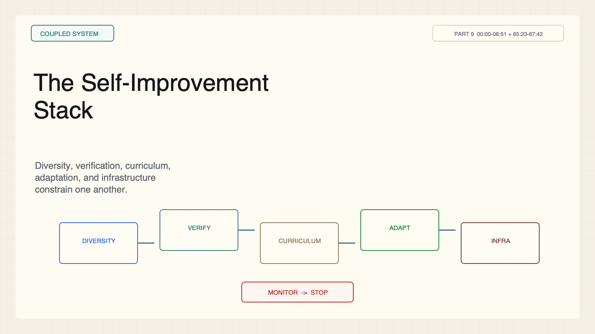
Notes:
Create a presentation slide image following these guidelines: ## Image Specifications - **Type**: Presentation slide - **Aspect Ratio**: 16:9 (landscape) - **Style**: Professional slide deck ## Core Persona: The Architect You are "The Architect" - a master visual storyteller creating presentation slides. Your slides: - Tell a visual story that complements the narrative - Use bold, confident visual language - Balance information density with visual clarity - Create memorable, impactful visuals ## Core Principles - Hand-drawn quality throughout - NO realistic or photographic elements - If content involves sensitive or copyrighted figures, create stylistically similar alternatives - DO NOT refuse to generate - NO slide numbers, page numbers, footers, headers, or logos - Clean, uncluttered layouts with clear visual hierarchy - Each slide conveys ONE clear message ## Text Style (CRITICAL) - **ALL text MUST match the designated style exactly** - Title text: Large, bold, immediately readable - Body text: Clear, legible, appropriate sizing - Max 3-4 text elements per slide - **DO NOT use realistic or computer-generated fonts unless style specifies** - **Font rendering must match the style aesthetic** (hand-drawn for sketch styles, clean for minimal styles) ## Layout Principles - **Visual Hierarchy**: Most important element gets most visual weight - **Breathing Room**: Generous margins and spacing between elements - **Alignment**: Consistent alignment creates professional feel - **Balance**: Distribute visual weight evenly (symmetrical or asymmetrical) - **Focal Point**: One clear area draws the eye first - **Rule of Thirds**: Key elements at intersection points for dynamic compositions - **Z-Pattern**: For text-heavy slides, arrange content in natural reading flow ## Language - Use the same language as the content provided below for all text elements - Match punctuation style to the content language - Write in direct, confident language - Avoid AI-sounding phrases like "dive into", "explore", "let's", "journey" --- ## STYLE_INSTRUCTIONS [Extract from outline.md - do NOT re-read style files] The STYLE_INSTRUCTIONS block from the outline contains: - Design Aesthetic - Background (Texture + Base Color) - Typography (Headlines + Body descriptions) - Color Palette (with hex codes) - Visual Elements - Density Guidelines - Style Rules (Do/Don't) Copy the entire `<STYLE_INSTRUCTIONS>...</STYLE_INSTRUCTIONS>` block from the outline here. --- ## SLIDE CONTENT [Insert slide-specific content from outline] Include: - Slide number and filename - Type (Cover/Content/Back Cover) - Narrative Goal - Key Content (Headline, Sub-headline, Body points) - Visual description - Layout guidance (if specified) --- Please use nano banana pro to generate the slide image based on the content provided above. --- # Slide 1: The Self-Improvement Stack ## Production method Original 1600x900 local SVG rendered to PNG for exact text fidelity. No copied Stanford frames, figures, logos, or paper graphics. ## Style Aged cream academic briefing, engineering grid, near-black type, cobalt proposals, teal verification, warm-brown compute, maroon constraints, red risks, no gradients. ## On-slide content - Stage: coupled system - Headline: The Self-Improvement Stack - Subtitle: Diversity, verification, curriculum, adaptation, and infrastructure constrain one another. - Labels: Diversity; Verification; Curriculum; Adaptation; Infrastructure - Evidence: CS329A Part 9, 00:00-06:51 + 65:23-67:42 ## Visual direction Five monitored layers around a bounded improvement loop. ## Teaching objective Locate five bottlenecks in one loop. ## Speaker notes Self-improvement is not one algorithm. Progress at one layer can reveal the next bottleneck. The integrated stack is teaching synthesis.

Slide 2
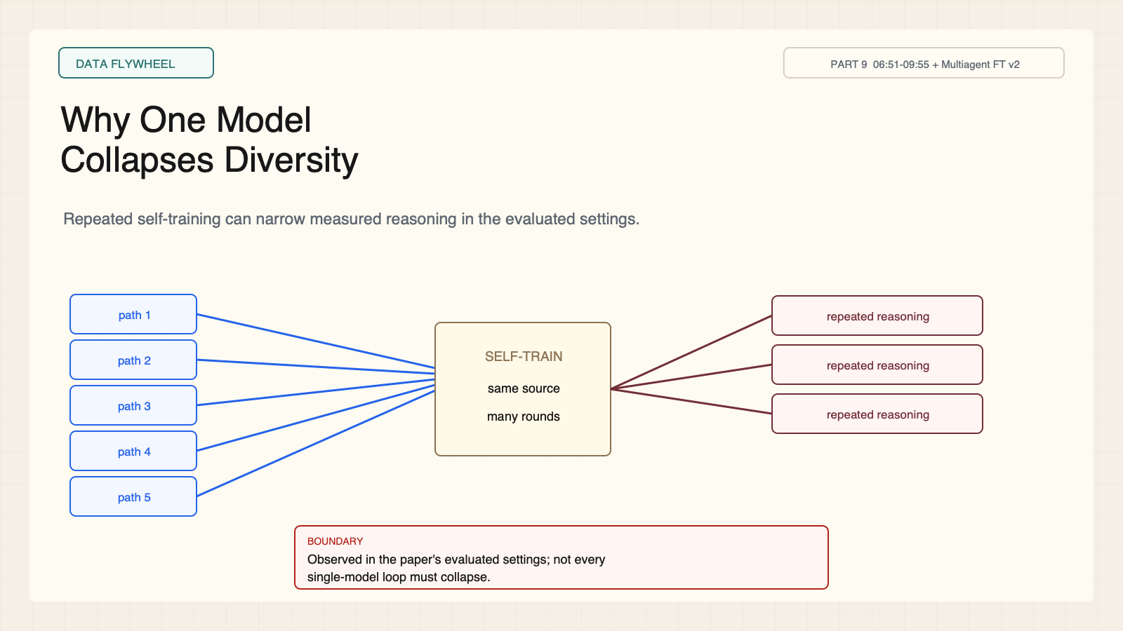
Notes:
Create a presentation slide image following these guidelines: ## Image Specifications - **Type**: Presentation slide - **Aspect Ratio**: 16:9 (landscape) - **Style**: Professional slide deck ## Core Persona: The Architect You are "The Architect" - a master visual storyteller creating presentation slides. Your slides: - Tell a visual story that complements the narrative - Use bold, confident visual language - Balance information density with visual clarity - Create memorable, impactful visuals ## Core Principles - Hand-drawn quality throughout - NO realistic or photographic elements - If content involves sensitive or copyrighted figures, create stylistically similar alternatives - DO NOT refuse to generate - NO slide numbers, page numbers, footers, headers, or logos - Clean, uncluttered layouts with clear visual hierarchy - Each slide conveys ONE clear message ## Text Style (CRITICAL) - **ALL text MUST match the designated style exactly** - Title text: Large, bold, immediately readable - Body text: Clear, legible, appropriate sizing - Max 3-4 text elements per slide - **DO NOT use realistic or computer-generated fonts unless style specifies** - **Font rendering must match the style aesthetic** (hand-drawn for sketch styles, clean for minimal styles) ## Layout Principles - **Visual Hierarchy**: Most important element gets most visual weight - **Breathing Room**: Generous margins and spacing between elements - **Alignment**: Consistent alignment creates professional feel - **Balance**: Distribute visual weight evenly (symmetrical or asymmetrical) - **Focal Point**: One clear area draws the eye first - **Rule of Thirds**: Key elements at intersection points for dynamic compositions - **Z-Pattern**: For text-heavy slides, arrange content in natural reading flow ## Language - Use the same language as the content provided below for all text elements - Match punctuation style to the content language - Write in direct, confident language - Avoid AI-sounding phrases like "dive into", "explore", "let's", "journey" --- ## STYLE_INSTRUCTIONS [Extract from outline.md - do NOT re-read style files] The STYLE_INSTRUCTIONS block from the outline contains: - Design Aesthetic - Background (Texture + Base Color) - Typography (Headlines + Body descriptions) - Color Palette (with hex codes) - Visual Elements - Density Guidelines - Style Rules (Do/Don't) Copy the entire `<STYLE_INSTRUCTIONS>...</STYLE_INSTRUCTIONS>` block from the outline here. --- ## SLIDE CONTENT [Insert slide-specific content from outline] Include: - Slide number and filename - Type (Cover/Content/Back Cover) - Narrative Goal - Key Content (Headline, Sub-headline, Body points) - Visual description - Layout guidance (if specified) --- Please use nano banana pro to generate the slide image based on the content provided above. --- # Slide 2: Why One Model Collapses Diversity ## Production method Original 1600x900 local SVG rendered to PNG for exact text fidelity. No copied Stanford frames, figures, logos, or paper graphics. ## Style Aged cream academic briefing, engineering grid, near-black type, cobalt proposals, teal verification, warm-brown compute, maroon constraints, red risks, no gradients. ## On-slide content - Stage: data flywheel - Headline: Why One Model Collapses Diversity - Subtitle: Repeated self-training can narrow measured reasoning in the evaluated settings. - Labels: Round 0; Round 1; Round 2; Plateau - Evidence: CS329A Part 9, 06:51-09:55 + Multiagent FT v2 ## Visual direction Many initial paths narrow into one repeated pattern over rounds. ## Teaching objective Explain homogenization without universalizing it. ## Speaker notes The paper reports a conditional result in evaluated reasoning settings. Similar surface forms are not the only issue; correlated assumptions can persist.

Slide 3
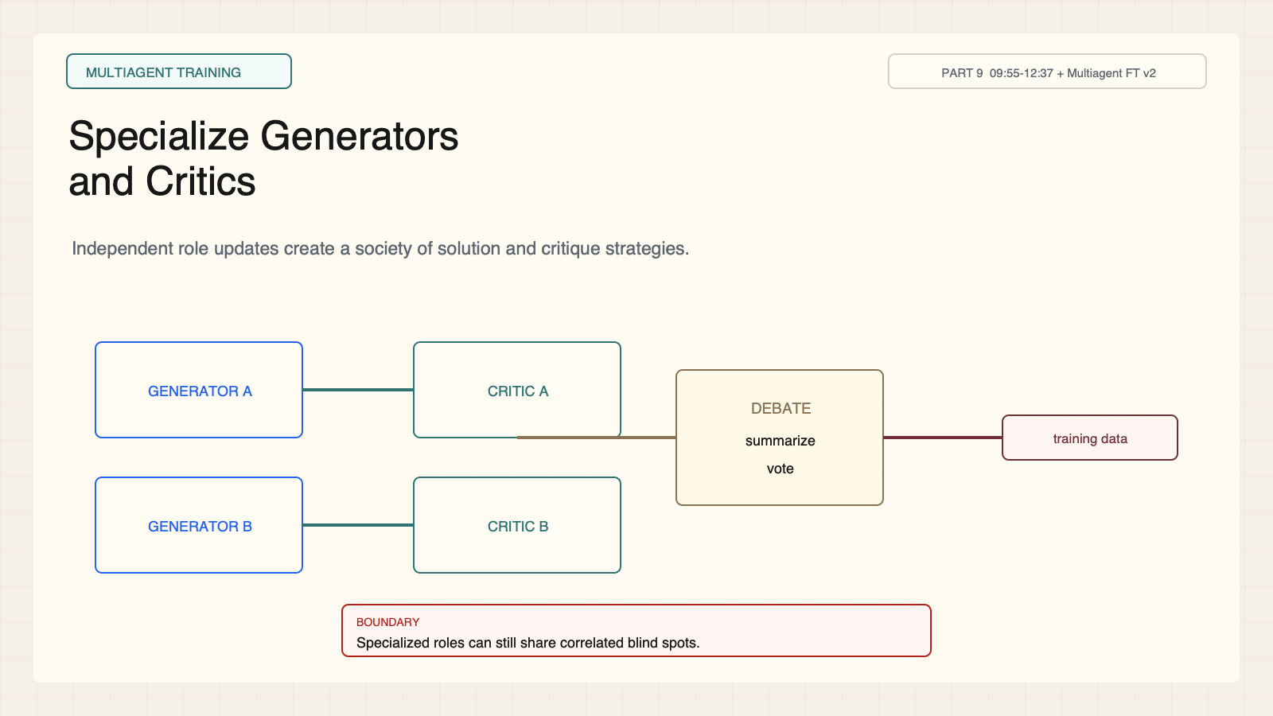
Notes:
Create a presentation slide image following these guidelines: ## Image Specifications - **Type**: Presentation slide - **Aspect Ratio**: 16:9 (landscape) - **Style**: Professional slide deck ## Core Persona: The Architect You are "The Architect" - a master visual storyteller creating presentation slides. Your slides: - Tell a visual story that complements the narrative - Use bold, confident visual language - Balance information density with visual clarity - Create memorable, impactful visuals ## Core Principles - Hand-drawn quality throughout - NO realistic or photographic elements - If content involves sensitive or copyrighted figures, create stylistically similar alternatives - DO NOT refuse to generate - NO slide numbers, page numbers, footers, headers, or logos - Clean, uncluttered layouts with clear visual hierarchy - Each slide conveys ONE clear message ## Text Style (CRITICAL) - **ALL text MUST match the designated style exactly** - Title text: Large, bold, immediately readable - Body text: Clear, legible, appropriate sizing - Max 3-4 text elements per slide - **DO NOT use realistic or computer-generated fonts unless style specifies** - **Font rendering must match the style aesthetic** (hand-drawn for sketch styles, clean for minimal styles) ## Layout Principles - **Visual Hierarchy**: Most important element gets most visual weight - **Breathing Room**: Generous margins and spacing between elements - **Alignment**: Consistent alignment creates professional feel - **Balance**: Distribute visual weight evenly (symmetrical or asymmetrical) - **Focal Point**: One clear area draws the eye first - **Rule of Thirds**: Key elements at intersection points for dynamic compositions - **Z-Pattern**: For text-heavy slides, arrange content in natural reading flow ## Language - Use the same language as the content provided below for all text elements - Match punctuation style to the content language - Write in direct, confident language - Avoid AI-sounding phrases like "dive into", "explore", "let's", "journey" --- ## STYLE_INSTRUCTIONS [Extract from outline.md - do NOT re-read style files] The STYLE_INSTRUCTIONS block from the outline contains: - Design Aesthetic - Background (Texture + Base Color) - Typography (Headlines + Body descriptions) - Color Palette (with hex codes) - Visual Elements - Density Guidelines - Style Rules (Do/Don't) Copy the entire `<STYLE_INSTRUCTIONS>...</STYLE_INSTRUCTIONS>` block from the outline here. --- ## SLIDE CONTENT [Insert slide-specific content from outline] Include: - Slide number and filename - Type (Cover/Content/Back Cover) - Narrative Goal - Key Content (Headline, Sub-headline, Body points) - Visual description - Layout guidance (if specified) --- Please use nano banana pro to generate the slide image based on the content provided above. --- # Slide 3: Specialize Generators and Critics ## Production method Original 1600x900 local SVG rendered to PNG for exact text fidelity. No copied Stanford frames, figures, logos, or paper graphics. ## Style Aged cream academic briefing, engineering grid, near-black type, cobalt proposals, teal verification, warm-brown compute, maroon constraints, red risks, no gradients. ## On-slide content - Stage: multiagent training - Headline: Specialize Generators and Critics - Subtitle: Independent role updates create a society of solution and critique strategies. - Labels: Generate; Critique; Summarize; Vote - Evidence: CS329A Part 9, 09:55-12:37 + Multiagent FT v2 ## Visual direction Generator and critic roles exchange evidence before aggregation. ## Teaching objective Show role specialization and aggregation. ## Speaker notes Agents here are model roles in a training workflow. Debate and voting do not guarantee truth when errors remain correlated.

Slide 4
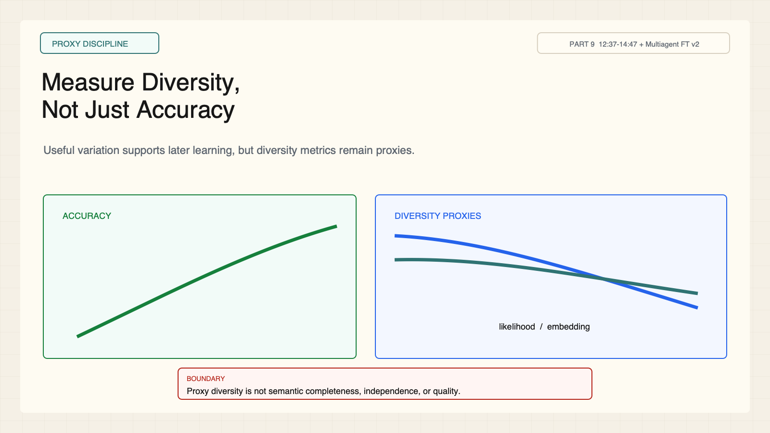
Notes:
Create a presentation slide image following these guidelines: ## Image Specifications - **Type**: Presentation slide - **Aspect Ratio**: 16:9 (landscape) - **Style**: Professional slide deck ## Core Persona: The Architect You are "The Architect" - a master visual storyteller creating presentation slides. Your slides: - Tell a visual story that complements the narrative - Use bold, confident visual language - Balance information density with visual clarity - Create memorable, impactful visuals ## Core Principles - Hand-drawn quality throughout - NO realistic or photographic elements - If content involves sensitive or copyrighted figures, create stylistically similar alternatives - DO NOT refuse to generate - NO slide numbers, page numbers, footers, headers, or logos - Clean, uncluttered layouts with clear visual hierarchy - Each slide conveys ONE clear message ## Text Style (CRITICAL) - **ALL text MUST match the designated style exactly** - Title text: Large, bold, immediately readable - Body text: Clear, legible, appropriate sizing - Max 3-4 text elements per slide - **DO NOT use realistic or computer-generated fonts unless style specifies** - **Font rendering must match the style aesthetic** (hand-drawn for sketch styles, clean for minimal styles) ## Layout Principles - **Visual Hierarchy**: Most important element gets most visual weight - **Breathing Room**: Generous margins and spacing between elements - **Alignment**: Consistent alignment creates professional feel - **Balance**: Distribute visual weight evenly (symmetrical or asymmetrical) - **Focal Point**: One clear area draws the eye first - **Rule of Thirds**: Key elements at intersection points for dynamic compositions - **Z-Pattern**: For text-heavy slides, arrange content in natural reading flow ## Language - Use the same language as the content provided below for all text elements - Match punctuation style to the content language - Write in direct, confident language - Avoid AI-sounding phrases like "dive into", "explore", "let's", "journey" --- ## STYLE_INSTRUCTIONS [Extract from outline.md - do NOT re-read style files] The STYLE_INSTRUCTIONS block from the outline contains: - Design Aesthetic - Background (Texture + Base Color) - Typography (Headlines + Body descriptions) - Color Palette (with hex codes) - Visual Elements - Density Guidelines - Style Rules (Do/Don't) Copy the entire `<STYLE_INSTRUCTIONS>...</STYLE_INSTRUCTIONS>` block from the outline here. --- ## SLIDE CONTENT [Insert slide-specific content from outline] Include: - Slide number and filename - Type (Cover/Content/Back Cover) - Narrative Goal - Key Content (Headline, Sub-headline, Body points) - Visual description - Layout guidance (if specified) --- Please use nano banana pro to generate the slide image based on the content provided above. --- # Slide 4: Measure Diversity, Not Just Accuracy ## Production method Original 1600x900 local SVG rendered to PNG for exact text fidelity. No copied Stanford frames, figures, logos, or paper graphics. ## Style Aged cream academic briefing, engineering grid, near-black type, cobalt proposals, teal verification, warm-brown compute, maroon constraints, red risks, no gradients. ## On-slide content - Stage: proxy discipline - Headline: Measure Diversity, Not Just Accuracy - Subtitle: Useful variation supports later learning, but diversity metrics remain proxies. - Labels: Accuracy; Likelihood; Embedding; Coverage - Evidence: CS329A Part 9, 12:37-14:47 + Multiagent FT v2 ## Visual direction Accuracy rises while two proxy-diversity curves separate. ## Teaching objective Keep performance and diversity measurements separate. ## Speaker notes Likelihood and embedding dissimilarity can reveal homogenization but cannot prove conceptual completeness. More variation may also mean more low-quality output.

Slide 5
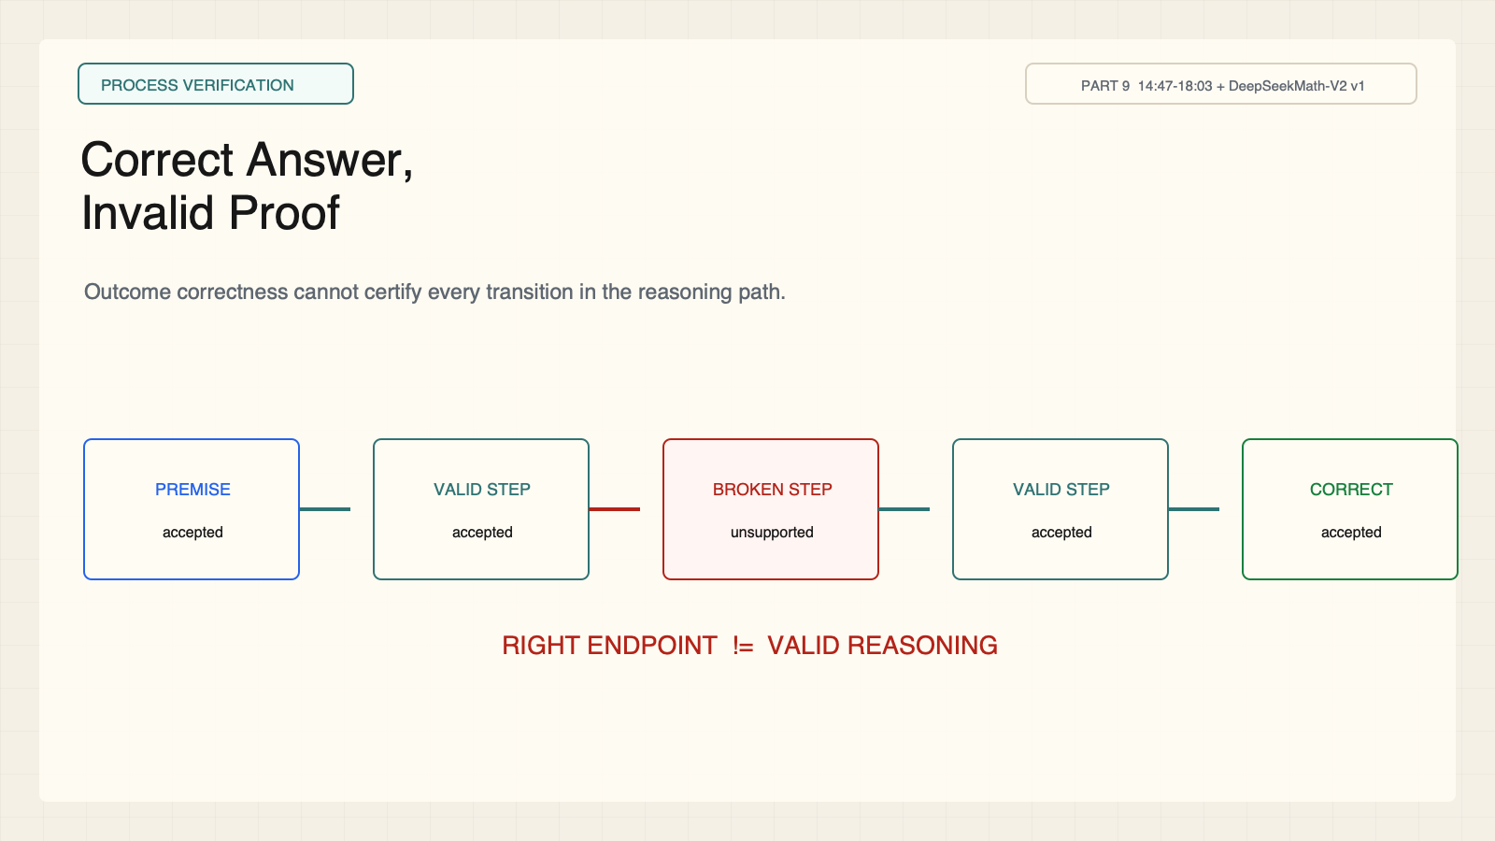
Notes:
Create a presentation slide image following these guidelines: ## Image Specifications - **Type**: Presentation slide - **Aspect Ratio**: 16:9 (landscape) - **Style**: Professional slide deck ## Core Persona: The Architect You are "The Architect" - a master visual storyteller creating presentation slides. Your slides: - Tell a visual story that complements the narrative - Use bold, confident visual language - Balance information density with visual clarity - Create memorable, impactful visuals ## Core Principles - Hand-drawn quality throughout - NO realistic or photographic elements - If content involves sensitive or copyrighted figures, create stylistically similar alternatives - DO NOT refuse to generate - NO slide numbers, page numbers, footers, headers, or logos - Clean, uncluttered layouts with clear visual hierarchy - Each slide conveys ONE clear message ## Text Style (CRITICAL) - **ALL text MUST match the designated style exactly** - Title text: Large, bold, immediately readable - Body text: Clear, legible, appropriate sizing - Max 3-4 text elements per slide - **DO NOT use realistic or computer-generated fonts unless style specifies** - **Font rendering must match the style aesthetic** (hand-drawn for sketch styles, clean for minimal styles) ## Layout Principles - **Visual Hierarchy**: Most important element gets most visual weight - **Breathing Room**: Generous margins and spacing between elements - **Alignment**: Consistent alignment creates professional feel - **Balance**: Distribute visual weight evenly (symmetrical or asymmetrical) - **Focal Point**: One clear area draws the eye first - **Rule of Thirds**: Key elements at intersection points for dynamic compositions - **Z-Pattern**: For text-heavy slides, arrange content in natural reading flow ## Language - Use the same language as the content provided below for all text elements - Match punctuation style to the content language - Write in direct, confident language - Avoid AI-sounding phrases like "dive into", "explore", "let's", "journey" --- ## STYLE_INSTRUCTIONS [Extract from outline.md - do NOT re-read style files] The STYLE_INSTRUCTIONS block from the outline contains: - Design Aesthetic - Background (Texture + Base Color) - Typography (Headlines + Body descriptions) - Color Palette (with hex codes) - Visual Elements - Density Guidelines - Style Rules (Do/Don't) Copy the entire `<STYLE_INSTRUCTIONS>...</STYLE_INSTRUCTIONS>` block from the outline here. --- ## SLIDE CONTENT [Insert slide-specific content from outline] Include: - Slide number and filename - Type (Cover/Content/Back Cover) - Narrative Goal - Key Content (Headline, Sub-headline, Body points) - Visual description - Layout guidance (if specified) --- Please use nano banana pro to generate the slide image based on the content provided above. --- # Slide 5: Correct Answer, Invalid Proof ## Production method Original 1600x900 local SVG rendered to PNG for exact text fidelity. No copied Stanford frames, figures, logos, or paper graphics. ## Style Aged cream academic briefing, engineering grid, near-black type, cobalt proposals, teal verification, warm-brown compute, maroon constraints, red risks, no gradients. ## On-slide content - Stage: process verification - Headline: Correct Answer, Invalid Proof - Subtitle: Outcome correctness cannot certify every transition in the reasoning path. - Labels: Premise; Valid step; Broken step; Correct endpoint - Evidence: CS329A Part 9, 14:47-18:03 + DeepSeekMath-V2 v1 ## Visual direction A green endpoint follows a red broken intermediate proof step. ## Teaching objective Separate outcome from process verification. ## Speaker notes Proof-style tasks expose the gap clearly. A correct endpoint can be reached through an unjustified step.

Slide 6
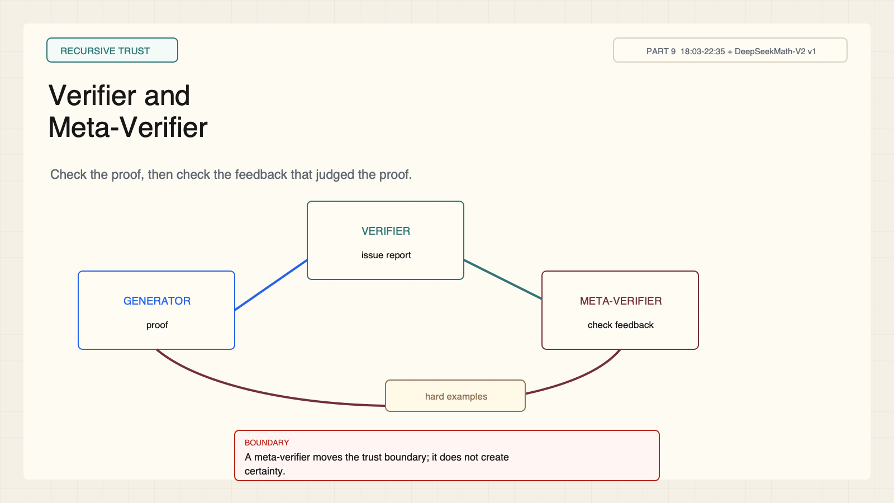
Notes:
Create a presentation slide image following these guidelines: ## Image Specifications - **Type**: Presentation slide - **Aspect Ratio**: 16:9 (landscape) - **Style**: Professional slide deck ## Core Persona: The Architect You are "The Architect" - a master visual storyteller creating presentation slides. Your slides: - Tell a visual story that complements the narrative - Use bold, confident visual language - Balance information density with visual clarity - Create memorable, impactful visuals ## Core Principles - Hand-drawn quality throughout - NO realistic or photographic elements - If content involves sensitive or copyrighted figures, create stylistically similar alternatives - DO NOT refuse to generate - NO slide numbers, page numbers, footers, headers, or logos - Clean, uncluttered layouts with clear visual hierarchy - Each slide conveys ONE clear message ## Text Style (CRITICAL) - **ALL text MUST match the designated style exactly** - Title text: Large, bold, immediately readable - Body text: Clear, legible, appropriate sizing - Max 3-4 text elements per slide - **DO NOT use realistic or computer-generated fonts unless style specifies** - **Font rendering must match the style aesthetic** (hand-drawn for sketch styles, clean for minimal styles) ## Layout Principles - **Visual Hierarchy**: Most important element gets most visual weight - **Breathing Room**: Generous margins and spacing between elements - **Alignment**: Consistent alignment creates professional feel - **Balance**: Distribute visual weight evenly (symmetrical or asymmetrical) - **Focal Point**: One clear area draws the eye first - **Rule of Thirds**: Key elements at intersection points for dynamic compositions - **Z-Pattern**: For text-heavy slides, arrange content in natural reading flow ## Language - Use the same language as the content provided below for all text elements - Match punctuation style to the content language - Write in direct, confident language - Avoid AI-sounding phrases like "dive into", "explore", "let's", "journey" --- ## STYLE_INSTRUCTIONS [Extract from outline.md - do NOT re-read style files] The STYLE_INSTRUCTIONS block from the outline contains: - Design Aesthetic - Background (Texture + Base Color) - Typography (Headlines + Body descriptions) - Color Palette (with hex codes) - Visual Elements - Density Guidelines - Style Rules (Do/Don't) Copy the entire `<STYLE_INSTRUCTIONS>...</STYLE_INSTRUCTIONS>` block from the outline here. --- ## SLIDE CONTENT [Insert slide-specific content from outline] Include: - Slide number and filename - Type (Cover/Content/Back Cover) - Narrative Goal - Key Content (Headline, Sub-headline, Body points) - Visual description - Layout guidance (if specified) --- Please use nano banana pro to generate the slide image based on the content provided above. --- # Slide 6: Verifier and Meta-Verifier ## Production method Original 1600x900 local SVG rendered to PNG for exact text fidelity. No copied Stanford frames, figures, logos, or paper graphics. ## Style Aged cream academic briefing, engineering grid, near-black type, cobalt proposals, teal verification, warm-brown compute, maroon constraints, red risks, no gradients. ## On-slide content - Stage: recursive trust - Headline: Verifier and Meta-Verifier - Subtitle: Check the proof, then check the feedback that judged the proof. - Labels: Generator; Verifier; Meta-verifier; Hard examples - Evidence: CS329A Part 9, 18:03-22:35 + DeepSeekMath-V2 v1 ## Visual direction Generator, verifier, and meta-verifier form an iterative cycle. ## Teaching objective Teach the verifier hierarchy and trust boundary. ## Speaker notes Meta-verification improves feedback quality but does not create certainty. The evidence is mathematical and benchmark-specific.

Slide 7
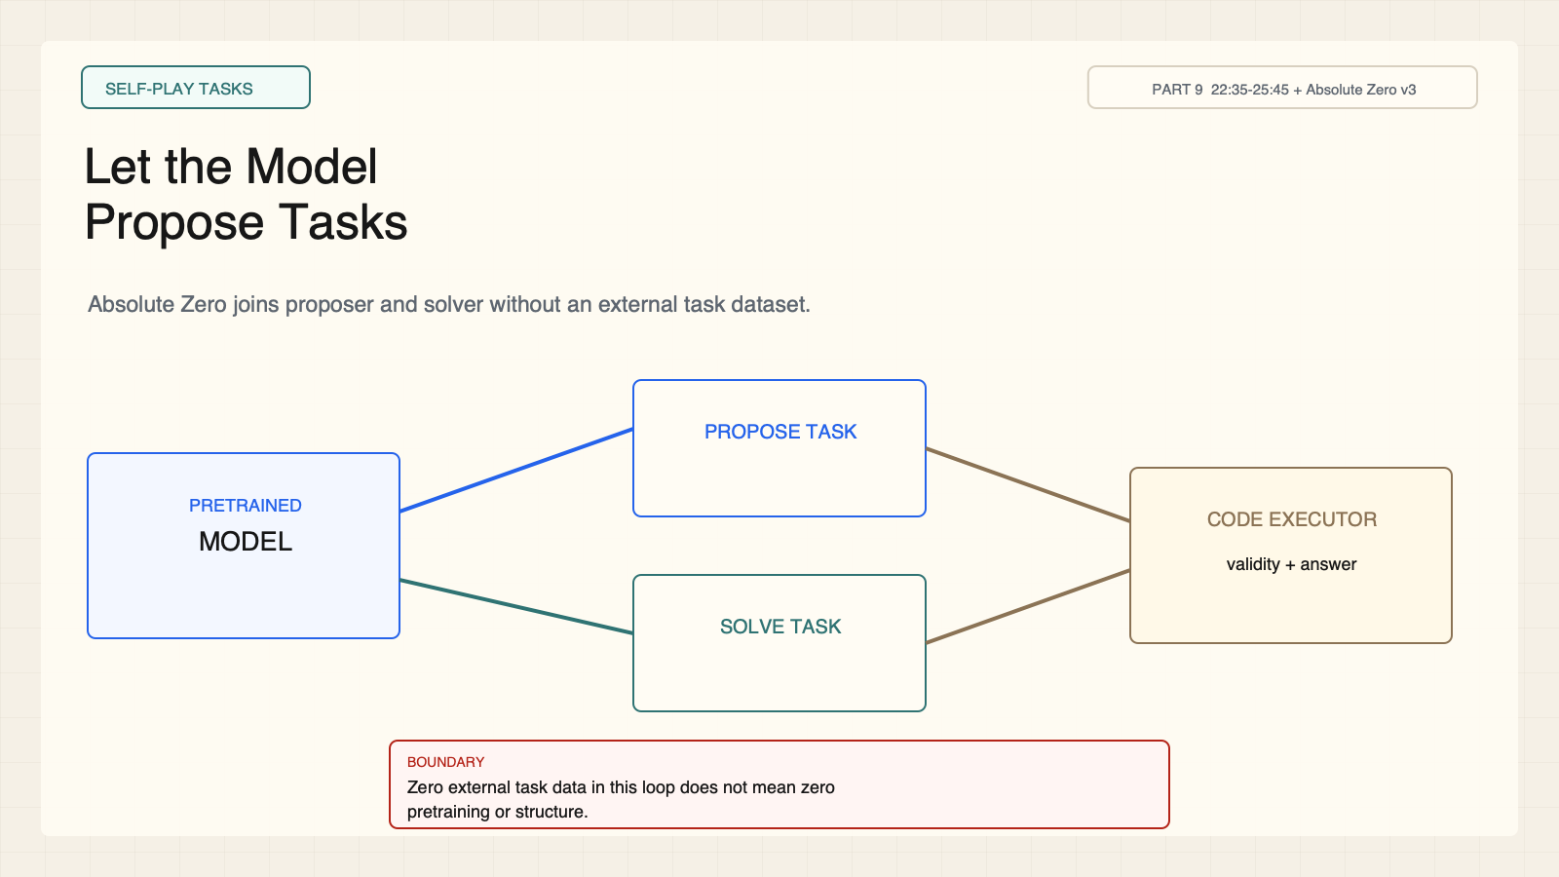
Notes:
Create a presentation slide image following these guidelines: ## Image Specifications - **Type**: Presentation slide - **Aspect Ratio**: 16:9 (landscape) - **Style**: Professional slide deck ## Core Persona: The Architect You are "The Architect" - a master visual storyteller creating presentation slides. Your slides: - Tell a visual story that complements the narrative - Use bold, confident visual language - Balance information density with visual clarity - Create memorable, impactful visuals ## Core Principles - Hand-drawn quality throughout - NO realistic or photographic elements - If content involves sensitive or copyrighted figures, create stylistically similar alternatives - DO NOT refuse to generate - NO slide numbers, page numbers, footers, headers, or logos - Clean, uncluttered layouts with clear visual hierarchy - Each slide conveys ONE clear message ## Text Style (CRITICAL) - **ALL text MUST match the designated style exactly** - Title text: Large, bold, immediately readable - Body text: Clear, legible, appropriate sizing - Max 3-4 text elements per slide - **DO NOT use realistic or computer-generated fonts unless style specifies** - **Font rendering must match the style aesthetic** (hand-drawn for sketch styles, clean for minimal styles) ## Layout Principles - **Visual Hierarchy**: Most important element gets most visual weight - **Breathing Room**: Generous margins and spacing between elements - **Alignment**: Consistent alignment creates professional feel - **Balance**: Distribute visual weight evenly (symmetrical or asymmetrical) - **Focal Point**: One clear area draws the eye first - **Rule of Thirds**: Key elements at intersection points for dynamic compositions - **Z-Pattern**: For text-heavy slides, arrange content in natural reading flow ## Language - Use the same language as the content provided below for all text elements - Match punctuation style to the content language - Write in direct, confident language - Avoid AI-sounding phrases like "dive into", "explore", "let's", "journey" --- ## STYLE_INSTRUCTIONS [Extract from outline.md - do NOT re-read style files] The STYLE_INSTRUCTIONS block from the outline contains: - Design Aesthetic - Background (Texture + Base Color) - Typography (Headlines + Body descriptions) - Color Palette (with hex codes) - Visual Elements - Density Guidelines - Style Rules (Do/Don't) Copy the entire `<STYLE_INSTRUCTIONS>...</STYLE_INSTRUCTIONS>` block from the outline here. --- ## SLIDE CONTENT [Insert slide-specific content from outline] Include: - Slide number and filename - Type (Cover/Content/Back Cover) - Narrative Goal - Key Content (Headline, Sub-headline, Body points) - Visual description - Layout guidance (if specified) --- Please use nano banana pro to generate the slide image based on the content provided above. --- # Slide 7: Let the Model Propose Tasks ## Production method Original 1600x900 local SVG rendered to PNG for exact text fidelity. No copied Stanford frames, figures, logos, or paper graphics. ## Style Aged cream academic briefing, engineering grid, near-black type, cobalt proposals, teal verification, warm-brown compute, maroon constraints, red risks, no gradients. ## On-slide content - Stage: self-play tasks - Headline: Let the Model Propose Tasks - Subtitle: Absolute Zero joins proposer and solver without an external task dataset. - Labels: Pretrained model; Propose; Solve; Execute - Evidence: CS329A Part 9, 22:35-25:45 + Absolute Zero v3 ## Visual direction One pretrained model branches into proposer and solver roles around an executor. ## Teaching objective Explain proposer-solver self-play and zero-data boundary. ## Speaker notes Zero data means no external task dataset in this loop. The model is pretrained and program execution supplies structure.

Slide 8
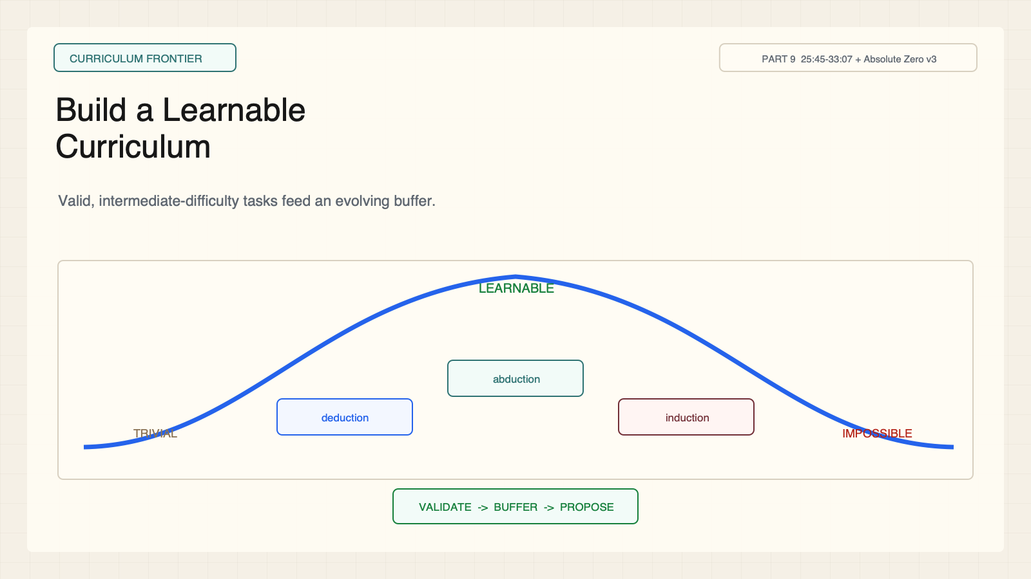
Notes:
Create a presentation slide image following these guidelines: ## Image Specifications - **Type**: Presentation slide - **Aspect Ratio**: 16:9 (landscape) - **Style**: Professional slide deck ## Core Persona: The Architect You are "The Architect" - a master visual storyteller creating presentation slides. Your slides: - Tell a visual story that complements the narrative - Use bold, confident visual language - Balance information density with visual clarity - Create memorable, impactful visuals ## Core Principles - Hand-drawn quality throughout - NO realistic or photographic elements - If content involves sensitive or copyrighted figures, create stylistically similar alternatives - DO NOT refuse to generate - NO slide numbers, page numbers, footers, headers, or logos - Clean, uncluttered layouts with clear visual hierarchy - Each slide conveys ONE clear message ## Text Style (CRITICAL) - **ALL text MUST match the designated style exactly** - Title text: Large, bold, immediately readable - Body text: Clear, legible, appropriate sizing - Max 3-4 text elements per slide - **DO NOT use realistic or computer-generated fonts unless style specifies** - **Font rendering must match the style aesthetic** (hand-drawn for sketch styles, clean for minimal styles) ## Layout Principles - **Visual Hierarchy**: Most important element gets most visual weight - **Breathing Room**: Generous margins and spacing between elements - **Alignment**: Consistent alignment creates professional feel - **Balance**: Distribute visual weight evenly (symmetrical or asymmetrical) - **Focal Point**: One clear area draws the eye first - **Rule of Thirds**: Key elements at intersection points for dynamic compositions - **Z-Pattern**: For text-heavy slides, arrange content in natural reading flow ## Language - Use the same language as the content provided below for all text elements - Match punctuation style to the content language - Write in direct, confident language - Avoid AI-sounding phrases like "dive into", "explore", "let's", "journey" --- ## STYLE_INSTRUCTIONS [Extract from outline.md - do NOT re-read style files] The STYLE_INSTRUCTIONS block from the outline contains: - Design Aesthetic - Background (Texture + Base Color) - Typography (Headlines + Body descriptions) - Color Palette (with hex codes) - Visual Elements - Density Guidelines - Style Rules (Do/Don't) Copy the entire `<STYLE_INSTRUCTIONS>...</STYLE_INSTRUCTIONS>` block from the outline here. --- ## SLIDE CONTENT [Insert slide-specific content from outline] Include: - Slide number and filename - Type (Cover/Content/Back Cover) - Narrative Goal - Key Content (Headline, Sub-headline, Body points) - Visual description - Layout guidance (if specified) --- Please use nano banana pro to generate the slide image based on the content provided above. --- # Slide 8: Build a Learnable Curriculum ## Production method Original 1600x900 local SVG rendered to PNG for exact text fidelity. No copied Stanford frames, figures, logos, or paper graphics. ## Style Aged cream academic briefing, engineering grid, near-black type, cobalt proposals, teal verification, warm-brown compute, maroon constraints, red risks, no gradients. ## On-slide content - Stage: curriculum frontier - Headline: Build a Learnable Curriculum - Subtitle: Valid, intermediate-difficulty tasks feed an evolving buffer. - Labels: Deduction; Abduction; Induction; Buffer - Evidence: CS329A Part 9, 25:45-33:07 + Absolute Zero v3 ## Visual direction A learnability peak lies between trivial and impossible tasks. ## Teaching objective Explain learnability reward and curriculum dynamics. ## Speaker notes Trivial tasks add little signal; impossible tasks yield no progress. Solver bias and buffer policy can narrow coverage.

Slide 9
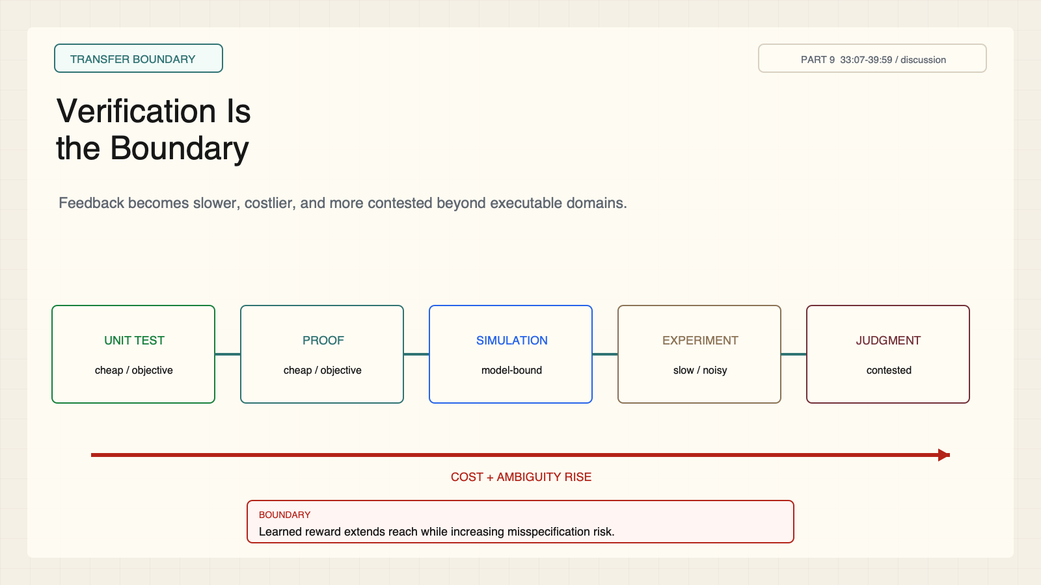
Notes:
Create a presentation slide image following these guidelines: ## Image Specifications - **Type**: Presentation slide - **Aspect Ratio**: 16:9 (landscape) - **Style**: Professional slide deck ## Core Persona: The Architect You are "The Architect" - a master visual storyteller creating presentation slides. Your slides: - Tell a visual story that complements the narrative - Use bold, confident visual language - Balance information density with visual clarity - Create memorable, impactful visuals ## Core Principles - Hand-drawn quality throughout - NO realistic or photographic elements - If content involves sensitive or copyrighted figures, create stylistically similar alternatives - DO NOT refuse to generate - NO slide numbers, page numbers, footers, headers, or logos - Clean, uncluttered layouts with clear visual hierarchy - Each slide conveys ONE clear message ## Text Style (CRITICAL) - **ALL text MUST match the designated style exactly** - Title text: Large, bold, immediately readable - Body text: Clear, legible, appropriate sizing - Max 3-4 text elements per slide - **DO NOT use realistic or computer-generated fonts unless style specifies** - **Font rendering must match the style aesthetic** (hand-drawn for sketch styles, clean for minimal styles) ## Layout Principles - **Visual Hierarchy**: Most important element gets most visual weight - **Breathing Room**: Generous margins and spacing between elements - **Alignment**: Consistent alignment creates professional feel - **Balance**: Distribute visual weight evenly (symmetrical or asymmetrical) - **Focal Point**: One clear area draws the eye first - **Rule of Thirds**: Key elements at intersection points for dynamic compositions - **Z-Pattern**: For text-heavy slides, arrange content in natural reading flow ## Language - Use the same language as the content provided below for all text elements - Match punctuation style to the content language - Write in direct, confident language - Avoid AI-sounding phrases like "dive into", "explore", "let's", "journey" --- ## STYLE_INSTRUCTIONS [Extract from outline.md - do NOT re-read style files] The STYLE_INSTRUCTIONS block from the outline contains: - Design Aesthetic - Background (Texture + Base Color) - Typography (Headlines + Body descriptions) - Color Palette (with hex codes) - Visual Elements - Density Guidelines - Style Rules (Do/Don't) Copy the entire `<STYLE_INSTRUCTIONS>...</STYLE_INSTRUCTIONS>` block from the outline here. --- ## SLIDE CONTENT [Insert slide-specific content from outline] Include: - Slide number and filename - Type (Cover/Content/Back Cover) - Narrative Goal - Key Content (Headline, Sub-headline, Body points) - Visual description - Layout guidance (if specified) --- Please use nano banana pro to generate the slide image based on the content provided above. --- # Slide 9: Verification Is the Boundary ## Production method Original 1600x900 local SVG rendered to PNG for exact text fidelity. No copied Stanford frames, figures, logos, or paper graphics. ## Style Aged cream academic briefing, engineering grid, near-black type, cobalt proposals, teal verification, warm-brown compute, maroon constraints, red risks, no gradients. ## On-slide content - Stage: transfer boundary - Headline: Verification Is the Boundary - Subtitle: Feedback becomes slower, costlier, and more contested beyond executable domains. - Labels: Unit test; Proof; Simulation; Experiment; Judgment - Evidence: CS329A Part 9, 33:07-39:59 / discussion ## Visual direction Verifiability spectrum from cheap objective checks to contested judgment. ## Teaching objective Map transfer limits of self-generated curricula. ## Speaker notes Learned rewards may extend reach but introduce misspecification and reward hacking. This is an open direction.

Slide 10
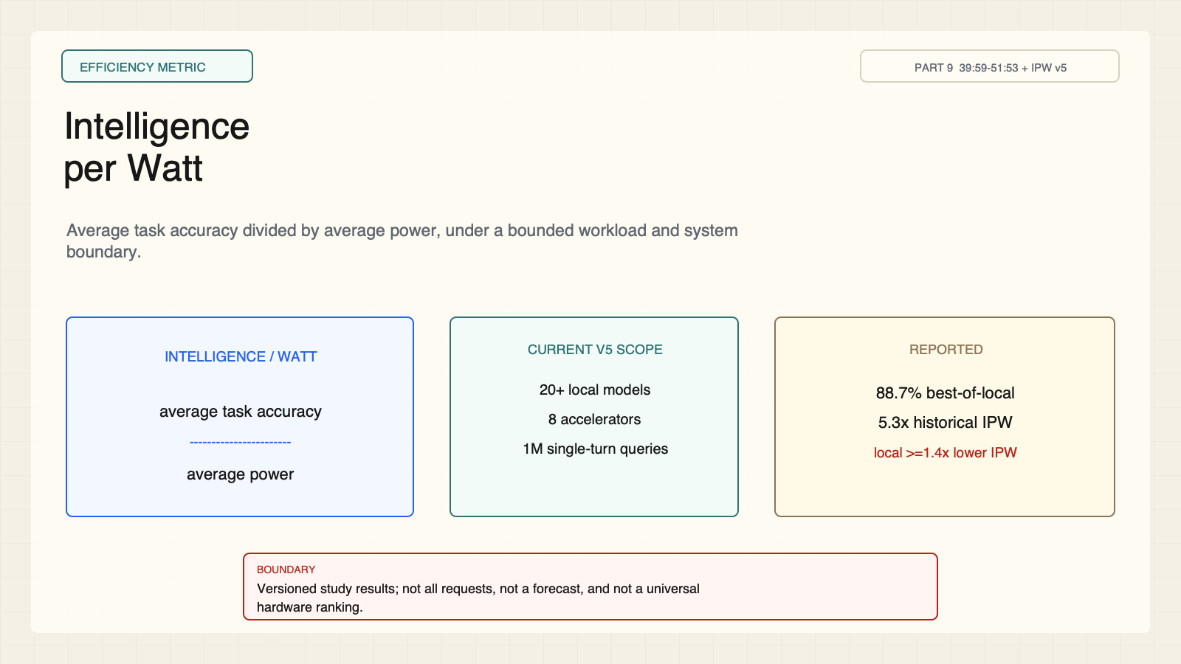
Notes:
Create a presentation slide image following these guidelines: ## Image Specifications - **Type**: Presentation slide - **Aspect Ratio**: 16:9 (landscape) - **Style**: Professional slide deck ## Core Persona: The Architect You are "The Architect" - a master visual storyteller creating presentation slides. Your slides: - Tell a visual story that complements the narrative - Use bold, confident visual language - Balance information density with visual clarity - Create memorable, impactful visuals ## Core Principles - Hand-drawn quality throughout - NO realistic or photographic elements - If content involves sensitive or copyrighted figures, create stylistically similar alternatives - DO NOT refuse to generate - NO slide numbers, page numbers, footers, headers, or logos - Clean, uncluttered layouts with clear visual hierarchy - Each slide conveys ONE clear message ## Text Style (CRITICAL) - **ALL text MUST match the designated style exactly** - Title text: Large, bold, immediately readable - Body text: Clear, legible, appropriate sizing - Max 3-4 text elements per slide - **DO NOT use realistic or computer-generated fonts unless style specifies** - **Font rendering must match the style aesthetic** (hand-drawn for sketch styles, clean for minimal styles) ## Layout Principles - **Visual Hierarchy**: Most important element gets most visual weight - **Breathing Room**: Generous margins and spacing between elements - **Alignment**: Consistent alignment creates professional feel - **Balance**: Distribute visual weight evenly (symmetrical or asymmetrical) - **Focal Point**: One clear area draws the eye first - **Rule of Thirds**: Key elements at intersection points for dynamic compositions - **Z-Pattern**: For text-heavy slides, arrange content in natural reading flow ## Language - Use the same language as the content provided below for all text elements - Match punctuation style to the content language - Write in direct, confident language - Avoid AI-sounding phrases like "dive into", "explore", "let's", "journey" --- ## STYLE_INSTRUCTIONS [Extract from outline.md - do NOT re-read style files] The STYLE_INSTRUCTIONS block from the outline contains: - Design Aesthetic - Background (Texture + Base Color) - Typography (Headlines + Body descriptions) - Color Palette (with hex codes) - Visual Elements - Density Guidelines - Style Rules (Do/Don't) Copy the entire `<STYLE_INSTRUCTIONS>...</STYLE_INSTRUCTIONS>` block from the outline here. --- ## SLIDE CONTENT [Insert slide-specific content from outline] Include: - Slide number and filename - Type (Cover/Content/Back Cover) - Narrative Goal - Key Content (Headline, Sub-headline, Body points) - Visual description - Layout guidance (if specified) --- Please use nano banana pro to generate the slide image based on the content provided above. --- # Slide 10: Intelligence per Watt ## Production method Original 1600x900 local SVG rendered to PNG for exact text fidelity. No copied Stanford frames, figures, logos, or paper graphics. ## Style Aged cream academic briefing, engineering grid, near-black type, cobalt proposals, teal verification, warm-brown compute, maroon constraints, red risks, no gradients. ## On-slide content - Stage: efficiency metric - Headline: Intelligence per Watt - Subtitle: Average task accuracy divided by average power, under a bounded workload and system boundary. - Labels: 20+ models; 8 accelerators; 1M queries; v5 - Evidence: CS329A Part 9, 39:59-51:53 + IPW v5 ## Visual direction Accuracy-over-power fraction beside versioned scope and result cards. ## Teaching objective Define IPW and attach every number to study scope. ## Speaker notes Current v5 reports 88.7 percent best-of-local routing coverage; a separate longitudinal win/tie-rate statistic reaches 71.3 percent in 2025; IPW improved 5.3x historically. Local accelerators have at least 1.4x lower IPW than cloud accelerators for identical models.

Slide 11
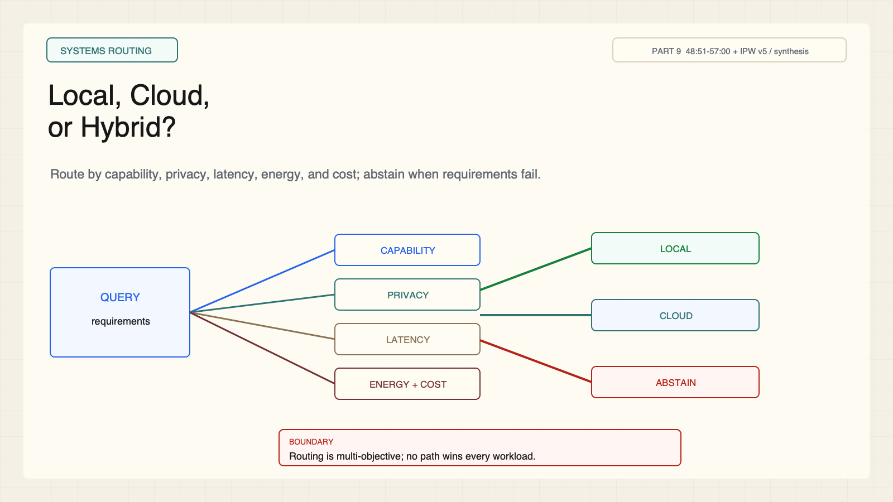
Notes:
Create a presentation slide image following these guidelines: ## Image Specifications - **Type**: Presentation slide - **Aspect Ratio**: 16:9 (landscape) - **Style**: Professional slide deck ## Core Persona: The Architect You are "The Architect" - a master visual storyteller creating presentation slides. Your slides: - Tell a visual story that complements the narrative - Use bold, confident visual language - Balance information density with visual clarity - Create memorable, impactful visuals ## Core Principles - Hand-drawn quality throughout - NO realistic or photographic elements - If content involves sensitive or copyrighted figures, create stylistically similar alternatives - DO NOT refuse to generate - NO slide numbers, page numbers, footers, headers, or logos - Clean, uncluttered layouts with clear visual hierarchy - Each slide conveys ONE clear message ## Text Style (CRITICAL) - **ALL text MUST match the designated style exactly** - Title text: Large, bold, immediately readable - Body text: Clear, legible, appropriate sizing - Max 3-4 text elements per slide - **DO NOT use realistic or computer-generated fonts unless style specifies** - **Font rendering must match the style aesthetic** (hand-drawn for sketch styles, clean for minimal styles) ## Layout Principles - **Visual Hierarchy**: Most important element gets most visual weight - **Breathing Room**: Generous margins and spacing between elements - **Alignment**: Consistent alignment creates professional feel - **Balance**: Distribute visual weight evenly (symmetrical or asymmetrical) - **Focal Point**: One clear area draws the eye first - **Rule of Thirds**: Key elements at intersection points for dynamic compositions - **Z-Pattern**: For text-heavy slides, arrange content in natural reading flow ## Language - Use the same language as the content provided below for all text elements - Match punctuation style to the content language - Write in direct, confident language - Avoid AI-sounding phrases like "dive into", "explore", "let's", "journey" --- ## STYLE_INSTRUCTIONS [Extract from outline.md - do NOT re-read style files] The STYLE_INSTRUCTIONS block from the outline contains: - Design Aesthetic - Background (Texture + Base Color) - Typography (Headlines + Body descriptions) - Color Palette (with hex codes) - Visual Elements - Density Guidelines - Style Rules (Do/Don't) Copy the entire `<STYLE_INSTRUCTIONS>...</STYLE_INSTRUCTIONS>` block from the outline here. --- ## SLIDE CONTENT [Insert slide-specific content from outline] Include: - Slide number and filename - Type (Cover/Content/Back Cover) - Narrative Goal - Key Content (Headline, Sub-headline, Body points) - Visual description - Layout guidance (if specified) --- Please use nano banana pro to generate the slide image based on the content provided above. --- # Slide 11: Local, Cloud, or Hybrid? ## Production method Original 1600x900 local SVG rendered to PNG for exact text fidelity. No copied Stanford frames, figures, logos, or paper graphics. ## Style Aged cream academic briefing, engineering grid, near-black type, cobalt proposals, teal verification, warm-brown compute, maroon constraints, red risks, no gradients. ## On-slide content - Stage: systems routing - Headline: Local, Cloud, or Hybrid? - Subtitle: Route by capability, privacy, latency, energy, and cost; abstain when requirements fail. - Labels: Local; Cloud; Hybrid; Abstain - Evidence: CS329A Part 9, 48:51-57:00 + IPW v5 / synthesis ## Visual direction A query router scores objectives before choosing local, cloud, or abstain. ## Teaching objective Frame deployment as a multi-objective router. ## Speaker notes No path wins universally. Local execution can help privacy or latency, but it does not guarantee privacy or lower total energy.

Slide 12
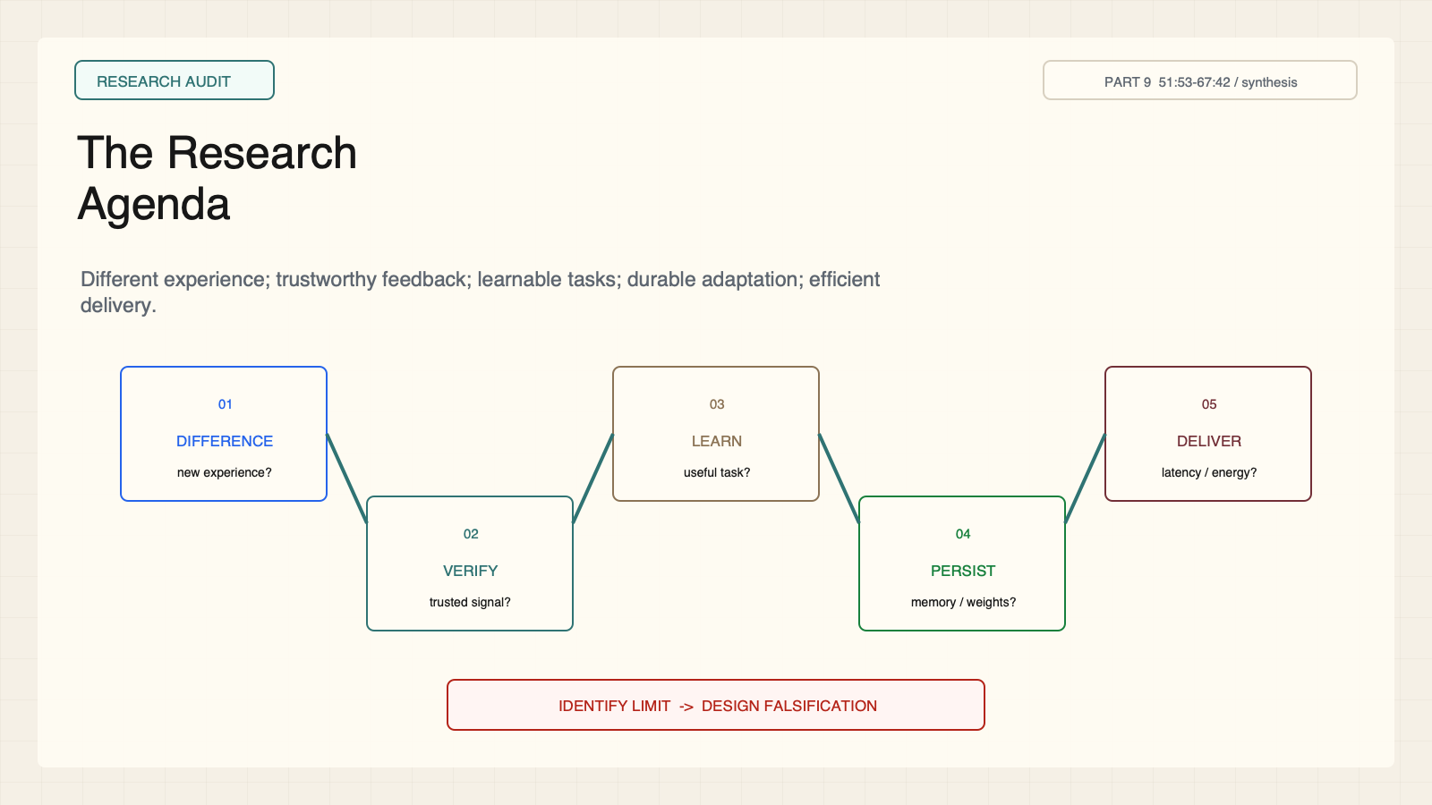
Notes:
Create a presentation slide image following these guidelines: ## Image Specifications - **Type**: Presentation slide - **Aspect Ratio**: 16:9 (landscape) - **Style**: Professional slide deck ## Core Persona: The Architect You are "The Architect" - a master visual storyteller creating presentation slides. Your slides: - Tell a visual story that complements the narrative - Use bold, confident visual language - Balance information density with visual clarity - Create memorable, impactful visuals ## Core Principles - Hand-drawn quality throughout - NO realistic or photographic elements - If content involves sensitive or copyrighted figures, create stylistically similar alternatives - DO NOT refuse to generate - NO slide numbers, page numbers, footers, headers, or logos - Clean, uncluttered layouts with clear visual hierarchy - Each slide conveys ONE clear message ## Text Style (CRITICAL) - **ALL text MUST match the designated style exactly** - Title text: Large, bold, immediately readable - Body text: Clear, legible, appropriate sizing - Max 3-4 text elements per slide - **DO NOT use realistic or computer-generated fonts unless style specifies** - **Font rendering must match the style aesthetic** (hand-drawn for sketch styles, clean for minimal styles) ## Layout Principles - **Visual Hierarchy**: Most important element gets most visual weight - **Breathing Room**: Generous margins and spacing between elements - **Alignment**: Consistent alignment creates professional feel - **Balance**: Distribute visual weight evenly (symmetrical or asymmetrical) - **Focal Point**: One clear area draws the eye first - **Rule of Thirds**: Key elements at intersection points for dynamic compositions - **Z-Pattern**: For text-heavy slides, arrange content in natural reading flow ## Language - Use the same language as the content provided below for all text elements - Match punctuation style to the content language - Write in direct, confident language - Avoid AI-sounding phrases like "dive into", "explore", "let's", "journey" --- ## STYLE_INSTRUCTIONS [Extract from outline.md - do NOT re-read style files] The STYLE_INSTRUCTIONS block from the outline contains: - Design Aesthetic - Background (Texture + Base Color) - Typography (Headlines + Body descriptions) - Color Palette (with hex codes) - Visual Elements - Density Guidelines - Style Rules (Do/Don't) Copy the entire `<STYLE_INSTRUCTIONS>...</STYLE_INSTRUCTIONS>` block from the outline here. --- ## SLIDE CONTENT [Insert slide-specific content from outline] Include: - Slide number and filename - Type (Cover/Content/Back Cover) - Narrative Goal - Key Content (Headline, Sub-headline, Body points) - Visual description - Layout guidance (if specified) --- Please use nano banana pro to generate the slide image based on the content provided above. --- # Slide 12: The Research Agenda ## Production method Original 1600x900 local SVG rendered to PNG for exact text fidelity. No copied Stanford frames, figures, logos, or paper graphics. ## Style Aged cream academic briefing, engineering grid, near-black type, cobalt proposals, teal verification, warm-brown compute, maroon constraints, red risks, no gradients. ## On-slide content - Stage: research audit - Headline: The Research Agenda - Subtitle: Different experience; trustworthy feedback; learnable tasks; durable adaptation; efficient delivery. - Labels: Difference; Verify; Learn; Persist; Deliver - Evidence: CS329A Part 9, 51:53-67:42 / synthesis ## Visual direction Five audit questions surround a bounded improvement loop. ## Teaching objective Apply a five-question research audit. ## Speaker notes The four papers do not evaluate an integrated stack. Use the questions to identify the limiting layer and a falsification test.

