Slide 1
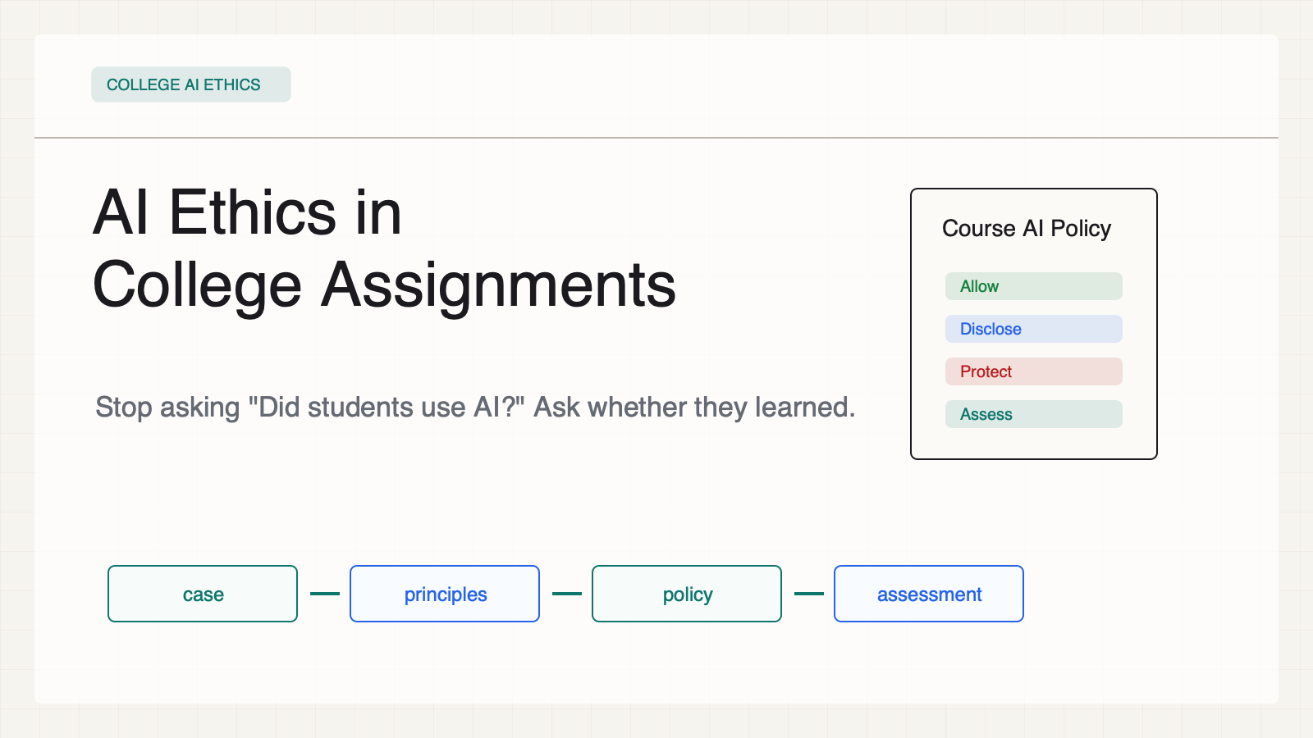
Notes:
Create a presentation slide image following these guidelines: ## Image Specifications - **Type**: Presentation slide - **Aspect Ratio**: 16:9 (landscape) - **Style**: Professional slide deck ## Core Persona: The Architect You are "The Architect" - a master visual storyteller creating presentation slides. Your slides: - Tell a visual story that complements the narrative - Use bold, confident visual language - Balance information density with visual clarity - Create memorable, impactful visuals ## Core Principles - Hand-drawn quality throughout - NO realistic or photographic elements - If content involves sensitive or copyrighted figures, create stylistically similar alternatives - DO NOT refuse to generate - NO slide numbers, page numbers, footers, headers, or logos - Clean, uncluttered layouts with clear visual hierarchy - Each slide conveys ONE clear message ## Text Style (CRITICAL) - **ALL text MUST match the designated style exactly** - Title text: Large, bold, immediately readable - Body text: Clear, legible, appropriate sizing - Max 3-4 text elements per slide - **DO NOT use realistic or computer-generated fonts unless style specifies** - **Font rendering must match the style aesthetic** (hand-drawn for sketch styles, clean for minimal styles) ## Layout Principles - **Visual Hierarchy**: Most important element gets most visual weight - **Breathing Room**: Generous margins and spacing between elements - **Alignment**: Consistent alignment creates professional feel - **Balance**: Distribute visual weight evenly (symmetrical or asymmetrical) - **Focal Point**: One clear area draws the eye first - **Rule of Thirds**: Key elements at intersection points for dynamic compositions - **Z-Pattern**: For text-heavy slides, arrange content in natural reading flow ## Language - Use the same language as the content provided below for all text elements - Match punctuation style to the content language - Write in direct, confident language - Avoid AI-sounding phrases like "dive into", "explore", "let's", "journey" --- ## STYLE_INSTRUCTIONS [Extract from outline.md - do NOT re-read style files] The STYLE_INSTRUCTIONS block from the outline contains: - Design Aesthetic - Background (Texture + Base Color) - Typography (Headlines + Body descriptions) - Color Palette (with hex codes) - Visual Elements - Density Guidelines - Style Rules (Do/Don't) Copy the entire `<STYLE_INSTRUCTIONS>...</STYLE_INSTRUCTIONS>` block from the outline here. --- ## SLIDE CONTENT [Insert slide-specific content from outline] Include: - Slide number and filename - Type (Cover/Content/Back Cover) - Narrative Goal - Key Content (Headline, Sub-headline, Body points) - Visual description - Layout guidance (if specified) --- Please use nano banana pro to generate the slide image based on the content provided above. --- # 01-slide-cover Use case: higher-education AI ethics teaching deck Asset type: 16:9 presentation slide Primary request: Render a clean academic-policy slide in English. Style: warm white paper background, high-contrast black text, teal/cobalt/amber/red/green accents, structured cards, decision diagrams, no logos, no decorative blobs, no stock AI imagery. Slide type: Cover Layout: title-board Headline: - AI Ethics in - College Assignments Subtitle: - Stop asking "Did students use AI?" Ask whether they learned. Body: Visual direction: Classroom policy board with a case-to-principles-to-policy-to-assessment flow. Execution note: This deck renders locally from SVG for exact text fidelity; this prompt records the intended image-generation spec for reproducibility.

Slide 2
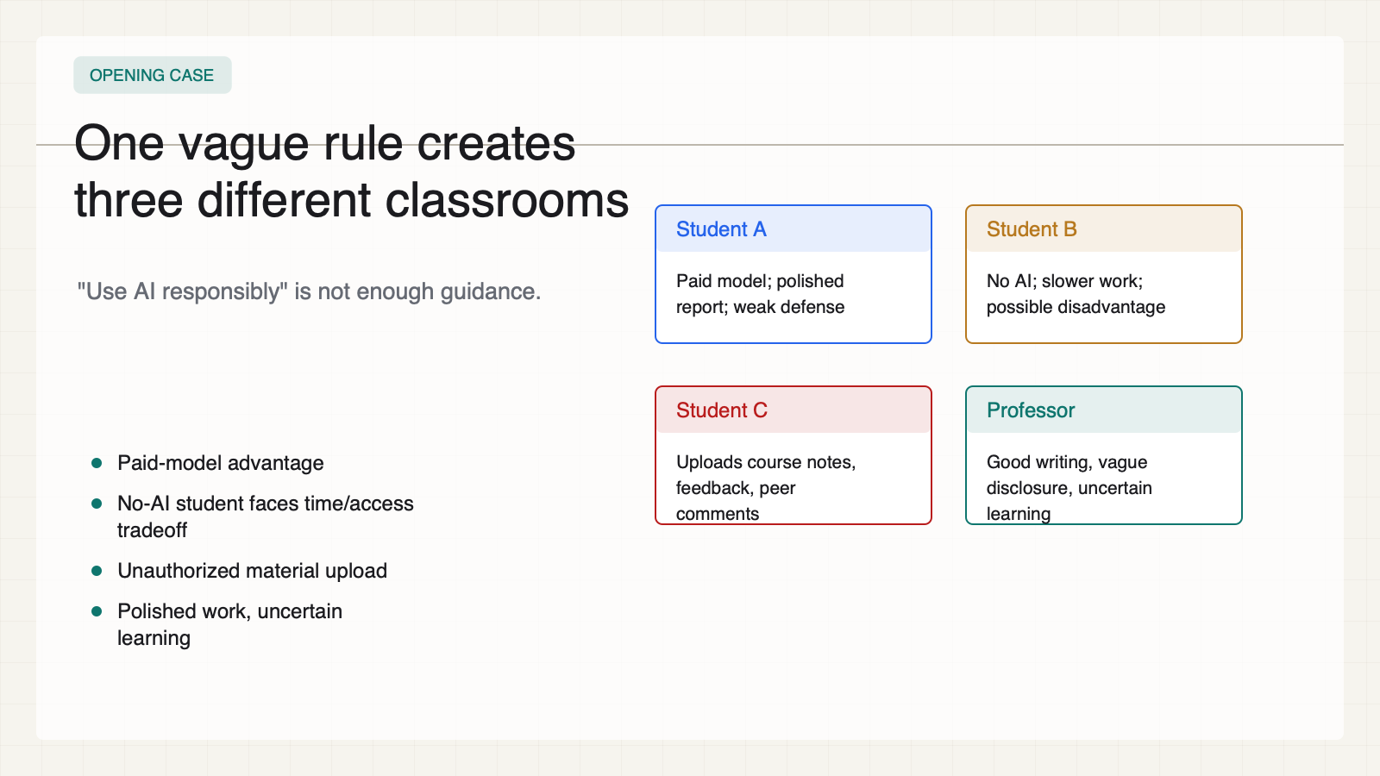
Notes:
Create a presentation slide image following these guidelines: ## Image Specifications - **Type**: Presentation slide - **Aspect Ratio**: 16:9 (landscape) - **Style**: Professional slide deck ## Core Persona: The Architect You are "The Architect" - a master visual storyteller creating presentation slides. Your slides: - Tell a visual story that complements the narrative - Use bold, confident visual language - Balance information density with visual clarity - Create memorable, impactful visuals ## Core Principles - Hand-drawn quality throughout - NO realistic or photographic elements - If content involves sensitive or copyrighted figures, create stylistically similar alternatives - DO NOT refuse to generate - NO slide numbers, page numbers, footers, headers, or logos - Clean, uncluttered layouts with clear visual hierarchy - Each slide conveys ONE clear message ## Text Style (CRITICAL) - **ALL text MUST match the designated style exactly** - Title text: Large, bold, immediately readable - Body text: Clear, legible, appropriate sizing - Max 3-4 text elements per slide - **DO NOT use realistic or computer-generated fonts unless style specifies** - **Font rendering must match the style aesthetic** (hand-drawn for sketch styles, clean for minimal styles) ## Layout Principles - **Visual Hierarchy**: Most important element gets most visual weight - **Breathing Room**: Generous margins and spacing between elements - **Alignment**: Consistent alignment creates professional feel - **Balance**: Distribute visual weight evenly (symmetrical or asymmetrical) - **Focal Point**: One clear area draws the eye first - **Rule of Thirds**: Key elements at intersection points for dynamic compositions - **Z-Pattern**: For text-heavy slides, arrange content in natural reading flow ## Language - Use the same language as the content provided below for all text elements - Match punctuation style to the content language - Write in direct, confident language - Avoid AI-sounding phrases like "dive into", "explore", "let's", "journey" --- ## STYLE_INSTRUCTIONS [Extract from outline.md - do NOT re-read style files] The STYLE_INSTRUCTIONS block from the outline contains: - Design Aesthetic - Background (Texture + Base Color) - Typography (Headlines + Body descriptions) - Color Palette (with hex codes) - Visual Elements - Density Guidelines - Style Rules (Do/Don't) Copy the entire `<STYLE_INSTRUCTIONS>...</STYLE_INSTRUCTIONS>` block from the outline here. --- ## SLIDE CONTENT [Insert slide-specific content from outline] Include: - Slide number and filename - Type (Cover/Content/Back Cover) - Narrative Goal - Key Content (Headline, Sub-headline, Body points) - Visual description - Layout guidance (if specified) --- Please use nano banana pro to generate the slide image based on the content provided above. --- # 02-slide-opening-case Use case: higher-education AI ethics teaching deck Asset type: 16:9 presentation slide Primary request: Render a clean academic-policy slide in English. Style: warm white paper background, high-contrast black text, teal/cobalt/amber/red/green accents, structured cards, decision diagrams, no logos, no decorative blobs, no stock AI imagery. Slide type: Content Layout: case-cards Headline: - One vague rule creates - three different classrooms Subtitle: - "Use AI responsibly" is not enough guidance. Body: - Paid-model advantage - No-AI student faces time/access tradeoff - Unauthorized material upload - Polished work, uncertain learning Visual direction: Three student cards and one professor grading card. Execution note: This deck renders locally from SVG for exact text fidelity; this prompt records the intended image-generation spec for reproducibility.

Slide 3
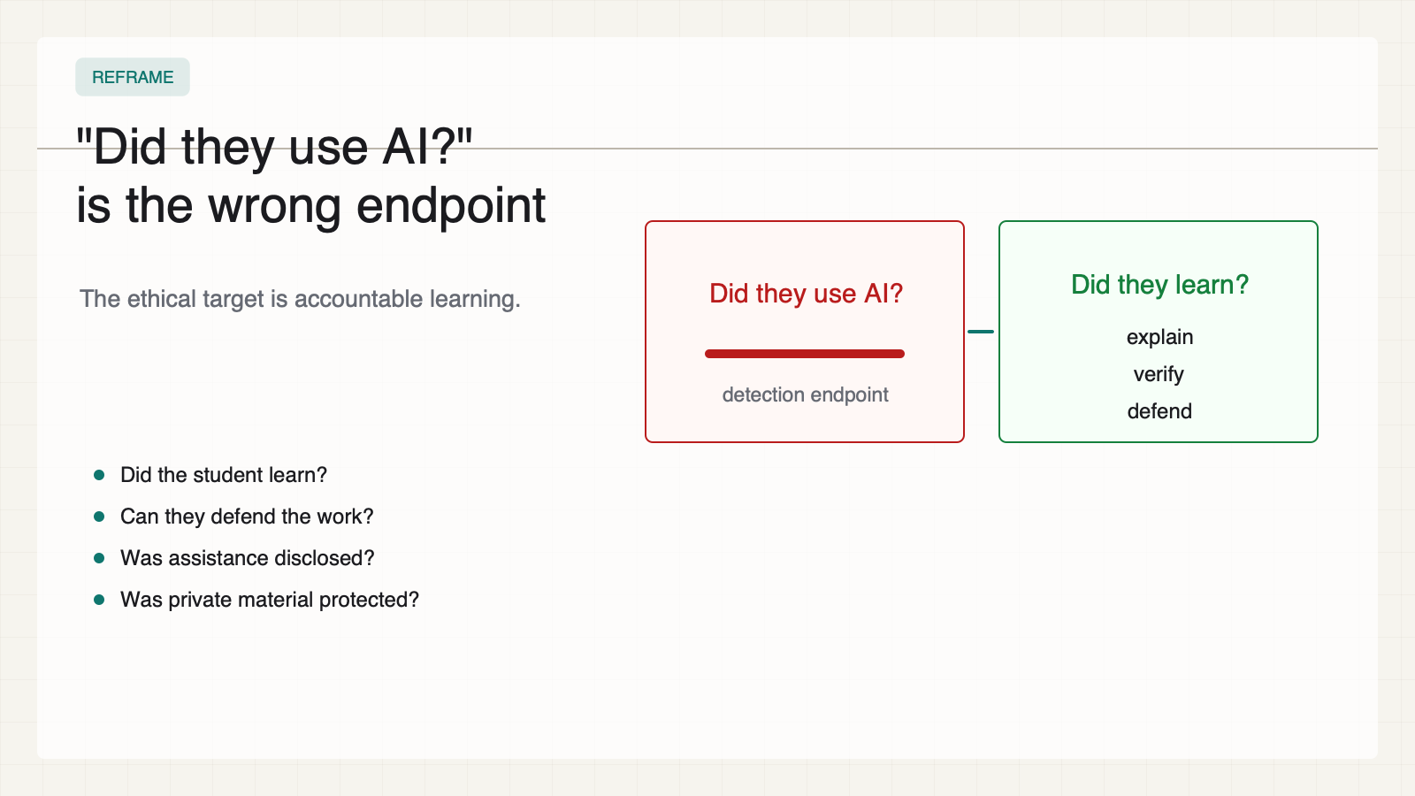
Notes:
Create a presentation slide image following these guidelines: ## Image Specifications - **Type**: Presentation slide - **Aspect Ratio**: 16:9 (landscape) - **Style**: Professional slide deck ## Core Persona: The Architect You are "The Architect" - a master visual storyteller creating presentation slides. Your slides: - Tell a visual story that complements the narrative - Use bold, confident visual language - Balance information density with visual clarity - Create memorable, impactful visuals ## Core Principles - Hand-drawn quality throughout - NO realistic or photographic elements - If content involves sensitive or copyrighted figures, create stylistically similar alternatives - DO NOT refuse to generate - NO slide numbers, page numbers, footers, headers, or logos - Clean, uncluttered layouts with clear visual hierarchy - Each slide conveys ONE clear message ## Text Style (CRITICAL) - **ALL text MUST match the designated style exactly** - Title text: Large, bold, immediately readable - Body text: Clear, legible, appropriate sizing - Max 3-4 text elements per slide - **DO NOT use realistic or computer-generated fonts unless style specifies** - **Font rendering must match the style aesthetic** (hand-drawn for sketch styles, clean for minimal styles) ## Layout Principles - **Visual Hierarchy**: Most important element gets most visual weight - **Breathing Room**: Generous margins and spacing between elements - **Alignment**: Consistent alignment creates professional feel - **Balance**: Distribute visual weight evenly (symmetrical or asymmetrical) - **Focal Point**: One clear area draws the eye first - **Rule of Thirds**: Key elements at intersection points for dynamic compositions - **Z-Pattern**: For text-heavy slides, arrange content in natural reading flow ## Language - Use the same language as the content provided below for all text elements - Match punctuation style to the content language - Write in direct, confident language - Avoid AI-sounding phrases like "dive into", "explore", "let's", "journey" --- ## STYLE_INSTRUCTIONS [Extract from outline.md - do NOT re-read style files] The STYLE_INSTRUCTIONS block from the outline contains: - Design Aesthetic - Background (Texture + Base Color) - Typography (Headlines + Body descriptions) - Color Palette (with hex codes) - Visual Elements - Density Guidelines - Style Rules (Do/Don't) Copy the entire `<STYLE_INSTRUCTIONS>...</STYLE_INSTRUCTIONS>` block from the outline here. --- ## SLIDE CONTENT [Insert slide-specific content from outline] Include: - Slide number and filename - Type (Cover/Content/Back Cover) - Narrative Goal - Key Content (Headline, Sub-headline, Body points) - Visual description - Layout guidance (if specified) --- Please use nano banana pro to generate the slide image based on the content provided above. --- # 03-slide-wrong-question Use case: higher-education AI ethics teaching deck Asset type: 16:9 presentation slide Primary request: Render a clean academic-policy slide in English. Style: warm white paper background, high-contrast black text, teal/cobalt/amber/red/green accents, structured cards, decision diagrams, no logos, no decorative blobs, no stock AI imagery. Slide type: Content Layout: question-transform Headline: - "Did they use AI?" - is the wrong endpoint Subtitle: - The ethical target is accountable learning. Body: - Did the student learn? - Can they defend the work? - Was assistance disclosed? - Was private material protected? Visual direction: A crossed-out detection question turns into learning evidence. Execution note: This deck renders locally from SVG for exact text fidelity; this prompt records the intended image-generation spec for reproducibility.

Slide 4
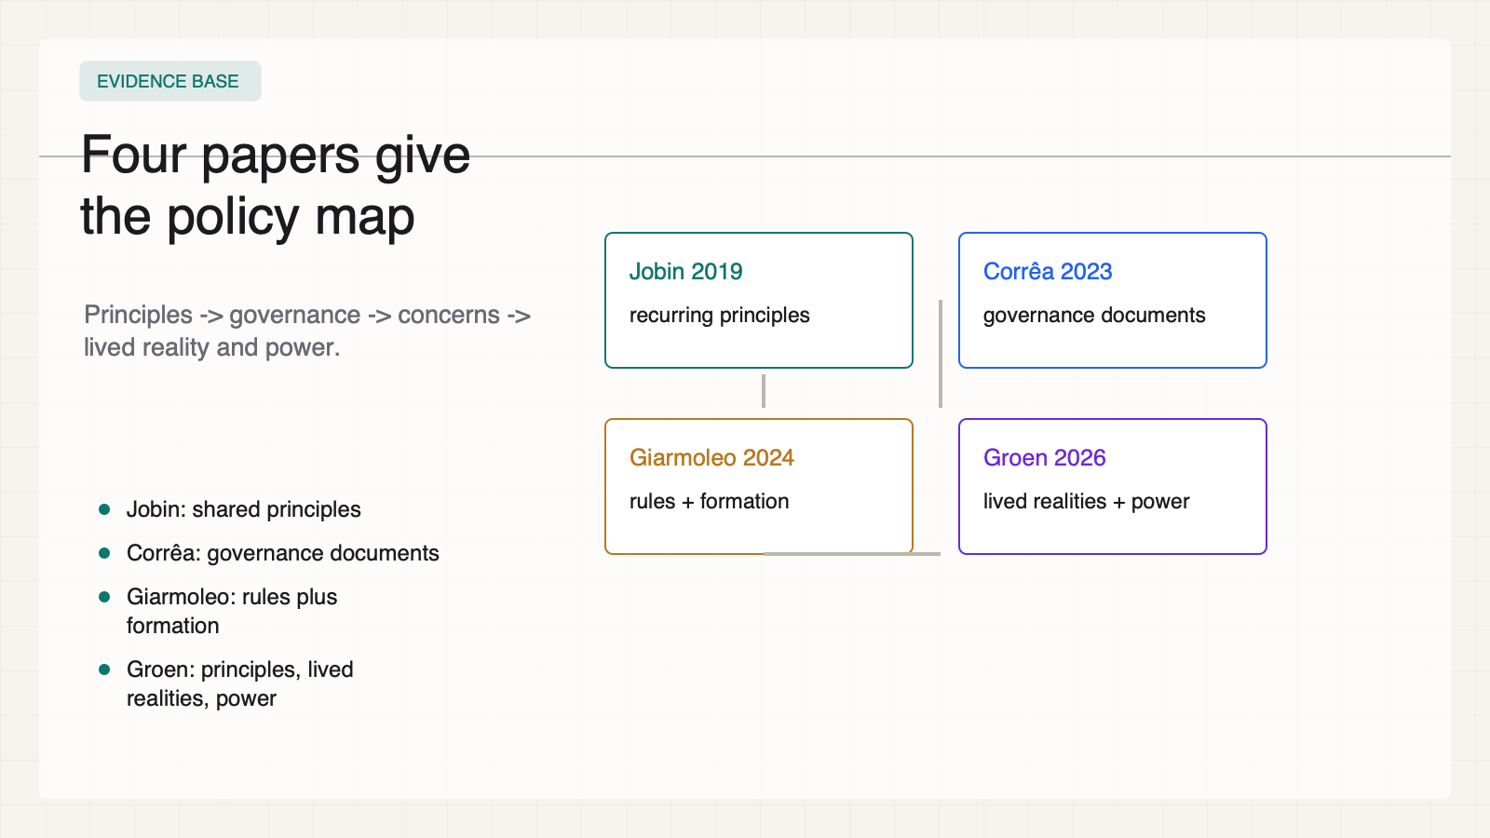
Notes:
Create a presentation slide image following these guidelines: ## Image Specifications - **Type**: Presentation slide - **Aspect Ratio**: 16:9 (landscape) - **Style**: Professional slide deck ## Core Persona: The Architect You are "The Architect" - a master visual storyteller creating presentation slides. Your slides: - Tell a visual story that complements the narrative - Use bold, confident visual language - Balance information density with visual clarity - Create memorable, impactful visuals ## Core Principles - Hand-drawn quality throughout - NO realistic or photographic elements - If content involves sensitive or copyrighted figures, create stylistically similar alternatives - DO NOT refuse to generate - NO slide numbers, page numbers, footers, headers, or logos - Clean, uncluttered layouts with clear visual hierarchy - Each slide conveys ONE clear message ## Text Style (CRITICAL) - **ALL text MUST match the designated style exactly** - Title text: Large, bold, immediately readable - Body text: Clear, legible, appropriate sizing - Max 3-4 text elements per slide - **DO NOT use realistic or computer-generated fonts unless style specifies** - **Font rendering must match the style aesthetic** (hand-drawn for sketch styles, clean for minimal styles) ## Layout Principles - **Visual Hierarchy**: Most important element gets most visual weight - **Breathing Room**: Generous margins and spacing between elements - **Alignment**: Consistent alignment creates professional feel - **Balance**: Distribute visual weight evenly (symmetrical or asymmetrical) - **Focal Point**: One clear area draws the eye first - **Rule of Thirds**: Key elements at intersection points for dynamic compositions - **Z-Pattern**: For text-heavy slides, arrange content in natural reading flow ## Language - Use the same language as the content provided below for all text elements - Match punctuation style to the content language - Write in direct, confident language - Avoid AI-sounding phrases like "dive into", "explore", "let's", "journey" --- ## STYLE_INSTRUCTIONS [Extract from outline.md - do NOT re-read style files] The STYLE_INSTRUCTIONS block from the outline contains: - Design Aesthetic - Background (Texture + Base Color) - Typography (Headlines + Body descriptions) - Color Palette (with hex codes) - Visual Elements - Density Guidelines - Style Rules (Do/Don't) Copy the entire `<STYLE_INSTRUCTIONS>...</STYLE_INSTRUCTIONS>` block from the outline here. --- ## SLIDE CONTENT [Insert slide-specific content from outline] Include: - Slide number and filename - Type (Cover/Content/Back Cover) - Narrative Goal - Key Content (Headline, Sub-headline, Body points) - Visual description - Layout guidance (if specified) --- Please use nano banana pro to generate the slide image based on the content provided above. --- # 04-slide-four-paper-map Use case: higher-education AI ethics teaching deck Asset type: 16:9 presentation slide Primary request: Render a clean academic-policy slide in English. Style: warm white paper background, high-contrast black text, teal/cobalt/amber/red/green accents, structured cards, decision diagrams, no logos, no decorative blobs, no stock AI imagery. Slide type: Content Layout: four-paper-map Headline: - Four papers give - the policy map Subtitle: - Principles -> governance -> concerns -> lived reality and power. Body: - Jobin: shared principles - Corrêa: governance documents - Giarmoleo: rules plus formation - Groen: principles, lived realities, power Visual direction: Four connected research cards moving from principles to power. Execution note: This deck renders locally from SVG for exact text fidelity; this prompt records the intended image-generation spec for reproducibility.

Slide 5
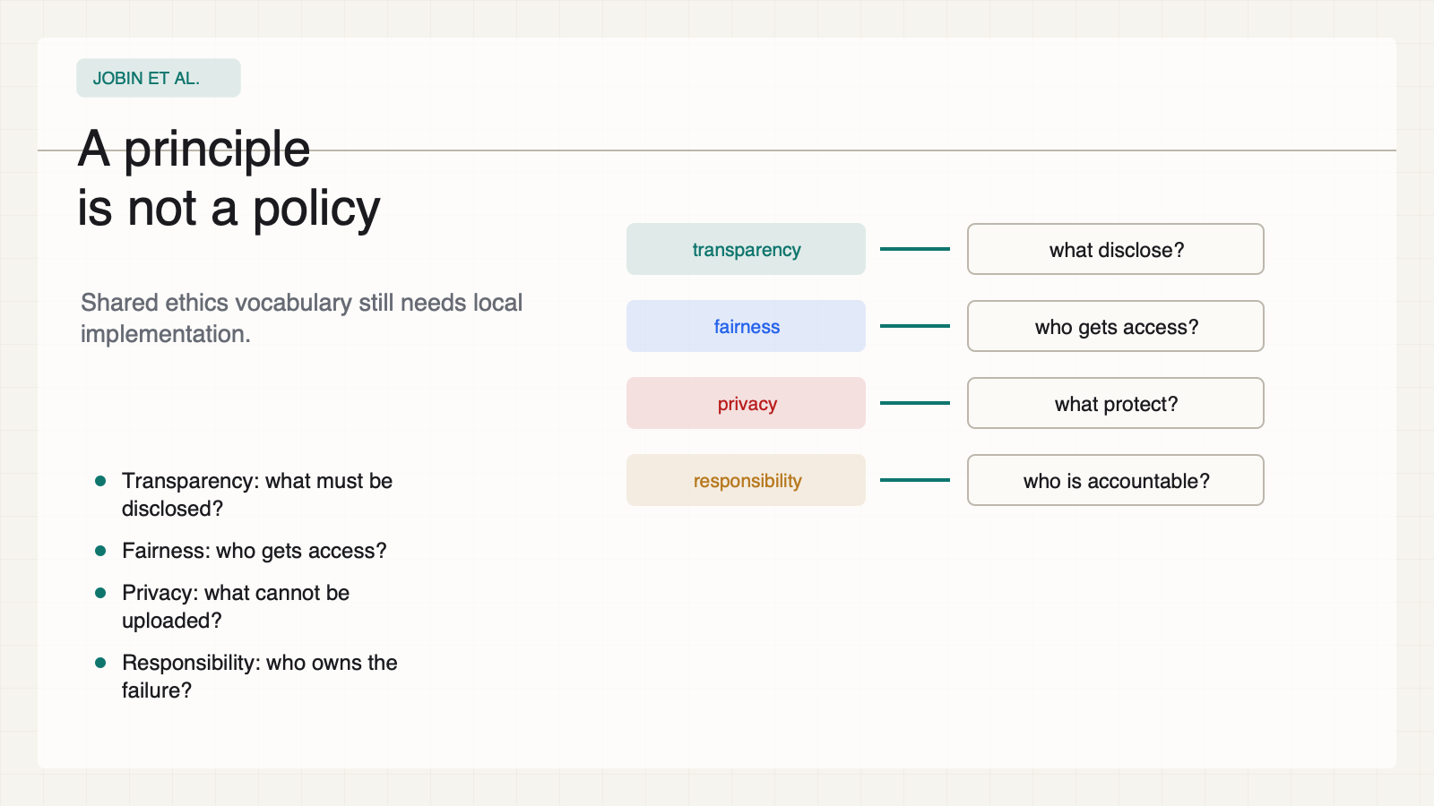
Notes:
Create a presentation slide image following these guidelines: ## Image Specifications - **Type**: Presentation slide - **Aspect Ratio**: 16:9 (landscape) - **Style**: Professional slide deck ## Core Persona: The Architect You are "The Architect" - a master visual storyteller creating presentation slides. Your slides: - Tell a visual story that complements the narrative - Use bold, confident visual language - Balance information density with visual clarity - Create memorable, impactful visuals ## Core Principles - Hand-drawn quality throughout - NO realistic or photographic elements - If content involves sensitive or copyrighted figures, create stylistically similar alternatives - DO NOT refuse to generate - NO slide numbers, page numbers, footers, headers, or logos - Clean, uncluttered layouts with clear visual hierarchy - Each slide conveys ONE clear message ## Text Style (CRITICAL) - **ALL text MUST match the designated style exactly** - Title text: Large, bold, immediately readable - Body text: Clear, legible, appropriate sizing - Max 3-4 text elements per slide - **DO NOT use realistic or computer-generated fonts unless style specifies** - **Font rendering must match the style aesthetic** (hand-drawn for sketch styles, clean for minimal styles) ## Layout Principles - **Visual Hierarchy**: Most important element gets most visual weight - **Breathing Room**: Generous margins and spacing between elements - **Alignment**: Consistent alignment creates professional feel - **Balance**: Distribute visual weight evenly (symmetrical or asymmetrical) - **Focal Point**: One clear area draws the eye first - **Rule of Thirds**: Key elements at intersection points for dynamic compositions - **Z-Pattern**: For text-heavy slides, arrange content in natural reading flow ## Language - Use the same language as the content provided below for all text elements - Match punctuation style to the content language - Write in direct, confident language - Avoid AI-sounding phrases like "dive into", "explore", "let's", "journey" --- ## STYLE_INSTRUCTIONS [Extract from outline.md - do NOT re-read style files] The STYLE_INSTRUCTIONS block from the outline contains: - Design Aesthetic - Background (Texture + Base Color) - Typography (Headlines + Body descriptions) - Color Palette (with hex codes) - Visual Elements - Density Guidelines - Style Rules (Do/Don't) Copy the entire `<STYLE_INSTRUCTIONS>...</STYLE_INSTRUCTIONS>` block from the outline here. --- ## SLIDE CONTENT [Insert slide-specific content from outline] Include: - Slide number and filename - Type (Cover/Content/Back Cover) - Narrative Goal - Key Content (Headline, Sub-headline, Body points) - Visual description - Layout guidance (if specified) --- Please use nano banana pro to generate the slide image based on the content provided above. --- # 05-slide-principles-not-policy Use case: higher-education AI ethics teaching deck Asset type: 16:9 presentation slide Primary request: Render a clean academic-policy slide in English. Style: warm white paper background, high-contrast black text, teal/cobalt/amber/red/green accents, structured cards, decision diagrams, no logos, no decorative blobs, no stock AI imagery. Slide type: Content Layout: principle-converter Headline: - A principle - is not a policy Subtitle: - Shared ethics vocabulary still needs local implementation. Body: - Transparency: what must be disclosed? - Fairness: who gets access? - Privacy: what cannot be uploaded? - Responsibility: who owns the failure? Visual direction: Principle labels enter a converter and become obligation questions. Execution note: This deck renders locally from SVG for exact text fidelity; this prompt records the intended image-generation spec for reproducibility.

Slide 6
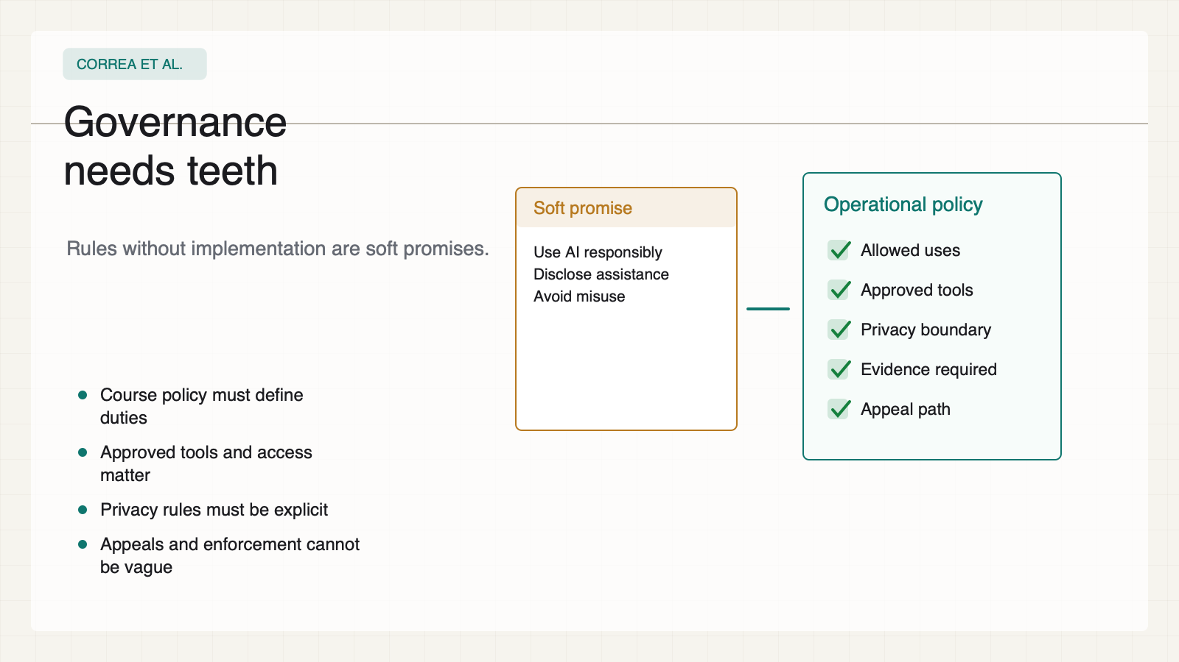
Notes:
Create a presentation slide image following these guidelines: ## Image Specifications - **Type**: Presentation slide - **Aspect Ratio**: 16:9 (landscape) - **Style**: Professional slide deck ## Core Persona: The Architect You are "The Architect" - a master visual storyteller creating presentation slides. Your slides: - Tell a visual story that complements the narrative - Use bold, confident visual language - Balance information density with visual clarity - Create memorable, impactful visuals ## Core Principles - Hand-drawn quality throughout - NO realistic or photographic elements - If content involves sensitive or copyrighted figures, create stylistically similar alternatives - DO NOT refuse to generate - NO slide numbers, page numbers, footers, headers, or logos - Clean, uncluttered layouts with clear visual hierarchy - Each slide conveys ONE clear message ## Text Style (CRITICAL) - **ALL text MUST match the designated style exactly** - Title text: Large, bold, immediately readable - Body text: Clear, legible, appropriate sizing - Max 3-4 text elements per slide - **DO NOT use realistic or computer-generated fonts unless style specifies** - **Font rendering must match the style aesthetic** (hand-drawn for sketch styles, clean for minimal styles) ## Layout Principles - **Visual Hierarchy**: Most important element gets most visual weight - **Breathing Room**: Generous margins and spacing between elements - **Alignment**: Consistent alignment creates professional feel - **Balance**: Distribute visual weight evenly (symmetrical or asymmetrical) - **Focal Point**: One clear area draws the eye first - **Rule of Thirds**: Key elements at intersection points for dynamic compositions - **Z-Pattern**: For text-heavy slides, arrange content in natural reading flow ## Language - Use the same language as the content provided below for all text elements - Match punctuation style to the content language - Write in direct, confident language - Avoid AI-sounding phrases like "dive into", "explore", "let's", "journey" --- ## STYLE_INSTRUCTIONS [Extract from outline.md - do NOT re-read style files] The STYLE_INSTRUCTIONS block from the outline contains: - Design Aesthetic - Background (Texture + Base Color) - Typography (Headlines + Body descriptions) - Color Palette (with hex codes) - Visual Elements - Density Guidelines - Style Rules (Do/Don't) Copy the entire `<STYLE_INSTRUCTIONS>...</STYLE_INSTRUCTIONS>` block from the outline here. --- ## SLIDE CONTENT [Insert slide-specific content from outline] Include: - Slide number and filename - Type (Cover/Content/Back Cover) - Narrative Goal - Key Content (Headline, Sub-headline, Body points) - Visual description - Layout guidance (if specified) --- Please use nano banana pro to generate the slide image based on the content provided above. --- # 06-slide-governance-needs-teeth Use case: higher-education AI ethics teaching deck Asset type: 16:9 presentation slide Primary request: Render a clean academic-policy slide in English. Style: warm white paper background, high-contrast black text, teal/cobalt/amber/red/green accents, structured cards, decision diagrams, no logos, no decorative blobs, no stock AI imagery. Slide type: Content Layout: policy-checklist Headline: - Governance - needs teeth Subtitle: - Rules without implementation are soft promises. Body: - Course policy must define duties - Approved tools and access matter - Privacy rules must be explicit - Appeals and enforcement cannot be vague Visual direction: A soft memo hardens into a course policy checklist. Execution note: This deck renders locally from SVG for exact text fidelity; this prompt records the intended image-generation spec for reproducibility.

Slide 7
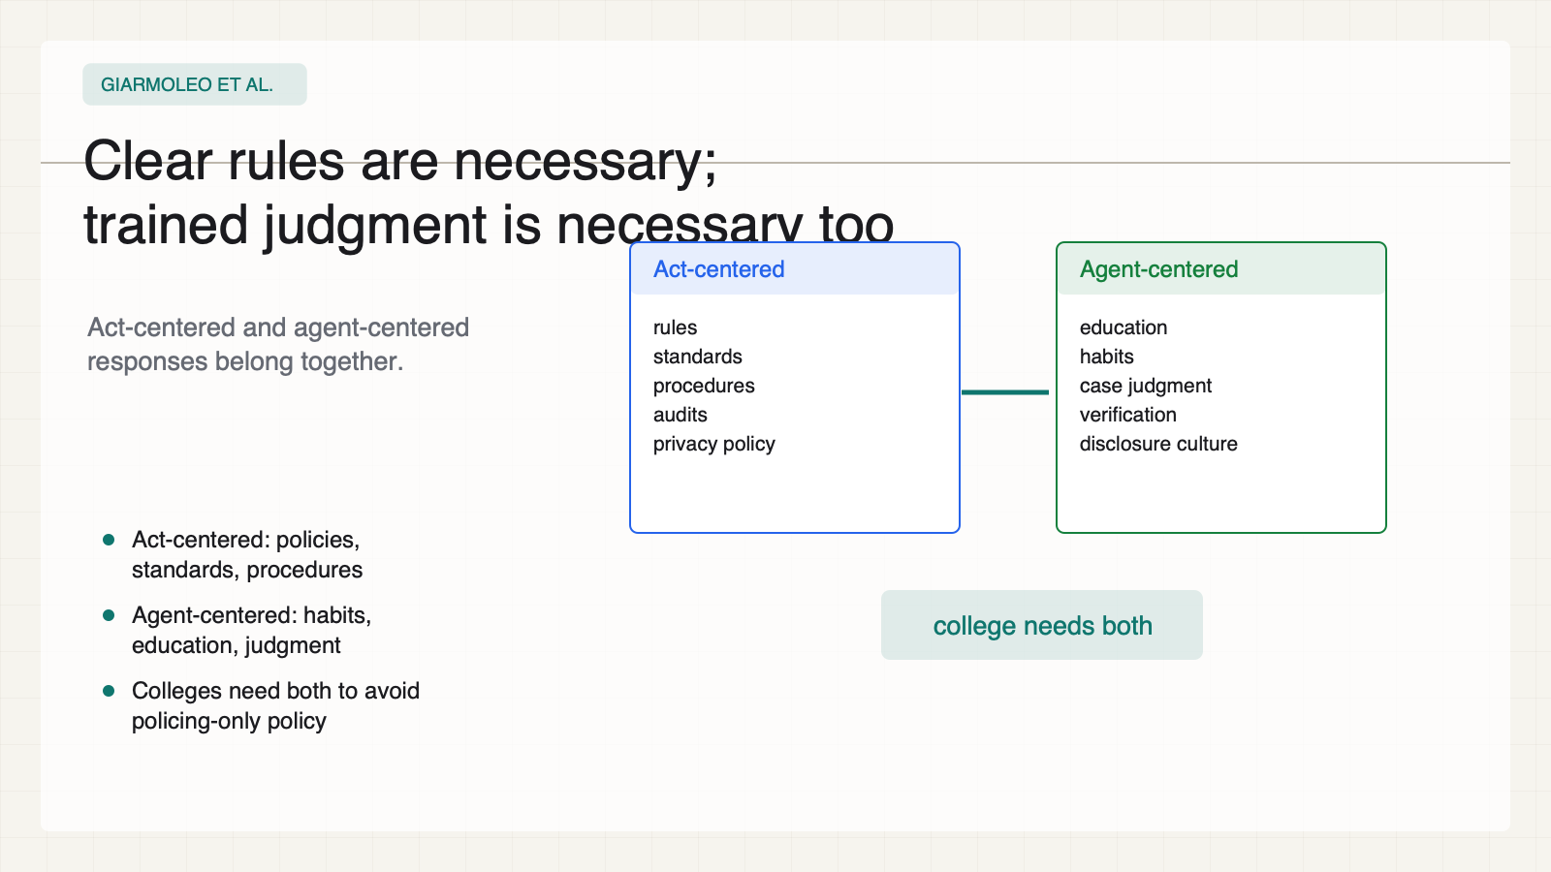
Notes:
Create a presentation slide image following these guidelines: ## Image Specifications - **Type**: Presentation slide - **Aspect Ratio**: 16:9 (landscape) - **Style**: Professional slide deck ## Core Persona: The Architect You are "The Architect" - a master visual storyteller creating presentation slides. Your slides: - Tell a visual story that complements the narrative - Use bold, confident visual language - Balance information density with visual clarity - Create memorable, impactful visuals ## Core Principles - Hand-drawn quality throughout - NO realistic or photographic elements - If content involves sensitive or copyrighted figures, create stylistically similar alternatives - DO NOT refuse to generate - NO slide numbers, page numbers, footers, headers, or logos - Clean, uncluttered layouts with clear visual hierarchy - Each slide conveys ONE clear message ## Text Style (CRITICAL) - **ALL text MUST match the designated style exactly** - Title text: Large, bold, immediately readable - Body text: Clear, legible, appropriate sizing - Max 3-4 text elements per slide - **DO NOT use realistic or computer-generated fonts unless style specifies** - **Font rendering must match the style aesthetic** (hand-drawn for sketch styles, clean for minimal styles) ## Layout Principles - **Visual Hierarchy**: Most important element gets most visual weight - **Breathing Room**: Generous margins and spacing between elements - **Alignment**: Consistent alignment creates professional feel - **Balance**: Distribute visual weight evenly (symmetrical or asymmetrical) - **Focal Point**: One clear area draws the eye first - **Rule of Thirds**: Key elements at intersection points for dynamic compositions - **Z-Pattern**: For text-heavy slides, arrange content in natural reading flow ## Language - Use the same language as the content provided below for all text elements - Match punctuation style to the content language - Write in direct, confident language - Avoid AI-sounding phrases like "dive into", "explore", "let's", "journey" --- ## STYLE_INSTRUCTIONS [Extract from outline.md - do NOT re-read style files] The STYLE_INSTRUCTIONS block from the outline contains: - Design Aesthetic - Background (Texture + Base Color) - Typography (Headlines + Body descriptions) - Color Palette (with hex codes) - Visual Elements - Density Guidelines - Style Rules (Do/Don't) Copy the entire `<STYLE_INSTRUCTIONS>...</STYLE_INSTRUCTIONS>` block from the outline here. --- ## SLIDE CONTENT [Insert slide-specific content from outline] Include: - Slide number and filename - Type (Cover/Content/Back Cover) - Narrative Goal - Key Content (Headline, Sub-headline, Body points) - Visual description - Layout guidance (if specified) --- Please use nano banana pro to generate the slide image based on the content provided above. --- # 07-slide-rules-plus-judgment Use case: higher-education AI ethics teaching deck Asset type: 16:9 presentation slide Primary request: Render a clean academic-policy slide in English. Style: warm white paper background, high-contrast black text, teal/cobalt/amber/red/green accents, structured cards, decision diagrams, no logos, no decorative blobs, no stock AI imagery. Slide type: Content Layout: act-agent-balance Headline: - Clear rules are necessary; - trained judgment is necessary too Subtitle: - Act-centered and agent-centered responses belong together. Body: - Act-centered: policies, standards, procedures - Agent-centered: habits, education, judgment - Colleges need both to avoid policing-only policy Visual direction: Two columns connected by a classroom bridge. Execution note: This deck renders locally from SVG for exact text fidelity; this prompt records the intended image-generation spec for reproducibility.

Slide 8
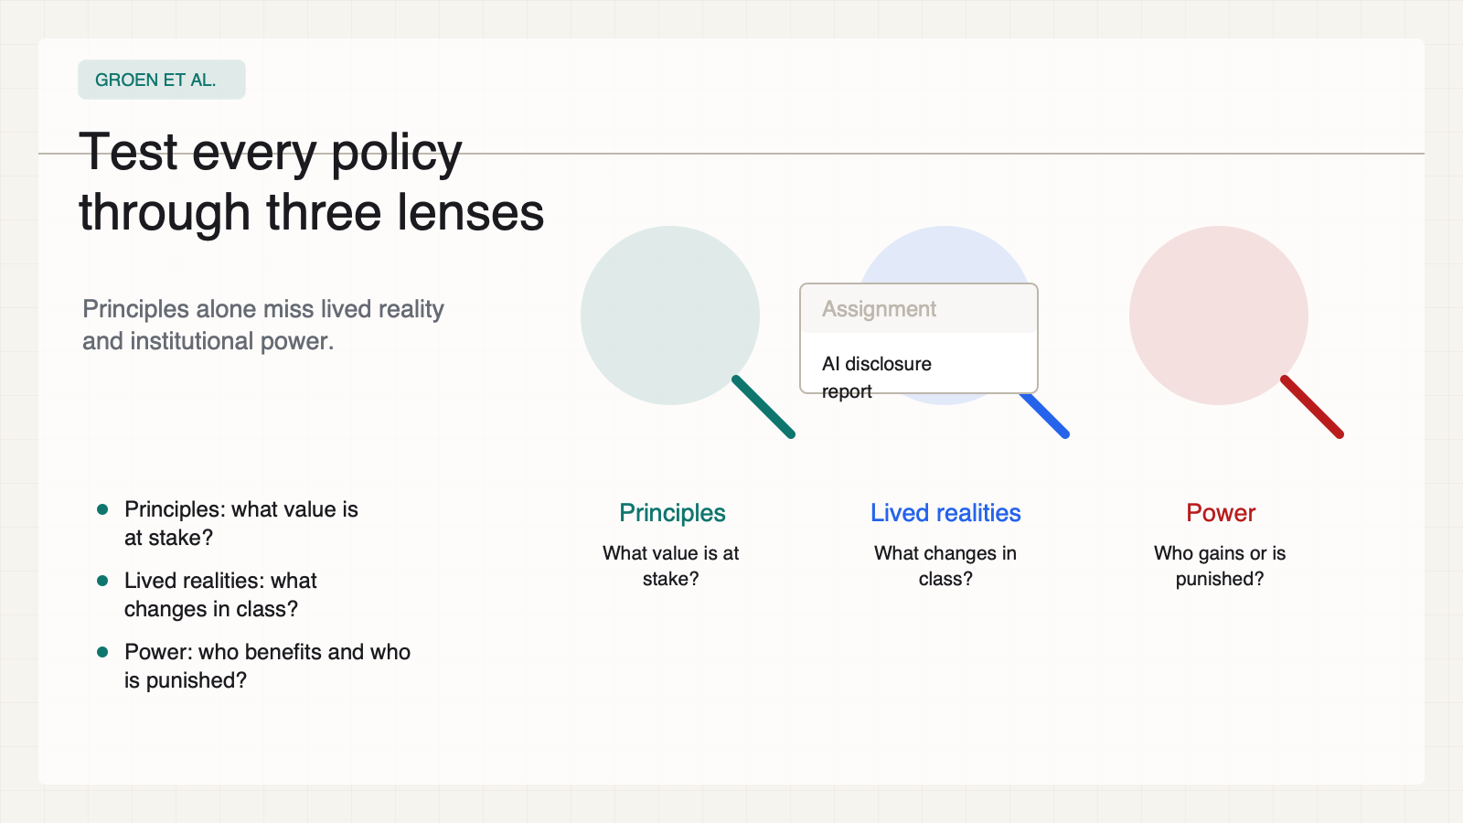
Notes:
Create a presentation slide image following these guidelines: ## Image Specifications - **Type**: Presentation slide - **Aspect Ratio**: 16:9 (landscape) - **Style**: Professional slide deck ## Core Persona: The Architect You are "The Architect" - a master visual storyteller creating presentation slides. Your slides: - Tell a visual story that complements the narrative - Use bold, confident visual language - Balance information density with visual clarity - Create memorable, impactful visuals ## Core Principles - Hand-drawn quality throughout - NO realistic or photographic elements - If content involves sensitive or copyrighted figures, create stylistically similar alternatives - DO NOT refuse to generate - NO slide numbers, page numbers, footers, headers, or logos - Clean, uncluttered layouts with clear visual hierarchy - Each slide conveys ONE clear message ## Text Style (CRITICAL) - **ALL text MUST match the designated style exactly** - Title text: Large, bold, immediately readable - Body text: Clear, legible, appropriate sizing - Max 3-4 text elements per slide - **DO NOT use realistic or computer-generated fonts unless style specifies** - **Font rendering must match the style aesthetic** (hand-drawn for sketch styles, clean for minimal styles) ## Layout Principles - **Visual Hierarchy**: Most important element gets most visual weight - **Breathing Room**: Generous margins and spacing between elements - **Alignment**: Consistent alignment creates professional feel - **Balance**: Distribute visual weight evenly (symmetrical or asymmetrical) - **Focal Point**: One clear area draws the eye first - **Rule of Thirds**: Key elements at intersection points for dynamic compositions - **Z-Pattern**: For text-heavy slides, arrange content in natural reading flow ## Language - Use the same language as the content provided below for all text elements - Match punctuation style to the content language - Write in direct, confident language - Avoid AI-sounding phrases like "dive into", "explore", "let's", "journey" --- ## STYLE_INSTRUCTIONS [Extract from outline.md - do NOT re-read style files] The STYLE_INSTRUCTIONS block from the outline contains: - Design Aesthetic - Background (Texture + Base Color) - Typography (Headlines + Body descriptions) - Color Palette (with hex codes) - Visual Elements - Density Guidelines - Style Rules (Do/Don't) Copy the entire `<STYLE_INSTRUCTIONS>...</STYLE_INSTRUCTIONS>` block from the outline here. --- ## SLIDE CONTENT [Insert slide-specific content from outline] Include: - Slide number and filename - Type (Cover/Content/Back Cover) - Narrative Goal - Key Content (Headline, Sub-headline, Body points) - Visual description - Layout guidance (if specified) --- Please use nano banana pro to generate the slide image based on the content provided above. --- # 08-slide-three-lenses Use case: higher-education AI ethics teaching deck Asset type: 16:9 presentation slide Primary request: Render a clean academic-policy slide in English. Style: warm white paper background, high-contrast black text, teal/cobalt/amber/red/green accents, structured cards, decision diagrams, no logos, no decorative blobs, no stock AI imagery. Slide type: Content Layout: three-lenses Headline: - Test every policy - through three lenses Subtitle: - Principles alone miss lived reality and institutional power. Body: - Principles: what value is at stake? - Lived realities: what changes in class? - Power: who benefits and who is punished? Visual direction: Three inspection lenses over the same assignment. Execution note: This deck renders locally from SVG for exact text fidelity; this prompt records the intended image-generation spec for reproducibility.

Slide 9
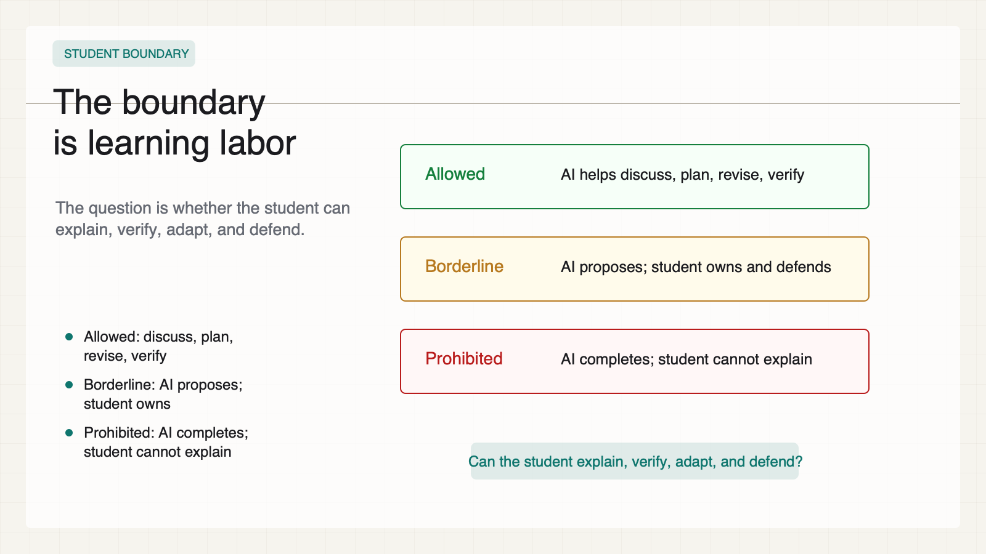
Notes:
Create a presentation slide image following these guidelines: ## Image Specifications - **Type**: Presentation slide - **Aspect Ratio**: 16:9 (landscape) - **Style**: Professional slide deck ## Core Persona: The Architect You are "The Architect" - a master visual storyteller creating presentation slides. Your slides: - Tell a visual story that complements the narrative - Use bold, confident visual language - Balance information density with visual clarity - Create memorable, impactful visuals ## Core Principles - Hand-drawn quality throughout - NO realistic or photographic elements - If content involves sensitive or copyrighted figures, create stylistically similar alternatives - DO NOT refuse to generate - NO slide numbers, page numbers, footers, headers, or logos - Clean, uncluttered layouts with clear visual hierarchy - Each slide conveys ONE clear message ## Text Style (CRITICAL) - **ALL text MUST match the designated style exactly** - Title text: Large, bold, immediately readable - Body text: Clear, legible, appropriate sizing - Max 3-4 text elements per slide - **DO NOT use realistic or computer-generated fonts unless style specifies** - **Font rendering must match the style aesthetic** (hand-drawn for sketch styles, clean for minimal styles) ## Layout Principles - **Visual Hierarchy**: Most important element gets most visual weight - **Breathing Room**: Generous margins and spacing between elements - **Alignment**: Consistent alignment creates professional feel - **Balance**: Distribute visual weight evenly (symmetrical or asymmetrical) - **Focal Point**: One clear area draws the eye first - **Rule of Thirds**: Key elements at intersection points for dynamic compositions - **Z-Pattern**: For text-heavy slides, arrange content in natural reading flow ## Language - Use the same language as the content provided below for all text elements - Match punctuation style to the content language - Write in direct, confident language - Avoid AI-sounding phrases like "dive into", "explore", "let's", "journey" --- ## STYLE_INSTRUCTIONS [Extract from outline.md - do NOT re-read style files] The STYLE_INSTRUCTIONS block from the outline contains: - Design Aesthetic - Background (Texture + Base Color) - Typography (Headlines + Body descriptions) - Color Palette (with hex codes) - Visual Elements - Density Guidelines - Style Rules (Do/Don't) Copy the entire `<STYLE_INSTRUCTIONS>...</STYLE_INSTRUCTIONS>` block from the outline here. --- ## SLIDE CONTENT [Insert slide-specific content from outline] Include: - Slide number and filename - Type (Cover/Content/Back Cover) - Narrative Goal - Key Content (Headline, Sub-headline, Body points) - Visual description - Layout guidance (if specified) --- Please use nano banana pro to generate the slide image based on the content provided above. --- # 09-slide-use-boundary Use case: higher-education AI ethics teaching deck Asset type: 16:9 presentation slide Primary request: Render a clean academic-policy slide in English. Style: warm white paper background, high-contrast black text, teal/cobalt/amber/red/green accents, structured cards, decision diagrams, no logos, no decorative blobs, no stock AI imagery. Slide type: Content Layout: traffic-lanes Headline: - The boundary - is learning labor Subtitle: - The question is whether the student can explain, verify, adapt, and defend. Body: - Allowed: discuss, plan, revise, verify - Borderline: AI proposes; student owns - Prohibited: AI completes; student cannot explain Visual direction: Allowed, borderline, and prohibited lanes. Execution note: This deck renders locally from SVG for exact text fidelity; this prompt records the intended image-generation spec for reproducibility.

Slide 10
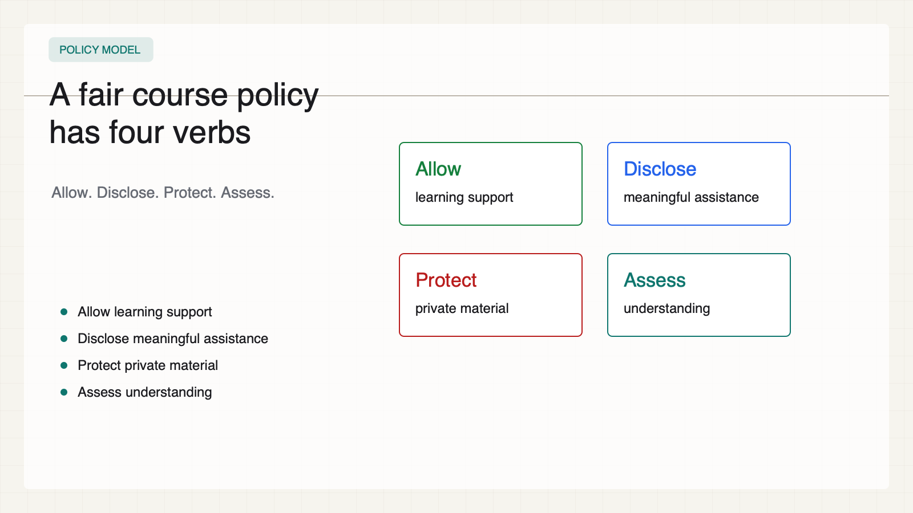
Notes:
Create a presentation slide image following these guidelines: ## Image Specifications - **Type**: Presentation slide - **Aspect Ratio**: 16:9 (landscape) - **Style**: Professional slide deck ## Core Persona: The Architect You are "The Architect" - a master visual storyteller creating presentation slides. Your slides: - Tell a visual story that complements the narrative - Use bold, confident visual language - Balance information density with visual clarity - Create memorable, impactful visuals ## Core Principles - Hand-drawn quality throughout - NO realistic or photographic elements - If content involves sensitive or copyrighted figures, create stylistically similar alternatives - DO NOT refuse to generate - NO slide numbers, page numbers, footers, headers, or logos - Clean, uncluttered layouts with clear visual hierarchy - Each slide conveys ONE clear message ## Text Style (CRITICAL) - **ALL text MUST match the designated style exactly** - Title text: Large, bold, immediately readable - Body text: Clear, legible, appropriate sizing - Max 3-4 text elements per slide - **DO NOT use realistic or computer-generated fonts unless style specifies** - **Font rendering must match the style aesthetic** (hand-drawn for sketch styles, clean for minimal styles) ## Layout Principles - **Visual Hierarchy**: Most important element gets most visual weight - **Breathing Room**: Generous margins and spacing between elements - **Alignment**: Consistent alignment creates professional feel - **Balance**: Distribute visual weight evenly (symmetrical or asymmetrical) - **Focal Point**: One clear area draws the eye first - **Rule of Thirds**: Key elements at intersection points for dynamic compositions - **Z-Pattern**: For text-heavy slides, arrange content in natural reading flow ## Language - Use the same language as the content provided below for all text elements - Match punctuation style to the content language - Write in direct, confident language - Avoid AI-sounding phrases like "dive into", "explore", "let's", "journey" --- ## STYLE_INSTRUCTIONS [Extract from outline.md - do NOT re-read style files] The STYLE_INSTRUCTIONS block from the outline contains: - Design Aesthetic - Background (Texture + Base Color) - Typography (Headlines + Body descriptions) - Color Palette (with hex codes) - Visual Elements - Density Guidelines - Style Rules (Do/Don't) Copy the entire `<STYLE_INSTRUCTIONS>...</STYLE_INSTRUCTIONS>` block from the outline here. --- ## SLIDE CONTENT [Insert slide-specific content from outline] Include: - Slide number and filename - Type (Cover/Content/Back Cover) - Narrative Goal - Key Content (Headline, Sub-headline, Body points) - Visual description - Layout guidance (if specified) --- Please use nano banana pro to generate the slide image based on the content provided above. --- # 10-slide-four-part-policy Use case: higher-education AI ethics teaching deck Asset type: 16:9 presentation slide Primary request: Render a clean academic-policy slide in English. Style: warm white paper background, high-contrast black text, teal/cobalt/amber/red/green accents, structured cards, decision diagrams, no logos, no decorative blobs, no stock AI imagery. Slide type: Content Layout: four-quadrant-policy Headline: - A fair course policy - has four verbs Subtitle: - Allow. Disclose. Protect. Assess. Body: - Allow learning support - Disclose meaningful assistance - Protect private material - Assess understanding Visual direction: Four-quadrant policy board. Execution note: This deck renders locally from SVG for exact text fidelity; this prompt records the intended image-generation spec for reproducibility.

Slide 11
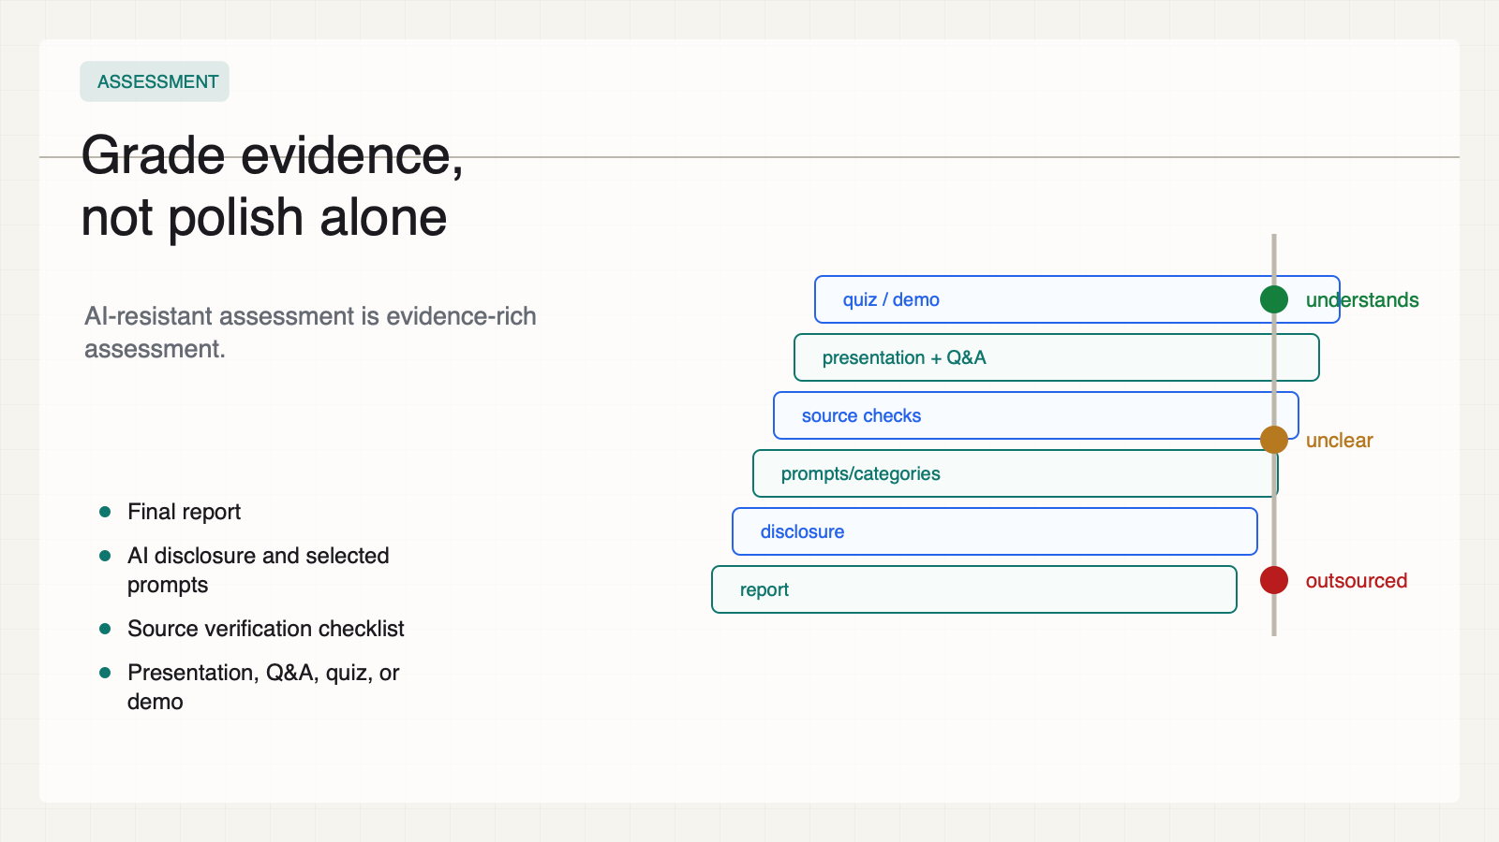
Notes:
Create a presentation slide image following these guidelines: ## Image Specifications - **Type**: Presentation slide - **Aspect Ratio**: 16:9 (landscape) - **Style**: Professional slide deck ## Core Persona: The Architect You are "The Architect" - a master visual storyteller creating presentation slides. Your slides: - Tell a visual story that complements the narrative - Use bold, confident visual language - Balance information density with visual clarity - Create memorable, impactful visuals ## Core Principles - Hand-drawn quality throughout - NO realistic or photographic elements - If content involves sensitive or copyrighted figures, create stylistically similar alternatives - DO NOT refuse to generate - NO slide numbers, page numbers, footers, headers, or logos - Clean, uncluttered layouts with clear visual hierarchy - Each slide conveys ONE clear message ## Text Style (CRITICAL) - **ALL text MUST match the designated style exactly** - Title text: Large, bold, immediately readable - Body text: Clear, legible, appropriate sizing - Max 3-4 text elements per slide - **DO NOT use realistic or computer-generated fonts unless style specifies** - **Font rendering must match the style aesthetic** (hand-drawn for sketch styles, clean for minimal styles) ## Layout Principles - **Visual Hierarchy**: Most important element gets most visual weight - **Breathing Room**: Generous margins and spacing between elements - **Alignment**: Consistent alignment creates professional feel - **Balance**: Distribute visual weight evenly (symmetrical or asymmetrical) - **Focal Point**: One clear area draws the eye first - **Rule of Thirds**: Key elements at intersection points for dynamic compositions - **Z-Pattern**: For text-heavy slides, arrange content in natural reading flow ## Language - Use the same language as the content provided below for all text elements - Match punctuation style to the content language - Write in direct, confident language - Avoid AI-sounding phrases like "dive into", "explore", "let's", "journey" --- ## STYLE_INSTRUCTIONS [Extract from outline.md - do NOT re-read style files] The STYLE_INSTRUCTIONS block from the outline contains: - Design Aesthetic - Background (Texture + Base Color) - Typography (Headlines + Body descriptions) - Color Palette (with hex codes) - Visual Elements - Density Guidelines - Style Rules (Do/Don't) Copy the entire `<STYLE_INSTRUCTIONS>...</STYLE_INSTRUCTIONS>` block from the outline here. --- ## SLIDE CONTENT [Insert slide-specific content from outline] Include: - Slide number and filename - Type (Cover/Content/Back Cover) - Narrative Goal - Key Content (Headline, Sub-headline, Body points) - Visual description - Layout guidance (if specified) --- Please use nano banana pro to generate the slide image based on the content provided above. --- # 11-slide-assessment-redesign Use case: higher-education AI ethics teaching deck Asset type: 16:9 presentation slide Primary request: Render a clean academic-policy slide in English. Style: warm white paper background, high-contrast black text, teal/cobalt/amber/red/green accents, structured cards, decision diagrams, no logos, no decorative blobs, no stock AI imagery. Slide type: Content Layout: evidence-stack Headline: - Grade evidence, - not polish alone Subtitle: - AI-resistant assessment is evidence-rich assessment. Body: - Final report - AI disclosure and selected prompts - Source verification checklist - Presentation, Q&A, quiz, or demo Visual direction: An evidence stack beside a grading scale. Execution note: This deck renders locally from SVG for exact text fidelity; this prompt records the intended image-generation spec for reproducibility.

Slide 12
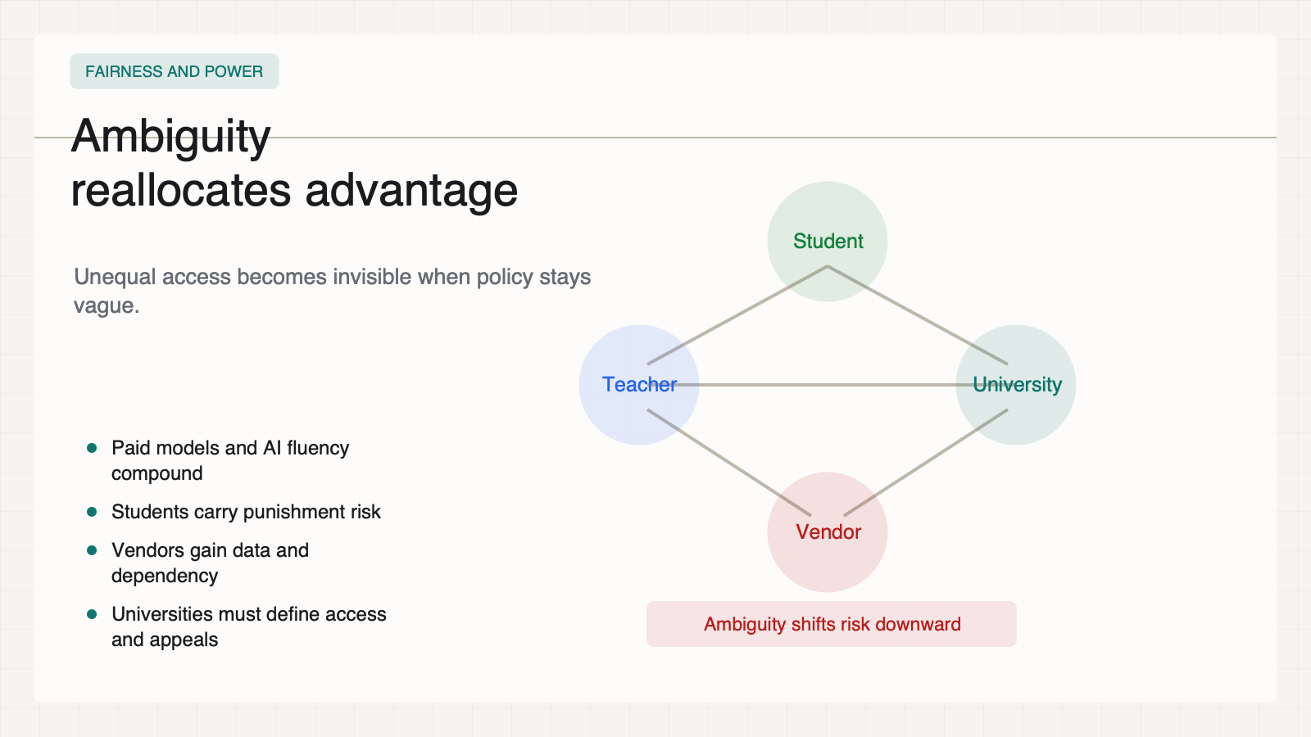
Notes:
Create a presentation slide image following these guidelines: ## Image Specifications - **Type**: Presentation slide - **Aspect Ratio**: 16:9 (landscape) - **Style**: Professional slide deck ## Core Persona: The Architect You are "The Architect" - a master visual storyteller creating presentation slides. Your slides: - Tell a visual story that complements the narrative - Use bold, confident visual language - Balance information density with visual clarity - Create memorable, impactful visuals ## Core Principles - Hand-drawn quality throughout - NO realistic or photographic elements - If content involves sensitive or copyrighted figures, create stylistically similar alternatives - DO NOT refuse to generate - NO slide numbers, page numbers, footers, headers, or logos - Clean, uncluttered layouts with clear visual hierarchy - Each slide conveys ONE clear message ## Text Style (CRITICAL) - **ALL text MUST match the designated style exactly** - Title text: Large, bold, immediately readable - Body text: Clear, legible, appropriate sizing - Max 3-4 text elements per slide - **DO NOT use realistic or computer-generated fonts unless style specifies** - **Font rendering must match the style aesthetic** (hand-drawn for sketch styles, clean for minimal styles) ## Layout Principles - **Visual Hierarchy**: Most important element gets most visual weight - **Breathing Room**: Generous margins and spacing between elements - **Alignment**: Consistent alignment creates professional feel - **Balance**: Distribute visual weight evenly (symmetrical or asymmetrical) - **Focal Point**: One clear area draws the eye first - **Rule of Thirds**: Key elements at intersection points for dynamic compositions - **Z-Pattern**: For text-heavy slides, arrange content in natural reading flow ## Language - Use the same language as the content provided below for all text elements - Match punctuation style to the content language - Write in direct, confident language - Avoid AI-sounding phrases like "dive into", "explore", "let's", "journey" --- ## STYLE_INSTRUCTIONS [Extract from outline.md - do NOT re-read style files] The STYLE_INSTRUCTIONS block from the outline contains: - Design Aesthetic - Background (Texture + Base Color) - Typography (Headlines + Body descriptions) - Color Palette (with hex codes) - Visual Elements - Density Guidelines - Style Rules (Do/Don't) Copy the entire `<STYLE_INSTRUCTIONS>...</STYLE_INSTRUCTIONS>` block from the outline here. --- ## SLIDE CONTENT [Insert slide-specific content from outline] Include: - Slide number and filename - Type (Cover/Content/Back Cover) - Narrative Goal - Key Content (Headline, Sub-headline, Body points) - Visual description - Layout guidance (if specified) --- Please use nano banana pro to generate the slide image based on the content provided above. --- # 12-slide-fairness-and-power Use case: higher-education AI ethics teaching deck Asset type: 16:9 presentation slide Primary request: Render a clean academic-policy slide in English. Style: warm white paper background, high-contrast black text, teal/cobalt/amber/red/green accents, structured cards, decision diagrams, no logos, no decorative blobs, no stock AI imagery. Slide type: Content Layout: power-map Headline: - Ambiguity - reallocates advantage Subtitle: - Unequal access becomes invisible when policy stays vague. Body: - Paid models and AI fluency compound - Students carry punishment risk - Vendors gain data and dependency - Universities must define access and appeals Visual direction: Power map across student, teacher, university, and vendor. Execution note: This deck renders locally from SVG for exact text fidelity; this prompt records the intended image-generation spec for reproducibility.

Slide 13
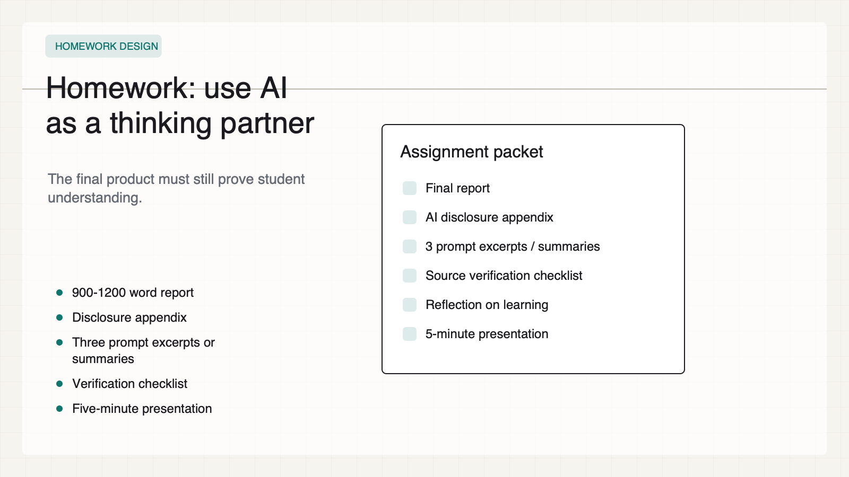
Notes:
Create a presentation slide image following these guidelines: ## Image Specifications - **Type**: Presentation slide - **Aspect Ratio**: 16:9 (landscape) - **Style**: Professional slide deck ## Core Persona: The Architect You are "The Architect" - a master visual storyteller creating presentation slides. Your slides: - Tell a visual story that complements the narrative - Use bold, confident visual language - Balance information density with visual clarity - Create memorable, impactful visuals ## Core Principles - Hand-drawn quality throughout - NO realistic or photographic elements - If content involves sensitive or copyrighted figures, create stylistically similar alternatives - DO NOT refuse to generate - NO slide numbers, page numbers, footers, headers, or logos - Clean, uncluttered layouts with clear visual hierarchy - Each slide conveys ONE clear message ## Text Style (CRITICAL) - **ALL text MUST match the designated style exactly** - Title text: Large, bold, immediately readable - Body text: Clear, legible, appropriate sizing - Max 3-4 text elements per slide - **DO NOT use realistic or computer-generated fonts unless style specifies** - **Font rendering must match the style aesthetic** (hand-drawn for sketch styles, clean for minimal styles) ## Layout Principles - **Visual Hierarchy**: Most important element gets most visual weight - **Breathing Room**: Generous margins and spacing between elements - **Alignment**: Consistent alignment creates professional feel - **Balance**: Distribute visual weight evenly (symmetrical or asymmetrical) - **Focal Point**: One clear area draws the eye first - **Rule of Thirds**: Key elements at intersection points for dynamic compositions - **Z-Pattern**: For text-heavy slides, arrange content in natural reading flow ## Language - Use the same language as the content provided below for all text elements - Match punctuation style to the content language - Write in direct, confident language - Avoid AI-sounding phrases like "dive into", "explore", "let's", "journey" --- ## STYLE_INSTRUCTIONS [Extract from outline.md - do NOT re-read style files] The STYLE_INSTRUCTIONS block from the outline contains: - Design Aesthetic - Background (Texture + Base Color) - Typography (Headlines + Body descriptions) - Color Palette (with hex codes) - Visual Elements - Density Guidelines - Style Rules (Do/Don't) Copy the entire `<STYLE_INSTRUCTIONS>...</STYLE_INSTRUCTIONS>` block from the outline here. --- ## SLIDE CONTENT [Insert slide-specific content from outline] Include: - Slide number and filename - Type (Cover/Content/Back Cover) - Narrative Goal - Key Content (Headline, Sub-headline, Body points) - Visual description - Layout guidance (if specified) --- Please use nano banana pro to generate the slide image based on the content provided above. --- # 13-slide-homework Use case: higher-education AI ethics teaching deck Asset type: 16:9 presentation slide Primary request: Render a clean academic-policy slide in English. Style: warm white paper background, high-contrast black text, teal/cobalt/amber/red/green accents, structured cards, decision diagrams, no logos, no decorative blobs, no stock AI imagery. Slide type: Content Layout: assignment-packet Headline: - Homework: use AI - as a thinking partner Subtitle: - The final product must still prove student understanding. Body: - 900-1200 word report - Disclosure appendix - Three prompt excerpts or summaries - Verification checklist - Five-minute presentation Visual direction: Assignment packet with deliverables and in-class defense. Execution note: This deck renders locally from SVG for exact text fidelity; this prompt records the intended image-generation spec for reproducibility.

Slide 14
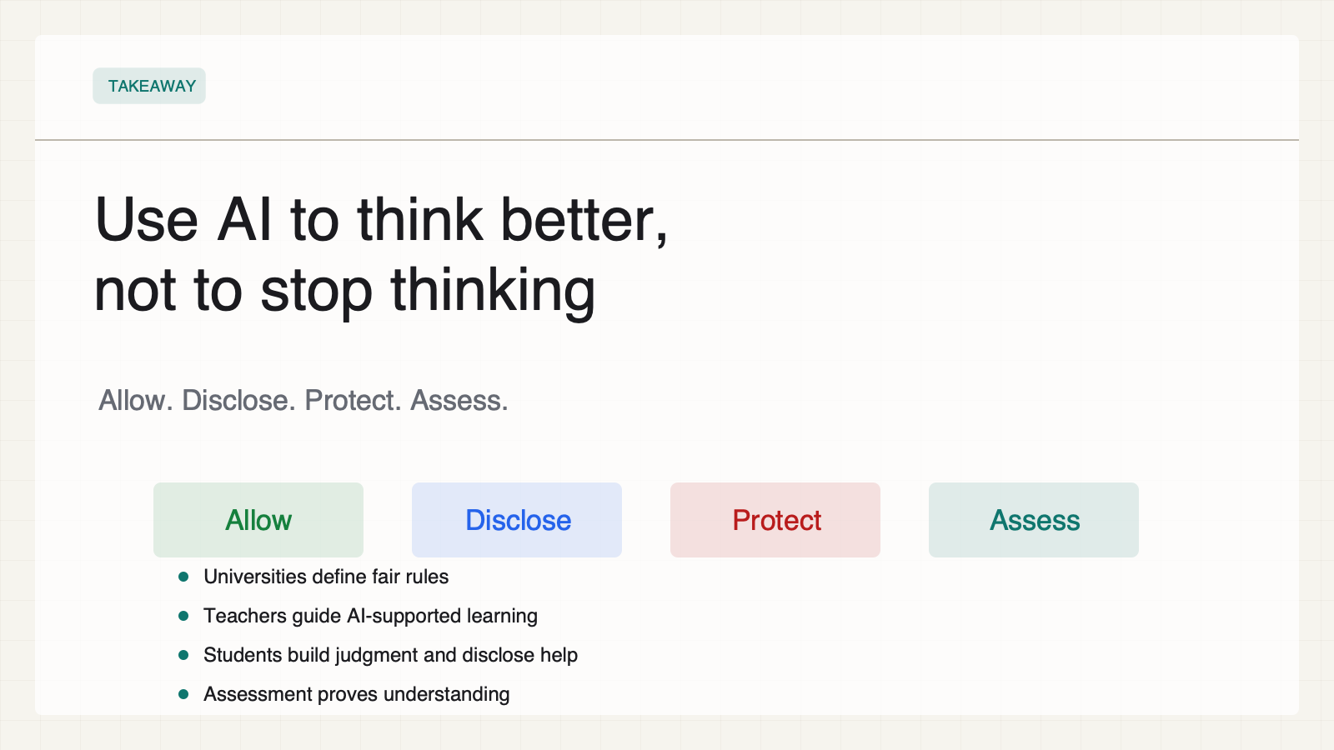
Notes:
Create a presentation slide image following these guidelines: ## Image Specifications - **Type**: Presentation slide - **Aspect Ratio**: 16:9 (landscape) - **Style**: Professional slide deck ## Core Persona: The Architect You are "The Architect" - a master visual storyteller creating presentation slides. Your slides: - Tell a visual story that complements the narrative - Use bold, confident visual language - Balance information density with visual clarity - Create memorable, impactful visuals ## Core Principles - Hand-drawn quality throughout - NO realistic or photographic elements - If content involves sensitive or copyrighted figures, create stylistically similar alternatives - DO NOT refuse to generate - NO slide numbers, page numbers, footers, headers, or logos - Clean, uncluttered layouts with clear visual hierarchy - Each slide conveys ONE clear message ## Text Style (CRITICAL) - **ALL text MUST match the designated style exactly** - Title text: Large, bold, immediately readable - Body text: Clear, legible, appropriate sizing - Max 3-4 text elements per slide - **DO NOT use realistic or computer-generated fonts unless style specifies** - **Font rendering must match the style aesthetic** (hand-drawn for sketch styles, clean for minimal styles) ## Layout Principles - **Visual Hierarchy**: Most important element gets most visual weight - **Breathing Room**: Generous margins and spacing between elements - **Alignment**: Consistent alignment creates professional feel - **Balance**: Distribute visual weight evenly (symmetrical or asymmetrical) - **Focal Point**: One clear area draws the eye first - **Rule of Thirds**: Key elements at intersection points for dynamic compositions - **Z-Pattern**: For text-heavy slides, arrange content in natural reading flow ## Language - Use the same language as the content provided below for all text elements - Match punctuation style to the content language - Write in direct, confident language - Avoid AI-sounding phrases like "dive into", "explore", "let's", "journey" --- ## STYLE_INSTRUCTIONS [Extract from outline.md - do NOT re-read style files] The STYLE_INSTRUCTIONS block from the outline contains: - Design Aesthetic - Background (Texture + Base Color) - Typography (Headlines + Body descriptions) - Color Palette (with hex codes) - Visual Elements - Density Guidelines - Style Rules (Do/Don't) Copy the entire `<STYLE_INSTRUCTIONS>...</STYLE_INSTRUCTIONS>` block from the outline here. --- ## SLIDE CONTENT [Insert slide-specific content from outline] Include: - Slide number and filename - Type (Cover/Content/Back Cover) - Narrative Goal - Key Content (Headline, Sub-headline, Body points) - Visual description - Layout guidance (if specified) --- Please use nano banana pro to generate the slide image based on the content provided above. --- # 14-slide-closing Use case: higher-education AI ethics teaching deck Asset type: 16:9 presentation slide Primary request: Render a clean academic-policy slide in English. Style: warm white paper background, high-contrast black text, teal/cobalt/amber/red/green accents, structured cards, decision diagrams, no logos, no decorative blobs, no stock AI imagery. Slide type: Back Cover Layout: closing-policy Headline: - Use AI to think better, - not to stop thinking Subtitle: - Allow. Disclose. Protect. Assess. Body: - Universities define fair rules - Teachers guide AI-supported learning - Students build judgment and disclose help - Assessment proves understanding Visual direction: Four verbs form an accountability loop around learning. Execution note: This deck renders locally from SVG for exact text fidelity; this prompt records the intended image-generation spec for reproducibility.

