Slide 1

Basketball
Eason Guo (yg8ca)
Flora Lee (kl2em)
Weiheng Su (ws2ta)
Jonathan Youssef (jay4ek)
Group 7

Slide 2
Introduction
A data storage application for specific basketball statistics.
View and modify various data on players, teams, referees, championship games, and divisions

Slide 3
1
ER Diagram
Entity-Relationship Diagram

Slide 4
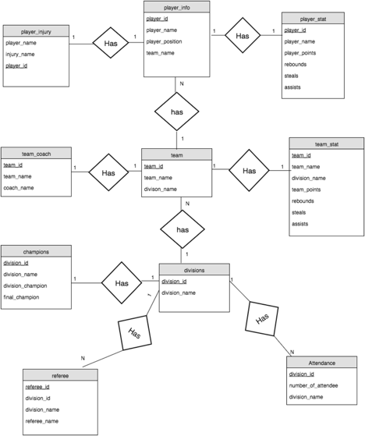

Slide 5
2
3NF
The Third Normal Form

Slide 6
3NF
Table Name | F+ | Fc | 3NF
Attendance | A->ABC | A->BC | ABC
Champions | A->ACDE | A->CDE | ACDE
Divisions | A->AC | A->C | AC
Referee | G->GACF | G->ACF | GACF
Team_Coach | I->IJH | I->JH | IJH
Team | I->IJA | I->JA | IJA
Team_stat | I->IJKLTU | I->JKLTU | IJKLTU
Player_info | M->MJNP | M->JNP | MJNP
Player_stat | M->MNQVWX | M->NQVWX | MNQVWX
Player_injury | M->MNS | M->NS | MNS
A = division_id
B = number of attendee
C = division_name
D = division_champion
E = final_champion
F = referee_name
G = referee_id
H = coach_name
I = team_id
J = team_name
K = team_points
L = team_rebounds
M = player_id
N = player_name
P = player_position
Q = player_points
S = injury_name
T = team_assists
U = team_steals
V = player_rebounds
W = player_assists
X = player_steals

Slide 7
Application Demo

Slide 8
Thanks!
Any questions?

