Slide 1
PROJECT OVERVIEW
Brazilian E-Commerce Public Dataset by Olist
Tools: DuckDB, dbt, Python, Pandas, Matplotlib
Notes:
Pilo: Problem Statement & Dataset: Olist is a Brazilian marketplace connecting sellers to customers across multiple channels. 9 source CSV files: orders, customers, products, sellers, order items, payments, reviews, geolocation. Business questions: how is revenue trending, which products perform best, who are the most valuable customers? Our project analyzes the Brazilian E-Commerce Public Dataset by Olist. The goal was to build an end-to-end analytics workflow: load raw data into DuckDB, model it into a star schema using dbt, validate data quality with dbt tests, and then perform business analysis and visualization with Python and Pandas.

Slide 2
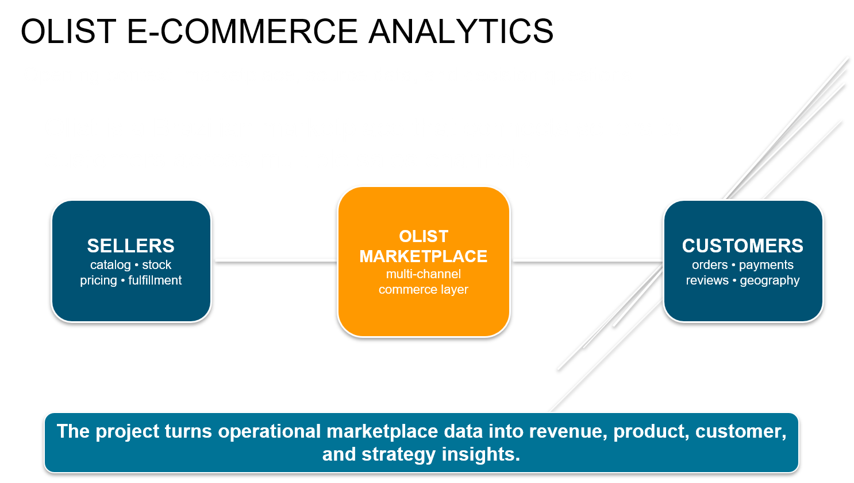
Notes:
Pilo: This slide sets the business-model lens for the rest of the presentation. The important distinction is that Olist should not be treated as a traditional retailer selling its own inventory directly to consumers. Olist is better understood as a commerce enablement platform for sellers. Sellers are Olist's primary clients. Olist helps them manage catalog, stock, pricing, fulfillment, marketplace access, logistics, payments, and operating tools. Marketplaces provide large customer traffic, while end customers generate the orders, payments, reviews, and demand signals we see in the dataset. So when we analyze orders, products, geography, reviews, and repeat buyers later in the deck, we should read those metrics as signals of platform activity and seller success, not simply as consumer retail metrics.

Slide 3
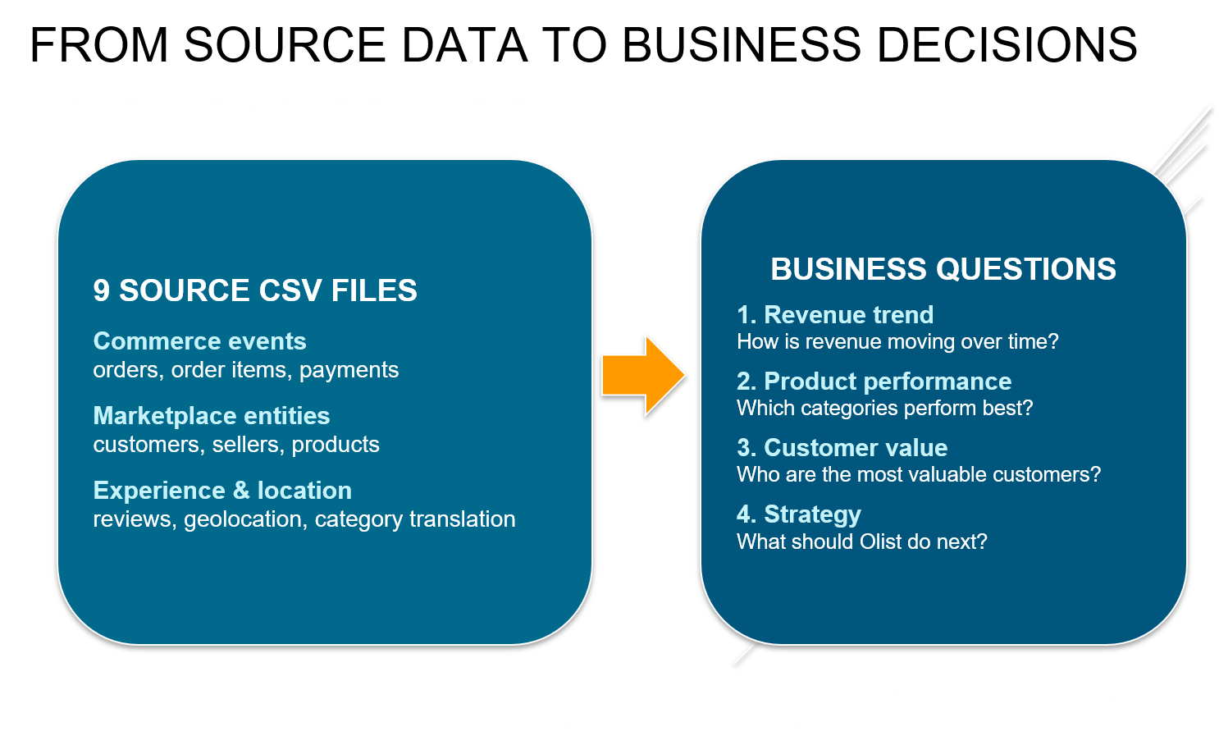
Notes:
Pilo: This slide explains how the data connects to the business questions. The nine CSV files are operational records of marketplace activity. They are very useful, but they are not a full financial view of Olist. In particular, transaction value should be treated as a GMV proxy, not true Olist revenue. The questions move from measurement to decision-making: first, how much commerce is moving through the platform; second, which categories are strongest; third, which sellers and customers drive value; and fourth, what Olist should do next. The key message is that buyer and product analysis still matters, but the strategic use of that analysis is seller-centric. The goal is to help sellers grow GMV, improve delivery and review performance, and convert buyer demand into repeat platform activity.

Slide 4
ARCHITECTURE
CSV Files → DuckDB → dbt Staging → Star Schema → dbt Tests → Analytics
Notes:
Huang Wei: The workflow starts with CSV files from the Olist dataset. We loaded them into DuckDB, then used dbt to create staging models and dimensional warehouse tables. After validating the data with dbt tests, we used Pandas and Matplotlib to generate business insights and charts. We selected DuckDB as our analytical database because it can work directly with CSV files, and it is fully supported by dbt. We chose dbt because it separates raw data from transformed business-ready models, makes transformations modular and reusable, provides built-in testing, and automatically documents data lineage. In our project, dbt helped us build a maintainable star schema on top of DuckDB while ensuring data quality through automated tests.

Slide 5
STAR SCHEMA
stg_orders
\
--> fact_sales
/
stg_order_items
dim_customer
dim_product
dim_seller
Fact: fact_sales
Dimensions: dim_customer, dim_product, dim_seller
Notes:
Dick: The warehouse uses a star schema. We created stg_order_items and stg_orders as staging models to separate raw source data from business transformations. The staging layer provides a place to clean, standardize, and validate data before building the fact and dimension tables. The central fact table is fact_sales, which contains transaction-level sales data. Around it are three dimensions: dim_customer, dim_product, and dim_seller. This structure simplifies analytical queries and reporting.

Slide 6
Data Quality
Olist Brazilian E-Commerce Project
dbt Native Tests
data_quality.py
Two-Layer Approach
Notes:
Jacky“My part of the project covers the data quality. The goal was to make sure the data feeding our charts and analysis is actually trustworthy — that primary keys are clean, relationships hold, and business rules like valid sales amounts are enforced. We will go through the two-layer approach used and what each layer catches.”

Slide 7
Overview
A Two-Layer Quality Approach
Layer 1 — dbt
Layer 2 — Python
Structural integrity
unique + not_null tests
Runs on every model refresh
7 tests — all passed
Business rule checks
Null FKs + negative amounts
SQL run against DuckDB
4 custom checks
+
Notes:
Jacky:

Slide 8
Layer 1 — dbt
dbt Native Tests
Table
Column
Tests Applied
dim_customer
customer_id
unique + not_null
dim_product
product_id
unique + not_null
dim_seller
seller_id
unique + not_null
fact_sales
order_id
not_null
All 7 tests passed ✔
Notes:
Jacky: “The first layer uses dbt’s built-in test types — unique and not_null — applied to the primary keys of all three dimension tables and the fact table. In total, 7 tests, and all 7 passed.”

Slide 9
Layer 2 — Python
4 Custom Checks via data_quality.py
Check
SQL Condition
Why It Matters
Null customer_id
customer_id IS NULL
Breaks customer segment analysis
Null product_id
product_id IS NULL
Breaks category & revenue analysis
Null seller_id
seller_id IS NULL
Seller performance metrics unreliable
Negative sales amount
sales_amount < 0
Flags refunds or data entry errors
Notes:
Jacky: “The second layer goes beyond structure. Here a Python script called data_quality.py runs four additional SQL checks directly against DuckDB to catch business rule violations that dbt’s built-in tests don’t cover.”

Slide 10
Layer 2 — Python
data_quality.py — How It Works
import duckdb
Connect
conn = duckdb.connect('olist.db')
Opens olist.db directly via DuckDB
checks = {
Dict-driven
"Null customer_id": "...WHERE customer_id IS NULL",
Name + SQL pairs — add checks with one line
"Null product_id": "...WHERE product_id IS NULL",
"Null seller_id": "...WHERE seller_id IS NULL",
"Negative sales": "...WHERE sales_amount < 0"
Loop & log
}
Count > 0 flags affected rows for review
for check_name, query in checks.items():
result = conn.sql(query).fetchone()[0]
print(f"{check_name}: {result}")
Notes:
Jacky: The script stores each check’s name and SQL in a Python dictionary, then loops through them — running each query against DuckDB and printing the row count. A result of 0 means the check passed. Anything above 0 flags the number of affected rows for investigation.

Slide 11
Summary
What the Two Layers Deliver
7
4
0
dbt tests
Python checks
Hard failures
unique + not_null across all 3 dim tables and fact_sales
Null FKs + negative amounts via data_quality.py
All findings treated as documented limitations — pipeline kept auditable
Both layers together ensure structural integrity and business rule compliance across the entire pipeline.
Notes:
Jacky: “Together, these two layers give us complementary coverage. dbt catches structural problems at the schema level — things that would break joins. The Python script catches business rule violations at the row level — things that would silently corrupt analysis.”

Slide 12
Data quality is not just about
cleaning data.
It’s about making sure everyone who touches
the data downstream can trust what they see.
Notes:
Jacky:

Slide 13
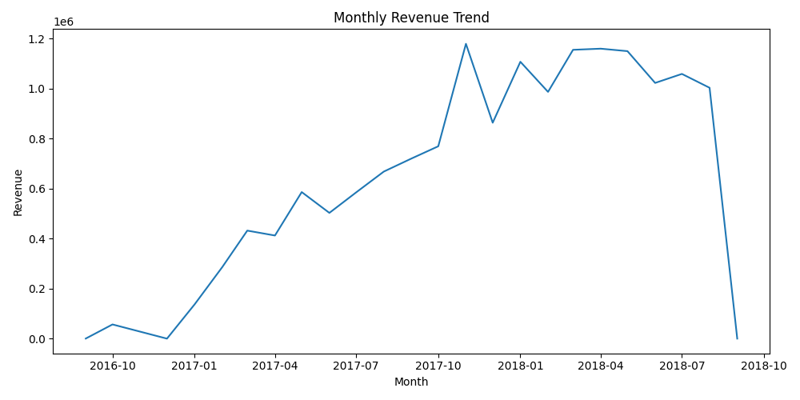
MONTHLY SALES TREND
Oct 2016: R$354
Feb 2017: R$286k
Nov 2017: R$1.18M
Avg MoM: +8.8%
Data pipeline transforms 9 raw CSVs into a time-series that immediately shows business momentum
Notes:
Sean: This chart shows monthly revenue over time. Revenue generally increased during 2017 and 2018, indicating significant growth in the platform during the observed period. The trend also shows seasonal fluctuations, which are common in e-commerce businesses.

Slide 14
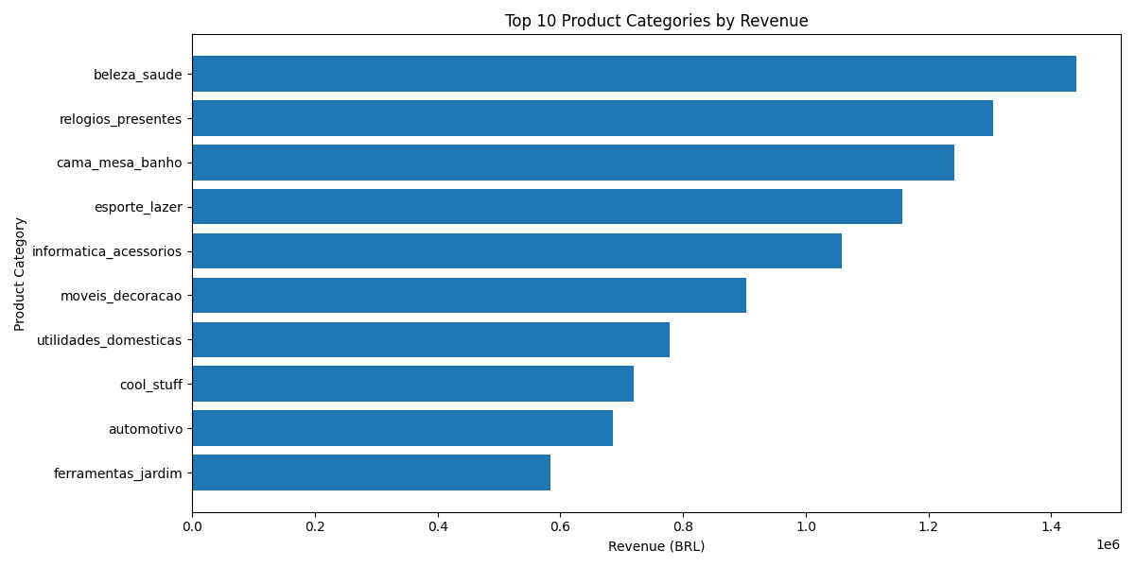
TOP PRODUCT CATEGORIES
Top categories = Beauty & Health, Watches & Gifts, Bed/Bath/Table
Accounts for R$4M of Revenue (25.2%)
Defend top 3 while explore upselling for top 4-5
Notes:
Sean: The highest-revenue product categories were Beauty & Health, Watches & Gifts, and Bed, Bath & Table. These categories contributed a large share of total revenue and could be prioritized for marketing and inventory planning.

Slide 15
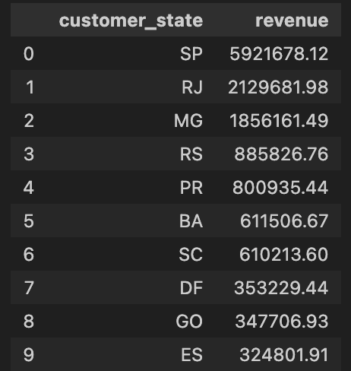
REVENUE BY STATE
Sao Paulo is 3x the next state (R$5.9M)
Retention for top 3 (SP, RJ, MG)
Acquisition for RS & PR (most developed but low market penetration)
Revenue is geographically concentrated in Southeast Brazil. Consolidate and accelerate in South BR further
Notes:
Sean: Revenue was heavily concentrated in São Paulo (SP), followed by Rio de Janeiro and Minas Gerais. This suggests that customer demand is strongest in Brazil’s largest economic regions.

Slide 16
CUSTOMER RETENTION
RFM shows the biggest opportunity is converting valuable one-time buyers.
95,420
customers scored
Only 3.05% of customers are repeat buyers, so frequency is scored with honest order-count buckets rather than misleading percentiles.
2,913
repeat customers
Segment
Customers
Share
Gross sales
Campaign use
Recent New Customers
23,179
24.29%
R$1.46M
Second-purchase coupon
Core / Mid-Value Customers
24,071
25.23%
R$2.70M
General nurture
Dormant Low Value
11,959
12.53%
R$523k
Low-cost reactivation
At-Risk High Spenders
11,274
11.82%
R$1.59M
Win-back campaign
High-Value New Customers
11,081
11.61%
R$4.34M
Priority second-purchase
Big Spenders - One-Time Buyers
10,943
11.47%
R$4.32M
Premium cross-sell
Recent Repeat Buyers
1,518
1.59%
R$453k
Loyalty campaign
At-Risk Repeat Buyers
1,314
1.38%
R$402k
Win-back repeat
Champions
81
0.08%
R$50k
VIP treatment
Source: local Olist warehouse, fact_sales. Gross item sales include product price plus freight value.
1
Notes:
Annie2: Lastly, lets dive into customer retention. So, we ran an RFM model—looking at Recency, Frequency, and Monetary value—to see how our customers are actually behaving.
When we looked at the results, one number really jumped out is the retention rate - only about 3 percent of the customers in this dataset are repeat buyers.
Because that repeat rate is so low, recommending a broad, general loyalty program just wouldn't make sense here. But as we looked closer at the middle section of this table ie the 'High-Value New Customers' and 'Big Spenders' groups, we see a massive opportunity, approx 8Mil in sales, which is a massive 55% of the entire revenue
If we were to present this data to a CMO today, our main recommendation would be that the priority should not be launching a broad loyalty program. Instead, the real strategy for the CMO needs to be converting these valuable first-time buyers into second-time buyers
=========================================================================================================================================
Annie: This slide explains why customer retention is the most important customer strategy question in the Olist dataset. The key point is that only 2,913 out of 95,420 customers are repeat buyers, which is just 3.05% of the customer base. Because repeat purchasing is so rare, a standard frequency percentile score would exaggerate small differences between mostly one-time customers.
The RFM scoring therefore uses a more honest frequency method:
1 order = low frequency
2 orders = repeat buyer
3-5 orders = strong repeat buyer
6+ orders = very frequent buyer
The segment table shows that most customers are either new, mid-value, dormant, or one-time high spenders. The most commercially important insight is that the high-value one-time groups are large and valuable. High-Value New Customers and Big Spenders - One-Time Buyers together represent more than 22,000 customers and more than R$8M in gross item sales.
The business takeaway is that Olist should not treat retention as a generic loyalty problem yet. The first priority is to convert valuable one-time buyers into second-time buyers, because that is where the largest customer value opportunity sits.

Slide 17
CAMPAIGN PRIORITIES
Do not start with broad loyalty; first convert high-value one-time buyers.
3.05%
The RFM result points to a staged retention strategy: second purchase first, win-back second, loyalty only for the small repeat base.
repeat-customer share
01
02
03
04
High-value new customers
At-risk high spenders
Recent repeat buyers
Champions
11,081 customers | R$4.34M
11,274 customers | R$1.59M
1,518 customers | R$453k
81 customers | R$50k
Priority second-purchase offer
Timed win-back campaign
Loyalty rewards
VIP treatment
Recent one-time buyers already proved willingness to spend.
High value is present, but recency has weakened.
This small base has already crossed the repeat threshold.
Tiny group with recent, frequent, high-value behavior.
Slide message: RFM scoring shows Olist's biggest customer opportunity is converting high-value one-time buyers into repeat customers.
Source: local Olist warehouse, fact_sales. Gross item sales include product price plus freight value.
2
Notes:
Annie2: To capture that 8 million, I mapped out four clear campaign priorities:
First, we target 'High-Value New Customers' with an immediate second-purchase offer while our brand is still fresh.
Second, we win back our 'At-Risk High Spenders' using personalized campaigns based on their past purchases.
Third, we protect our small 3 percent baseline of 'Recent Repeat Buyers' with standard loyalty rewards.
Finally, we give our 'Champions' the VIP treatment.
Ultimately, this shows how we can stop guessing and focus our marketing budget exactly where the data shows the highest return
===================================================================================================================================
Annie: This slide translates the RFM results into campaign priorities. Since only 3.05% of customers are repeat buyers, broad loyalty campaigns would reach a very small part of the customer base. A staged retention strategy is more practical.
The first priority is High-Value New Customers. These customers purchased recently, bought only once, and generated high gross item sales. They are the best audience for second-purchase coupons, category recommendations, or limited-time follow-up offers.
The second priority is At-Risk High Spenders. These customers generated meaningful sales but have not purchased recently. They are good candidates for win-back campaigns, especially if offers are personalized around previous product categories.
The third priority is Recent Repeat Buyers. This group is much smaller, but they have already shown repeat purchase behavior. They are the right audience for loyalty rewards, early access, or benefits that encourage continued engagement.
Champions are the smallest group, but they show the strongest combination of recency, frequency, and monetary value. They should receive VIP treatment, premium offers, or early access campaigns.
The main presenter message is:
RFM scoring shows Olist's biggest customer opportunity is converting high-value one-time buyers into repeat customers, while using win-back campaigns for older high-spend customers and loyalty offers for the small repeat-buyer base.

Slide 18
BUSINESS INSIGHT CONCLUSION
From nine operational CSV files to an auditable decision model for GMV, seller performance, products, customers, and growth strategy.
+8.8%
avg MoM GMV growth
R$4.0M
top 3 categories GMV (25.2% of total)
R$5.9M
São Paulo GMV (dominant market)
3,095
active sellers
Recommended next moves
01
02
03
Defend proven demand
Grow seller success
Manage by experiment
Prioritize high-GMV categories (Beauty & Health, Watches & Gifts, Bed/Bath/Table) and strong seller regions (SP, RJ, MG).
Help sellers convert demand into repeat platform activity.
Track active sellers, GMV per seller, delivery, and reviews monthly.
Final takeaway: use operational data to grow GMV, strengthen seller success, improve repeat demand, and keep the analytics pipeline auditable. Source: Local Olist DuckDB warehouse (fact_sales + dimensions).
Notes:
Michelle: Wrapping up our analysis, we’ve transformed nine raw CSV files into a clean, auditable analytics model that gives Olist clear visibility into GMV, products, customers, and sellers.
As you can see, the platform showed strong momentum with +8.8% average month-over-month GMV growth. Our top three product categories drove R$4 million, while São Paulo alone contributed R$5.9 million — highlighting where the strongest demand sits. We also identified 3,095 active sellers operating on the platform.
Looking ahead, we recommend three priorities: First, defend our proven demand by focusing on high-performing categories and regions. Second, help sellers turn that demand into repeat business. And third, manage performance through continuous experimentation — tracking GMV per seller, delivery, and reviews every month.
Ultimately, this project shows how a solid data pipeline can drive growth, improve seller success, and unlock repeat customer value while keeping everything fully auditable."
Wrapping up — we transformed nine raw CSV files into a clean analytics model, uncovering strong platform momentum: 8.8% month-over-month GMV growth, top categories pulling in R$4M, and São Paulo contributing R$5.9M across 3,095 active sellers.
Moving forward, our three priorities are clear: defend top categories, drive seller repeat business and continuously monitor performance.
A solid data pipeline drives real growth — transparently and auditably.

Slide 19
KEY LEARNINGS
End-to-End Analytics Engineering Mastery
Successfully built a complete modern analytics pipeline — from raw CSV files to a clean, documented star schema using DuckDB + dbt. This demonstrates the ability to productionize data workflows following analytics engineering best practices.
Data Quality as a Foundation for Trust
Implemented a robust two-layer data quality approach (dbt native tests + custom Python business rule checks). This ensured structural integrity and reliable business metrics, proving that trustworthy insights start with trustworthy data.
Actionable Business Impact from Data
Transformed raw transactional data into clear strategic recommendations — identifying +8.8% MoM GMV growth, high-value product categories, geographic concentration, and the critical opportunity in converting one-time high-value buyers into repeat customers.
Notes:
"Good morning everyone. As we wrap up our presentation, I’d liked to share the three key learnings from this Olist project.
First, we gained hands-on mastery of end-to-end analytics engineering. We started with nine messy CSV files and successfully built a complete, modern data pipeline using DuckDB and dbt. This included creating a clean star schema, modular transformations, and proper documentation. It really showed us how to move from raw data to production-ready analytics models.
Second, we learned that data quality is foundational. By implementing a two-layer approach — dbt’s built-in tests plus custom Python business rule checks — we ensured our data was reliable and trustworthy. This gave us confidence that all the insights and recommendations we’re presenting are based on solid, auditable data.
Third, and most importantly, we saw how powerful good data can be for business decisions. Through GMV trend analysis, category performance, geographic insights, and RFM segmentation, we didn’t just generate charts — we uncovered actionable strategies, especially the big opportunity in converting high-value one-time buyers into repeat customers.
Overall, this project taught us that a well-designed analytics pipeline is not just a technical exercise — it’s a strategic capability that drives real business growth and seller success."
To close, here are three key learnings we're taking away from the Olist project.
And most importantly, a well-designed analytics pipeline unlocks the true power of big data — making it not just technical, but a strategic business capability. Thank you.

