Slide 1
sql_connection_to_remote_database

Slide 2
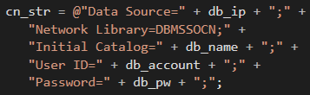
sql_connection_to_remote_database
The difference is the connection string

Slide 3
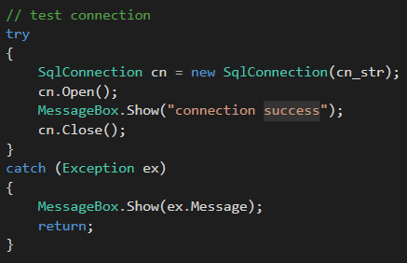
sql_connection_to_remote_database
Test connection

Slide 4
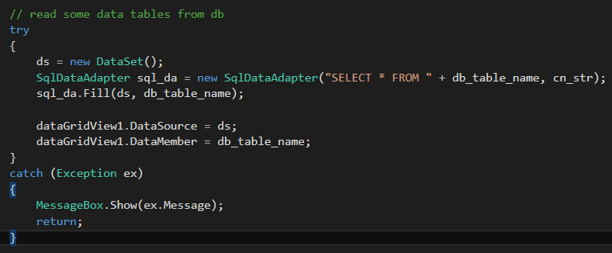
sql_connection_to_remote_database
Read some data

