Slide 1
Restaurants recommendation system for Yelp user
Hua Wei
2018-Mar-28

Slide 2
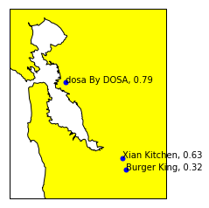

Motivation
Target: Get recommendeds restaurant within a certain range for a specific user
Example: Heroku APP under construction...
Input
Output
User ID (unique ID to obtain user history, like rate, review for all restaurants)
Range (In miles)

Slide 3
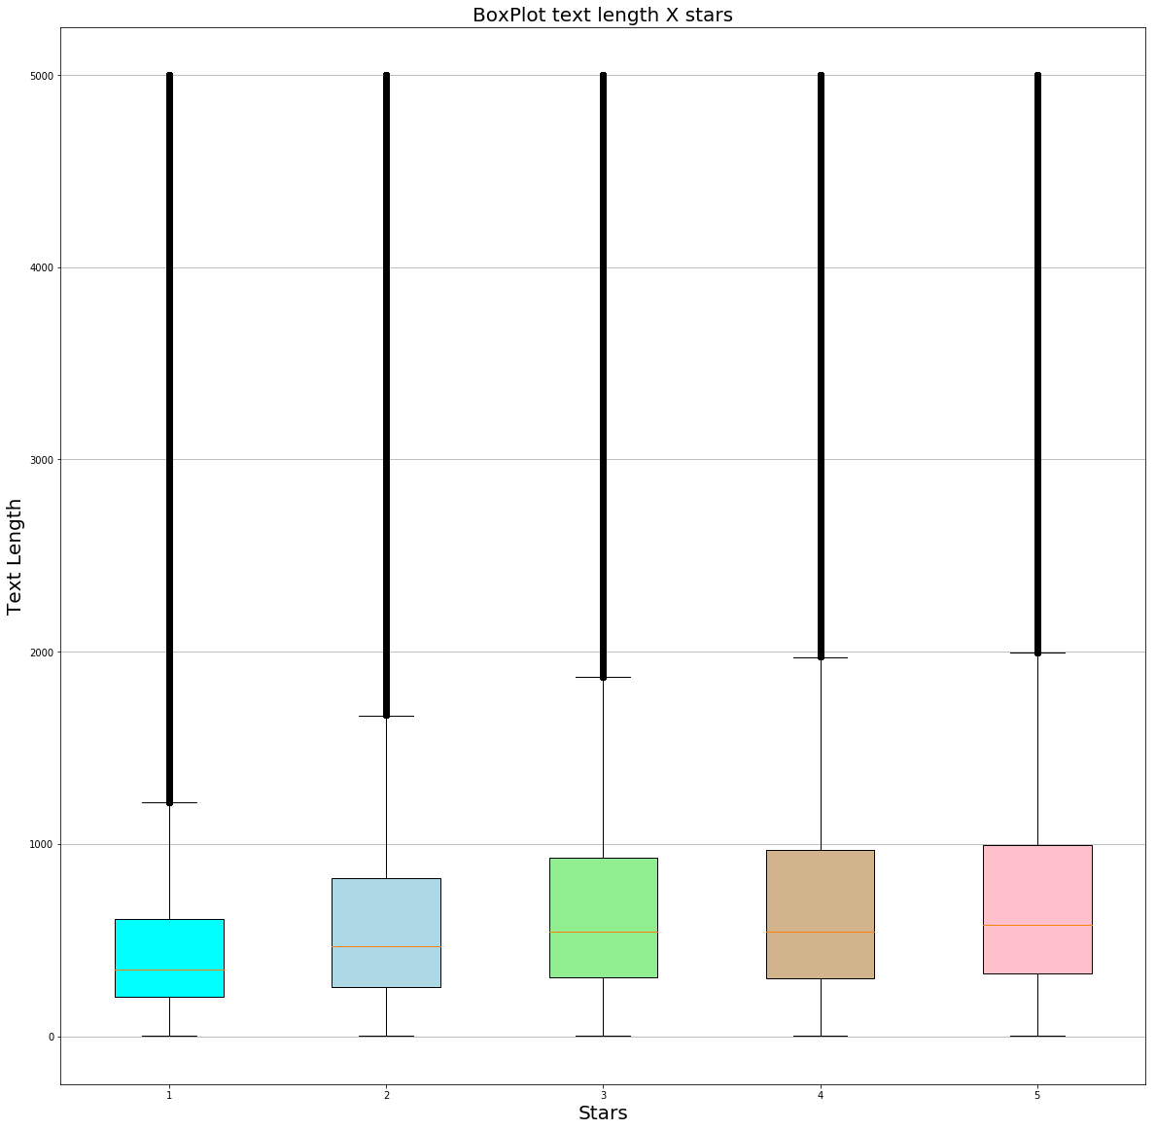
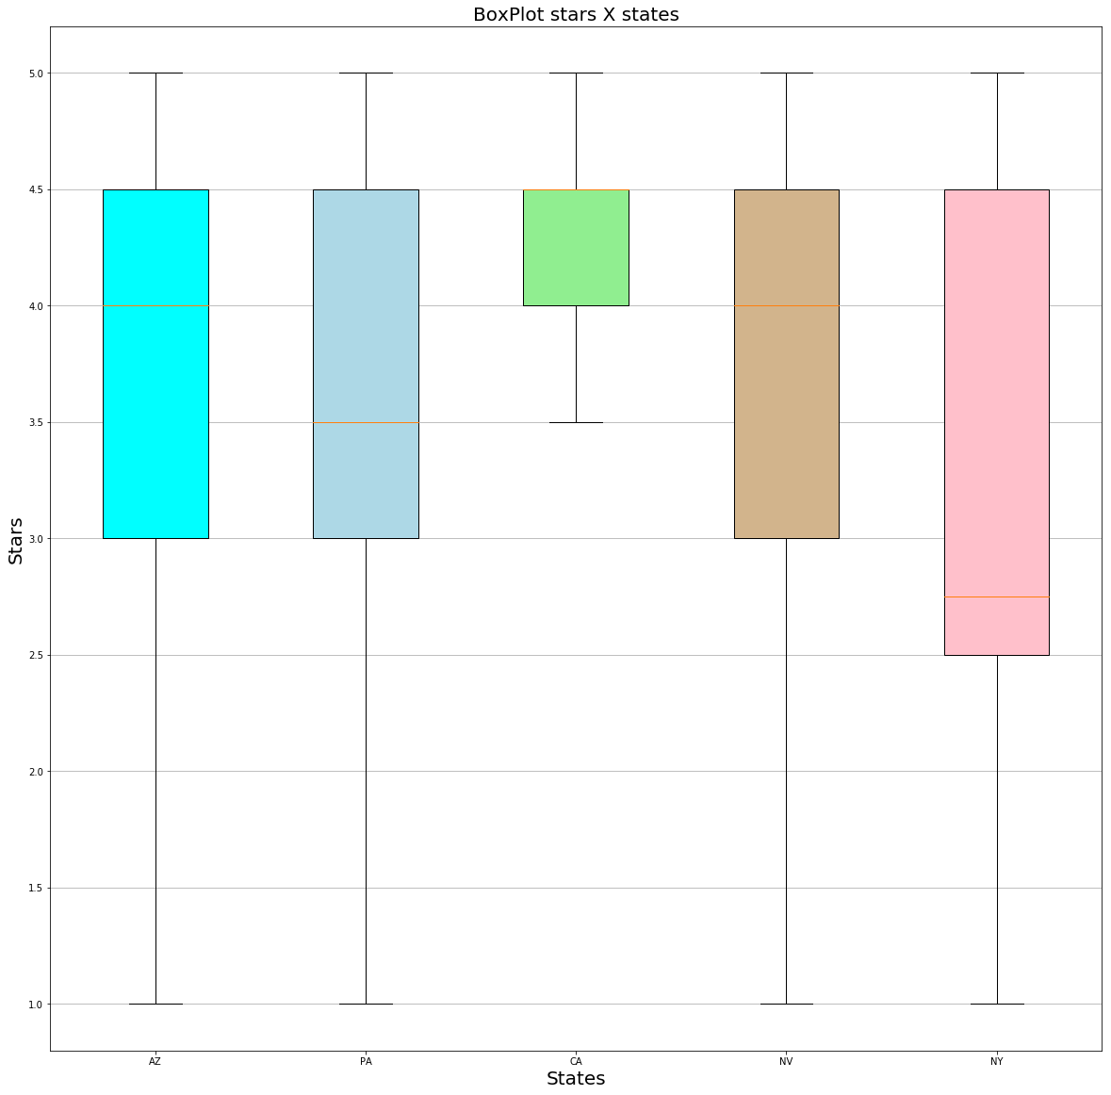

Yelp Dataset
Dataset:
  review.json: review content, like text, stars(rate), user_id, business_id, etc.
  user.json: user information, like number of friends, followers, etc
  business.json: restaurant details, like average rate
  tips.json: tip text from a user for a restaurant

Slide 4
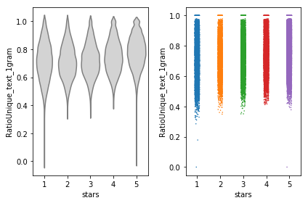
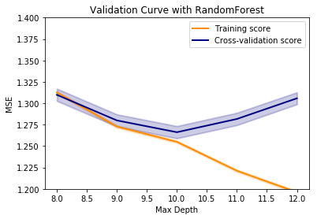
Feature engineering and Machine learning system
Feature engineering:
  Text: review text(tip text). Count, distance, TF-IDF based similarity
  User and business info
Machine learning system:
  Predicted rate: PredictRateModels.ipynb
  Recommendation with predicted rate: RecommendationSysTest.ipynb

Slide 5

Conclusion, Plan and Challenge
Build a vanilla data analysis framework to predict review rate with 20% data
Build a baseline recommendation system with surprise package
Try to build rate predict models for every metropolitan area
More feature engineer on tips.json, etc
Tune model with Bayesian optimization
Parallel processing (distributed system) on dataset

