Slide 1


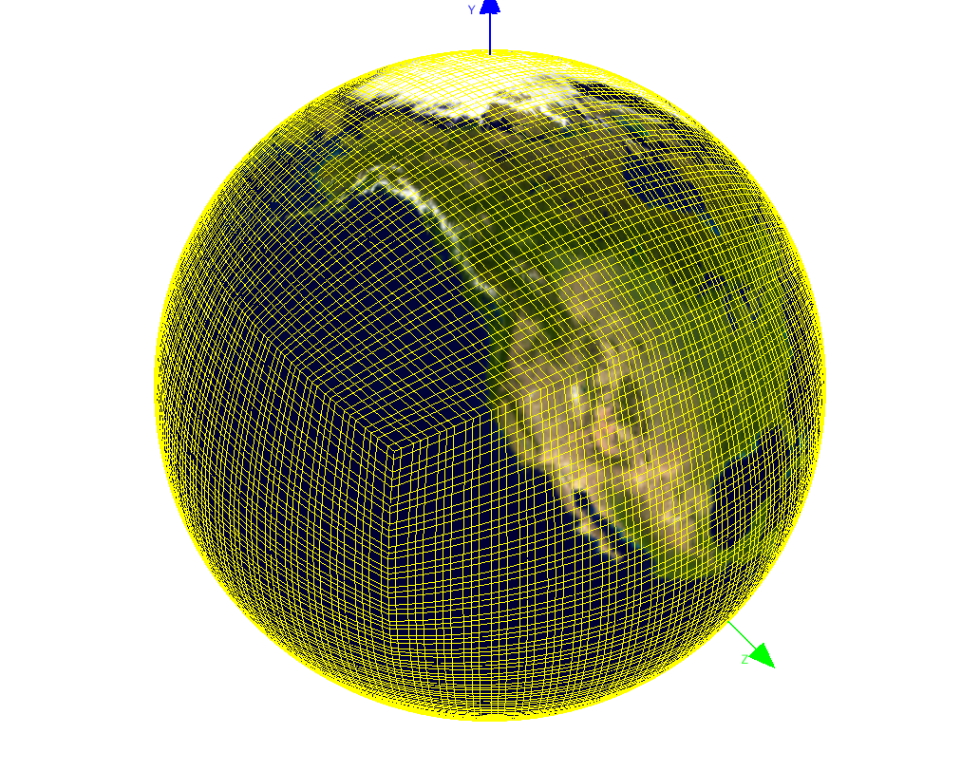
NV for CAM
Wei Huang, Dave Brown,
Mary Haley, Rick Brownrigg
Quick Access to CAM data with NV
NV (NCAR Viewer) integrates NCL, OpenGL, and Qt together to give users
a quick way to access CAM finite-volume, and spectral-element output.
NV has installed in NCAR’s data analysis and visualization machine “geyser”,
so users can use it there directly.
Visualizing CAM-SE data
NV can view CAM-SE data on its original grids (shown in Fig. 1, and Fig. 2).
Figure 1. Process and visualize HIRDLS data (Left O3, right the track)
Figure 1 CAM-SE grids on sphere

Slide 2
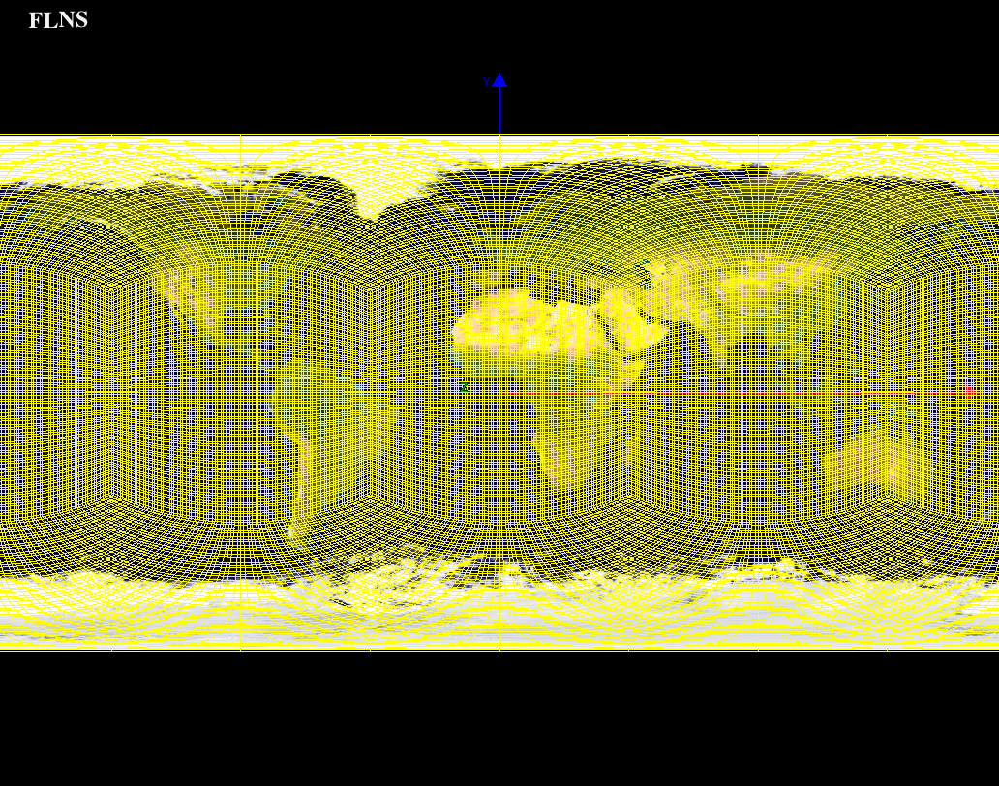
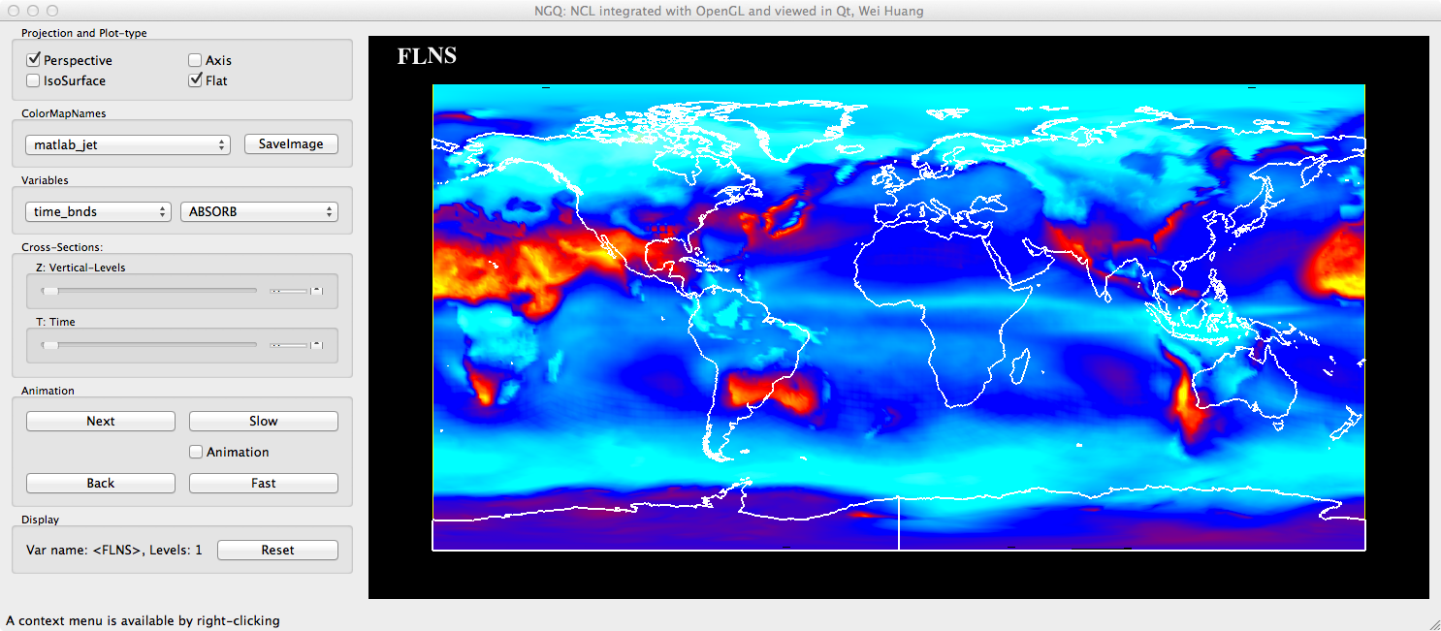
Figure 2 CAM-SE grids projects to equal cylinder map
Display a CAM-SE 2D variable
Figure 2 OMI-Auto-L3, O3 Column Amount

Slide 3
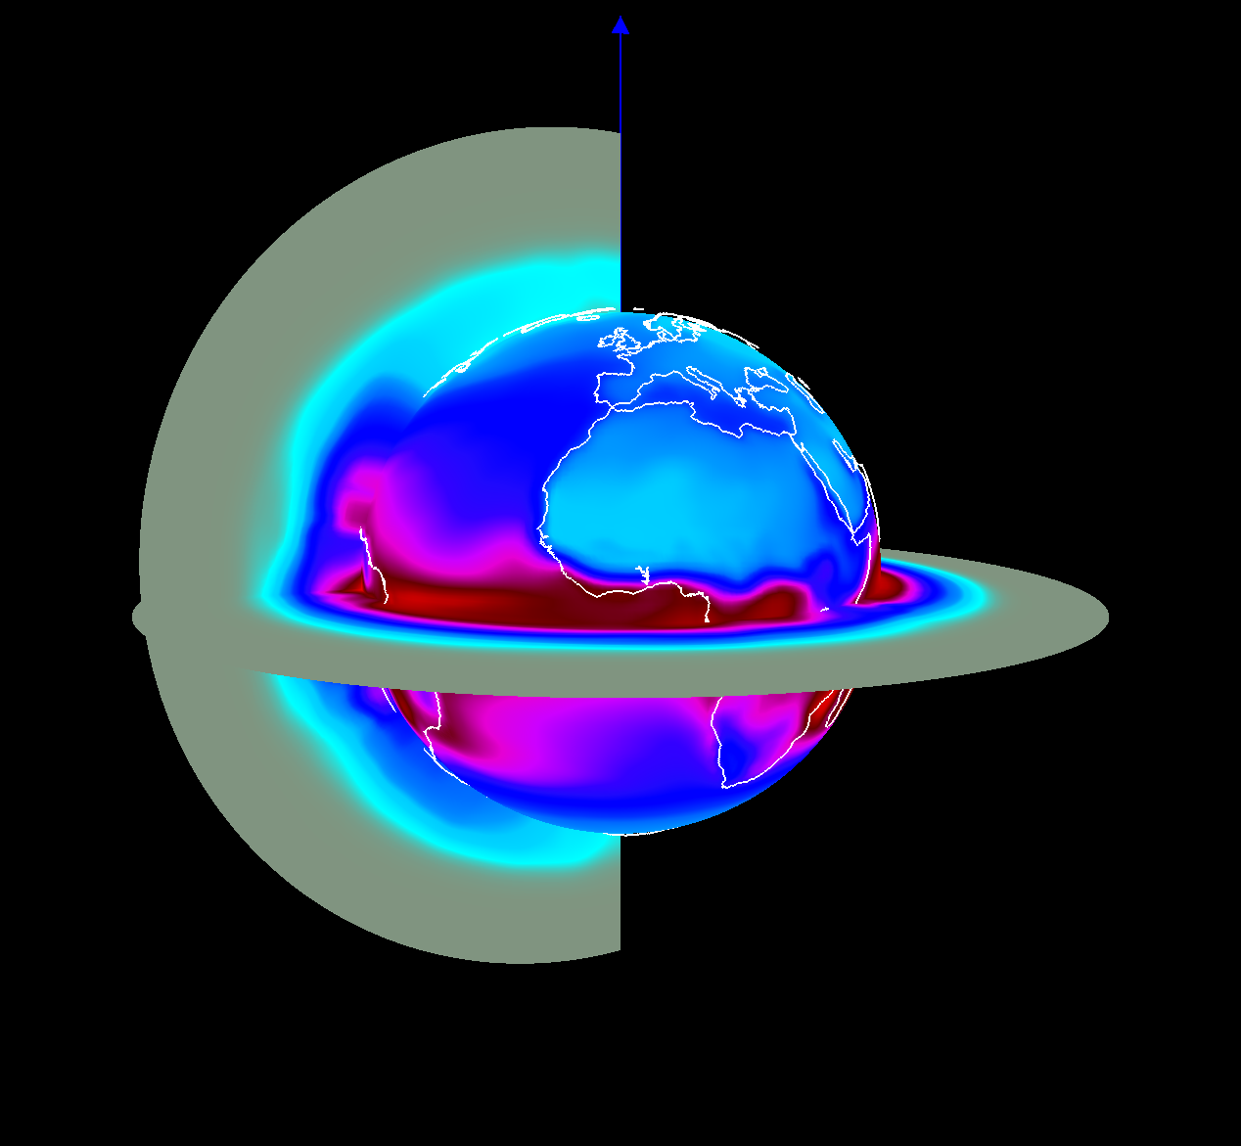
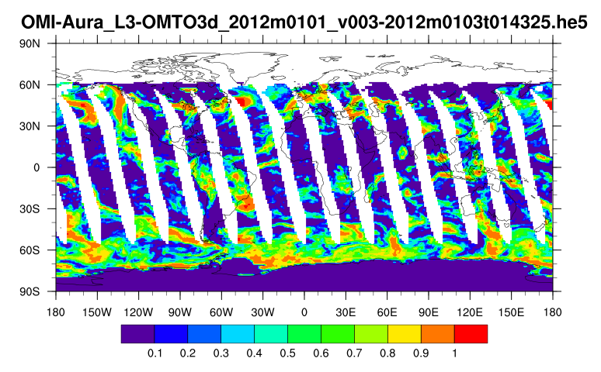
Figure 3 Monthly Surface Reflectance (January)
Figure 4 Radiactive Cloud Fraction

Slide 4
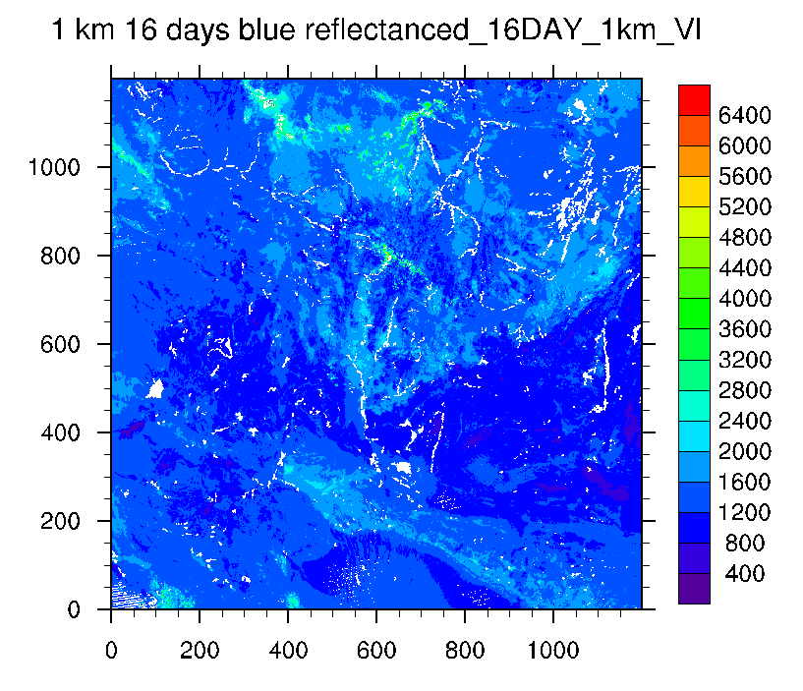
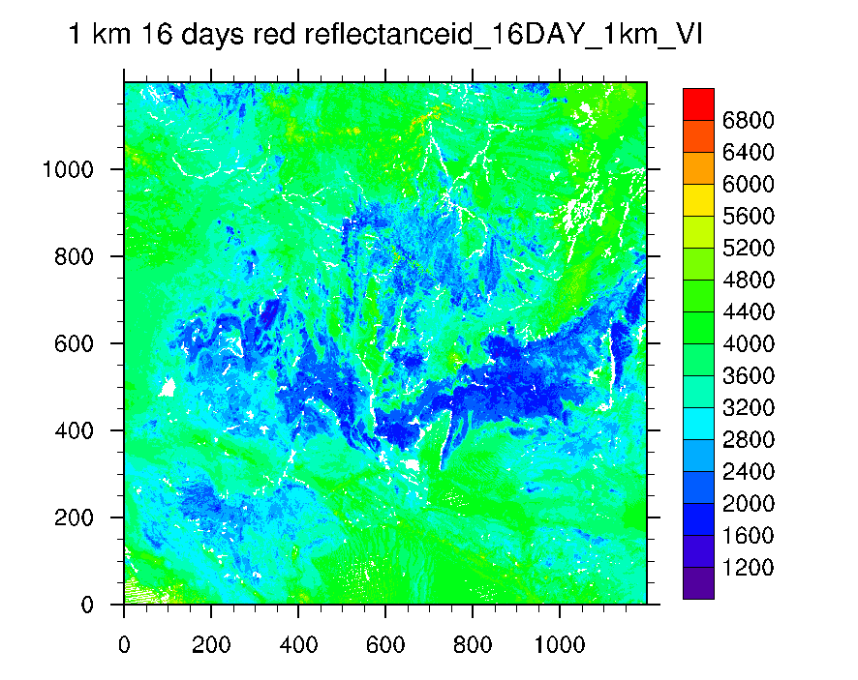
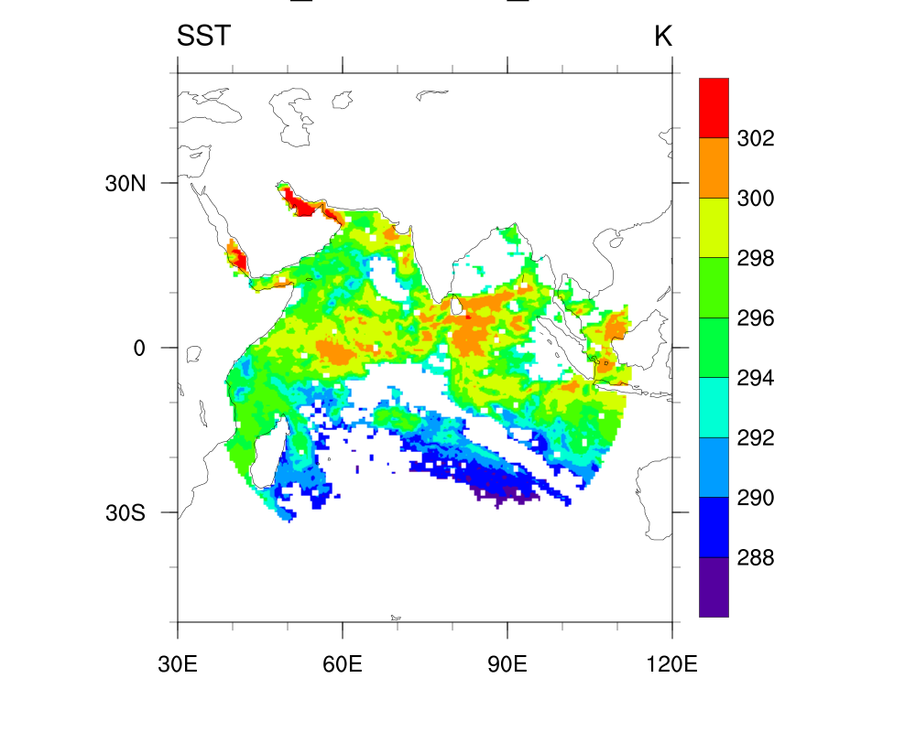
HDF5 data
Processing and Visualizing HDF5 dataset
Figure 5 Blue (left) and Red (right) Reflectance from a HDF5 file
Figure 6 Sea Surface Temperature (HDF5 with Compound data type)
Reference: http://www.ncl.ucar.edu/Applications/HDF.shtml
Contact: huangwei@ucar.edu

