Slide 1
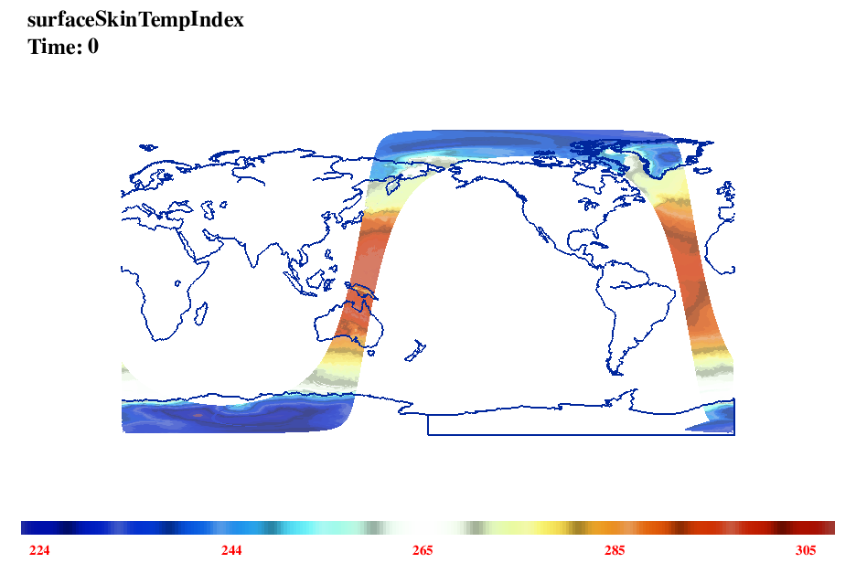
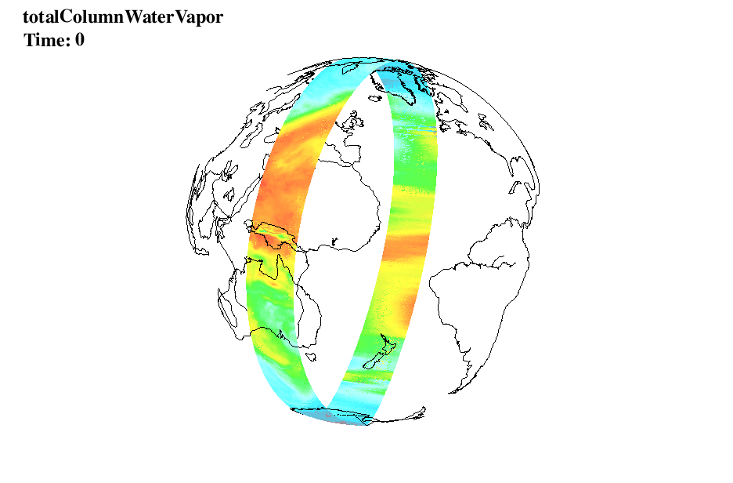
Visualize NASA GPM Data
Wei Huang
http://www.cisl.ucar.edu/staff/huangwei/nv
Contact: huangwei@ucar.edu
Notes:
Must work closely with MM5, WRF developers

