Slide 1
MPI Demo with NV
Wei Huang

Slide 2
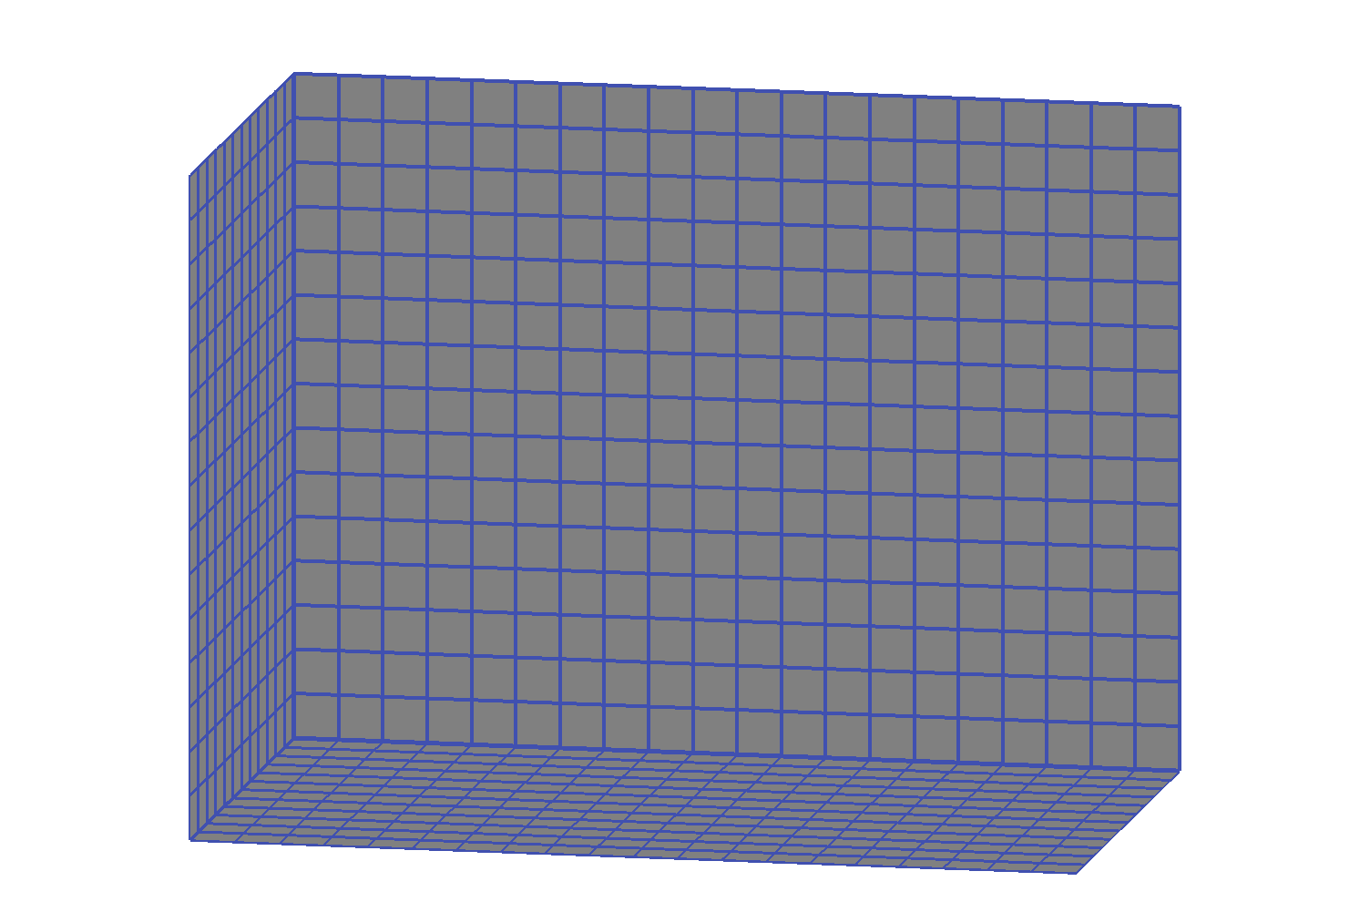
The Domain -- 20x15x12
Notes:
Mainly before 2001.

Slide 3
Decompostion
Domain size:
20 * 15 * 12
Check-board decomposition
Use 12 CPUs
N = 12 = P * Q
P = 4, Q = 3

Slide 4
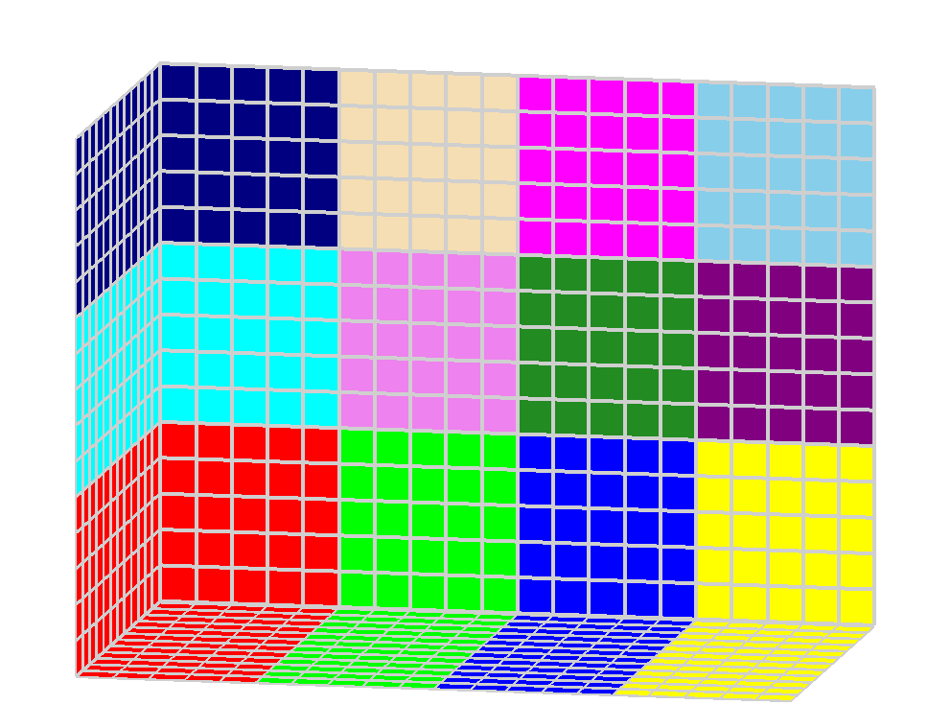
Decompose without halo
Notes:
When I was about 13 years old, I saw calculator first time, at that time I am thinking of computer science.
But China has different education system, it could be hard to choose the major you want.

Slide 5
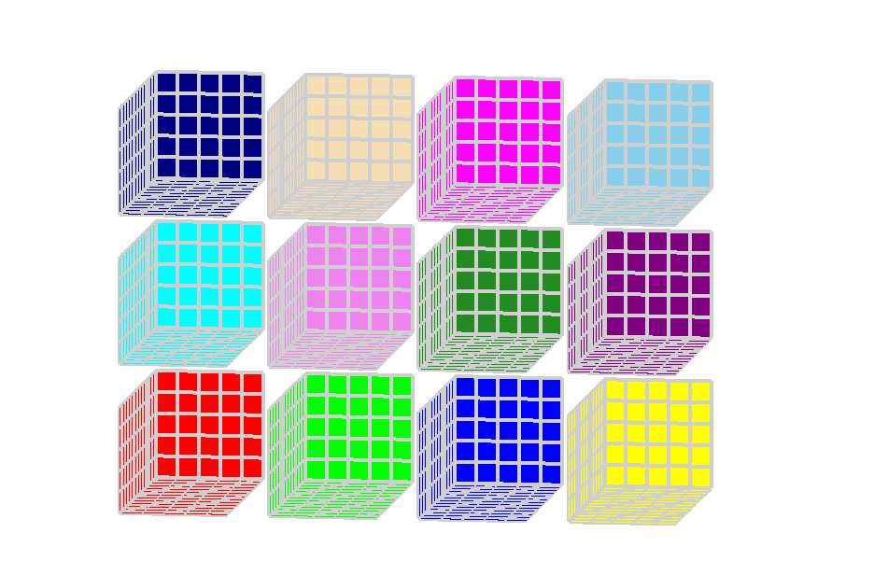
Separate to Processor
Notes:
Must work closely with MM5, WRF developers

Slide 6
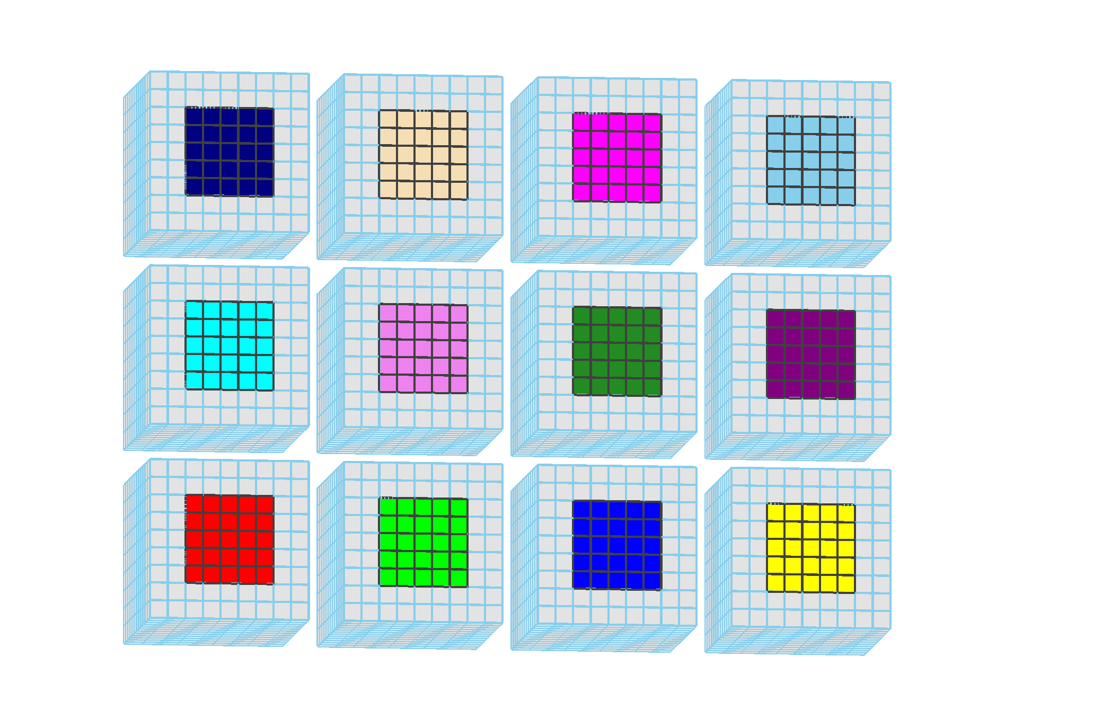
Add Halo
Notes:
Start from 2001. Lots of C programming, some Java.

Slide 7
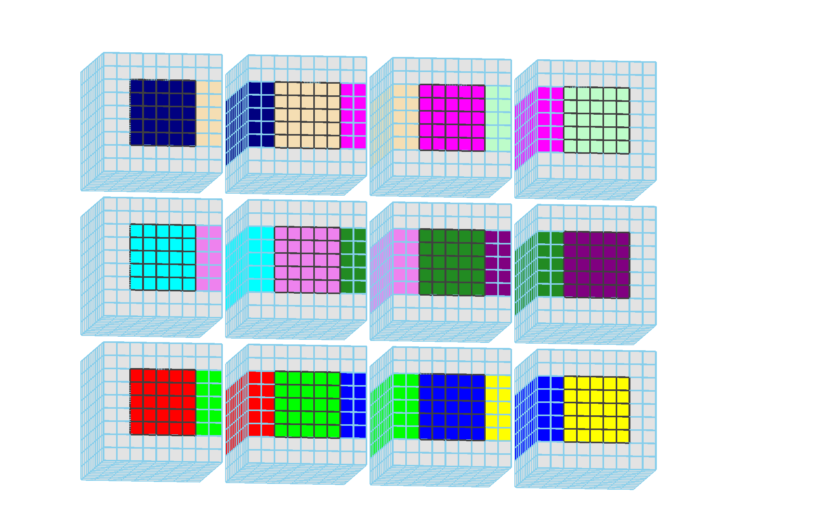
Change within Rows

Slide 8
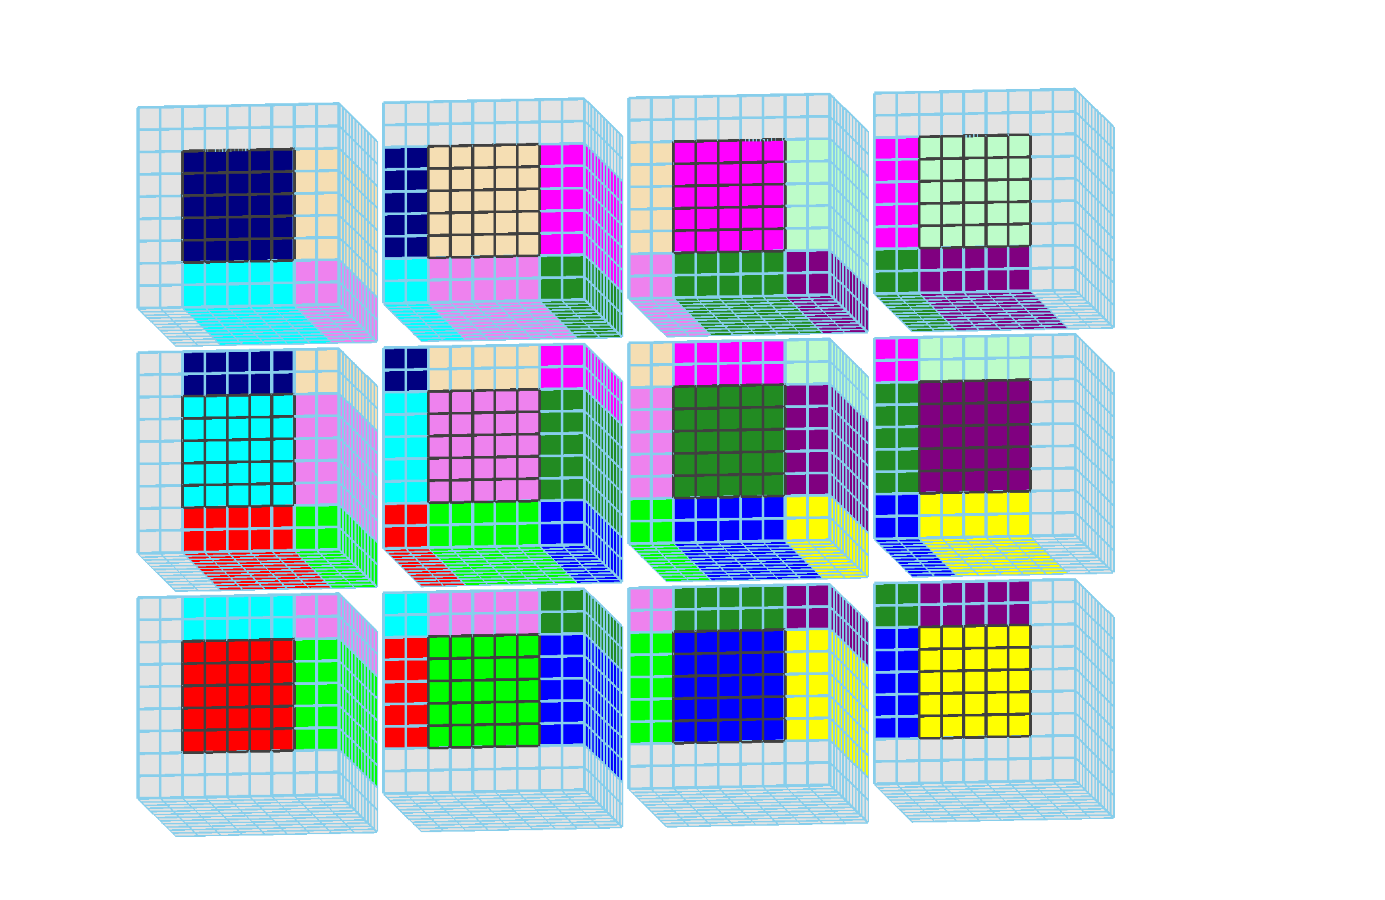
Column Exchange
Notes:
VDRAS people asked to help them, but my supervisor did not agree.
After moved to CISL, they asked my group head, and I was allowed to work with them.

Slide 9
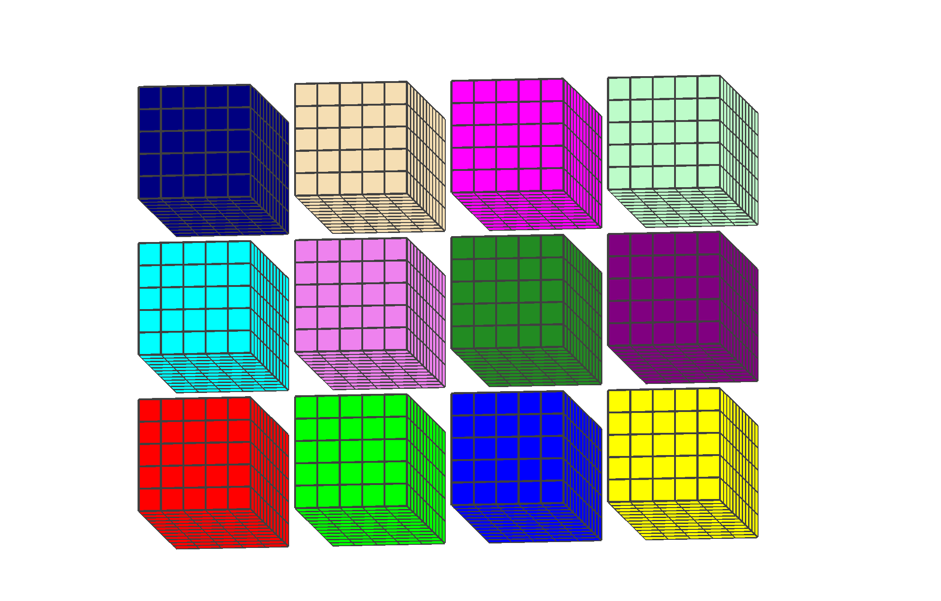
Prepare for X Transpose
Notes:
VDRAS people asked to help them, but my supervisor did not agree.
After moved to CISL, they asked my group head, and I was allowed to work with them.

Slide 10
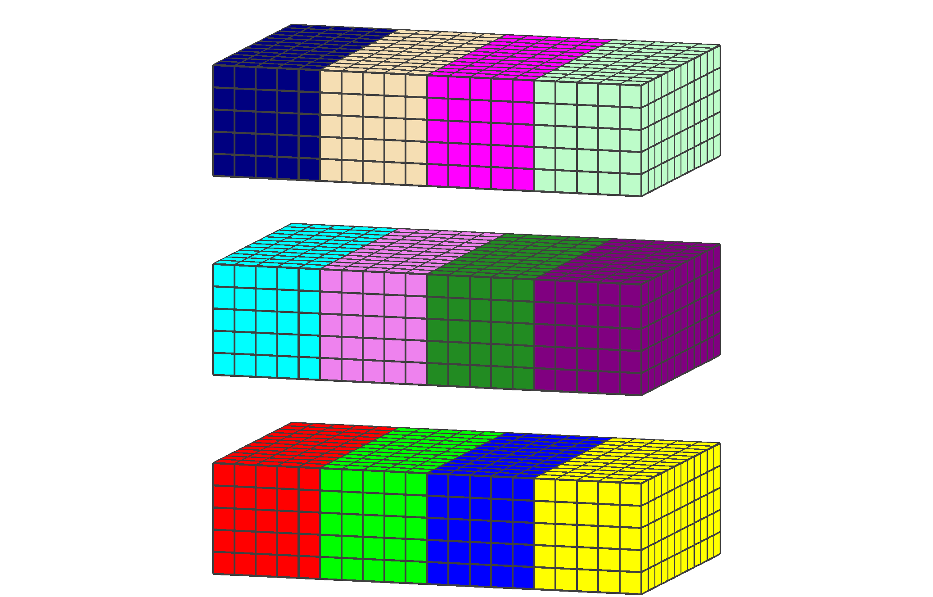
Sum-up in X-Direction
Notes:
VDRAS people asked to help them, but my supervisor did not agree.
After moved to CISL, they asked my group head, and I was allowed to work with them.

Slide 11
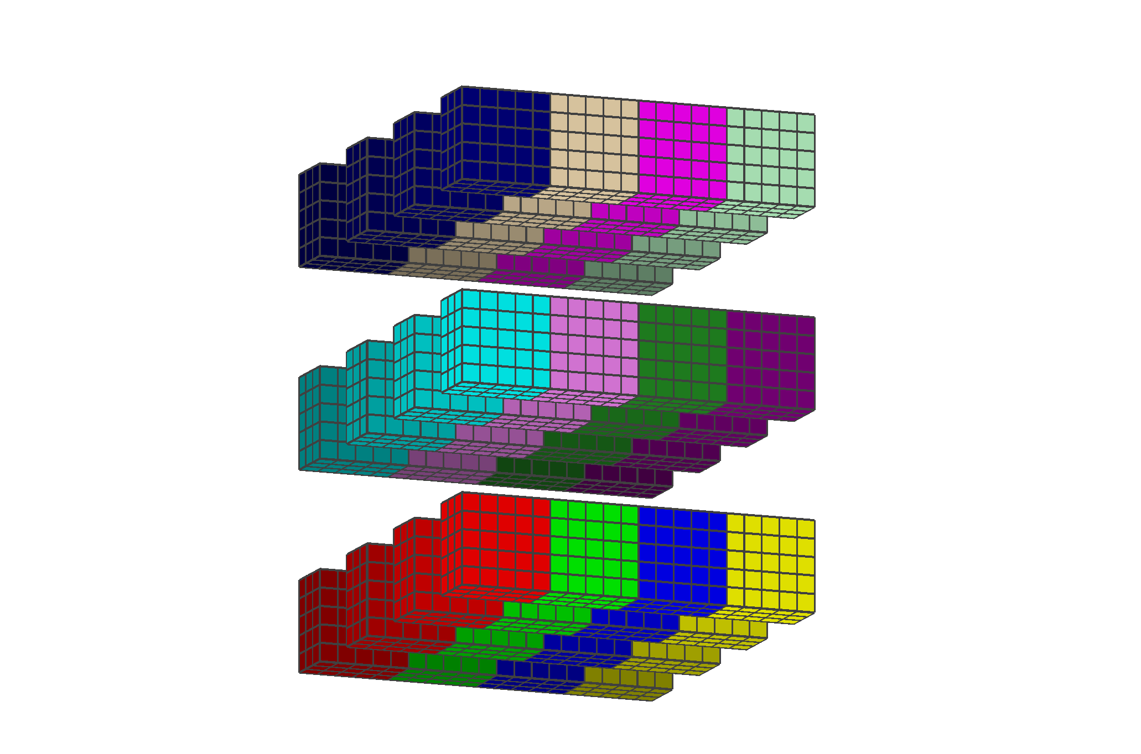
Decompose in x-Plane
Notes:
VDRAS people asked to help them, but my supervisor did not agree.
After moved to CISL, they asked my group head, and I was allowed to work with them.

Slide 12
Sum-back to Rows
Notes:
VDRAS people asked to help them, but my supervisor did not agree.
After moved to CISL, they asked my group head, and I was allowed to work with them.

Slide 13
Back to z-Plane
Notes:
VDRAS people asked to help them, but my supervisor did not agree.
After moved to CISL, they asked my group head, and I was allowed to work with them.

Slide 14
Prepare for Y Transpose
Notes:
VDRAS people asked to help them, but my supervisor did not agree.
After moved to CISL, they asked my group head, and I was allowed to work with them.

Slide 15
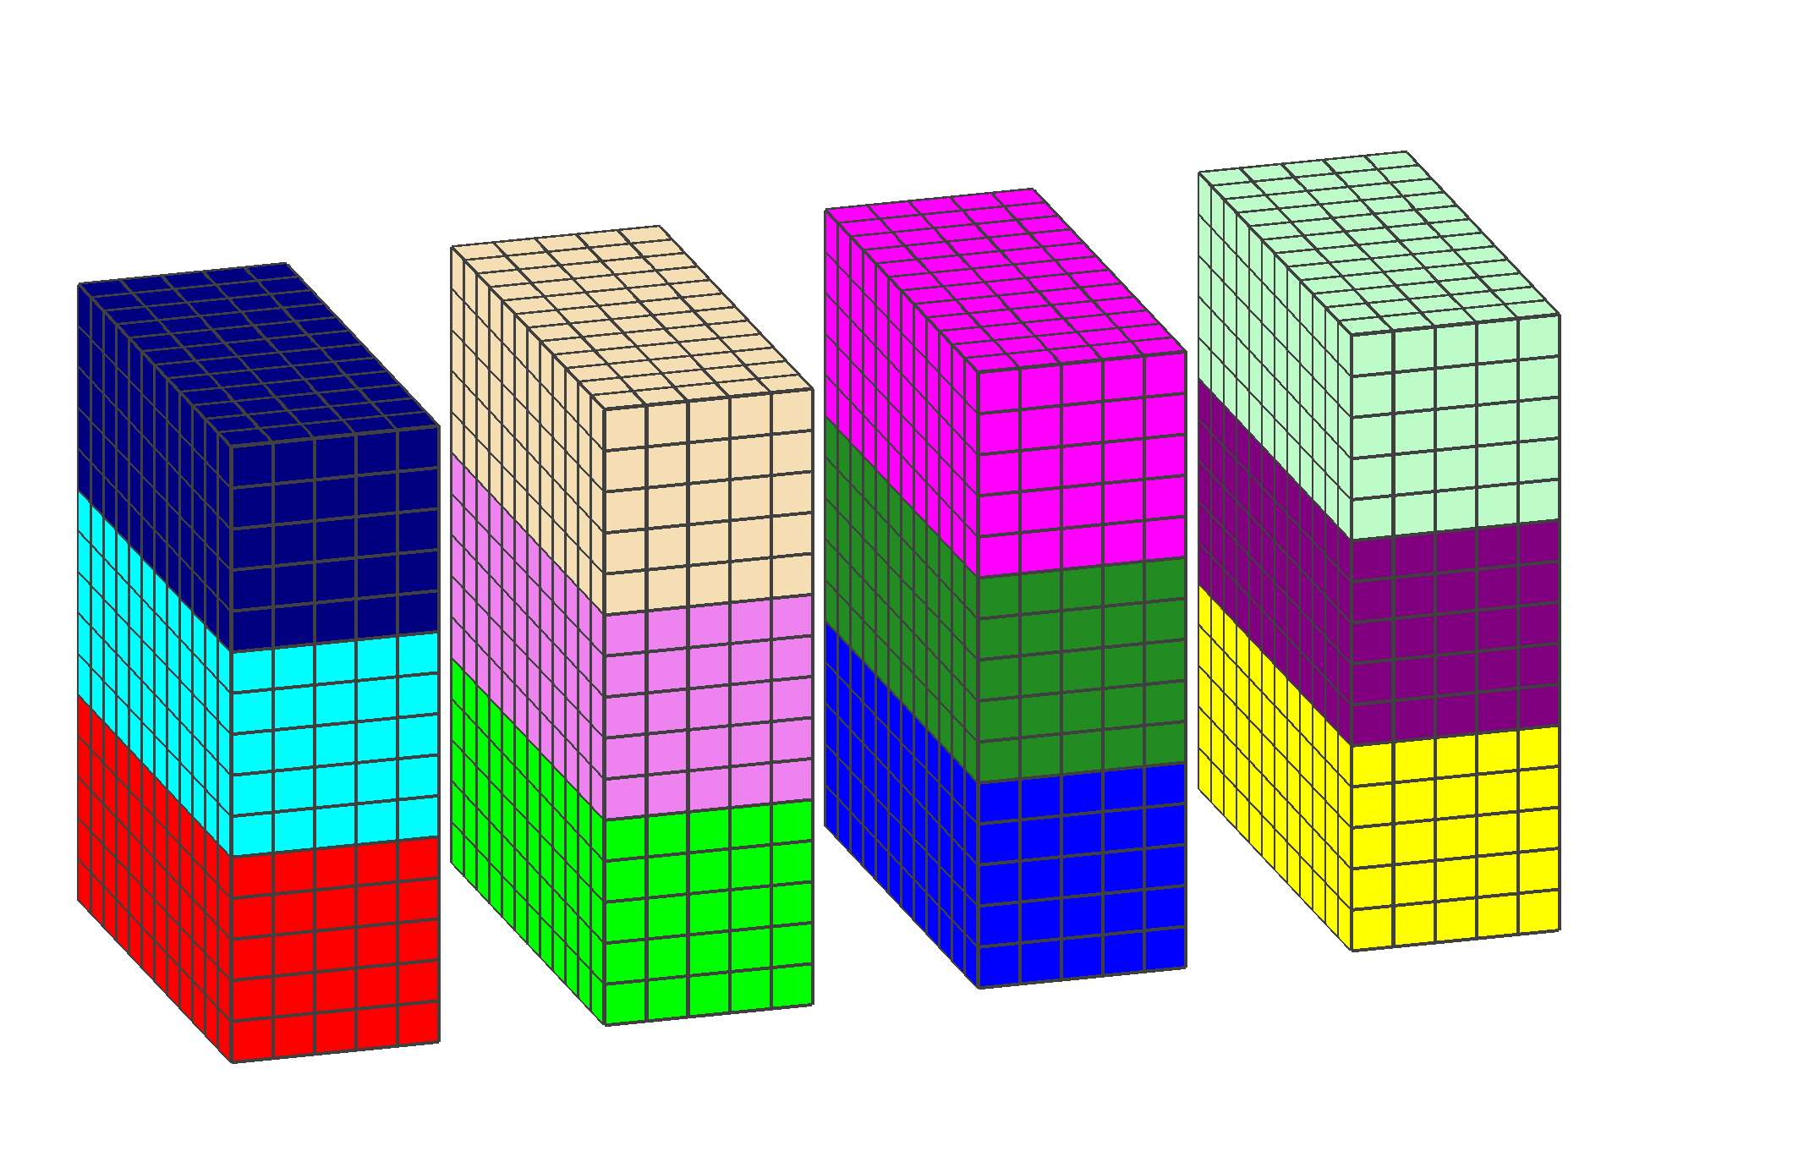
Sum-up in Columns
Notes:
VDRAS people asked to help them, but my supervisor did not agree.
After moved to CISL, they asked my group head, and I was allowed to work with them.

Slide 16
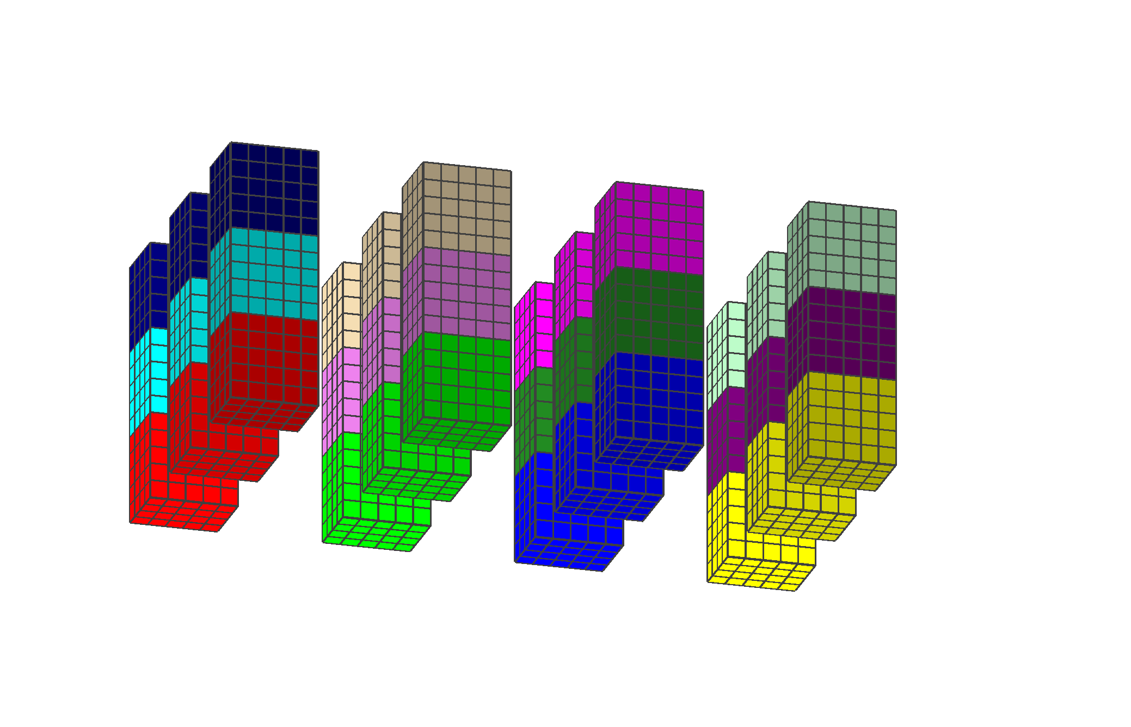
Decompose in y-Plane
Notes:
VDRAS people asked to help them, but my supervisor did not agree.
After moved to CISL, they asked my group head, and I was allowed to work with them.

Slide 17
Collect Back to Columns
Notes:
VDRAS people asked to help them, but my supervisor did not agree.
After moved to CISL, they asked my group head, and I was allowed to work with them.

Slide 18
Back to z-Plane
Notes:
VDRAS people asked to help them, but my supervisor did not agree.
After moved to CISL, they asked my group head, and I was allowed to work with them.

