Slide 1
NCAR Viwer --For WRF
Wei Huang

Slide 2
NCAR Viewer
A GUI tools to visualize NCAR major models, such as: WRF, CESM, MPAS, POP
Other data: GRIB, NexRadar
Notes:
Mainly before 2001.

Slide 3
What is WRF
WRF stands for Weather Research and Forecast model
http://www.wrf-model.org
Notes:
When I was about 13 years old, I saw calculator first time, at that time I am thinking of computer science.
But China has different education system, it could be hard to choose the major you want.

Slide 4
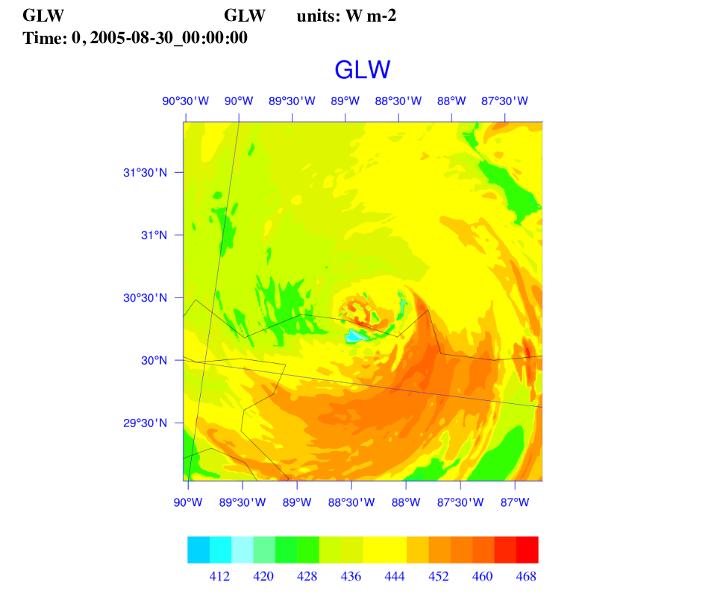
Visualize NCL Image
Notes:
Must work closely with MM5, WRF developers

Slide 5
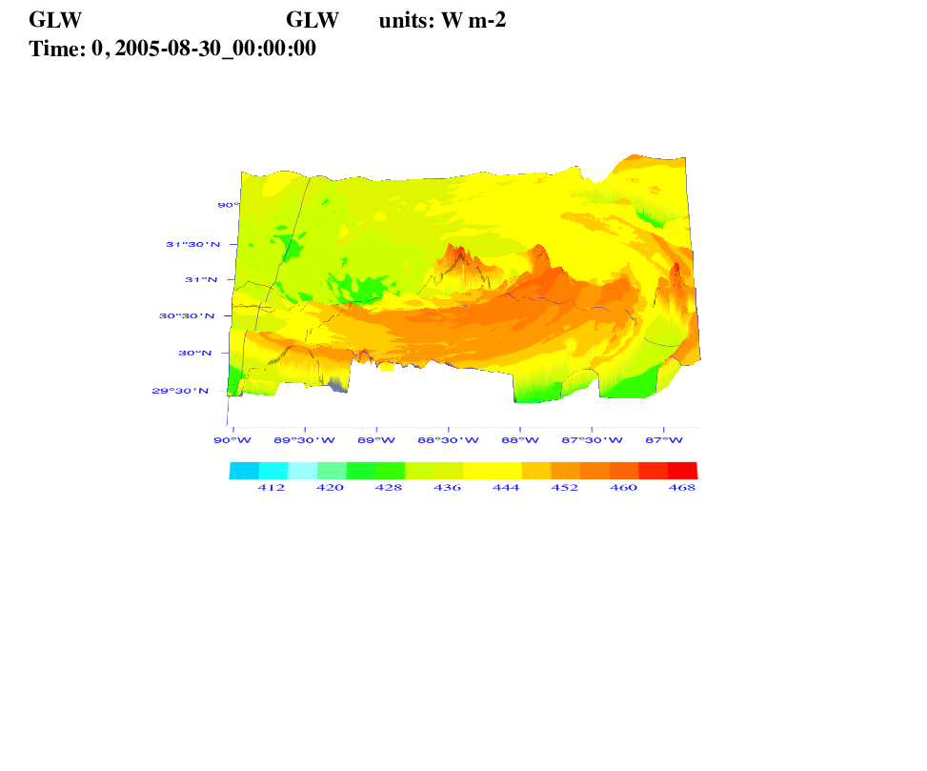
Bump and Rotation
Notes:
Start from 2001. Lots of C programming, some Java.

Slide 6
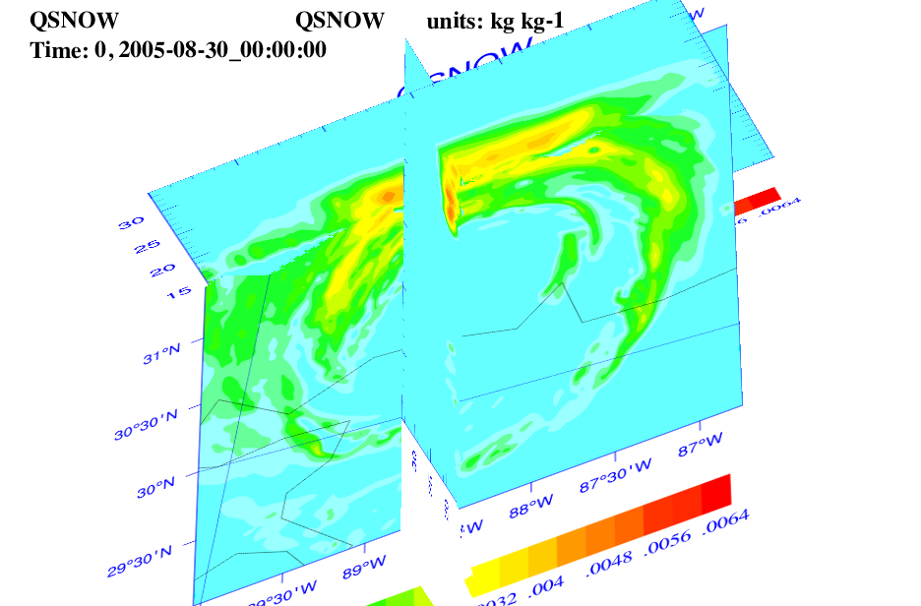
3D cross-sections

Slide 7
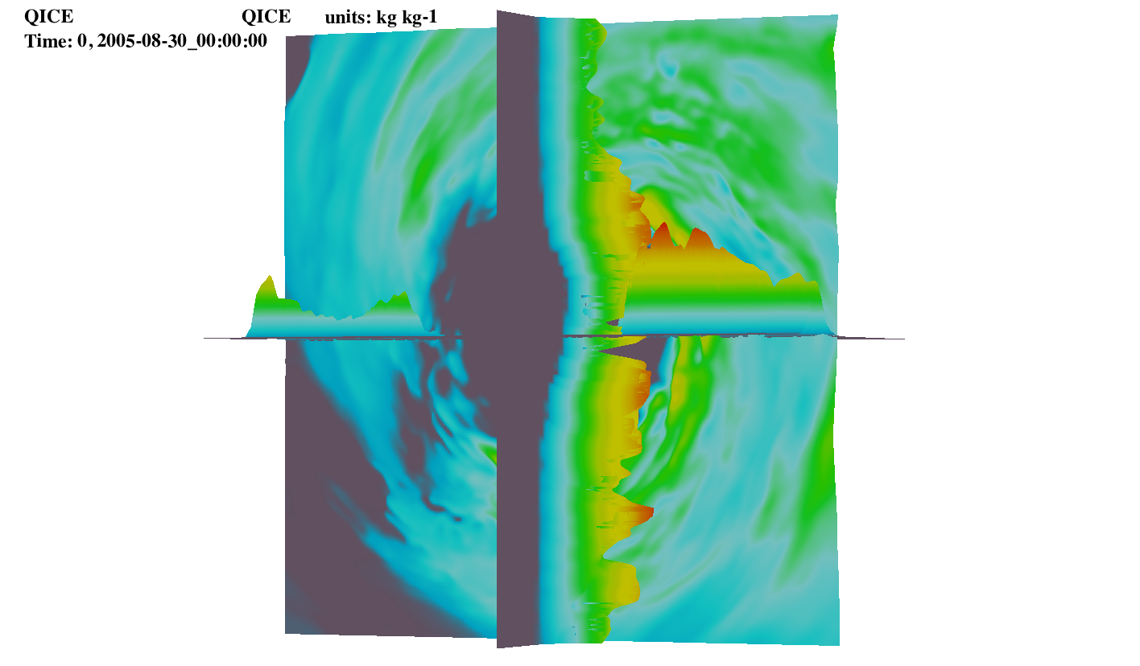
Cross-section --OpenGL
Notes:
VDRAS people asked to help them, but my supervisor did not agree.
After moved to CISL, they asked my group head, and I was allowed to work with them.

Slide 8
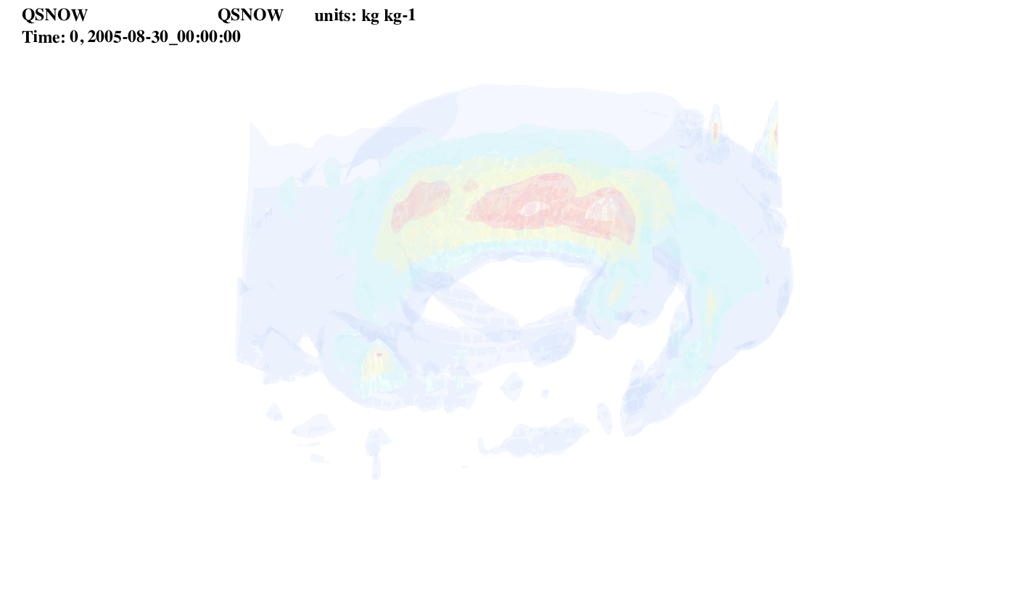
Isosurface
Notes:
VDRAS people asked to help them, but my supervisor did not agree.
After moved to CISL, they asked my group head, and I was allowed to work with them.

Slide 9
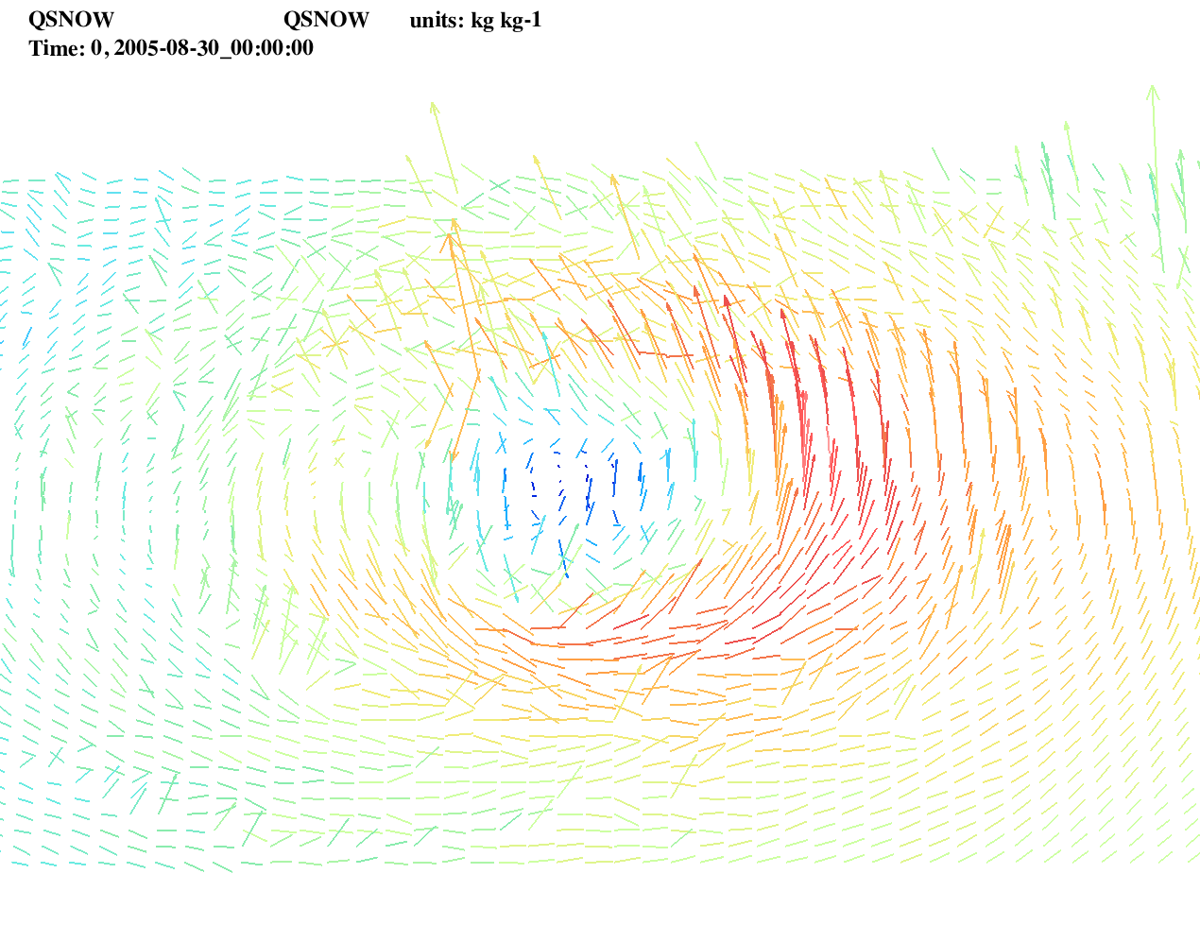
Wind Vector
Notes:
VDRAS people asked to help them, but my supervisor did not agree.
After moved to CISL, they asked my group head, and I was allowed to work with them.

Slide 10
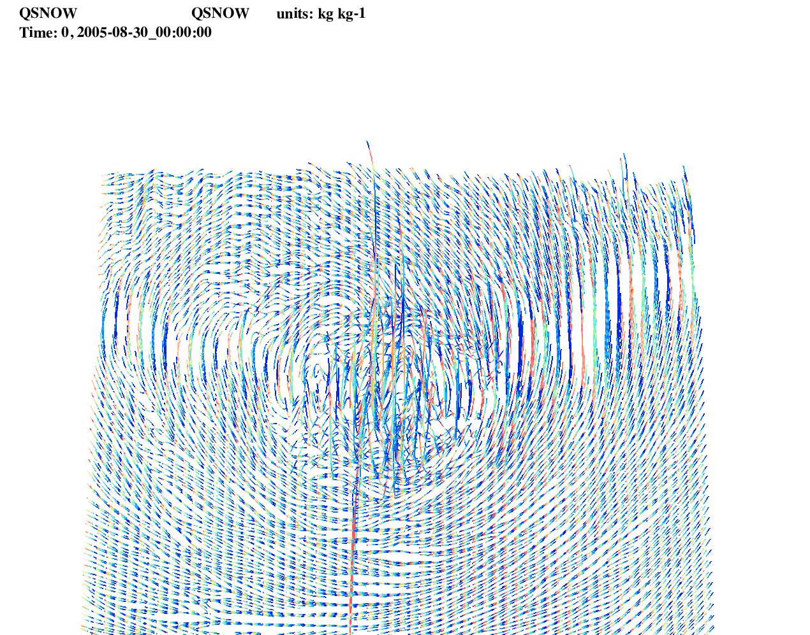
Line Plot
Notes:
VDRAS people asked to help them, but my supervisor did not agree.
After moved to CISL, they asked my group head, and I was allowed to work with them.

Slide 11
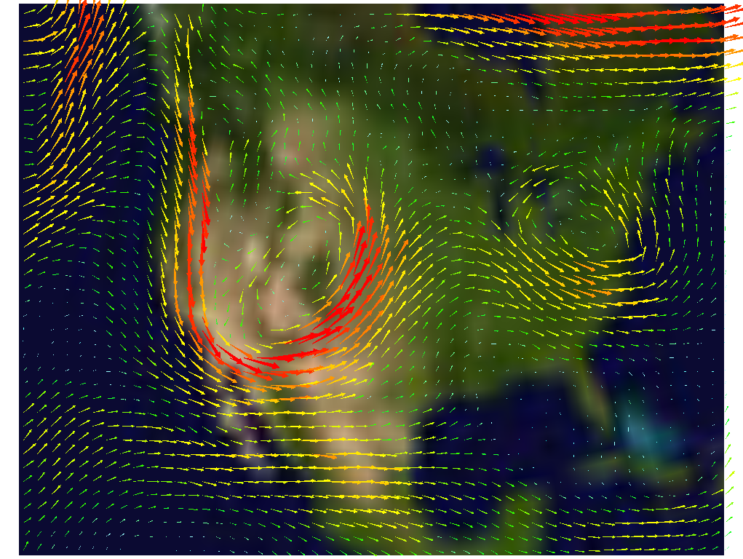
Another Vector Plot
Notes:
VDRAS people asked to help them, but my supervisor did not agree.
After moved to CISL, they asked my group head, and I was allowed to work with them.

Slide 12
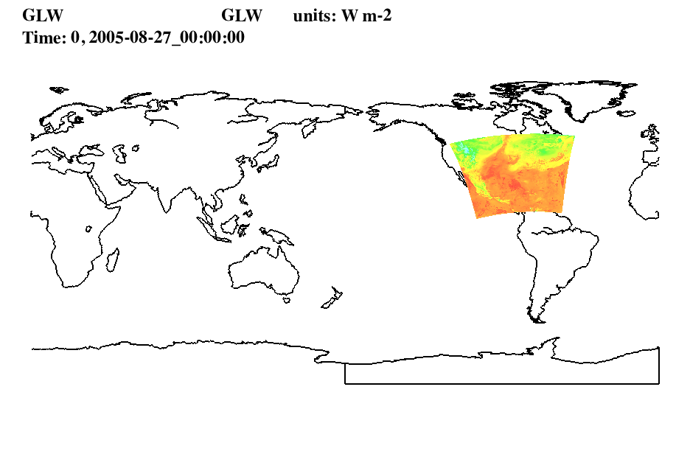
Put it on Map
Notes:
VDRAS people asked to help them, but my supervisor did not agree.
After moved to CISL, they asked my group head, and I was allowed to work with them.

Slide 13
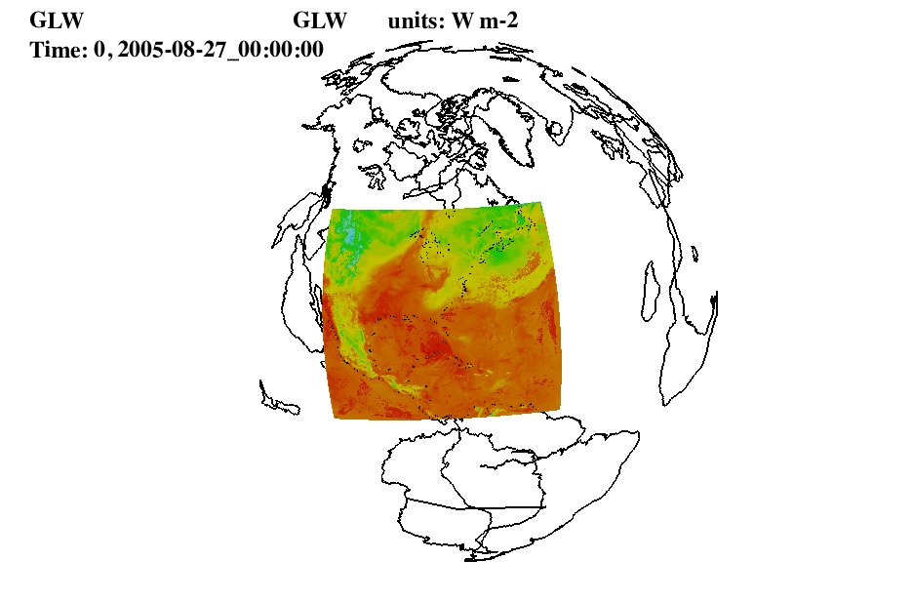
On Sphere
Notes:
VDRAS people asked to help them, but my supervisor did not agree.
After moved to CISL, they asked my group head, and I was allowed to work with them.

Slide 14
Future Works
Trajectory
Clip of IsoSurface
Notes:
Mainly before 2001.

