Slide 1
Final Presentation Pattern Recognition Birds Sounds
Wei Huang

Slide 2
Assumption
Birds’ sounds spectrum has unique pattern
Different birds should have unique of sound printing
Different birds have different figures in signal
Using Time, Frequency, Energy in difference point we might find difference distance between different birds .

Slide 3
Classification Birds’ Sounds
Birds Sounds
Birds’ Songs – Consider Birds Sound ID, related to unique rating and have more melody.
Birds’ Calls – Alert sound and short
Vocalization of birds’ sound
Used SNR (min, median, max) Data
Created Model set for different birds
Frequency Track Extraction Algorithm (FTE )
Transforms a time series into a spectrogram
Using T – Time, F – Frequency, A – Amplitude

Slide 4
Data Collection
Bald Eagle
Black Crows
Black Gull
Blue Jay
Hawk
Merlin
Owl
Parrot
Peacock
Rooster

Slide 5
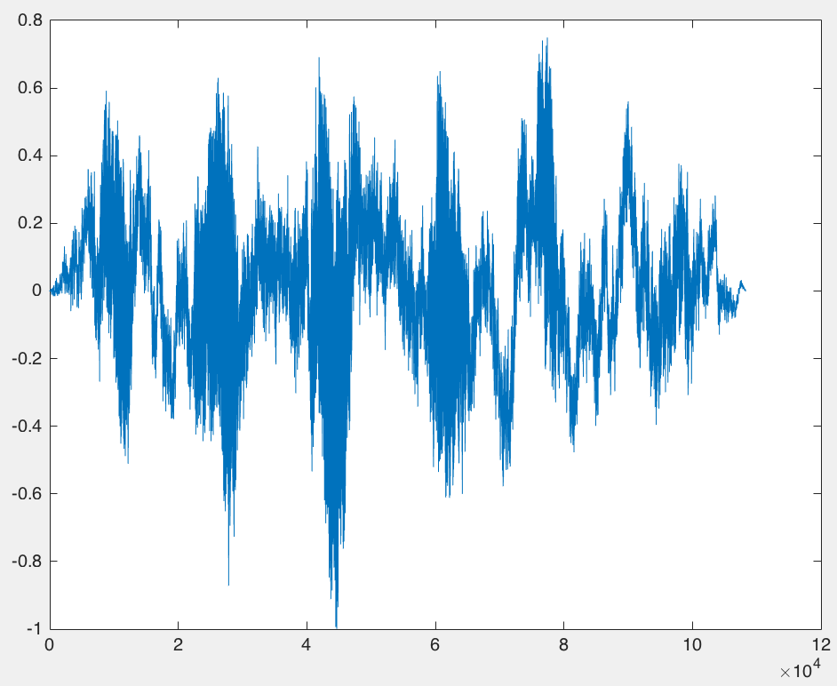
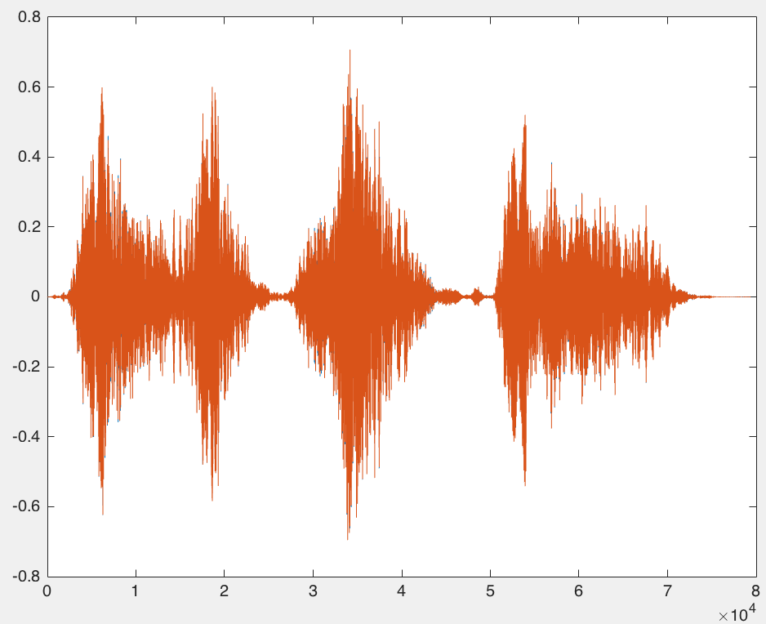
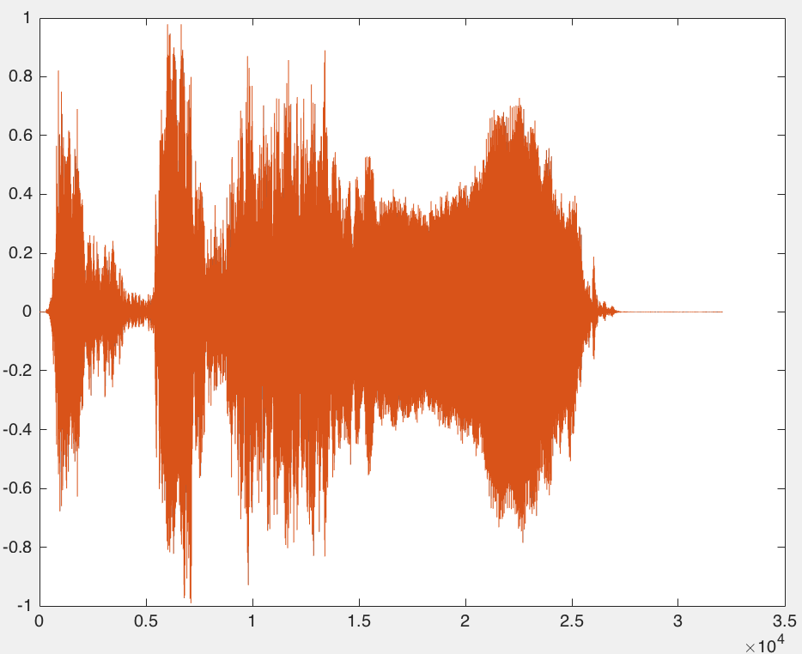
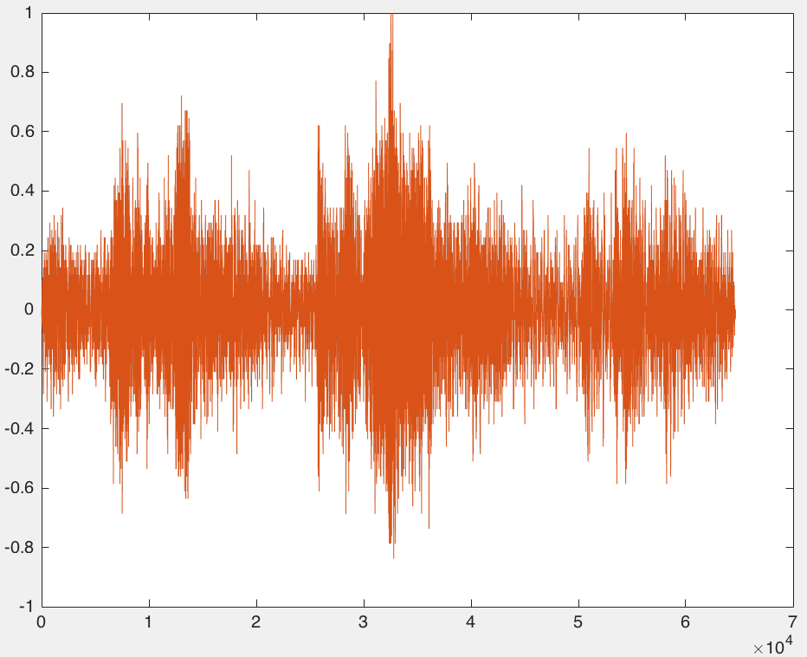
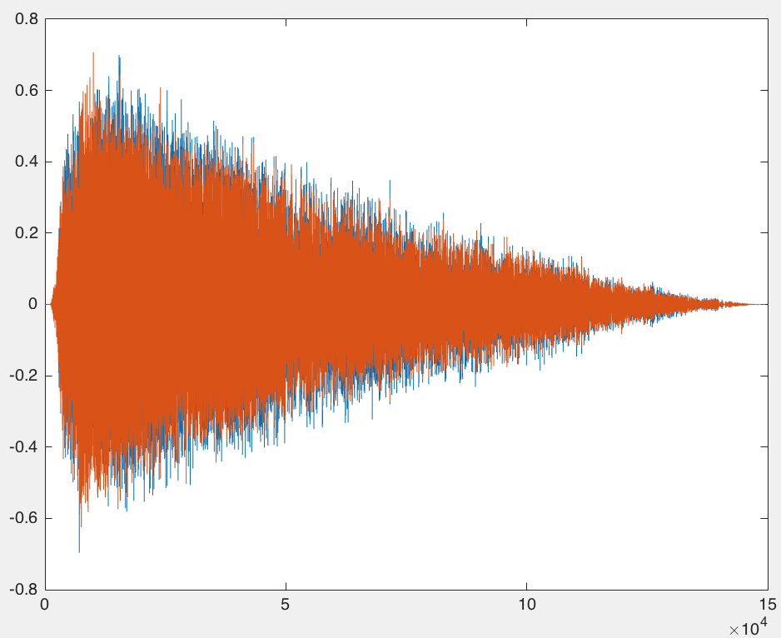
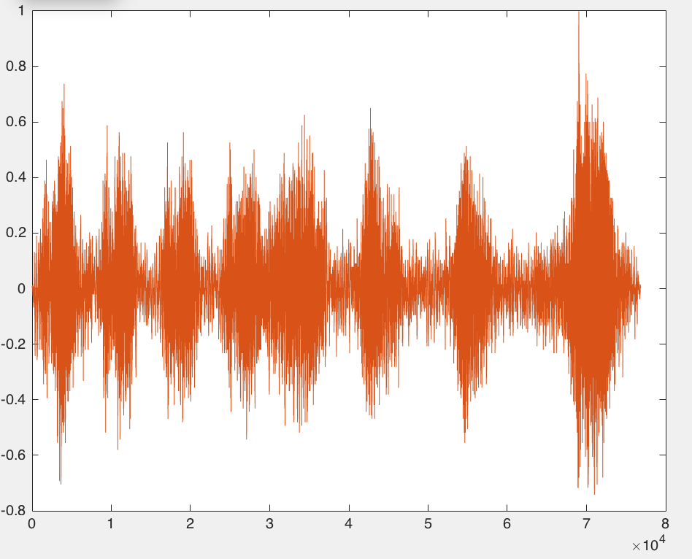
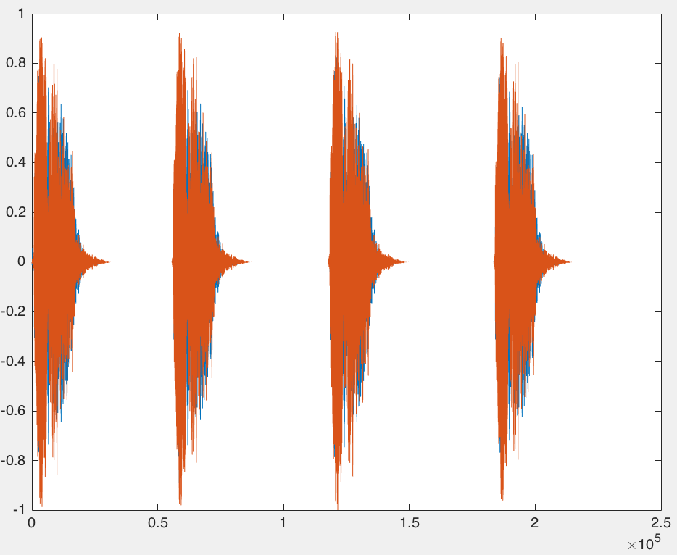
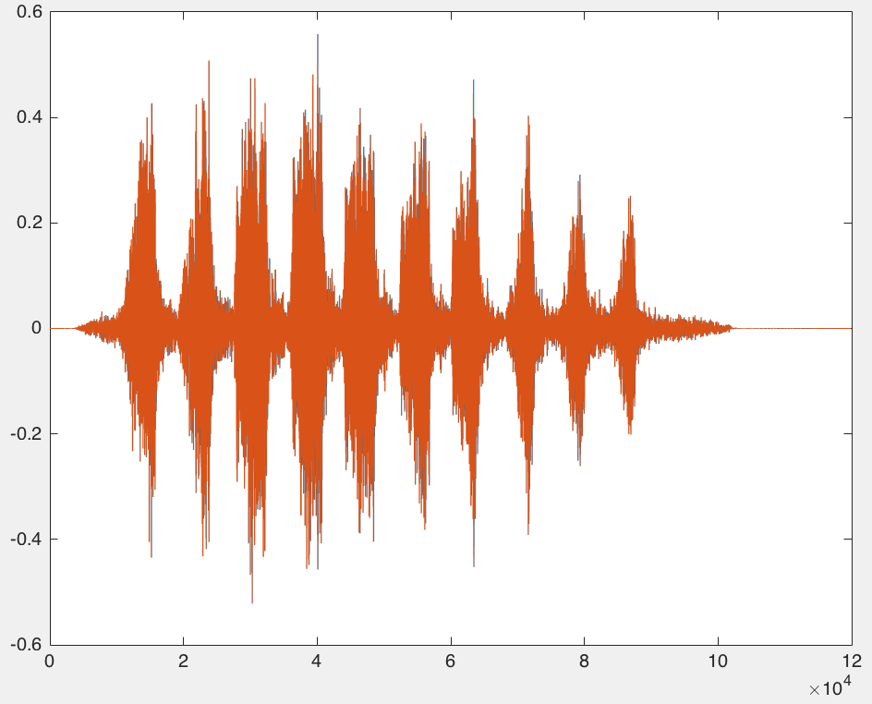
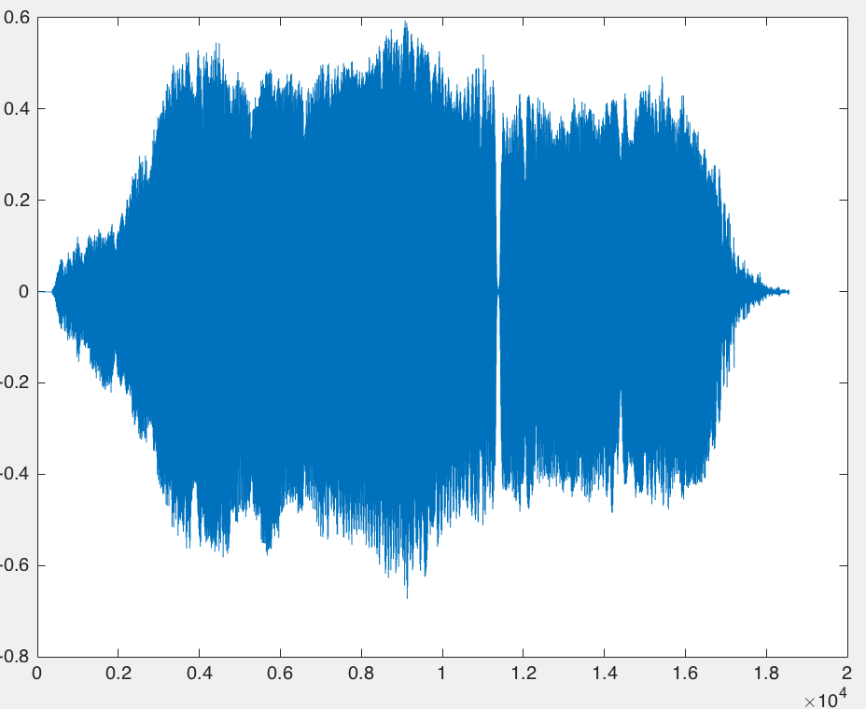
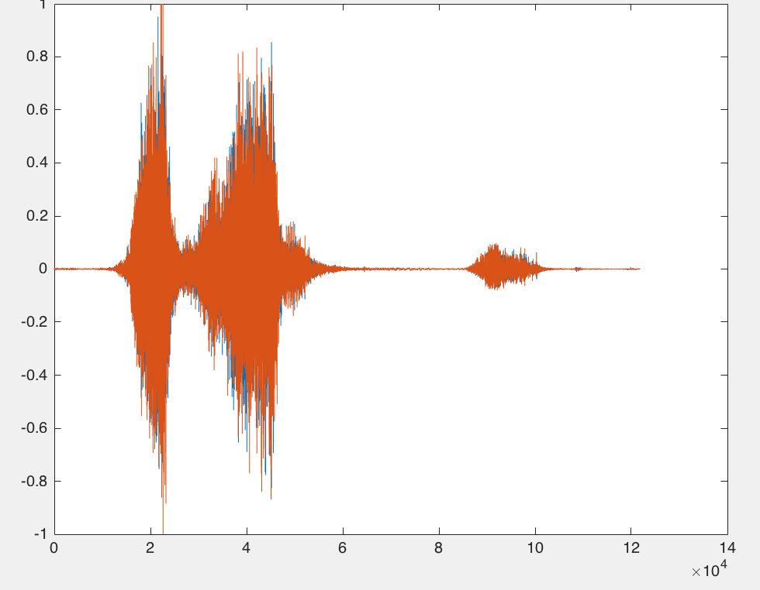
Raw Data
Birds | Sounds
Bald Eagle
Black Crows
Rooster
Owl
Hawk
Black Gull
Blue Jay
Merlin
Peacock
Parrot

Slide 6
Signal Analysis Application and Signal Process Tools in MatLab
Signal Process tools
Comparing signals with different sampling rates
Measuring Delay between signals and aligning
Resampling Function for removing noise, outliers, and spurious content from data
Signal Analysis Application
Comparing the frequency content of signals
Finding periodicities in a signal

Slide 7
FFT

Slide 8
Angular

Slide 9
Magnitude

