Slide 1
Bird Sound

Slide 2
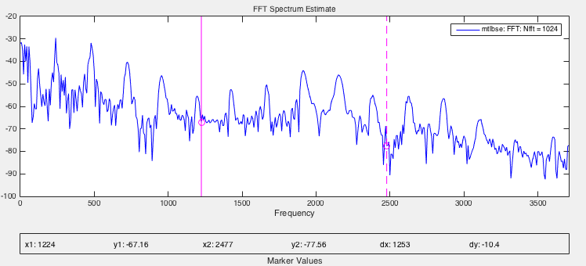
FFT

Slide 3
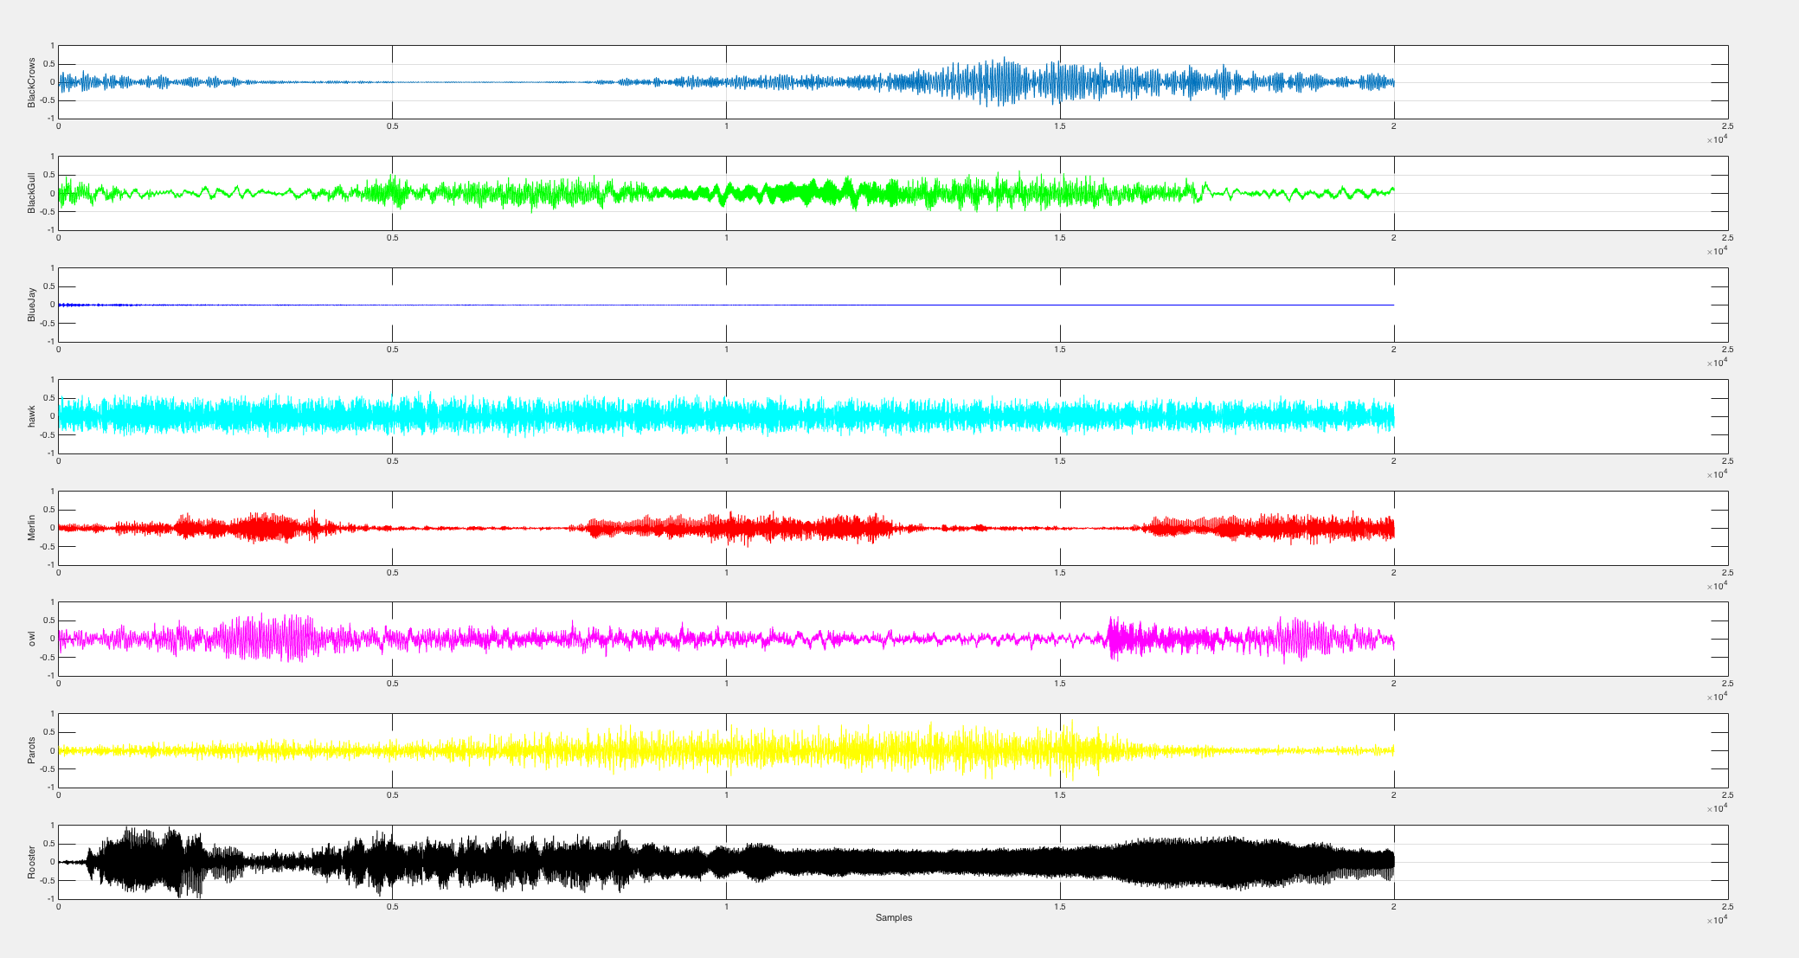
Signal

Slide 4
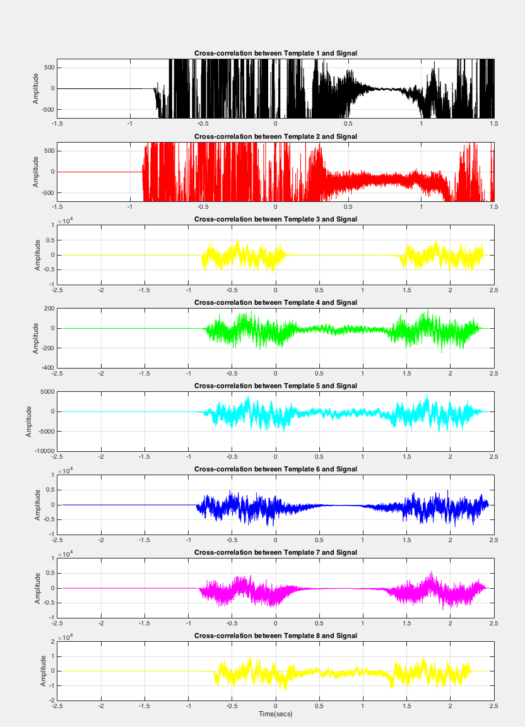
Cross Correlation

Slide 5
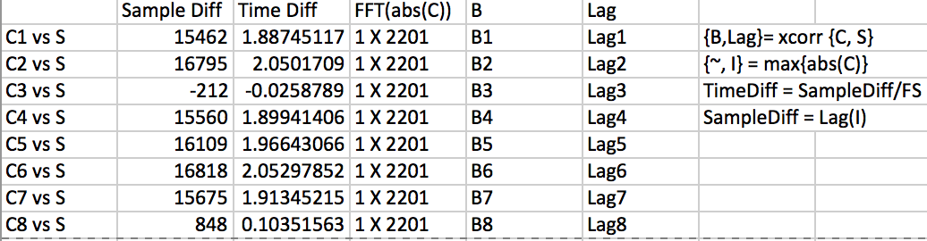
Similar different and Time Different

Slide 6
Next?
Create two table with between two different birds
Sample different
Time different
Define how close the relationship between two bird

Slide 7
Reference
Graham Reith. “ Signal Analysis and Measurement Techniques in Matlab.” The MathWorks. 8 Dec 2015

