Slide 1
Sounds of Birds
Wei Huang

Slide 2
Data Collection
Bald Eagle
Black Crows
Black Gull
Blue Jay
Hawk
Merlin
Owl
Parrot
Peacock
Rooster

Slide 3
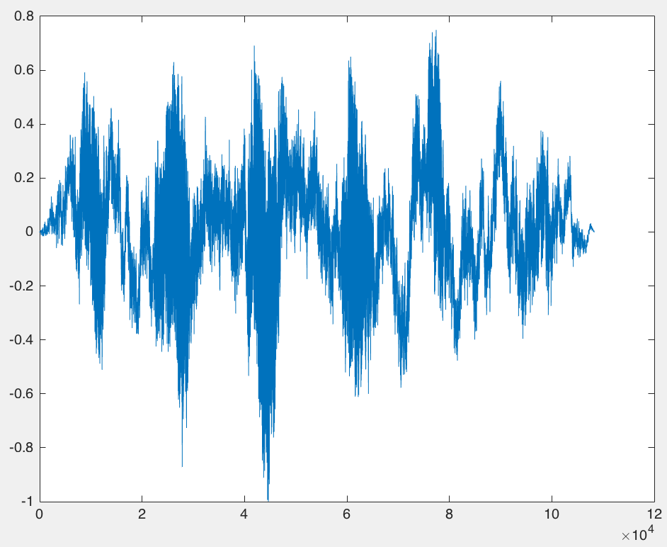
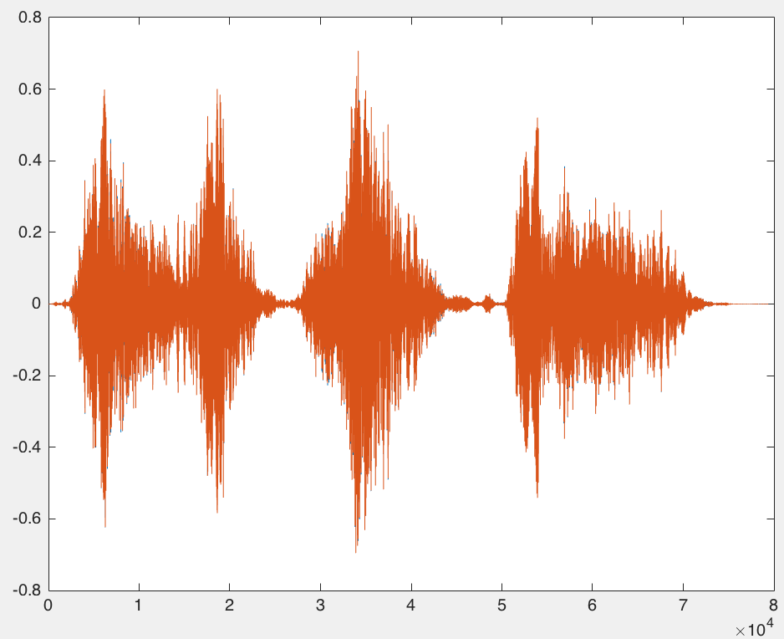
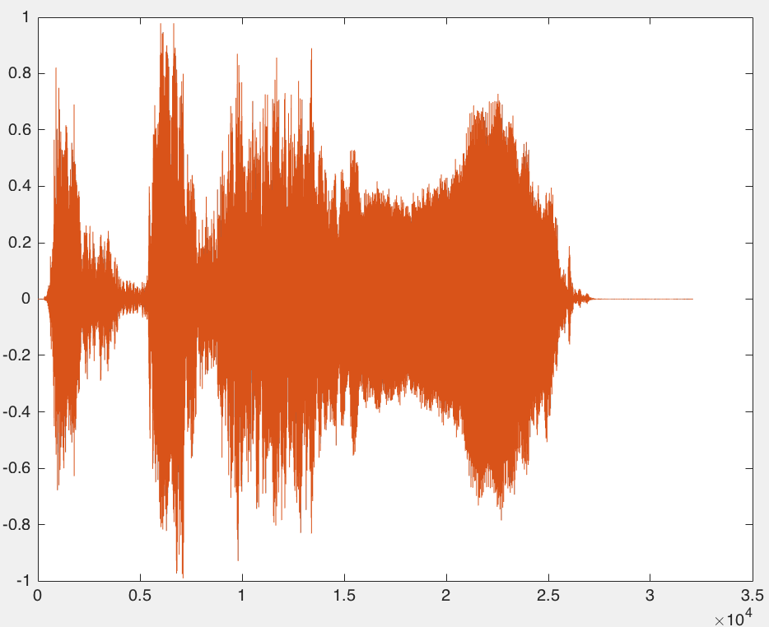
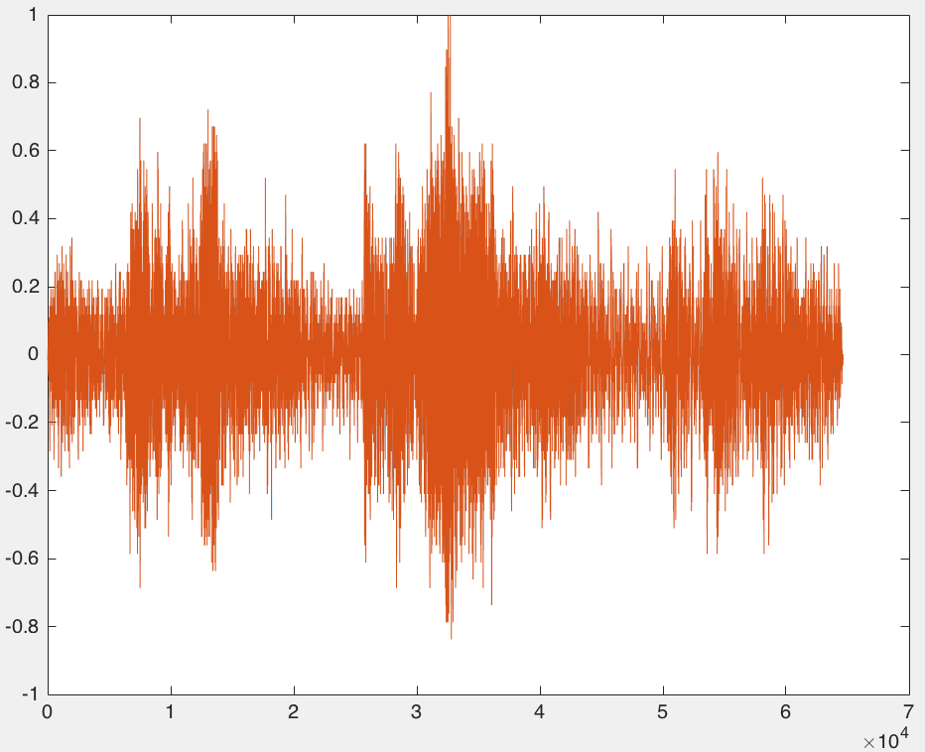
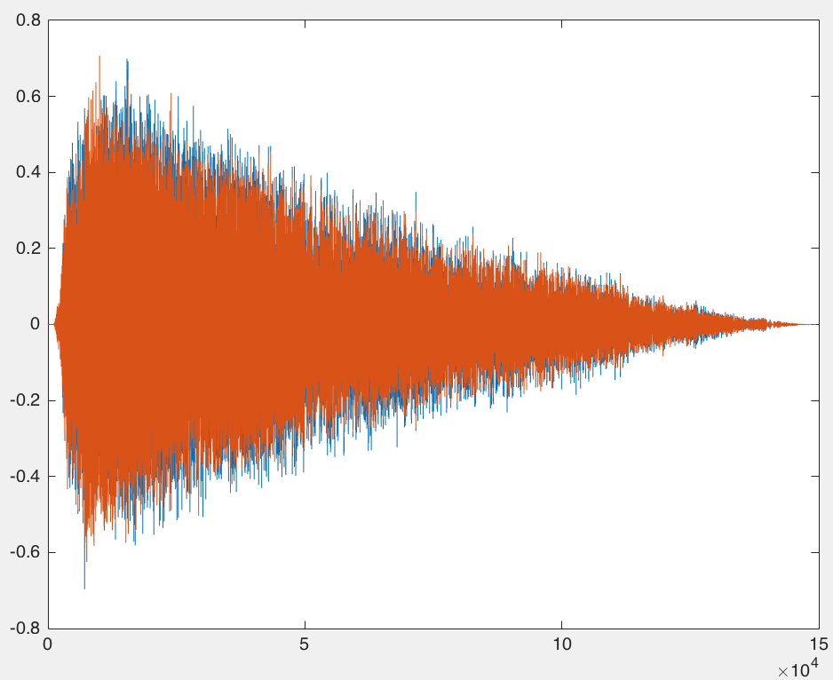
Data Analysis 1
Birds | Sounds
Bald Eagle
Black Crows
Rooster
Owl
Hawk

Slide 4
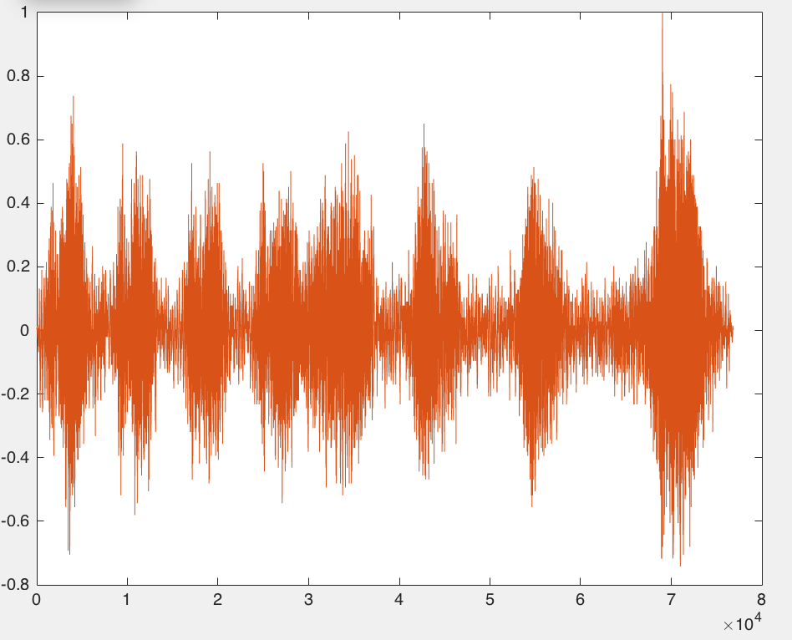
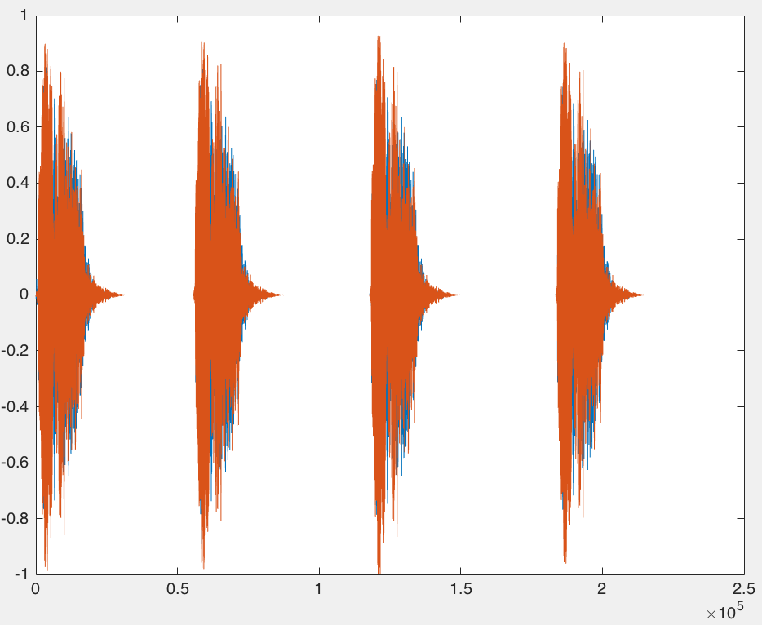
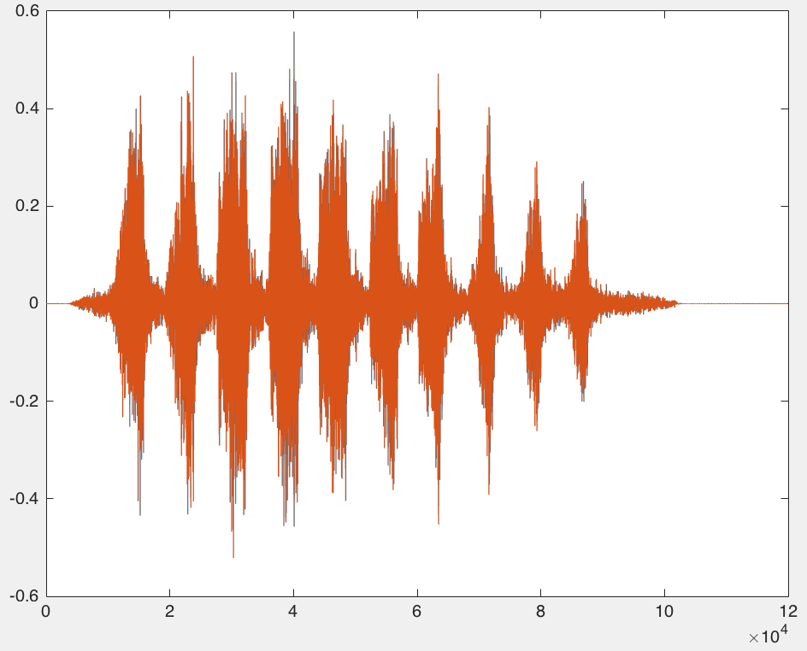
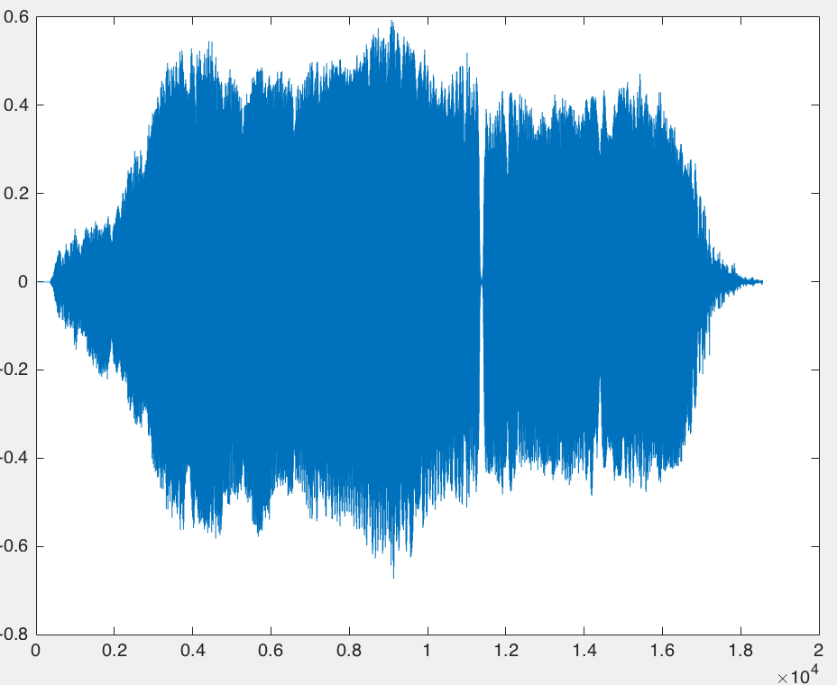
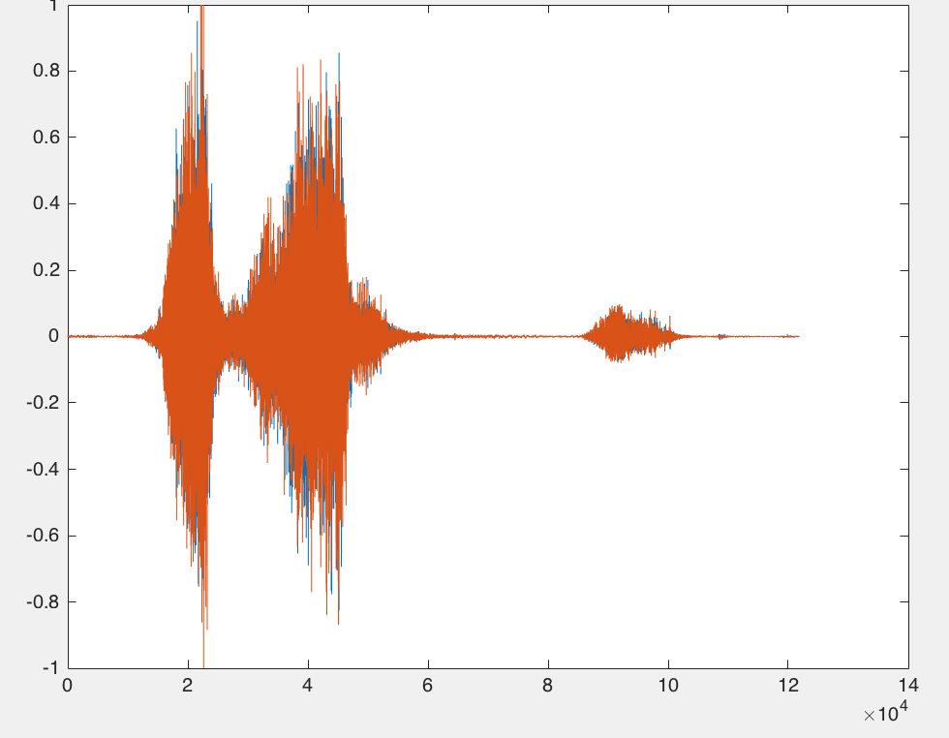
Data Analysis 2
Birds | Sounds
Black Gull
Blue Jay
Merlin
Peacock
Parrot

Slide 5
Assumption
Each spectrum has unique pattern for each birds
Different birds should have unique of sound printing
Different birds have different figure
Using Time, Frequency, Energy in different point we might identified different birds in sound

