Slide 1
Final Presentation Pattern Recognition Birds Sounds
Wei Huang

Slide 2
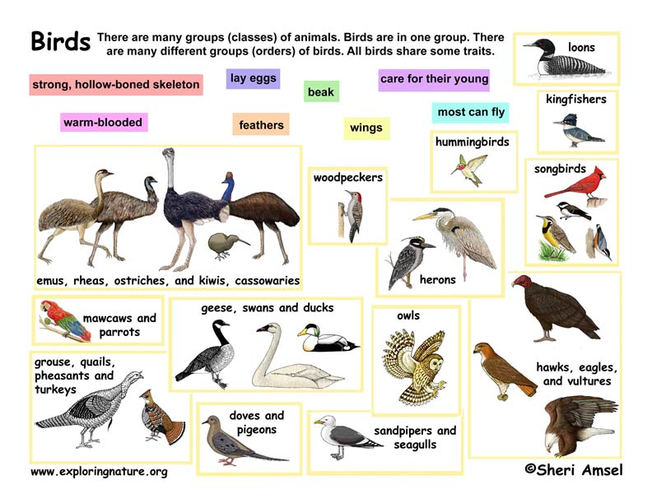
Assumption
Birds’ sounds spectrum has unique pattern
Different birds should have unique of sound printing
Different birds have different figures in signal
Using Time, Frequency, Energy in difference point we might find difference distance between different birds

Slide 3
Classification Birds’ Sounds
Birds Sounds
Birds’ Songs – Consider Birds Sound ID, related to unique rating and have more melody.
Birds’ Calls – Alert sound and short
Vocalization of birds’ sound
Used SNR (min, median, max) Data
Created Model set for different birds
Frequency Track Extraction Algorithm (FTE )
Transforms a time series into a spectrogram
Using T – Time, F – Frequency, A – Amplitude

Slide 4
My Goals
Relationship of birds’ organization
Mapping with Combination of birds’ sounds and DNA

Slide 5
Data Collection
Bald Eagle
Black Crows
Black Gull
Blue Jay
Hawk
Merlin
Owl
Parrot
Peacock
Rooster

Slide 6
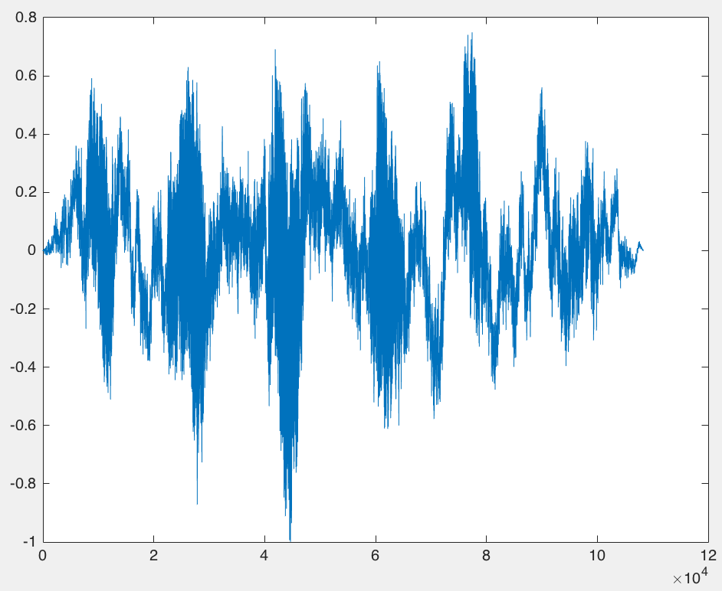
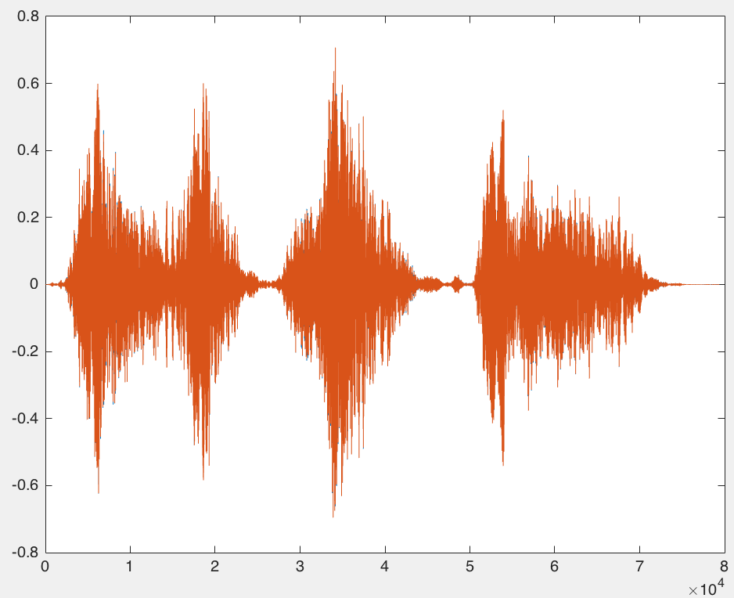
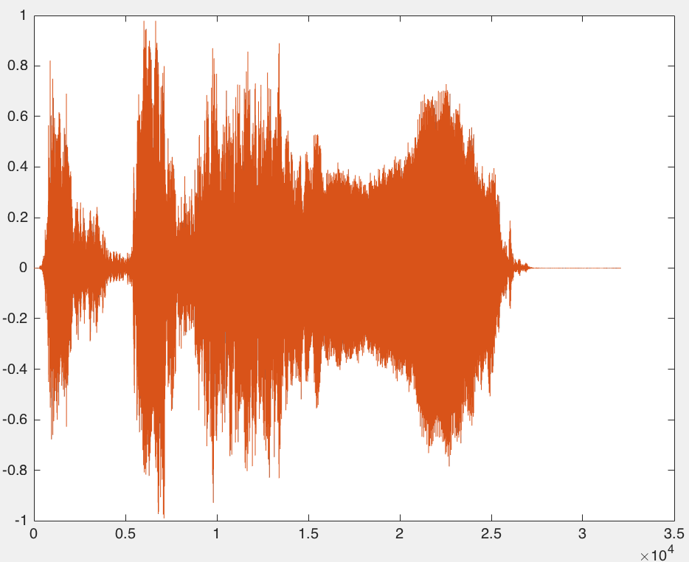
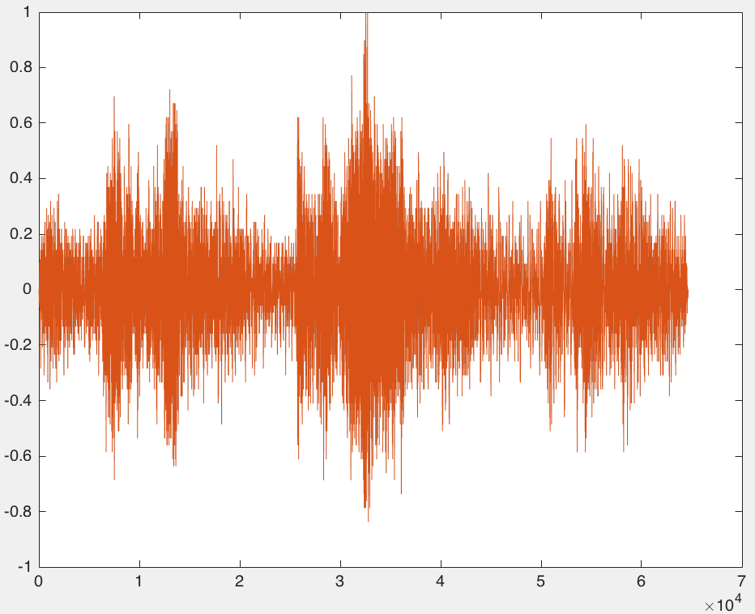
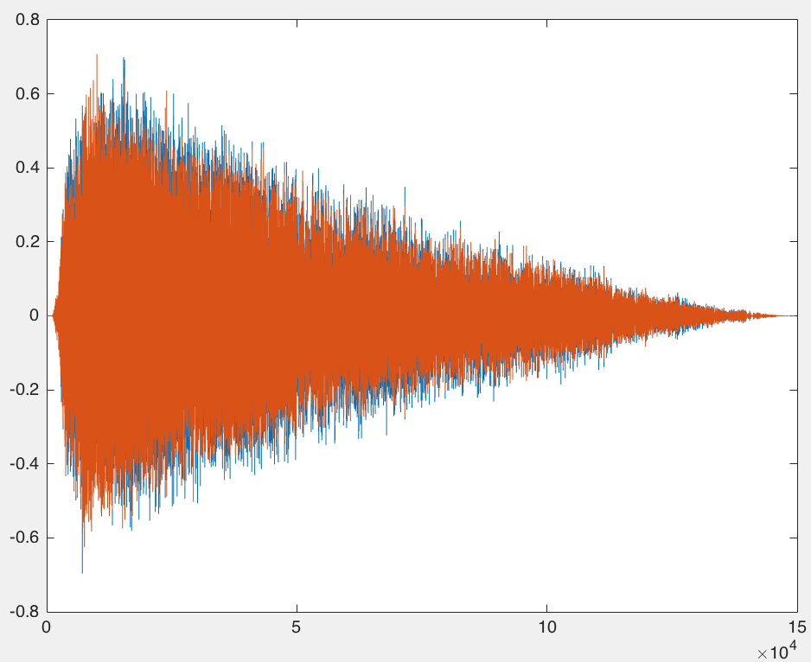
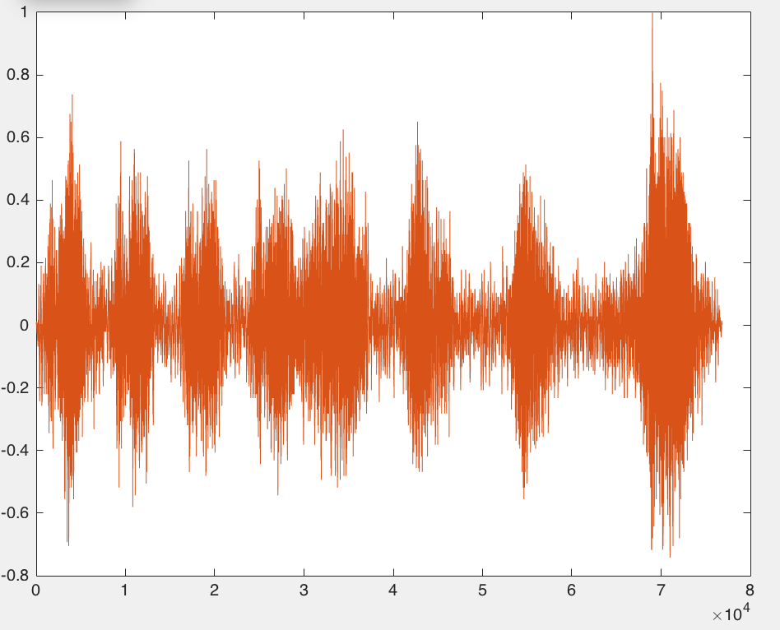
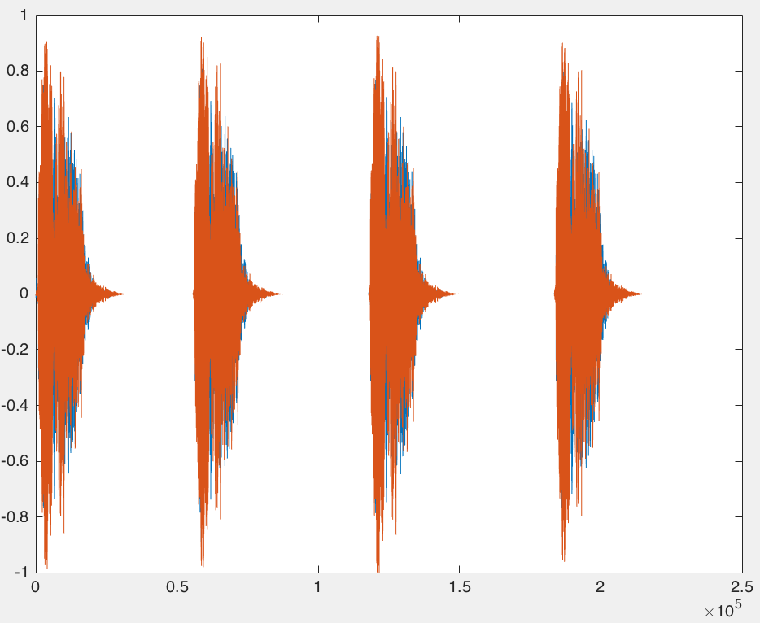
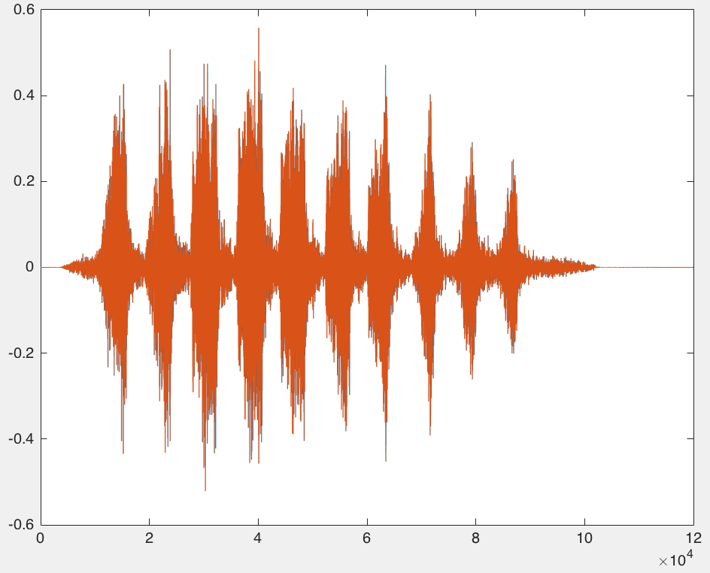
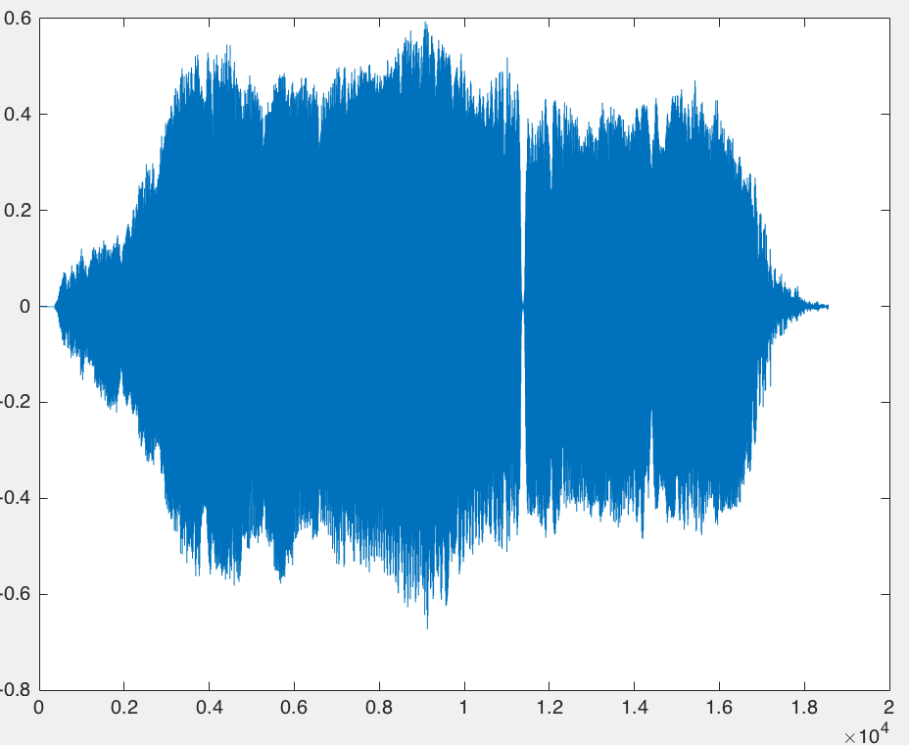
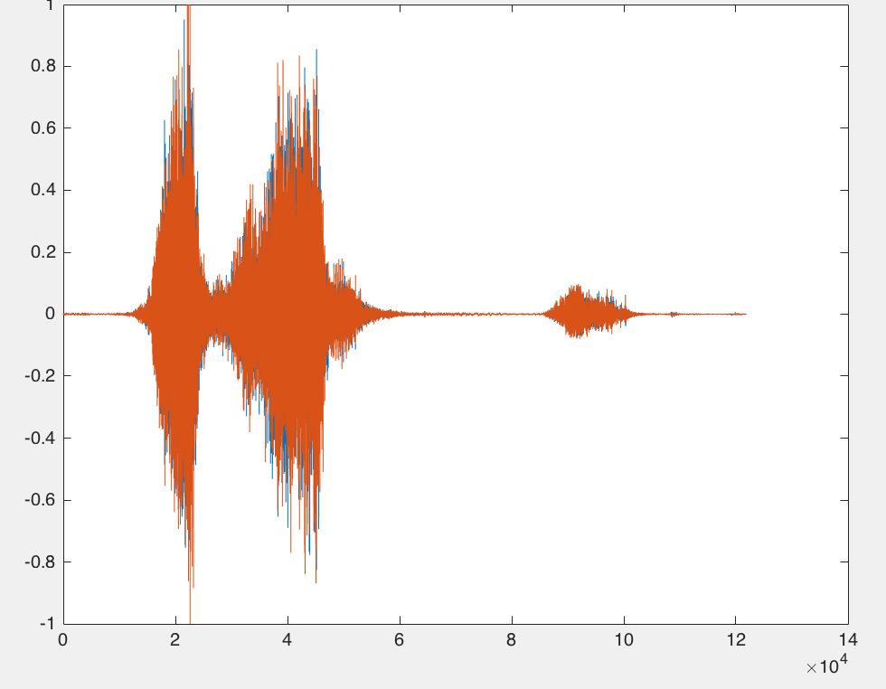
Raw Data
Birds | Sounds
Bald Eagle
Black Crows
Rooster
Owl
Hawk
Black Gull
Blue Jay
Merlin
Peacock
Parrot

Slide 7
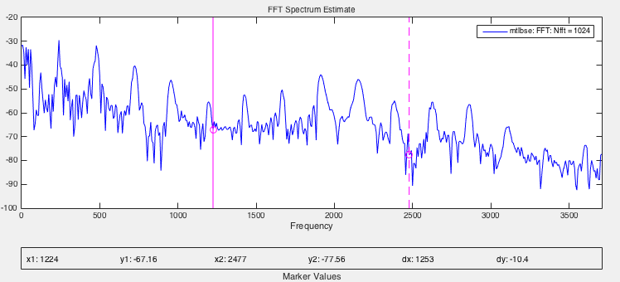
Signal Analysis Application and Signal Process Tools in MatLab
Signal Process tools
Comparing signals with different sampling rates
Measuring Delay between signals and aligning
Resampling Function for removing noise, outliers, and spurious content from data
Signal Analysis Application
Comparing the frequency content of signals
Finding periodicities in a signal

Slide 8
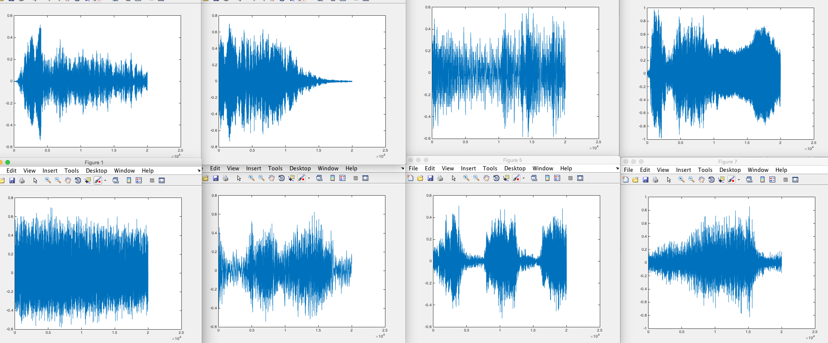
Filter Data

Slide 9
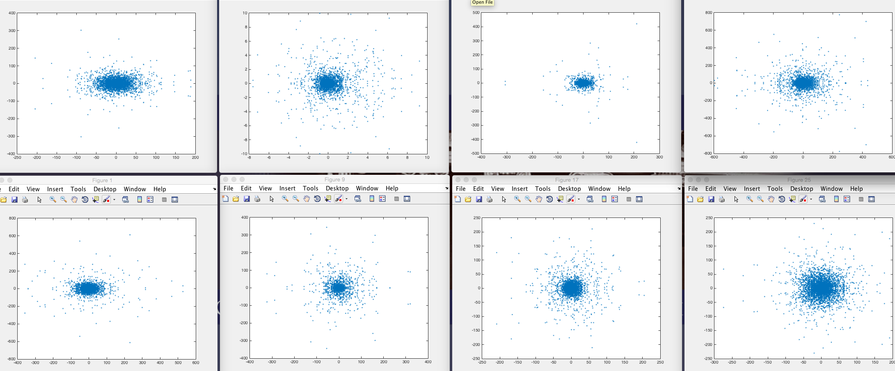
FFT

Slide 10
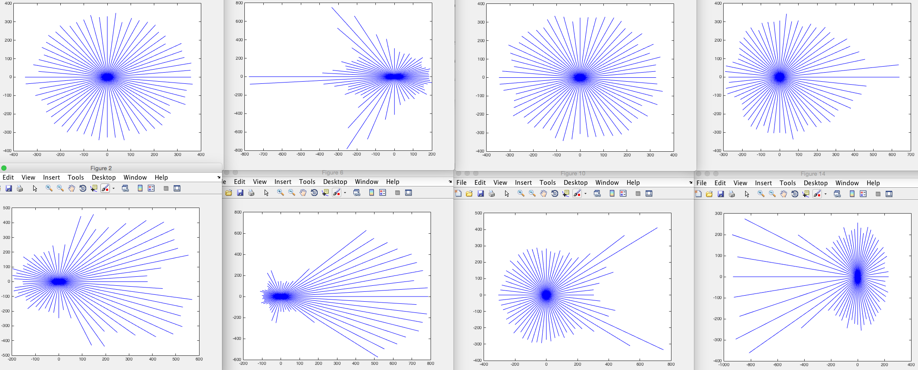
Angular

Slide 11
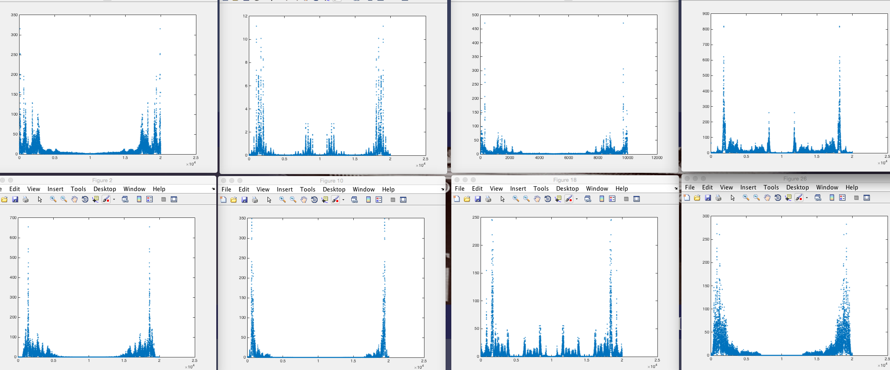
Magnitude

Slide 12
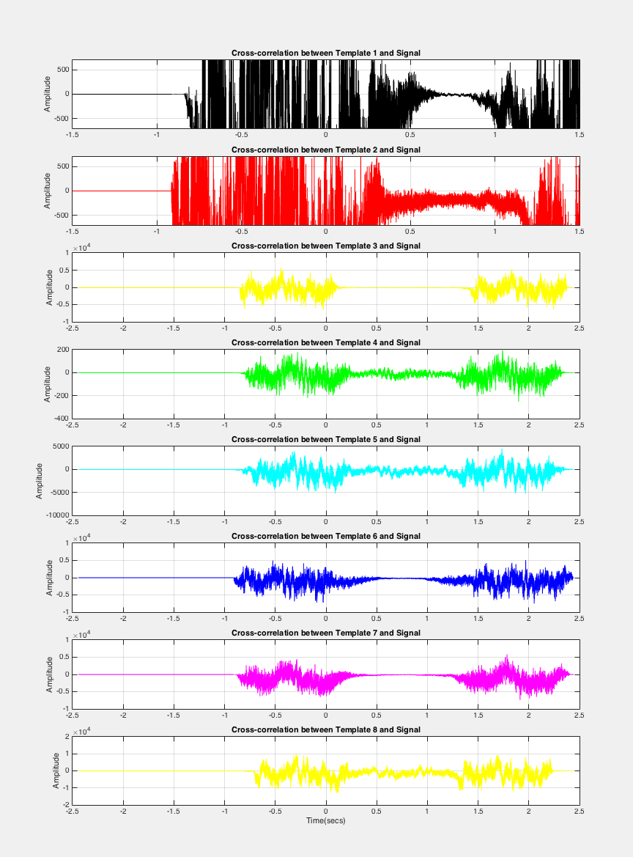
Cross Correlation

Slide 13
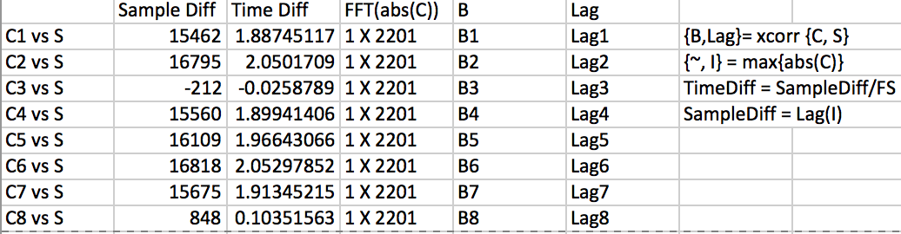
Sample Diff and Time Diff

Slide 14
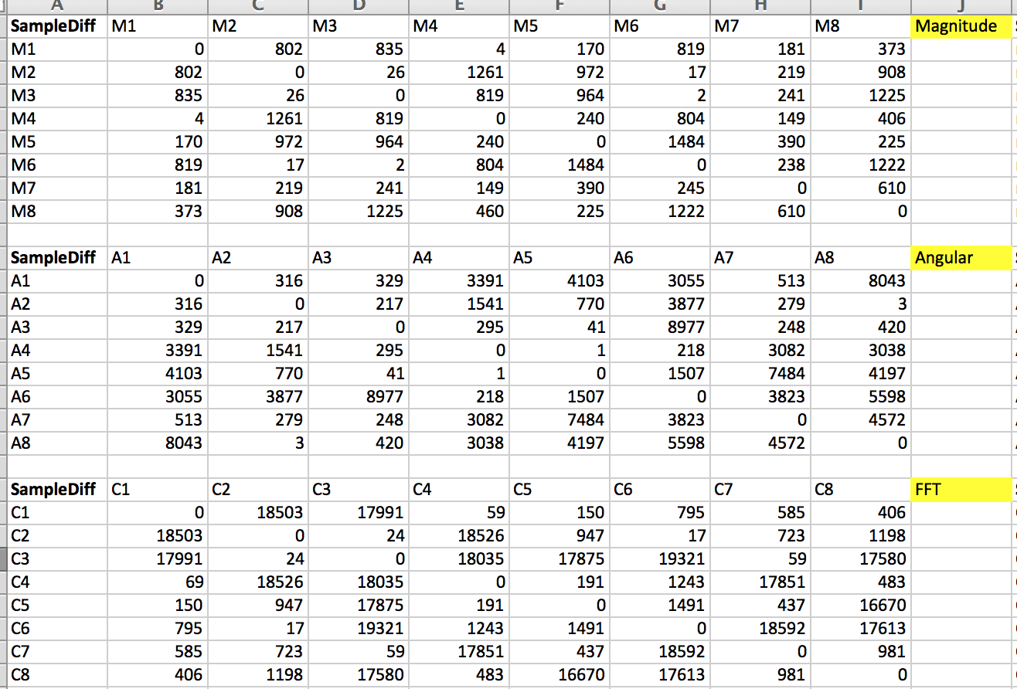
Comparison

Slide 15
Summary
Created method for measuring signal similarities
Found similarities in difference distance between birds
Built Distance Relationship with 8 different birds
Table Results with FFT, Angular and Magnitude
Adding more birds
Combining birds’ sounds and birds’ DNA sequence

Slide 16
Question?

Slide 17
References
[1] Buck, John R., Michael M. Daniel, and Andrew C. Singer. Computer Explorations in Signals and Systems Using MATLAB. 2nd Edition. Upper Saddle River, NJ: Prentice Hall, 2002. Web. 30 Nov. 2015.
[2] Stoica, Petre, and Randolph Moses. Spectral Analysis of Signals. Upper Saddle River, NJ: Prentice Hall, 2005. Web. 30 Nov. 2015.
[3] Heller, Jason R., and John D. Pinezich. "Automatic Recognition Of Harmonic Bird Sounds Using A Frequency Track Extraction Algorithm." Journal Of The Acoustical Society Of America 124.3 (2008): 1830-1837. Academic Search Complete. Web. 30 Nov. 2015.
[4] Thiago L.F. Evangelista, Thales M. Priolli, Carlos N. Silla Jr, Bruno A. Angelico, Celso A.A. Kaestner, "Automatic Segmentation of Audio Signals for Bird Species Identification.” IEEE International Symposium on Multimedia (ISM) 2014. Web. 30 Nov. 2015.
[5] J. A. Kogan and D. Margoliash, “Automated recognition of bird song elements from continuous recordings using dynamic time warping and hidden Markov models: A comparative study,” J. Acoust. Soc. Am. 103, 2185–2196 1998. Web. 30 Nov. 2015.
[6] X. Serra and J. Smith, “Spectral modeling synthesis,” Comput. Music J. 14, 12–24 1990. Web. 30 Nov. 2015.
[7] Z. Chen and R. C. Maher, “Semi-automatic classification of bird vocalizations using spectral peak tracks,” J. Acoust. Soc. Am. 120, 2974–2984 2006. Web. 30 Nov. 2015.
[8] Cooley, J.W. and J.W. Tukey. "An Algorithm for the Machine Calculation of Complex Fourier Series." Mathematics of Computation. Vol. 19. 1965, pp. 297–301. Web. 30 Nov. 2015.
[9] Heideman M., D. Johnson, and C. Burrus. "Gauss and the History of the Fast Fourier Transform." Arch. Hist. Exact Sciences. Vol. 34. 1985, pp. 265–277. Web. 30 Nov. 2015.

