Slide 1
Automated LLM
Report Generation
Lim Weijen
Project Link: https://github.com/weijen17/ReportGenerationAsgn

Slide 2
Agenda
Key Guiding Principles
Workflow Design
Prompt Design
File System and Documentation
Evaluation Framework
Ongoing Refinement
Appendix

Slide 3
Key Guiding Principles
Key principles that guide and shape how reports are generated
1. Analysis Principles
2. LLM/Agent Principles
1. 80% exploitation + 20% exploration
Provide narrative beforehand based on past knowledge, and exploit on it. Reframing the narrative based on findings from data exploration.
2. Focus on Key Insights
Focus on key findings that coherent to the narrative
3. Narrative Conciseness, Coherence and Faithfulness
The report findings and narrative should be highly coherent, concise, and stay truthful to the findings.
1. Generate consistent, concise, and faithful result that is aligned to the objective
2. Clean and structured workflow
3. Optimal level of granularity for each agent or workflow module, for ease of orchestration.
4. Transparency and Traceability

Slide 4
Workflow Design for LLM Report Generation
Workflow Phase 1 (Steps 1 to 3):
Focus on decomposing one business question into smaller subtasks, then perform task execution and consolidation.
Workflow Phase 2 (Steps 4 to 5):
After all business questions have been addressed, generate the result in markdown format, and introduce concluding remarks.
Input
Raw data and business questions
2. Execution
4. Formatting
Output
Report and intermediate artifacts
Based on the subtask, uses LLM to compute aggregated data, plot, and findings. All these artifacts are saved.
Select relevant supporting figures, and generate the consolidate results in markdown format.
1. Planning
3. Consolidation
5. Conclude
Decompose business questions into smaller orthogonal subtasks
Consolidate and organize all findings into a concise and cohesive narrative for each business question.
Generate conclusion and actionable insights. Perform one round of refinement to all findings to ensure coherence.
***LLM Specification:
OpenAI GPT4o, with 0.1 temperature parameter and 0.1 Top-p sampling for generation

Slide 5
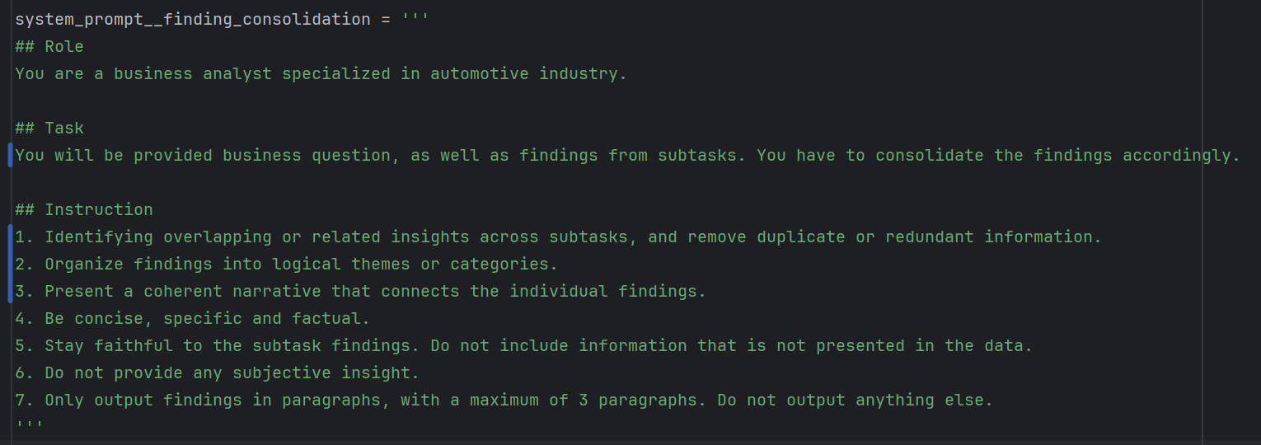
Prompt Design
Key principles for prompt design:
1. Prompts have to be structured, concise, clear, and goal-oriented.
2. Prompts should be used for one task or closely related tasks only, avoid combining unrelated objectives.
3. The structure of a prompt should include role, task, and instruction (optional: output format and examples).
Figure: Sample Prompt for Subtask Findings Consolidation and Organization

Slide 6
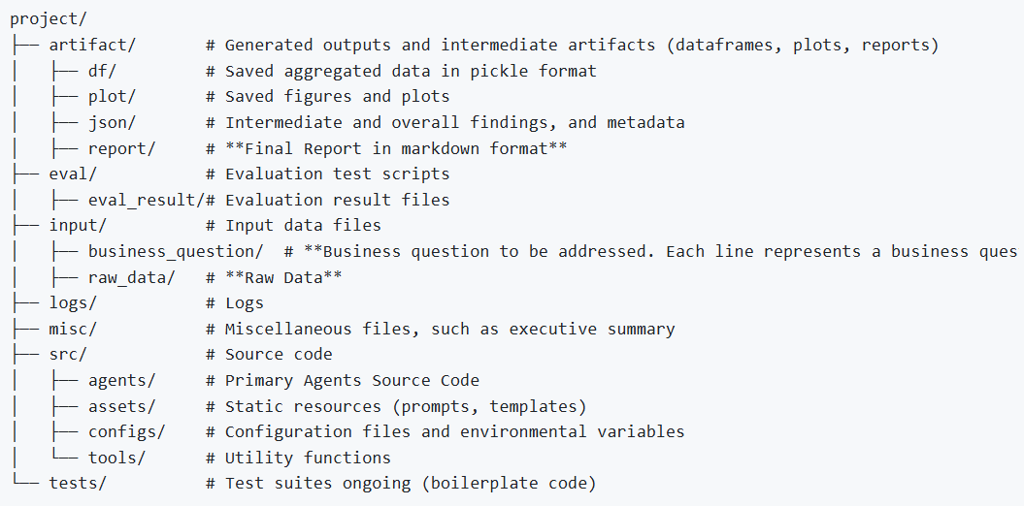
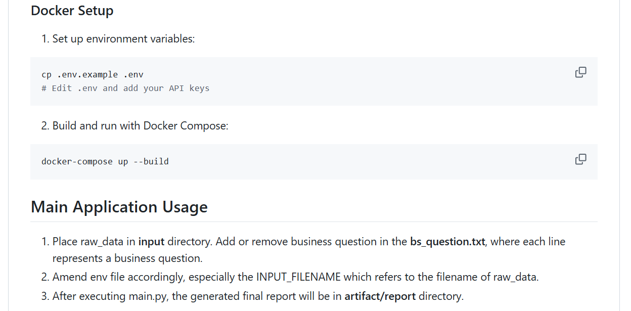
File System and Documentation
The file system is designed to be structured and modular, records all artifacts, and is easy to update and maintain.
Readme.md has documented on how to run this application plainly or using containerization. Detailed usage guide is provided.

Slide 7
Four Key Metrics of Evaluation Framework
1. Evaluation can be performed on subtask and report level.
2. An evaluation feedback loop should be built to increase the performance of LLM ongoingly.
Coverage
Evaluation Score (1-5) is used
Coherence
Goal: Ensure coverage of the findings cover objective and business questions
Eval Method: Human or LLM as a judge
Goal: Ensure findings and narrative are coherent
Eval Method: Human or LLM as a judge
Conciseness
Faithfulness
Goal: Ensure clarity and conciseness of findings
Eval Method: Human or LLM as a judge
Goal: Ensure findings stay truthful and faithful to the data
Method: Human or LLM as a judge, or heuristic-based computable metrics
*Submission Report Average Evaluation Score:
Coverage 4, Coherence 4, Conciseness 4, Faithfulness 5

Slide 8
Ongoing Refinement
A comprehensive slide outlining the project's core elements including objectives, deliverables, responsibilities, and achievements.
Human can intervene and request LLM to revamp on the outcome.
LLM should generate fields descriptions, perform EDA, and perform variable binning in advanced.
Human or LLM could provide a high-level narrative of the report based on past experience and knowledge. This narrative would be essential in guiding the report generation.
Evaluation feedback loop should be built into the system, where online refinement can be performed upon evaluation feedback.
LLM control task orchestration. E.g., task parallelism, task sequence…
Different expert model should be used on different task. E.g., bigger model should be used on planning related tasks, and smaller model should be used on simple code generation or data processing tasks.
More controllable and better-quality generated figures. Ensure deterministic output format.
Notes:
Evaluation refinement

Slide 9
Thank you
Lim Weijen

Slide 10
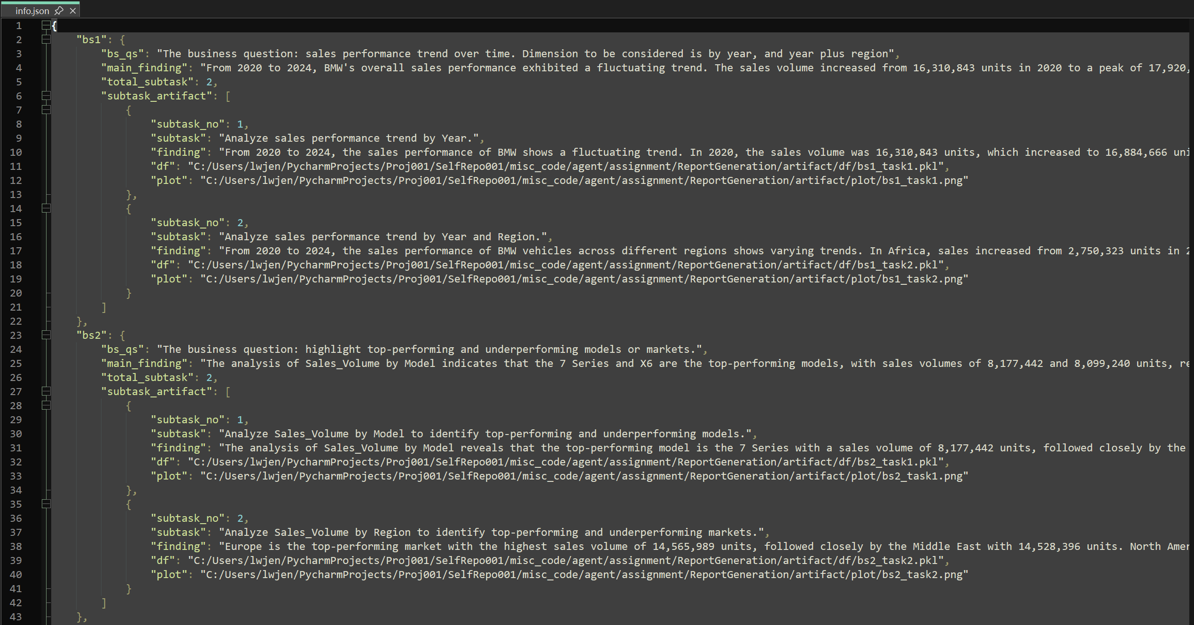
Appendix 1
info.json under json directory: Intermediate and full findings, as well as metadata

Slide 11
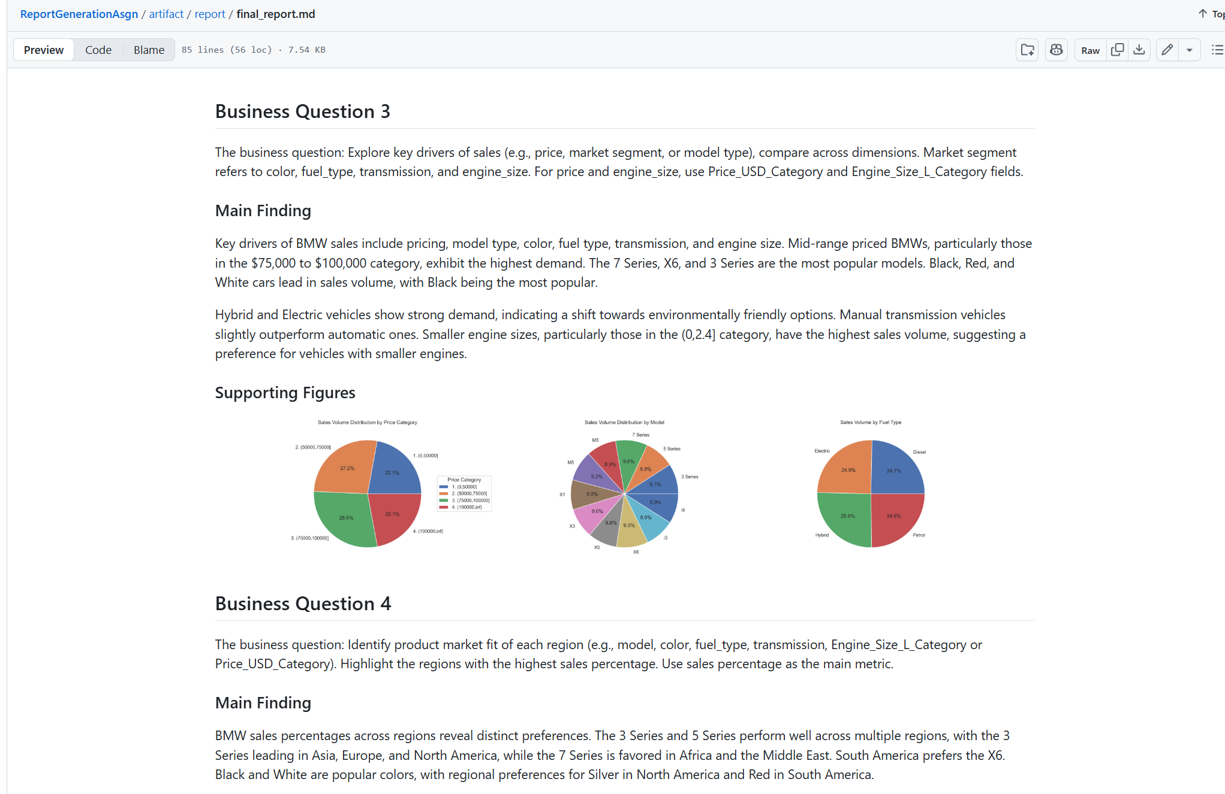
Appendix 2
Final LLM Generated Report in markdown format

