Slide 1
To-do’s from last meeting
Fit loglogistic AFT model
Extract the estimated surface from additive model
Apply method to real data
Check the FTTM paper and AOAS latex template

Slide 2
User-defined functions
optimize_AFT(Y, delta, X, data, family, lambda, k = 30, se = FALSE)
Y: survival time variable
delta: censoring indicator variable
X: functional predictor variable
data: name of data frame
family: lognormal or loglogistic
k: number of spline basis to construct beta1(s)
lambda: smoothing parameter
se: whether to calculate standard error and CI for parameters
Will add Z (scalar variables)

Slide 3
User-defined functions
optimize_lambda <- function(Y, delta, X, data, family, lambda_grid)
Perform a grid search on lambda_grid to find the optimal lambda which minimizes the GCV value

Slide 4
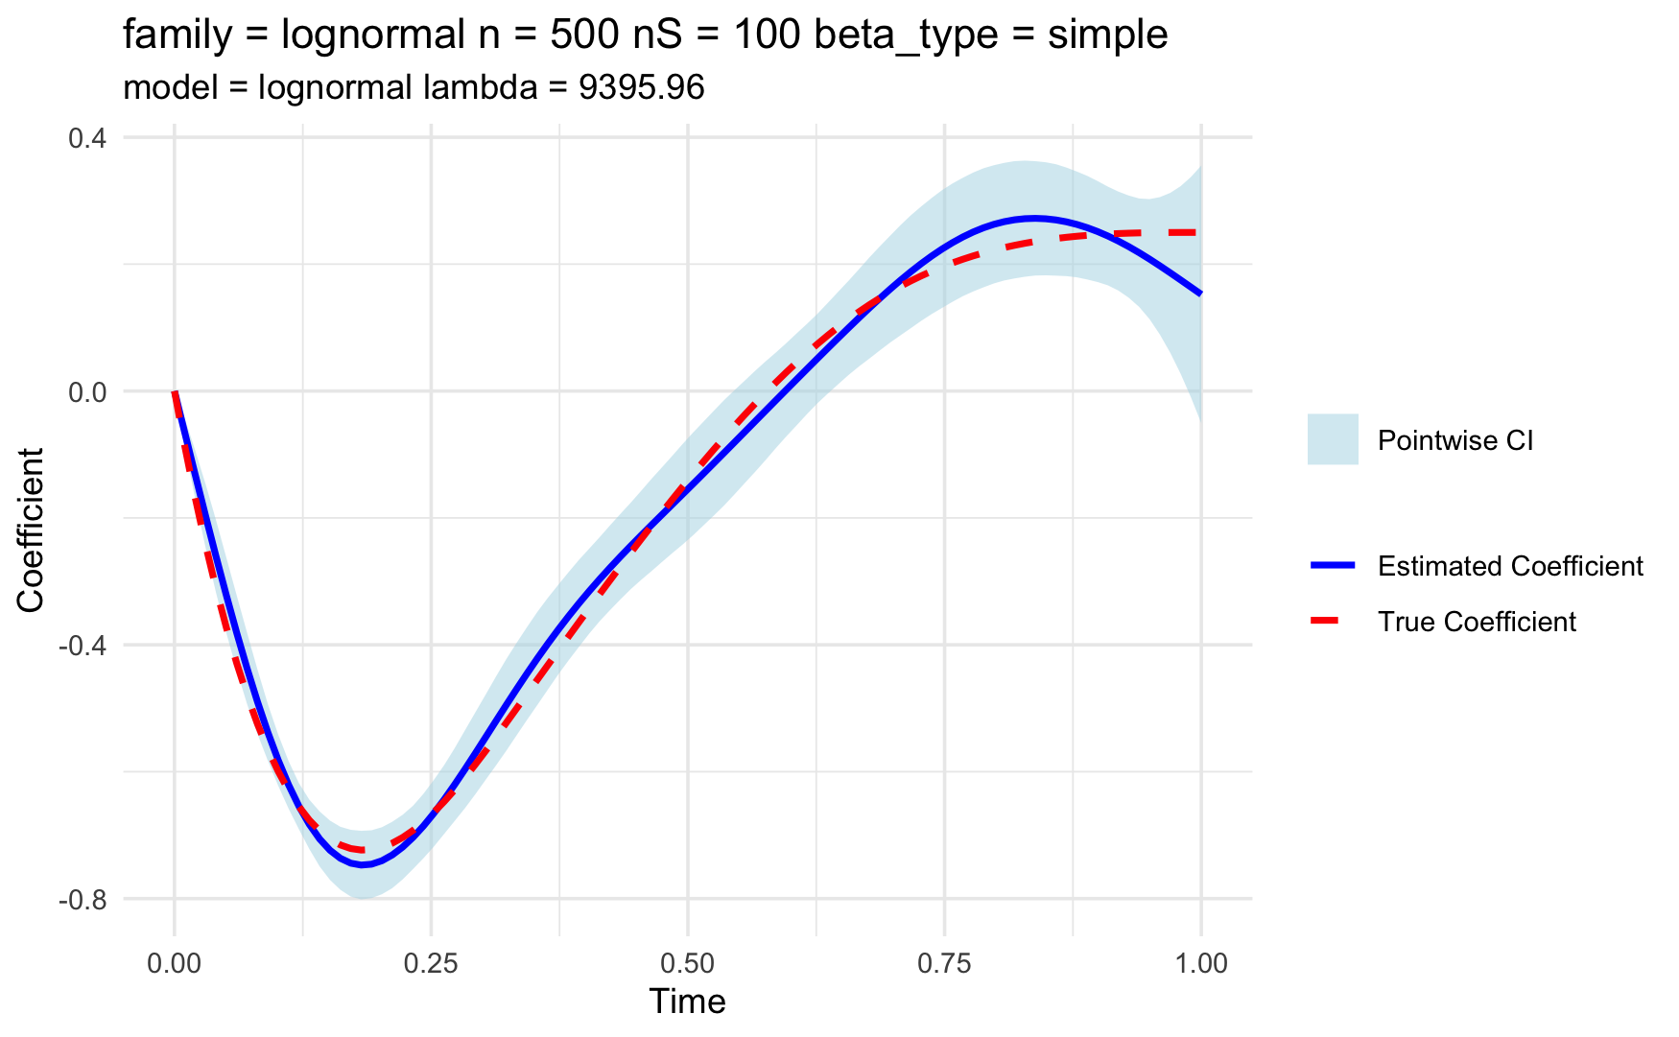
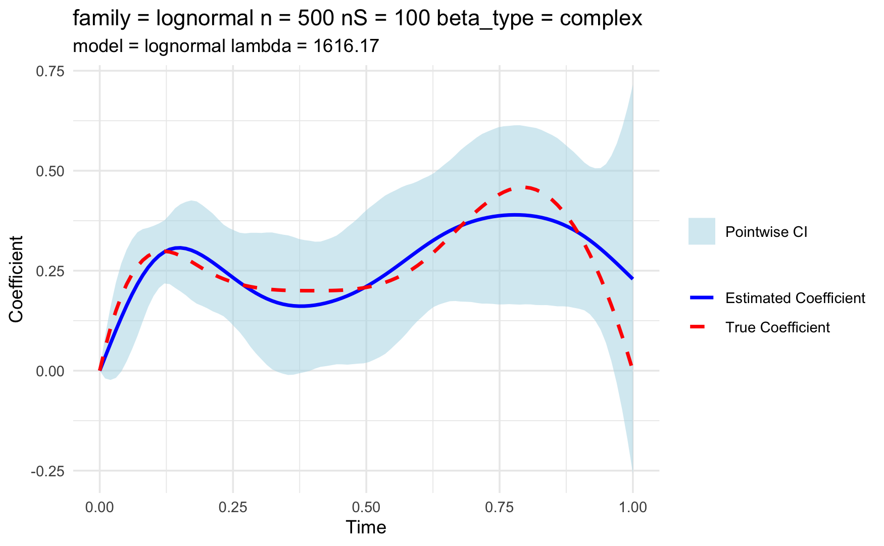
Estimated coefficient function
True model is lognormal; estimation model is lognormal

Slide 5
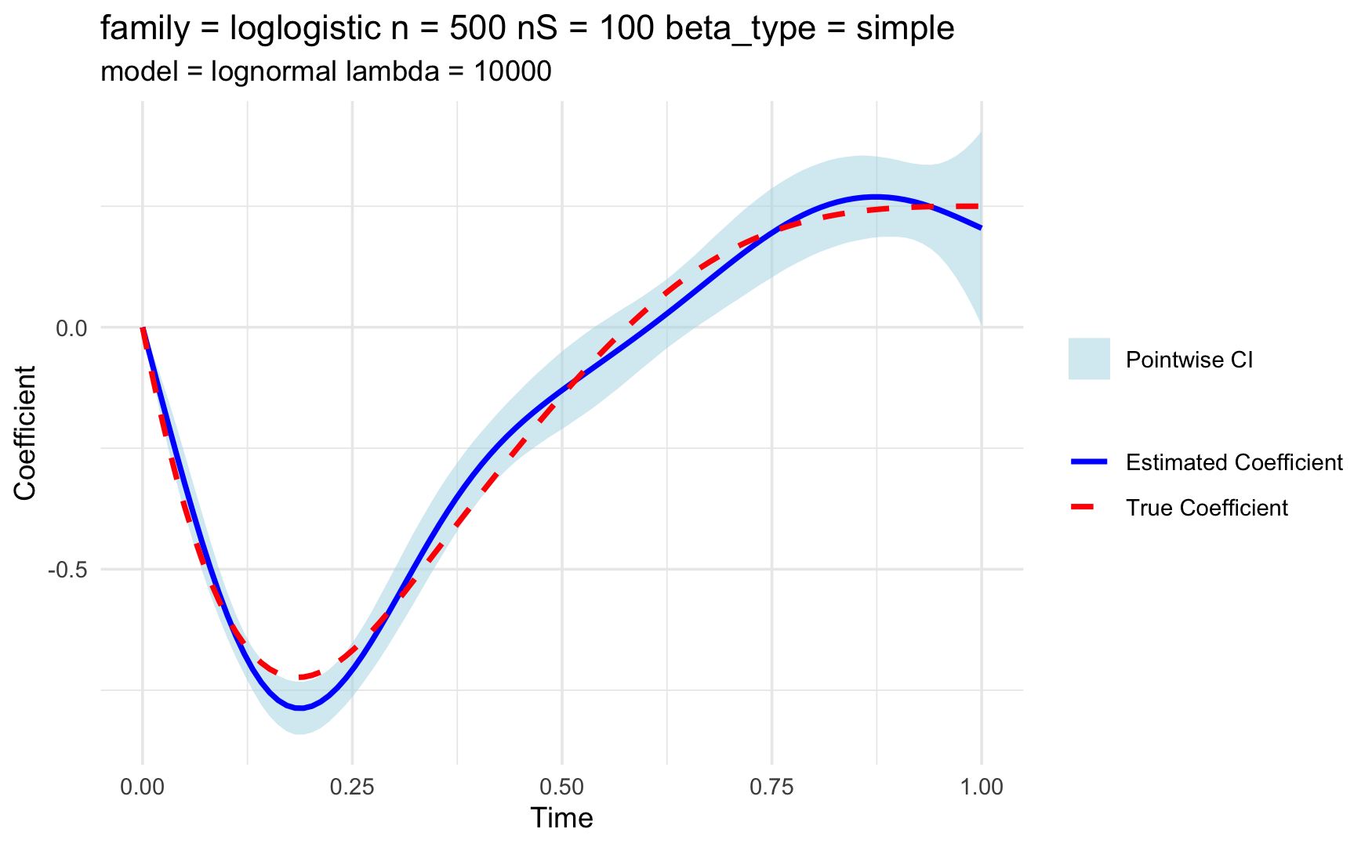
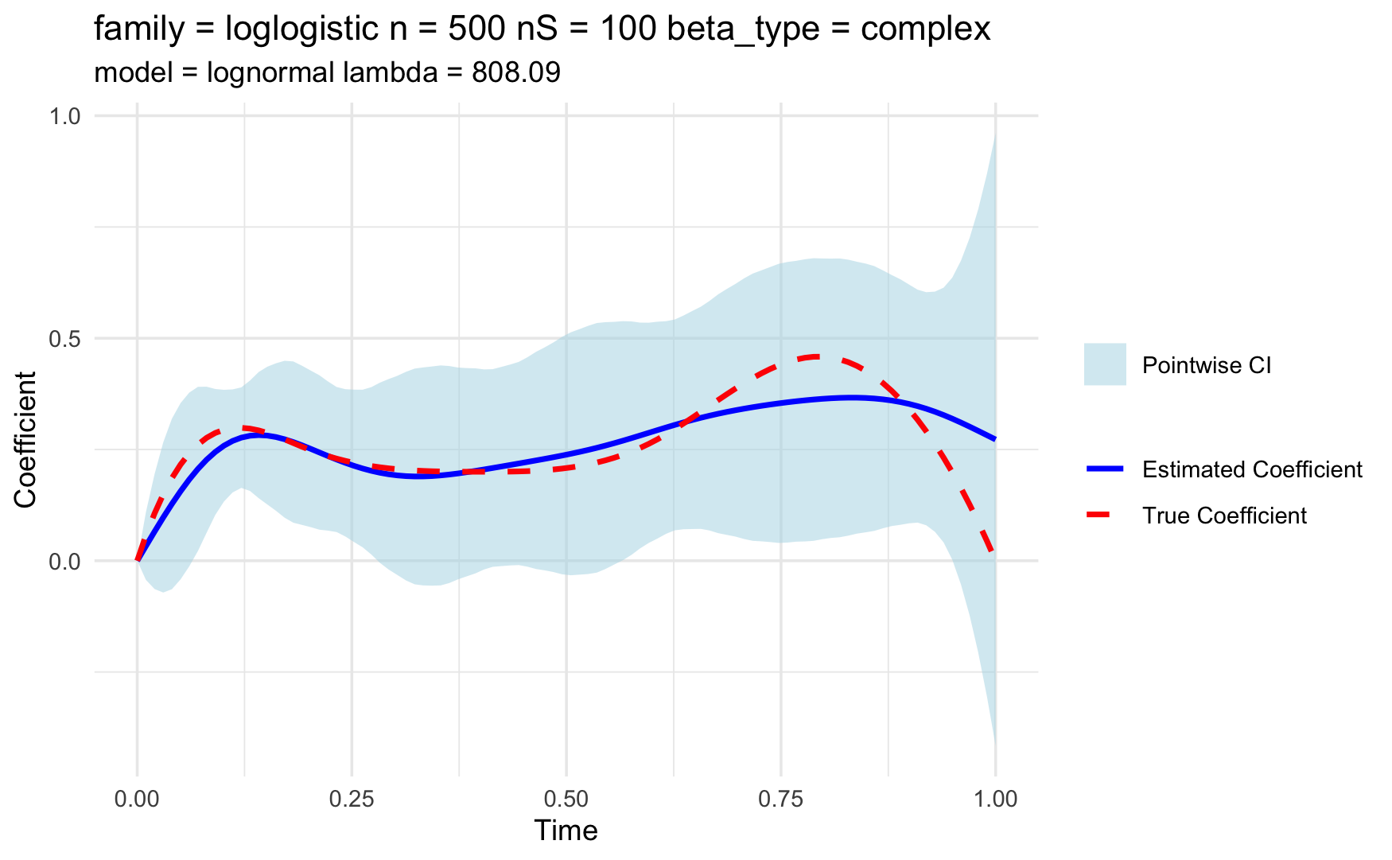
Estimated coefficient function
True model is loglogistic; estimation model is lognormal

Slide 6
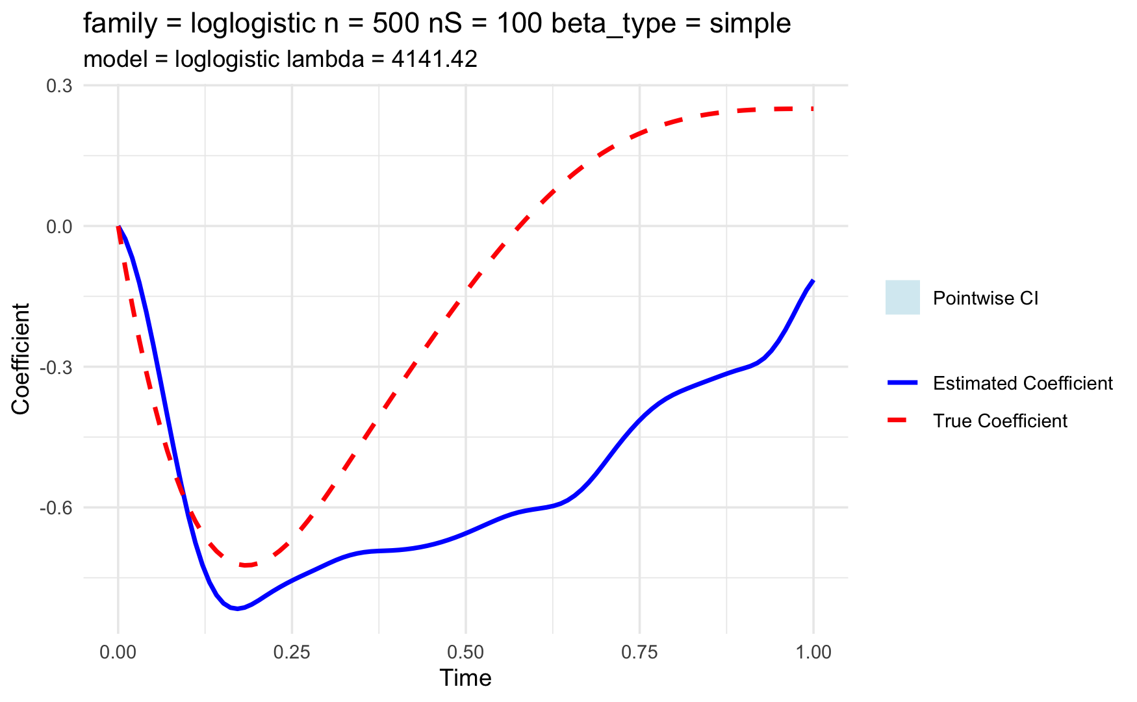
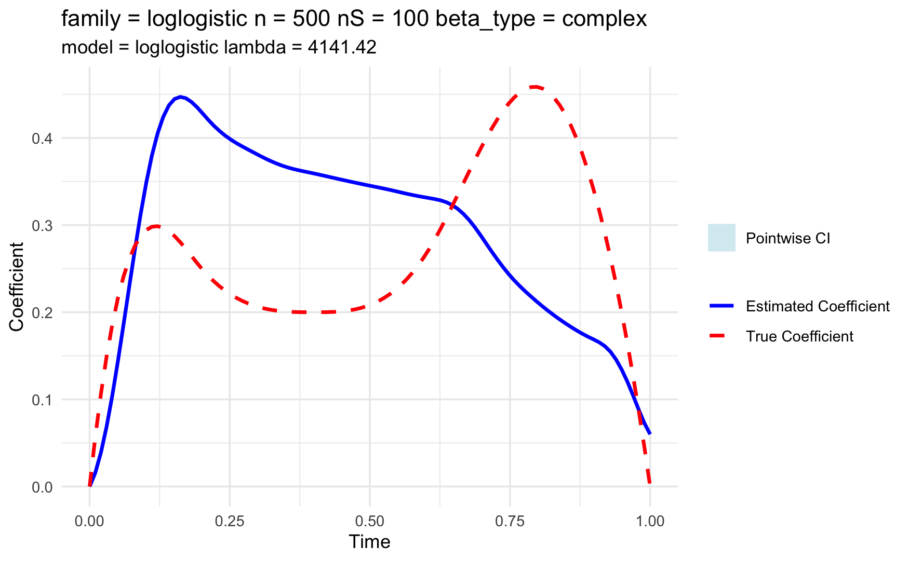
Estimated coefficient function
True model is loglogistic; estimation model is loglogistic
Need to troubleshoot the gradient function

Slide 7
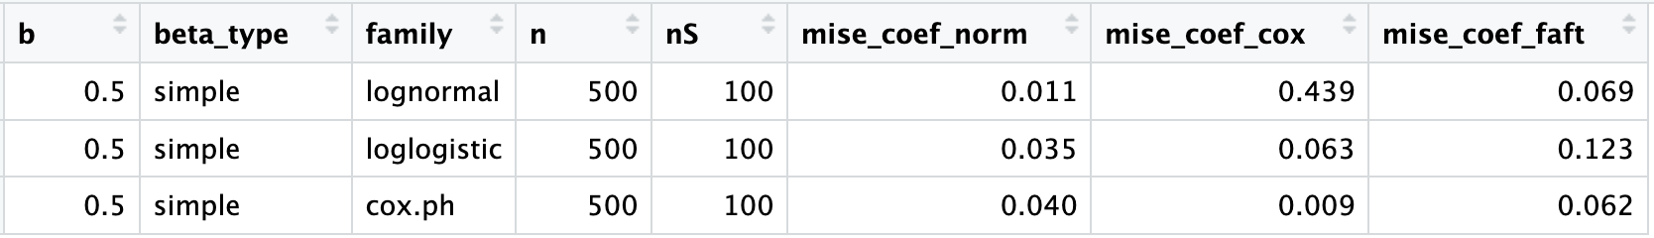
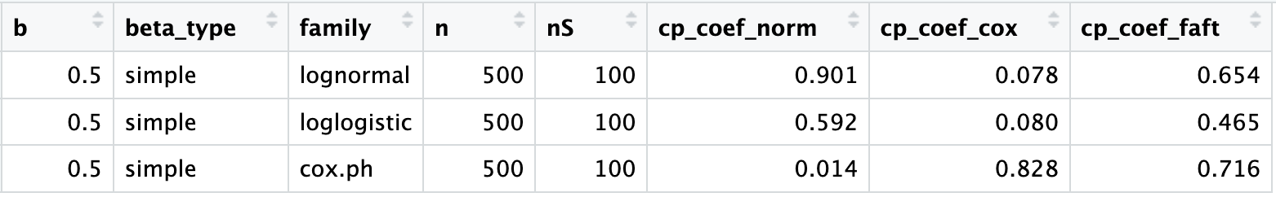
Average MISE of coefficient function across 10 iterations
Average coverage of the 95% pointwise CI of coefficient function
Potential reason for the high bias of FAFT:
A sparse lambda grid was used (100 grids), and model is highly sensitive to lambda…

Slide 8
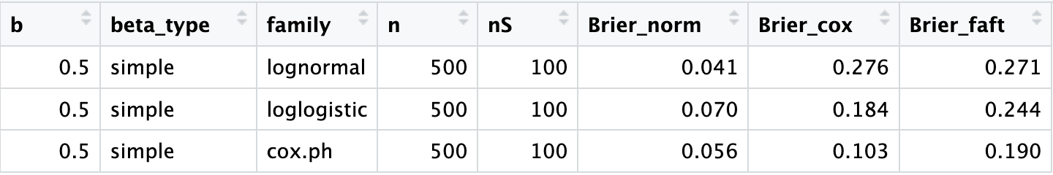
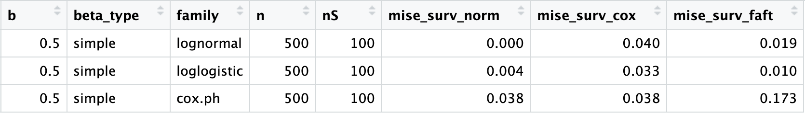
Average Brier score across 10 iterations
Average MISE of survival function across 10 iterations

Slide 9
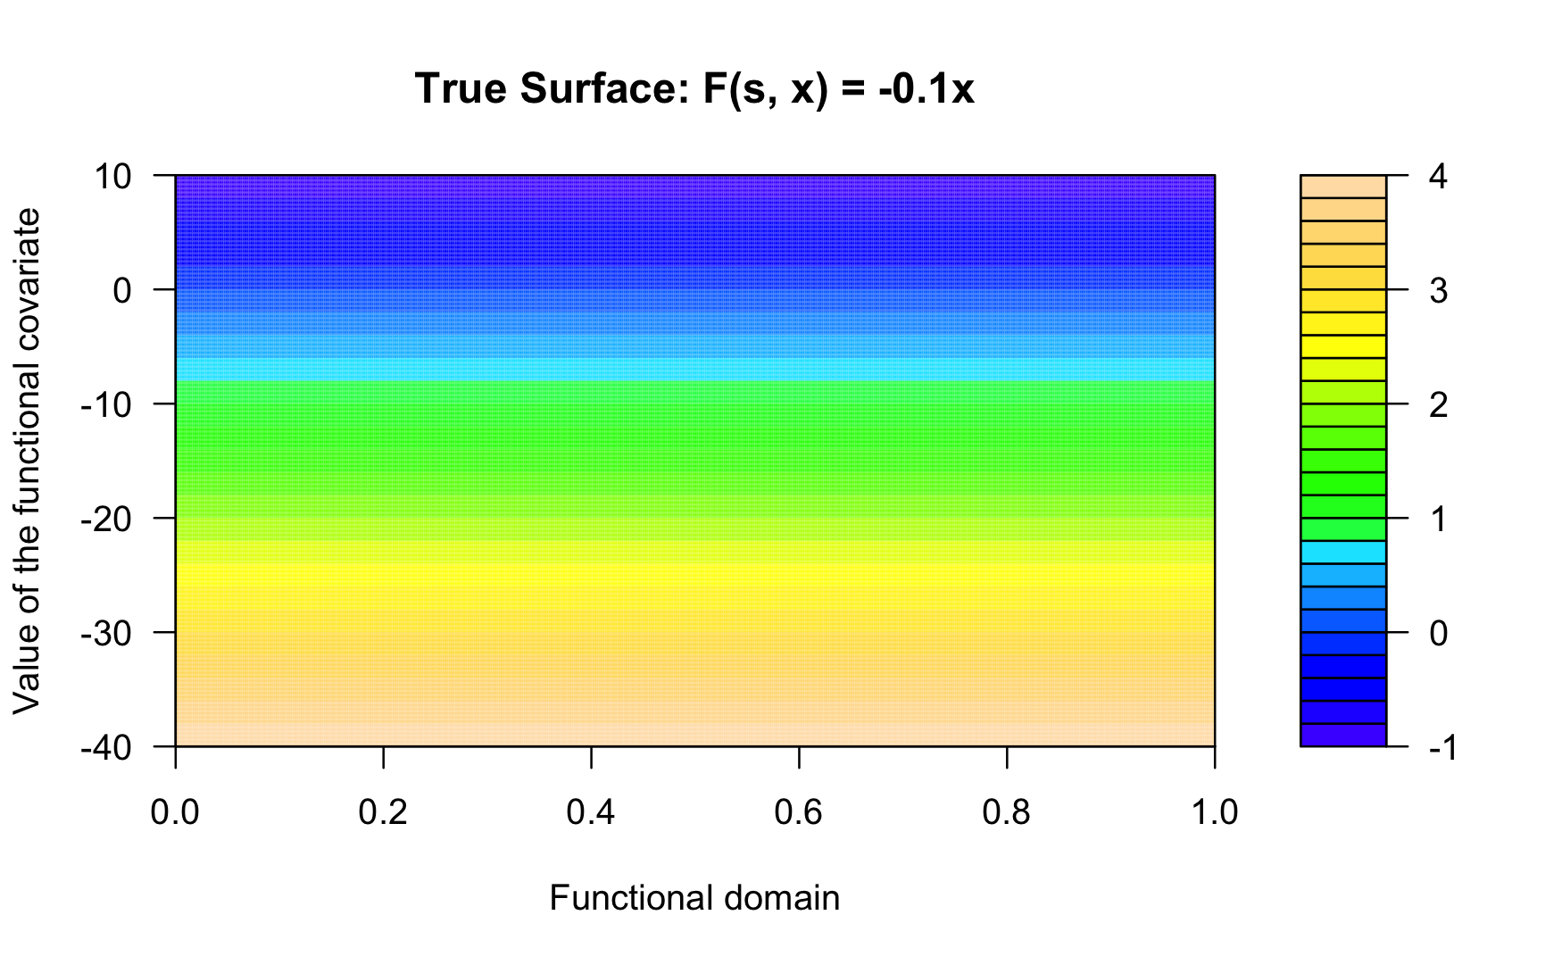
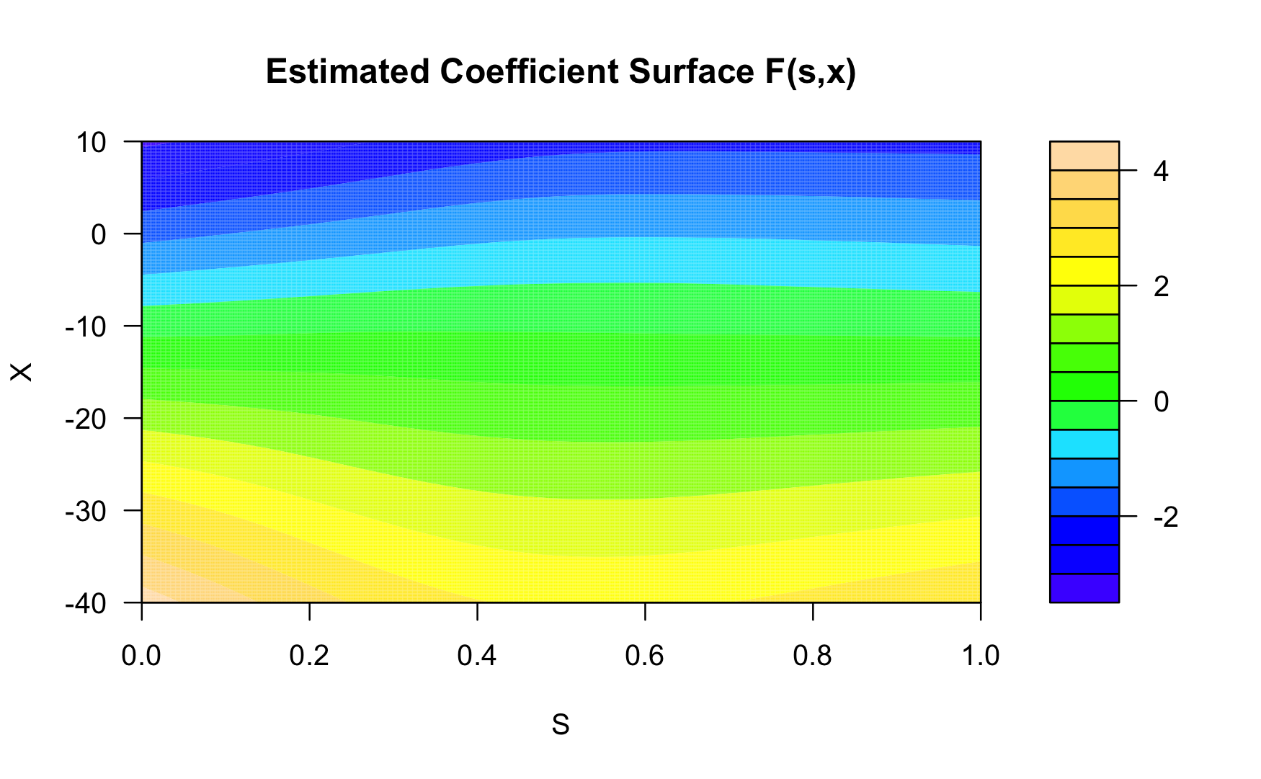
Addictive functional AFT model

Slide 10
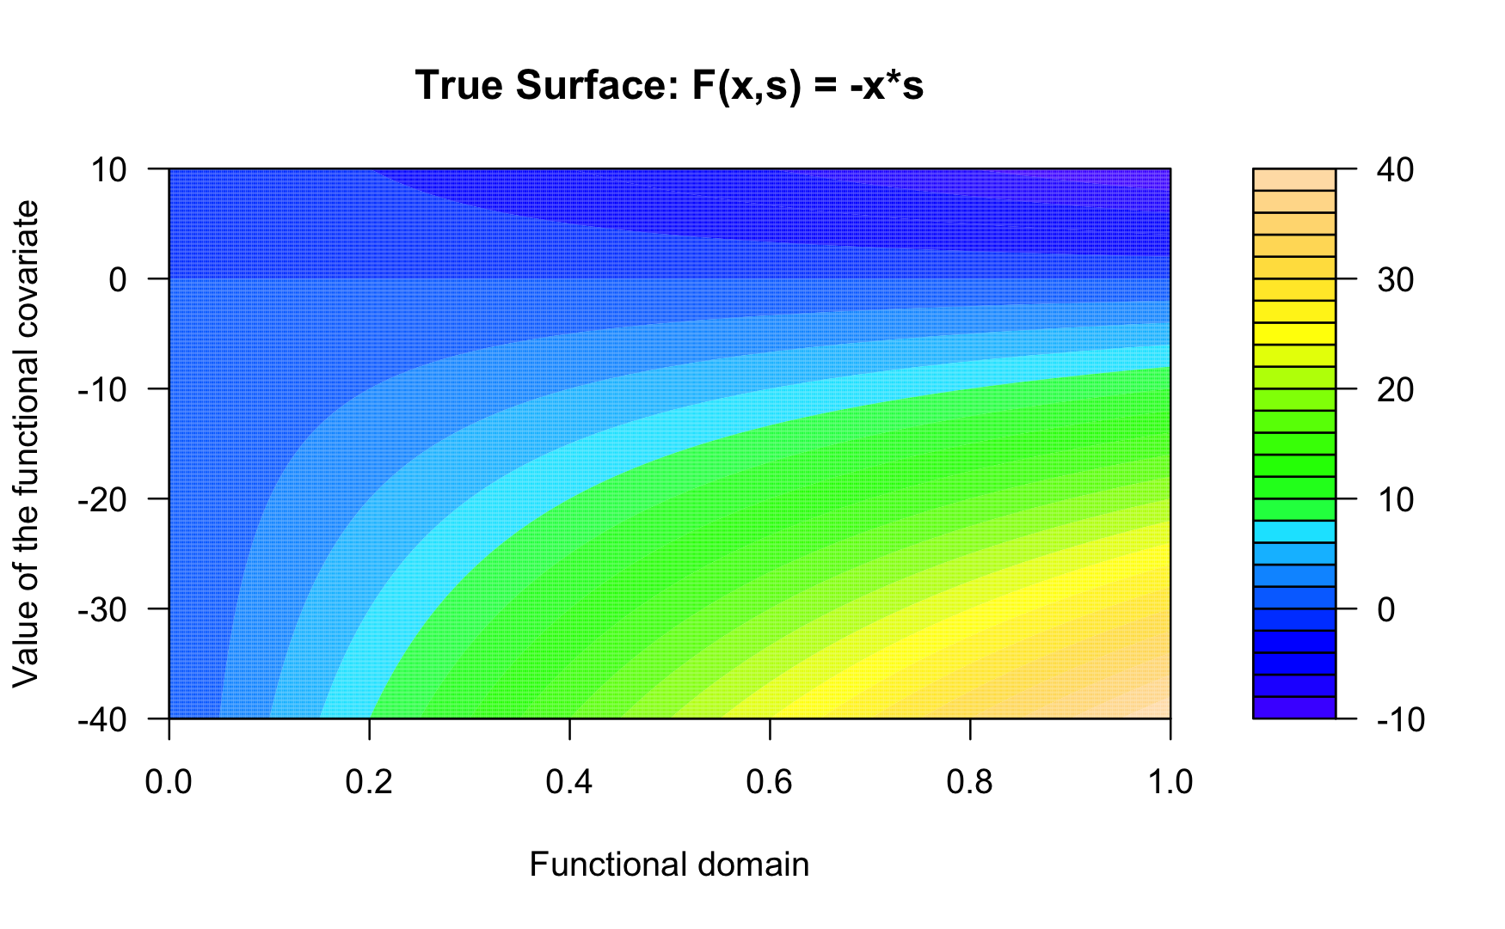
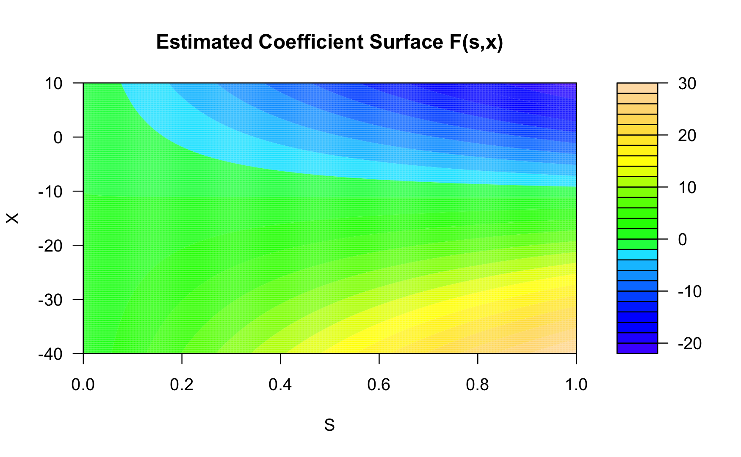
Addictive functional AFT model

Slide 11
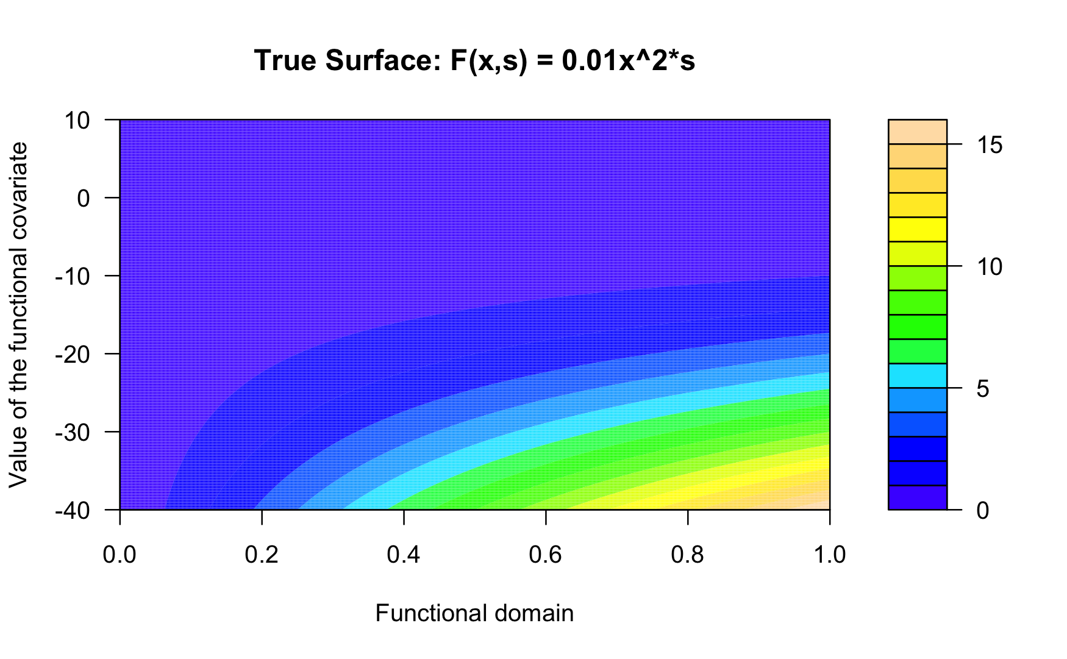
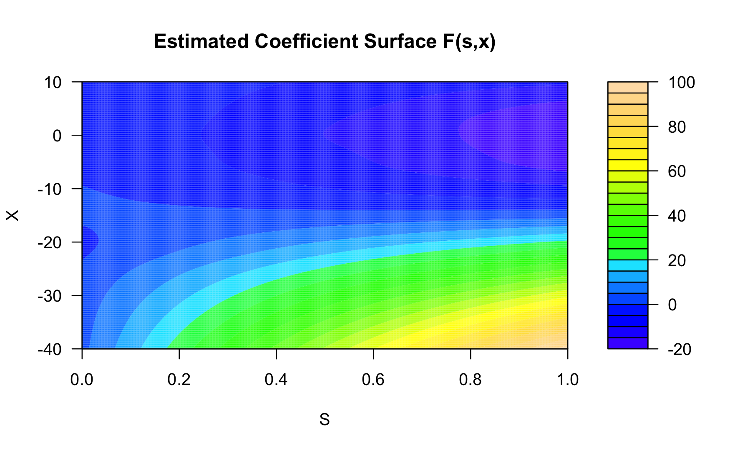
Addictive functional AFT model

Slide 12
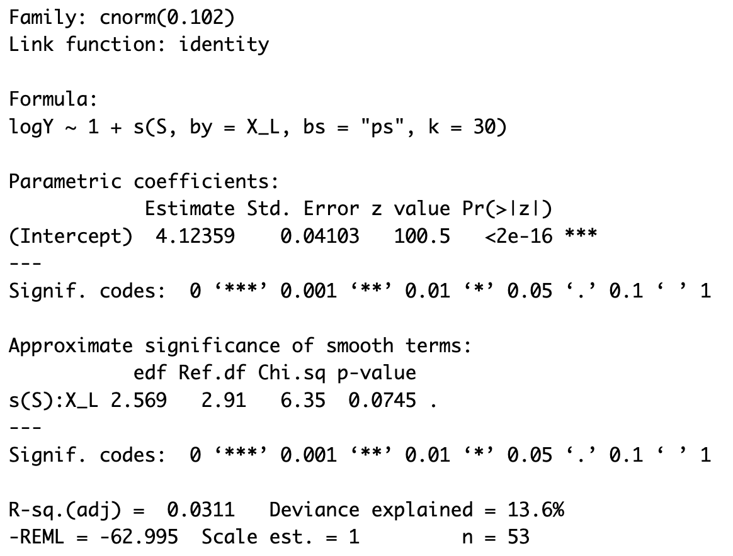
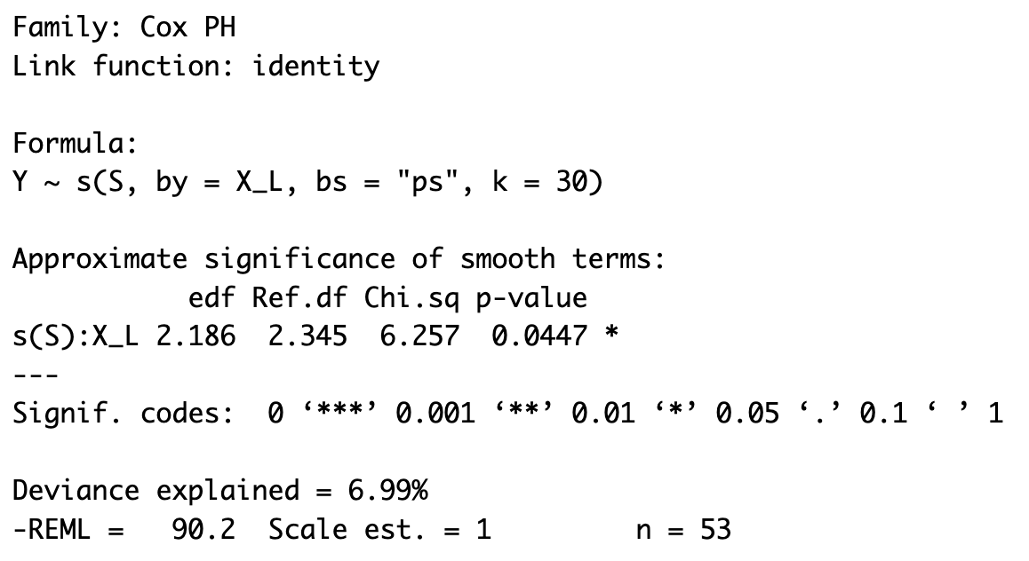
Real data analysis
84 subjects, 401 time frames
Fitted with functional AFT (cnorm) and LFCM

Slide 13
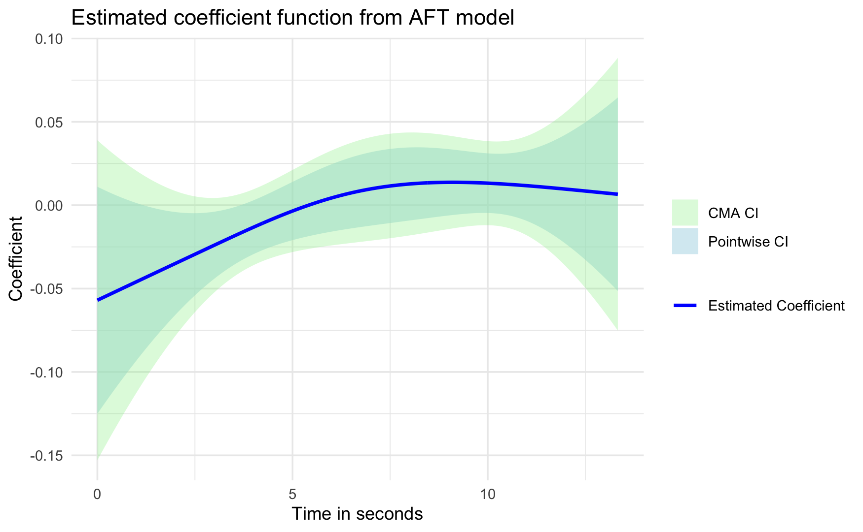
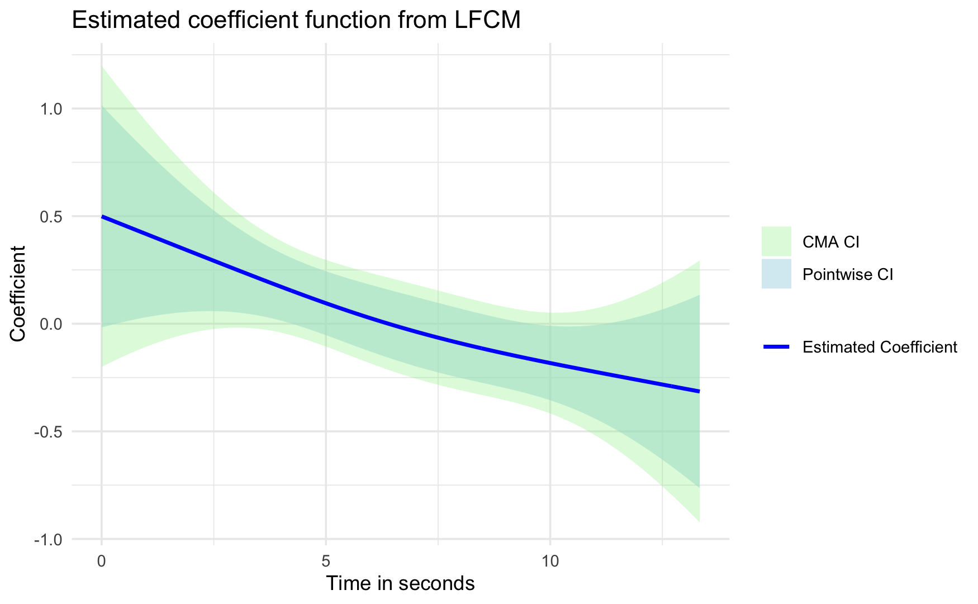
Estimate coefficient functions

Slide 14
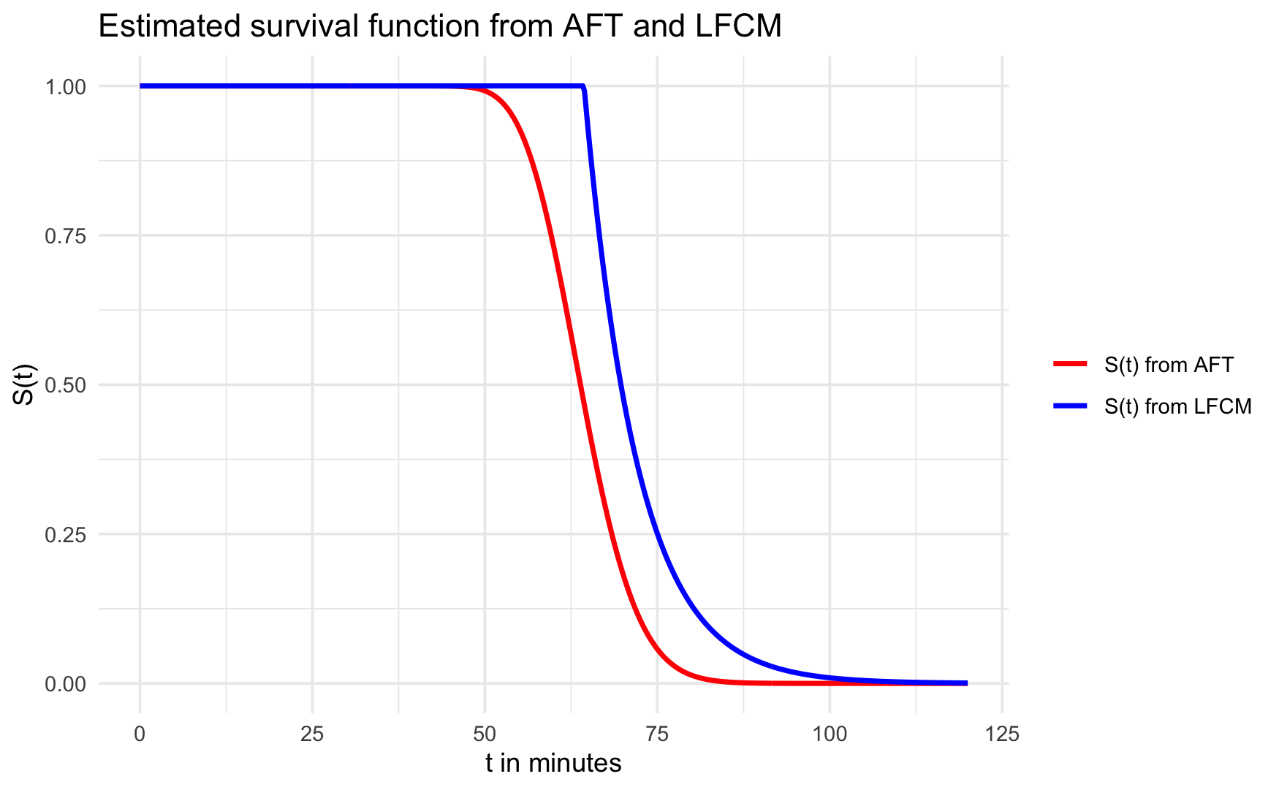
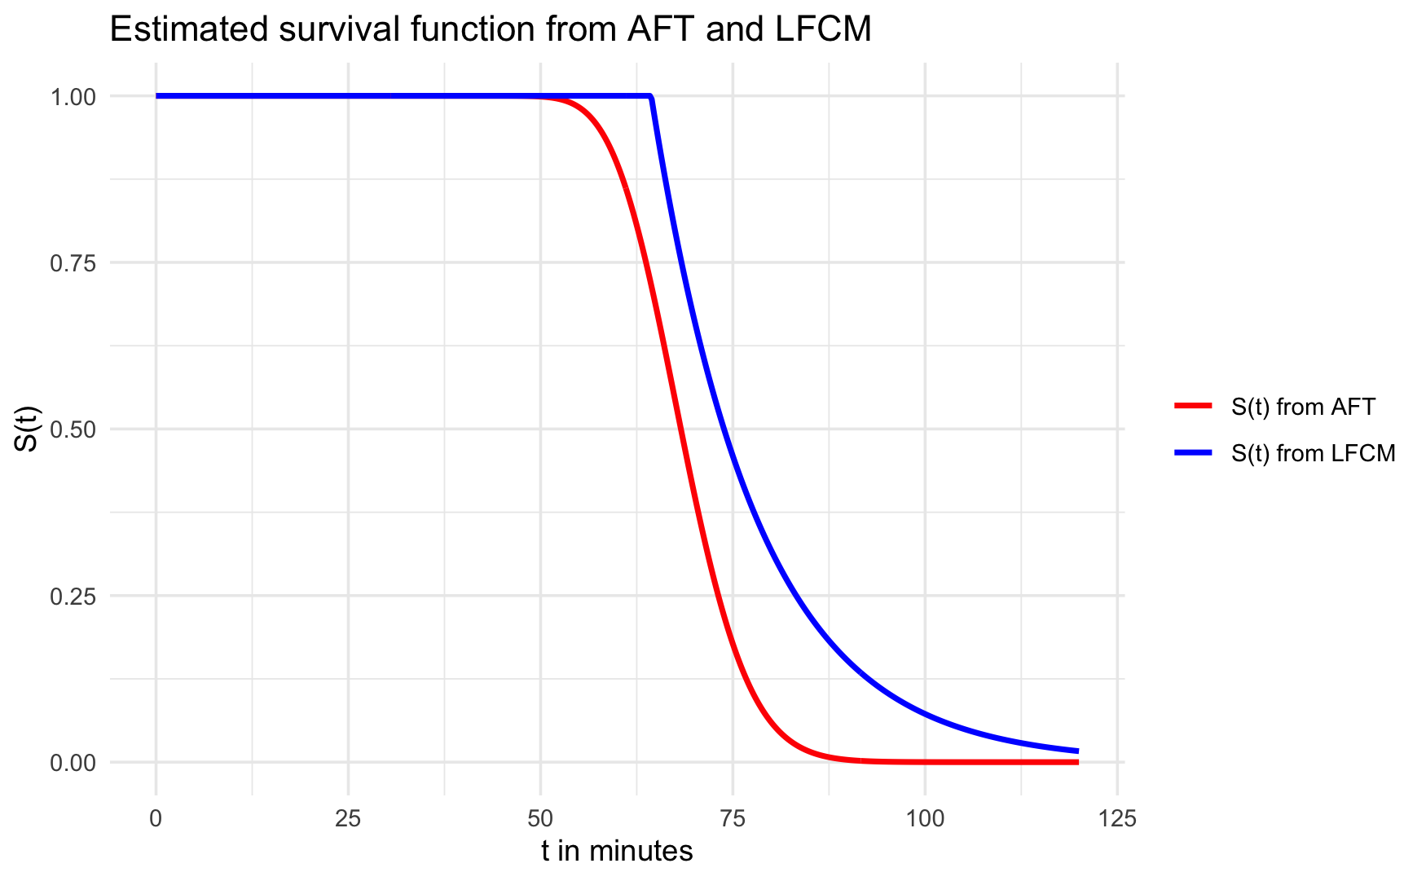
Estimated survival functions
A subject from the user group:
A subject from the non-user group:

