Slide 1
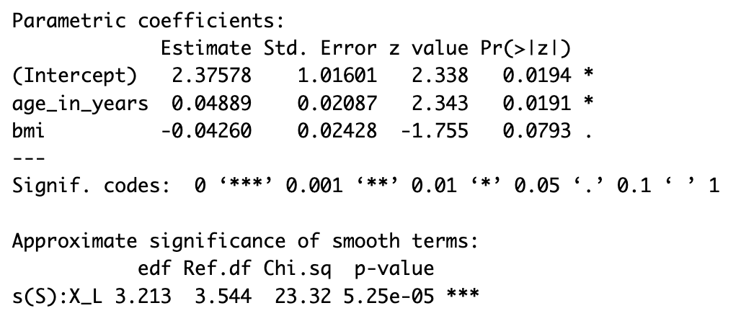
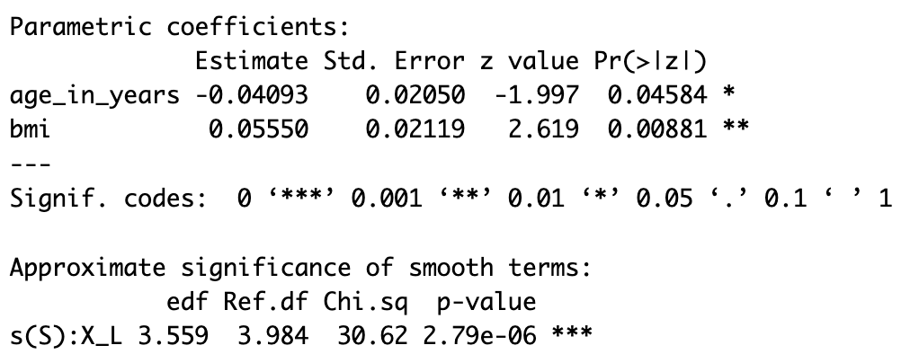
Real data analysis
Added 2 covariate: age and bmi
Linear functional AFT model
Linear functional Cox model

Slide 2
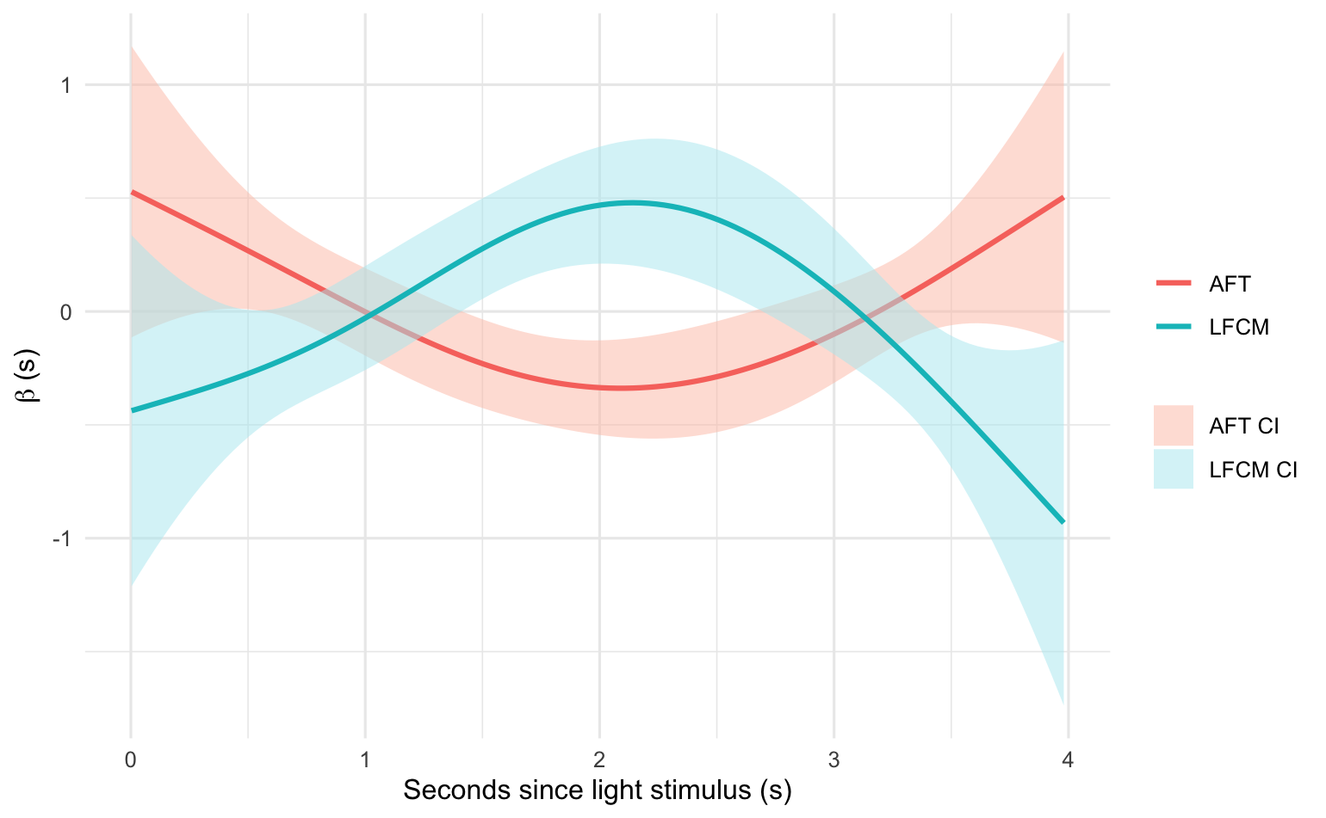
Estimated beta(s) from linear functional models

Slide 3
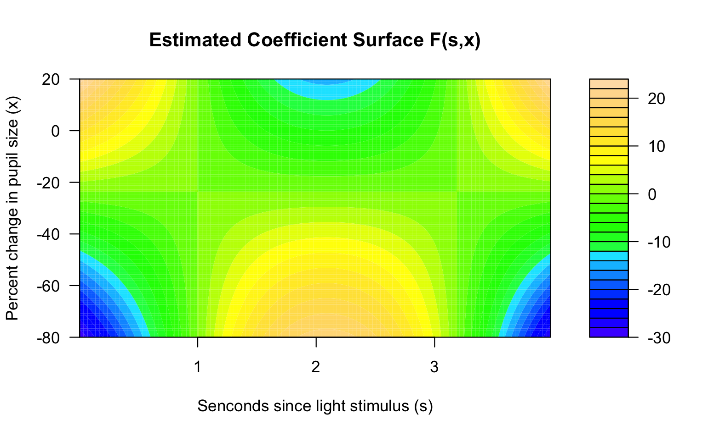
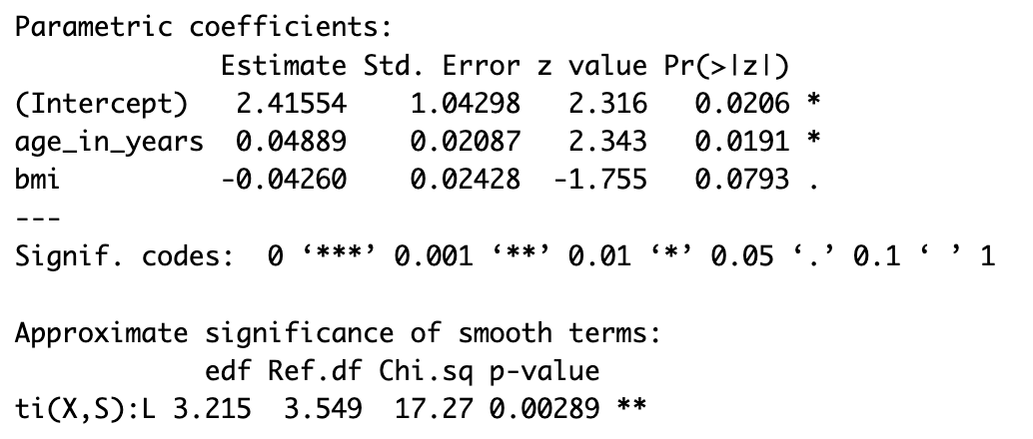
Fit additive model on real data

Slide 4
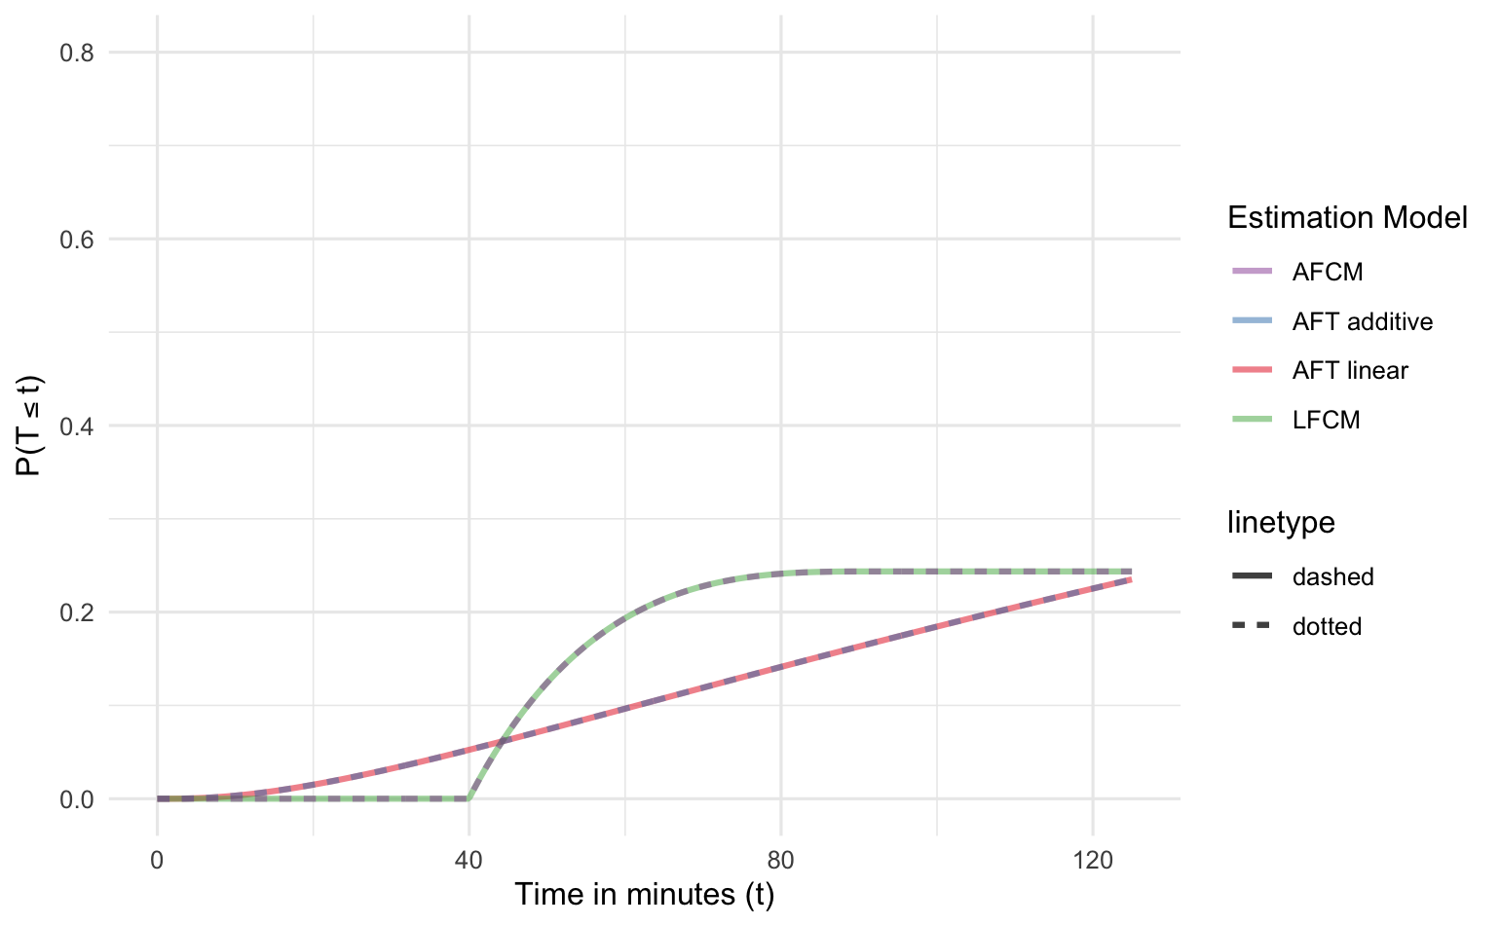
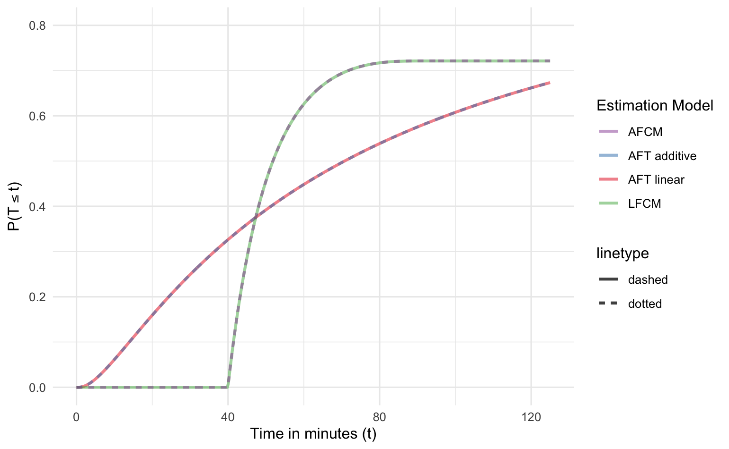
Estimated CDFs from real data
The estimated CDFs from linear and additive models are almost identical

Slide 5
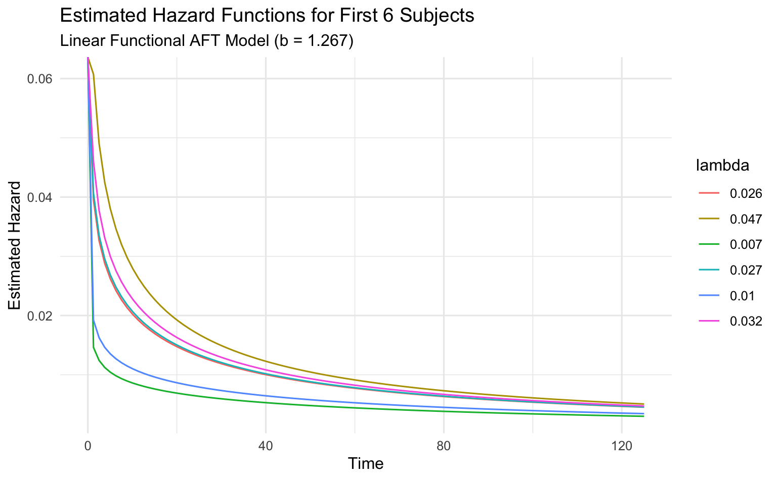
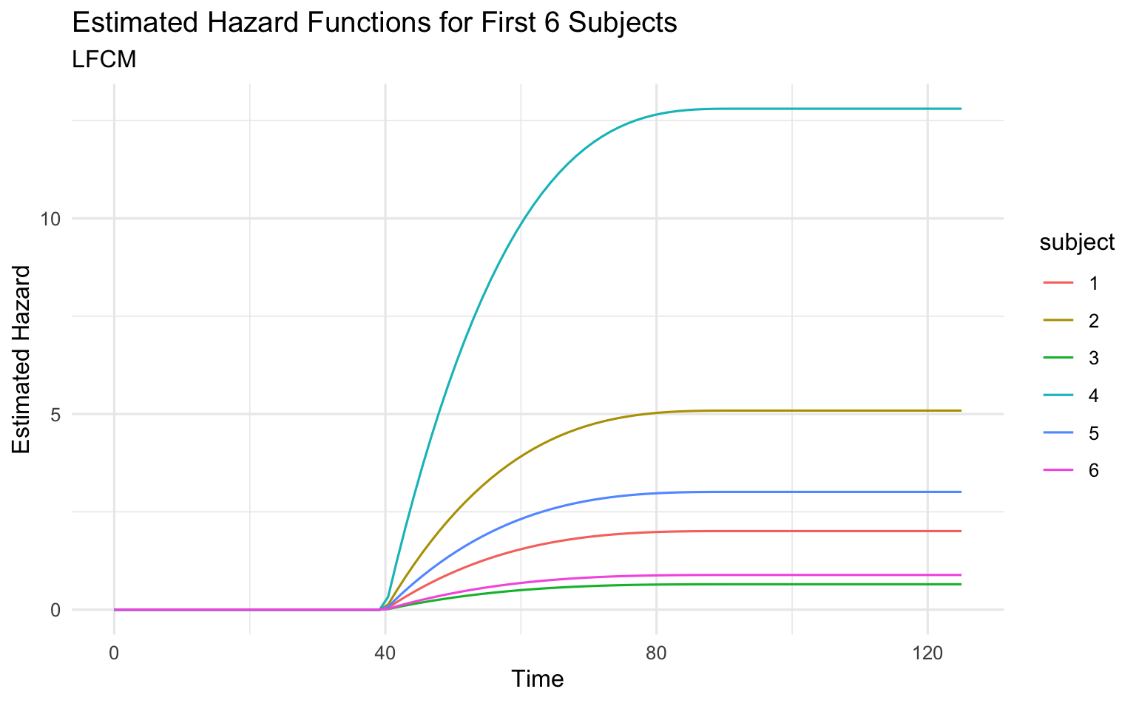
Estimated hazard functions from real data

