Slide 1
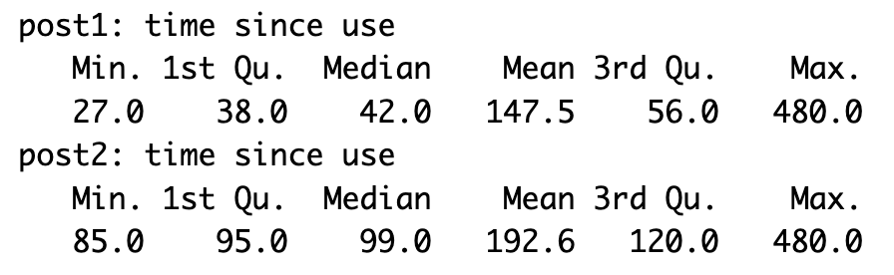
Real data analysis
127 subjects
123 has post1 right eye assessment
125 has post2 right eye assessment
Censored time set to 8h
Summary of time since cannabis use:

Slide 2
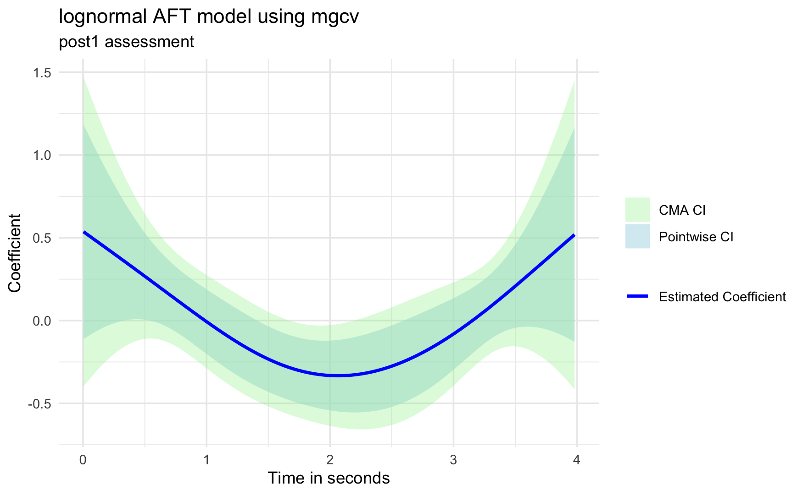
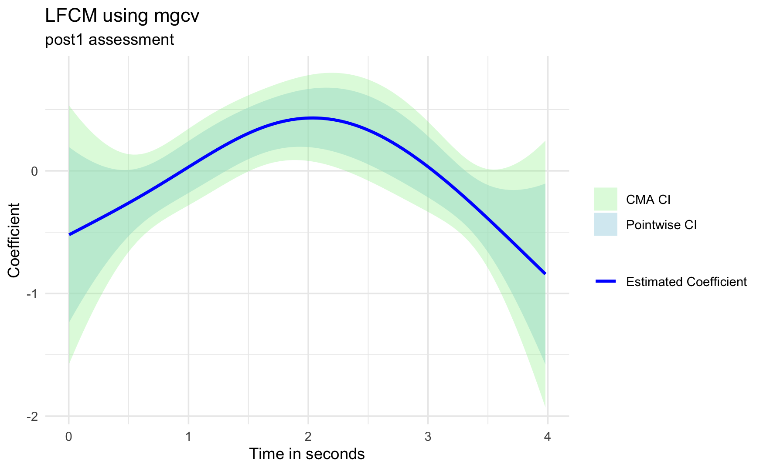
Post1: estimated coefficient functions

Slide 3
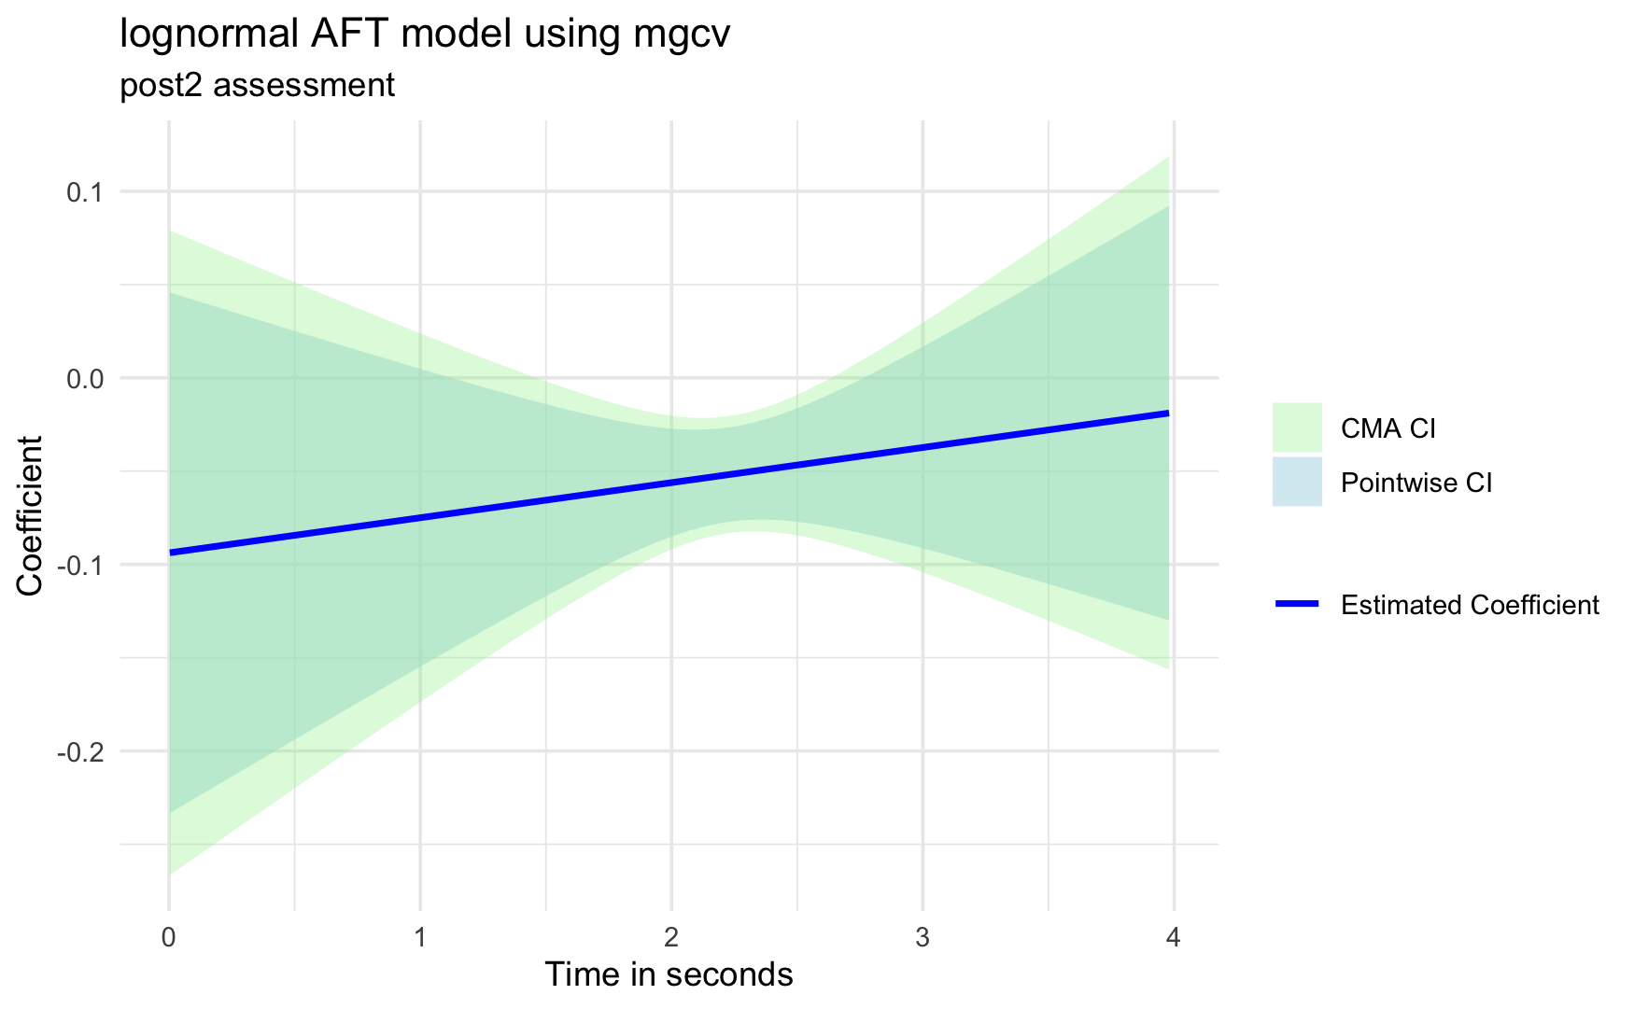
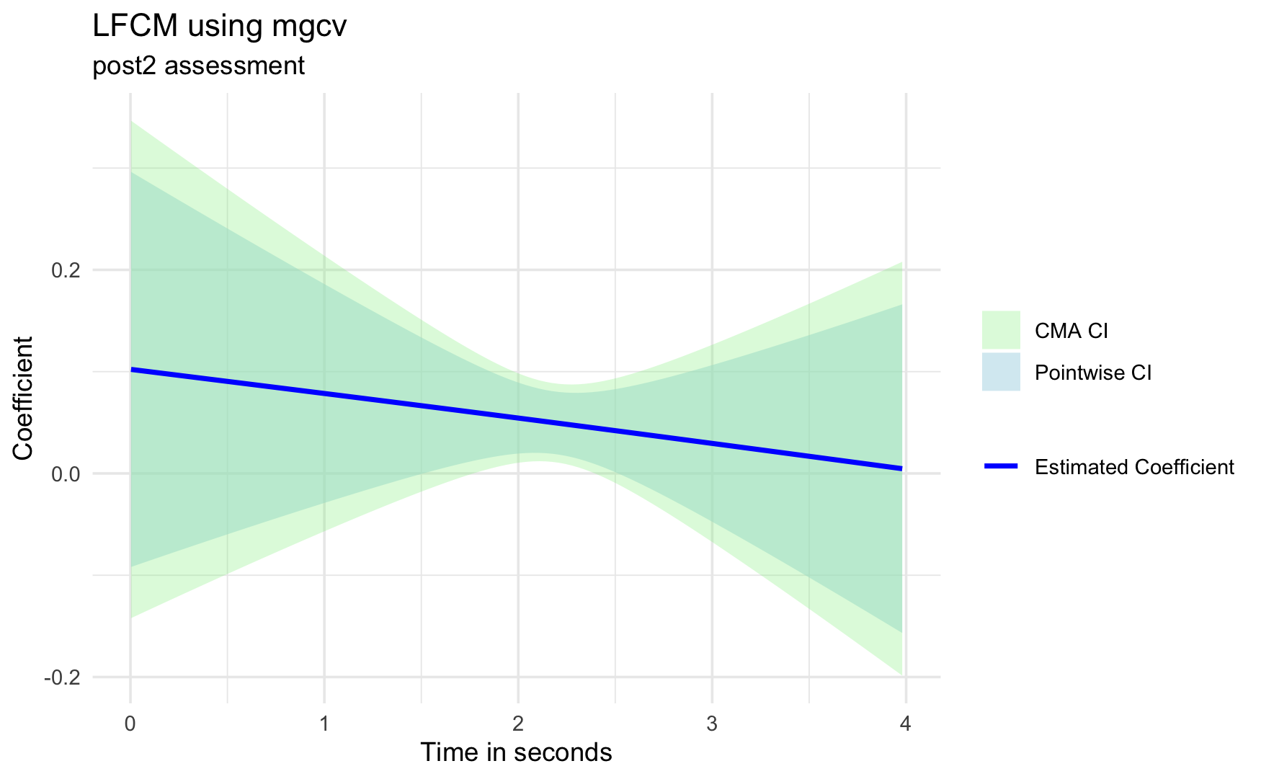
Post2: estimated coefficient functions

Slide 4
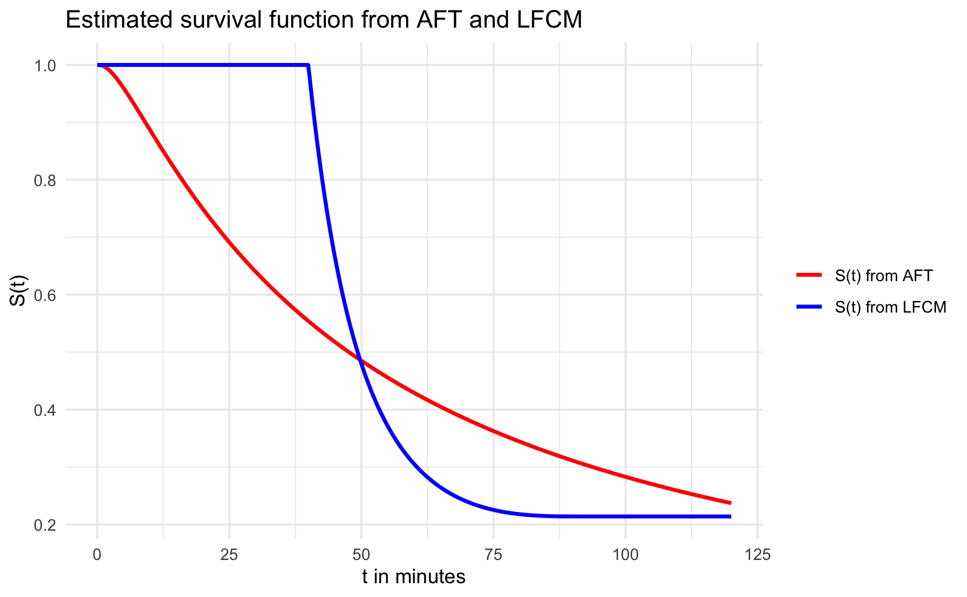
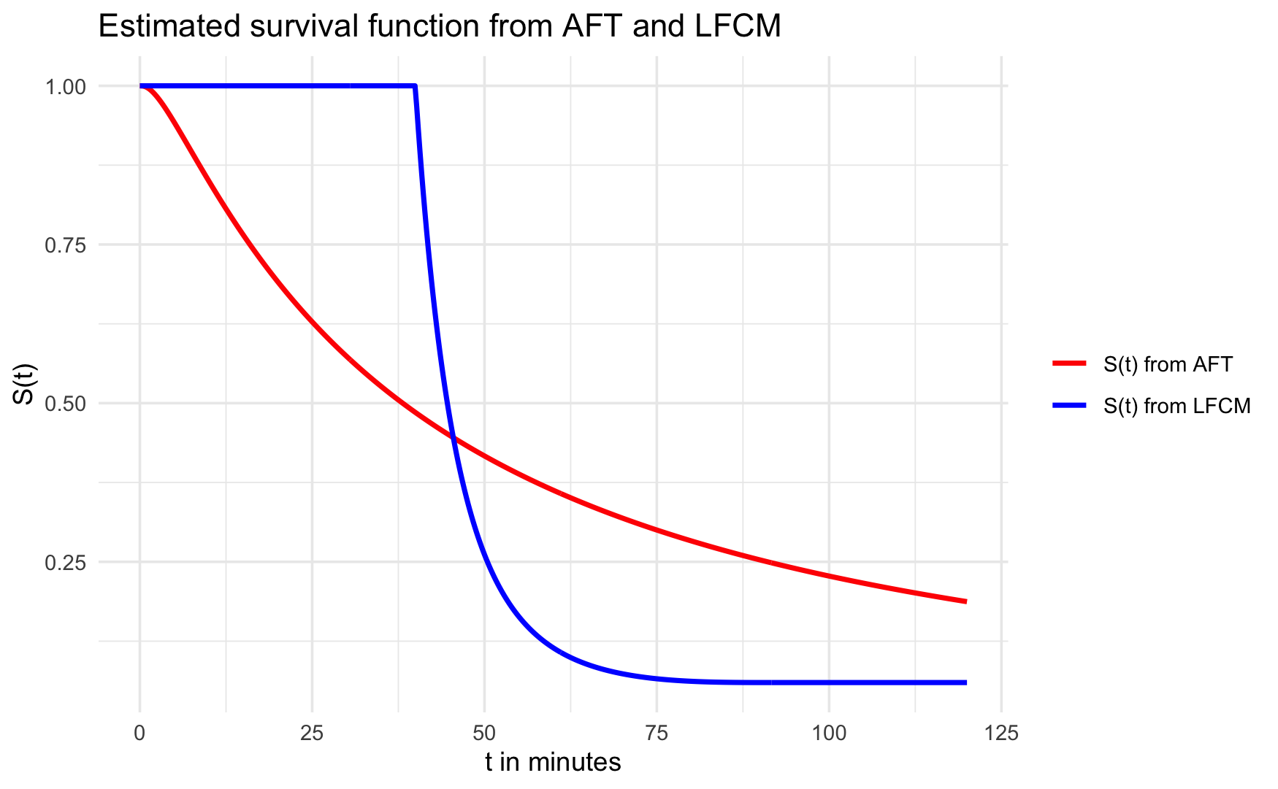
Post1: estimated survival functions

Slide 5
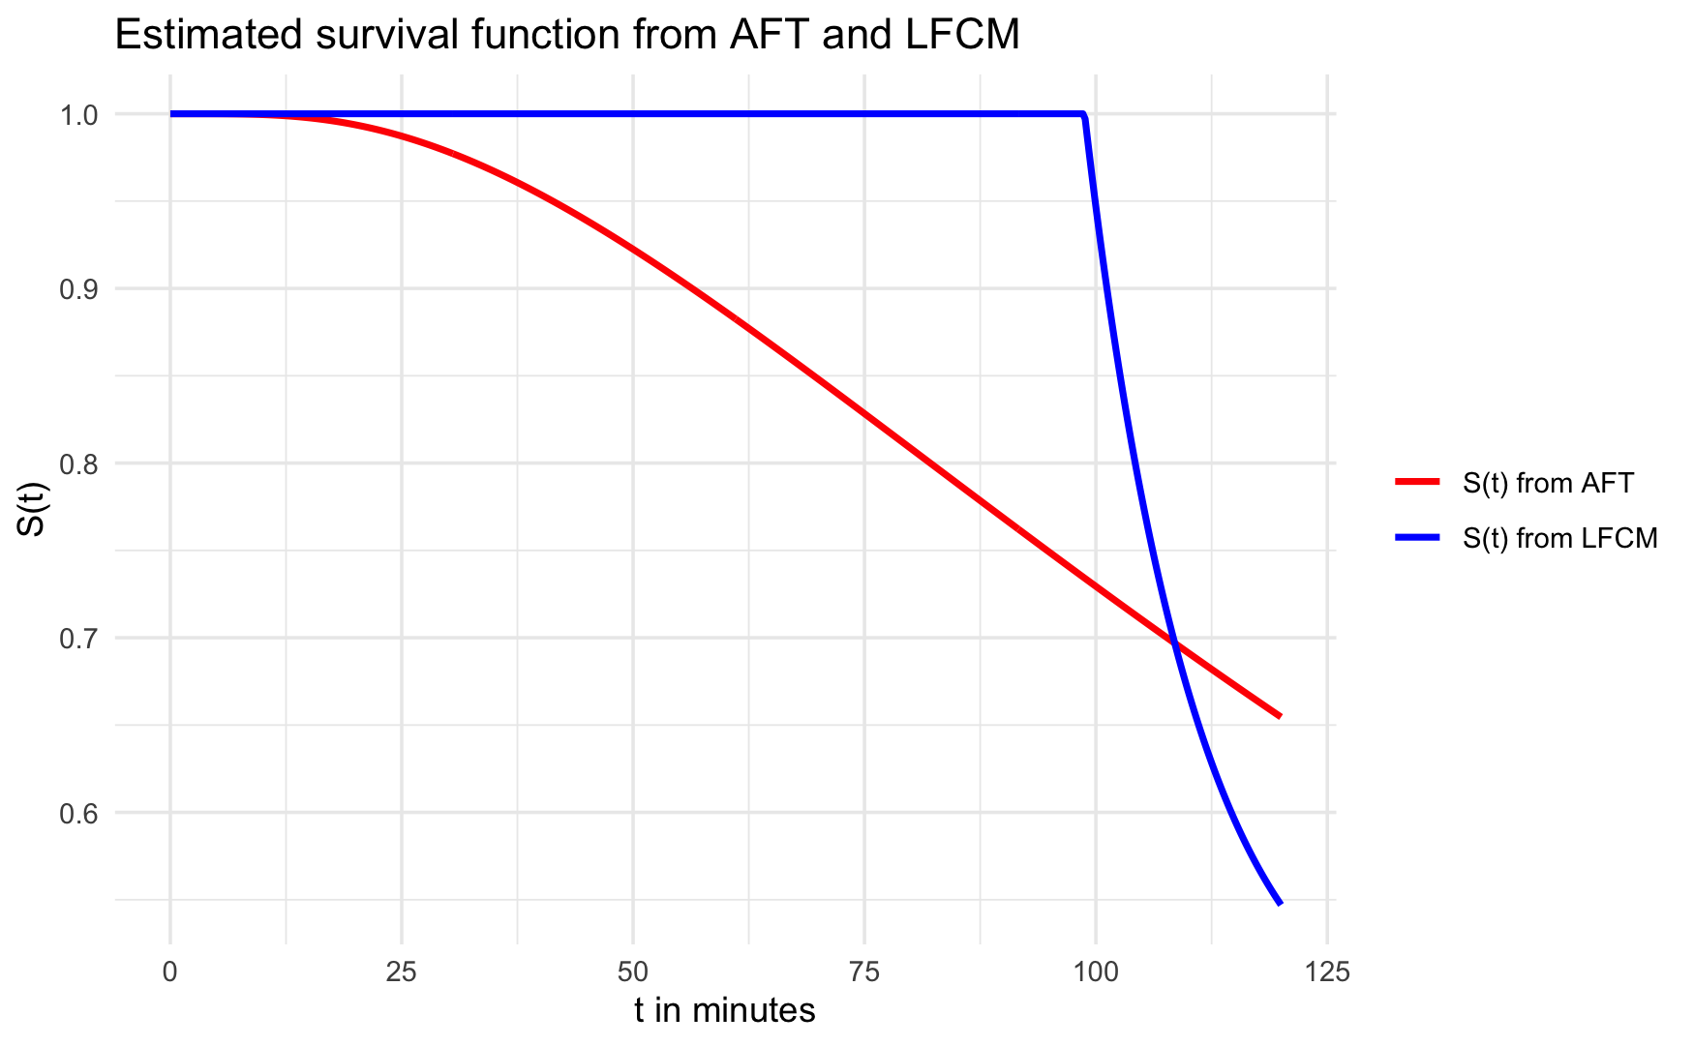
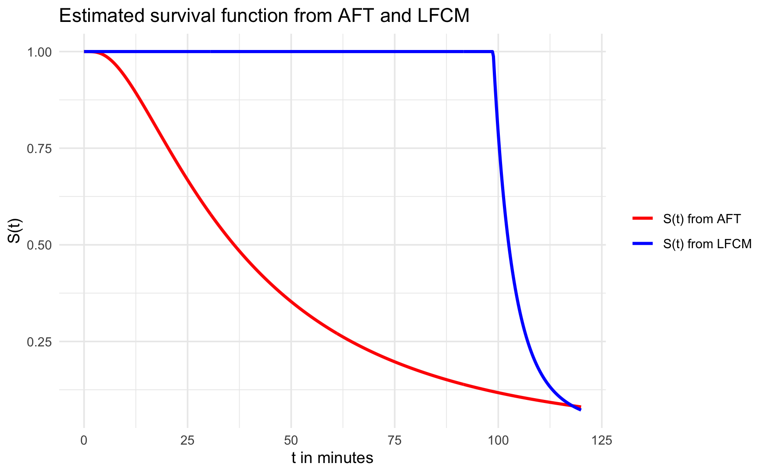
Post2: estimated survival functions

