Slide 1
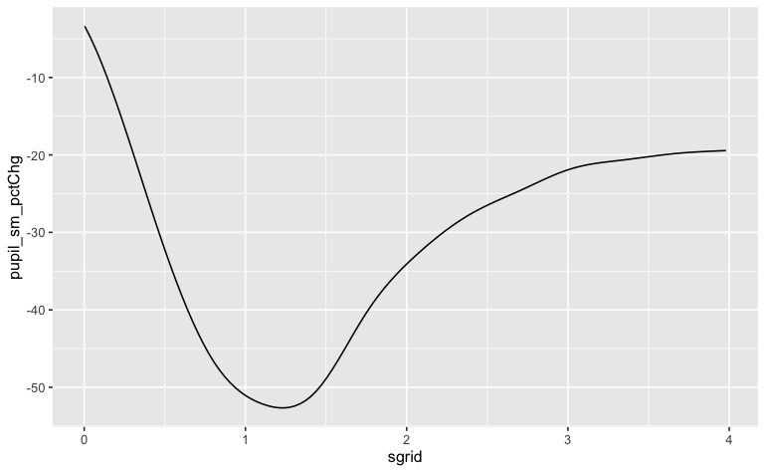
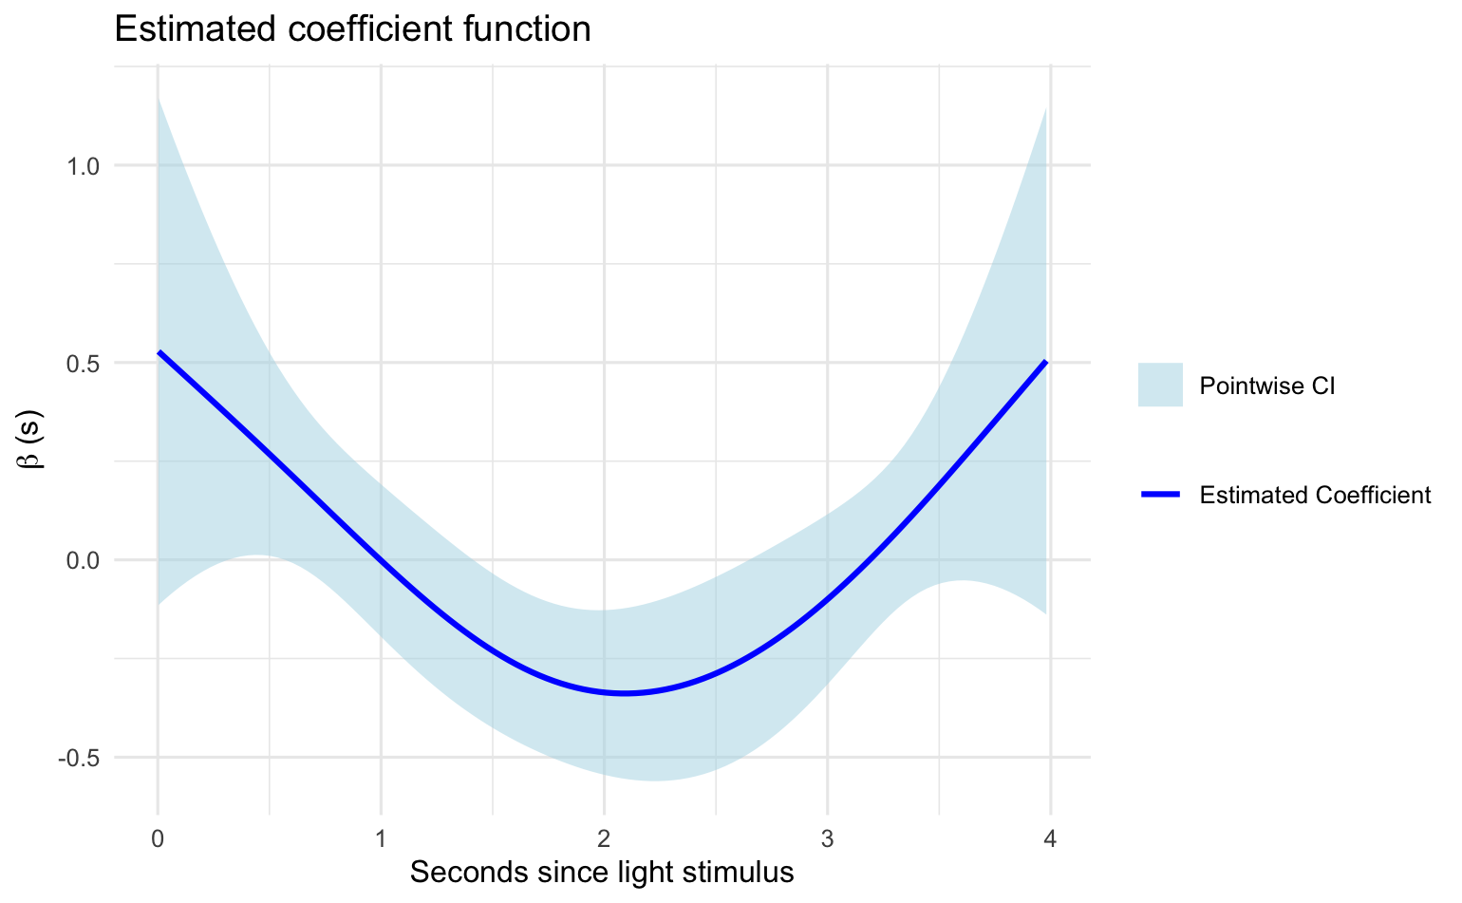
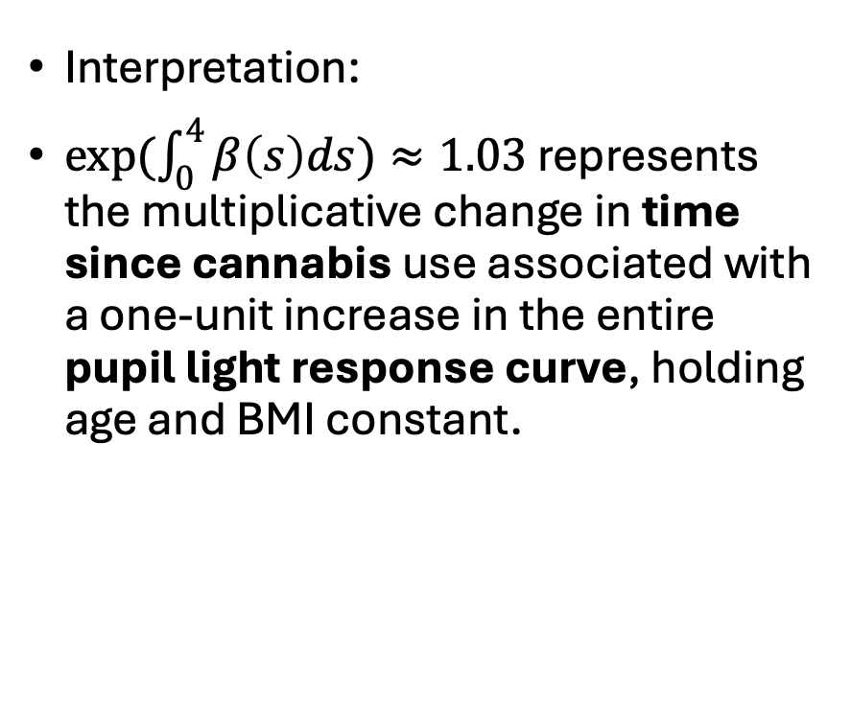
Linear functional AFT model
Interpretation:
$exp(\int_{0}^{4}{β\left(s\right)ds)}≈1.03$ represents the multiplicative change in time since cannabis use associated with a one-unit increase in the entire pupil light response curve, holding age and BMI constant.

Slide 2
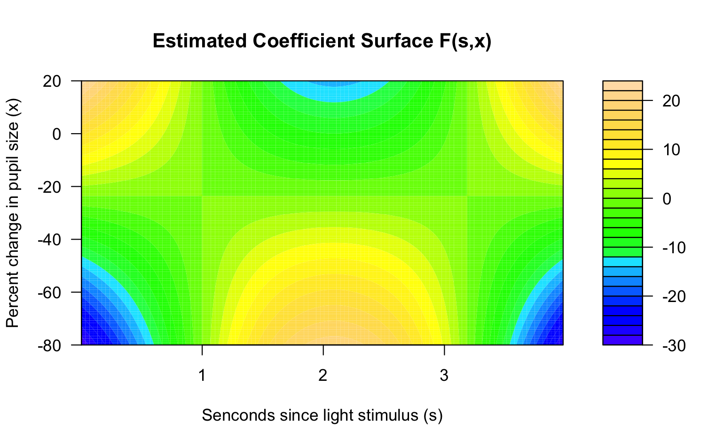
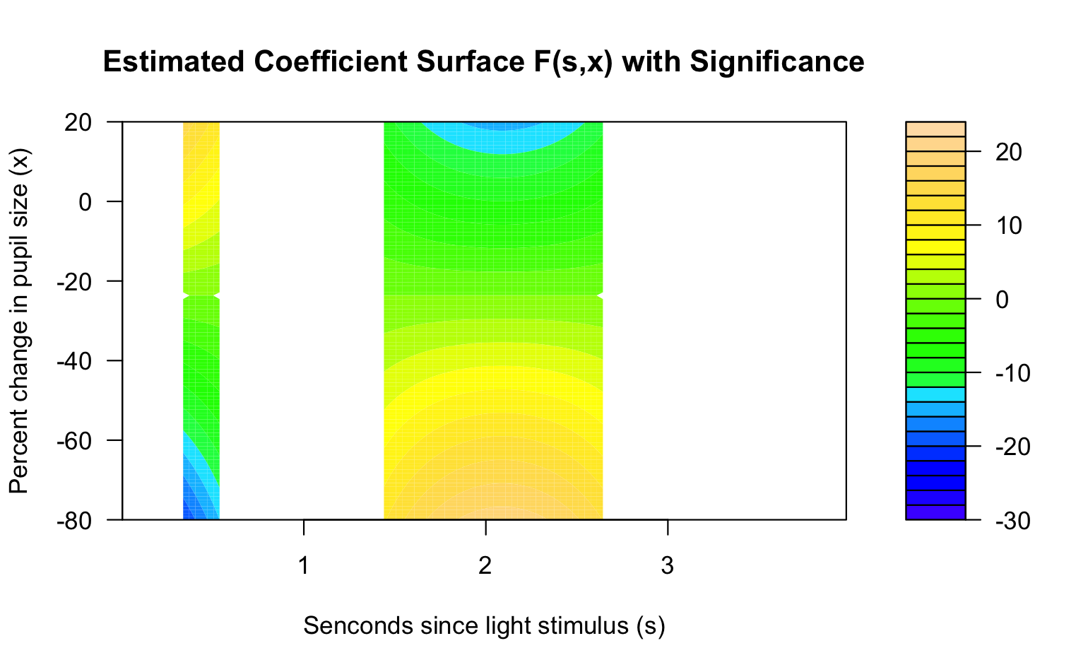
Additive functional AFT model
Notes:
Between 1.5 and 2.5s, more negative percent change in pupil size is associated with longer time since cannabis use (positive coefficient value).

Slide 3
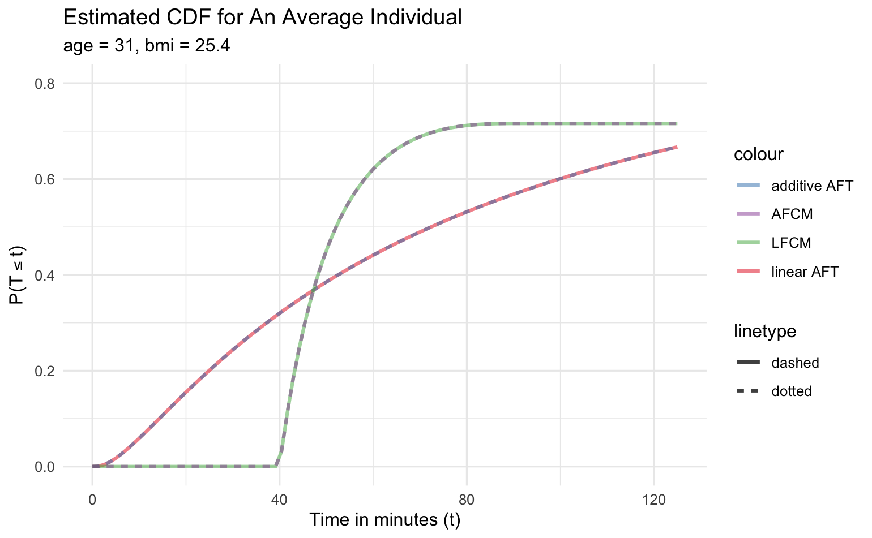
Estimated CDFs from real data

Slide 4
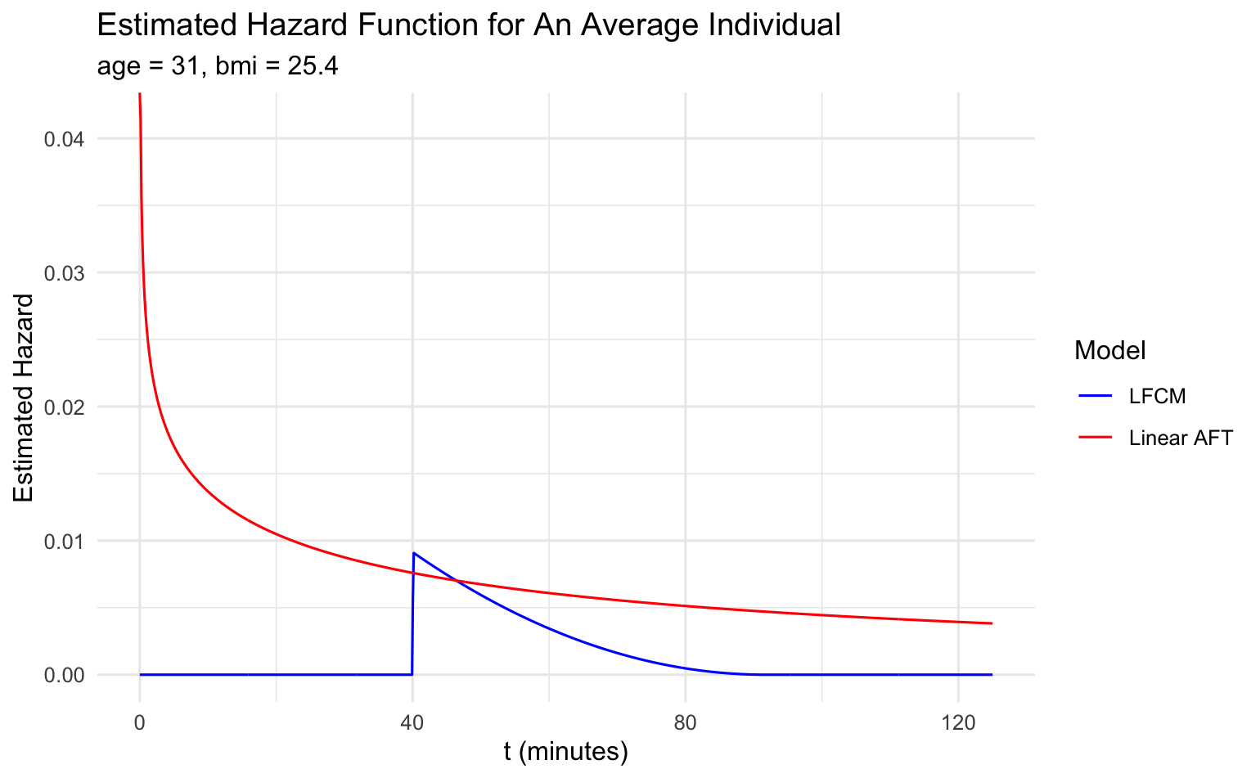
Estimated hazard functions from real data

Slide 5
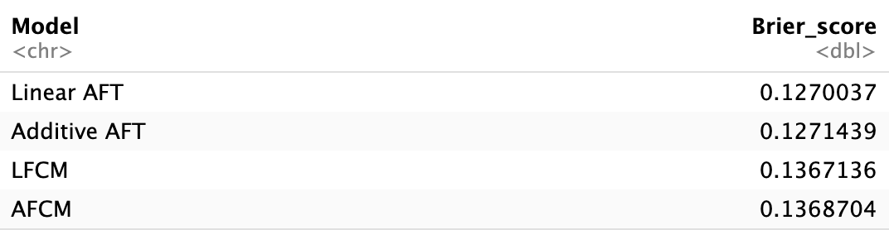
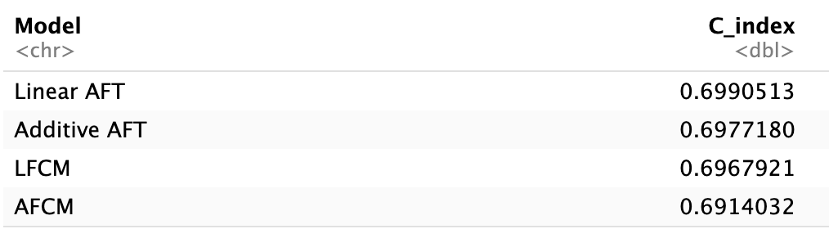
10-fold cross-validated Brier score & c-index

