Slide 1
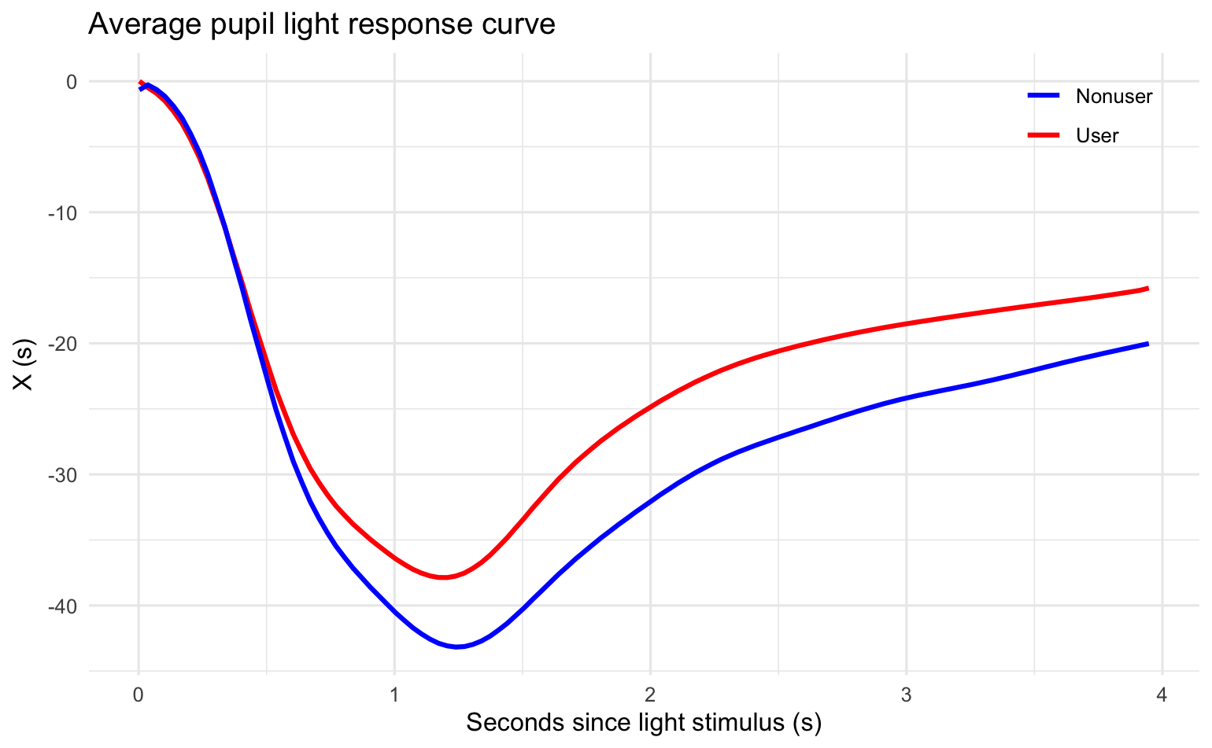
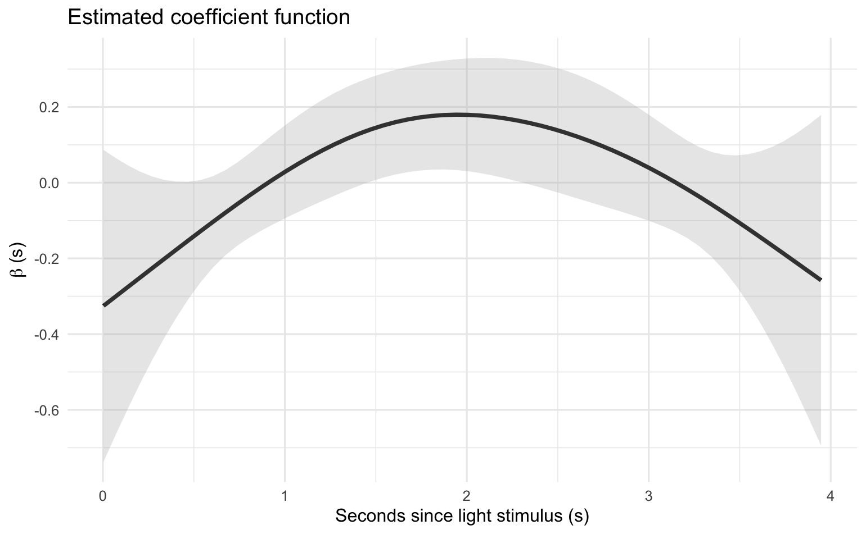
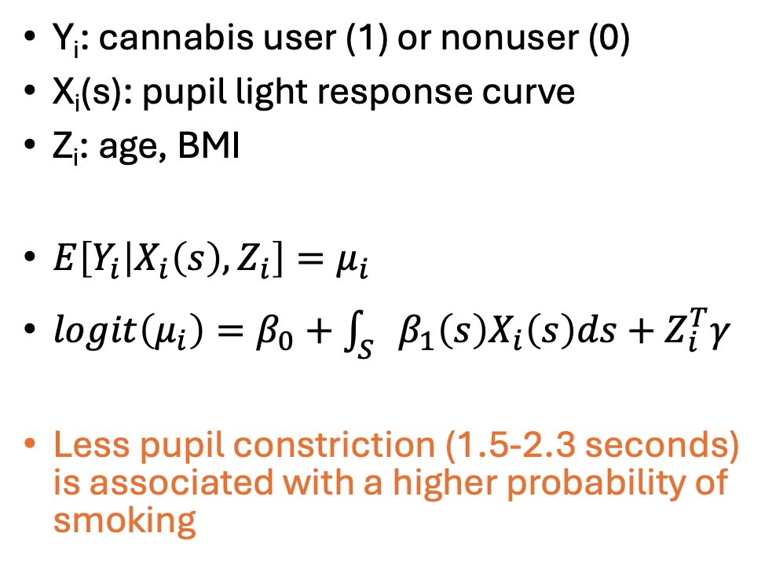
Functional Logistic Regression
Y_{i}: cannabis user (1) or nonuser (0)
X_{i}(s): pupil light response curve
Z_{i}: age, BMI
$E\left[Y_{i} | X_{i}\left(s\right), Z_{i}\right]=μ_{i}$
$logit\left(μ_{i}\right)=β_{0}+\int_{S}{β_{1}\left(s\right)X_{i}\left(s\right)ds+Z_{i}^{T}γ}$
Less pupil constriction (1.5-2.3 seconds) is associated with a higher probability of smoking

Slide 2
10-Fold Cross-Validated Brier Score
Functional AFT models have better prediction accuracy than functional Cox models and functional logistic regression model
Model | Brier Score
Linear functional AFT | 0.1231
Additive functional AFT | 0.1227
LFCM | 0.1426
AFCM | 0.1397
Functional logistic | 0.1645

Slide 3
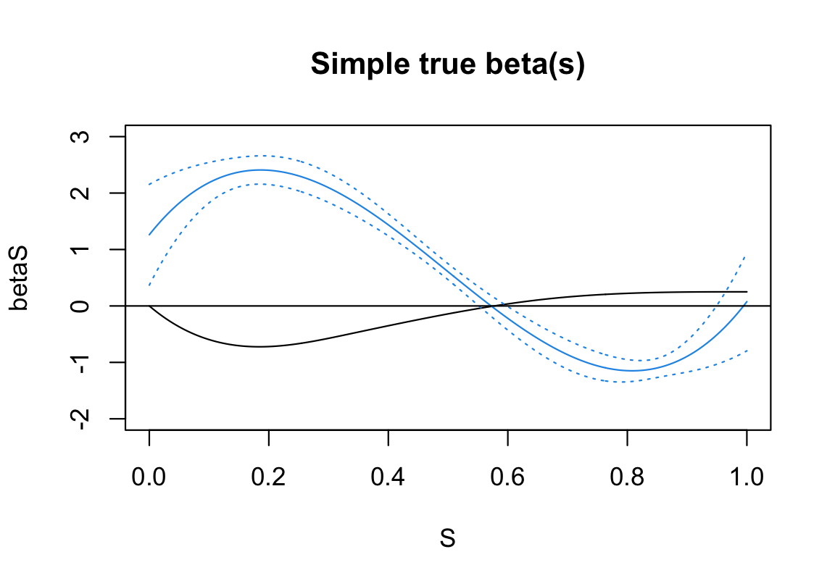
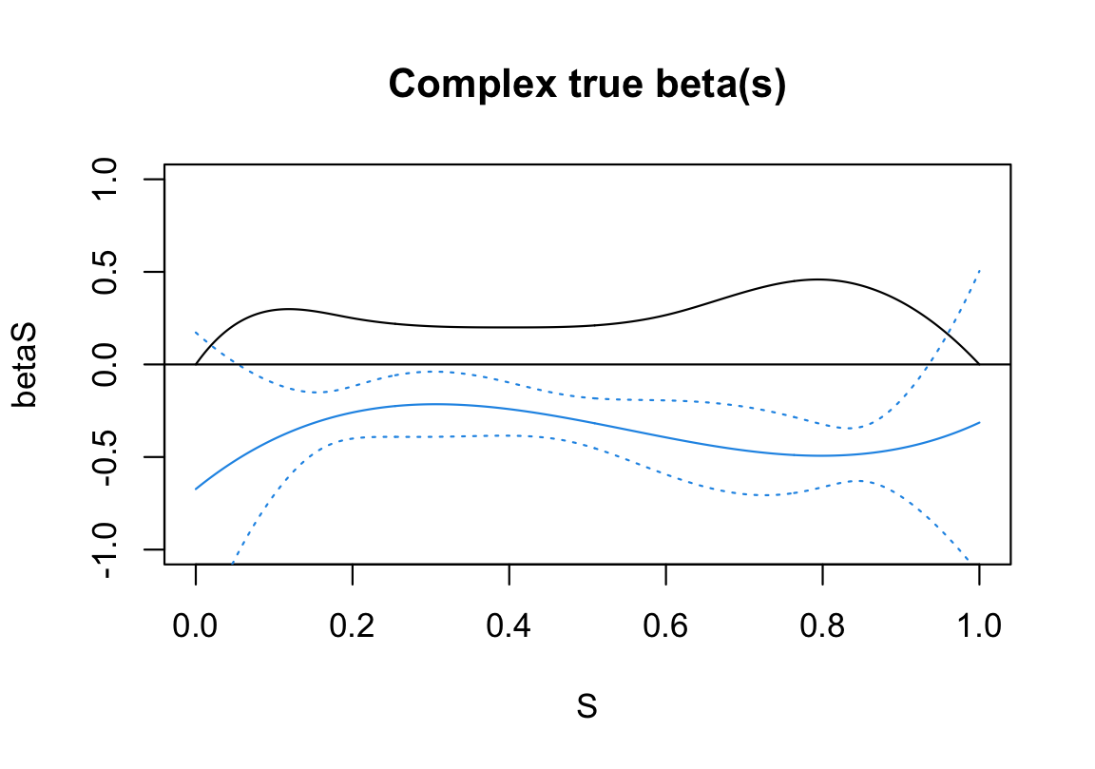
Functional Time-Transformation Model (FTTM)
Ghosal et al., 2025
Long computation time since it performs a grid search for N₀, N₁, and r

Slide 4
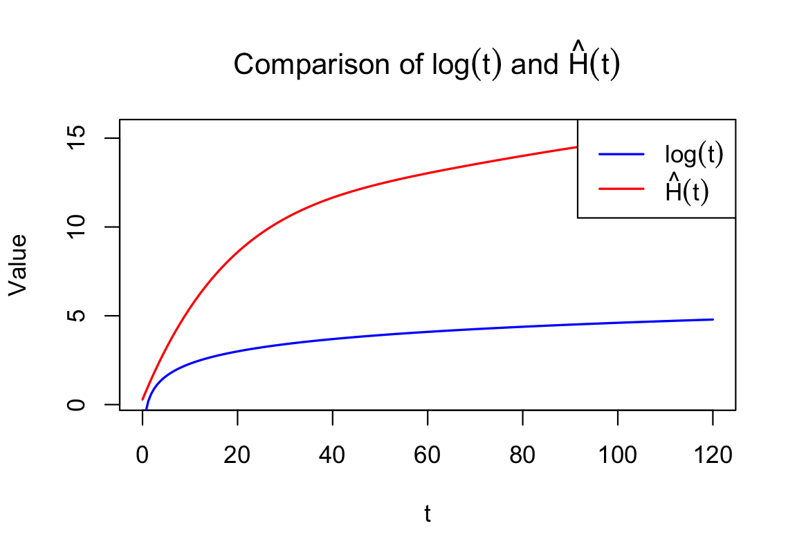
Functional Time-Transformation Model (FTTM)
For AFT models, true H(t) = log(t)

Slide 5

Simulation Plan
Simulations to compare additive functional AFT and Cox models
1) Linear scenario: $F\left(s,x\right)=−s∙x$
2) Nonlinear scenario: $F\left(s,x\right)=s∙0.1x^{2}$
Add FTTM to compare with linear functional AFT and Cox models

