Slide 1
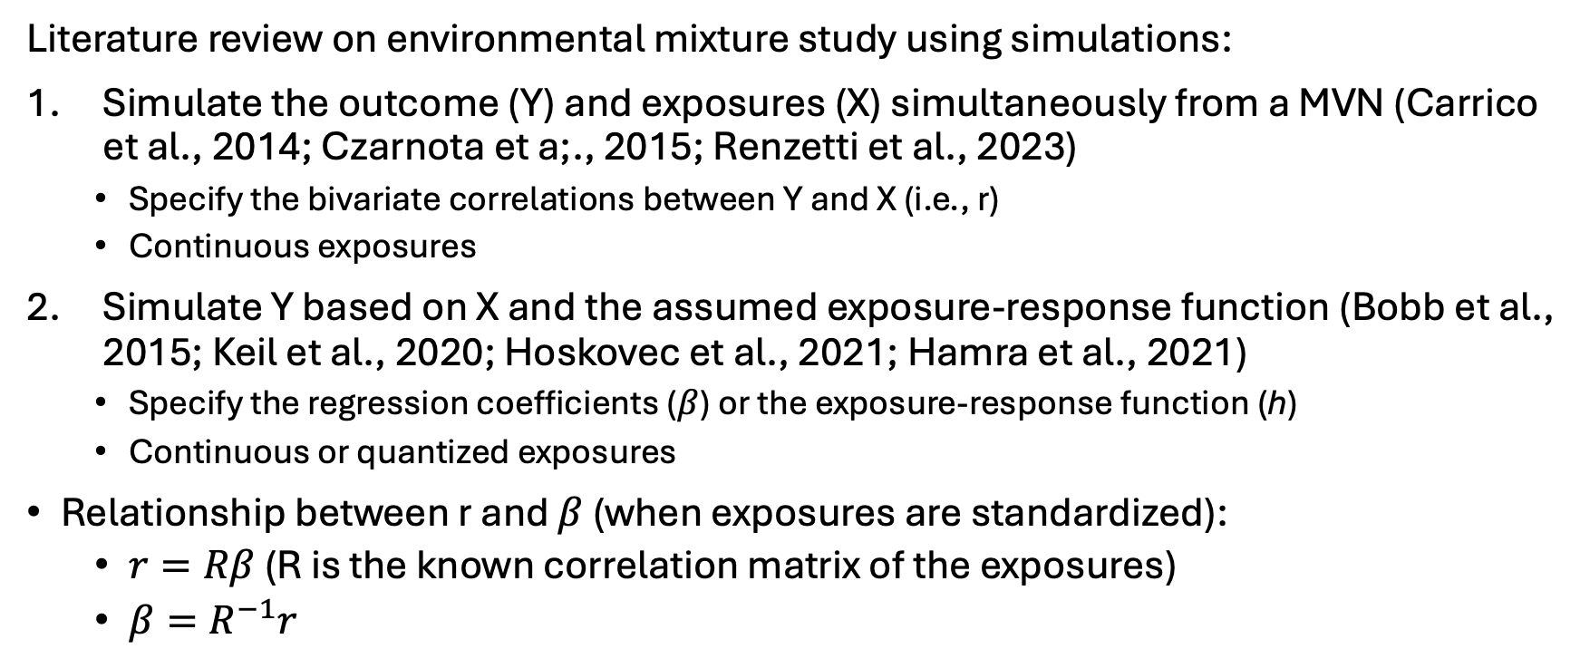
Simulation study design
Literature review on environmental mixture study using simulations:
Simulate the outcome (Y) and exposures (X) simultaneously from a MVN (Carrico et al., 2014; Czarnota et a;., 2015; Renzetti et al., 2023)
Specify the bivariate correlations between Y and X (i.e., r)
Continuous exposures
Simulate Y based on X and the assumed exposure-response function (Bobb et al., 2015; Keil et al., 2020; Hoskovec et al., 2021; Hamra et al., 2021)
Specify the regression coefficients ($β$) or the exposure-response function (h)
Continuous or quantized exposures
Relationship between r and $β$ (when exposures are standardized):
$r=Rβ$ (R is the known correlation matrix of the exposures)
$β=R^{−1}r$

Slide 2
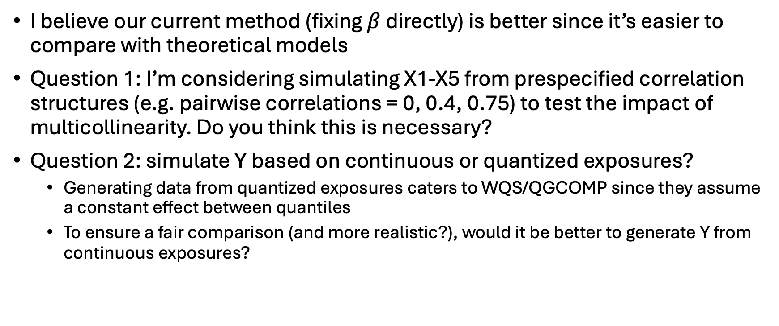
Simulation study design
I believe our current method (fixing $β$ directly) is better since it’s easier to compare with theoretical models
Question 1: I’m considering simulating X1-X5 from prespecified correlation structures (e.g. pairwise correlations = 0, 0.4, 0.75) to test the impact of multicollinearity. Do you think this is necessary?
Question 2: simulate Y based on continuous or quantized exposures?
Generating data from quantized exposures caters to WQS/QGCOMP since they assume a constant effect between quantiles
To ensure a fair comparison (and more realistic?), would it be better to generate Y from continuous exposures?

Slide 3
Simulation study evaluation metrics
Sensitivity and specificity
Carrico et al., 2014; Czarnota et a;., 2015; Hoskovec et al., 2021; Renzetti et al., 2023
Power/Type 1 error
Carrico et al., 2014; Czarnota et a;., 2015; Bobb et al., 2015; Keil et al., 2020
Bias/MSE
Keil et al., 2020; Hamra et al., 2021; Hoskovec et al., 2021; Renzetti et al., 2023;
Coverage
Bobb et al., 2015; Keil et al., 2020; Hamra et al., 2021; Hoskovec et al., 2021

Slide 4
Simulation study evaluation metrics
Question:
Since our simulations involve quantile-based methods and model misspecification, calculating the true mixture effect is challenging or may not be meaningful. Would it be reasonable to remove bias and coverage from the analysis and focus on power/type 1 error and sensitivity/specificity? If so, I can use the default WQS/QGCOMP settings to quantize exposures.

Slide 5
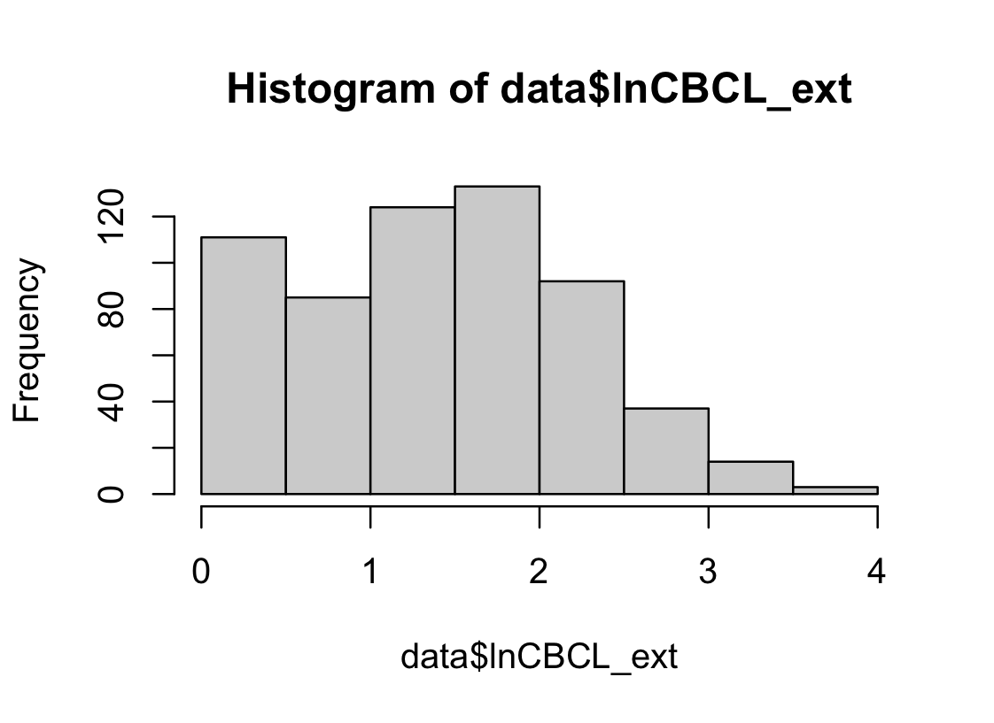
Log-transformation of outcome
In the DCHS analysis, the outcome variable is log-transformed before modelling to address right skewness
Question: Would it be more appropriate to fit a gamma/gaussian GLM with a log link instead?
Suitable for continuous, positive, rights-skewed data
Addresses potential heteroskedasticity
The log-transformed outcome (lnCNCL_ext) is left skewed, aligning with the distribution of gamma data on the log-scale but not with normal data
Supported by WQS and QGCOMP (family = Gamma(link = “log”) / family = gaussian(link = "log")), but not supported by BKMR and BWS
We can mention this as a limitation of BKMR and BWS, especially for BKMR because it’s sensitive to data distribution (https://arxiv.org/pdf/2411.00286)

Slide 6
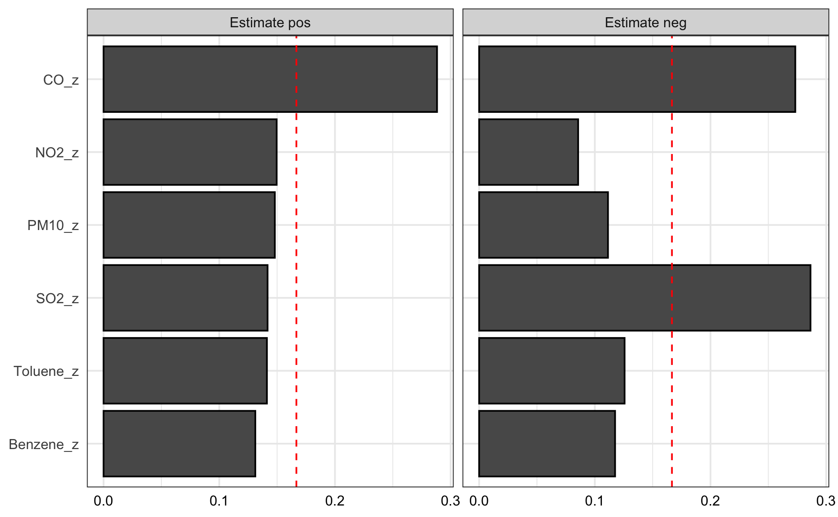
Confusing results from applying 2iWQS
Significant positive joint effect in the negative direction! Even if 𝛽_{nwqs} should have a negative constraint
𝛽_{pwqs}: 0.003; 95% CI: -0.102, 0.108
𝛽_{nwqs}: 0.122; 95% CI: 0.031, 0.213
Hard to interpret positive and negative weights in this case

Slide 7
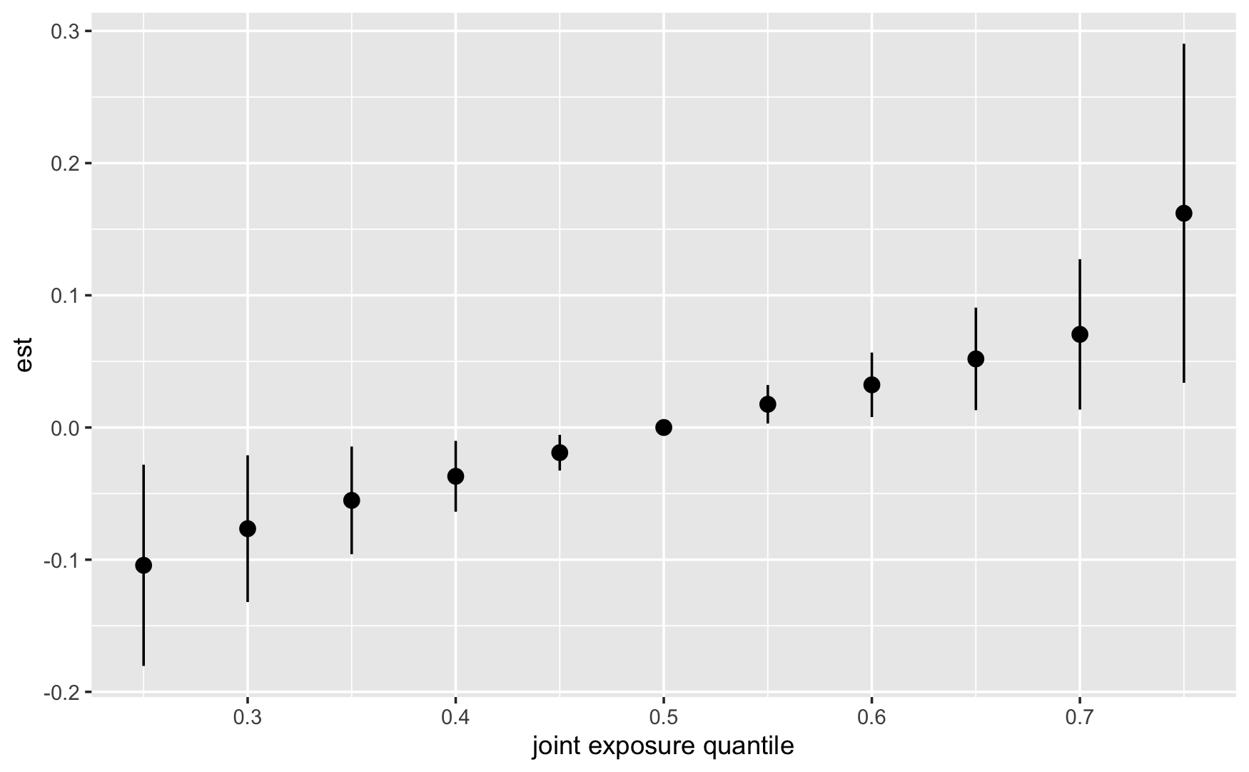
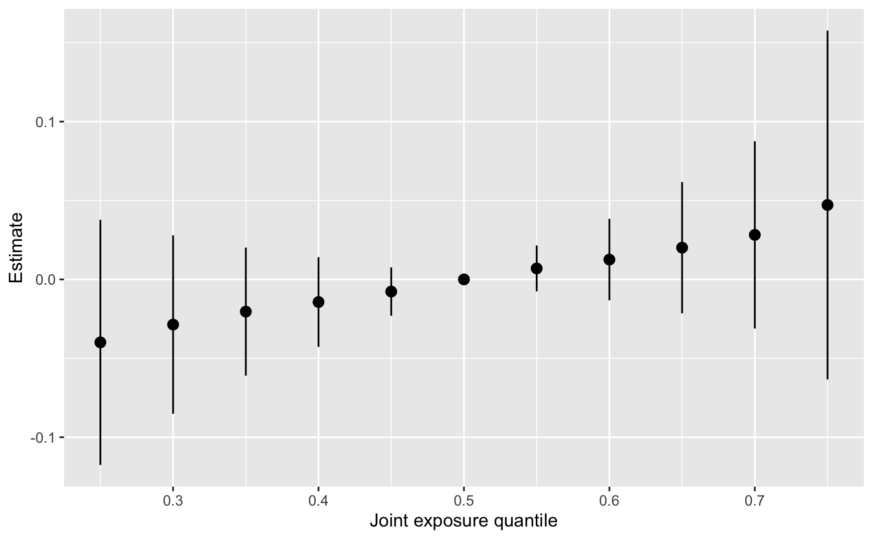
Updated BKMR results
“Approx” method can underestimate credible intervals (according to this guide)
When applying the “exact” method, the overall effect is no longer significant, which is inconsistent with the other three methods

