Slide 1
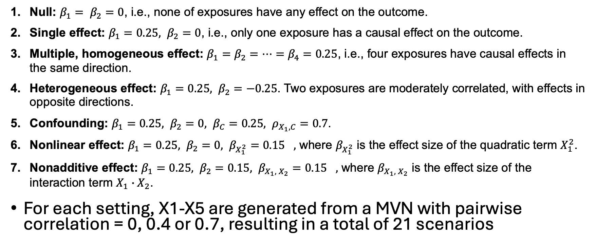
Updated simulation design
Null: $β_{1}= β_{2}=0$, i.e., none of exposures have any effect on the outcome.
Single effect: $β_{1}=0.25, β_{2}=0$, i.e., only one exposure has a causal effect on the outcome.
Multiple, homogeneous effect: $β_{1}=β_{2}=⋯=β_{4}=0.25$, i.e., four exposures have causal effects in the same direction.
Heterogeneous effect: $β_{1}=0.25, β_{2}=−0.25$. Two exposures are moderately correlated, with effects in opposite directions.
Confounding: $β_{1}=0.25, β_{2}=0, {β_{C}=0.25, ρ}_{X_{1}, C}=0.7$.
Nonlinear effect: $β_{1}=0.25, β_{2}=0, {β_{X_{1}^{2}}=0.15}_{},$ where $β_{X_{1}^{2}}$ is the effect size of the quadratic term $X_{1}^{2}$.
Nonadditive effect: $β_{1}=0.25, β_{2}=0.15, {β_{X_{1}, { X}_{2}}=0.15}_{},$ where $β_{X_{1}, { X}_{2}}$ is the effect size of the interaction term $X_{1}∙X_{2}$.
For each setting, X1-X5 are generated from a MVN with pairwise correlation = 0, 0.4 or 0.7, resulting in a total of 21 scenarios

Slide 2
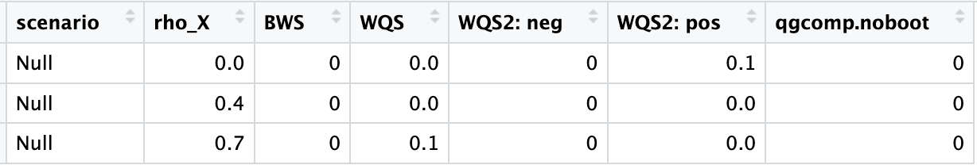
Simulation: type 1 error
Null effect scenario:

Slide 3
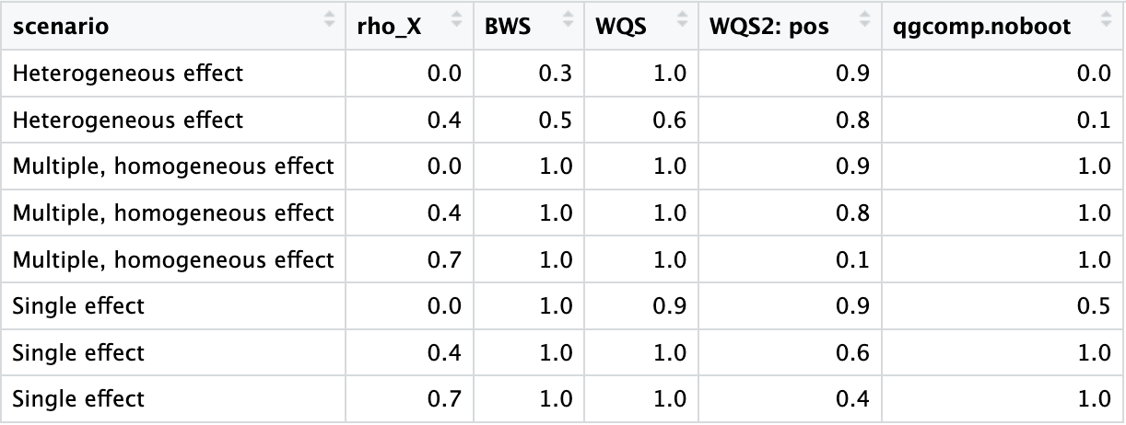
Simulation: power

Slide 4
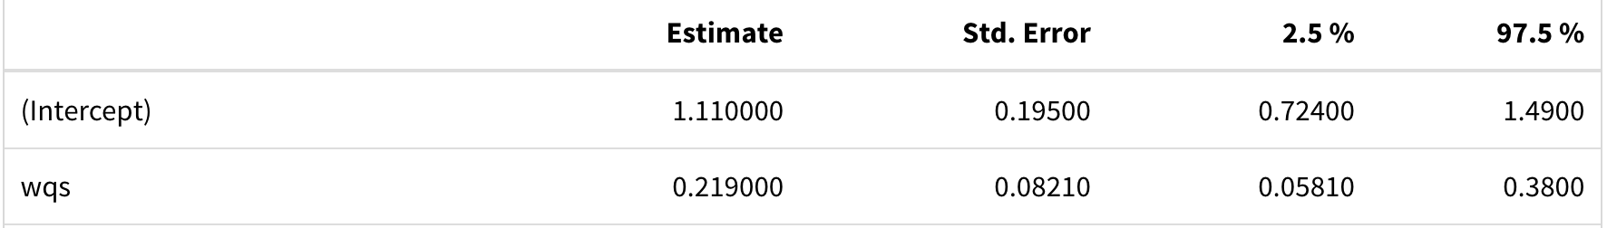
Real data analysis using WQS (q = 4)
WQS with a single index (positive or negative) gives similar estimates on the joint effect
WQS with two indices (2iWQS) results has higher SE and hard to interpret
In this case, we can hardly assess the direction of joint effect using 2iWQS

Slide 5
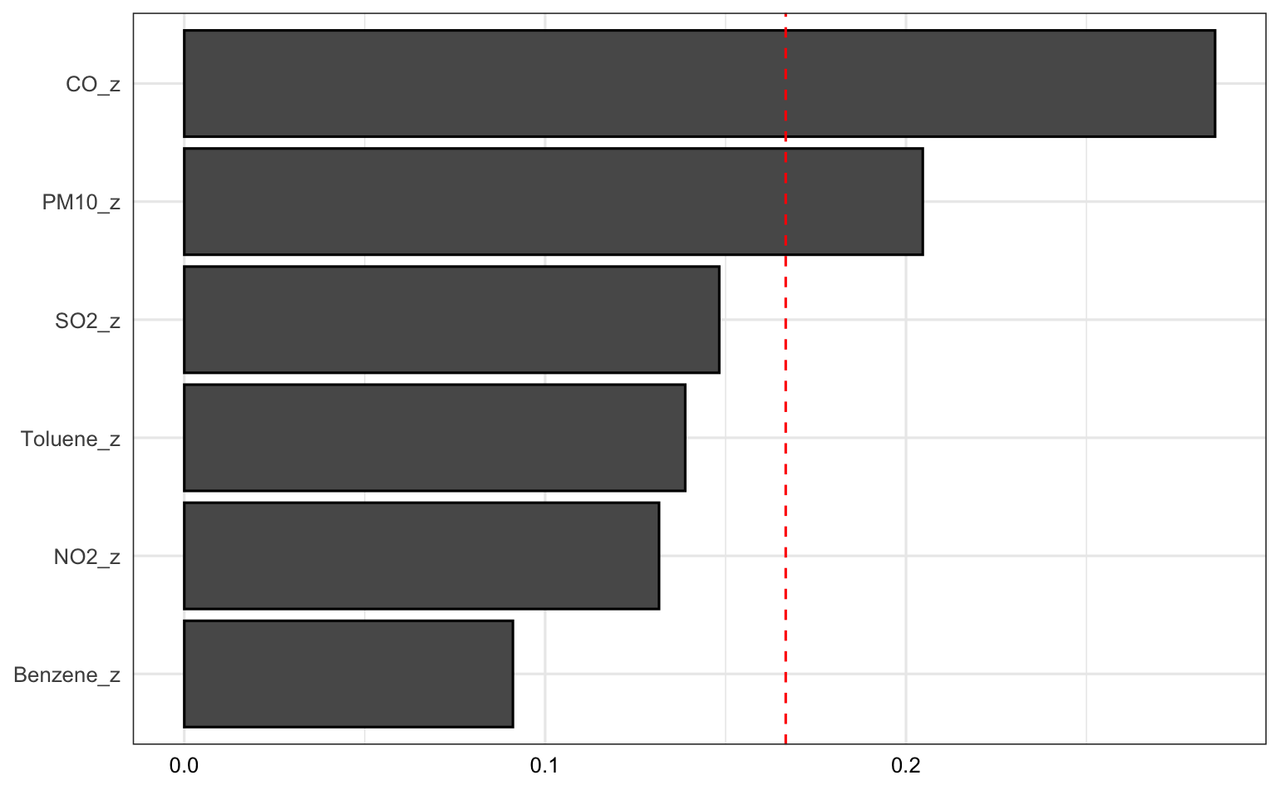
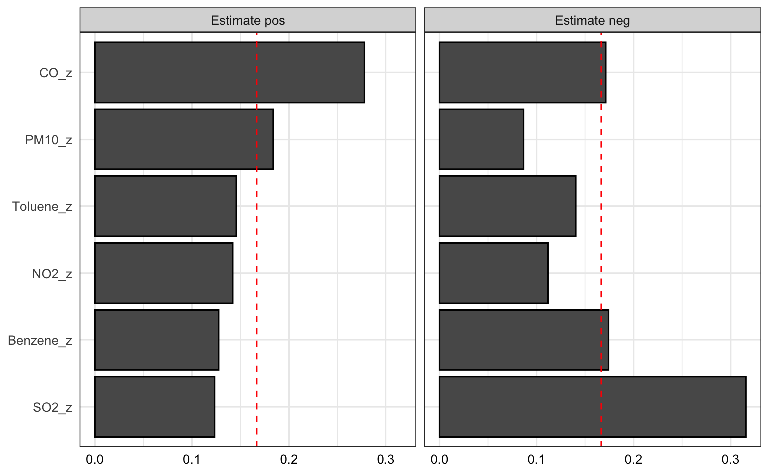
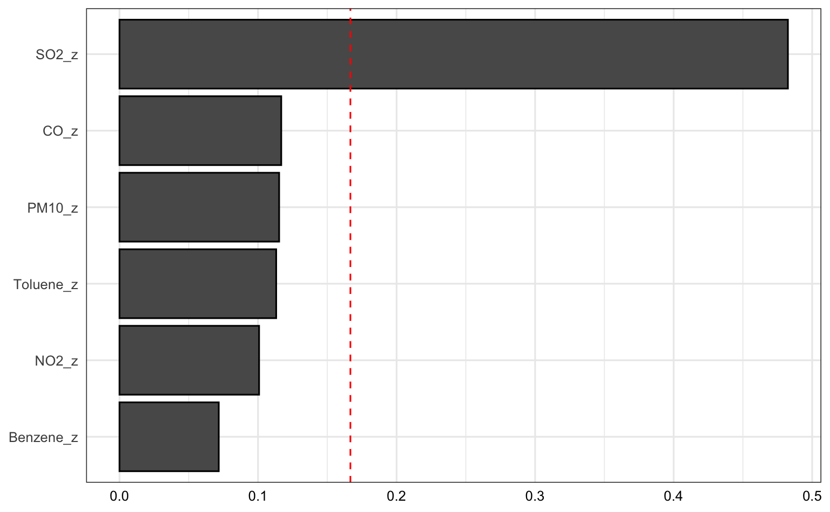
Real data analysis using WQS (q = 4)
WQS with a positive index
2iWQS
WQS with a negative index

Slide 6
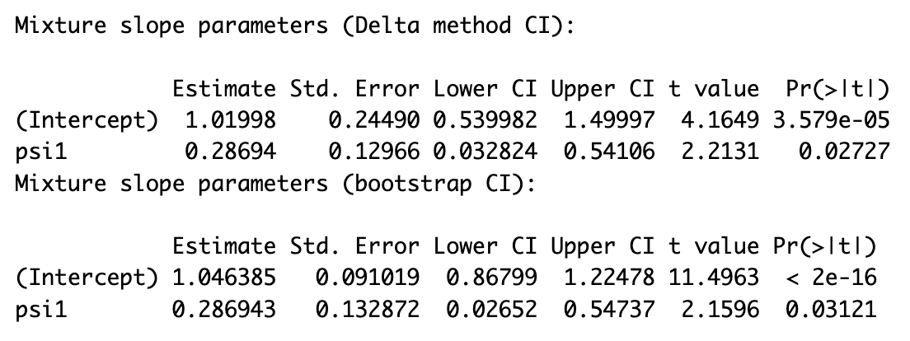
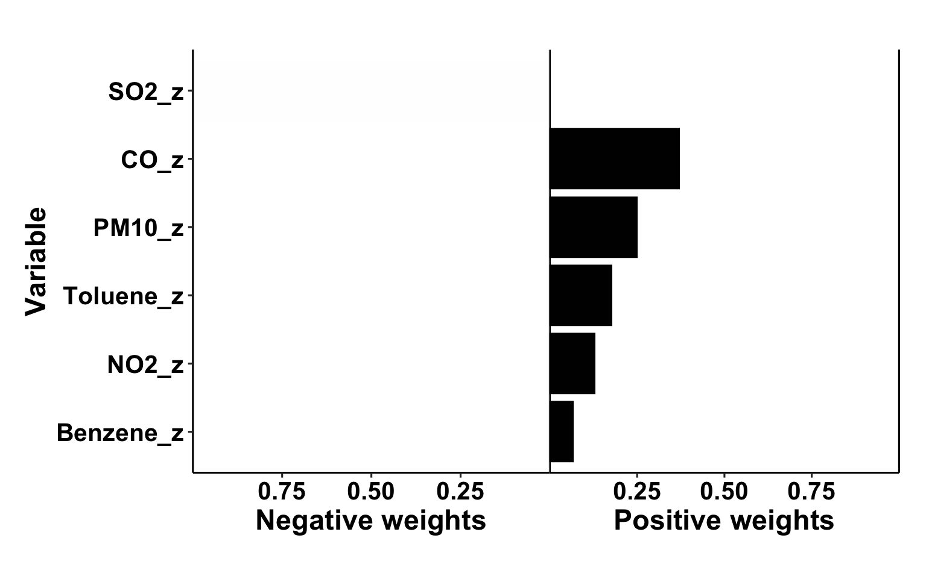
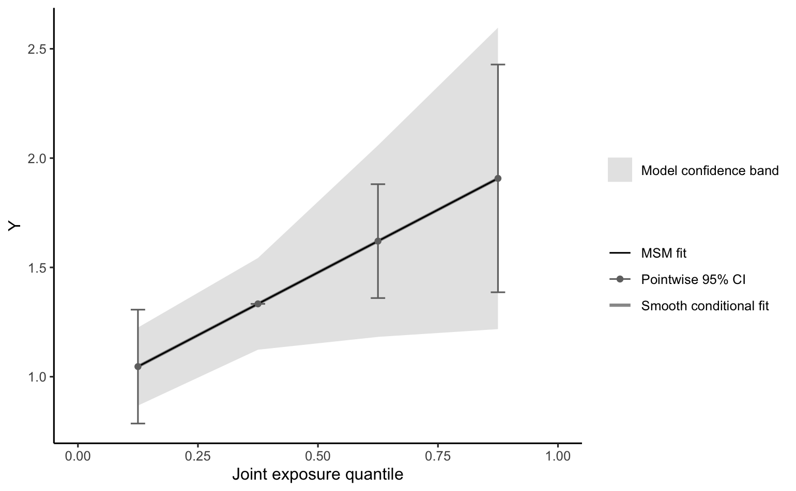
Real data analysis using qgcomp (q = 4)

Slide 7
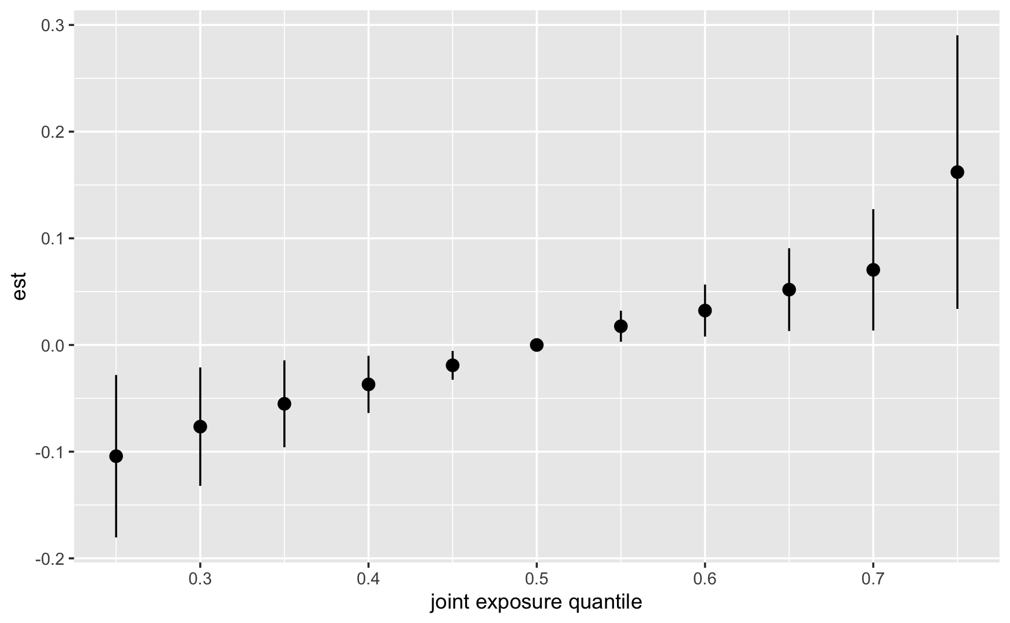
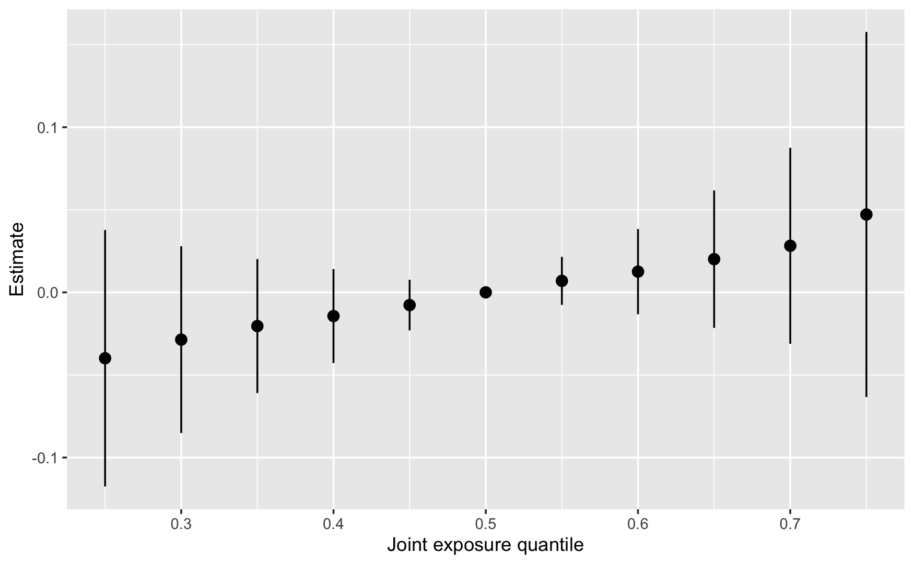
Real data analysis using BKMR
“Approx” method can underestimate credible intervals (according to this guide)
When applying the “exact” method, the overall effect is no longer significant, which is inconsistent with the other three methods

Slide 8
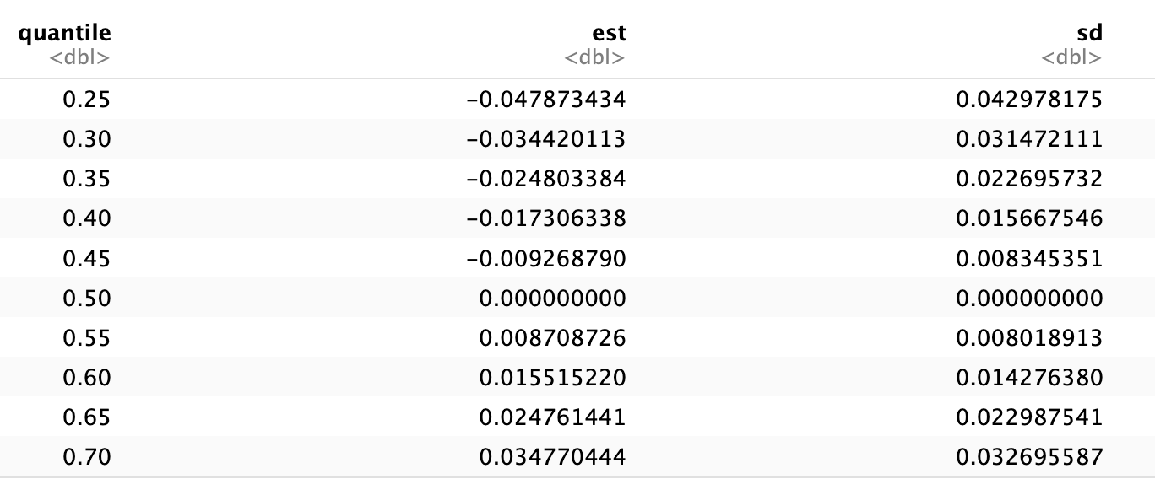
Overall risk by BKMR

Slide 9
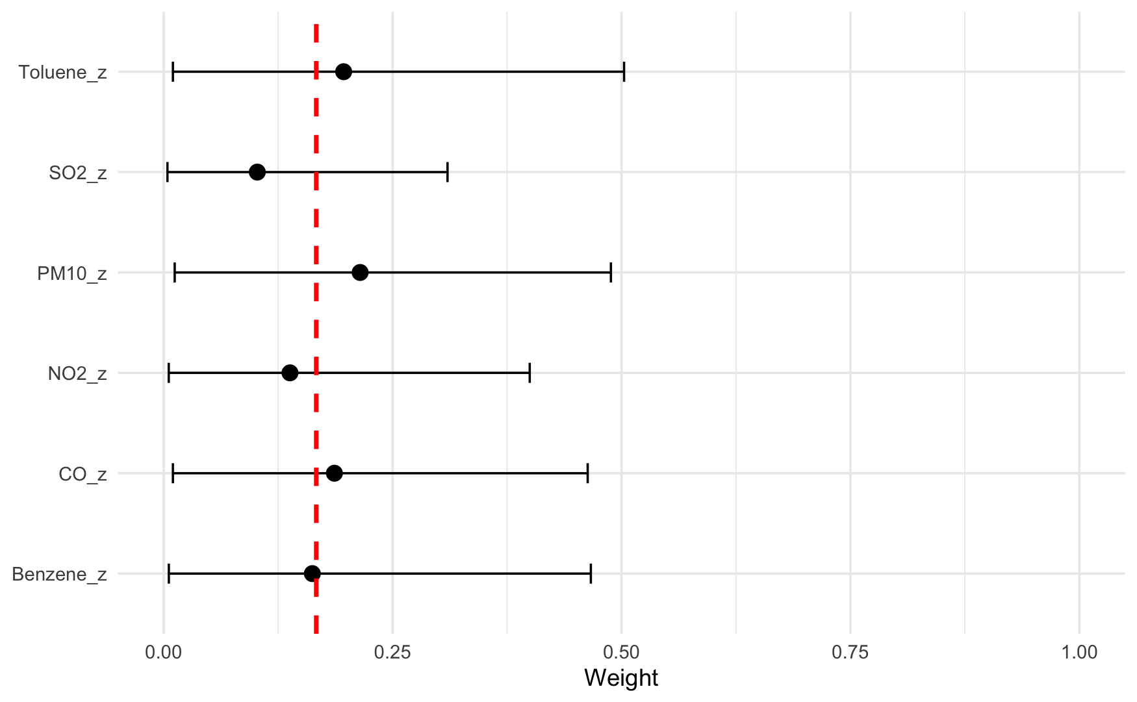
Real data analysis using BWS
Significant joint effect (theta: 0.17; 95% CI: 0.04, 0.31) in the positive direction
PM10 is the largest contributor, followed by toluene and CO

Slide 10
Next step
Run simulations with 100 iterations per scenario
Revise the method and results parts

